Slide 1

Course Structure
Allocation Overview
Master Data
Allocation Cycles
Cost Allocations
Statistical Key Figures
Reporting
Direct MCA
Reporting

Slide 2
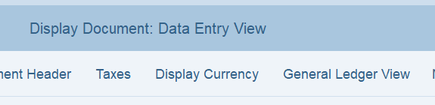
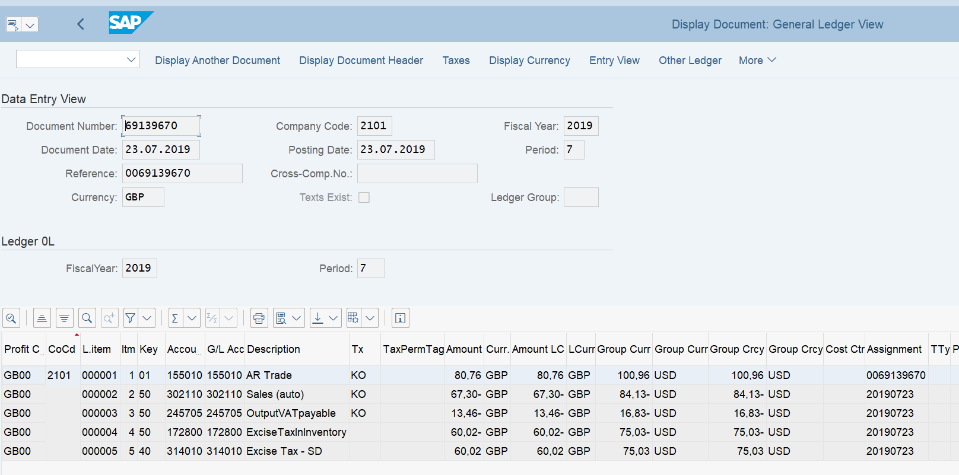
FB03L – Display document: General Ledger view
Select General Ledger View to see for each line item the Profit Center (default will show Entry view – so you need to change)

Slide 3
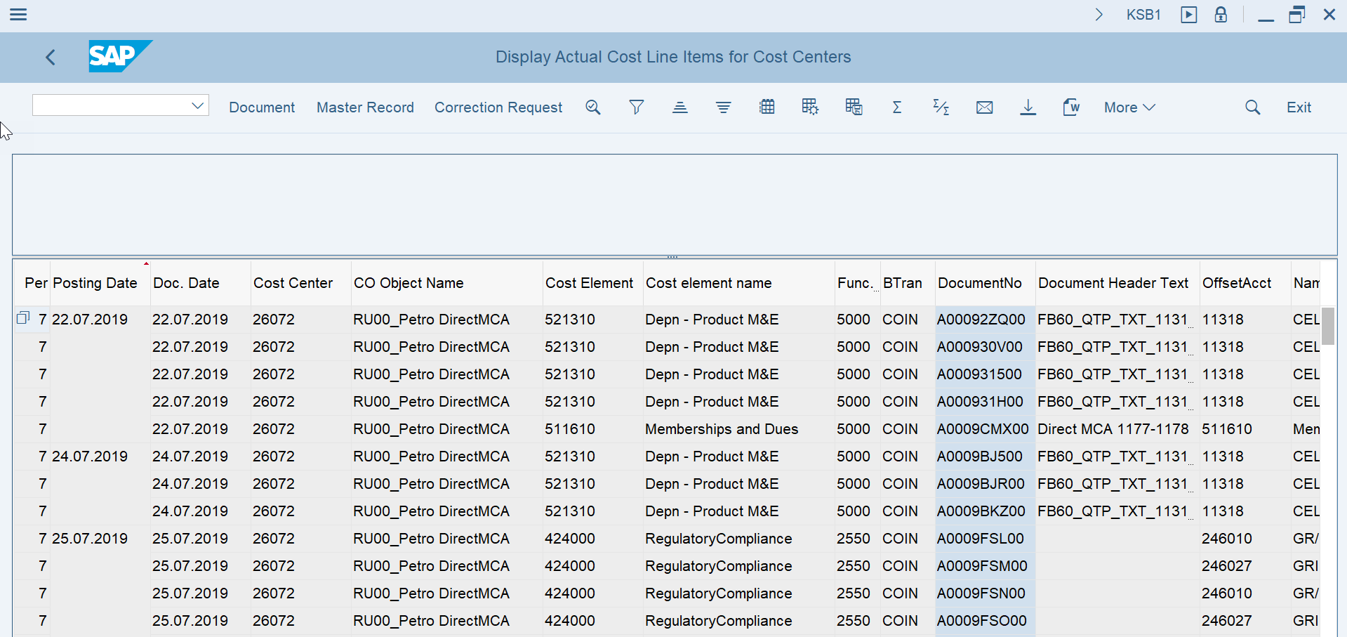
KSB1 - Cost center line item report

Slide 4

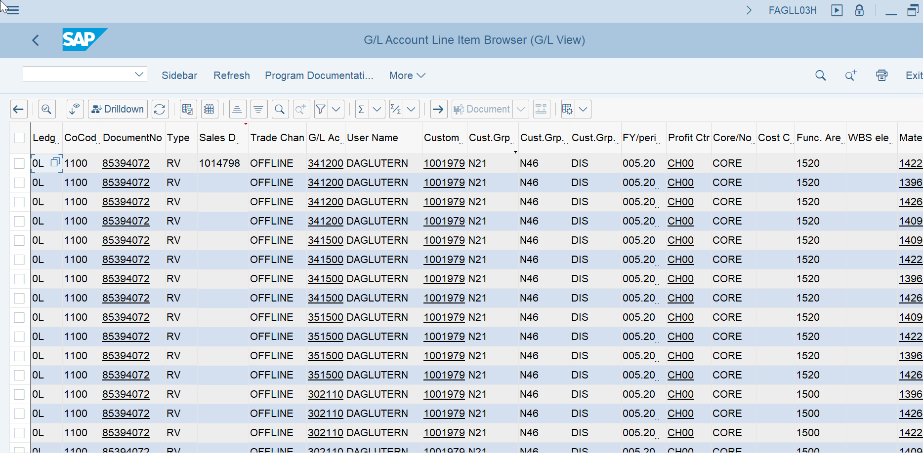
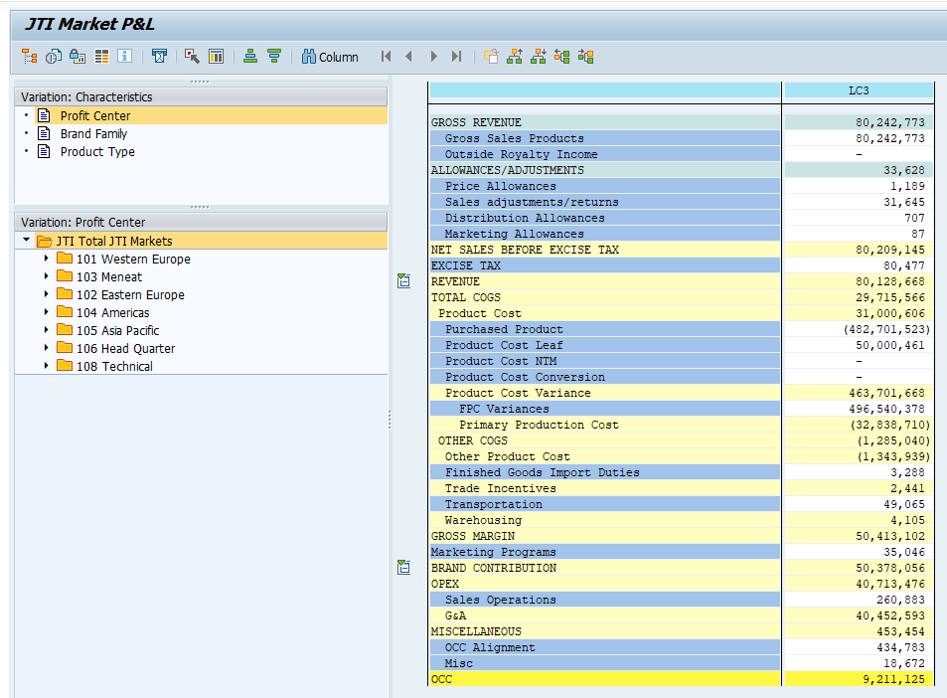
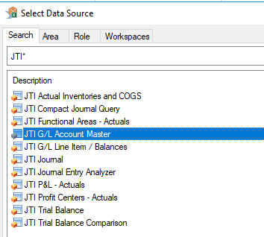

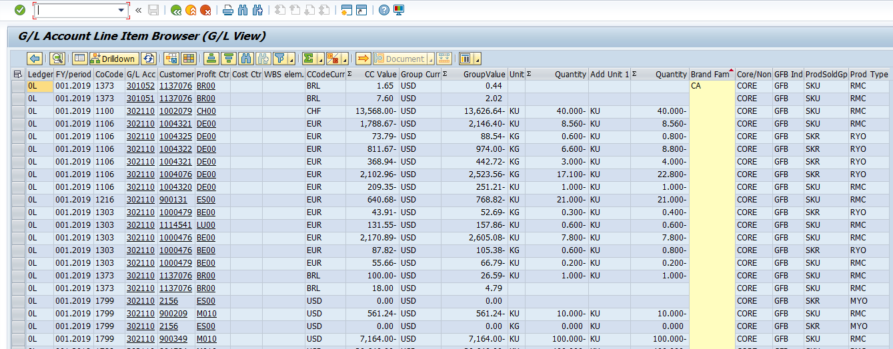
S/4 Instant Operational Reporting - 3 key Options
Instant
1. GL Line Item Browser FAGLL03H
2. Market P/L (GR55 – Z4PL)*
3. CDS Views/Queries (AFO)
Instant S/4 Market P&L – aligned with GPM & GPM+ structure - (will include the key dimensions like Brand Family and Product Type)
Instant S/4 Market P&L – aligned with GPM & GPM+ structure - (will include the key dimensions like Brand Family and Product Type)
CDS Views - SAP Analysis for Office queries (AfO). All dimensions present in the Universal Journal have been identified as relevant & to which we want have instant visibility on.
CDS views standard queries**
Set of predefined workbooks
Drill down to FAGLLO3H
NB! Save the work books in a local folder
* For Go Live Jan 2020 Market P&L will be seen through GR55 transaction with its traditional format. Option to bring AFO into S/4 will be evaluated post Go Live 2020
** Market P&L Lines – JTIO mapping some subject to changes

Slide 5
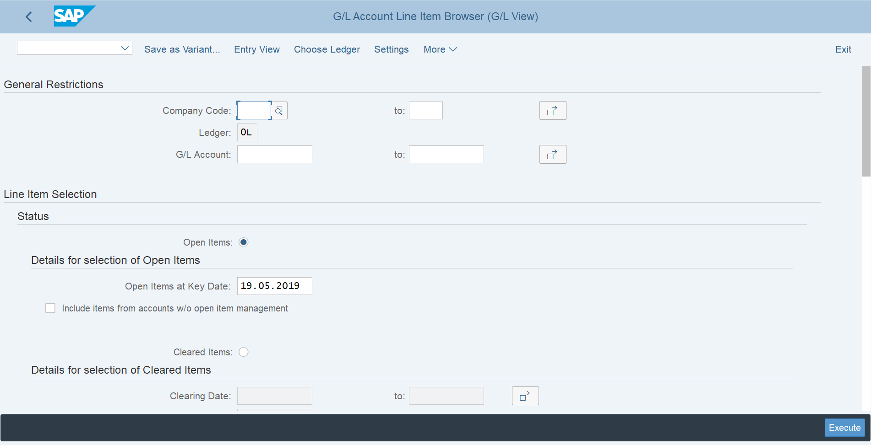
GL Line Item Browser FAGLL03H
FAGLL03H is the S4 version of R3 legacy GL Line Items report FBL3N The front end should be very familiar to those who have used FBL3N

Slide 6
. GL Line Item Browser FAGLL03H
Drill down from GR55 will be into the default layout of the GL Line Item Browser report
This can be accessed on its own via Tcode FAGLL03H and will be familiar to those who use FBL3n
Screenshot shows few dimensions but will display all ACDOCA dimensions
We will create a default layout which can then be tailored

Slide 7
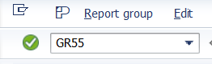
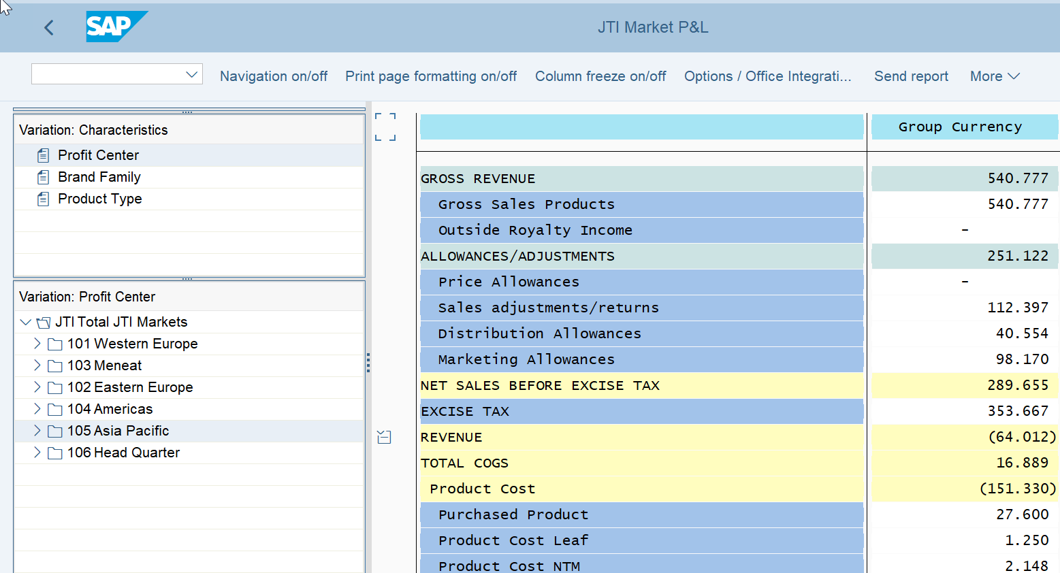
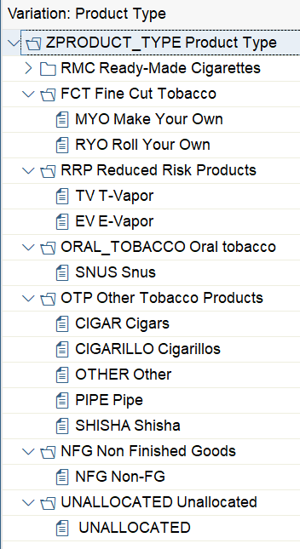
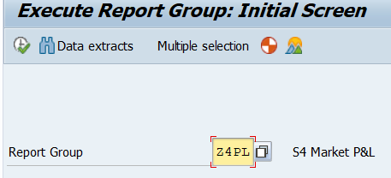
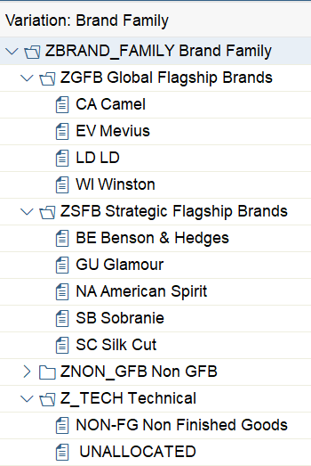
S/4 Market P&L (GR55 – Z4PL)
Tcode
Report Group
Dimensions
Profit Center / Brand Family / Product Type
Dimensions are static and can help spot unallocated postings. For dynamic reports it is recommended to use CDS Query functionality (Analysis for Office)
Drill down of P&L lines to FAGLL03H. To note that drill down will show all postings to the specific JTIO which can result in a different total of the Market P&L in case JTIOs have multiple Functional Areas as it is also currently the case.
Example *
2
1
2
3
2
1
* For Go Live Jan 2020 Market P&L will be seen through GR55 transaction with its traditional format. Option to bring AFO into S-4 will be evaluated post Go Live 2020 . Market P&L Lines subject to changes.

Slide 8
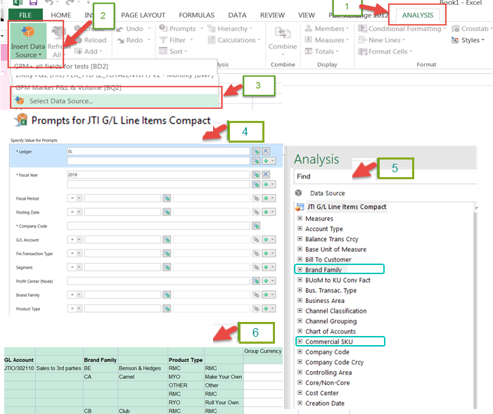
S/4 CDS Query functionality with AFO (excel)
CDS views (Core Data Services) are built on existing S/4 database tables and views, to provide efficient way of data modelling.
“Analysis for Office” (AO) is used similarly to how BW / GPM reports are ran through excel. Reports / workbooks can be saved and refreshed.
“Slice and Dice” functionality by selecting in a dynamic manner FI&CO dimensions to meet specific needs.
Selection criteria, characteristics and key figures are being enhanced to meet JTI reporting requirements in the following SAP S4 HANA standard CDS views:
G/L Account Balance Cube
G/L Account Balance Comparison Cube
Accounting Journal Entry Item Cube
G/L Line Items Cube
GL Account Master Cube
Enhanced views will allow end users to access and analyze transactional data at both account balance and line item levels in single and multiple ledgers including its comparison.

Slide 9
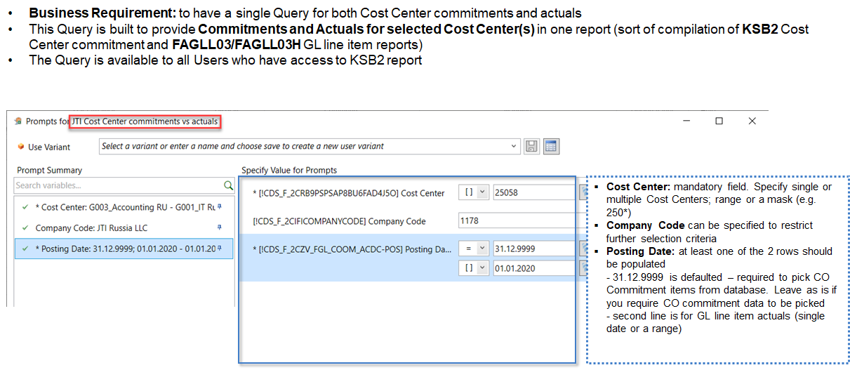
JTI Cost Center Commitment vs Actuals

Slide 10
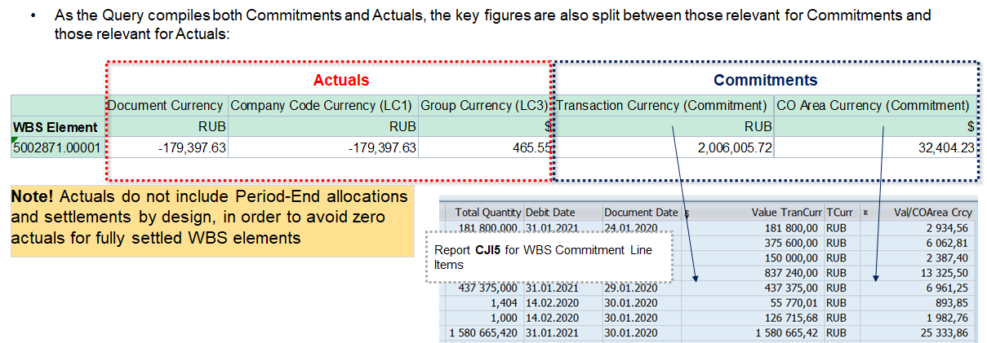
JTI Cost Center Commitment vs Actuals
Key Figures

Slide 11
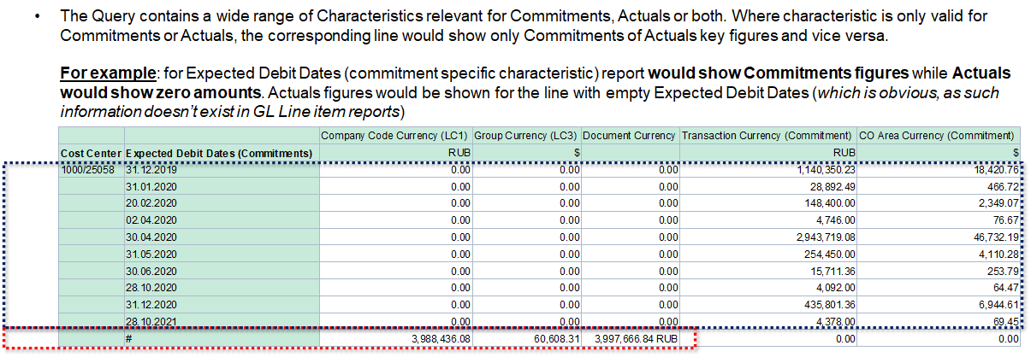
JTI Cost Center Commitment vs Actuals
Characteristics

Slide 12
Exercises:
Exercise 1.7: FB03L – Display different document numbers for postings in the different ledgers:
0L
ST
TX

Slide 13
Exercises:
Exercise 1.8 & 1.9: KSB1 – Display cost center line items

