Slide 2
COST CENTER ALLOCATIONS

Slide 3


Cost Center Allocations
Structure of the course
S4F-ERP
Master Data
PROJECT
Icon here
Cost Allocations
TRAINING
Reporting
Simplify, Standardize, Accelerate

Slide 4

Overview – About this course
Course Objectives
This course provides information on:
Prepare Power Users for delivering this training materials to end-users
Refresh knowledge of Power Users in the creation, maintenance and executing processes involved using Cost Center Allocations
Provide the understanding of the newly implemented and refined processes
Target Audiences
This course is mandatory for:
Power Users who will be involved in allocating costs using Cost Center Allocation Cycles
Learning Guide
Related courses:
Prerequisite course:
Finance Fundamentals Overview
Finance Fundamentals
Chart of Accounts (CoA)
R2R Guidelines
CO Controlling and Profitability Analysis
CO Controlling WBS Elements & Projects – OPEX

Slide 5

Course Structure
Master Data Overview
Cost Center Category
Master Data
Hierarchy Area
Cost Allocations
Functional Area
Reporting

Slide 6




Cost Centers – Overview of key changes
Cost center creation and maintenance procedure: to be published by 2020 as part of the Record-to-Report Global Reference Model (R2R GRM)
Cost center approval: Market CFO / Function Finance Lead / Factory Controller, with notification sent to Entity CFO
Overall cost center master data owner: Corporate FP&A
Branded cost centers: will be removed due to removal of branded profit centers, with branded WBS elements used instead

Slide 7
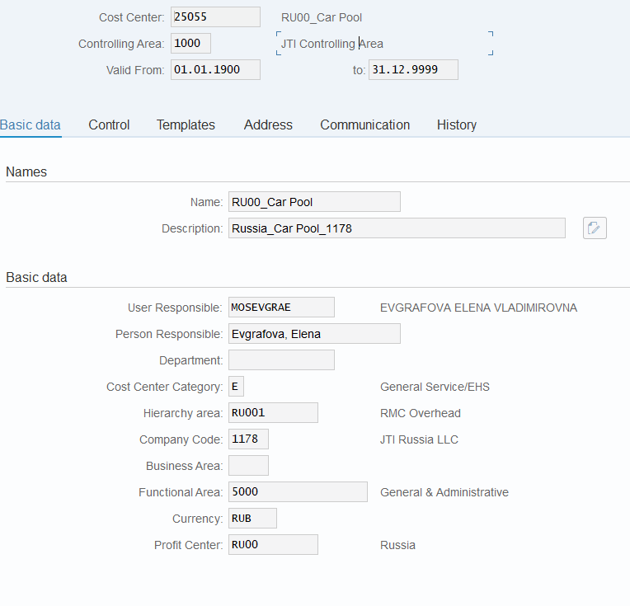

CC Key Master Data Fields – Basic Fields
KS03 – Display CC
All CCs have 5 digits numeric codes. CCs migrated from ECC have the same number in S/4 as in ECC.
All CCs in JTI are created in Controlling Area 1000.
All valid CCs must be in its validity period defined here.
A new standard naming convention for cost centers are introduced to include the profit center code (e.g. RU00) in the “Name” field, and the profit center name in the “Description” field. Both will be visible in GPM+ reporting
Every cost center must have a user responsible populated – this will be used to identify the purchase requisition approver in cases where the PR contains a cost center not linked to the SAP HR hierarchy.
In S/4HANA, Spending Approval is changing!¹⁾
PR approval will be based on HR hierarchy²⁾ .
1st level PR approver name will be populated with “User Responsible” field from CC master data, in case of PR linked to a CC other than the purchase requisitioner’s own CC. This is applicable to purchasing to CC, Capex/Opex/Marketing WBS, or orders.
Once the 1st level approver name is populated, the further level approvers are populated based on the HR hierarchy of the first approver.
¹⁾ Refer to P2P courses for further details.
²⁾ You can find HR hierarchy via Outlook Properties of a given user.

Slide 8
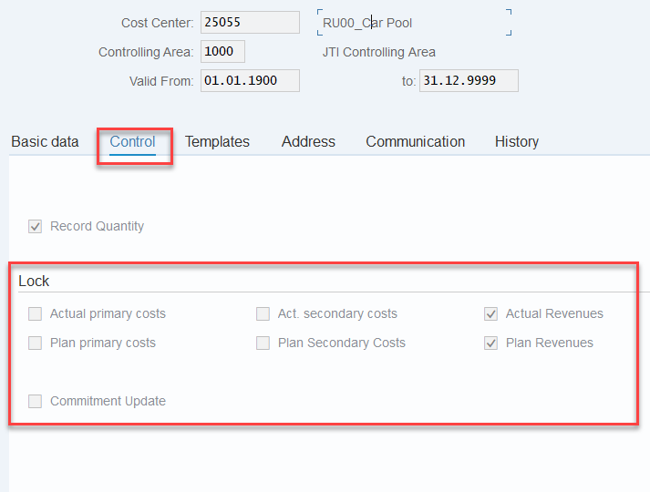
CC Key Master Data Fields – Lock Indicators
KS03 – Display CC
The Lock Indicators in CC Master Data restrict the usage of cost centers.
If a indicator is selected, it means that the cost center cannot be used for that particular purpose. E.g.
For all active cost centers which allow for primary costs posting in actual and plan, the indicators of “Actual primary costs” and “Plan primary costs” should be left blank.
Locked cost centers should not be maintained in other objects in the system, such as in Asset master data, in WBS elements, etc.. This is because there will be postings to these CCs from the postings to the cost objects in which the CC is assigned to, which will fail due to blocked CC. E.g.
When you run depreciation for Assets with blocked CC assigned in Assets master data, your depreciation run will not be able to be completed due to blocked CC.
Some cost centers allow statistical postings of revenues. In this case the “Actual Revenues” and “Plan Revenues” need to be left blank for this to be achieved.
You may navigate to other tabs for additional information, which are generally technical and do not require update by end users.

Slide 9
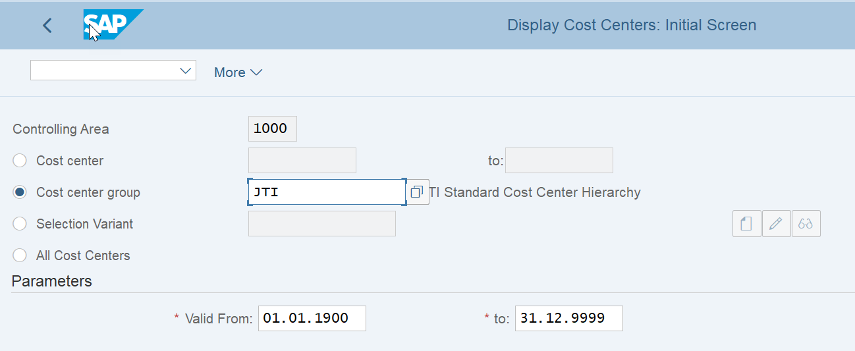
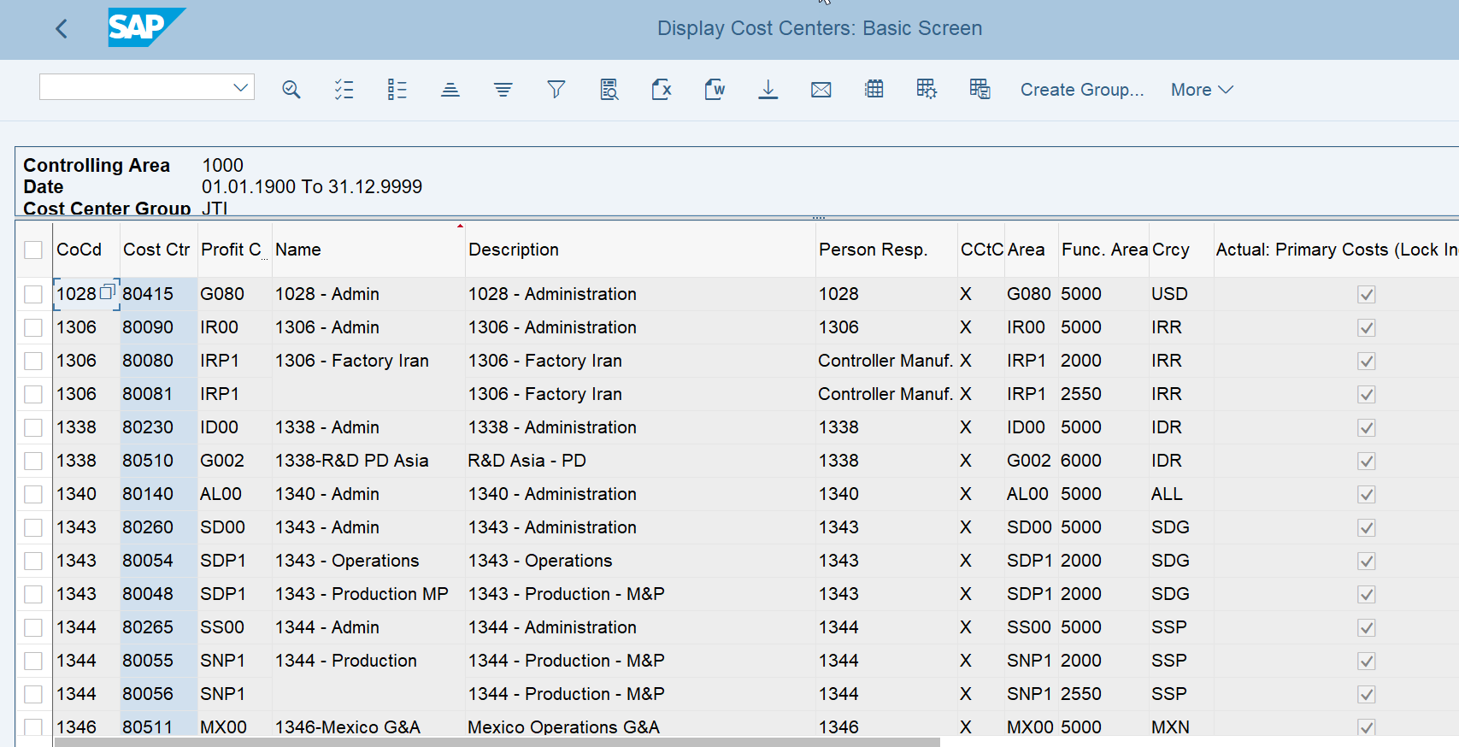
Display Cost Center Master Data (Mulitple Cost centers)
Display Cost Centers:
Cost Center Master data can be viewed for more than one cost center at a time. Either a range or the whole JTI Standard Hierarchy can be viewed using KS13
KS13 – Display Cost Centers

Slide 10
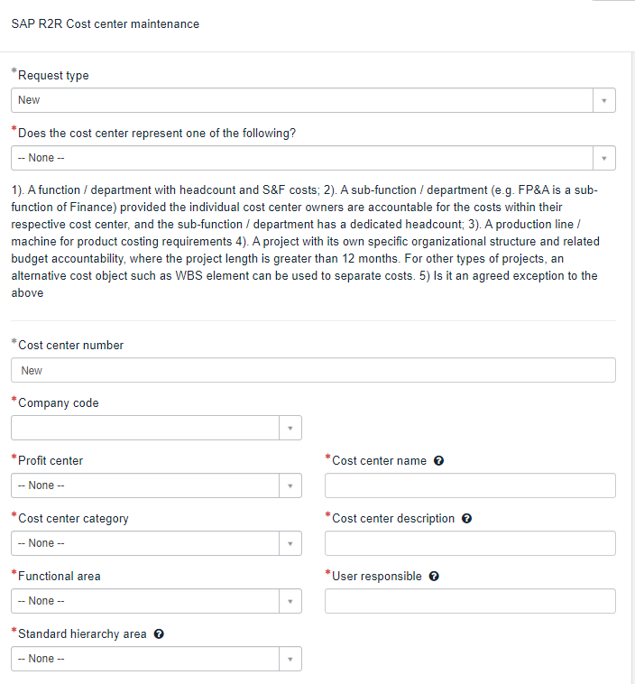
Cost Center Accounting
Cost Center Master data - Maintenance Process
Cost center maintenance process is owned by IT BTS Finance.
Users request for CC Maintenance via IT Service Portal.
IT Service Portal
R2R Competency center provides the governance on cost center related business questions as well as serves as a judge for exceptional cases
Market/Factory users requiring cost center master data changes are requesting them via IT Service Portal
Form on the IT Service portal mirrors the fields available in cost center master data in SAP
There is a level of automation within master data maintenance process allowing changes done in the main S/4 PROD system to be replicated in other systems.

Slide 11
Cost Center Accounting
Cost Center Master data - Maintenance Process
Followings are R&R for Cost Center Maintenance;
Role | Responsibility
Market/Factory user | Submits requests for cost center maintenance providing enough information for CFO to approve and BTS to maintain the master data
R2R Competency center | Provides the governance to the markets/factories/functions, reviews and approves exceptional cases
Market/Factory CFO, Function Lead | Reviews submitted requests and approves them based on Profit center basis
R2R CC Team | Exceptionally approve requests regarding cost center master on ITSP
Entity CFO | Is informed via IT Service portal that such a cost center change has been made in a company code
IT BTS Finance | Checks submitted request on IT Service Portal and creates/changes cost center master data in S/4

Slide 12
Cost Center Accounting
Cost Center Master data - Maintenance Process
Followings are process flow for Cost Center Maintenance;
Market
ITSP
Market
ITSP
R2R CC
ITSP
Service request for cost center changes is raised on IT Service Portal
Service request is approved by the market/factory CFO or function lead
Service request is approved by R2RCC on exceptional basis
IT BTS
SAP HR
Cost center master data is automatically transferred via IDoc to SAP HR
IT BTS
SAP S/4
IT BTS
SAP S/4
Cost center master data is replicated in S4 test systems automatically
Cost center is created/changed/blocked in S4 PROD
IT BTS
BW
Cost center master data is automatically extracted to BW

Slide 13
Course Structure
Master Data Overview
Master Data
Cost Center Category
Hierarchy Area
Cost Allocations
Functional Area
Reporting

Slide 14
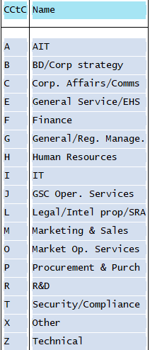
CC Key Master Data Fields – CC Category
KS03 – Display CC
Cost center categories are used to define cost centers within JTI functions, such as Finance, HR, IT, Marketing & Sales.
Each cost center will be mapped to one of the new CC categories in S/4HANA.
This will support global analysis currently performed off-system or via excel-based surveys.
The categories have been aligned with Corporate HR and are closely linked to HR functional areas and job families concept.
This will therefore help to ensure that Finance and HR use aligned information when reporting on headcount or cost of functions.
*
*Human Resources will change to People & Culture

Slide 15
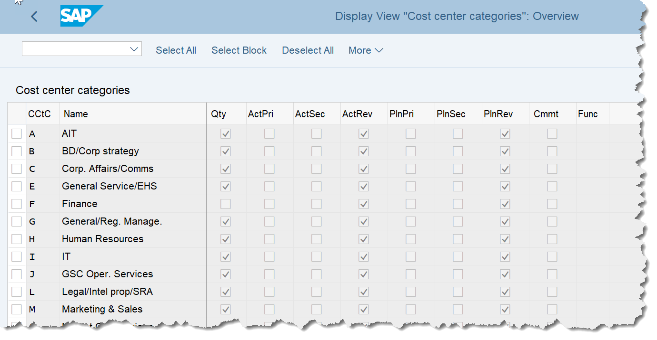
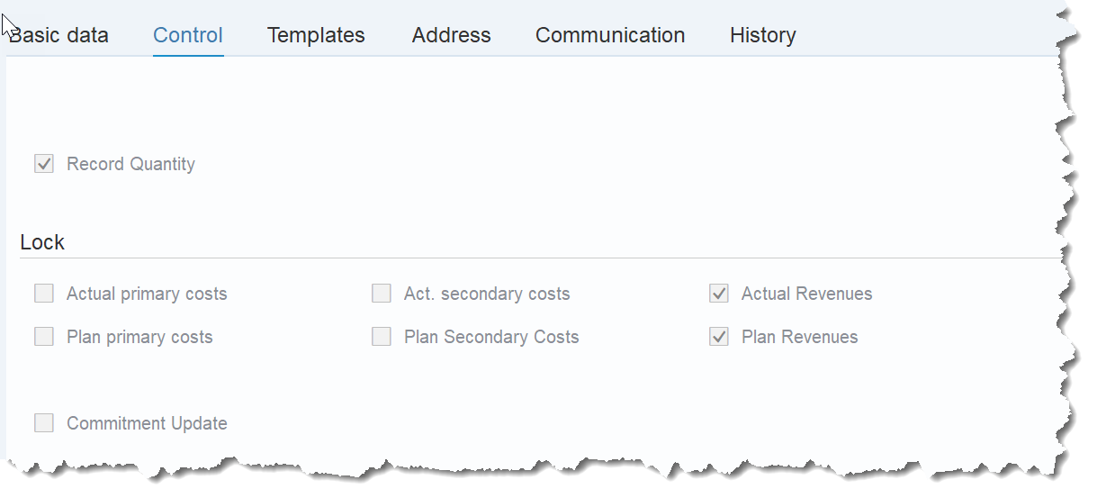
CC Key Master Data Fields – CC Category
Cost Center Categories
Definition and Principles :
Cost center categories defines the type of activity performed by the cost center. They are used to restrict cost centers that may perform a particular activity and provide the ability to safe guard your postings to cost centers as they will prevent non-category costs being posted to the wrong cost center. In addition it provides greater organizational ability across your cost objects.
You can assign the same characteristics to similar cost centers. For example, you can allow particular activity types only for particular cost centers. This is useful to prevent production activities from being posted to administrative cost centers by mistake.
You can also use the cost center category for cost calculation, where it controls what percentage of the overheads applies to that cost center category
The lock indicators select the type of activities allowed by the cost center and when maintained are visible in the Control tab of the Cost Center Master Data
KS03 – Display Cost Center (Control tab)
15

Slide 16
CC Key Master Data Fields – CC Categories
CC Category | Cost Center Category description
AIT | AIT category includes the following activity: Anti Illicit Trade
Business Development and Corporate Strategy | Business Development and Corporate Strategy category includes the following job families / activities: Business Development (M&A) & Corporate Strategy
Corporate Affairs and Communications | Corporate Affairs and Communications category includes the following job families / activities: Communications; Corporate Affairs; Media Relations; Government Relations; Tobacco Taxation, Corporate Sustainability
Finance | Finance category includes the following job families / activities: Accounting & Reporting; Audit & Internal Controls; Finance (BSC Management, CFO, Corporate Finance); Financial Planning & Analysis (including Investor Relations); Tax; Treasury
General Management / Regional Management | General Management & Regional Management category includes the following job families / activities: General Management (GM and assistants) & Regional Management (Regional VP reporting line) where a separate cost center exists and cannot be mapped into other categories
General Services / EHS | General Service and EHS category includes the following job families: General Services; Environment health & Safety / activities
GSC Operational Services | GSC Operational Services category includes the following job families / activities within GSC: Manufacturing management; Production; Customer Services; Engineering; GSC Planning; GSC Quality; GSC RRP; Logistics & Warehousing; Manufacturing; Manufacturing Services; Leaf Commercial Purchasing; Leaf Operations; Leaf Planning; Leaf Processing; Leaf Product Quality; Leaf Production; Leaf Services; Leaf Strategy & New Business; Leaf Supply; Leaf Technical Quality
HR | HR category includes the following job families / activities: Compensation and Benefits; Payroll; Human Resources; Talent Management. Will be described as People and Culture going forward.

Slide 17
CC Key Master Data Fields – CC Categories
CC Category | Cost Center Category description
IT | IT category includes the following job families / activities: Business Technology Services; Global Service Desk; Infrastructure; IT Development; IT Security; Technical Analysis
Legal / Intellectual Property / SRA | Legal/ Intellectual Property/SRA category includes the following job families / activities: Intellectual Property, Legal; Regulatory Affairs (including SRA)
Marketing & Sales | Marketing & Sales category includes the following job families / activities: Brand Marketing; Portfolio Strategy & Innovation, Portfolio & Brand Strategy; Sales (Field Sales, Key Account, Merchandiser/Sales Representative/ Sales Support); Strategic Insights; Trade Marketing (Consumer Trade Channel; Development & Planning; Program Development)
Market Operational Services | Market Operational Services category includes the following job families / activities within markets: Customer Services; Logistics & Warehousing
Procurement and Purchasing | Procurement and Purchasing category includes the following job families / activities: Procurement and Purchasing
R&D | R&D category includes the following job families / activities: Global Product Specification; Packaging; Product & Technology Planning; Product Development; R&D Quality Assurance; R&D Regional Services
Security / Compliance | Security/Compliance category includes the following job families / activities: Security, Compliance
Technical | Technical category includes all cost centers required for technical purposes documented in R2R GRM including income/expense from investments in associated companies, gain/loss on intercompany sales of fixed assets etc.

Slide 18
Course Structure
Master Data Overview
Master Data
Cost Center Category
Hierarchy Area
Cost Allocations
Functional Area
Reporting

Slide 19
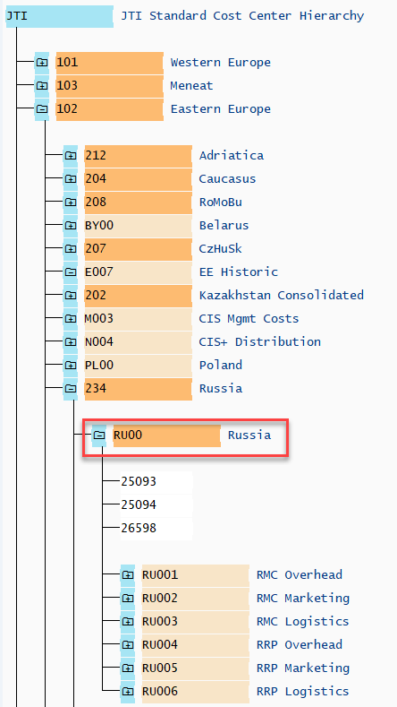
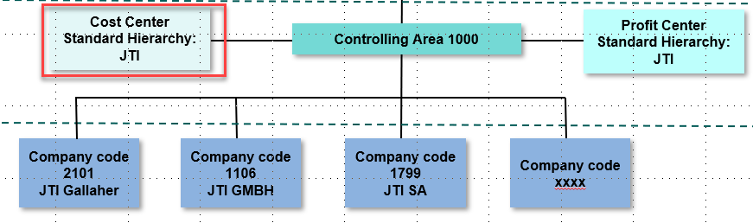
CC Key Master Data Fields – Hierarchy/Company Code
KS03 – Display CC
Organizational Levels in SAP
As a structural master data, each cost center is created within a company code (and can only be linked to one company code) and assigned to the Cost Center Standard Hierarchy. There is only one CC Standard Hierarchy within a Controlling Area.
The field “Hierarchy area” indicates the node where the cost center is assigned to in the Cost Center Standard Hierarchy.
As Company Codes are assigned to Controlling Area according to the organizational levels in SAP, the company code currency becomes the currency of a cost center. This is shown as “object currency” in Cost Center reports. It is not possible to change the CC Currency as it is inherited from the company code.
Every Cost Center is assigned to one Profit Center only. According to S/4 PC structure, a CC is assigned to the PC which represent the market/function/factory that the CC belongs to.

Slide 20
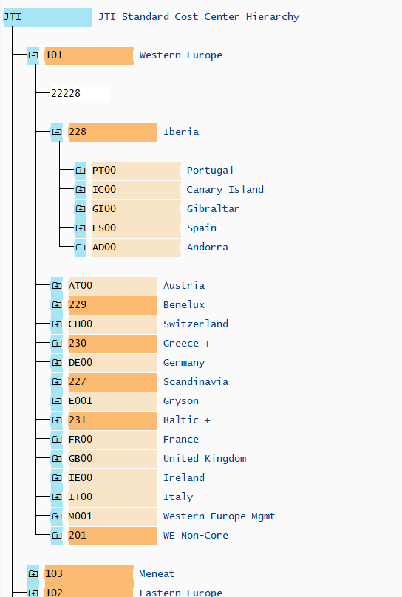
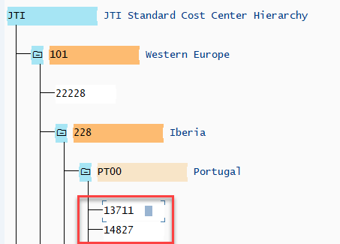
Cost Center Standard Hierarchy
The CC Standard Hierarchy “JTI” has all CCs assigned to a node within it.
The highest level nodes within the hierarchy represent Regions. E.g. 101- Western Europe, 102-Eastern Europe, 103-Meneat, 104-Americas,105-Asia Pacific, 106-HQ and 108-Technical. This is the same as in PC Standard Hierarchy.
KSH3 – Display CC Group
In the cases for a sub-region, such as 228-Iberia, the Market/Functions are assigned under the nodes representing sub-region.
The next level under Region may represent directly the Market/Function, such as AT00, CH00, etc. or a sub-region, e.g. in the cases of 228-Iberia and 231-Baltics +.
Here you may also have groups of Non-Core PCs within a region, e.g. 201-WE Non-Core. Again this is the same as in PC Standard Hierarchy.
The lowest level object in any cost center hierarchy is always individual cost centers. If you double click a cost center in the hierarchy, you will be taken to the CC master screen.

Slide 21
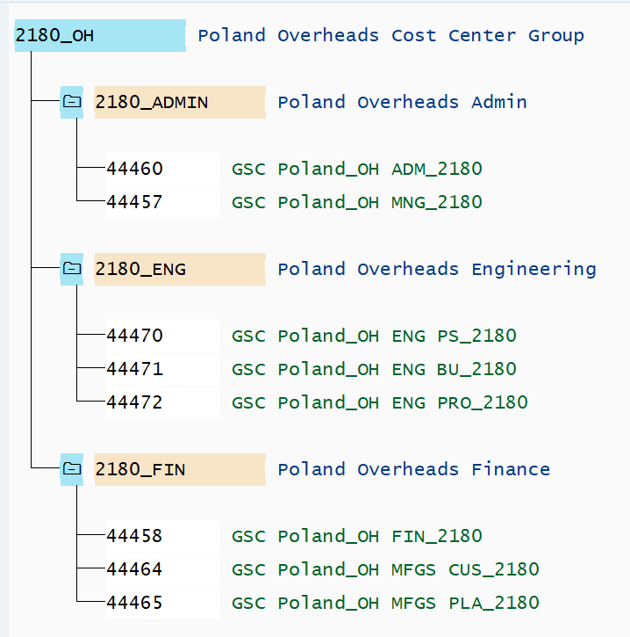

Cost Center Alternative Hierarchies
KSH3 – Display CC Group
An example of an Alternative hierarchy used in JTI is Cost Center Group “2180_OH”.
Cost center groups can contain other cost center groups giving a flexibile approach to grouping cost centers for specific business requirements
Cost center group hierarchies like this are used to group similar Cost centers together for things such as:
Reporting (cost center groups can be used to group similar types of costs together, for example, cost center group 2180_OH groups Polish overhead groups so a report on overheads can easily be created
Cost Center allocations: In allocation cycles cost center groups can be used especially in the cases of more complex cycles which will include a lot of cost centers performing similar types of allocations
The end nodes are lists of the individual cost centers required to be included in the group. Making it easy to uniquely tailor groups to include any cost centers the user may need.
Requests to create new Cost Center groups is done through ITSP

Slide 22
Course Structure
Master Data Overview
Master Data
Cost Center Category
Hierarchy Area
Cost Allocations
Functional Area
Reporting

Slide 23
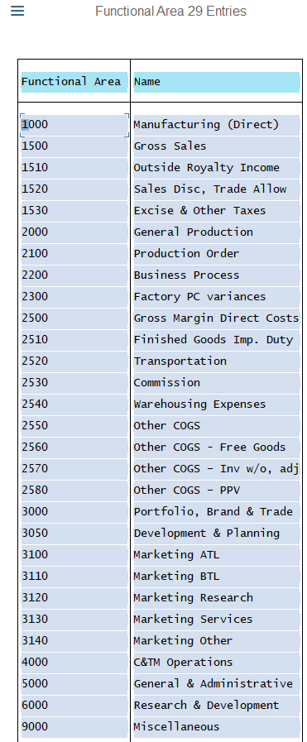
CC Key Master Data Fields – Functional Area
KS03 – Display CC
Functional areas (FA) are used in combination with JTIG (group account) to ensure entries are recorded in the correct P&L line on the Market P&L for management reporting and the IFRS P&L for JT Reporting.
Pre-defined logic for FA on G/L line items in SAP:
If a G/L account has a defined functional area mapped to it (maintained in G/L MD), this is used in the entry regardless of the functional area mapped to the cost center.
If the G/L account does not have a functional area maintained in its MD, FA comes from the cost center – therefore the functional area on the G/L accounts has priority.
What G/L accounts already have FA maintained in their master data?
G/L accounts such as for marketing programs, marketing allowances, inventory write-off and bank fees
It is therefore not required to maintain separate cost centers for these to ensure that the costs end up in the correct lines of the Market P&L
In S/4, we will also have G/L accounts with functional area 9000 that can be used when income / expenses should be recorded in “Miscellaneous” in the Market P&L – therefore there is no need for CCs with FA 9000 in S/4HANA from January 2020.

Slide 24
CC Key Master Data Fields – G/L Accounts for Misc.
Below are some examples of G/L accounts that have FA 9000 (Miscellaneous) in S/4HANA:
Nature of account | JTIO numbers / JTIO descriptions
Intercompany P&L | For example: 304070 - GSA Revenue, 304075 - GSA Revenue (Auto), 504001 – Marketing Costs Rec Income, 504002 – Marketing Costs Rec Exp, 512300 - GSA Expense, 512305 - GSA Expense (Auto)
Gain / loss on sales of fixed assets | For example: 605012 – Gain on Sale of Buildings, 605015 - Gain on Sale of Vehicles, 605020 – Gain on Sale of Fixed Asset (I/C), 606012 – Loss on Sale of Buildings, 606015 – Loss on Sale of Vehicles
Other | For example: 611010 – Doubtful Debt Expense, 614030 – Equity on Gain in Associated Companies, 616011 – Other Miscellaneous Operating Income, 616021 – Other Miscellaneous Operating Expenses

Slide 25
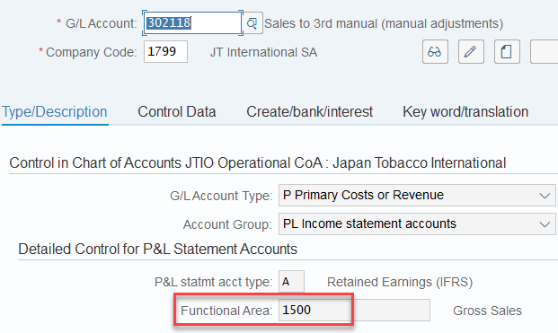
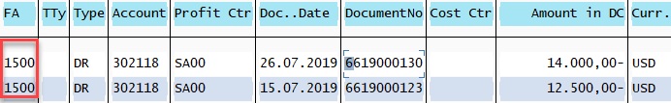
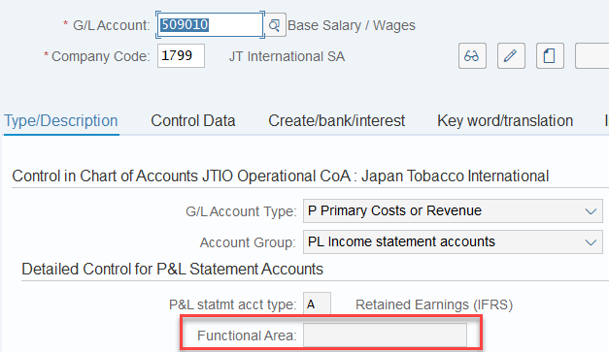
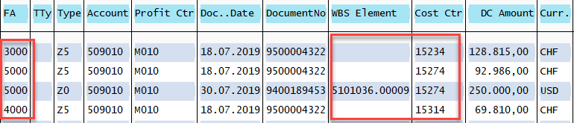
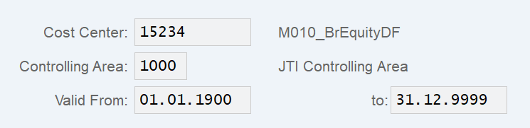
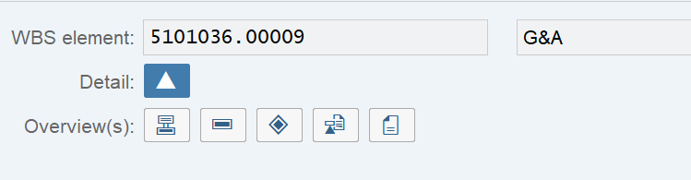
CC Key Master Data Fields – Functional Area
FS00 – Display G/L Master Data
Definition and Principles :
In JTI “Functional Area” (FA) is populated in accounting records posted to a given P&L account. It is used as a criterion in Market P&L structure to determine which P&L line a P&L posting should be reported, and can be used for analytical purposes by functional aspects defined by different Functional Areas.
Example 1
Posting Rules as per SAP standard:
If FA is maintained in G/L master data, all postings made to the G/L will have this FA. (See Example 1)
However if FA is left blank in G/L master data, the FA on the respective G/L line items is determined by the FA maintained in the cost objects to which the G/L is posted to. (See Example 2)
FS00 – Display G/L Master Data
Example 2
CJ20N – Project Builder
KS03 – Display Cost Centre
Cost Objects
25

