Slide 1

Course Structure
Rationale for CO-PA changes
Profitability Analysis: Intro to S/4
The 3 Building Blocks
Profit Center Reorganization
Profit Center Reorganization
Standardization of Dimensions
Market P&L
Cost Center Standardization
Reporting Capabilities

Slide 2

Profit Center Re-Organization
1. Profit Centers and Cost Centers to reflect the organization
Key Changes
New framework to be applied for Profit Centers (PC) and Cost Centers (CC)
New Framework to support FCF by market
Mandatory for all postings
PC for Market, Factory, Global Function and Regions
Product Type and Brand not included in PC → will become characteristics
New naming and numbering convention (alpha – numeric)
Main PC hierarchies included in S/4
PC/CC creation and maintenance procedure as part of R2R GRM
PC & CC ownership: Corporate F&A
CC approval: Market CFO / Function Finance Lead / Factory Controller, with notification sent to Entity CFO
Profit Centers
Cost Centers
Markets
Click here to open PC Finder

Slide 3







Profit Center New Framework
Russia
Russia DF
Petro
1 PC for Market
(country / accountability)
RUD0
RUP1
RU00
1 PC for Duty Free Market
(country / accountability)*
1 PC for Factory
Business Development
Western Europe Mgmt
Sales Error Process
G001
M001
S999
1 PC for Function
Ultimate responsibility area of the Function (HQ) and
Cost Centers for Sub functions
1 PC for Regional Team and (Sub Regional: treated on an ad-hoc basis)**
Limit use of Technical PC ‘s
Acquisitions to be treated ad-hoc
* WWDF Structure due to its specific set up also includes mix of Distributer and Market destinations. For non markets the coding D01, D02,..is applied
** Sub Regional PC’s: allocation of Sub Regional PC’s is advised, however there can be cases in which Sub regional PCs are too complex to allocate and have a clear accountability. These cases should be logged as exception at the discretion of the Region CFO / Corp. FP&A.
- Non Core PCs follow numbering (N01,N02,..) These are areas of our business such as Distribution, Leaf Sales to JT and Third Parties, CMA and Sale of Private Labels.
If a business is managed independently it shall sit on a separate Profit Center, with the exception of Private Labels (with a specific numbering). If it is deemed the Market GM is still accountable for the business flows, PL will be part of the Market Profit Center and carved out based upon non-JTI brands classification.
- In category Factory F01, F02,.. coding is applied in cases of Non Plants.

Slide 4
Profit Center Example Old vs New
As/Is
To/Be
New Profit Center (PC) will be used in S/4 with a new naming and coding
Product Type and Brand Family will not be included in the new PCs

Slide 5
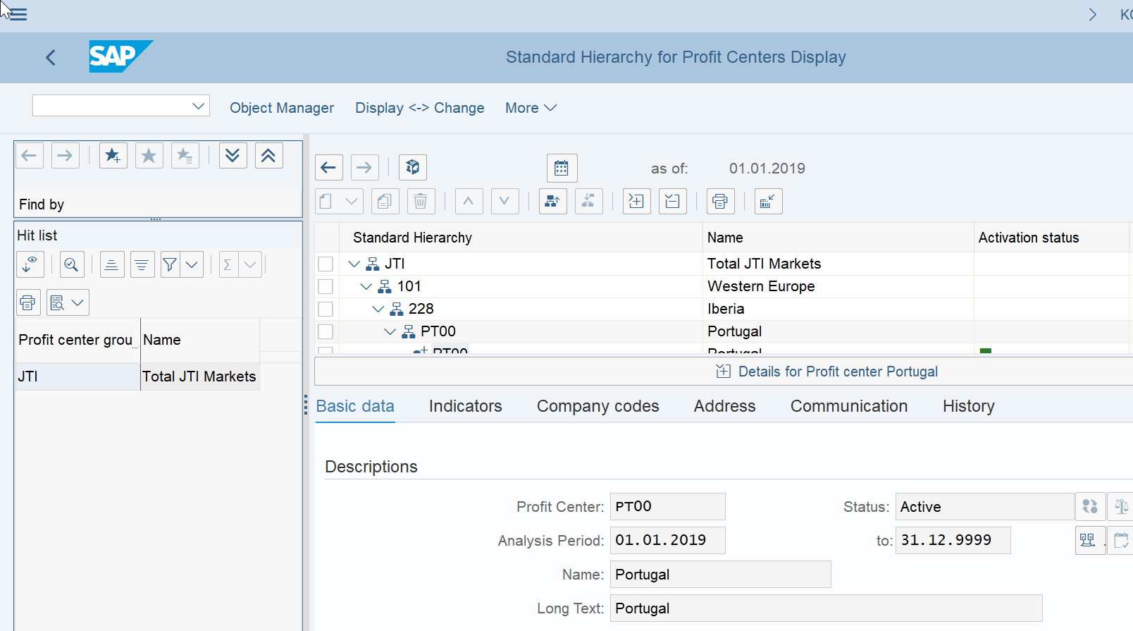
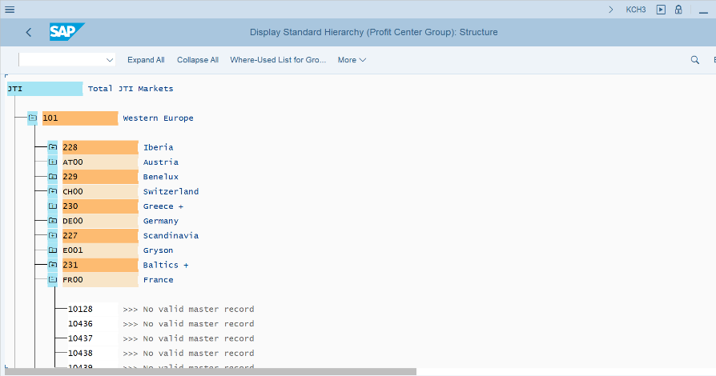
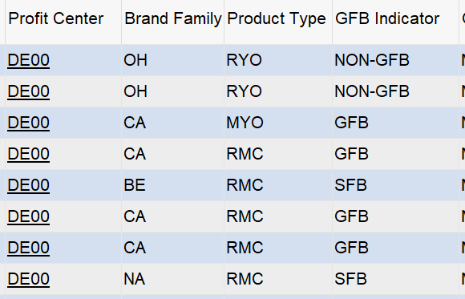
Profit Centers in S/4 - TCodes
New Profit Center (PC) will be used in S/4 with a new naming and coding
Product Type and Brand Family will not be included in the new PCs.
Info will be kept through CO-PA characteristics/dimensions
Therefore if you display the G/L line item view, you will see, amongst other info, both PC and dimensions (ACDOCA).
This set up allows FCF by market since this is done at the level of PC.
PCs are one of the so called structural Master Data within S/4 and S/4 is considered the single source of both the PC and main PC Hierarchy. BW will read and use the data and hierarchy from S/4.
Tcode to display the PC Hierarchy KCH3 is unchanged in S/4
T:Code KCH6N also displays top node hierarchy with master data viewable in same screen
KCH3 – Display PC
Abstract Tcode FAGLL03
H
New Profit Centers
PC +
Dimensions
KCH6N – Display PC

Slide 6
Demonstration & exercises
Exercise 1.1: Display Profit Center Hierarchy

Slide 7
Course Structure
Rationale for CO-PA changes
Profitability Analysis: Intro to S/4
The 3 Building Blocks
Profit Center Reorganization
Standardization of Dimensions
Profit Center Reorganization
Market P&L
Cost Center Standardization
Reporting Capabilities

Slide 8
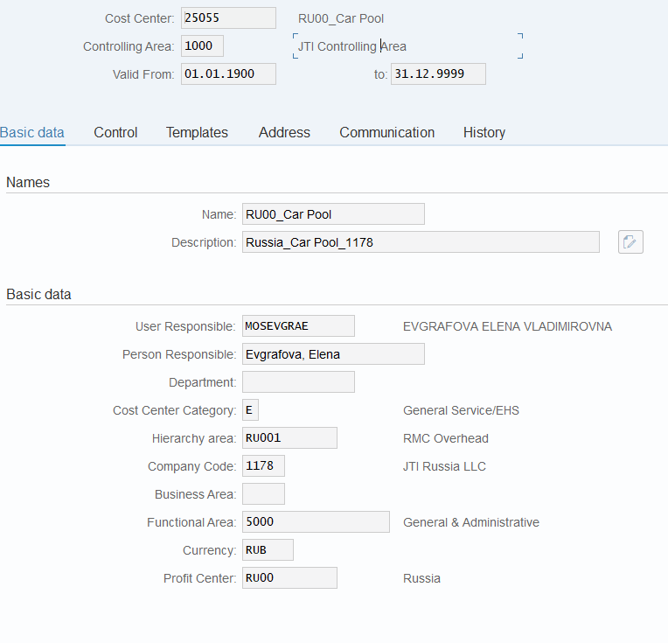

Cost Center Key Master Data Fields – Basic Fields
KS03 – Display CC
All Cost Centers have 5 digits numeric codes. Cost Centers migrated from ECC have the same number in S/4 as in ECC.
All Cost Centers in JTI are created in Controlling Area 1000.
All valid Cost Centers must be in its validity period defined here.
A new standard naming convention for cost centers are introduced to include the profit center code (e.g. RU00) in the “Name” field, and the profit center name in the “Description” field. Both will be visible in GPM+ reporting
Every cost center must have a user responsible populated – this will be used to identify the purchase requisition approver in cases where the PR contains a cost center not linked to the SAP HR hierarchy.
In S/4HANA, Spending Approval is changing!¹⁾
PR approval will be based on HR hierarchy²⁾ .
1st level PR approver name will be populated with “User Responsible” field from Cost Center master data, in case of PR linked to a Cost Center other than the purchase requisitioner’s own Cost Center. This is applicable to purchasing to Cost Center, Capex/Opex/Marketing WBS, or orders.
Once the 1st level approver name is populated, the further level approvers are populated based on the HR hierarchy of the first approver.
¹⁾ Refer to P2P courses for further details.
²⁾ You can find HR hierarchy via Outlook Properties of a given user.

