Slide 1

Course Structure
Profitability Analysis: Intro to S/4
Dimensions Overview
Profit Center Reorganization
Standardization of Dimensions
Key Dimensions
Market P&L
Dimensions Derivation and Value Flow
Reporting Capabilities

Slide 2
Profitability Analysis – Value Flows
Production Variances - Settlement
Financial Accounting
Cost Element Accounting
Production
Sales & Distribution (SD)
Profitability Analysis
CO-PA
(ACDOCA Table)
Market P&L Profit Center
Billing
Tcode: GR55 (Z4PL)
Tcode: FAGLL03H (line item)
Product Cost
Cost of Goods Sold
Overhead Management
Allocations/Settlements
Direct FI Posting

Slide 3
SALES & Distribution (SD) flows

Slide 4
Sales & Distribution Value Flows
Sales Order Creation
Post Goods Issue (PGI)
Billing
With Account based CO-PA Sales Order creation is no longer the first step in data transfer to CO-PA. There is no accounting document posting at this stage and therefore no posting to G/L accounts
Post Goods Issue is the first time data is transferred to CO-PA, as this is the first step that an accounting document is generated to G/L Accounts (using condition type VPRS)
Posting to Costs Of Goods Sold (COGS) G/L account occurs
Billing creates CO-PA postings using the JTI 3rd party sales pricing condition ZPD0. This is Sales value.

Slide 5
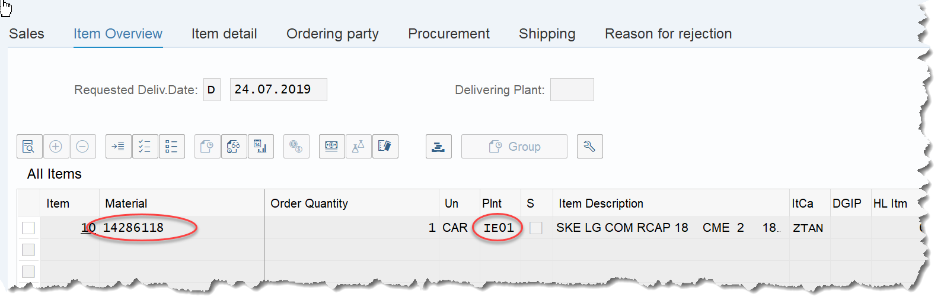
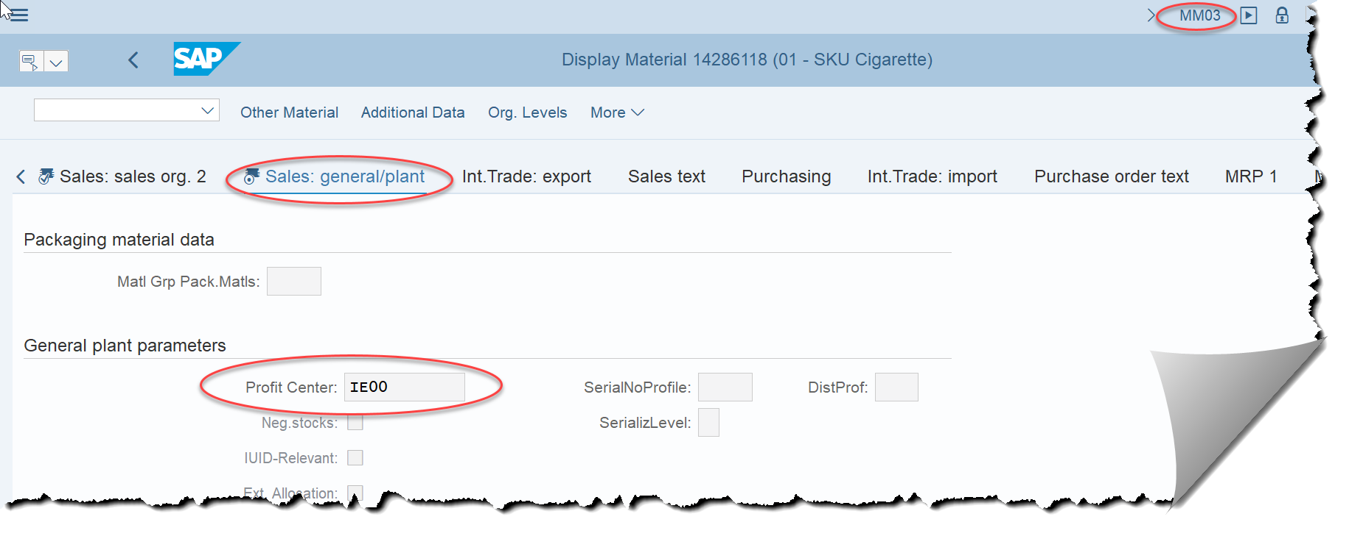
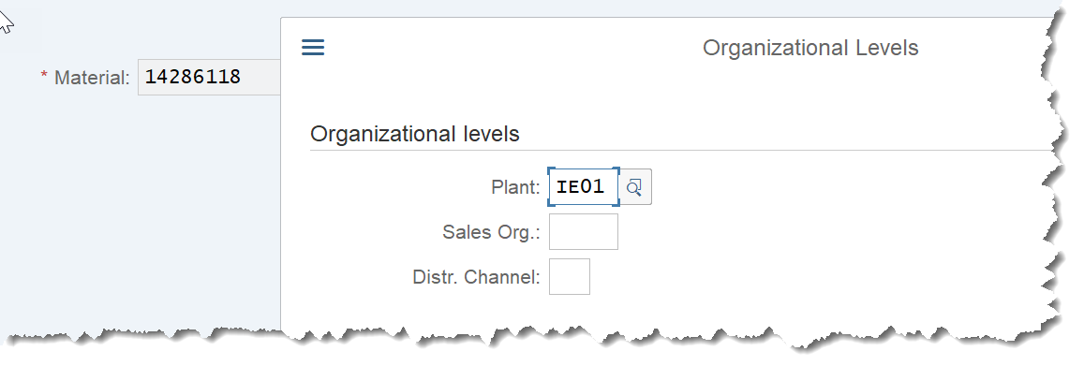
Sales & Distribution: Profit Center Derivation
VA03 – Display Sales Order
Postings are automated through SD flows using Sales Orders.
Upon creation OTC colleagues enter Material and Plant information. SAP can then derive the Profit Center from this information from the Sales: General/Plant tab in the Material Master.
MM03– Display Material Master - Sales: General/Plant

Slide 6
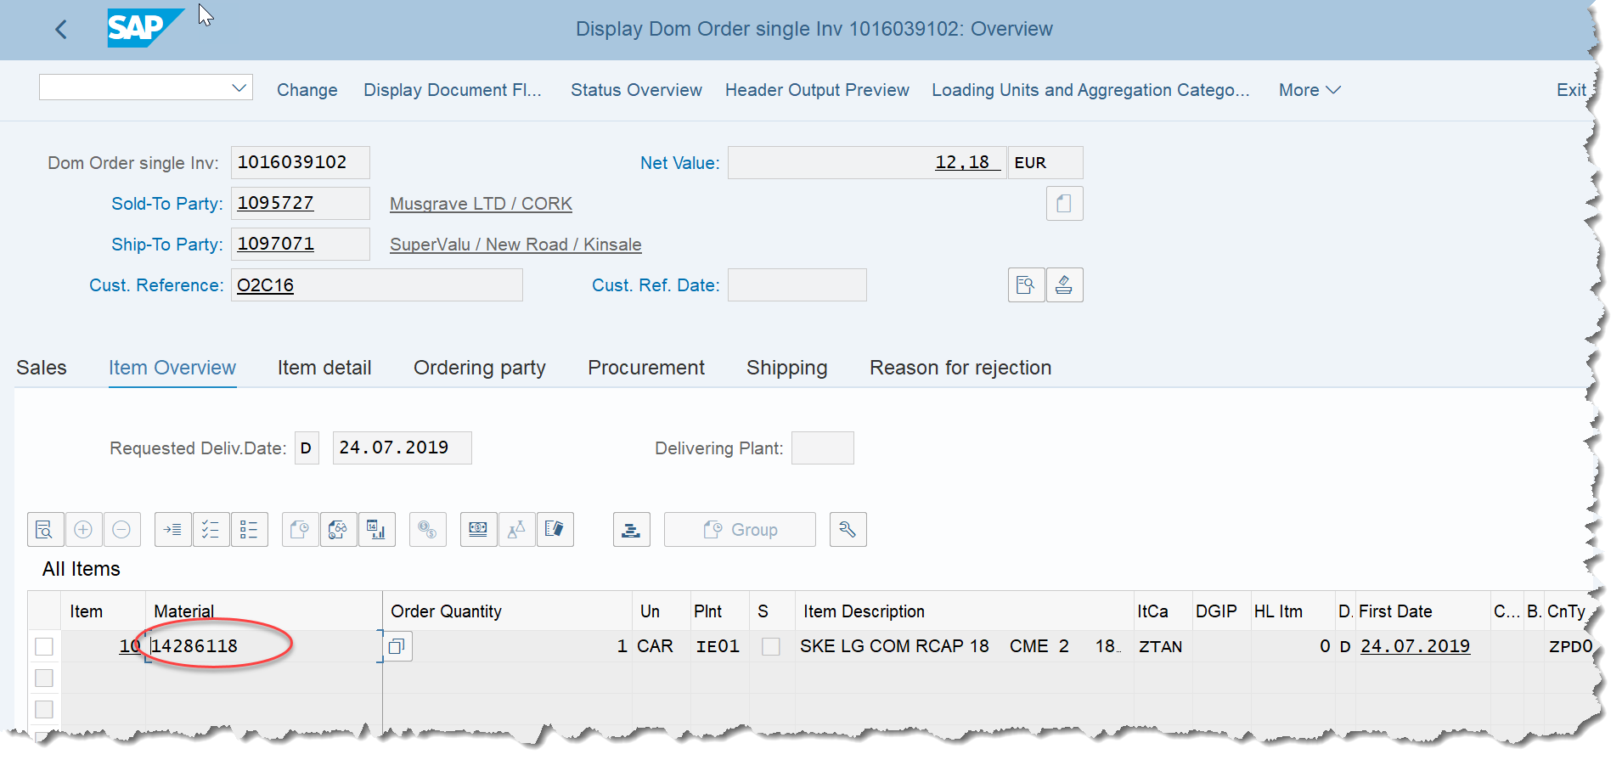
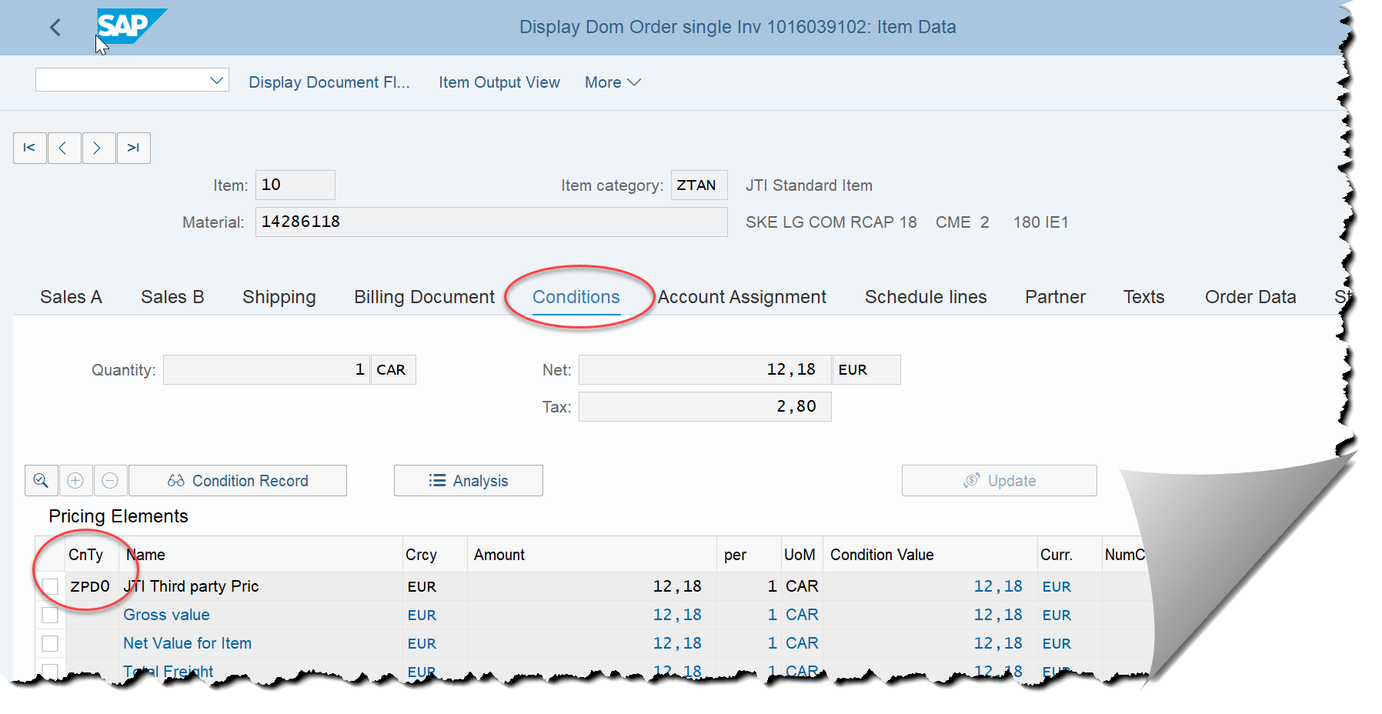
Sales & Distribution: G/L Account determination
Definition and Functionality :
Condition Types are defined as specific features of daily pricing activities. Using the condition type, you can also put different condition types for each pricing, discounts on goods, tax and surcharge that occurs in business transactions.
Condition types are used in Sales Orders to determine which values are to be posted to which G/L Account.
Conditions can be viewed in Sales Order by double clicking on the Material required
VA03 – Display Sales Order

Slide 7
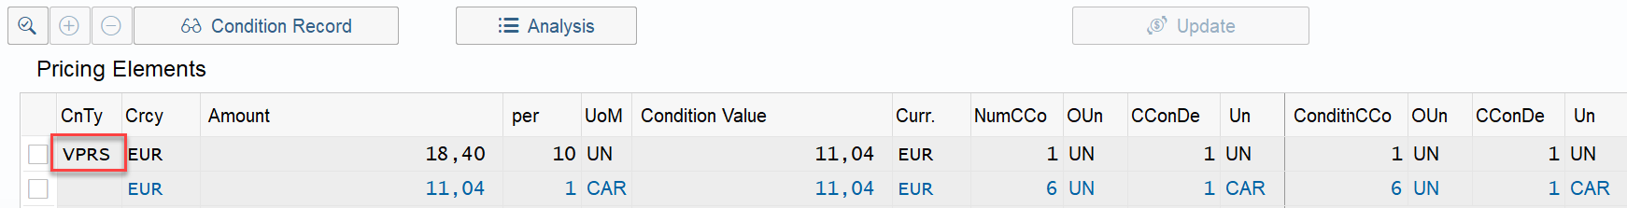
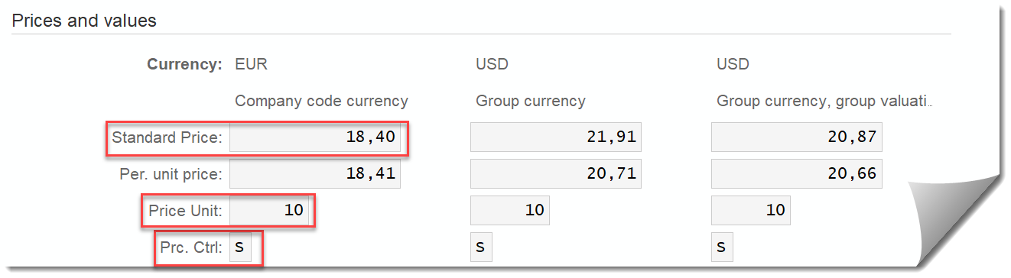
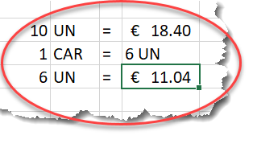
Sales & Distribution: Pricing Determination
On Post Goods Issue, the system takes values using VPRS condition type. VPRS (Internal Cost):
The condition type VPRS is labeled as a statistical condition in the pricing procedure. in this, using the condition category G, the condition type VPRS goes into the valuation segment of the material master and determines from here the standard or average price. Standard price is used in JTI as indicated in Accounting 1 views in MM with Pricing Control S
This is Cost Of Goods Sold (COGS)
VA03 – Display Sales Order
MM03 – Display Material Master – Accounting 1
FAGLL03H – Display G/L Account Line Items

Slide 8
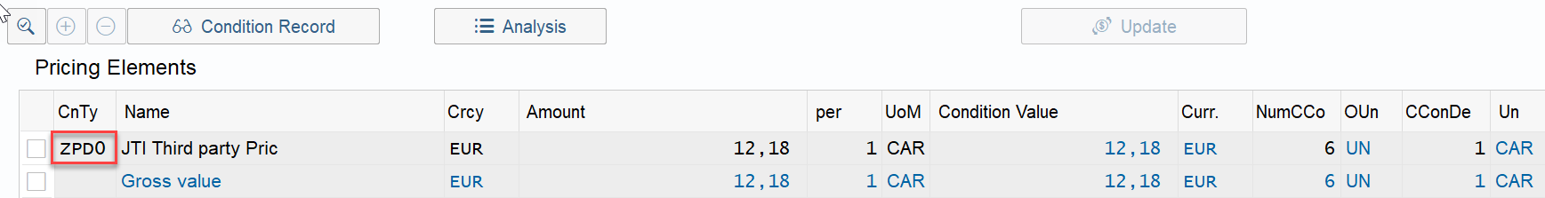
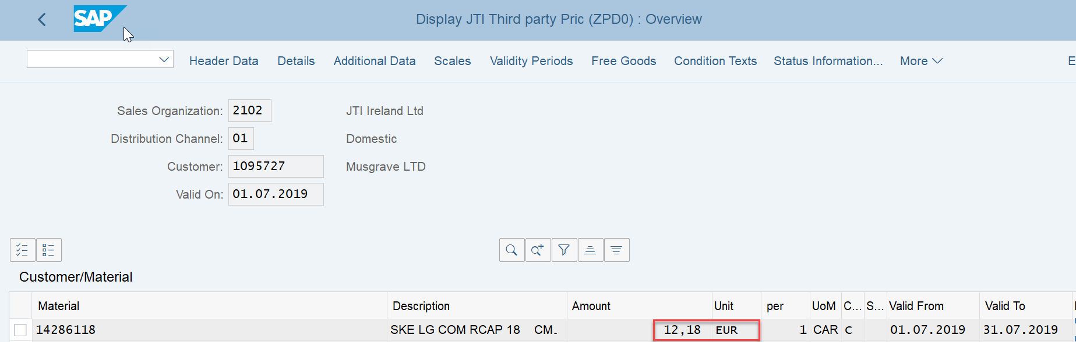
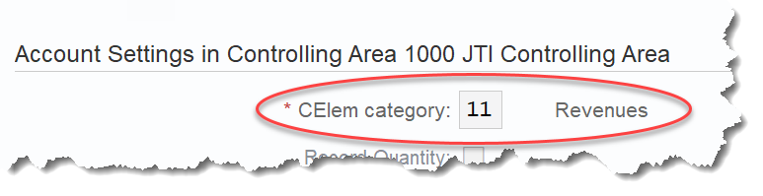
Sales & Distribution: Condition Types – ZPD0
On Billing, the system takes values using ZPD0 (JTI Third party pricing) pricing condition type.
These prices are the Sales Revenue price calculated for different products using the JTI business model. Sales prices are maintained in SAP via VK11.
Condition type ZPD0 automatically assigns these prices to G/L Account 302110 (“Sales to third parties (automated SD entries)”)
Cost Element Category 11 (Revenues) correctly applies the appropriate signage for CO-PA
VA03 – Display Sales Order
VK13 – Display Pricing Conditions
FAGLL03H – Display G/L Account Line Items

Slide 9
Allocations & settlements

Slide 10

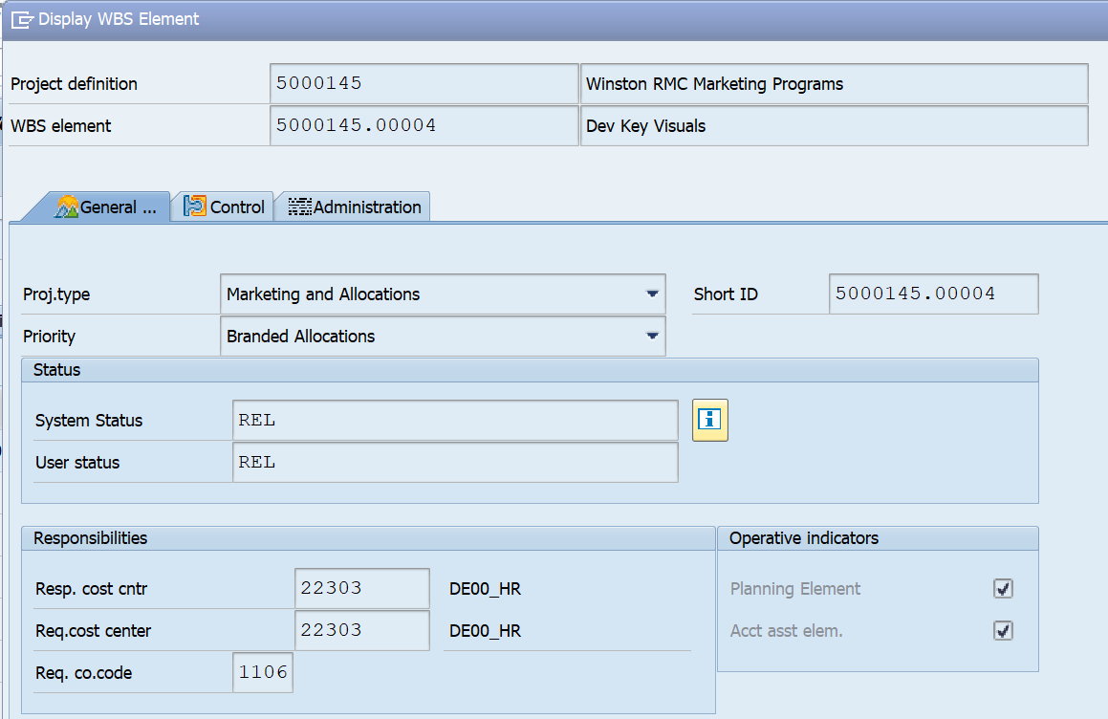
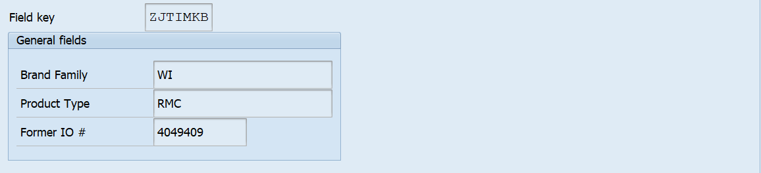
WBS Settlement to CO-PA - Branded
Branded WBS elements
Each branded WBS element must be linked to a brand and product type – these are CO-PA characteristics. This is completed in the Master Data of the WBS Element.
As expenses are recorded against the WBS element the brand family / product type will also be visible for reporting via instant derivation functionality.
At month-end WBS settlement will be performed by BSC and this is the value flow to CO-PA.

Slide 11

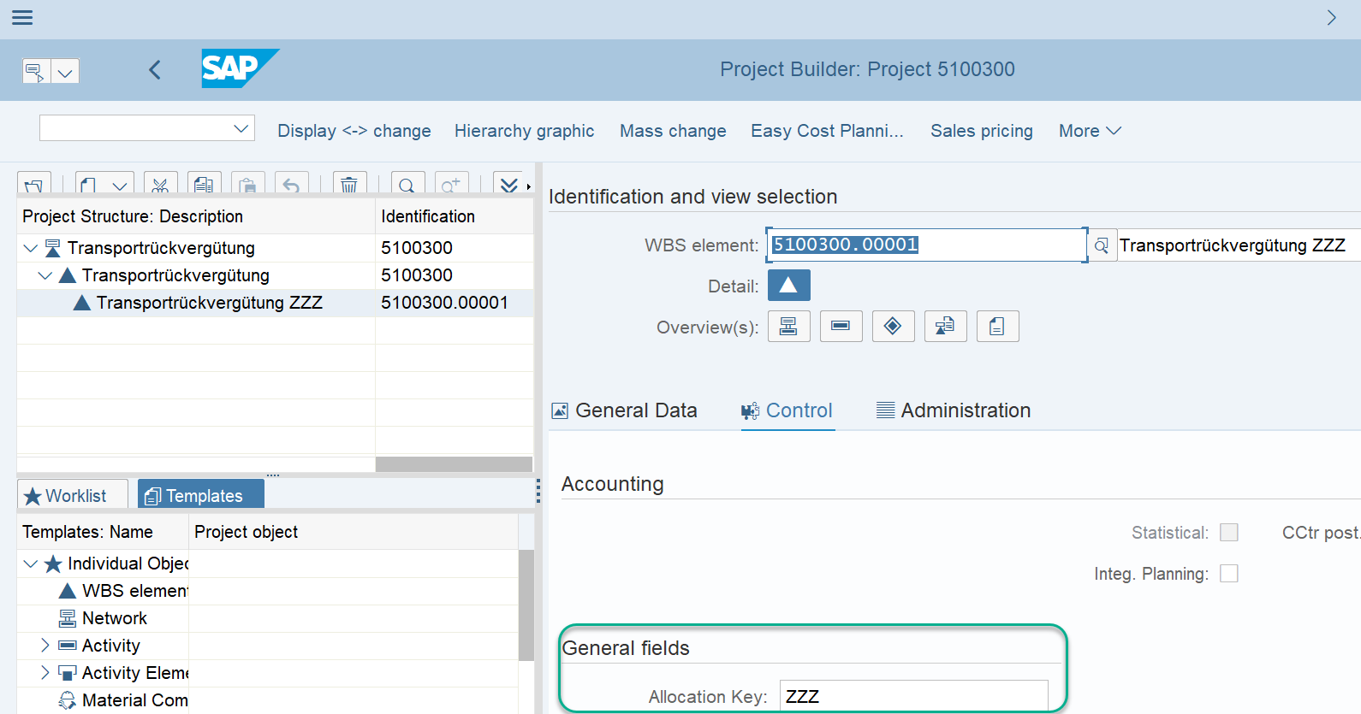
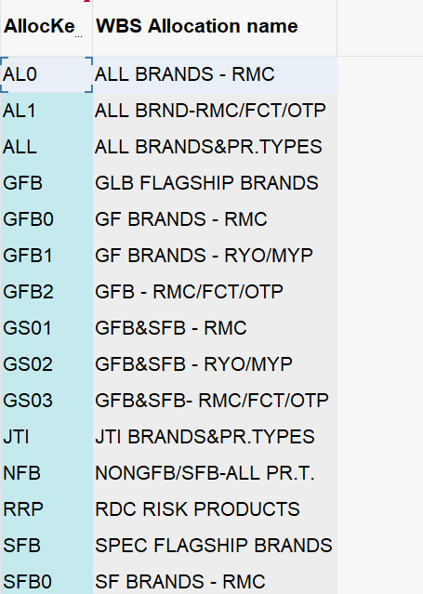

WBS Settlement to CO-PA – Multi-Branded
Multi-brand WBS elements
A multi-brand WBS element will be used to collect costs where brand and product type is unknown when the purchase order is created
On a monthly basis the custom WBS allocation program will be executed, and the costs will be allocated from the multi-brand WBS to brand family / product type CO-PA characteristics based on the weighting of year-to-date net revenue per brand family / product type for the market
This will be done by using allocation keys maintained in the master data of the WBS. The allocation key have a pre defined calculation basis assigned to them except ZZZ which allows users to create their own allocation rules.
For more information on Above Brand Contribution Allocations and Settlements, please see course CO Controlling WBS Elements & Projects – ABC

Slide 12


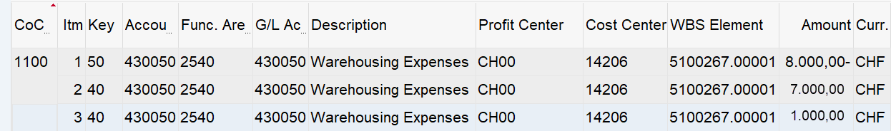
WBS Settlement Flow to CO-PA
FB03L – Branded WBS Settlement
Debit and Credit in same:
G/L Account √
Functional Area √
Profit Center √
Balanced to zero √
Ledger other than 0L possible √
Document type SZ √
FB03L – Multi Branded WBS Settlement – Allocation ZZZ
Debit and Credit in same:
G/L Account √
Functional Area √
Profit Center √
Balanced to zero √
Ledger other than 0L possible √
Document type SZ √
FB03L – Multi Branded WBS Settlement
Debit and Credit in same:
G/L Account √
Functional Area √
Profit Center √
Balanced to zero √
Ledger other than 0L possible X
Document type XW √

Slide 13

Cost Center Allocation - Introduction
Cost Center Allocation Cycles
Ability to collect costs against a cost center and allocate these costs to multiple cost centers / WBS elements based on the rules defined in the cycle
The cycles are executed on a monthly basis by BSC as per the rules defined – eliminating the need to submit journals each month through the MyRequest system (note: GSC cycles are executed by GSC Finance)
Allocation cycle entries in S/4 HANA will generate FI postings and therefore are visible in FI reports. They can be performed in a specific ledger only (for example IFRS ledger only for management accounting allocations) if needed, or can impact all ledgers
For markets, BSC will create allocation cycles in SAP on receipt of a MyRequest template
The rules defined in the cycle can be:
A fixed amount or fixed % which is updated periodically
A Statistical Key Figure – a key of allocations populated in SAP such as headcount per cost center, square meters per cost center etc.
Based on split of costs between cost centers / profit centers / WBS elements in other accounts

Slide 14
Cost Center Allocations for OpEx
1. Goods receipt for electricity costs
2. Total balance on General Services cost center
DR/CR | Account | Cost center | Profit Center | Amount EUR
CR | GRIR |  | France Market | (1000)
DR | Electricity | General Services | France Market | 1000
Cost Center Report:
Cost Center: General Services
Reporting Period: 1 to 3 2019
Cost element | Actual Amount
Electricity | 1000 EUR
3. Allocation cycle
4. Allocation cycle postings
Cost Center Allocation Cycle:
DR/CR | Account | Cost center | Profit Center | Amount EUR
CR | Electricity | General Services | France Market | (500)
DR | Electricity | IT Dept | Global IT | 200
DR | Electricity | WWDF France | WWDF France | 300
Sending cost center
General Services
Receiving cost centers
IT Dept, WWDF
Sender rule
Posted amounts
Receiver rule
Fixed percentage
Receiver 1 %
20%
Receiver 2 %
30%
For more information on OPEX allocations, please see course CO Controlling WBS Elements & Projects – OPEX

Slide 15
Direct fi postings - Manual postings

Slide 16
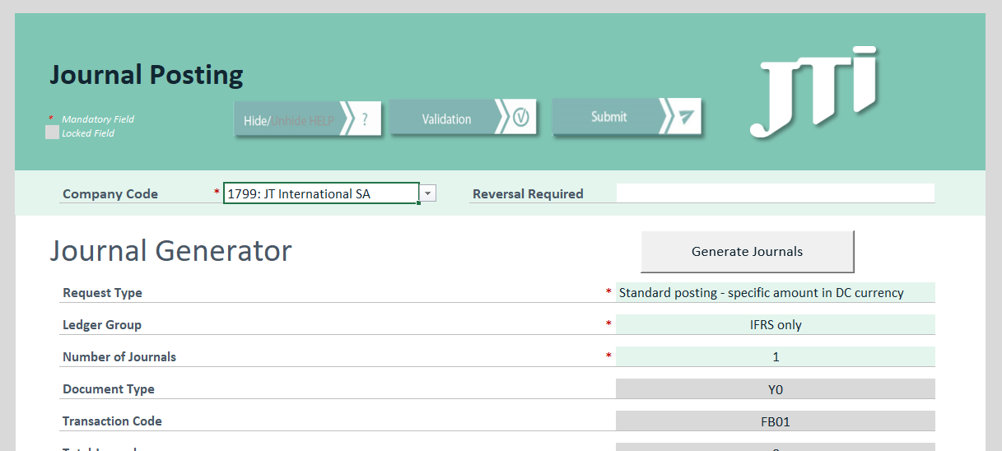
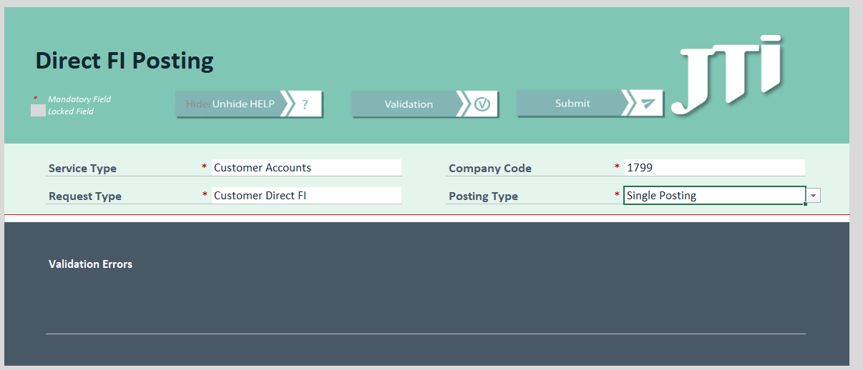
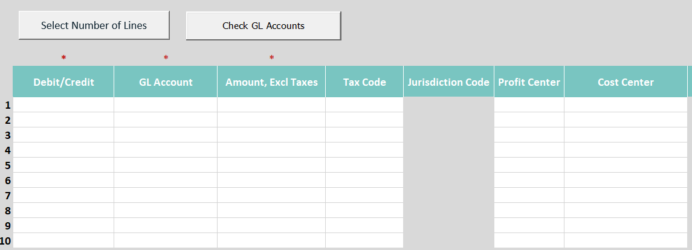
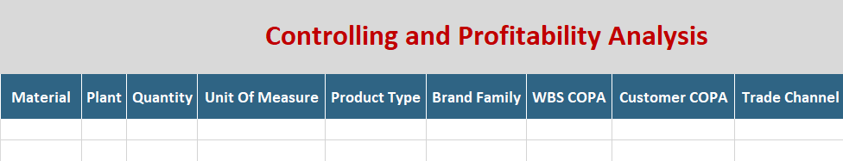
Manual Postings via MyRequest templates
MyRequest Templates
MyRequest templates are used to make manual postings and will have additional Profitability fields to capture dimensions in postings (eg. “Brand Family” and “Product type”)
If “Brand family” is populated, “If “Material field” is populated then “Brand Family” and Product Type” should not be populated. If users fill out all 3 fields for Material, Brand Family and Product Type it will trigger a validation error, flagging these three fields red. Users should only enter either Material data or the Brand Family and Product Type fields.
If “Brand family” is populated, “Product type” should be populated and vice versa.
Additional information for Customers will be included in MD Template:
Customer field is optional.
Trade Channel field has 2 values: On-line and Off-line (defaulted if not changed to On-line).
Dimensions in the MyRequest templates will be limited to the key dimensions from which other dimensions can be derived.
Additional Profitability Fields
Use “Check GL Accounts” button on MyRequest template to ensure you have entered the required dimensions for granularity purpose set up based on FSG and Cost Element Category master data
Dimensions in the MyRequest templates will be limited to the key dimensions from which other dimensions can be derived.

Slide 17
Validations/Dropdowns in S/4 & MyRequest Templates *
Brand Family Brand family name (drop down and will convert to key in the cell once you press enter – copy possible).
Product Type Drop down for product type with product type key only – no description
Internal Order, WBS element, WBS COPA
Only one of the following fields should be populated for any given line item
UOM Drop down included with values KU, KG, UN, CS, PAC, PAL & CAR
UoM and Quantity
If UoM is populated, quantity is required and vice versa
Brand Family &Product Type Brand family is populated, product type should be populated and vice versa
Material
Material is populated, brand family and product type should be greyed out and vice versa
Trade Channel
2 options will be available in drop down “Online” vs “Offline”
Granularity*
Granularity is determined by Field status group assigned to GL accounts at the company code level (button Check GL Accounts)
* Final S/4 validations to be included in MyRequest are subject to changes (only in Direct FI and Journal Posting templates)
** Strongly recommended to trigger Granularity check via <GL account Check> button
17

Slide 18
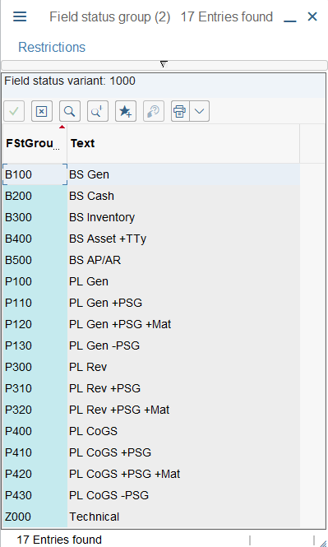
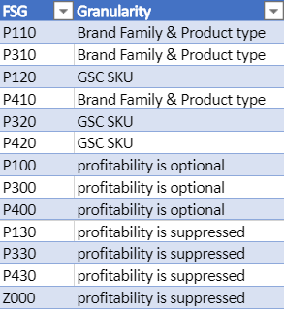
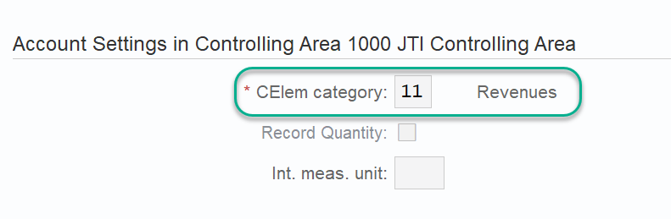
Controls for Required Dimensions in MyRequest Templates – Field Status Group
FSG for P&L Accounts
Assigned to P&L Accounts including Secondary Cost Elements
Different set up for supressed/required/optional fields based on minimum Market P&L Granularity requirement set by Corporate FP&A
It is important to note that FSG works in conjunction with other settings in G/L Master Data. E.g.
All Primary Cost Elements (CE Cat. 0x, 1x, 22) require account assignment objects which accept either revenue, such as Profit Center, Profitability Segment for revenue accounts, or cost objects such as Cost Center, WBS element, etc. for expense accounts.
Therefore although you may see in a FSG set up that a field is optional, you may still get error message if you do not post the required account assignment object as described above.

Slide 19
Demonstration & exercises
Exercise 1.2: Display Sales Order and Material Master Data
VA03 – Display Sales Order
MM03 - Display Material Master
Sales General/Plant – Profit Center
Accounting 1 – Cost Component Split

