Slide 1

Course Structure
Profitability Analysis: Intro to S/4
Profit Center Reorganization
Changes to Market P&L
Standardization of Dimensions
Market P&L
Granularity behind P&L Lines
Reporting Capabilities
Volume Conversion

Slide 2

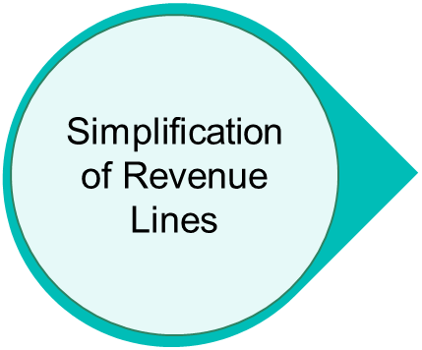
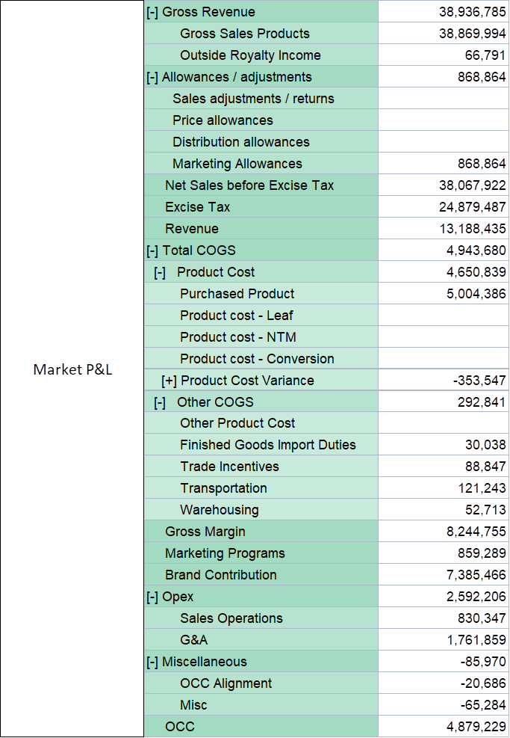
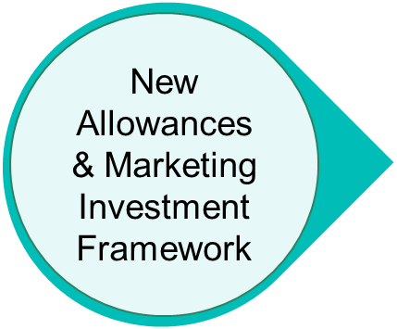

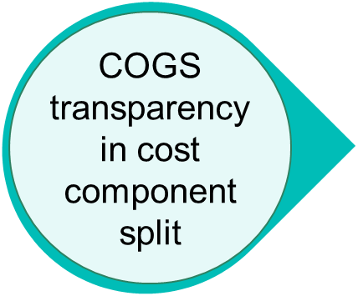
Market P&L
COURSE TITLE HERE
Structure of the course
GPM
Areas of change
New Market P&L
Small change in OPEX P&L line
P&L structure to support globally aligned definitions
Simplify, Standardize, Accelerate

Slide 3
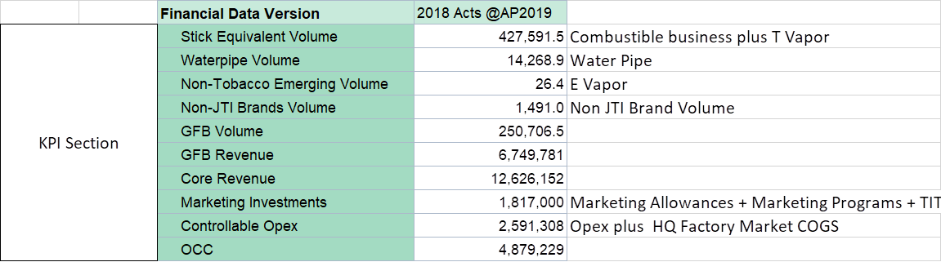

Key dimensions used in CO-PA
P&L Indicators
GPM
KPIs & Volume
Volume metrics
Volume conversion metrics embedded into S/4HANA (converted volume available in GPM)
Simplify, Standardize, Accelerate
3

Slide 4
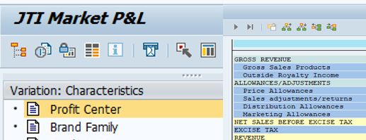
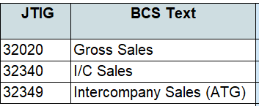
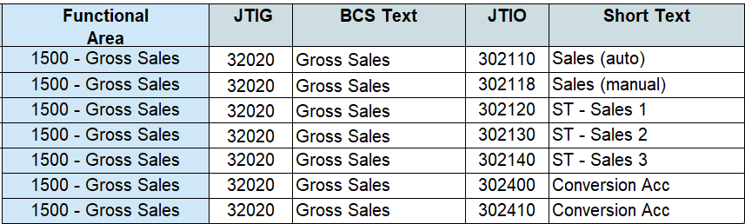
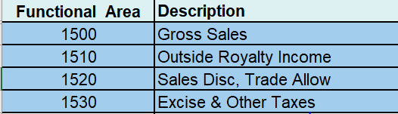
How Market P&L Lines link to JTIOs
The Market P&L structure is owned by Corporate FP&A) and reflects the P&L for management reporting and the IFRS P&L for JT Reporting.
The Functional Area (FA)* (which is part of the JTIO Masterdata) is used to ensure postings are mapped into the correct Market P&L line.
MPL Lines
GR55 MPL
JTIG
JTIO
* If FA is maintained in G/L master data, all postings made to the G/L will have this FA. However if FA is left blank in G/L master data, the FA on the respective G/L line items is determined by the FA maintained in the cost objects (e.g. cost centers) to which the G/L is posted to. (See next slides for examples)

Slide 5
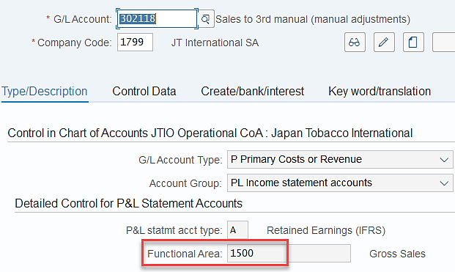
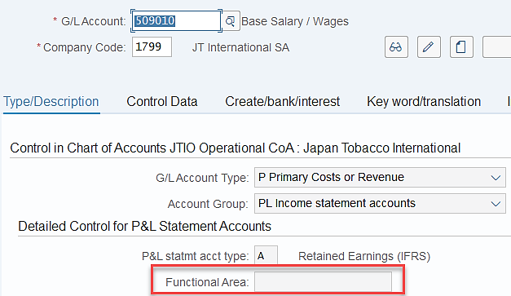
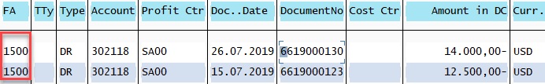
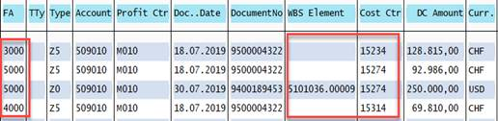
G/L Masterdata & Functional Area (FA) - Posting Rules as per SAP
If FA is maintained in G/L master data, all postings made to the G/L will have this FA (Example 1). In the case the FA is left blank in G/L master data, the FA on the respective G/L line items is determined by the FA maintained in the cost objects (e.g. cost centers /derived from WBS) to which the G/L is posted to (Example 2)
Example 1: Cases JTIO with FA (eg. Sales to 3rd Party (man) JTIO 302118
Example 2: Cases JTIO used in multiple FA (eg. Base Salary/Wages JTIO 500910)
FS00 – Display G/L Master Data
FS00 – Display G/L Master Data

Slide 6
Market P&L Areas of Change
Simplification of Revenue Lines
Through removal of Product Type, Revenue Accounts can be reduced significantly. Product type will instead be available through leveraging on information already embedded in to the transactional processes

Slide 7
Simplified Revenue Accounts
Current JTIO Set-Up
New Set-Up
GL accounts in Sales Area are currently duplicated by product type.
This allows BW to pick up easy volume conversion metrics by product type and transform KG to table from KG to KU for RYO/ MYO product types in BW.
For SD postings this means that the correct “account determination” is key to ensure postings flow into the correct JTIO.
This solution is not flexible to capture easily changes in the product types structure
New structure is simplified to exclude product type* and allows a more flexible set up for future portfolio expansions
Volume conversion embedded in S/4* which will allow GPM/BW reports to provide product type information leveraging on source SKU Master Data (for SD flows)
Separate accounts created for SD and manual accounts
Simplification should help reduce a number of manual correction journals
Stat/Tax accounts to be activated for selected Entities
*volume conversion functionality in S4 works only for PL JTIO. The activation of this functionality for BS JTIO in S4 is under investigation

Slide 8

Example of Changes
New Reporting will combine “JTIO” and “Product Type” as a dimension
Current JTIO Set-Up
New Set-Up
JTIO
JTIO
+
Dimension in Reporting
JTIOs for each Product Type
Sales to 3rd parties – Cigarettes
Sales to 3rd parties - RYO
Sales to 3rd parties – MYO
----
----
1 JTIO
Sales to 3rd parties
Product Types
Cigarettes
RYO
MYO
----

Slide 9
Overview of Sales Account
New JTIG and JTIOs - as of Jan 2020
JTIG | JTIG Desc | JTIO | Long Text
32040 | Sales to third parties - other | 301050 | ICMS on sales Other Prod
32040 | Sales to third parties - other | 301051 | COFINS on sales Other Prod
32040 | Sales to third parties - other | 301052 | PIS/PASEP on sales OthProd
32220 | Outside Royalty Income | 302015 | Outside Royalty Income
32220 | Outside Royalty Income | 302018 | Outside Royalty Income Adjustment
32020 | Gross Sales | 302110 | Sales to third parties (automated SD entries)
32020 | Gross Sales | 302118 | Sales to 3rd manual (manual adjustments)
32020 | Gross Sales | 302120 | ST - Sales to 3rd parties - granularity 1
32020 | Gross Sales | 302130 | ST - Sales to 3rd parties - granularity 2
32020 | Gross Sales | 302140 | ST - Sales to 3rd parties - granularity 3
32620 | Sales Returns | 302210 | Sales returns (automated SD entries)
32620 | Sales Returns | 302218 | Sales returns (manual adjustments)
32620 | Sales Returns | 302220 | ST - Sales returns - granularity 1
32620 | Sales Returns | 302230 | ST - Sales returns - granularity 2
32620 | Sales Returns | 302240 | ST - Sales returns - granularity 3
32349 | Intercompany Sales (ATG) | 302310 | Intercompany sales ATG (automated SD entries)
32349 | Intercompany Sales (ATG) | 302318 | Intercompany sales ATG (manual adjustments)
32340 | Intercompany Sales | 302320 | ST - Intercompany sales - granularity 1
32340 | Intercompany Sales | 302330 | ST - Intercompany sales - granularity 2
New structure is simplified to exclude product type* and allows a more flexible set up for future portfolio expansions

Slide 10
Market P&L Area of Change
New Allowances & Marketing Investment Framework
Develop standard definitions and one way of seeing allowances & marketing investments to increase analytical capabilities.

Slide 11


Allowances & Marketing Investments Framework
Standardization
Expense Type
Reporting Capabilities
Revenue Reduction
Primarily automatically allocated to GSC SKU through invoice
Price Allowances
Sales Adjustments & Returns
Distribution Allowances
Brand Family
Product type
GSC SKU level populated at data entry (SD)
Any additional SKU / Customer related characteristics
Variable
Click here for detailed Marketing Allowances
Marketing Investments determine allocation key through creation of WBS at point of plan
Marketing Allowances
Brand Family
Product Type
COGS
Fixed
TITP & TIP (not changed)
Marketing Programs
Marketing Programs (not changed)

Slide 12

New Allowances – JTIG and JTIO
New Allowances Framework - As of Jan. 2020
Market P&L lines | JTIG | JTIG Desc | JTIO | Long Text
Price Allowances | 34110 | Consumer Allowances | 341100 | Consumer Allowances - (automated SD entries)
 |  |  | 341108 | Consumer Allowances - (manual adjustments)
 | 34120 | Payment Allowances | 341200 | Payment allowances - (automated SD entries)
 |  |  | 341208 | Payment allowances - (manual adjustments)
Sales Adjustments / Returns | 34130 | Sales Allowances | 341300 | Sales/Returns Allowances - (automated SD entries)
 |  |  | 341308 | Sales/Returns Allowances - (manual adjustments)
 | 34140 | Other Sales Allowances | 341400 | TITP Allowances - (automated SD entries)
 |  |  | 341408 | TITP Allowances - (manual adjustments)
Distribution Allowances | 34150 | Distribution Allowances | 341500 | Distribution Allowances - (automated SD entries)
 |  |  | 341508 | Distribution Allowances - (manual adjustments)
 |  |  | 341518 | ST - Distribution allowances granularity 1 *
 |  |  | 341528 | ST - Distribution allowances granularity 2 *
 |  |  | 341538 | ST - Distribution allowances granularity 3 *
Marketing Allowances | 35110 | Listing / Visibility Fees | 351100 | Listing / Visibility Fees
 | 35120 | POPMs Placement Fees (PERM) | 351200 | POPM Placement Fees (PERM)
 | 35130 | POPMs Placement Fees (TEMP) | 351300 | POPM Placement Fees (TEMP)
 | 35140 | Retail Allowances | 351400 | Retail Allowances
 |  |  | 351408 | Retail Allowances - (manual adjustments)
 |  |  | 351418 | ST - Retail allowances granularity 1 *
 | 35150 | Sales/Marketing Information | 351500 | Sales/Marketing Information
 |  |  | 351508 | Sales/Mark. Inf. - (manual adjsutments)
Click here to view Allowances Decision Trees
Stat/Tax accounts activated for selected Entities only after approval by R2R Team (refer also to CoA Knowledge Transfer Material)

Slide 13




Allowances Marketing Investment & Marketing
Consistent definition and treatment costs which are Revenue Reducing
One definition for Marketing Investment
Simple approach to ensure marketing investments are allocated to a brand family and product type
Brand Family / SKU allocations are automated where possible using SD
Marketing Investment available on the Mgmt P&L
Quicker analytics available to support faster business decision making
Standardize
Simplify
Accelerate

Slide 14
Market P&L Areas of Change
COGS transparency in cost component split
COGS lines will be able to be detailed ensuring more insight in its underlying drivers with the new S/4Hana.

Slide 15
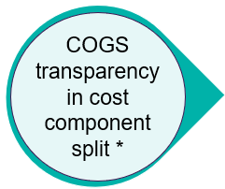


COGS Lines with enhanced transparency
Cost Components will be visible and provide insight in cost details
Delivery to 3rd Party
Before S/4 HANA
S/4 HANA
Before S/4
COGS are posted to one G/L account in accounting only.
Details for the manufacturing of the product were not displayed
SKU 123456
Quantity: 50
COGS Value 1000
SKU 123456
Quantity: 50
COGS Leaf 40
COGS Convers. 20
COGS Depr. 10
COGS NTM 30
Excise 900
With S/4H
Profitability analysis has been refined to reflect the standard cost component split on the G/L account.
Example: Excise** will be posted to a dedicated account with no need for manual re-classes in all 3 currencies.
Note: COGS split “standard” during the month and “variances” at month end of the ML process
* *We refer here to excise that has been included in cost estimates in Material Ledger. Some Markets instead have Excise postings flowing through SD Conditions.

Slide 16
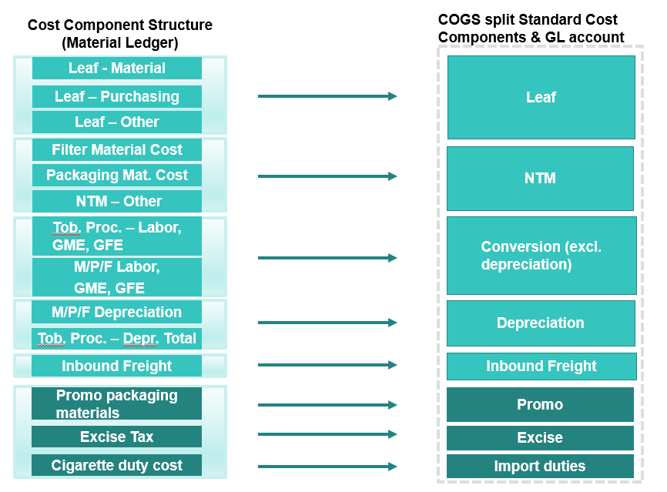

COGS Splitting (Cost component group - FI Posting)
Cost Component Structure (Material Ledger)
COGS split Market P&L G/L accounts
In S/4HANA, Profitability Analysis has been refined to reflect the standard cost component split on the G/L account. The main focus is Finished Goods (FG) sold from market.
Upon each posting of third party COGS, SAP will split COGS line item into several JTIO accounts based on cost components. The same split will be done for material ledger variances related to third party COGS (consumption) at the end of the month. Posting of both standard and variances split in COGS will be done only in IFRS ledger.
This requirement is based on request from Corporate FP&A with the purpose to gain better insight into third party COGS. This has minor impact on product cost processes.

Slide 17

COGS Splitting Flow Standard vs Actual Variances
STANDARD
COGS SPLITTING available during the month after each daily job
Cost Estimates with Cost Component Split
Goods Issue (triggered through SD)
DR 414010 Cogs 3rd Party
(DR 414015 Cogs B2B) **
CR 172611 Invent. FG
DAILY JOB
Document type YG
+
DR XXXXXX Leaf
DR XXXXXX NTM
DR ........................
CR 414010 Cogs 3rd Party
(CR 414015 Cogs B2B)**
Cost Component Posting to GL account*
VARIANCES
@ Month end
Single Material Ledger CLOSE (check schedule)
VARIANCES BOOKED ON SAME ACCOUNTS (MARKET VARIANCES = EXCISE, IMPORT DUTIES, FREIGHT)*
* COGS split logic standard and variances should reflect current set-up. Promo costs have been defined during Fit Gap. On Freight their can be exceptions to the general rule of allocating variances to Market and will reflect current flow in ECC. ** - See next slide for B2B process flow which has dedicated JTIO.

Slide 18
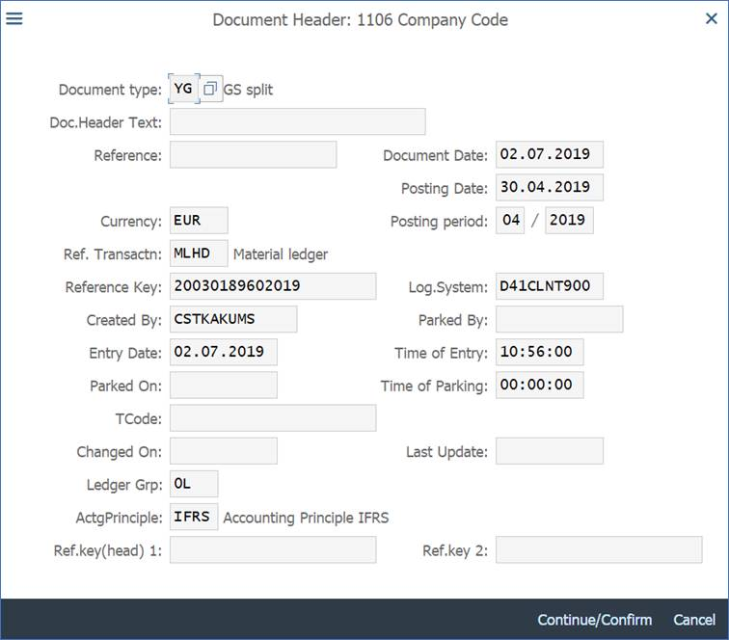
COGS Splitting Flow - Actual Variances reference
VARIANCES @ Month end
FAGLL03H
Document Type for standard & Actuals = YG
If you want to see if the YG (COGS splitting document type) refers to the ML Closing of Actuals, you can find in the Document Header “Reference transaction” field the value of “MLHD”. This means this posting was included in the ML Closing run.
Ref. Transaction for ML closing Actuals = MLHD

Slide 19
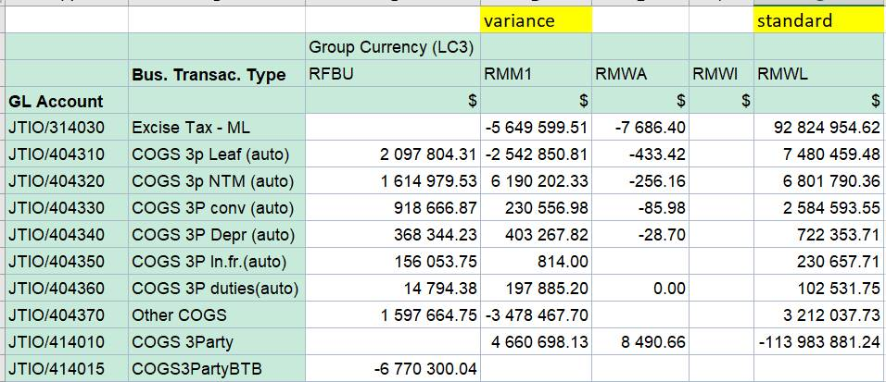
COGS Splitting Flow – Standard vs Actual Variances
S/4 Query dimensions
Business Transaction Type RMWL and RMM1 will provide split between standard and variance COGS splitting
If you want to distinguish in the COGS splitting postings (YG document type) standard postings from the ML Closing of Actuals, you use the Business Transaction Type dimension:
RMWL for standard
RFBU for variances after Material Ledger close
S/4 Queries

Slide 20
Back-2-back COGS flow
Back-to-Back COGS flow is used in JTI in cases when FGs are physically transported from one company code, while sales invoice and third party COGS are issues from another company code.
For example sales invoice and third party COGS are booked in German entity (1106), whereas goods are physically located on the plant belonging to JTI SA (1799)
Such flow is subject to COGS splitting and will have COGS posted on a dedicated JTIO 414015 Cogs B2B (vs the standard 414010 Cogs 3rd Party)

Slide 21





Back-2-back COGS flow - Summary
Financial document – not a real goods issue. Posting is done to JTIO account 414015 Back-2-Back COGS
Customer
JTI SA 1799
Germany 1106
IC COGS
IC Sales
3rd party COGS
3rd party Sales
COGS SPLIT
Physical
goods flow
-3rd party COGS
+ COGS Leaf
+ COGS NTM
+ COGS Conversion
+ COGS Freight
…
Financial flow
21

Slide 22
Market P&L Lines / JTIG / JTIO
22
COGS split on PC Market and Factory *
 | Market P&L Line | New JTIG | New JTIG Description | New JTIO | New JTIO description | Standard cost | Variances
Product Cost Other Cogs | Purchased Product | 40720 | Purchased Prod, Outside Sales | 414010 | COGS 3 party | Market | Factory
 |  |  |  | 414015 | COGS3PartyBTB | Market | Factory
 |  | 40721 | Purchased Product - Outside Sales adj. | 414011 | COGS 3 party - Manual | Market | Market
 |  |  |  | ---- |  | Market | Factory
 |  | 40437 | COGS Other | 404370 | Other COGS | Market | Factory
 | Product Cost Leaf | 40431 | COGS 3 party - Leaf | 404310 | COGS 3 party - Leaf (automated ML entries) | Market | Factory
 | Product Cost NTM | 40432 | COGS 3 party - NTM | 404320 | COGS 3 party - NTM (automated ML entries) | Market | Factory
 | Product Cost Conversion * | 40433 | COGS 3Party - Conv ex. Deprec. | 404330 | COGS 3Party - Conv ex. Deprec. (automated ML entries) | Market | Factory
 |  | 40434 | COGS 3P Depr (auto) | 404340 | COGS 3Party - Deprec (automated ML entries) | Market | Factory
 |  | 40435 | COGS 3Party - inbound freight* | 404350 | COGS 3Party - inbound freight (automated ML entries) | Market | Market**
 |  |  |  | 404358 | COGS 3Party - inbound freight (manual adjustments) | Market | Market**
 | Finished Goods Import Duties | 40436 | COGS 3Party - import duties* | 404360 | COGS 3Party - import duties (automated ML entries) | Market | Market
 |  |  |  | 404368 | COGS 3Party - import duties (manual adjustments) | Market | Market**
Excise | Excise Tax | 33520 | Excise Tax | 314030 | Excise tax sales through ML (automated) | Market | Market
 |  |  |  | 314038 | Excise tax sales through ML (manual postings) | Market | Market
Marketing | Marketing Programs | 5114 | Prod. & Packaging Development | 503170 | Promotional Costs (automated ML entries) | Market | Factory**
 |  |  |  | 503178 | Promotional Costs (manual adjustments) | Market | Factory**
Note: COGS split standard during the month and variances at month end of ML process
* COGS split logic standard and variances should reflect current set-up in ECC. Promo costs have been defined during Fit Gap. On Freight their can be exceptions to the general rule of allocating variances to Market. Please verify results for your Market / Factory after Month End Close

Slide 23


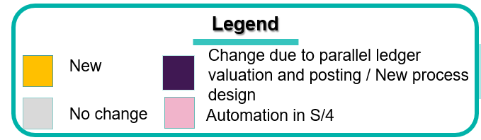
Attention to Period End Key Closing tasks Sales / COGS / WBS / Manual postings*
WD1 | WD2 | WD3
Complete Volume Submission: Non-SAP and SAP entities
Start Material Ledger closing
Confirmation of ML close – IFRS ONLY
Close Sales Accounts & automatic I/Co Sales – ALL Ledgers
Run multi-brand WBS allocation
Run reposting of ET in Inventories and PII elimination – IFRS ONLY
COGS splitting – IFRS ONLY
(Central Close for all Factories)
Cease postings impacting COGS Accounts – ALL Ledgers
NB!. Attention for variances posted to Markets e.g. Excise,.. and lead time for manual postings
Cease MyRequest submission for GL journals (except for Direct Tax)
WD3 10.00 BSC time
Final settlement of Branded WBS settlements (multiple executions before the close) and Multibrand with ZZZ
* For full steps please refer to Period End Closing KT
S/4 UAT Controlling Madrid - 2019
Notes:
Most WD closings are in line with current ECC Closing cockpit
WBS Multibrand WD2
To draw attention on new ML Close (1 general close) for markets that have actual variances (Excise, Import duties)
Impact on markets for Multibrand Allocations is being assessed.

