Slide 1

Course Structure
Creating a Project
Introduction to WBS
WBS Projects
WBS Budgeting
WBS Costs & Reporting
Project Status

Slide 2
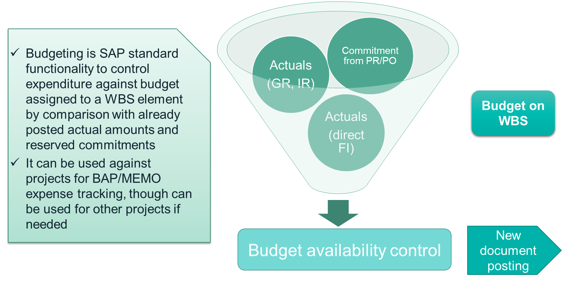
Budgeting functionality - Overview
Budget availability control functionality in SAP to compare the budget amount to any expenditure against the WBS element. Availability control will be activated when a PR or PO is created, or when an invoice or journal posting against the WBS element takes place. For WBS elements, availability control is calculated by converting the budget amount and expenditure from document currency to USD using the budget FX rate type and year, therefore avoiding the budget being exceeded due to FX. For this reason, it is important that the budget is defined using the correct currency mix as per what the actual expenditure will be

Slide 3
Budgeting with WBS vs Internal Orders
Able to distribute budget within project instead of using multiple IOs
Transfer of budget between WBS elements
Availability control is at project FX rate rather than actual FX rates
Assign budget in multiple transaction currencies

Slide 4

Opex Flow
When using WBS for Opex, you create an Opex project on Fiori Launchpad.
Upon project creation, the first level WBS elements are created based on the “Template” selected on creation screen. You may modify the structure or create more WBS elements later.
Maintain budget is not mandatory for Opex flow, therefore you may select “Budget not required” to progress further with your WBS.
If you need to track the spending against budget, you can maintain a budget. Use BAP information (Currency, FX rate, etc.) if you have a BAP.
Budget needs to be approved before WBS can be used for purchasing.
Opex WBS elements are statistical cost objects in S/4HANA therefore no settlement is required.
The costs booked to WBS are automatically reflected in Cost Center reporting, allowing analysis to be done by cost center.
Reports are available in both S/4 and GPM.
Fiori
S/4HANA
Create Project/WBS elements
Approve
Plan
Maintain budget and budget Approval
Book actual spending
Period End – No Settlement required
Fiori
Fiori
S/4HANA
Once a project has been created and it has at least an initial WBS structure, the status can be changed to “approve plan”, i.e. the project is approved for further usage.
This is inherited from EAM and has no impact on the ability to include a project in GPM planning. However, it is still necessary to change the status to “Approve plan” so that the project can be further used for actuals in SAP.
Actual spending are posted to WBS elements of the Opex project via transactions such as Goods Receipts, Invoice Receipts, GL journals, Direct FI invoices, etc.
PR account assignment category Y should be used for Opex WBS, to allow postings to be made to both WBS and Cost Center.

Slide 5
Above brand contribution WBS Flow
When using WBS for expenses above brand contribution such as price / distribution allowances, marketing allowances, marketing programs etc, you create an Above Brand Contribution (ABC) project on Fiori Launchpad.
Depending on the usage of your ABC project you may need to create further structures/WBS elements under the original structure which was created when you created the project using the selected template.
Maintain budget is not mandatory for ABC WBS flow, therefore you may select “Budget not required” to progress further with your WBS.
If you need to track the spending against budget, you can maintain a budget. Use BAP information (Currency, FX rate, etc.) if you have a BAP.
Budget needs to be approved before WBS can be used for purchasing.
Branded and Multi-brand ABC WBS elements needs to be settled/allocated at period end to CO-PA characteristics, while statistical ones do not require settlement.
Reports are available in both S/4 and GPM for cost and profitability analysis in relation to marketing expenses.
Fiori
S/4HANA
Create Project/WBS elements
Approve
Plan*
Maintain budget and budget Approval
Book actual spending
Period End – Settlement for Branded/Multi-branded WBS
Fiori
Fiori
S/4HANA
Once a project has been created and it has at least an initial WBS structure, the status can be changed to “approve plan”, i.e. the project is approved for further usage. Approve into plan’ functionality is included into the project manager’s role for Opex and ABC projects. For capex this is still a separate role
This is inherited from EAM and has no impact on the ability to include a project in GPM planning. However, it is still necessary to change the status to “Approve plan” so that the project can be further used for actuals in SAP. .
Actual spending are posted to WBS elements of the ABC project via transactions such as Goods Receipts, Invoice Receipts, GL journals, Direct FI invoices, etc.
PR account assignment category Y should be used for Marketing WBS, to allow postings to be made to both WBS and Cost Center.

Slide 6
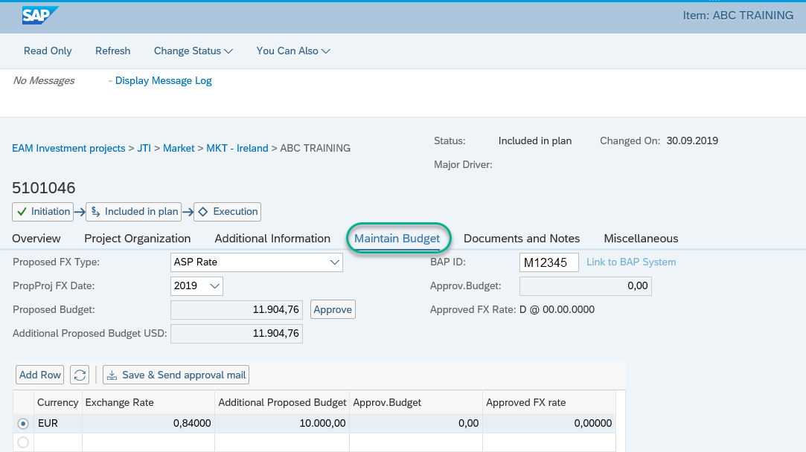
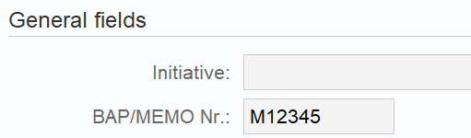
How to Assign a Budget to a WBS Project
The budget must first be assigned to the project, and this can be done via the project cockpit or directly in PPM under the Maintain Budget tab
Budget approval/access to assign/change budget is based on profit center
Each budget approval role is linked to a bucket
If a budget is required, the budget FX rate and FX date should be selected, this can be the FX rate as per the BAP / Memo, or the AP, LE1, LE2 FX rates can be used as appropriate
The budget FX rate and currency used will have an impact on the availability control calculation
SAP Fiori Project
There is also the possibility to enter a related BAP. This has a direct link to the BAP system for improved visibility of Project flow and information.
This master data created here will be visible in CJ20N when the Budget is approved.
It is not always necessary to enter Budget information so users can change the status of the Project to Budget not required, otherwise the approval is required.
CJ20N
Click Add Row to add budget. The budget amounts should be assigned by document currency with the appropriate currency mix expected for the expenditure.
On Enter the added budget becomes “Proposed Budget” which must then be Approved

Slide 7
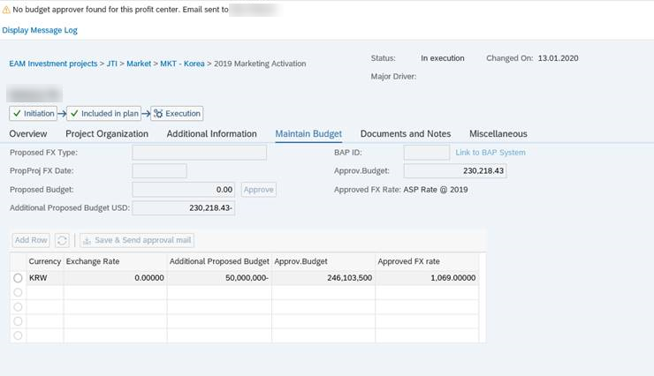
Changing a Budget for a WBS Project
SAP Fiori Project
For changes to Budget it is important that the following fields are populated otherwise the “Approve” button will not activate when sent to the approver:
Proposed FX Type
PropProj FX Date
Once all the required information is populated the Project should be saved and sent to approver, the Approve button will then be activated and available for the approver to use. The button will only become active for users with the authority to approve.

Slide 8
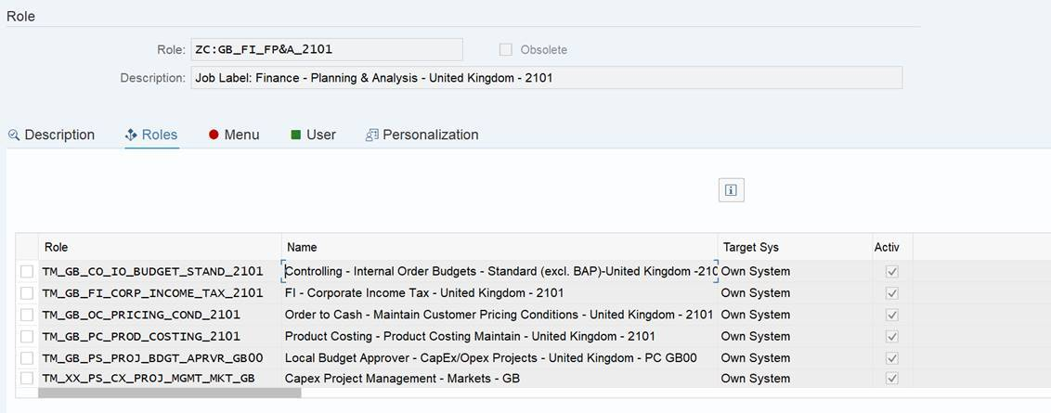
Budget Approval
It is no longer mandatory to use budget, even for spend with BAP/Memo
Therefore it has not been defined that only CFO or even delegate should approve the budget, all users with FP&A role can have access to approve.

Slide 9
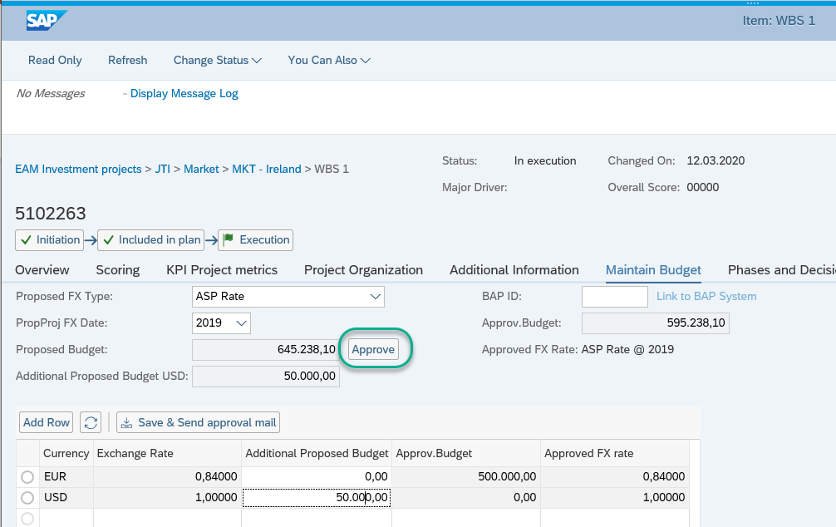
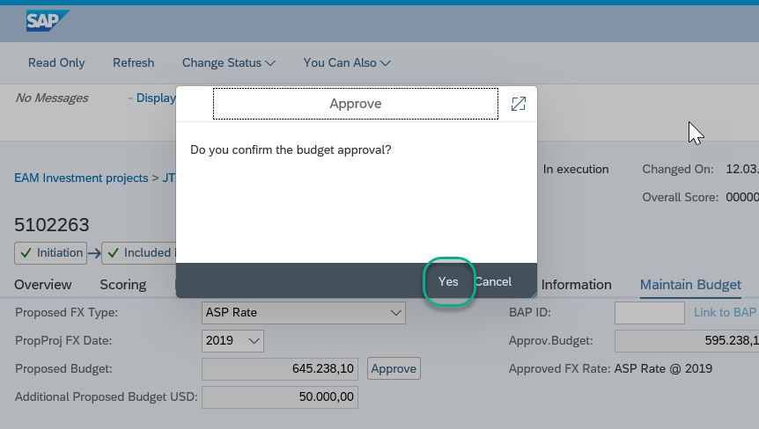

Budget Approval Process
Step 1
The approve button should be activated, check the Budget has been maintained correctly and if so, click to start the approval process
Step 2
Click Yes to confirm the budget approval. Approval has been successful if this message appears:
1
2

Slide 10
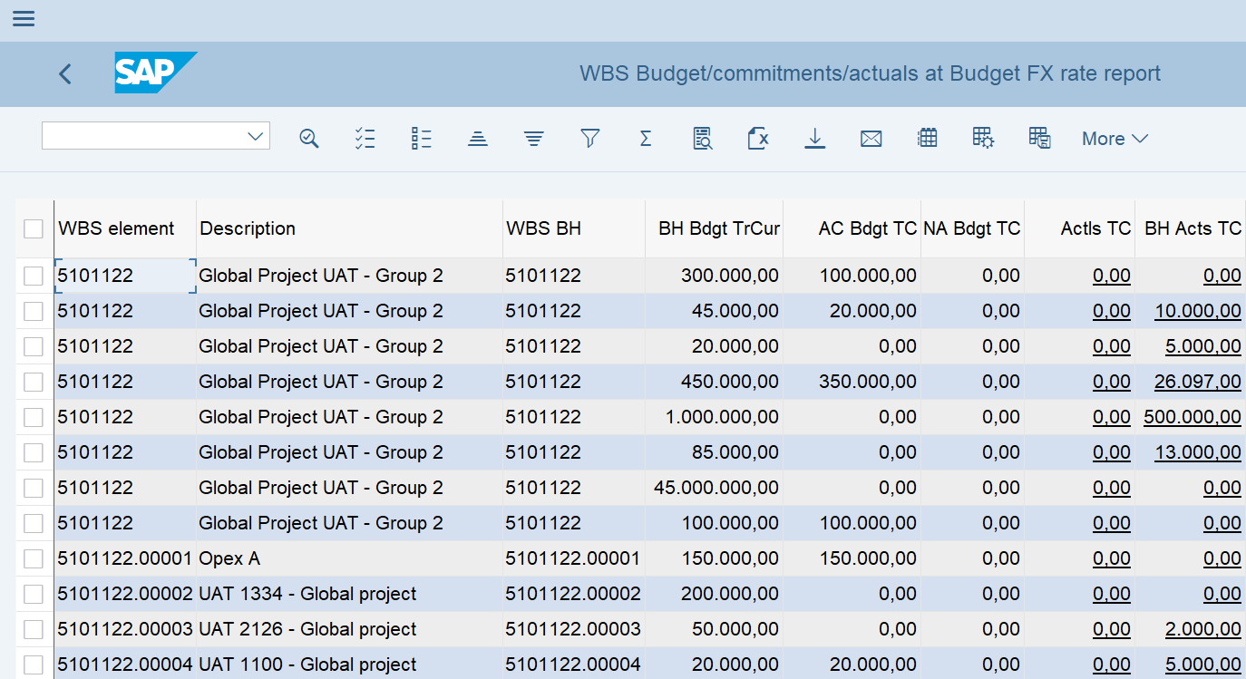
Budgeting report - ZBFIA_WBSREPORT
There is a newly created bespoke report created for JTI that shows Budget values per WBS Element, if applicable - ZBFIA_WBSREPORT
This report can be viewed for the full structure of the Project and shows assigned values, approved and non approved values and where these values sit
Please see more detail on this report in the Reporting section towards the end of this course

Slide 11
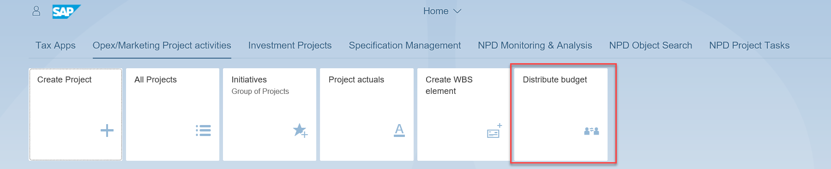
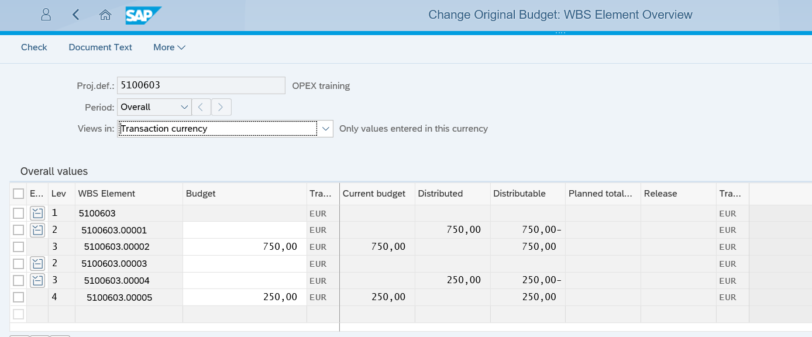
Distribute Budget - Fiori
“Distribute Budget” App is used to move budget from one WBS to another, initially from the root WBS where the Budget is originally maintained

Slide 12
Distribution of Budget Amounts
In EAM for investment / capex projects it is only possible to assign a budget to the project level
For opex and above brand contribution projects we will enable distribution of the budget to the lower level elements
When actuals are recorded against a WBS element, the system will check upwards through the project if there is sufficient budget available
Level 3
In this example the total project budget amount of 500M EUR has been distributed to WBS 2a and WBS 3c. Therefore, it is not possible to record actuals or raise a purchase requisition / purchase order for 400M EUR on WBS 3c
The 200M EUR budget from WBS 2a has not been distributed down to WBS 3a or WBS 3b. Therefore, technically it is possible for either WBS 3a or WBS 3b to consume the 200M EUR budget, but once it has been consumed there will be nothing more available
When actuals are recorded against WBS 3a or WBS 3b, because they do not directly have a budget assigned the system will look for the available budget amount on WBS 2a as it is one level higher in the project
WBS 1
WBS 2a
WBS 3a
WBS 3b
WBS 2b
WBS 3c
Level 2
Level 3
Level 1
200M EUR
500M EUR
Level 2
Level 3
300M EUR
300M EUR
Budget distribution

Slide 13
Distribute Budget Process
Step 3
Step 5
In case of any issue with auto release budget please follow these steps:
Step 1: Maintain and Approve Budget to WBS 1
Step 2: Distribute 200M and 300M Budget to WBS 2A and 2B respectively
Step 3: Wait for background job to auto-release budget to WBS 2A and 2B (system runs this every 30 minutes)
Step 4: Distribute 300M to WBS 3C
Step 5: Wait for background job to auto-release budget to WBS 3C (system runs this every 30 minutes)
Step 4
Step 2
Level 3
WBS 1
WBS 2a
WBS 3a
WBS 3b
WBS 2b
WBS 3c
Level 2
Step 1
Level 3
Level 1
200M EUR
500M EUR
Level 2
Level 3
300M EUR
300M EUR
Budget distribution

Slide 14
Budget Transfer – WBS Element to WBS Element
From 2 step procedure on internal orders to 1 step process of budget transfer between WBS elements
PROJECT
Internal Order A
Internal Order B
PROJECT
Budget Transfer
WBS Element A
WBS Element B
Remove budget
Assign budget

Slide 15
Budget Transfer – Project to Project
Budget can also be transferred from one Project to a different Project
This will need approval from the Approvers of both of the Projects prior to transfer.
Budget can also be transferred from one Project to a different Project
This will need approval from the Approvers of both of the Projects prior to transfer.
This also applies to any decreases of budget.
Budget Transfer
Project 1
WBS Element A
Project 2
WBS Element B
Approval Required
Approval Required

Slide 16
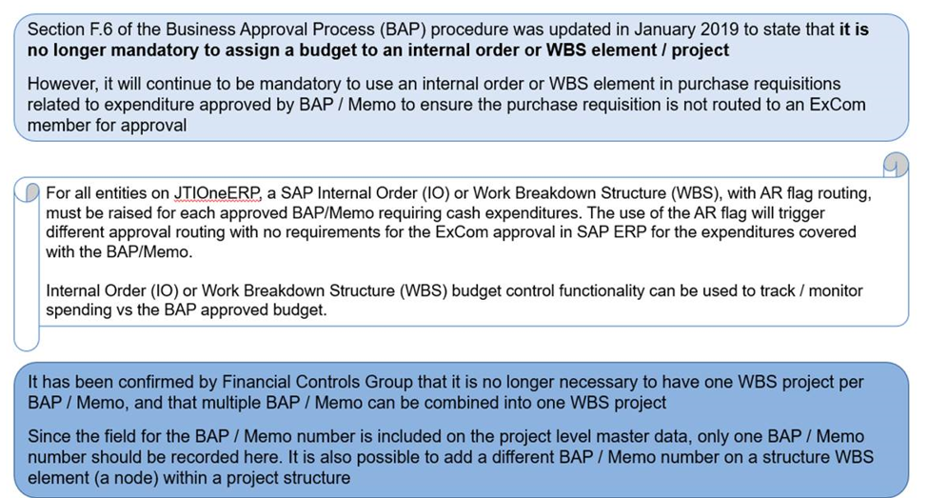
Change to Business Approval Process (BAP) Procedure

Slide 17
Spending Approval Changes
Changes have been made to spending approval process as detailed below. Please also see communication on Teams via this link:
Tenigina, Olga: Spending approval - changes
* As agreed between FCG and P2P CC, WG2 reporting to HQ Excom must have an approval threshold of 250M$ (apply the same technical principle than for VP reporting to HQ Excom) - Requirement moved to CHG178038
* For WG2 and WG1 (reporting to Excom) having higher approval level than other WG2 and WG1 reporting to them, PR must be approved up to their respective levels (and it shouldn't only be a notification)
* PRs with WBS related to approved BAP/MEMO should never be approved again at HQ level, typically if a WG2 reporting to Excom approves the PR, the system should stop the release there.
CHG177378
CHG178038
Design Change to cover HR exceptions in the PR Spending Approvals
Change in Spending Approval Limit and change to notification logic
Reasons:
Currently some entities are not creating PRs as these would go to Excom - business potential interruption (solution moved to CHG178038 – see next box)
Avoid JTI management to approve spend that have already been approved
Benefits:
Provides WG reporting to Excom ability to approve Spend in line with their role
Avoids HQ Excom having to approve numerous PR which have been approved through BAP/MEMO
Reasons:
HQ Excom members are receiving too many PR to approve
Benefits:
Limits HQ Excom approval requirements

Slide 18
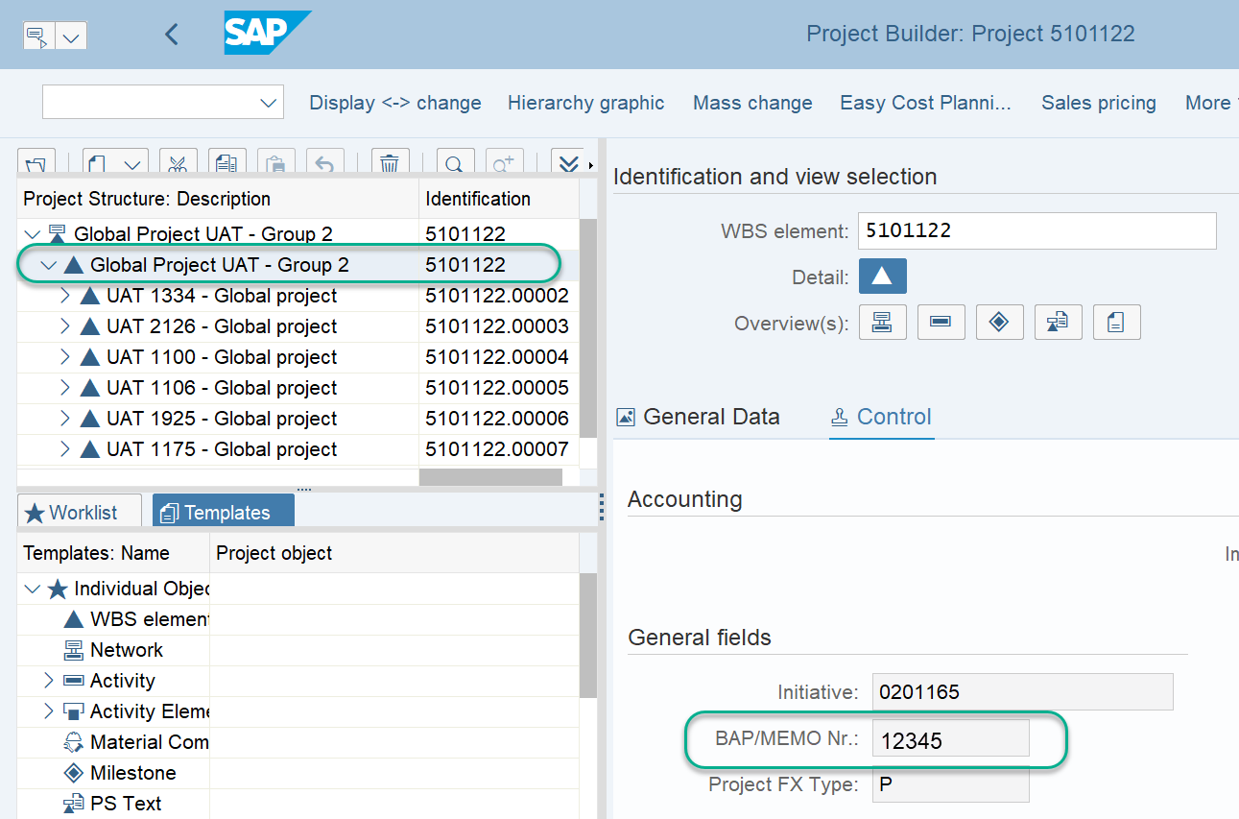
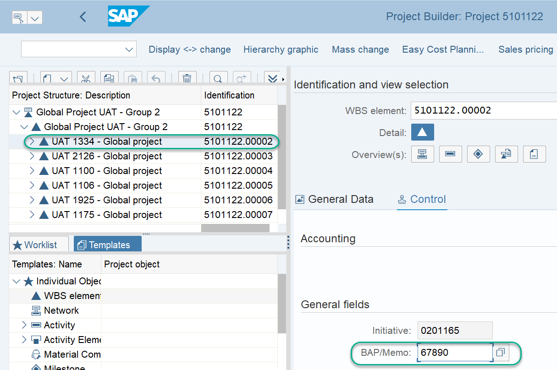
Additional BAP Memos on a Project
Project Root WBS for whole Project
The Level 1 Root WBS will automatically populate the BAP ID entered when maintaining the Budget for a Project in PPM. This field is greyed out and cannot be overwritten
Lower level structure WBS
However, each lower level Structure WBS can be populated manually with a different BAP ID should this be required. The field is editable in CJ20N but can also be changed in PPM

Slide 19
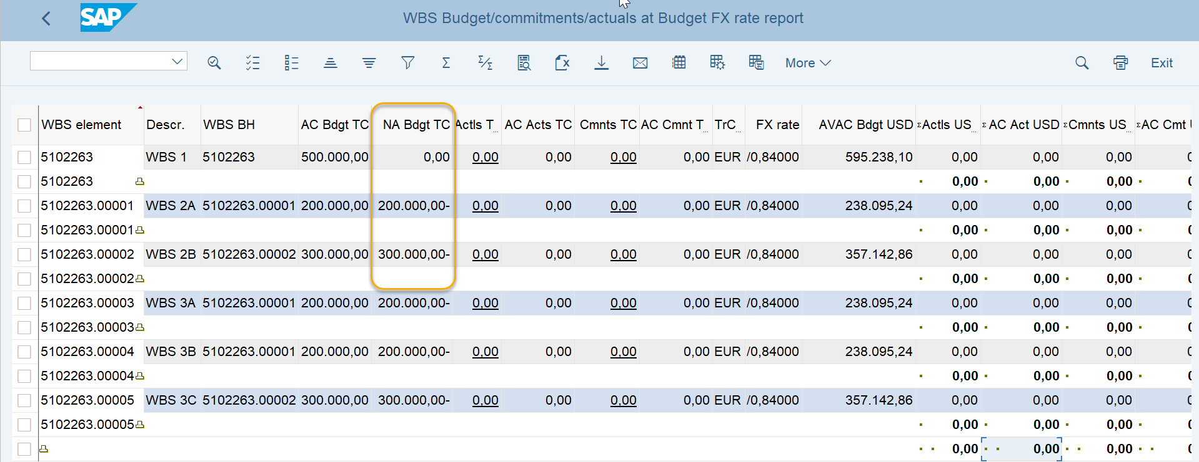
Checks for Markets - If the budget on your WBS project / element has not been released, you should: (1 of 3)
1. Check that the distributed budget was approved via ZBFIA_WBSREPORT. If you can see values in the “not approved budget” column, please contact responsible person from Finance team.
In the above screen shot there are values in the Not approved budget in Transaction currency: The budget amount(s) on WBS budget holder (in this case – 5102263.00001 and 5102263.00002 WBS elements) per budget transaction currency which has not yet been released/approved by Finance.

Slide 20
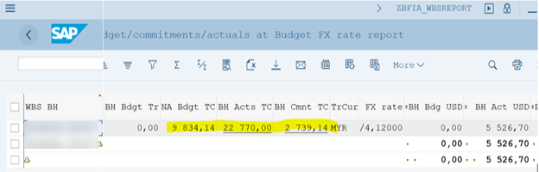
Checks for Markets - If the budget on your WBS project / element has not been released, you should: (2 of 3)
2. Check that assigned budget is more than actuals/commitments that already exist on this WBS.
3. Or check that budget of higher level WBS-element is more than actuals/commitments.

Slide 21
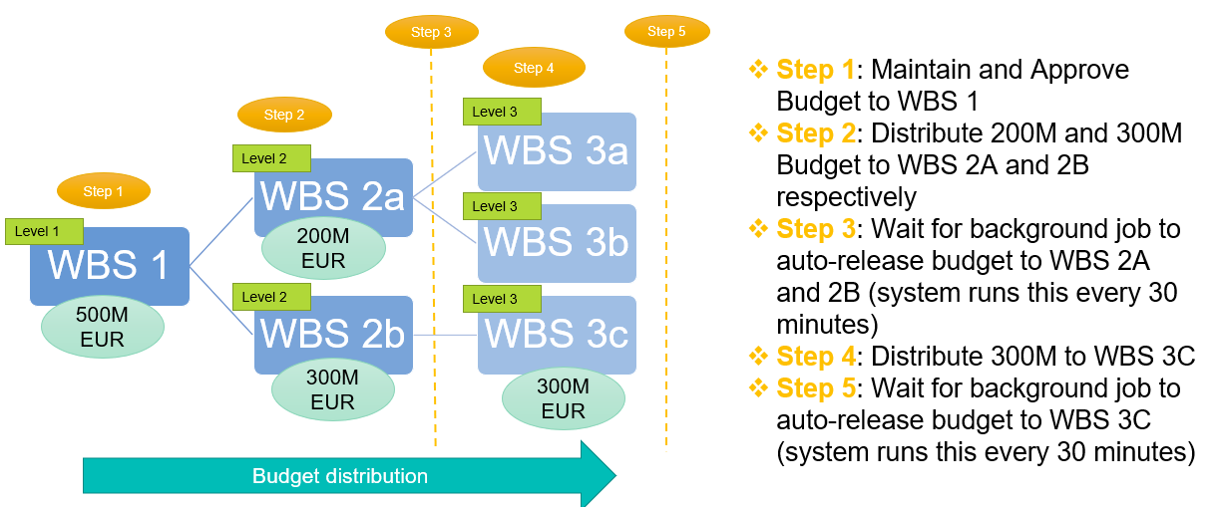
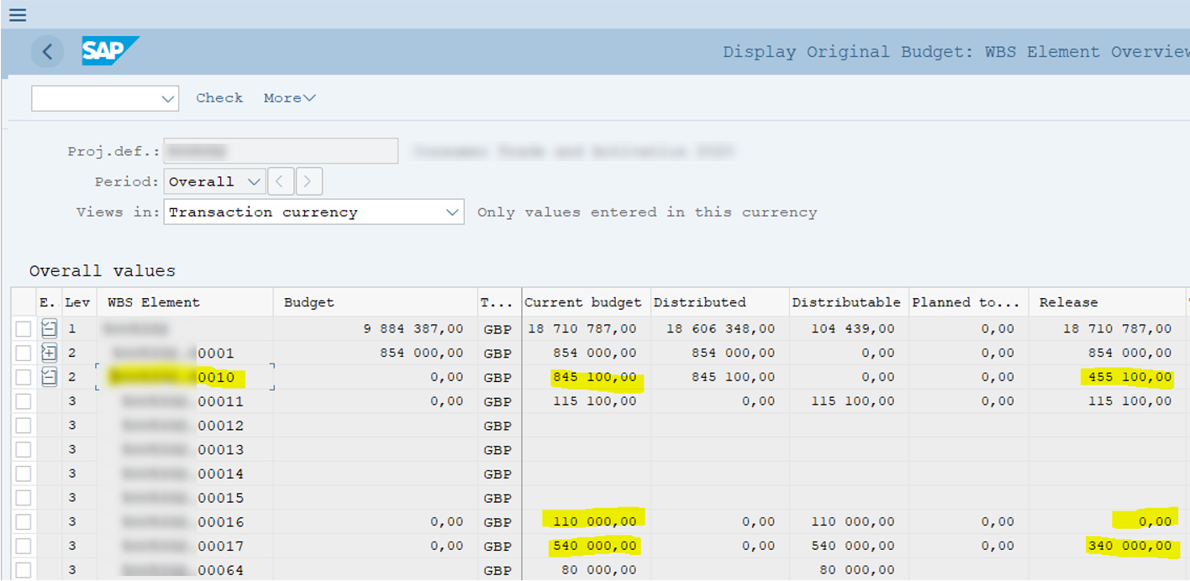
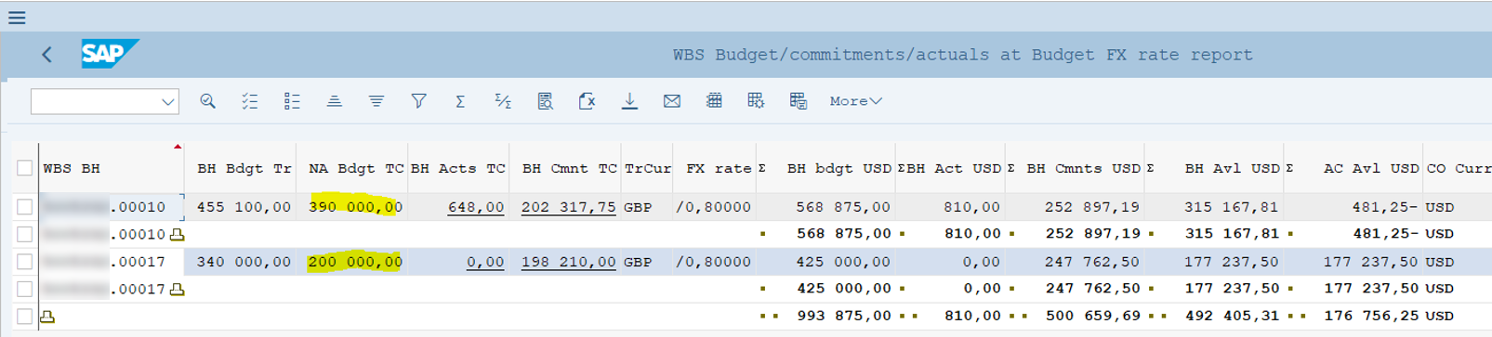
Checks for Markets - If the budget on your WBS project / element has not been released, you should: (3 of 3)
4. If WBS was migrated and has actuals/commitments, then each distribution to a lower level WBS element should be made step by step with auto-release on each level as explained in Slide 13.
In the below example distributed budget to level 3 WBS element was made before auto-release on level 2 WBS element (e.g. Step 3 is missed).
To resolve such situation, you should remove distribution on level 3 element and wait until the budget on level 2 element will be auto-released. Only after that you can distribute the budget further.

Slide 22
Exercises – OPEX WBS
Exercise 1.9 & 1.10:
Open Fiori Launchpad
Find and Select “All Projects” App
Select projects created
Assign Budget
Approve Budget

Slide 23
Exercises – ABC WBS
Exercise 1.11 & 1.12:
Open Fiori Launchpad
Find and Select “All Projects” App
Select ABC projects created
Assign Budget
Approve Budget

Slide 24
Exercises – Release Budget
Exercise 1.13:
Distribute Budget
Check Budget Report

Slide 25
Exercises
Exercise 1.14 & 1.15:
Create Initiative
Create Global Project

