Slide 1

Course Structure
Creating a Project
Introduction to WBS
WBS Projects
WBS Budgeting
WBS Costs & Reporting
Project Status

Slide 2
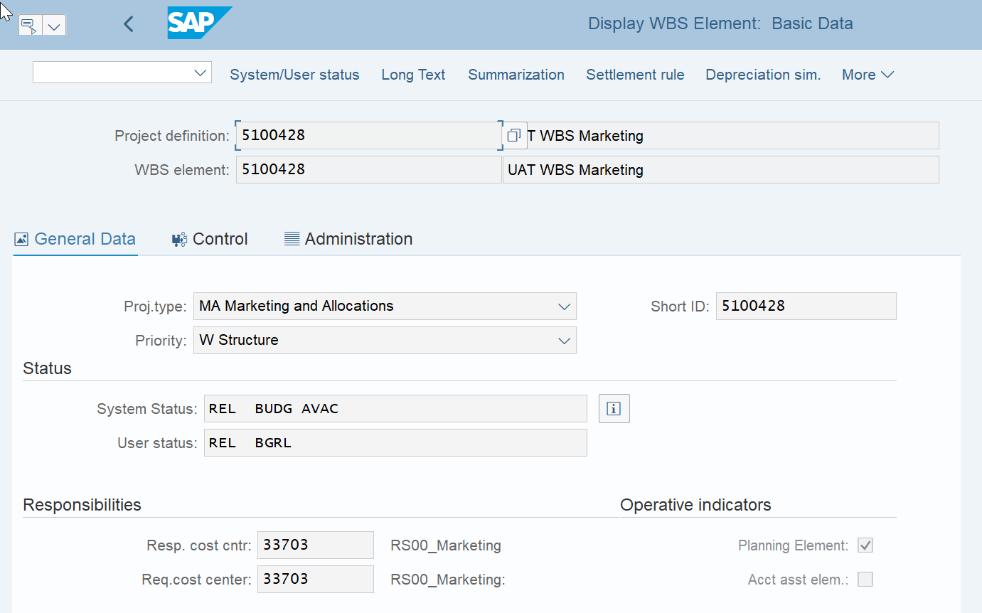
Project Status
Every project and every WBS element has a System Status and User Status.
Both Statuses are set either by users manually or by system automatically upon certain triggers, e.g. the WBS status will reflect that a budget has been entered if a user maintains budget for it.
Status set at Project level is automatically inherited by its lower level WBS elements, however status set at WBS element level is only applicable to itself.
Depending on the statuses of a WBS element, the system restricts the user actions that can be taken to process a WBS element.
E.g. if the WBS element has status “TECO”, it means no further purchase requisitions can be raised against this WBS but you can continue to post invoices from POs linked to this WBS that were created before the TECO status was set.
CJ13 – Display WBS Master Data

Slide 3
Project Status: System Status
System Status: System generated status. SAP Standard. Defines what business transactions are allowed
User Status: Customisable indicator. Defines what business transactions are allowed according to which step of the process a user has completed
CRTD
Created - Initial System Status. Automatic (on Project creation)
REL
Released (Non reversable status). Allows logistical operations (Creating PR/PO/postings) Manual
PREL
Partially Released – indicates that subordinate WBS elements were released
Automatic
TECO
Technically Complete (Reversable status). Does not allow NEW logistical operations (Creating PR/PO) Can still post to. Manual
CLSD
Closed (Reversable status). Does not allow any actual data input including new logistical operations. Manual

Slide 4
Project Status: System Status
System Status | Description | Actions Allowed
CRTD | This is the initial system status for new WBS elements. In this status you structure the project and plan dates, costs and revenues. The system sets this status automatically, when you create a new WBS element. | √ create new WBS/settlement rules √ budgeting X create PR/PO X post costs X run allocations
REL | In Released status you can still create new WBS elements and change the project hierarchy but more actions are now allowed and postings can now be made to the WBS elements. The status is passed on to subordinate WBS elements. You cannot change the status from Released to Created , as actual values from, for instance, purchase orders or confirmations may have been posted | √ create new WBS/settlement rules √ budget √ create PR/PO √ post costs √ run allocations
TECO | Technically Complete status for WBS elements that are completed from a technical point of view, but where you still expect costs to accrue. The status is passed on to subordinate WBS Elements. The status can be revoked and set back to Released. | ▲ create new subordinate WBS/settlement rules (warning) X budget X create PR √ post costs √ run allocations
CLSD | Closed status for a work breakdown structure or WBS element that has been completed from both a logistic and an accounting point of view. | X create new WBS/settlement rules X create PR/PO X post costs X run allocations

Slide 5
Project Status: System and User Status
There are also statuses available to show what stage if any the Budget for a WBS is
PLAN
Plan – The WBS has been created and included in plan Automatic
BUDG
Budgeted – The WBS has been budgeted Automatic
AVAC
Availability Control Active – System checks available budget in real time Automatic
BGRL
Budget Released – Budget has been released Automatic
BGPR
Budget Proposed – Budget has been proposed but not approved/released Automatic
NAPR
Not Approved – Approval is required before a subsequent step Automatic
SETC
Settlement Rule Created – Settlement rules have been created (BSC) Automatic

Slide 6

Project Status: Example
Project system and user status change on different actions during the process. The following changes are completed in Fiori:
Process Action | Root WBS | WBS Element
Project Creation Change Status: Approve Plan (Include project into plan) | System: CRTD User: PLAN NAPR | System: CRTD User: PLAN
3a. Maintain Budget, Manually Add Budget Line Item & Approve | System: CRTD BUDG AVAC User: PLAN BGRL | System: CRTD AVAC User: PLAN
3b. Add BAP ID | System: CRTD User: PLAN | System: CRTD User: PLAN
3c. Change Status (Budget Not Required) | System: CRTD User: PLAN | System: CRTD User: PLAN

Slide 7


Project Status: Example
All other status changes are performed in CJ20N in SAP GUI, under More → Edit → Status
Process Action | Root WBS | WBS Element
4a. Release Root WBS (automatically releases sub ordinate WBS) | System: REL *AVAC User: REL | System: REL *AVAC User: REL
4b. Release Sub Ordinate (Lower level) WBS | System: PREL *AVAC User: PREL | System: REL *AVAC User: REL
5. Set to Technically Complete (TECO) | System: TECO BUDG *AVAC User: TECO BGRL | System: TECO BUDG AVAC SETC User: TECO BGRL
6. Close Project | System: CLSD User: CLSD | System: CLSD *AVAC User: CLSD
SAP GUI
*AVAC if Budget assigned and approved

Slide 8
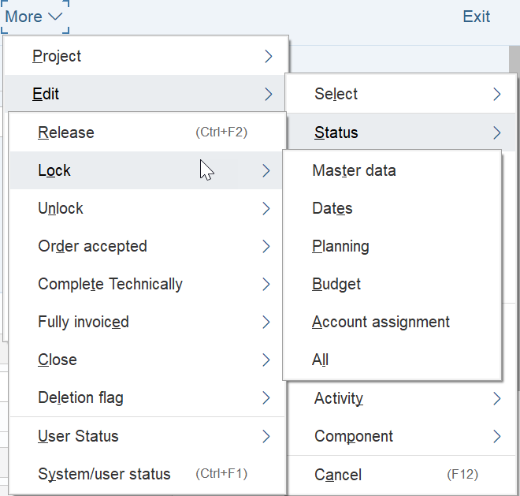
Project Status: Lock/Unlock WBS Elements
It is possible to Lock WBS elements so that certain actions cannot be performed or changes made to a specific WBS element.
For example, if a WBS element is created in error but budget has been assigned at one point, it is not possible to delete that WBS. It then becomes important to be able to lock this WBS.
MDLK
Master Data Locked Manual
DDLK
Date Definition Locked Manual
PLLK
Planning Locked Manual
BMLK
Budget Management Locked Manual
AALK
Account Assignment Locked Manual
LKD
All Locked Manual

Slide 9
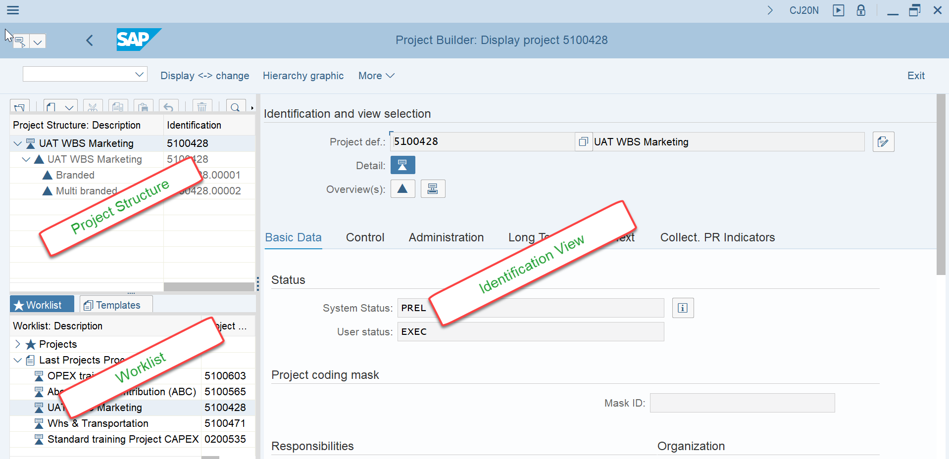
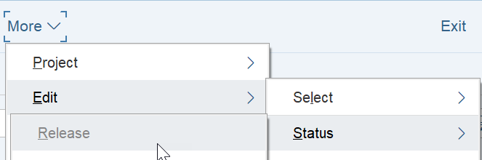

Project Builder Basic Navigation
Project Builder CJ20N is used to change the status of Project and Project WBS Elements beginning with setting status to Release.
Project Structure shows the project hierarchy including Project Definition, Structure WBS Elements and WBS Elements. You can display the full hierarchical project structure and navigate to individual WBS elements within it
WorkList shows list of Projects in a users history
Identification view shows the WBS specific details, such as Master Data, status and organisation details
ATTENTION! Ensure the required WBS is selected in the hierarchy to ensure the data for THAT WBS is displayed in the Identification and View Selection display panel.
Select the WBS Element to change status. Go to More → Edit → Status → Release etc

Slide 10
Exercises
Exercise 1.16:
CJ20N – Project Builder – Set WBS Status to Released (REL)

