Slide 1

Course Structure
Postings to WBS
Introduction to WBS
Settlement
WBS Projects
Multi Branded Settlement
WBS Costs & Reporting
Reporting

Slide 2
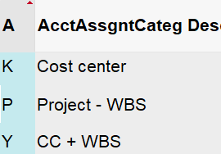
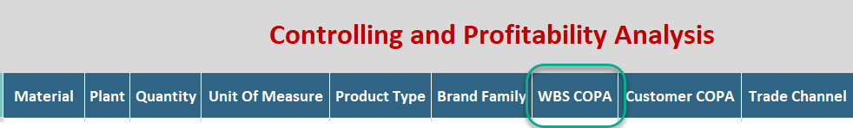
Practical Usage of WBS in S/4HANA
Planning
Actuals
When we refer to planning, this is Corporate FP&A financial planning submissions such as A&SP, LE, TDT, PMM etc.
At JTI, most planning is loaded in BW (e.g. in GPM) rather than SAP.
In EAM scenario, planning needs to be done at Capex WBS level via Planning Screen (linked to BW).
Purchasing
Payroll
MyRequest
WBS Settlement
In order for costs/expenses from Purchase Orders (PO) to be recorded in WBS, you need to select an Account Assignment Category related to WBS and indicate the WBS number in PR/PO.
A new PR/PO account assignment category Y has been created so that cost center and WBS element can both be used and posted into.
K is to be used when only a cost center is needed in the posting; P is for capex related expenditure and Y is for cost center and WBS element.
If a Budget is maintained for a Project, it must be assigned BEFORE PR/PO creation
WBS element has been added to the payroll file used for the payroll interface
Any locations who record payroll via the interface can therefore include WBS element in any payroll entries if applicable – this is not mandatory
WBS element is added as a field in all MyRequest templates where a posting against a P&L account is possible.
Where a branded WBS is used, there is no need to also populate brand family and product type in the MyRequest template as these will be derived from the WBS element master data.
Depending on the nature of the cost that you wish to book against a WBS element, you need to make sure you have populated the correct WBS number in your MyRequest template.
As explained earlier some WBS elements need to be settled at period end. These will create FI postings made to WBS elements.
Settlement is performed based on Settlement rules in each WBS.
Some of the settlement rules are automatically generated, e.g. in the case of Capex WBS settling to CIP; some of the settlement rules need to be maintained in WBS manually by users.
Details of settlement rules of each WBS scenario is explained in the respective training courses.
Budgeting
In SAP, a budget can be assigned to a WBS as a control mechanism.
Once a budget amount is assigned, spend on the internal order or WBS element cannot exceed the budget amount.
Budget is no longer mandatory for all spend with an approved BAP / Memo, and is optional for any other projects.
The budget amount is not necessarily the same as what is included in plan
Budget MUST be assigned before PR/PO creation in accordance to recommended business flow

Slide 3
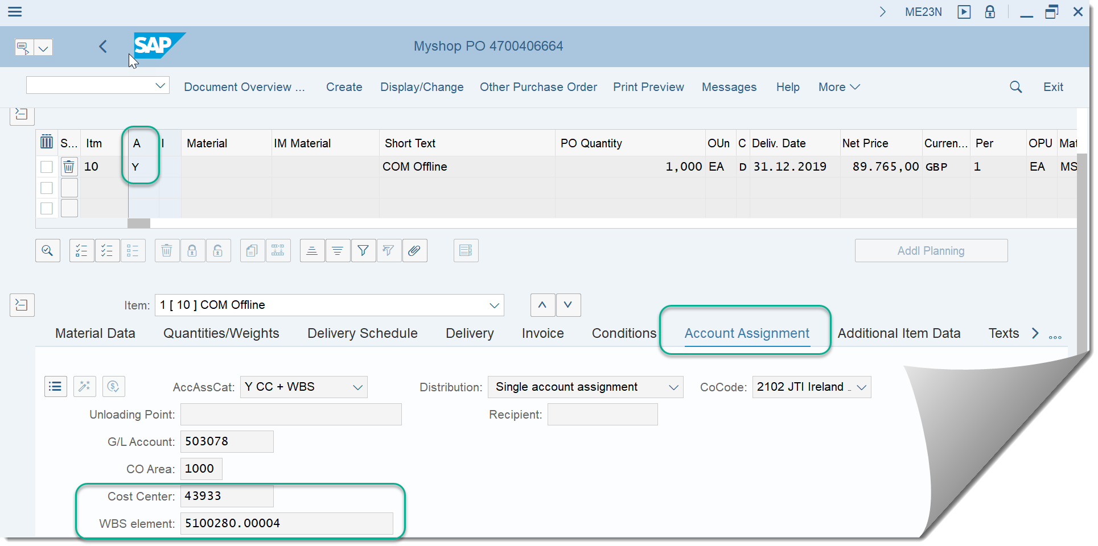


Purchase Orders
Within a Purchase Order there is an Account Assignment Category that determines the Accounts related postings will be posted to. Account Assignment Y has been created for postings to WBS Elements. When selected for line items the mandatory fields for Cost center and WBS Element appear in the Account Assignment tab for that line item and must be populated

Slide 4
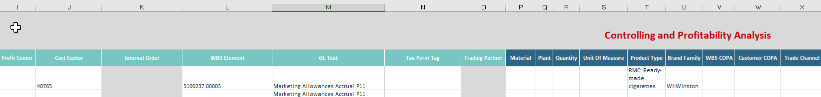
Manual Postings to Profitability Analysis with WBS Elements – Statistical Allocation
WBS elements with priority 1 – allocation statistical can be used for costs above brand contribution where a branded or multi-brand WBS element are not suitable
Such WBS elements must be used with a cost center, and with brand family and product type or material populated
It will not be possible to use these WBS elements in purchase orders for above brand contribution spend, these can only be used via manual postings such as journal postings, direct FI vendor or customer invoices etc. However, these can be used in purchase orders with opex GL accounts
If the WBS element or project has a budget assigned, these entries will reduce the amount remaining on the budget

Slide 5
Attributed Profitability
Attributed profitability is a new feature in S/4 HANA
It is only applicable for branded WBS elements where 100% of the costs will be allocated to one brand family / product type combination
Attributed profitability means that as soon as costs are posted against the WBS element, we can see the brand family and product type, even though BSC have not yet executed WBS settlement at month end
As a technical step, BSC will still perform WBS settlement. This ensures that WBS elements can later be closed
WBS element 123456
Settlement rule
Percentage | 100%
Brand: | WI
Prod. type: | RMC
Actuals
Settlement rule for profitability segment exists for WBS element
CO-PA characteristics are derived on initial posting – before settlement
Doc number | Item No. | Doc. Type | G/L Account | WBS element | Brand | Product type | …
5000000011 | 2 | WE | 502705 | 123456 | WI | RMC

Slide 6
FG Write off with WBS Elements
WBS element can be used to track the costs related to inventory write-offs
Specific movement type to be used where cost center and WBS element should be populated
G/L accounts are predefined in configuration based on the product type that is being written off
Brand family and product type should come directly from material, so no branded or multi-brand WBS elements are expected
Validation on the movement type 221 allowing only ‘Allocation statistical’ WBS element
CONFIGURATION (G/L ACCOUNT)
MOVEMENT TYPE
POSTING
G/L account 1 | WBS element A | Cost center X | WI | RMC
MATERIAL MASTER DATA
MANUAL INPUT (WBS & COST CENTER)

Slide 7
Course Structure
Postings to WBS
Introduction to WBS
Settlement
WBS Projects
Multi Brand Settlement
WBS Costs & Reporting
Reporting

Slide 8


WBS Settlement to CO-PA
Branded WBS elements
Multi-brand WBS elements
Each branded WBS element must be linked to a brand and product type – these are CO-PA characteristics
As expenses are recorded against the WBS element the brand family / product type will also be visible for reporting via instant derivation functionality
At month-end WBS settlement will be performed by BSC
A multi-brand WBS element will be used to collect costs where brand and product type is unknown when the purchase order is created
On a monthly basis the custom WBS allocation program will be executed, and the costs will be allocated from the multi-brand WBS to brand family / product type CO-PA characteristics based on the weighting of year-to-date net revenue per brand family / product type for the market
Multi-brand WBS allocation to SKU will be possible for transportation / warehousing costs based on year-to-date net volumes

Slide 9
WBS Settlement Expected Results
Validations/Expected Results | Branded WBS | Multi-Branded WBS with allocation type ZZZ | Multi-Branded WBS
Debits and credits are within the same GL account netting to 0 | Yes | Yes | Yes
Separate documents in all Ledgers – 0L, ST, TX, where costs have been posted to WBS | 0L, ST, TX, where costs have been posted to WBS | 0L, ST, TX, where costs have been posted to WBS | IFRS only
The same profit center is debited and credited | Yes | Yes | Yes
The same cost center is debited and credited (if Cost center information is included in settlement rule) | Yes | Yes | Yes
The same functional area is debited and credited | Yes | Yes | Yes
Multiple settlement documents generated (if more than one currency used) | Yes | Yes | Yes
Document Type | SZ | SZ | XW

Slide 10


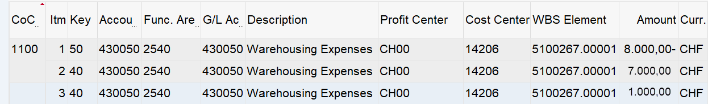
WBS Settlement Actual Results Example
FB03L – Branded WBS Settlement
Debit and Credit in same:
G/L Account √
Functional Area √
Profit Center √
Balanced to zero √
Ledger other than 0L possible √
Document type SZ √
FB03L – Multi Branded WBS Settlement – Allocation ZZZ
Debit and Credit in same:
G/L Account √
Functional Area √
Profit Center √
Balanced to zero √
Ledger other than 0L possible √
Document type SZ √
FB03L – Multi Branded WBS Allocation
Debit and Credit in same:
G/L Account √
Functional Area √
Profit Center √
Balanced to zero √
Ledger other than 0L possible X
Document type XW √

Slide 11
Course Structure
Postings to WBS
Introduction to WBS
Settlement
WBS Projects
Multi Brand Settlement
WBS Costs & Reporting
Reporting

Slide 12
Multi-brand WBS Settlement
The automated settlement program for multi-brand WBS allocations will have the below features to determine how the costs should be allocated, and whether the allocation will impact SKU (plus all characteristics derived from SKU) or brand family and product type
P&L Line | Marketing Investments | Transportation / Warehousing | Price / Distribution Allowances
Calculation basis | YTD net revenue (gross revenue – excise and returns) | YTD volumes | YTD net revenue (gross revenue – excise and returns)
Reference market hub | Used by profit centers where we have above brand contribution expenses, but don’t have 3rd party sales. This is mainly for Global Functions (G* profit centers) or Management profit centers (M*). | Used by profit centers where we have above brand contribution expenses, but don’t have 3rd party sales. This is mainly for Global Functions (G* profit centers) or Management profit centers (M*). | Used by profit centers where we have above brand contribution expenses, but don’t have 3rd party sales. This is mainly for Global Functions (G* profit centers) or Management profit centers (M*).
Characteristics populated | Brand family and product type | SKU, brand family, product type and all others derived from SKU | SKU, brand family, product type and all others derived from SKU
Allocation criteria – product types | All product types RMC FCT RMC / OTP / FCT RRP | All product types RMC FCT RMC / OTP / FCT RRP | All product types RMC FCT RMC / OTP / FCT RRP
Allocation criteria – brand family | All brands (incl. private labels) All JTI brands GFB and SFB GFB SFB | All brands (incl. private labels) All JTI brands GFB and SFB GFB SFB | All brands (incl. private labels) All JTI brands GFB and SFB GFB SFB
In cases where the above allocation keys are not appropriate, markets can manually enter a settlement rule on the WBS element master data (e.g. 50% Camel RMC, 50% Winston RMC). This approach is only recommended where the % allocation will not change every month. Manual entries with statistical WBS element will also be possible, with relevant CO-PA fields available to populate (such as where information comes from TME)

Slide 13
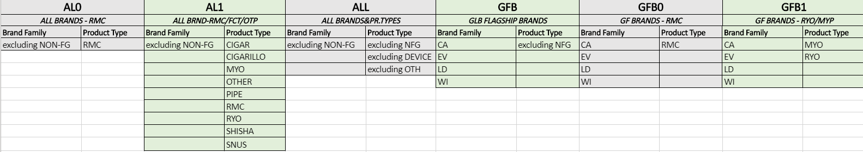
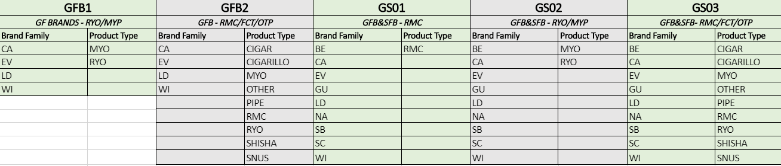
Allocation Keys – Examples
There are several different allocation keys that have been designed for Multi-brand allocations. These are groupings of different Brand Family/Product type dimensions (an example of some of these can be seen below). A full list can be found by link to WBS Allocation Keys and Accounts file

Slide 14
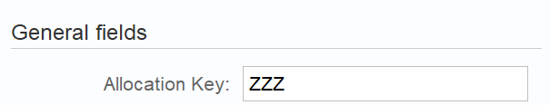
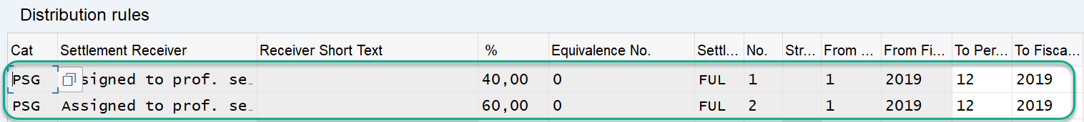
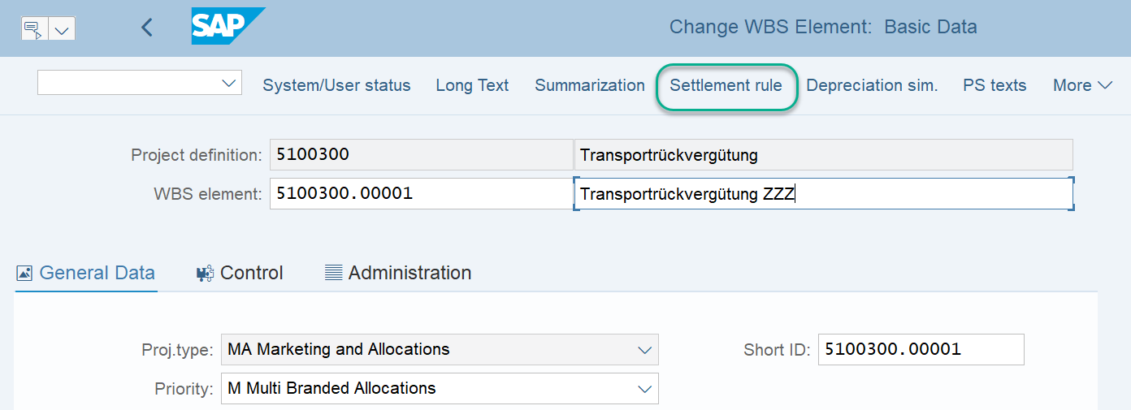
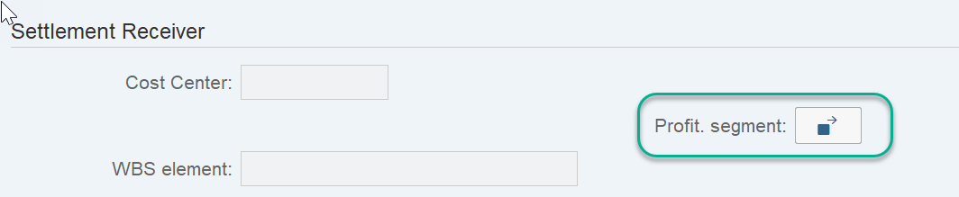
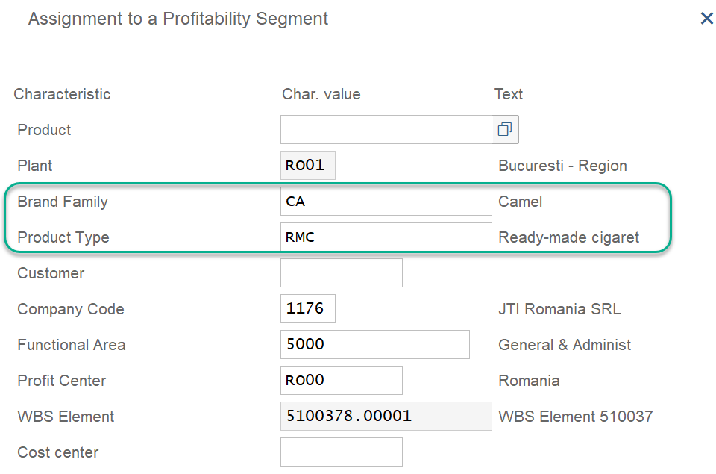
Allocation Keys – Custom ZZZ
In cases where the above allocation keys are not appropriate, markets can manually enter a settlement rule on the WBS element master data (e.g. 50% Camel RMC, 50% Winston RMC). This approach is only recommended where the % allocation will not change every month. They assign Allocation Key ZZZ when creating the WBS element
2
CJ12 – Change WBS Master Data
1
3
The settlement rule is created in CJ12 for the relevant WBS with allocation key ZZZ. Each month BSC run these to allocate costs according to the settlement rule created.
Click Settlement Rule.
A new window opens and here users assign the Category PSG (Profitability Segment) and the % split between Brand Family & Product Type so in this example the first split is 40% and also the type of settlement. Periodic settles only the costs that occurred in that period. This is not advised as late postings will result in unallocated costs on WBS Please always use Full as this settles all costs that have not yet been settled even if they occur in a different month
Double clicking on the line opens up another window where users can assign these values. Click on Profit. Segment
Assignment to Brand Family/Product Type
4
Please be advised that users should use the FUL settlement type and not PER (which the systems currently defaults to)

Slide 15
Results of Multi-brand WBS settlement
In the multi-brand WBS element master data, it will be possible to select that only certain brand family types or product types should be included in the settlement
In the below example, all JTI brands have been selected with product types RMC, OTP and FCT, therefore RRP is excluded. Therefore, even though the market has sales of RRP products, the costs are not allocated to RRP. Instead, the proportion allocated to other brand family / product type combinations is increased
Brand | Product type | Net revenue | %
Silk Cut | RMC | 500 | 23%
B&H | RMC | 1500 | 70%
B&H | RYO | 50 | 2%
Logic | RRP | 100 | 5%
TOTAL |  | 2150
WBS element
0100358.0001
Mkt info system
Ignored during allocation
Type
Multi-brand
Allocation key
All JTI_RMC / OTP / FCT
Reference market hub
Status
Created, Released
Brand | Product type | MKT info systems | %
Silk Cut | RMC | 24.4 | 24.4%
B&H | RMC | 73.2 | 73.2%
B&H | RYO | 2.4 | 2.4%
TOTAL |  | 100
No allocation to RRP
Company
code
2101
Profit center
GB00
Marketing info systems: $100M
Responsible cost center
43252

Slide 16
Multi-brand WBS settlement with defined settlement rule
If it is not appropriate to use net revenue to allocate marketing investments or price / distribution allowances, or net volumes for transportation and warehousing costs, there will be two alternative solutions available.
1. It will be possible to define the settlement rule on the WBS element master data (as a %), such as in the below example. From an efficiency perspective, it is not recommended to change the % every month
WBS element
0100123.0001
Brand | Prod. type | Marketing project | %
LD | RMC | 375 | 75%
Camel | RMC | 125 | 25%
TOTAL |  | 500
Type
Multi-brand
Settlement rule
Brand family | Prod. type | % | From | To
LD | RMC | 75% | 01.2019 | 12.2019
Camel | RMC | 25% | 01.2019 | 12.2019
Marketing project: $500M
2. It will also be possible to create a statistical WBS element and manually enter CO-PA characteristics such as brand family & product type or SKU directly in postings such as manual journals or manual vendor / customer invoices. This approach is only recommended where the amounts or proportions to be allocated are calculated in another system such as TME

Slide 17

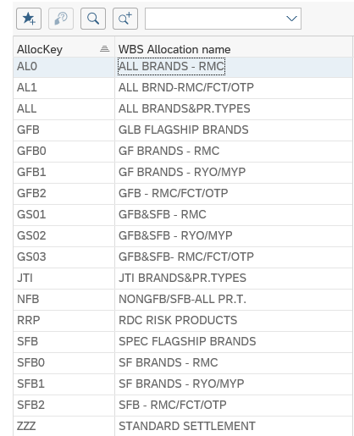
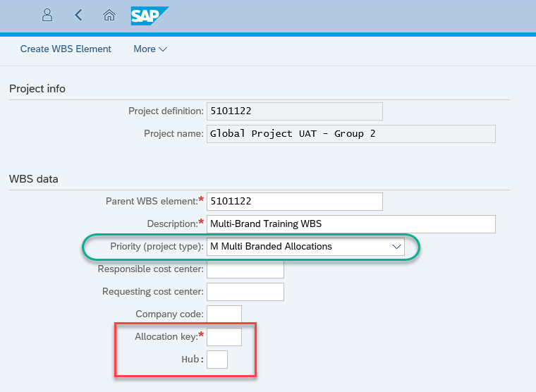
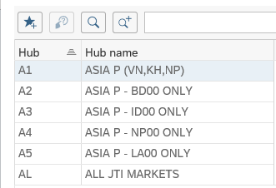
WBS allocation keys and posting rules
Allocation keys are assigned when creating the Multi Brand WBS in Fiori
Hubs are an optional entry
Click here for a Allocation Key and accounts
Allocation Key (Mandatory): A key which determines the rule for WBS allocation at month end. The allocation key defines which brand family and product types should be considered for the allocation. See more on allocation keys here
Hub (Optional): A key which determines the reference market(s) from which the system should analyze sales to calculate the allocation, to be used in cases where the costs are incurred in a difference profit center(s) to the sales revenue or volumes. Please note – in most cases this should not be populated. There is a validation that will prevent hub being used except for management or global functions profit centers. It is used by profit centers where we have above brand contribution expenses, but don’t have 3rd party sales. This is mainly for Global Functions (G* profit centers) or Management profit centers (M*).

Slide 18
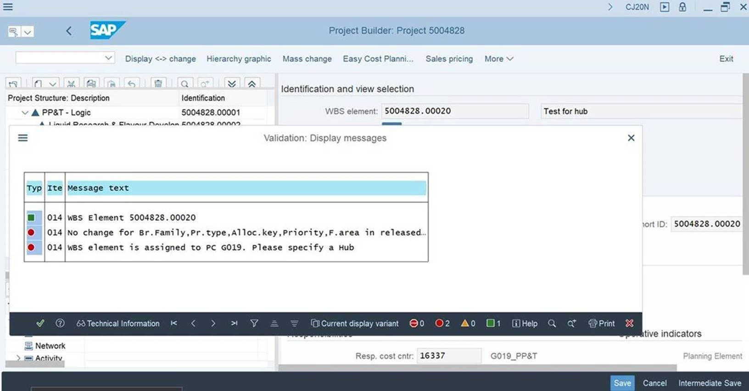
WBS Allocation Keys: HUB Requirement Update (with exception of WBS elements with allocation type ZZZ)
A new validation rule has been created to check the need to include an appropriate HUB.
For Profit Centers beginning with G* or M* a new validation rule will alert users to the need to include HUB information for all projects that are being created for these Profit Centers. If HUB details for these specific profit centers are not entered for the required WBS elements, users will now see an error message instructing them to provide a hub. If the hub is not entered the WBS cannot be saved.

Slide 19
WBS allocation keys and posting rules
G/L account (together with Functional Area) belonging to a particular P&L line determines:
P&L Granularity
Basis for the ratio calculation
Allocation key in WBS master data determines:
Reference Brand family and product type whose sales should be taken into account for ratio calculation
Target Brand Family and product type to which costs on WBS element should be allocated
G/L ACCOUNT | GRANULARITY | CALCULATION BASIS
503070 | Brand Family/Product Type | Net Revenue
430050 | Material | Net Volumes
ALLOCATON KEY GFB0
BRAND FAMILY | PRODUCT TYPE
WI | RMC
CA
EV
LD
SALES
WI/CA/EV/LD RMC
COSTS ALLOCATION
WI/CA/EV/LD RMC

Slide 20
WBS allocation keys and posting rules
Example
MATERIAL | BRAND FAMILY | PRODUCT TYPE | NET REVENUES | NET VOLUMES
Material 111 | WI | RMC | 10,000 | 500 KU
Material 222 | CA | RMC | 60,000 | 1000 KU
Material 333 | SB | RMC | 50,000 | 300 KU
Material 444 | CA | RYO | 50,000 | 200 KU
Material 555 | WI | RMC | 30,000 | 500 KU
RATIO 2
Material 111 | 25%
Material 222 | 50%
Material 555 | 25%
ALLOCATION KEY GFB0
RATIO 1
WI RMC | 40%
CA RMC | 60%
CALCULATION BASIS
POSTING
Cr | G/L 503070 | WBS element A | 100,000
Dr | G/L 503070 | WI RMC | 40,000
Dr | G/L 503070 | CA RMC | 60,000
Cr | G/L 430050 | WBS element A | 10,000
Dr | G/L 430050 | Material 111 | 2,500
Dr | G/L 430050 | Material 222 | 5,000
Dr | G/L 430050 | Material 555 | 2,500
ACTUALS ON WBS ELEMENT
G/L 503070 | WBS element A | 100,000
G/L 430050 | WBS element A | 10,000
GRANULARITY
20

Slide 21
Multi-brand WBS allocations – types of postings
1. WBS to profitability segment (with brand family / product type / SKU populated)
Actuals are collected on WBS element and at month end should be allocated to Profitability Analysis
Allocation proportion is calculated based on YTD net revenues/volumes
Each period YTD costs are reposted based on a new ratio
PARAMETER
Actuals on WBS element A | 100,000
WI RMC sales | 7,500,000
CA RMC sales | 2,500,000
RATIO
WI RMC | 75%
CA RMC | 25%
POSTING
CR | WBS element A | 100,000
DR | WI RMC | 75,000
DR | CA RMC | 25,000

Slide 22
Multi-brand WBS allocations – types of postings
2. Profitability segment to Profitability segment
There are already costs allocated to Profitability Analysis from prior periods which should be redistributed
YTD amount that was allocated in prior periods is greater than the amount for the current period
YTD amount that was allocated in prior periods is lower than the amount for the current period
Only the delta between the amounts previously allocated and the allocation for the current period will be posted (e.g. the previous allocation is not reversed and the full YTD amount posted)
PARAMETER | Amount
YTD Actuals on WBS element A | 120,000
Already allocated to WI RMC | 75,000
Already allocated to CA RMC | 25,000
 | NEW RATIO | EXPECTED AMOUNT
WI RMC | 50% | 60,000
CA RMC | 50% | 60,000
POSTING |  | Amount
CR | WBS element A | 20,000
CR | WI RMC | 15,000
DR | CA RMC | 35,000

Slide 23
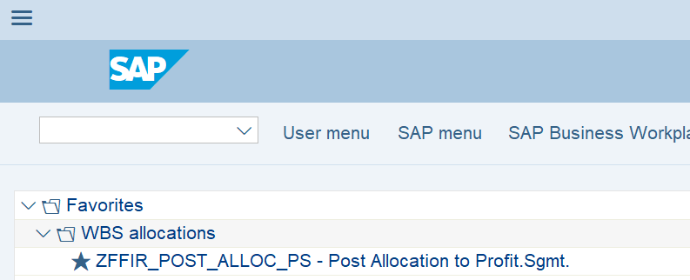
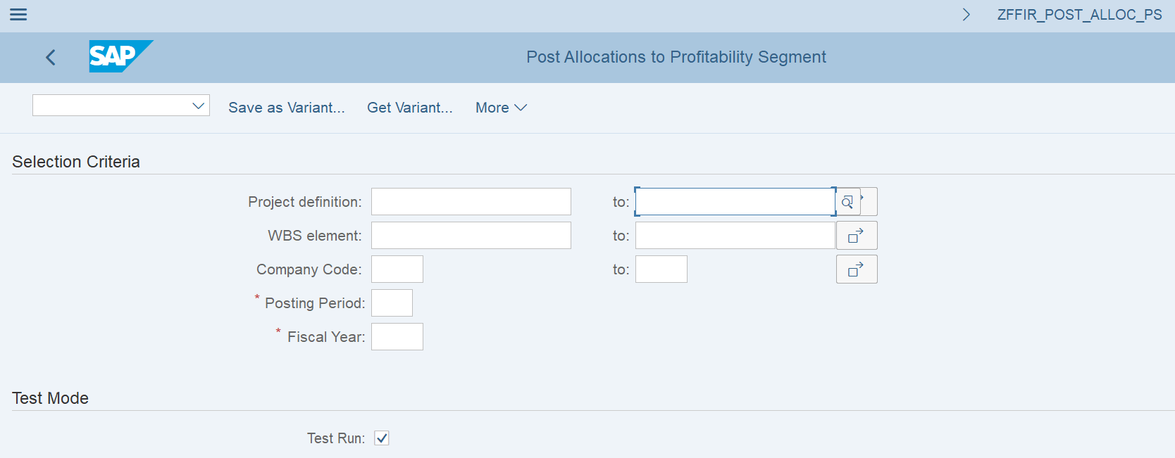
Display the calculation for automated WBS allocation to CO-PA – ZFFIR_POST_ALLOC_PS
This is to check that all allocations to Multi-Branded WBS Elements via pre defined allocation calculations have all been allocated successfully and we are not missing any. Some allocations could be missed if WBS elements are locked by other users. Important to remember not to keep a Project open in CJ20N
The fields that must be populated are as follows:
Project definition or WBS element: If you enter the project, you will see the proposed allocation for all multi-brand WBS elements within that project that do not have allocation key ZZZ. If you only enter the WBS element you will see the proposed allocation for one element only
Company code (optional): The company code where the element(s) have been created. This field is not mandatory
Posting period / year: The posting period and year in which the allocation will take place. Please note – the allocation is based on YTD net revenue or volumes
Test run: This should also be flagged by Markets as if it is not flagged the % allocation calculation report will not be displayed.
Please note that although test mode can be unflagged, only BSC has access to actually execute the allocation.

Slide 24
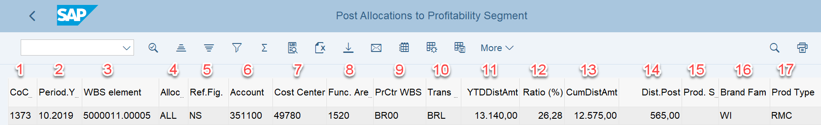
Display the calculation for automated WBS allocation to CO-PA – ZFFIR_POST_ALLOC_PS
Company Code: The company code where distribution from WBS to CO-PA is performed
Period,Year: Period/year which is used to define YTD costs and YTD reference sales figures to calculate the proportion for the distribution
WBS Element: WBS element holding the costs
Allocation Key: The allocation key from the WBS element master data which determines the rules for the distribution
Reference Figures: The basis for the reference sales figures: NS – net revenue; NV – net volumes
Account: G/L account with which distribution is performed
Cost Center: The original cost center that was posted along with WBS element and which will be inherited during distribution to CO-PA
Functional Area: Functional area where the costs were originally posted, and which will be inherited during cost distribution to CO-PA
Profit Center for WBS: Profit center within which the distribution of costs is performed
Transaction Currency: The original transaction currency for costs posting which will be inherited during distribution
YTD Distributed Amount: The proposed figures for distribution of YTD costs according to the ratio calculated based on latest reference sales figures
Ratio: Proposed distribution ration based on reference sales figures
Cumulative Distributed Amounts: The amount of costs from previous month which have already been distributed to profitability analysis according to the previous revenues/volumes
Distributed amount to post: The proposed amount to be posted in the current period which is always the delta between the amounts already distributed and newly calculated amounts according to the latest ratio
Product Sold Group: The material in profitability analysis which will receive the distributed amounts
Brand Family:The brand family in profitability analysis which will receive the distributed amounts
Product Type: The product type in profitability analysis which will receive the distributed amounts

Slide 25
Month end closing schedule: Settlements
End of WD1
End of WD2
Morning of WD3
Branded/Multi-Branded WBS with Allocation Key ZZZ to be settled:
After journals have been posted
End of WD2
Multi-Branded WBS based on Net Sales/Volumes to be settled:
WD3
After Material Ledger Close
Markets with excise NOT through Material Ledger
Markets WITH excise flow through Material Ledger

Slide 26
Automatic Sales data for Multi-brand allocation: Exceptions
PC | Do not have Sales every month* | Sales Booked at Month end*
AFD0 | ✓
AO00 | ✓
BHD0 | ✓
D013 | ✓
D021 | ✓
E005 | ✓
EGD0 | ✓
GT00 | ✓
JOD0 | ✓
KRD0 | ✓
OMD0 | ✓
MYD0 | ✓
NI00 | ✓
PHD0 | ✓
TF00 | ✓
TND0 | ✓
BY00 |  | ✓
UZ00 |  | ✓
*Costs will not be allocated until sales are posted
Please note: This list may not be exhaustive

Slide 27
Exercises
Exercise 1.17:
ZFFIR_POST_ALLOC_PS - Check expected results of allocations

