Slide 2
WBS ELEMENTS

Slide 3
Generic slides for each course

Slide 4


WBS Elements
Structure of the course
S4F-ERP
Introduction to WBS
PROJECT
Icon here
WBS Projects
TRAINING
WBS Costs & Reporting
Simplify, Standardize, Accelerate

Slide 5

Overview – About this course
Course Objectives
This course provides information on:
Prepare Power Users for delivering this training materials to end-users
Refresh knowledge of Power Users in the creation, maintenance and allocation processes involved using WBS Elements
Provide the understanding of the newly implemented and refined processes
Address any initial questions
Target Audiences
This course is mandatory for:
Power Users who will be involved in Projects using WBS Elements for OPEX or Above Brand Contributions (ABC)
Learning Guide
Related courses:
Prerequisite course:
Finance Fundamentals Overview
Finance Fundamentals
Profitability Analysis

Slide 6

Course Structure
Introduction to SAP Fiori
Introduction to WBS
What are WBS Elements
WBS Projects
WBS Process Overview
Cost management

Slide 7
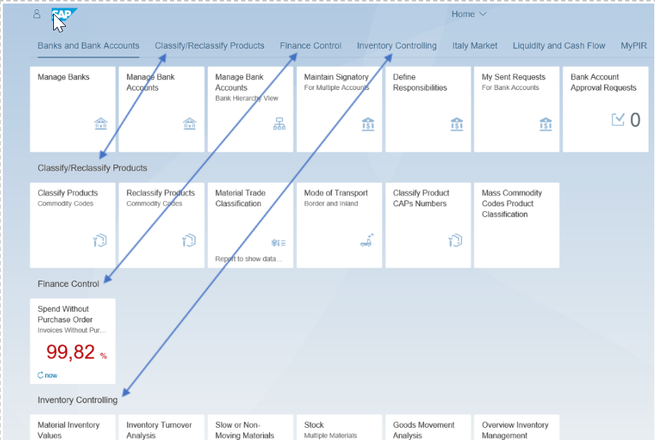
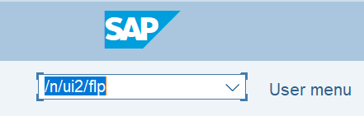
SAP Fiori
Introducing the Fiori Launchpad
WBS Projects and Elements will be created via SAP Fiori Launchpad. SAP Fiori Launchpad is a new user experience for SAP software and applications. It provides a set of applications (Apps) that are used in regular business functions. Apps are represented as square tiles in a user’s Home Page. A user can easily customize their home page with the Apps that they use as part of their daily work by pinning them and organizing them into different task areas. These tasks appear vertically down the page or as tabs across the top for users to be able to easily access the required App.
Accessing the Fiori Launchpad
Enter /n/ui2/flp in the SAP Easy Access Menu within SAP GUI and press Enter

Slide 8

Demonstration: SAP Fiori Launchpad
DEMO
Show:
Accessing Fiori Launchpad via SAP GUI
Navigating Fiori Launchpad
Catalogue
Pinning App in Fiori
/N/UI2/FLP: Access Fiori Launchpad
SAP Fiori: Navigation, Catalogue and pinning Apps

Slide 9
Course Structure
Introduction to SAP Fiori
Introduction to WBS
WBS Elements Master Data
WBS Projects
WBS Process Overview
WBS Costs & Reporting

Slide 10
Introduction to WBS
WBS stands for “Work Breakdown Structure”.
A work breakdown structure is a model of a project and shows all the activities to be carried out as a hierarchical structure thereby splitting the project into manageable units.
WBS are used to divide a project step by step into structure elements. Various parts of an overall project are described in individual work breakdown structures (WBS Elements). You can further divide these elements at various levels until you reach the level of detail required.
If you have a project with many WBS elements linked to it, these can be grouped using a WBS type called a structure, which is similar to a node in a hierarchy
It is not possible to record any actual postings against a structure WBS element, this should only be used for reporting purposes

Slide 11
Why Replacing Internal Orders with WBS?
Feature/ Functionality | Internal Order | WBS | Advantage of using WBS
Collect cost for a project | Yes – only for statistical purpose¹⁾ | Yes – can be either statistical or real | As real cost objects, WBS can be settled to final cost receivers, e.g. fixed assets for Capex project, CO-PA characteristics for Marketing projects.
Be assigned with a budget and perform availability control | Yes – only at overall project level | Yes – project or WBS level | Exchange rate can be specified so that budget availability control is done at the exchange rate used for budget, eliminating the noises caused by fluctuation of actual exchange rates.
Different types to distinguish usage | Yes – however no standardization | Yes – clearly defined and fit for purpose | Project types and WBS priorities are clearly defined for WBS to ensure correct WBS elements are used for the specific purposes.
Can be structured | No | Yes | WBS can be structured based on the nature of the spending. E.g. Capex projects can be structured based on the structure of the components of building an equipment; Opex/Marketing projects can be structured based on groups of activities, etc.
Can be linked to multiple company codes | No | Yes | Different WBS elements within a project can be linked to different company codes, e.g. in the use of Interco asset transfer or Interco Non-trade cross charge processes.
Can be used to generate invoices | No | Yes | WBS elements can be linked to sales orders so that invoices can be automatically generated. E.g in the use of Interco Non-trade cross charge processes.
¹⁾ Technically Internal Orders can be used as Real cost objects as well. However in JTI for the purpose of tracking project costs prior to S4F project, this particular usage is for statistical purposes only.

Slide 12

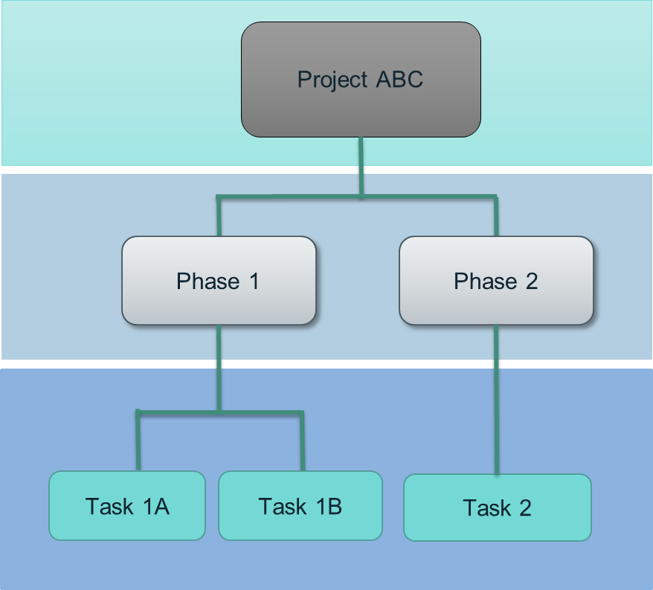
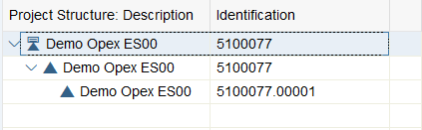
Project and Work Breakdown Structure
In SAP, Projects are used in Project System (PS) module which represent tasks meeting specific criteria, e.g. there is a clear goal, a defined duration, mile stones, a budget, etc. for a given project.¹⁾
Projects are organized using Work Breakdown Structures (WBS). A WBS is a model of the work to be performed in a project organized in a hierarchical structure.
The WBS is an important tool which helps you keep an overview of the project:
It forms the basis for organization and coordination in the project.
It shows the amount of work, the time required, and the costs involved in the project.
A project structure in S/4HANA
The top node in a work breakdown structure represents the project as a whole, which is called Project Definition in SAP. Project Definition can be used for reporting purpose but does not accept direct postings.
The individual elements represent activities within a WBS are called WBS Elements. A WBS elements can be a structure (a node) which is further divided into lower level tasks. These are called WBS Structure element. Technically you can define as many levels as you need. But no more than 5 is recommended.
In SAP, the system automatically creates a WBS with the same code as Project Definition when a project is created. This is also a WBS Structure element.
The WBS elements at the lowest level of the Work Breakdown Structure contain the most detailed project tasks/activities, where the detailed costs are recorded.
¹⁾ Based on different WBS scenarios used in JTI, the criteria of each type of projects are not entirely the same. Refer to respective courses for further details.

Slide 13
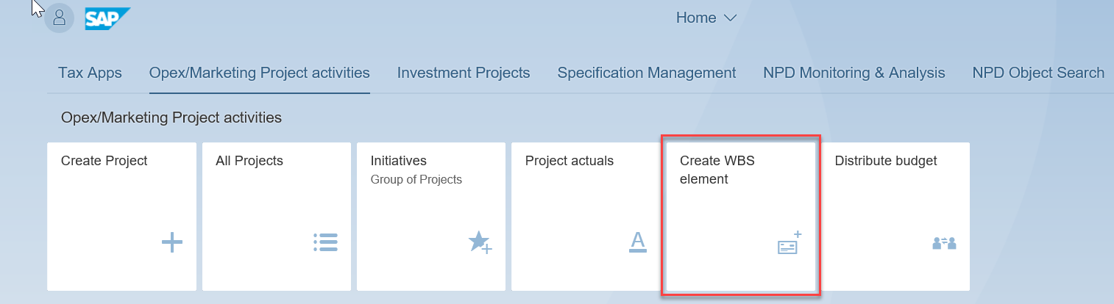
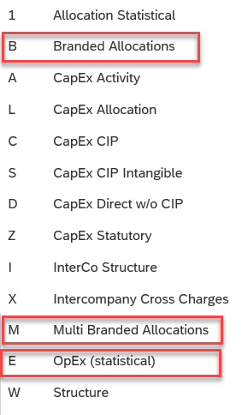
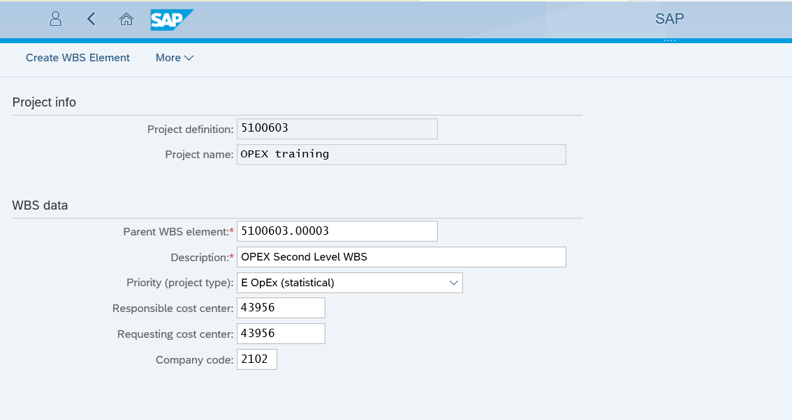
WBS Priorities – WBS element types creation
WBS Priorities are used to determine what type of WBS Element is to be used. Each different type determines different Master Data fields depending on the needs of the Project. Different WBS element types (priorities) allow for different activities, for example branded WBS elements are linked to a brand family and product type. Multi-brand WBS elements will be allocated to brand family / product type or even SKU depending on pre-defined rules
In SAP Fiori the “Create WBS Element” App is used to create new WBS elements within the Project in order to structure it to individual business needs. The user enters the Project Definition previously created during Project creation process and presses Execute. The Parent WBS element will be the WBS element ID of the WBS node a user wants to create the WBS under. Consequently creating a Project structure.
Rules:
OpEx priority type E WBS Elements can only be created under another E WBS Priority or under a structure element (W)
Multi Branded Allocations type M WBS Elements can only be created under another M WBS Priority or under a structure element (W)
Multi Branded Allocations can also have type 1 – Allocation Statistical and these WBS Elements can only be created under another 1 WBS Priority or under a structure element (W)
Branded Allocations type B WBS Elements can only be created under another B WBS Priority or under a structure element (W)

Slide 14
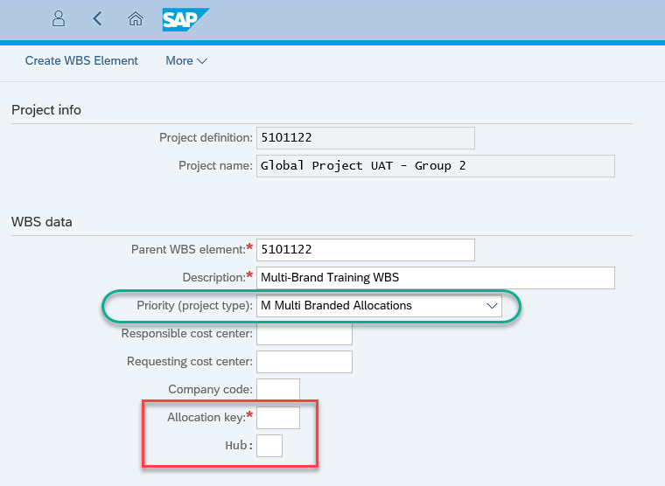
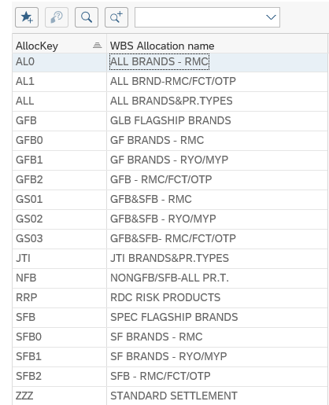
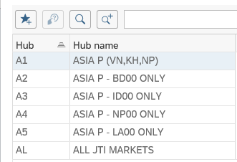
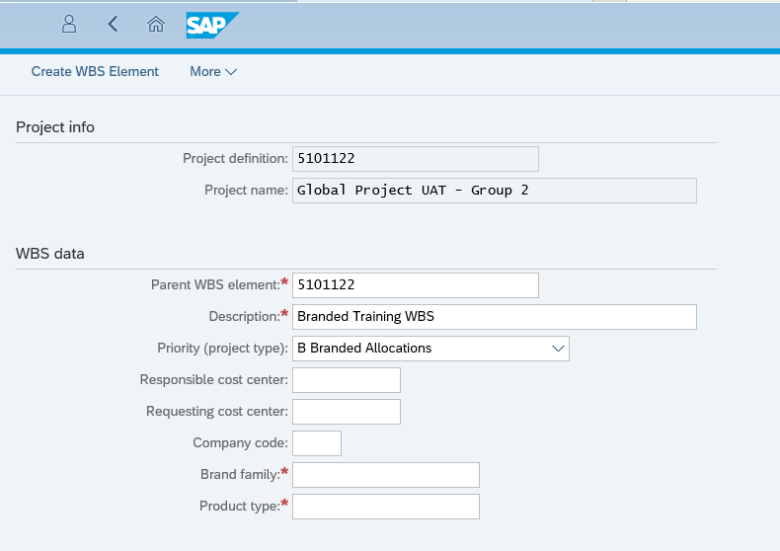
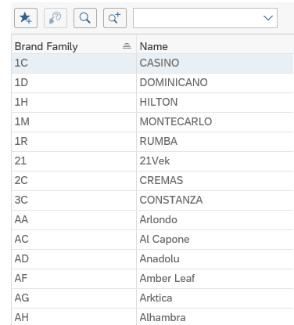
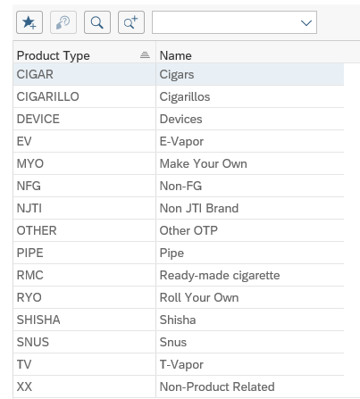
WBS Priorities – WBS element types creation
Multi-Brand and Branded WBS Priorities on creation each require additional fields to be populated.
Multi-brand WBS
Allocation Key (Mandatory): A key which determines the rule for WBS allocation at month end. The allocation key defines which brand family and product types should be considered for the allocation
Hub (Optional): A key which determines the reference market(s) from which the system should analyze sales to calculate the allocation, to be used in cases where the costs are incurred in a difference profit center(s) to the sales revenue or volumes. Please note – in most cases this should not be populated. There is a validation that will prevent hub being used except for management or global functions profit centers. It is used by profit centers where we have above brand contribution expenses, but don’t have 3rd party sales. This is mainly for Global Functions (G* profit centers) or Management profit centers (M*).
Branded WBS
Brand Family (Mandatory): Brand Family receiving the costs from this WBS, such as Camel, Winston, LD, Glamour etc.
Product Type (Mandatory): Product type receiving the costs from this WBS, such as RMC, RYO, MYO, Cigars etc.

Slide 15
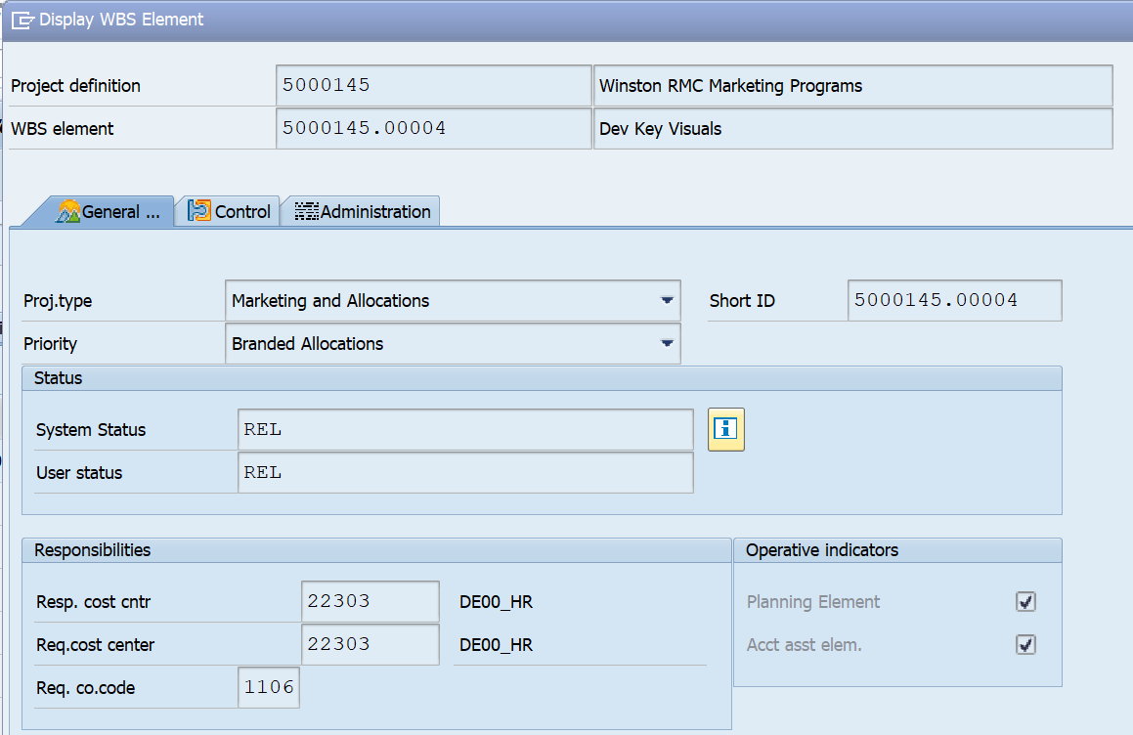
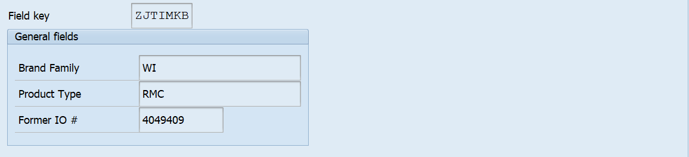
WBS element – Master Data
WBS element
Represents particular project activity
There are different WBS element types configured for different usage, for example for opex, branded, multi-brand
Branded WBS elements have specific fields where the brand family and product type must be populated
WBS elements that are migrated to S/4HANA from internal orders in ECC will contain the former internal order number
The settlement rule is defined on the WBS element (for settlement to capex or CO-PA)
WBS element in SAP

Slide 16
WBS Elements types
Project type | WBS element priority | Type of CO object | Settlement | Note
Intercompany | Intercompany | Real | Via interco invoices | Can only be created by BSC
Opex / Capex | Opex | Statistical | Not applicable | In S/4 HANA, we will no longer settle opex WBS elements
 | Capex | Real | Asset
Above brand contribution | Branded | Real | Settlement to CO-PA (brand family and product type) | Brand family and product type must be populated on the WBS master data
 | Multi-brand | Real | Settlement to CO-PA (SKU or brand family and product type depending on P&L line) | Settlement can be via the automated allocation, or a settlement rule can be entered on the WBS master data
 | Statistical above brand contribution | Statistical | Not applicable | Should only be used where other WBS types cannot be used the split between brand family / product type is available in another system such as TME

Slide 17
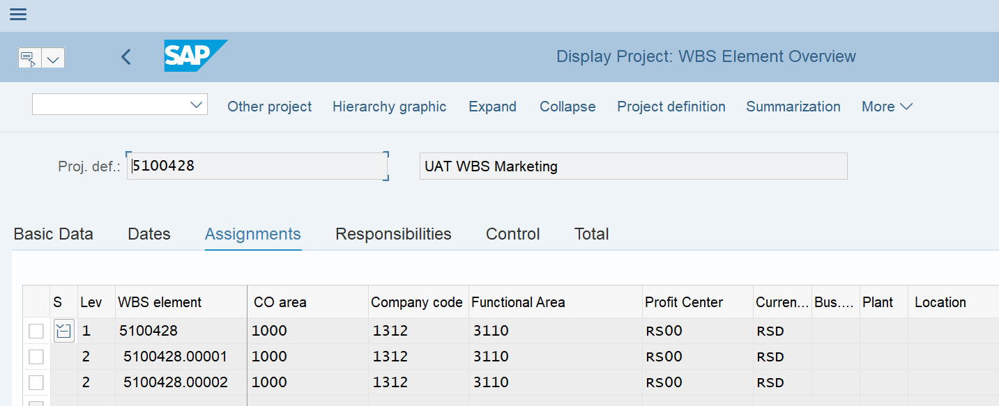
WBS Elements Master Data
For different types (WBS Priority) of WBS elements, different fields are maintained in the WBS master data. See below examples.
CJ03 – Display WBS Master Data
From cost management perspective, a WBS element is also a cost object, which is similar to a cost center or an internal order that is used to collect costs. Therefore for JTI, all WBS elements are created within the JTI Controlling Area 1000 for cost management purposes.
The Company Code information at project level is taken from the “Bucket” when a project is created. At lower WBS elements level you may extend the WBS to different company codes depending on the business scenarios.
WBS elements used for cost management purposes also need “Functional Area”, which will support the categorization of costs in Market P&L.

Slide 18
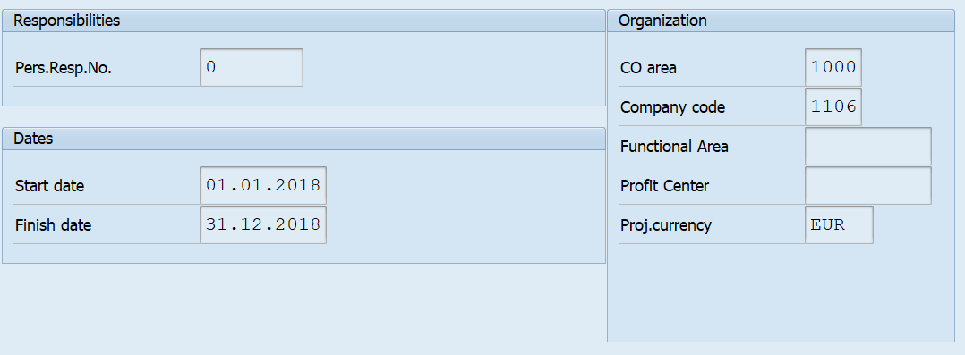
WBS Project Definition – Master Data
WBS project definition
Represents the ‘header’ of a project
Contains information about project, budgeting and settlement profiles
Contains system and user status of the project, e.g. if it is released, closed etc.
The initiative number can be populated on the project definition
Contains the company code with overall responsibility for the project, although this does not drive any postings in SAP
WBS project definition in SAP

Slide 19
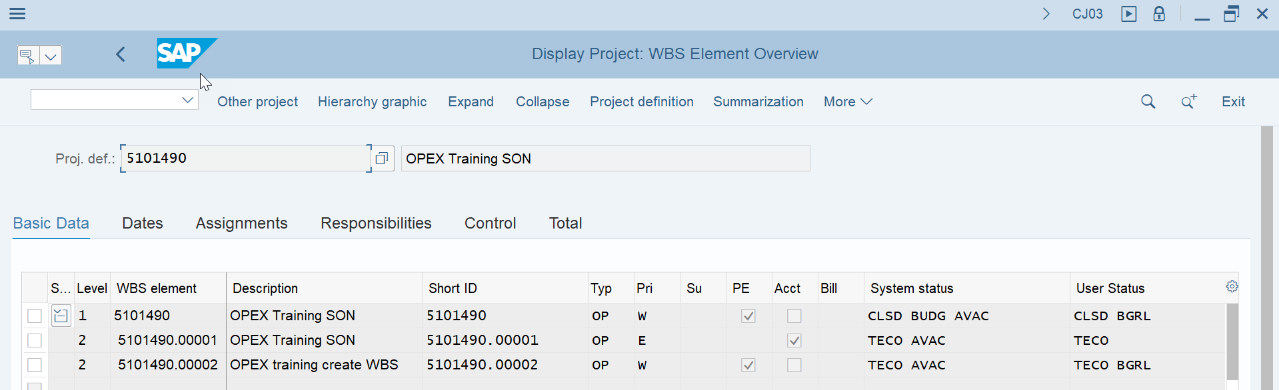
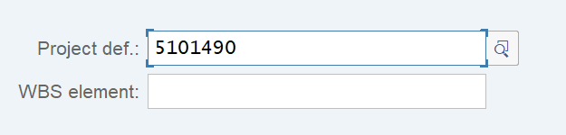
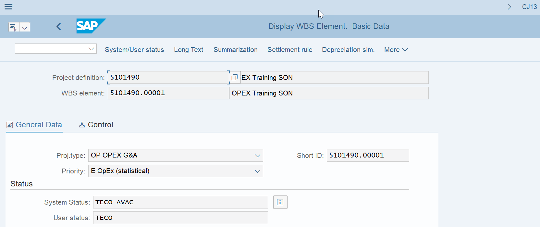
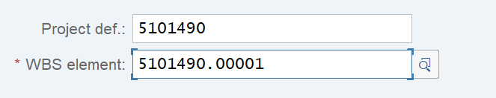
Master Data T:Codes
CJ03 – Display Project: WBS Overview
CJ03 – Displays a Project including all WBS Elements if you leave the WBS Element entry field blank (WBS Element is not mandatory in CJ03)
The report displays in tabular form and is good to use to view Project overall but if specific WBS element details are required it is best to use CJ13
CJ13 – Displays a Project by WBS Elements WBS Element is a mandatory field in CJ13 and therefore the master data being shown is ONLY for the named WBS
The report shows in a more structural view with the specific WBS master data easily seen
CJ13 – Display WBS Element

Slide 20
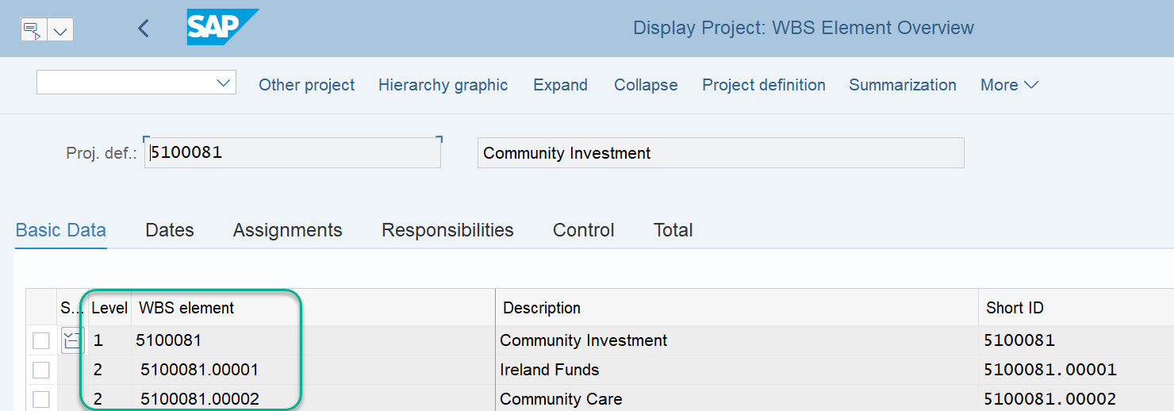
CJ03 – Display Project: Hierarchy and numbering convention
CJ03 – Display Project: WBS Overview
You can display the full hierarchical project structure and navigate to individual WBS elements within it
Details of the selected WBS is displayed on the right hand side of the screen and you can make changes to allowed fields and modify its status
There is a numbering convention of WBS as you can see. All WBS elements below the project WBS Structure element have a code ending with “.xxxxx” which represents the running number of WBS elements within a project, e.g. .00001, .00002. etc.
The name of the WBS element was provided when it was created but can be modified if needed

Slide 21
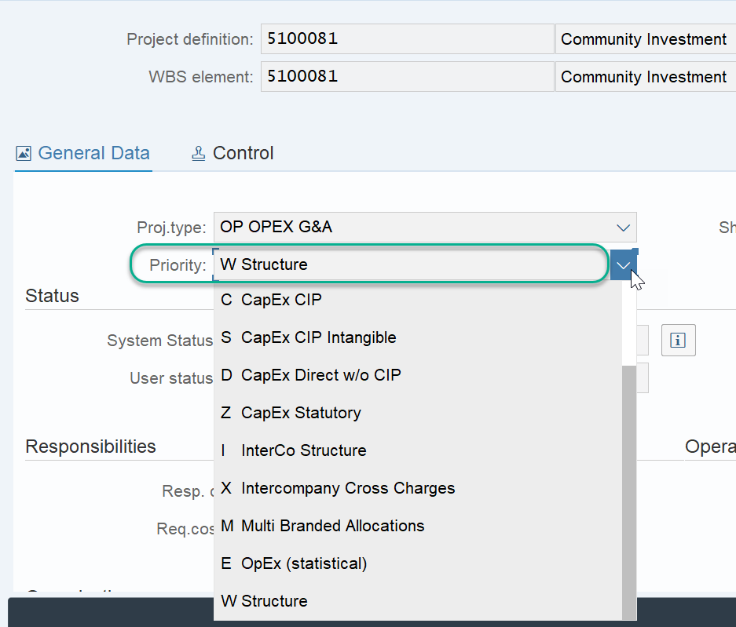
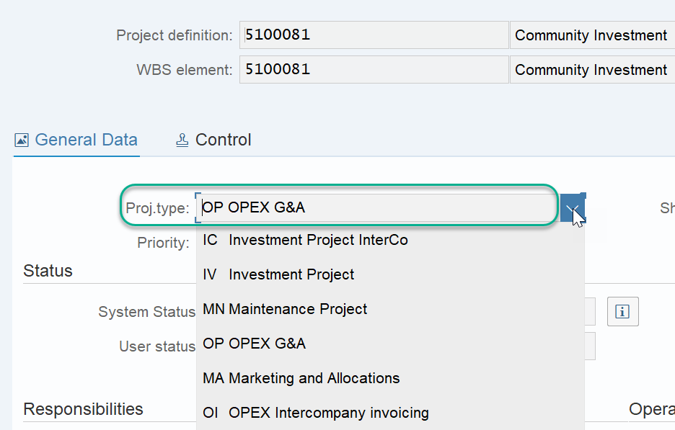
CJ13 – Display WBS Element: Project Type and Priority
CJ13 – Display WBS Element
Each Project Definition has a ”Project Profile” assigned to it upon creation. Project Profile determines the purpose of the project, i.e. for Intercompany Non-trade cross charge, GSC Capex, etc.
Depending on the Project Profile, you can select different Project Priority at the WBS element level to indicate the usage of it, which also determines what you can or cannot do with the respective WBS later in the process.
You will also notice there is a Project Type field at WBS level. This field is derived from Project profile and only visible in WBS elements belonging to projects of certain project profiles.

Slide 22
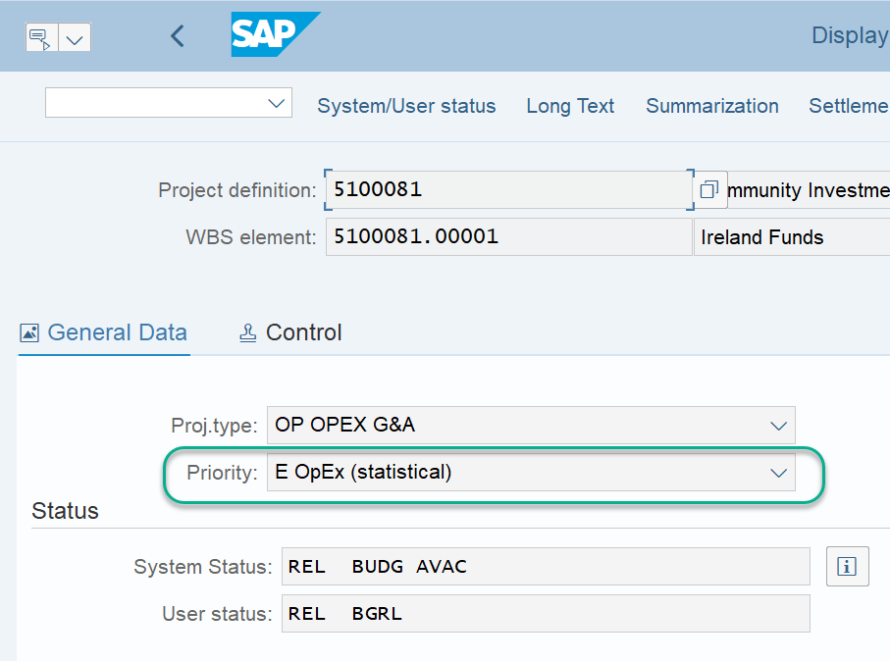
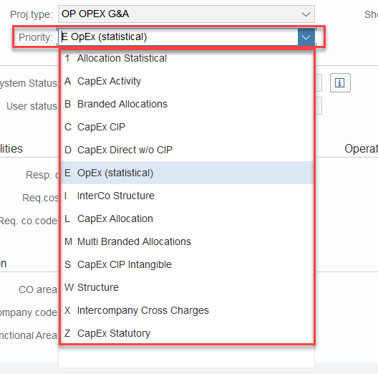
CJ13 – Display WBS Element: Priorities
Each WBS element has a “Priority”. It distinguishes the types and usage of different WBS elements.
Examples of WBS Priority:
Structure – to be used for a higher level WBS element which groups multiple lower level WBS elements. At WBS Structure level no posting can be made but reporting is possible.
OPEX * - to be used for OpEx costs which are statistical postings for traceability of costs, therefore are not settled at month end.
Multi Branded Allocation – to be used for Marketing expenses that are to be settled to CO-PA on multiple SKU/brand family+product type.
Users need to select the correct “Priority” when creating each WBS element. Wrong Priority may restrict further processing of WBS elements, e.g. required master data field not populated, required posting cannot be made, period end settlement cannot be performed, etc.
CJ13 – Display WBS Element

Slide 23
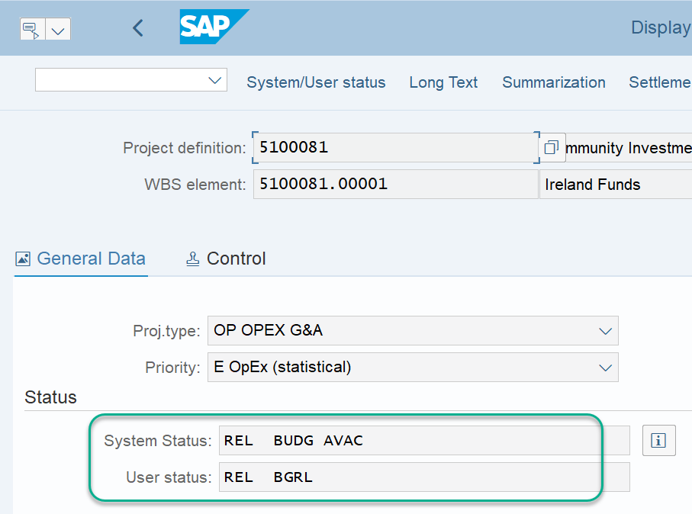
CJ13 – Display WBS Element: Project Status
Every project and every WBS element has a System Status and User Status.
Both Statuses are set either by users manually or by system automatically upon certain triggers, e.g. the WBS status will reflect that a budget has been entered if a user maintains budget for it.
Status set at Project level is automatically inherited by its lower level WBS elements, however status set at WBS element level is only applicable to itself.
Depending on the statuses of a WBS element, the system restricts the user actions that can be taken to process a WBS element.
E.g. if the WBS element has status “TECO”, it means no further purchase requisitions can be raised against this WBS but you can continue to post invoices from POs linked to this WBS that were created before the TECO status was set
More on statuses in following slides.
CJ13 – Display WBS Element

Slide 24
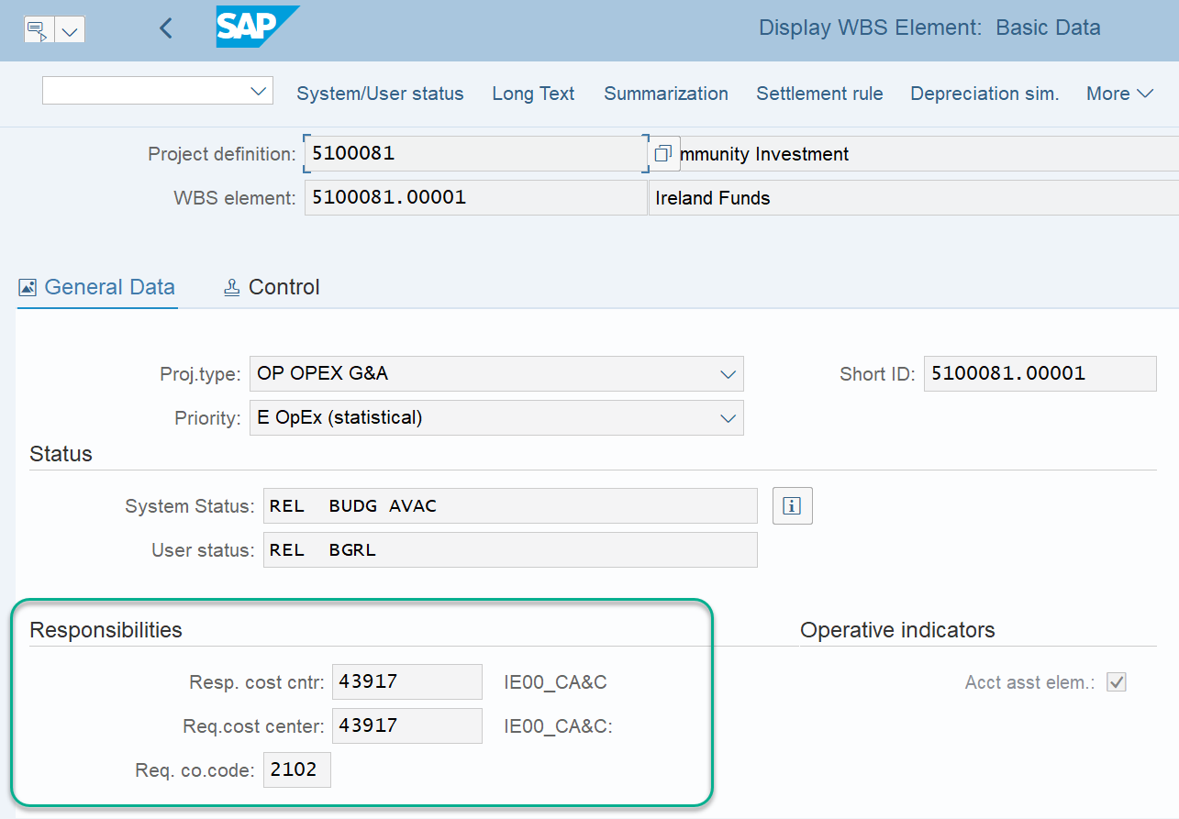
CJ13 – Display WBS Element: Responsibilities
CJ13 – Display WBS Element
In JTI, projects are created via FIORI launchpad (with the exception of Interco cross charge projects), where users select within which JTI organization ( “Bucket”) a project is to be created.
Depending on the “Bucket” selected, some default information such as company code, cost centers, etc. are assigned automatically. Users can modify them in Project master data if needed.
The information here will be used for postings, e.g. any costs posted against the WBS will also have the corresponding “Responsible cost center” assigned to the same accounting line item, unless this has been changed in the relevant purchase order.
The requesting cost center will pull into any PRs created for the WBS automatically on creation and entry of WBS Element

Slide 25
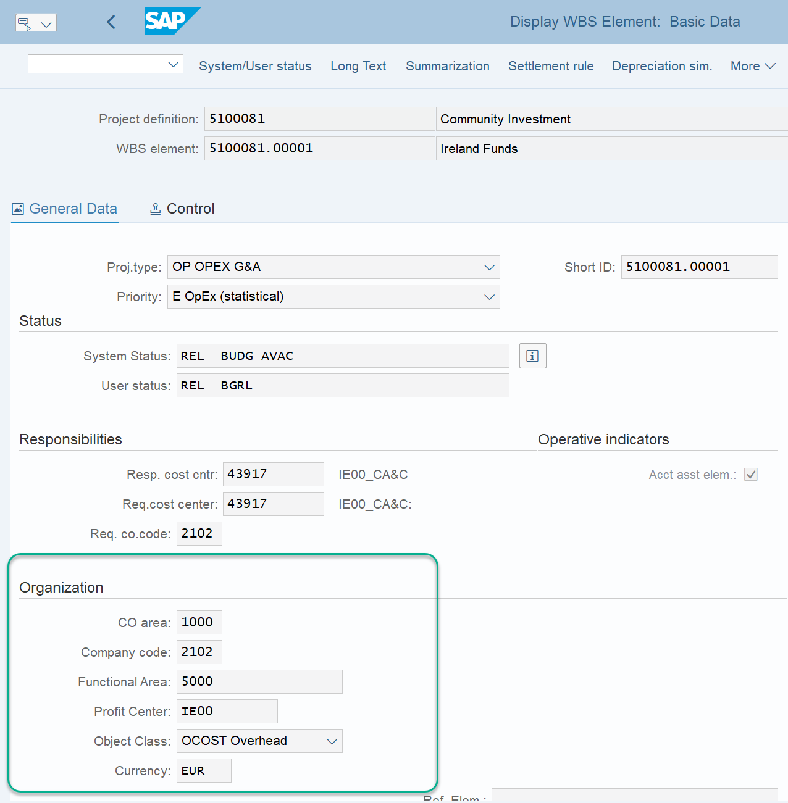
CJ13 – Display WBS Element: Organizational Data
For different types (WBS Priority) of WBS elements, different fields are maintained in the WBS master data. See below examples.
CJ13 – Display WBS Element
From cost management perspective, a WBS element is also a cost object, which is similar to a cost center or an internal order that is used to collect costs. Therefore for JTI, all WBS elements are created within the JTI Controlling Area 1000 for cost management purposes.
The Company Code information at project level is taken from the “Bucket” when a project is created. At lower WBS elements level you may extend the WBS to different company codes depending on the business scenarios.
WBS elements used for cost management purposes also need “Functional Area”, which will support the categorization of costs in Market P&L.

Slide 26
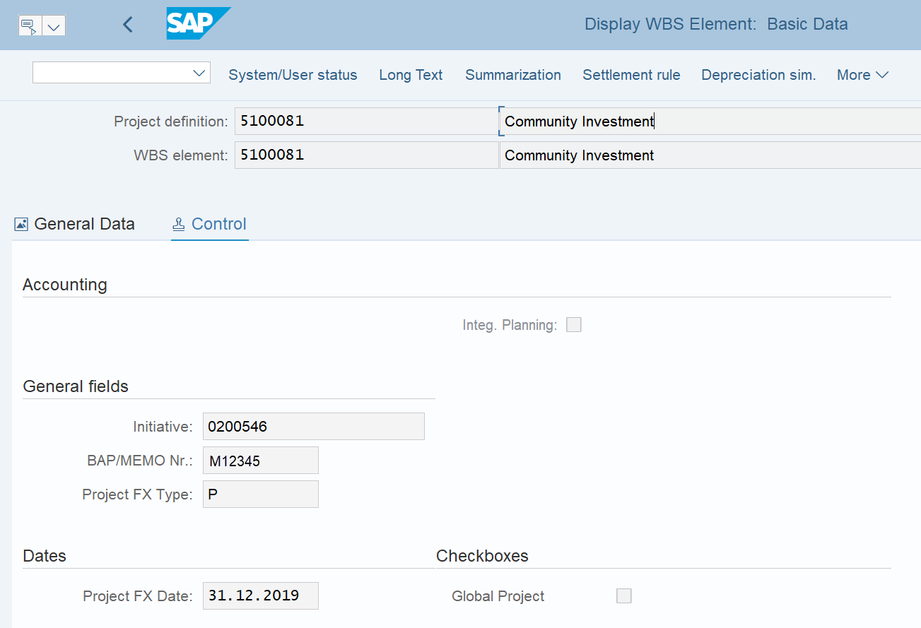
CJ13 – Display WBS Element: Control Tab
CJ13 – Display WBS Element
Project Structure Level 1
For Opex and Above Brand Contribution WBS, you may have a BAP and budget control, which is populated in the “Control” tab on creation of Project in PPM.
This is also informs users of the FX Rate type and date which is again indicated during Project creation in PPM, for example P rate is AP rate, LE1 is June LE etc. The FX date just refers to the year that the FX is set for (e.g. AP20 rate will have 31.12.20)
If a project is part of a group of projects/initiative the ID of that initiative will be populated.
If the project is one that involves different company codes it is set as a Global Project and the check box will indicate this

Slide 27
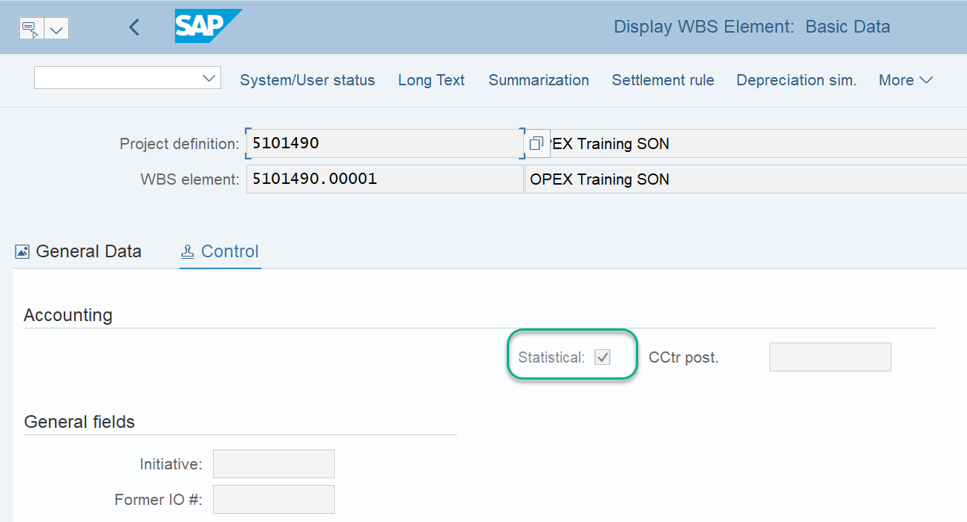
CJ13 – Display WBS Element: Statistical WBS Elements
For Opex and Above Brand Contribution WBS, you can have Statistical WBS Elements.
Statistical WBS elements are a reporting object only. You cannot post costs to a statistical WBS element. It is used for reporting purposes only as a view of the costs as a flow through object.
Statistical WBS Elements are therefore not settled

Slide 28
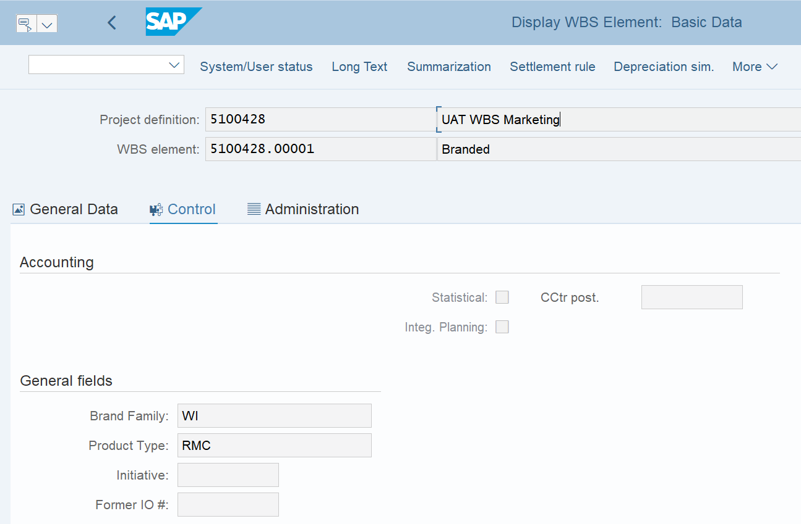
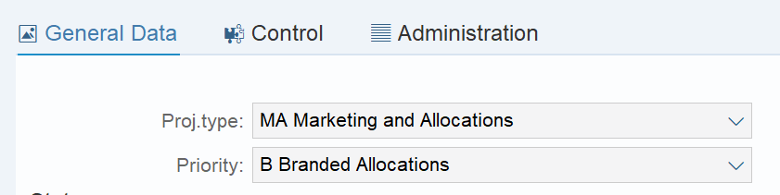
CJ13 – Display WBS Element: Branded WBS Elements: Master Data
CJ13 – Display WBS Element
For a Branded WBS which is an Above Brand Contribution WBS that is used for one Brand family & Product Type, these details are auto populated in CJ13 upon creation of the Branded WBS in Fiori.

Slide 29
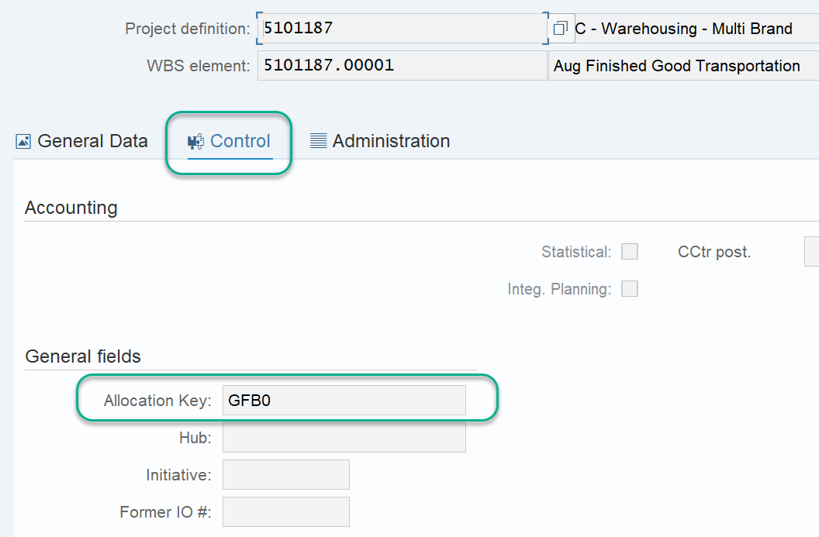
CJ13 – Display WBS Element: Multi - Branded WBS Elements: Master Data
CJ13 – Display WBS Element
Tabs for an Opex WBS
Project Structure Level 1
For a Multi-Branded WBS which is an Above Brand Contribution WBS that cannot be assigned to a specific Brand family & Product Type, an allocation key needs to be created to determine the rules by which the system should allocate costs to the different brand family/product types.
This is indicated in the control tab of the Multi Branded WBS and is assigned in PPM at the time of creating the WBS

Slide 30
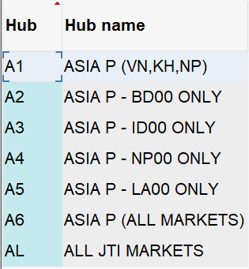
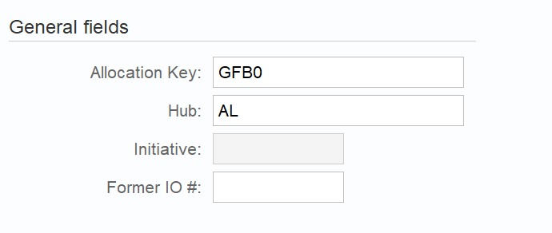
CJ13 – Display WBS Element: Multi - Branded WBS Elements: Master Data
CJ13 – Display WBS Element
Tabs for an Opex WBS
Project Structure Level 1
Hub: is used by profit centers where we have above brand contribution expenses, but don’t have 3rd party sales. This is mainly for Global Functions (G* profit centers) or Management profit centers (M*).

Slide 31
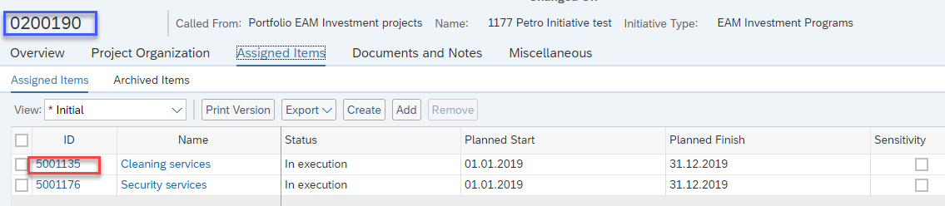
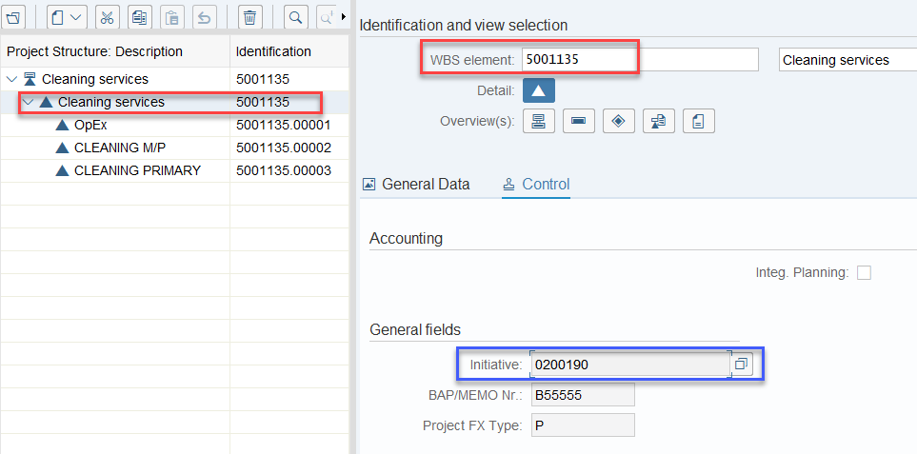
Master Data: Initiatives
If multiple projects should be linked to one another for reporting / analysis purposes, this can be achieved by creating an Initiative.
FIORI – Display Initiative
CJ20N – Project Builder
If a project is assigned to an Initiative, the number of the Initiative is visible in the project master data.
It is possible to search for projects linked to a particular initiative in standard SAP WBS reports, such as line items reports/master data reports and GPM05
Examples of using Initiatives:
Intercompany Asset Transfer
Group multiple Opex/Marketing projects for reporting purpose.

Slide 32
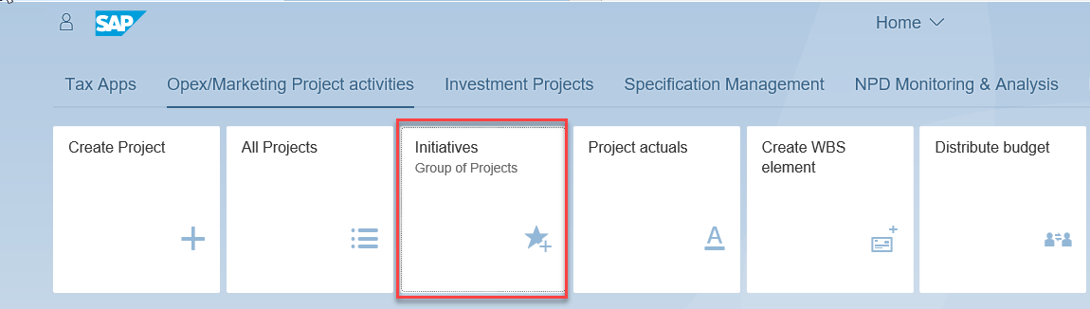
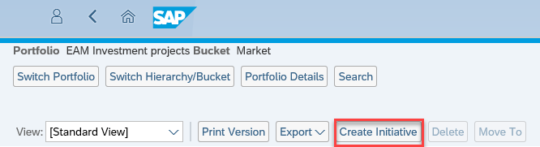
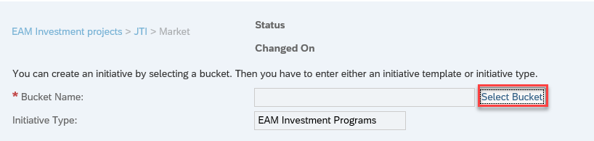
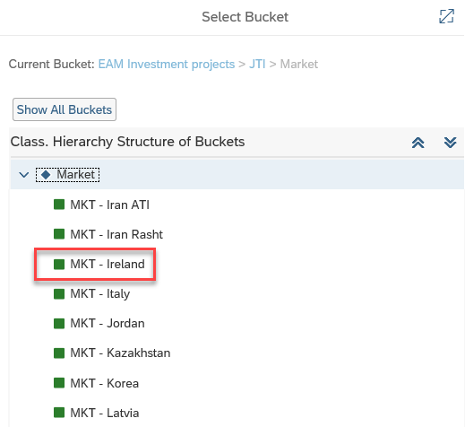
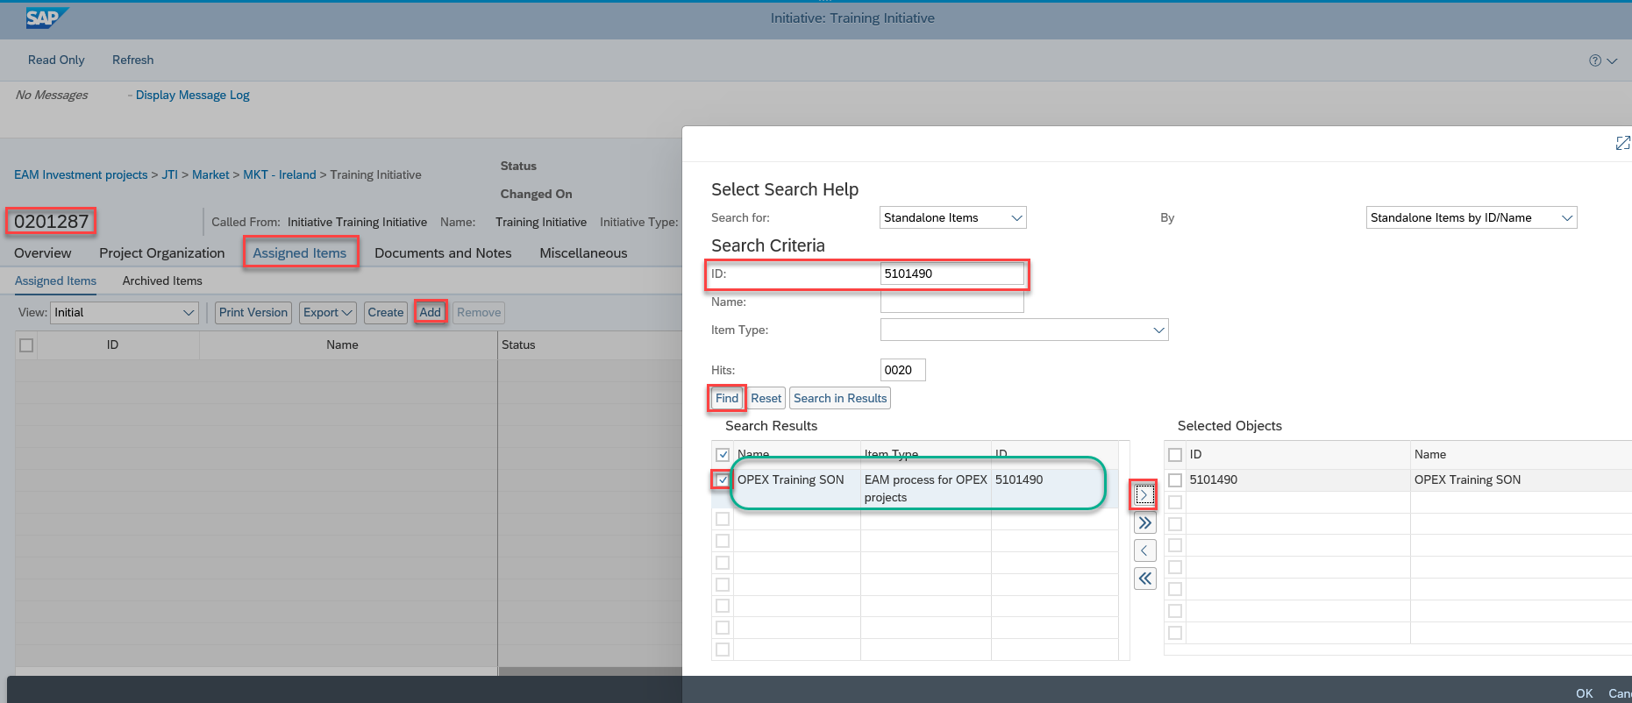
Master Data: Initiatives Creation
Initiatives are created in SAP Fiori App “Initiatives”. Select Create Initiatives, choose the bucket required. This creates the initiative and then users just needs to assign the required projects they want to link together using the search functionality in Assigned Items after clicking Add. The Initiative field in CJ20N for all assigned projects will update with the newly created Initiative number
FIORI – Initiatives

Slide 33
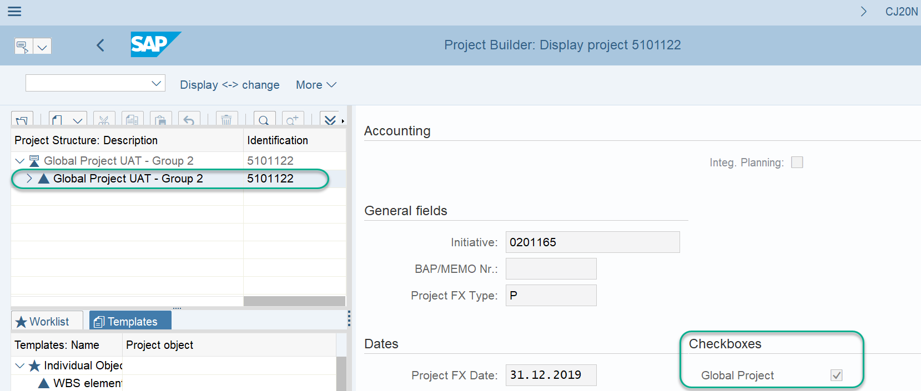
Master Data: Global Projects
A global project is defined as an OpEx or above brand contribution project that exists in more than one company code. They can be used for large projects across many entities such as BPM, or even relatively simple projects that such as shared costs between factory and market in the same location
Global Projects are created as per normal Project creation process. CJ20N is used to make a general Project a “Global” project. On the root (Level 2) WBS, Control tab the “Global Project” check box is checked. This defines the project as a global project and will allow different entities in different WBS elements. Without the tick you will get error messages when trying to save different WBS with different company codes. It can be made a Global Project at any time and doesn’t have to be immediately after creation.

Slide 34
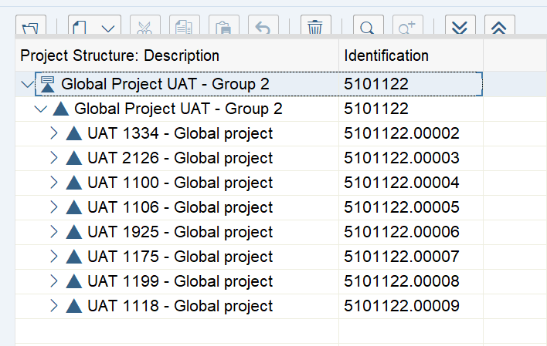
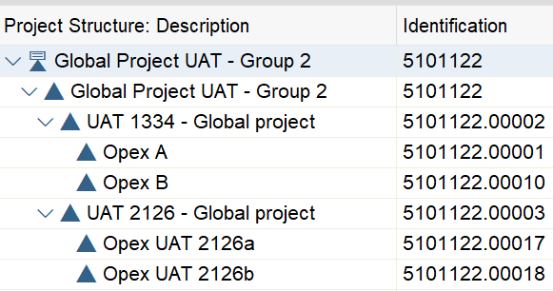
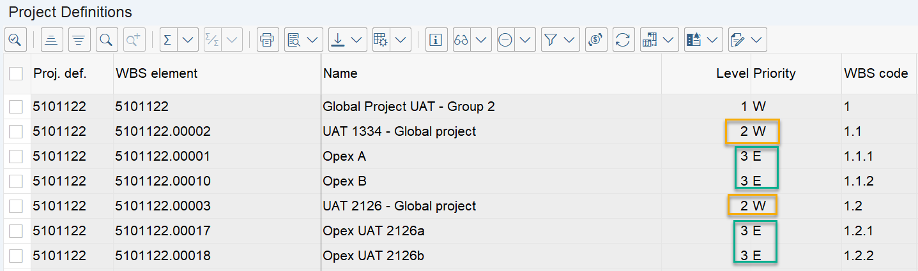
Master Data: Global Projects Overview
A global project is defined as an OpEx or above brand contribution project that exists in more than one company code
.
CJ20N – Project Builder
The Project is created by the responsible Entity/Function/Market etc. as per usual project creation process and will create the structural WBS to be used.
For global projects the second level of WBS must still be W (Structure) elements. It is mandatory that there should be a structure WBS element per company code involved in the global project.
Each entity can then create their own structure below this level 2 Structure WBS.
Each WBS element MUST have the Global Project check box checked.
Cost WBS Elements built under structural WBS for each Company Code
Structural WBS Elements for each Company Code
CN43N – WBS Elements Overview

Slide 35
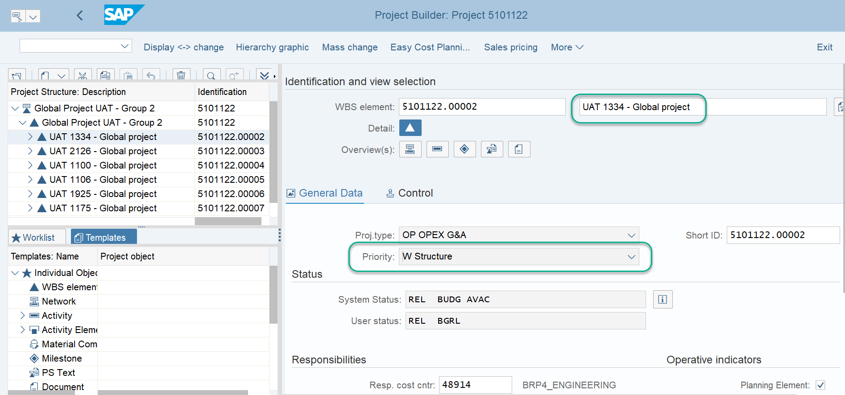
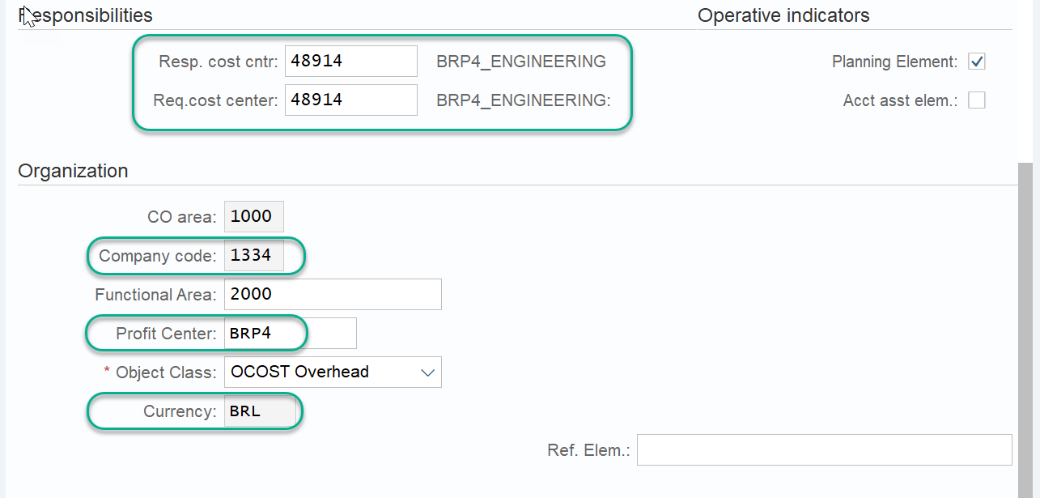
Master Data: Global Projects Overview
When creating the Structure WBS, due to several validation rules it is important to finalize all changes before pressing <ENTER>
.
The fields that must be populated before pressing enter are as follows:
Structure WBS element name: Provide a suitable name for the structure element, there are 40 characters available. It is recommended that the structure element name should include the company code
Priority: This should always be W for a structure WBS element
Responsible / requesting cost centers: The cost centers applicable for the company code and profit center which you are creating the structure element for
Company Code: The company code the structure element relates to. Ensure to enter the company code otherwise the Company code from the Project definition will default in
Profit Center: The profit center the structure element relates to. Again this needs to entered manually so as not to default from Project Definition
Currency: This should be derived from the cost center, but this can also be entered when the structure WBS element is created

Slide 36
Course Structure
Introduction to SAP Fiori
Introduction to WBS
WBS Elements Master Data
WBS Projects
WBS Process Overview
WBS Costs & Reporting

Slide 37
WBS Elements Process Overview
WBS Allocations and Reporting
Cost allocations for WBS elements
WBS Approval and Creation
SAP Fiori
WBS Budgeting
How to maintain budget
WBS and Project Maintenance
SAP GUI
Daily/Month end Reporting
System/User status
WBS Creation and Priorities
Budget Distribution
Master Data
Project Creation and types
CJ03/CJ13/CN43N
Project Structure
Organizational details

