Slide 1

Course Structure
Introduction to WBS
WBS Projects
Postings to WBS
WBS Costs & Reporting
Reporting

Slide 2
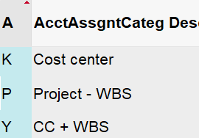
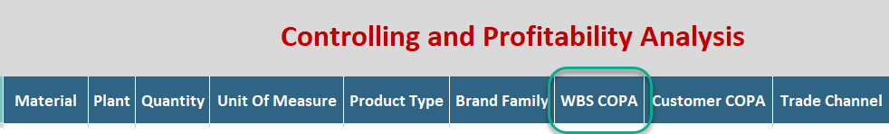
Practical Usage of WBS in S/4HANA
Planning
Actuals
When we refer to planning, this is Corporate FP&A financial planning submissions such as A&SP, LE, TDT, PMM etc.
At JTI, most planning is loaded in BW (e.g. in GPM) rather than SAP.
In EAM scenario, planning needs to be done at Capex WBS level via Planning Screen (linked to BW).
Purchasing
Payroll
MyRequest
In order for costs/expenses from Purchase Orders (PO) to be recorded in WBS, you need to select an Account Assignment Category related to WBS and indicate the WBS number in PR/PO.
A new PR/PO account assignment category Y has been created so that cost center and WBS element can both be used and posted into.
K is to be used when only a cost center is needed in the posting; P is for capex related expenditure and Y is for cost center and WBS element.
WBS element has been added to the payroll file used for the payroll interface
Any locations who record payroll via the interface can therefore include WBS element in any payroll entries if applicable – this is not mandatory
WBS element is added as a field in all MyRequest templates where a posting against a P&L account is possible.
Depending on the nature of the cost that you wish to book against a WBS element, you need to make sure you have populated the correct WBS number in your MyRequest template.
Budgeting
In SAP, a budget can be assigned to a WBS as a control mechanism.
Once a budget amount is assigned, spend on the internal order or WBS element cannot exceed the budget amount.
Budget is no longer mandatory for all spend with an approved BAP / Memo, and is optional for any other projects.
The budget amount is not necessarily the same as what is included in plan

Slide 3
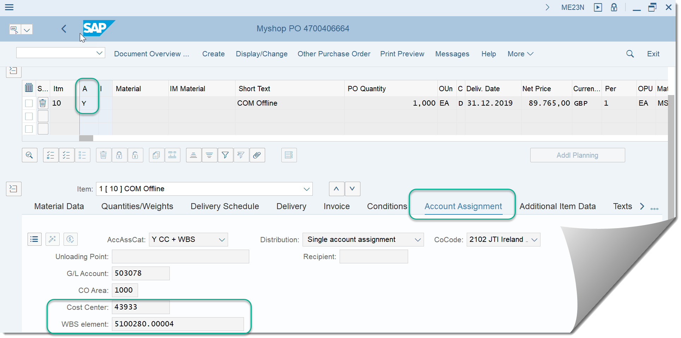


Purchase Orders
Within a Purchase Order there is an Account Assignment Category that determines the Accounts related postings will be posted to. Account Assignment Y has been created for postings to WBS Elements. When selected for line items the mandatory fields for Cost center and WBS Element appear in the Account Assignment tab for that line item and must be populated

Slide 4
Course Structure
Introduction to WBS
WBS Projects
Postings to WBS
WBS Costs & Reporting
Reporting

Slide 5
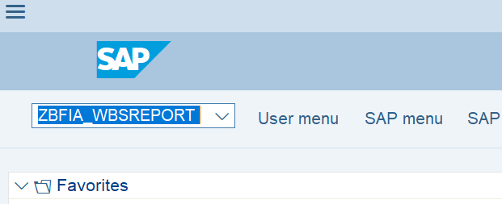
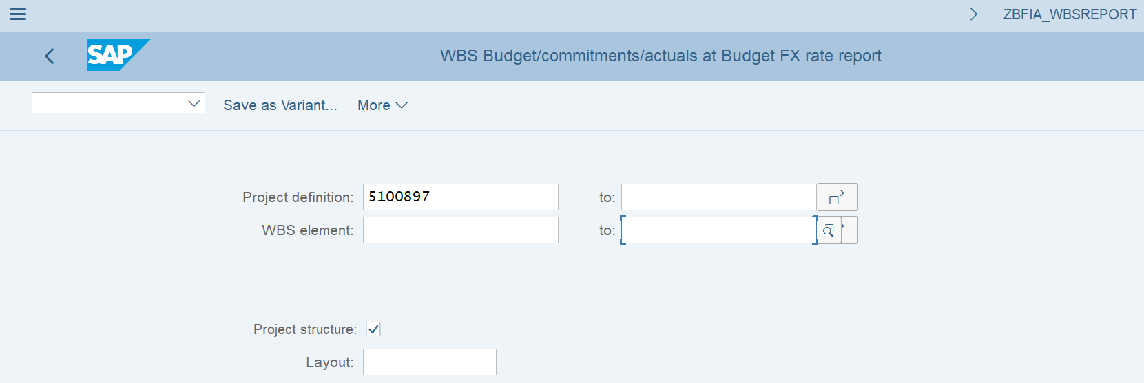
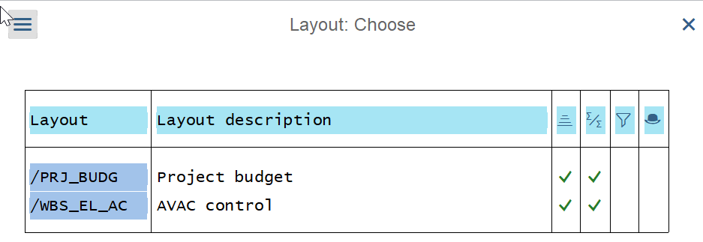
Budget Report - ZBFIA_WBSREPORT
The report can be used for the following purposes:
To display the remaining budget on a “budget holder” (a WBS project or a WBS element, depending on if you have distributed the budget)
To display the budget amount used for availability control
Go to transaction ZBFIA_WBSREPORT in SAP
On the selection screen you can either enter a project definition number (you can also run for more than one project) or for a WBS element (you can also run for more than one element)
If you execute the report for a project, you can also activate the option ‘Project structure’. In this case not only the values for a project but also for all WBS elements from this project will be displayed
There are many columns available in the report to meet the above requirements, and therefore we recommend that you use the below layouts when viewing the report:
/PRJ_BUDG – to display the budget on a “budget holder”
/WBS_EL_AC – to display the budget used for availability control for a WBS element

Slide 6

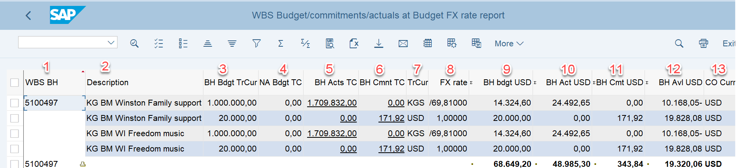
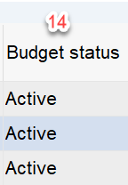
Budget Report – Budget Holder
WBS Budget Holder: The project (or WBS element) which holds the budget
Description: Description of each WBS for clear recognition
Budget of a budget holder in transaction currency: The total approved budget for the budget holder, displayed per budget transaction currency which is assigned to a particular WBS budget holder (in this case - project). For each separate budget transaction currency there will be a separate line in the report
Not approved budget in Transaction currency: The budget amount(s) on WBS budget holder (in this case - project) per budget transaction currency which has not yet been released/approved by Finance. For each separate budget transaction currency there will be a separate line in the report
Budget holder actuals in transaction currency: Actual costs in transaction currency posted to WBS elements located below the budget holder (in this case – project) within the structure. For each separate transaction currency with actuals there will be a separate line in the report. To view the line items of the underlined figure it is possible to drill down to CJI3 report (actual line items report) unless the value is zero as specific layouts are used to suppress line items with zero value
Budget holder commitments in transaction currency: purchase commitments in transaction currency posted to WBS elements located below the budget holder (in this case – project) within the structure. For each separate transaction currency of commitments there will be a separate line in the report. To view the line items of the underlined figure it is possible to drill down to CJI5 report (commitments line items report) unless the value is zero as specific layouts are used to suppress line items with zero value

Slide 7
Budget Report – Budget Holder
Transaction Currency: The document or transaction currency for budget / actuals / commitments transactions
FX Rate: The FX rate which is used when comparing the WBS budget and any actuals or commitments. The FX rate type and date are selected when the budget is assigned to the project
Budget of a budget holder at FX in USD: The full approved budget from the budget holder (in this case – project) translated to USD using project FX rate
Budget holder actuals at FX in USD: Actual costs from the budget holder (and WBS elements below) translated to USD using project FX rate
Budget holder commitments at FX in USD: Commitments from the budget holder (and WBS elements below) translated to USD using project FX rate
Budget holder Available at FX in USD: Total for all lines represents the remaining budget that is available for expenditure after deduction of all actuals and commitments
CO currency FX: Controlling area currency, i.e. USD which is used as a target currency for all translations and comparisons
Budget Status: Blocked (set in all the cases when approved amount is by some reason higher than originally proposed) or Active (set in all other cases, i.e. when the system will check if there is available budget or not). ). This gives visibility of budget control checks during document posting ensuring that when budget approved is higher than originally assigned there is an indication that it is blocked. This can be resolved by removing the extra budget and approving.

Slide 8
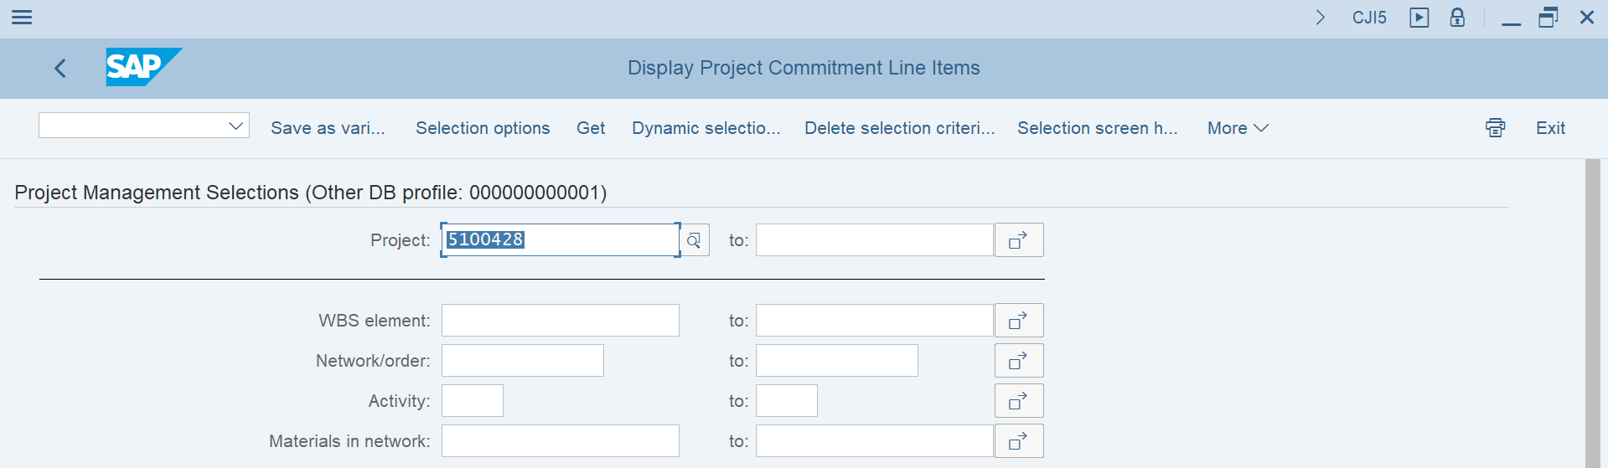
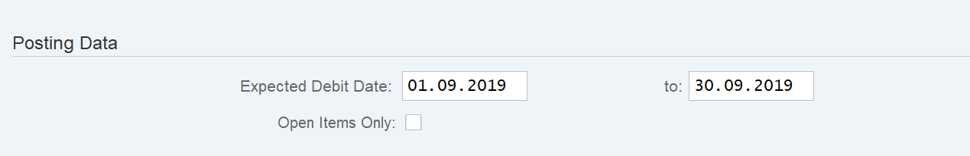
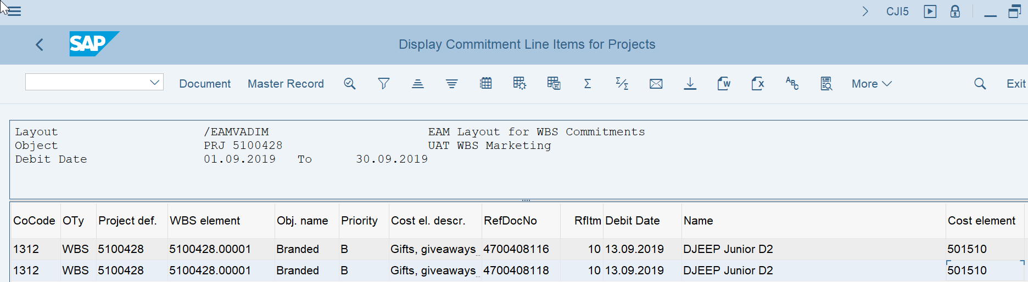
CJI5 – Display Project Commitment Line Items
The report is used to display all commitment costs posted to WBS Projects and/or WBS Elements arising from POs which have not yet had a Goods Receipt.
As mentioned in the Budget report slide previously, users can drill down to display CJI5 report or you alternatively users can go directly to transaction CJI5 in SAP
On the selection screen you can either enter a project definition number (you can also run for more than one project) or for a WBS element (you can also run for more than one element)
Commitments are based on the Expected Delivery date of the line item in the Purchase Order. It is therefore important to note that an adequate date range must be entered when executing CJI5 in order to capture all commitment line items!

Slide 9
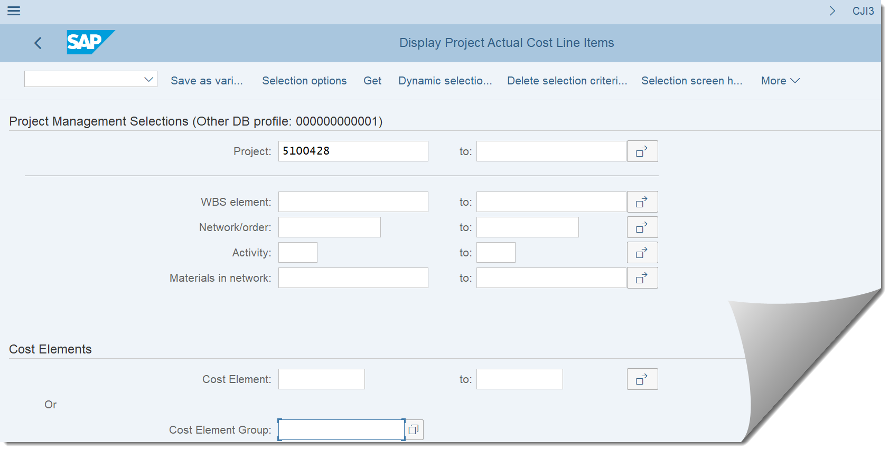
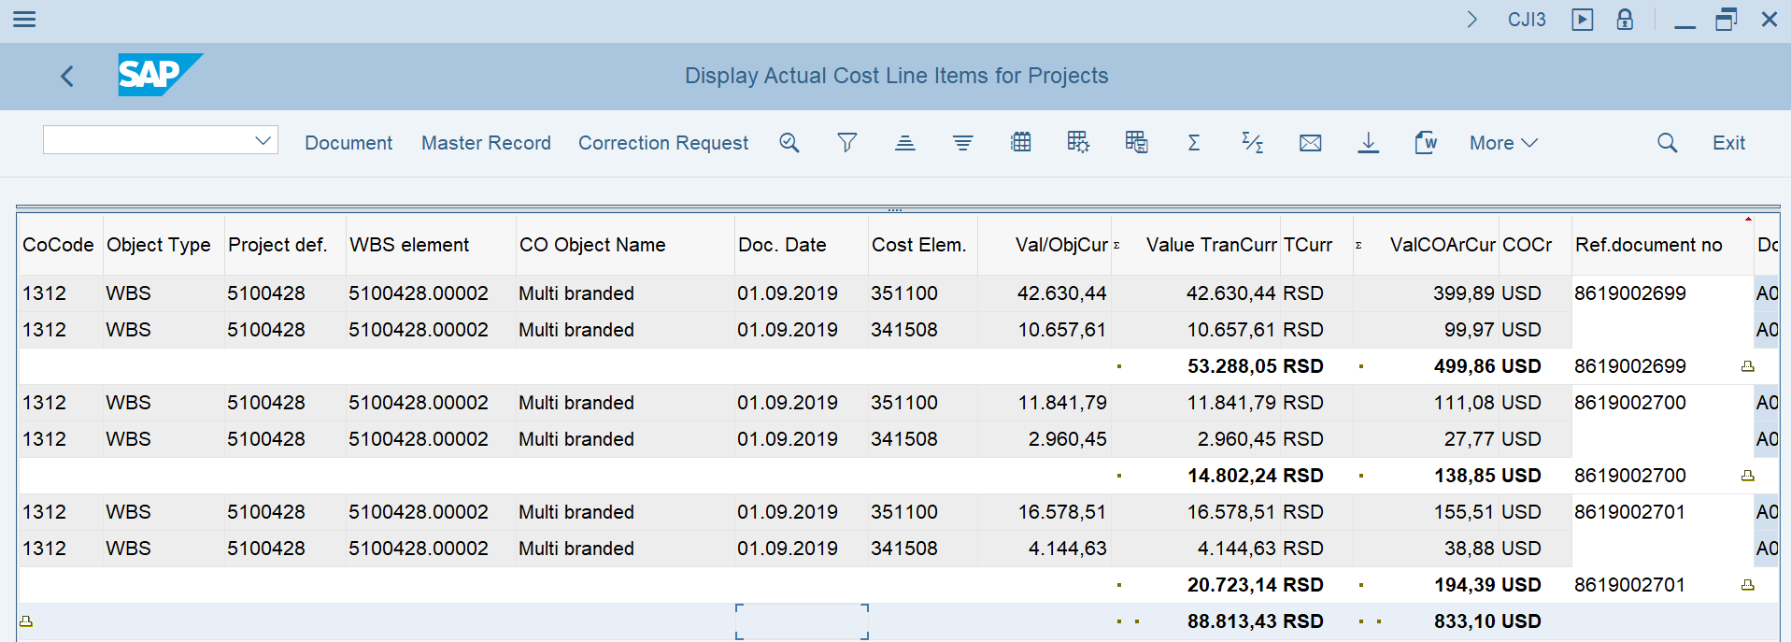
CJI3 – Display Project Actual Cost Line Items
The report is used to display all actual costs posted to WBS Projects and/or WBS Elements
As mentioned in the Budget report slide previously, users can drill down to display CJI3 report or you alternatively users can go directly to transaction CJI3 in SAP
On the selection screen you can either enter a project definition number (you can also run for more than one project) or for a WBS element (you can also run for more than one element)

Slide 10

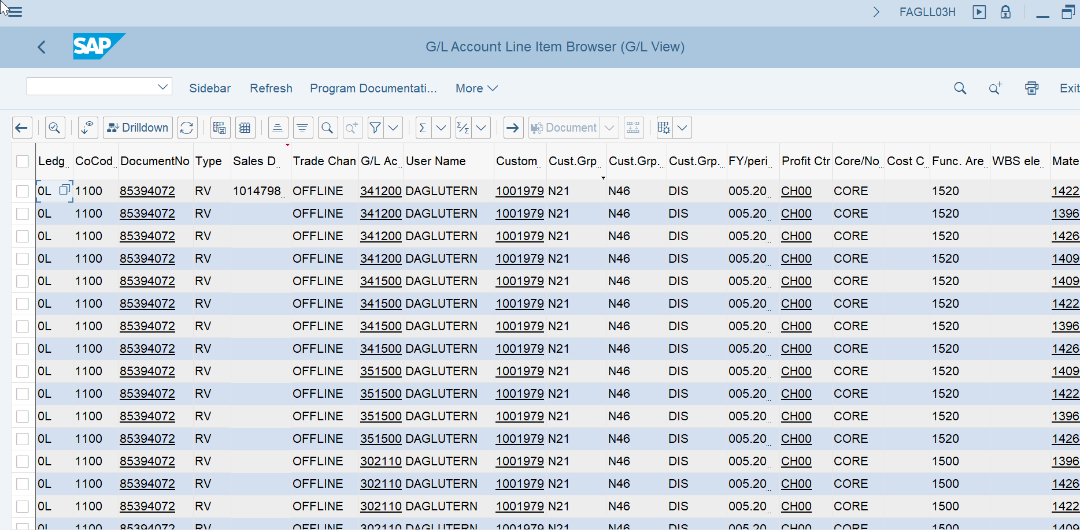
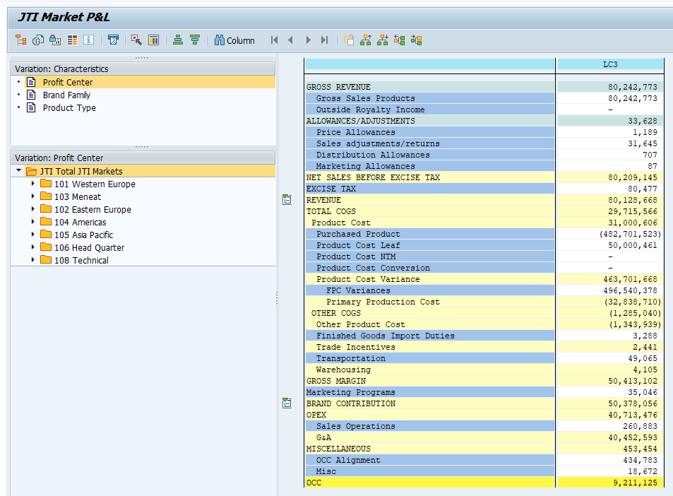
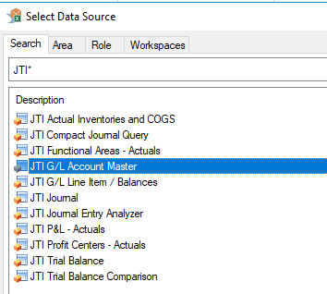

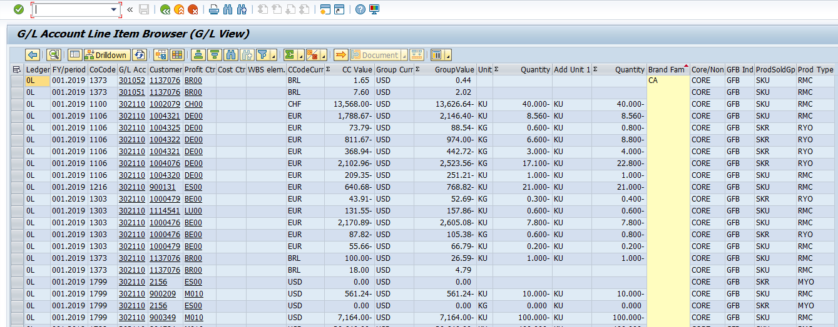
S/4 Instant Operational Reporting - 3 key Options
Instant
1. GL Line Item Browser FAGLL03H
2. Market P/L (GR55 – Z4PL)*
3. CDS Views/Queries (AFO)
Instant S/4 Market P&L – aligned with GPM & GPM+ structure - (will include the key dimensions like Brand Family and Product Type)
Instant S/4 Market P&L – aligned with GPM & GPM+ structure - (will include the key dimensions like Brand Family and Product Type)
CDS Views - SAP Analysis for Office queries (AfO). All dimensions present in the Universal Journal have been identified as relevant & to which we want have instant visibility on.
CDS views standard queries**
Set of predefined workbooks
Drill down to FAGGLO3H
NB! Save the work books in a local folder
* For Go Live Jan 2020 Market P&L will be seen through GR55 transaction with its traditional format. Option to bring AFO into S/4 will be evaluated post Go Live 2020
** Market P&L Lines – JTIO mapping some subject to changes

Slide 11
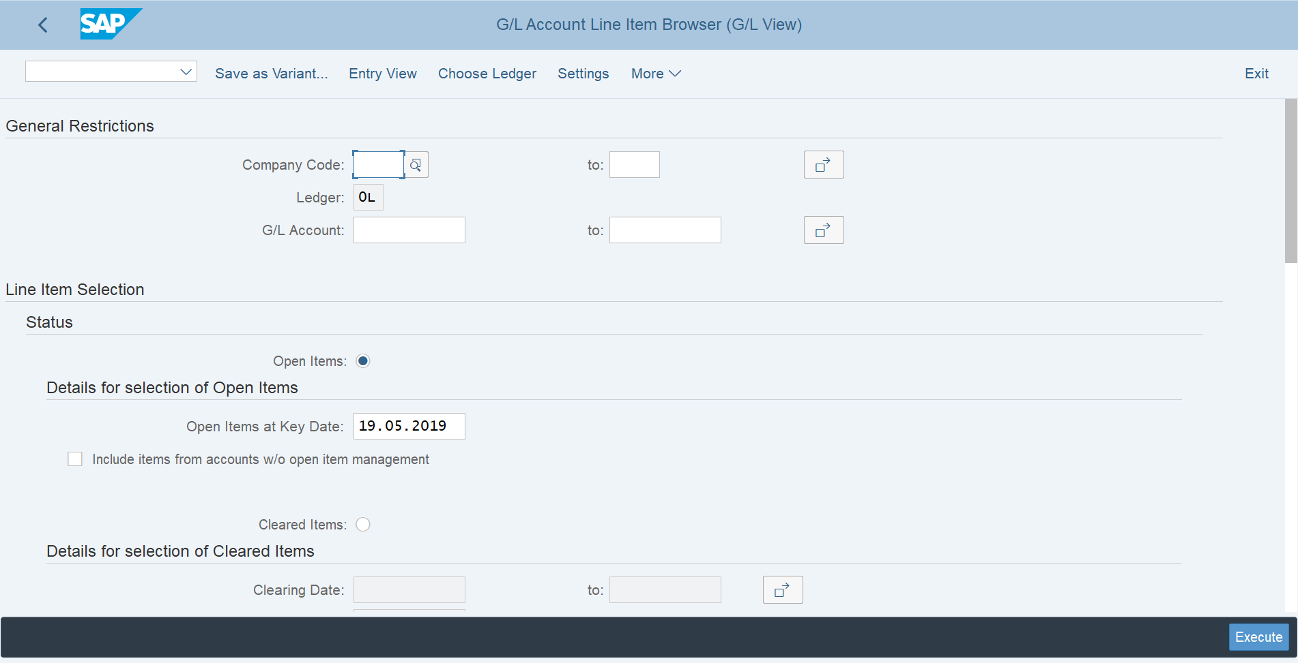
GL Line Item Browser FAGLL03H
FAGLL03H is the S4 version of R3 legacy GL Line Items report FBL3N The front end should be very familiar to those who have used FBL3N

Slide 12
. GL Line Item Browser FAGLL03H
Drill down from GR55 will be into the default layout of the GL Line Item Browser report
This can be accessed on its own via Tcode FAGLL03H and will be familiar to those who use FBL3n
Screenshot shows few dimensions but will display all ACDOCA dimensions
We will create a default layout which can then be tailored

Slide 13
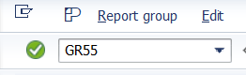
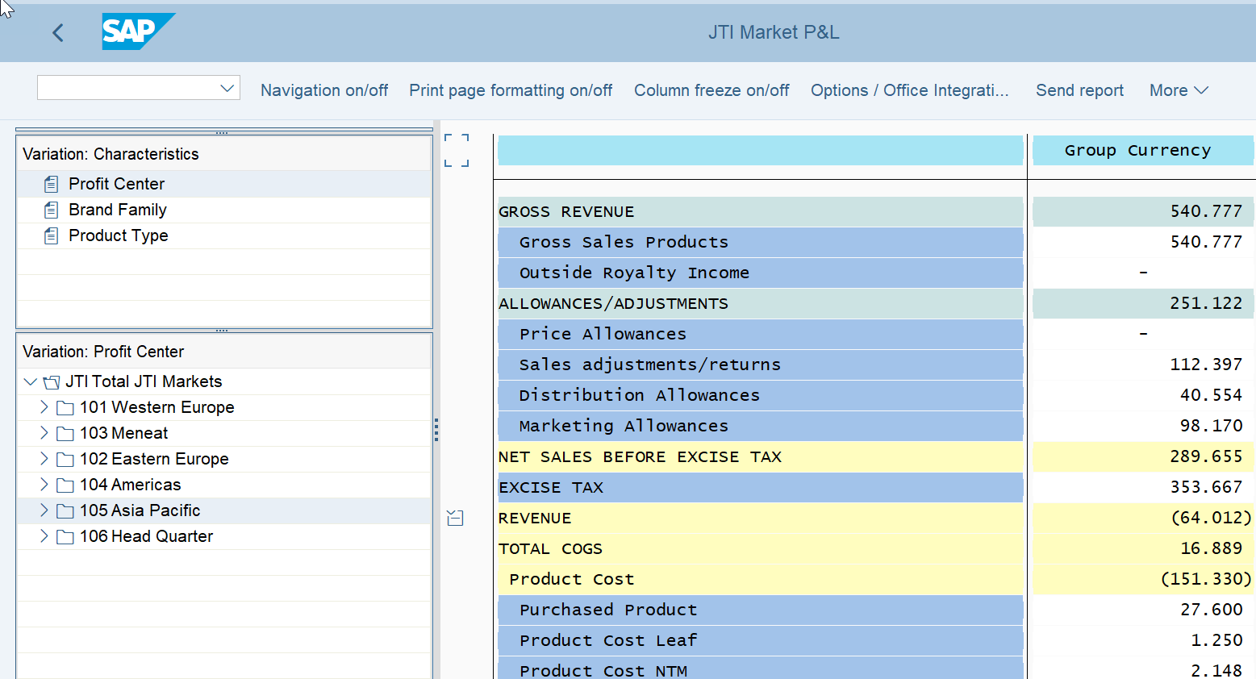
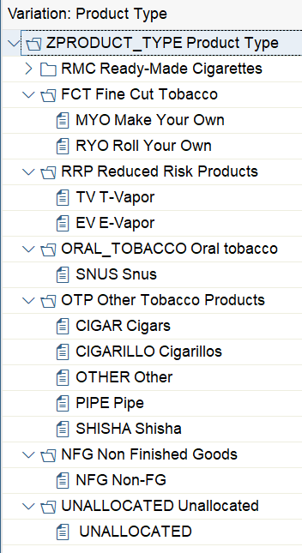
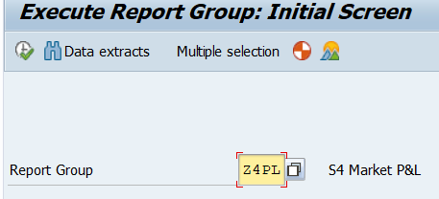
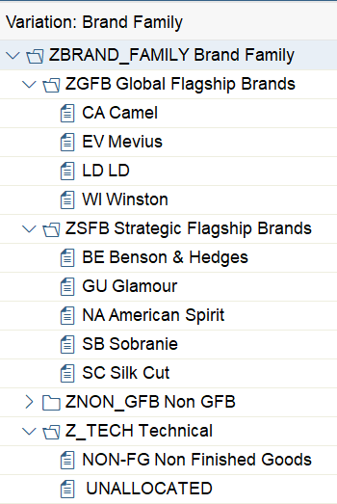
S/4 Market P&L (GR55 – Z4PL)
Tcode
Report Group
Dimensions
Profit Center / Brand Family / Product Type
Dimensions are static and can help spot unallocated postings. For dynamic reports it is recommended to use CDS Query functionality (Analysis for Office)
Drill down of P&L lines to FAGLL03H. To note that drill down will show all postings to the specific JTIO which can result in a different total of the Market P&L in case JTIOs have multiple Functional Areas as it is also currently the case.
Example *
2
1
2
3
2
1
* For Go Live Jan 2020 Market P&L will be seen through GR55 transaction with its traditional format. Option to bring AFO into S-4 will be evaluated post Go Live 2020 . Market P&L Lines subject to changes.

Slide 14
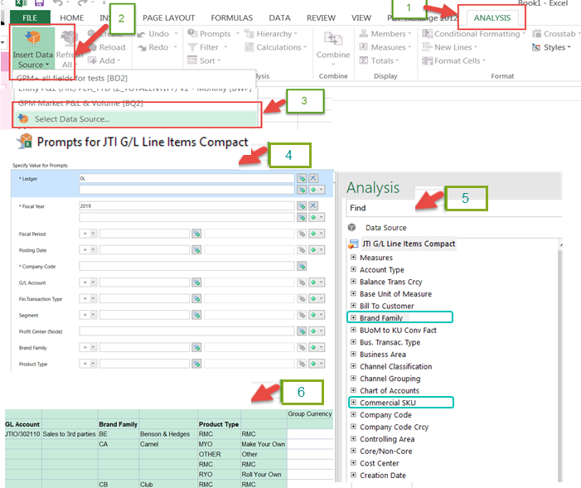
S/4 CDS Query functionality with AFO (excel)
CDS views (Core Data Services) are built on existing S/4 database tables and views, to provide efficient way of data modelling.
“Analysis for Office” (AO) is used similarly to how BW / GPM reports are ran through excel. Reports / workbooks can be saved and refreshed.
“Slice and Dice” functionality by selecting in a dynamic manner FI&CO dimensions to meet specific needs.
Selection criteria, characteristics and key figures are being enhanced to meet JTI reporting requirements in the following SAP S4 HANA standard CDS views:
G/L Account Balance Cube
G/L Account Balance Comparison Cube
Accounting Journal Entry Item Cube
G/L Line Items Cube
GL Account Master Cube
Enhanced views will allow end users to access and analyze transactional data at both account balance and line item levels in single and multiple ledgers including its comparison.

Slide 15
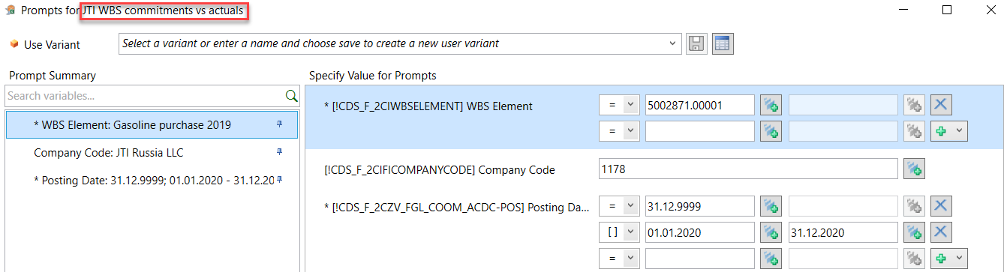
JTI WBS Commitments vs Actuals
Business Requirement: to have a single Query for both WBS commitments and actuals
This Query is built to provide Commitments and Actuals for selected WBS Element(s) in one report (sort of compilation of CJI5 WBS Element commitment and FAGLL03/FAGLL03H GL line item reports)
The Query is available to all Users who have access to CJI5 report
WBS Element: mandatory field. Specify single or multiple WBS; range or a mask (e.g. 50028*)
Company Code can be specified to restrict further selection criteria
Posting Date: at least one of the 2 rows should be populated - 31.12.9999 is defaulted – required to pick CO Commitment items from database. Leave as is if you require CO commitment data to be picked - second line is for GL line item actuals (single date or a range)

Slide 16
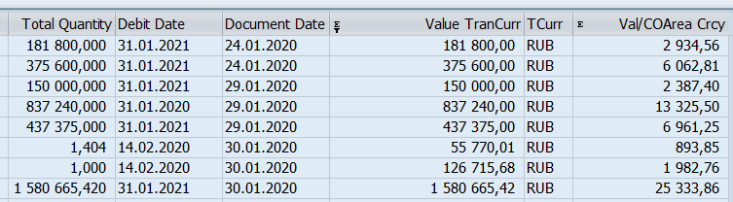
JTI WBS Commitments vs Actuals: key figures
As the Query compiles both Commitments and Actuals, the key figures are also split between those relevant for Commitments and those relevant for Actuals:
Actuals
Commitments
Note! Actuals do not include Period-End allocations and settlements by design, in order to avoid zero actuals for fully settled WBS elements
Report CJI5 for WBS Commitment Line Items

Slide 17
JTI WBS Commitments vs Actuals: characteristics
The Query contains a wide range of Characteristics relevant for Commitments, Actuals or both. Where characteristic is only valid for Commitments or Actuals, the corresponding line would show only Commitments of Actuals key figures and vice versa. For example: for Expected Debit Dates (commitment specific characteristic) report would show Commitments figures while Actuals would show zero amounts. Actuals figures would be shown for the line with empty Expected Debit Dates (which is obvious, as such information doesn’t exist in GL Line item reports)
Commitments
Actuals

Slide 18
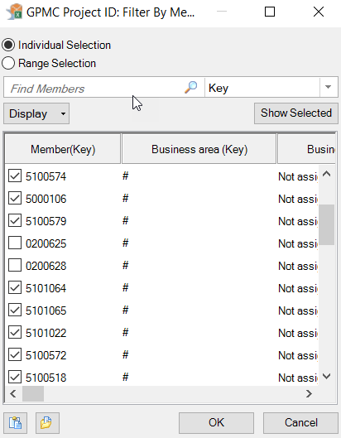
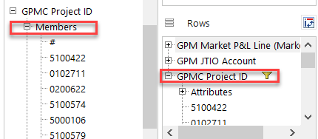
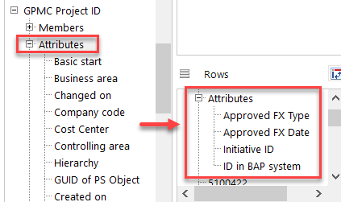
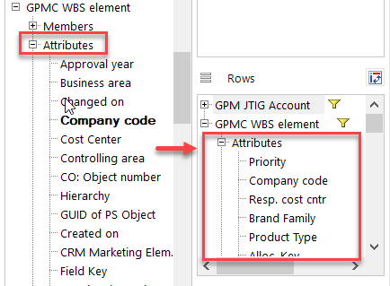
GPM05 – Display WBS features Project ID
“Analysis for Office” (AO) is used for BW / GPM reports are ran through excel. Reports / workbooks can be saved and refreshed.
WBS Features are available as navigable objects in the Design Panel. They can be found under ‘GPMC’ objects as related to costs (C)
If project ID is added as an object, the following features are available:
Filtering either by:
Using ‘Members’ or
Double clicking on GPMC Project ID added as a row/column
Adding Attributes, for example:
FX date for budget control
FX rate type for budget control
BAP/MEMO number
Initiative ID
Filtering
Adding Attributes

Slide 19
GPM05 – Display WBS features WBS Element
WBS Element can also be added as an object, which also allows user to filter as with Project ID by using members or double clicking on GPMC Project ID added as a row/column. There are useful WBS Element Attributes, for example:
Priority
Company Code
Responsible/Requesting cost centers
Brand Family
Product Type
Allocation key
Hub
Former IO number – this will be applicable for migrated WBS elements only
Initiative ID
By selecting such attributes, you can compare them with what was posted in SAP to validate:
If brand family/product type from the WBS element were inherited in the posting
If Allocation key in WBS element resulted in distribution to correct brand family/product type
The cost centers used in the posting and if they were inherited from the WBS element or a different one used
You can also view the previous IO number for migrated WBS elements, which will allow you to track the YoY expenditure related to the same IO
WBS Element Attributes:

Slide 20
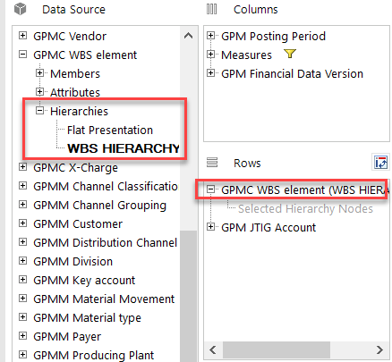
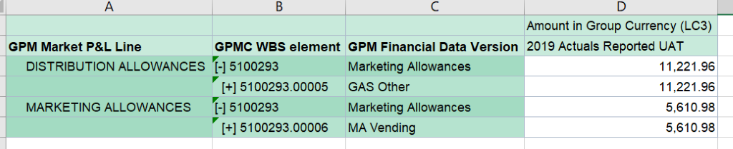
GPM05 – Display WBS Structure
The WBS Project Structure can be displayed in GPM05 by selecting GPMC WBS element, expand the selection criteria and select Hierarchies:
This allows us to view the costs in the WBS project in a hierarchical structure with all the nodes. For a particular WBS element it is an alternative to using CJI3 or FAGLL03H as long as G/L accounts are added into the view
WBS Element Structure:

Slide 21
Exercises
Exercise 1.9 & 1.10:
CJI5- Display Project Commitments Line Items
CJI3- Display Project Actual Line Items

Slide 22
Exercises
Exercise 1.13:
CJ20N – Project Builder – Set WBS Status to Technically Complete

