Slide 2
PROFITABILITY ANALYSIS

Slide 3

Overview – About this course
Course Objectives
This course provides information on:
Prepare Power Users for delivering this training materials to end-users
Refresh knowledge of Power Users in the understanding of Profitability Analysis including:
CO-PA using dimensions, characteristics and derivation rules
Changes made to Market P&L and the new reporting features of S/4 Hana as well as reporting methods.
Target Audiences
This course is mandatory for:
ALL Power Users for Controlling Profitability Analysis
FP&A Community
Learning Guide
Prerequisite training:
Finance Fundamentals Overview
Finance Fundamentals
Related training:
Chart of Accounts (CoA)
CO Cost Man. – CC and Allocations
CO Controlling WBS Elements & Projects – OPEX
CO Controlling WBS Elements & Projects – ABC
PC - Product Costing
R2R Guidelines

Slide 4


Controlling (CO): Profitability Analysis
Structure of the course
S4F-ERP
Profitability Analysis: Intro S/4
PROJECT
Profit Center Reorganization
Standardization of Dimensions
Market P&L
CONTENT
Reporting Capabilities
Simplify, Standardize, Accelerate

Slide 5
Profitability Analysis Chapter/Topic | Page No.
Profitability Analysis At A Glance ---------------------------------------- | 6
Business Rationale for Changes ---------------------------------------- | 23
The 3 Building Blocks ---------------------------------------- | 25
Profit Center Reorganization ---------------------------------------- | 27
Cost Center Standardization ---------------------------------------- | 33
Standardization of Dimensions ---------------------------------------- | 35
New Market P&L ----------------------------------------
Changes to Market P&L ---------------------------------- | 70
Simplification of Revenue Lines ----------------------------------- | 75
New Allowances and Marketing Investment Framework ---------------------- | 79
COGS Transparency in Cost Component Split --------------------------- | 83
Granularity behind P&L Lines ---------------------------------------- | 93
Volume Conversion ---------------------------------------- | 102
Reporting Capabilities ----------------------------------------- | 110
Reporting Overview ---------------------------------------- | 110
SAP GUI Reports ---------------------------------------- | 115
S/4 CDS Views (Analysis for Office) ---------------------------------- | 122
Backup Slides ------------------------------------------------------ | 140
Acronyms* used in Controlling and other modules --------------------------- | 141
S4F-ERP
PROJECT
CONTENT
Simplify, Standardize, Accelerate

Slide 6

Course Structure
Introduction to Profitability Analysis CO-PA
Profitability Analysis: Intro to S/4
Profitability Analysis Structure
Profit Center Reorganization
Profitability Analysis Master Data
Standardization of Dimensions
Profitability Analysis Derivation
Market P&L
Profitability Analysis Value Flows
Reporting Capabilities

Slide 7
Profitability Analysis (CO-PA) Purpose
Profitability Analysis (CO-PA)
The applications Profitability Analysis (CO-PA) provides effective tools for analyzing profitability and forms the basis performance management.
The application CO-PA lets you analyze the profitability of segments of your market - structured according to products, customers, orders, and summarizations of these and other characteristics - and organizational units such as company codes or business areas, in JTI we use Profit Centers.
The aim is to provide your sales, marketing, planning, and management organizations with decision-support from a market-oriented viewpoint.
The data can be analyzed by period, or by order or project.
S/4 will also provide embedded analysis for office queries to support real-time «slice and dice» functionalities in management reporting.

Slide 8

Profitability Analysis (CO-PA) Purpose
CO-PA
Answers questions such as:
What are my top performing products in different Markets?
How have sales and brand contribution margins
changed in the last period for certain
Brands and Product Types?
How much are we investing in Trade Programs across different Markets?

Slide 9

Profitability Analysis (CO-PA) Overview
FACTORY
MARKET
Key Sales Figures
Revenues, Cost of Sales…
Market Segments
Product,
Product Type, Customer, Brand Family, Distribution Channel…
SD
CO-PA
Billing Document

Slide 10
Course Structure
Introduction to Profitability Analysis CO-PA
Profitability Analysis Structure
Profitability Analysis: Intro to S/4
Profit Center Reorganization
Profitability Analysis Master Data
Standardization of Dimensions
Profitability Analysis Derivation
Market P&L
Profitability Analysis Value Flows
Reporting Capabilities

Slide 11
Organizational level in S/4 HANA - Finance
JTI S/4HANA System
(PRD Client 900)
A client is a separate unit of SAP with its own set of tables, master data and documents.
Group CoA JTIG is used for group consolidation purposes.
JTI uses a single 6-digit range Operational CoA (JTIO) for financial postings in S/4. It is assigned to all entities.
Every JTIO is assigned to a JTIG account, and an Alternative account if an entity uses a Country CoA.
Reporting can be done at all levels of CoAs, i.e. by JTIO, JTIG or Country CoA, provided appropriate Financial Statement Versions are created using those accounts.
Group Chart of Account: JTIG
Country CoA
(Alternative Accounts)
Operational CoA: JTIO
Operating Concern 1001
An Operating Concern is the valuation level for Profitability Analysis (CO-PA).
All JTI entities belong to Operating Concern 1001, through company code assignment to controlling area, which is subsequently assigned to this operating concern.
Cost Center Standard Hierarchy:
JTI
Profit Center Standard Hierarchy: JTI
A controlling area represents a closed system used for cost accounting purposes. JTI uses only one controlling area “1000”.
Profit Centers (PC) and Cost centers (CC) are created within a controlling area.
Every Cost Center is assigned to a Profit Center.
The standard hierarchies of PC and CC are tree structures representing all CCs and PCs belonging to a controlling area from a Controlling perspective.
Controlling Area 1000
Company code
2101
JTI Gallaher
Company code
1106
JTI GMBH
Company code
1799
JTI SA
Company code
xxxx
A Company Code is the smallest organizational unit of external accounting for which a complete, self-contained set of accounts can be created.
This includes the entry of all transactions that must be posted and the creation of all items for legal individual financial statements, such as the balance sheet and the profit and loss statement.
All company codes in JTI is assigned to the same controlling area and use the same operational CoA.
11

Slide 12
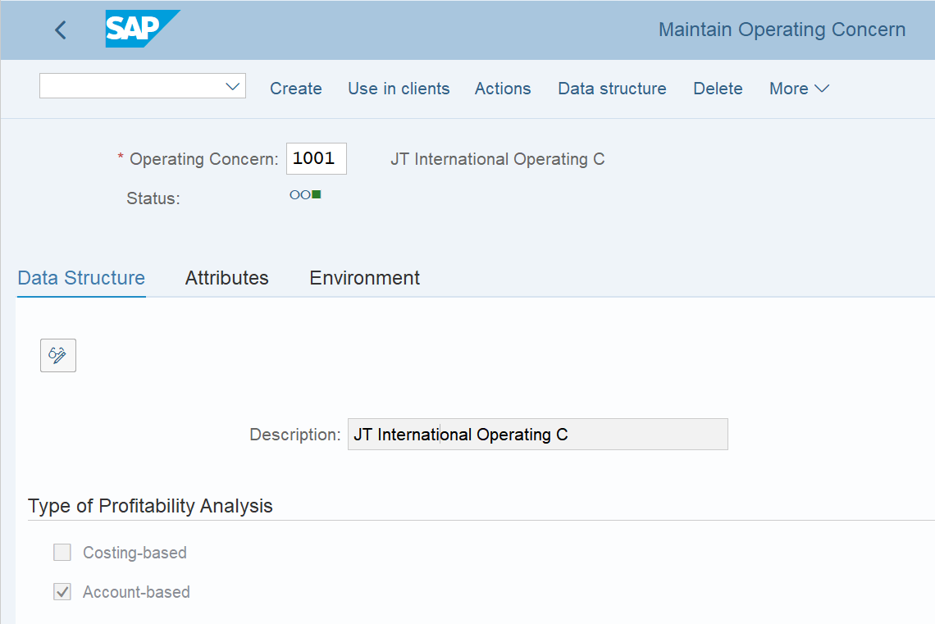

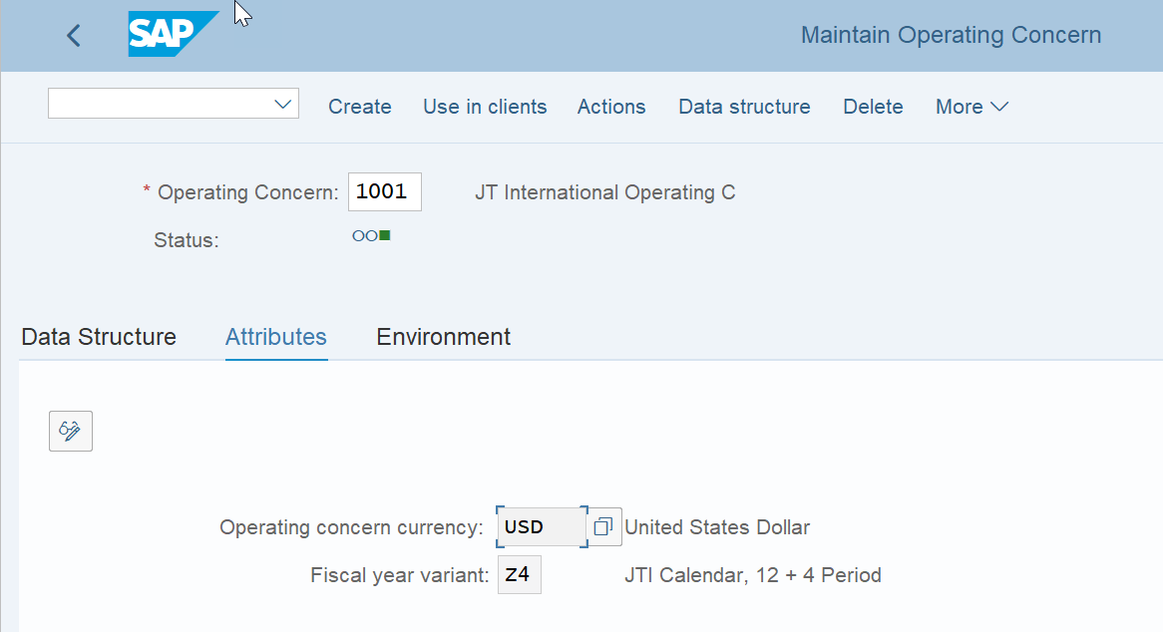
Profitability Analysis – Operating Concern
• The Operating Concern contains a structure composed by selected data objects (Characteristics and Cost Elements) that will be extracted from specific SAP Tables and that are part of the profitability segments
• Controlling Area(s) (JTI use one controlling area – 1000). Having one Chart of Accounts allows the use of one Controlling area which allows better flow of costs across different company codes). A controlling area needs to be assigned to an Operating Concern to enable CO-PA to work (1001 for JTI).
The currency of the Operating concern is set as Master Data
The Fiscal year variant controls parameters for a financial year, such as managing financial accounting year and posting period variants to open and close posting periods

Slide 13

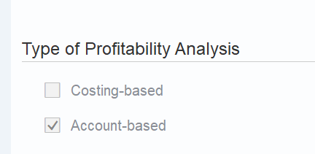

Profitability Analysis – Changes in CO-PA
In ECC JTI used a “Costing-based” CO-PA approach. But this is changing!! This approach:
Groups Revenues and costs based on Value Fields and Costing-based valuation approaches, both customized to fit JTI business
Was recommended for ECC but with move to S/4 HANA not many improvements have been made and is now outdated approach (eg. Tcodes KE24 and KE30)
Moving forward with S/4 HANA JTI are changing to an “Account-based” CO-PA. This is in part due to the improvements made as part of the move to S/4 HANA offered by SAP (eg. Tcode GR55)
This approach offers
Reporting fully based on costs and revenues elements
A permanently reconciled profitability report with Financial Accounting (Tcode FAGLL03H)
OLD
Tcodes: KE24 & KE30
FBL3N
NEW
New Tcode: GR55 & FAGLL03H (line item)

Slide 14
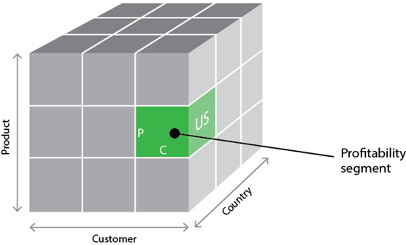
Profitability Analysis – Characteristics and Cost Elements
Characteristics:
Provide the classification of the data and describe it. e.g.Customer, Product, Region…
Are dimensions to analyze the operating results and perform differentiated sales and profit planning/reporting
Can be fixed or user defined characteristics
Cost Elements:
Store the base quantities and amounts for reporting and represent the structure of the costs and revenues
Can either be highly summarized (representing a summary of cost element balances) or highly detailed (representing just one part of a single cost element balance)
Characteristics | ID
Sales Order | 1015975925
Prod. Group Sold | SKU
Brand Family | SC
Customer | 1095727
Sales District | Ireland
Cost Elements
Revenue | 900
Allowances | 100
COGS | 600
Revenue
Allowances
COGS

Slide 15
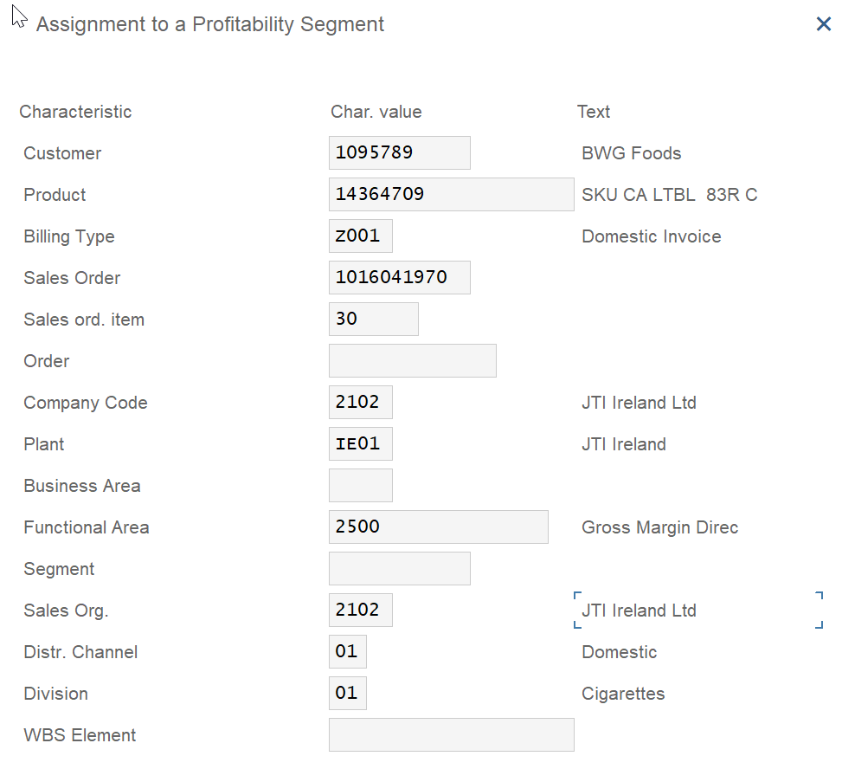
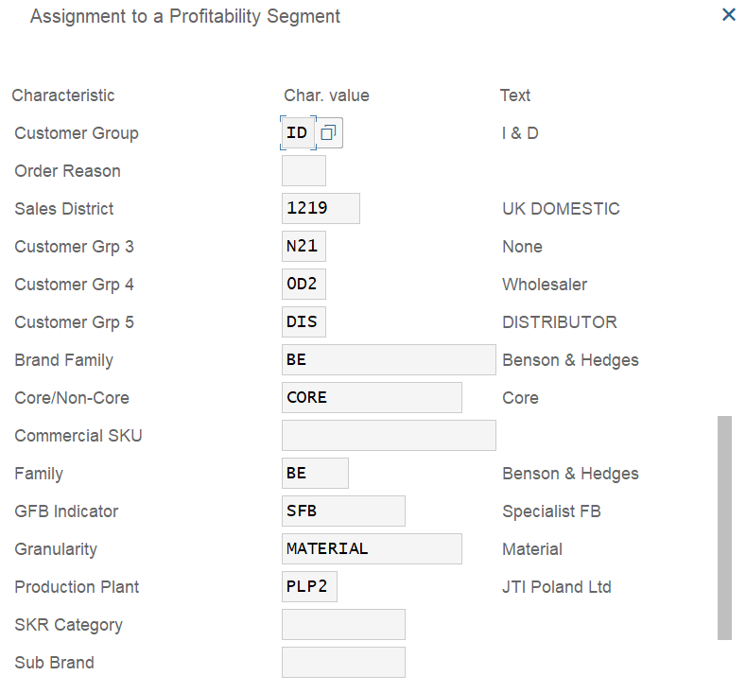
Profitability Analysis – Profitability Segment
Profitability Segments:
A profitability Segment represents a fixed combination of Characteristic values, e.g. Ireland & Camel
Is the object within Profitability Analysis to which costs and revenues are assigned
..and more
IE
Profitability
Segment

Slide 16
Course Structure
Introduction to Profitability Analysis CO-PA
Profitability Analysis Structure
Profitability Analysis: Intro to S/4
Profit Center Reorganization
Profitability Analysis Master Data
Standardization of Dimensions
Profitability Analysis Derivation
Market P&L
Reporting Capabilities
Profitability Analysis Value Flows

Slide 17
Profitability Analysis (CO-PA) Master Data
It is preferable to leverage as much as possible on standard transactional processes that have embedded Master Data (dimensions) at the source
Master Data: Using the SAP master data (Customer, Product, ..) or CO‑PA derivation rules, the system can derive additional characteristics based on the ones entered manually or transferred from primary transactions. A combination of characteristic values forms a multidimensional profitability segment for which you can analyze profit by comparing its costs and revenues
Flows of Actual Values: The flows of actual values represent the most important source of information in CO‑PA. You can transfer both sales orders and billing documents from the Sales and Distribution (SD) application component to CO-PA in realtime. In addition, an interface program is available to let you transfer external data to the R/3 System such as from Payroll systems. You can also transfer costs from cost centers, orders and projects, as well as costs and revenues from direct postings (for example, G/L account postings in FI) or settle costs from CO to profitability segments.

Slide 18
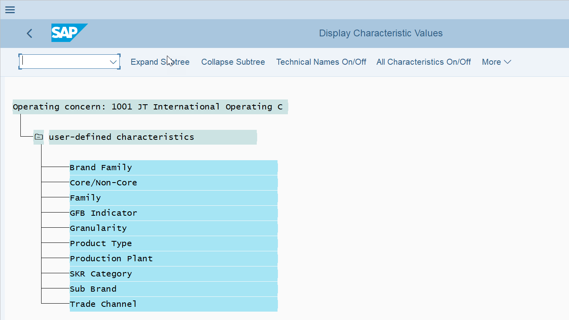
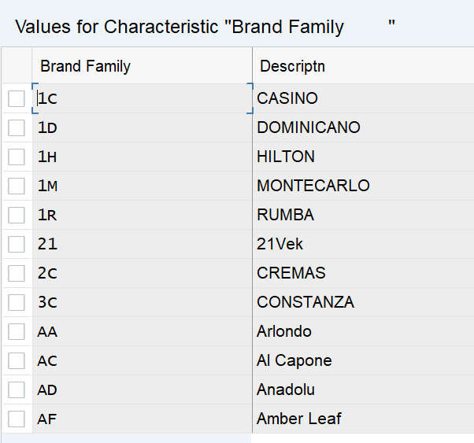
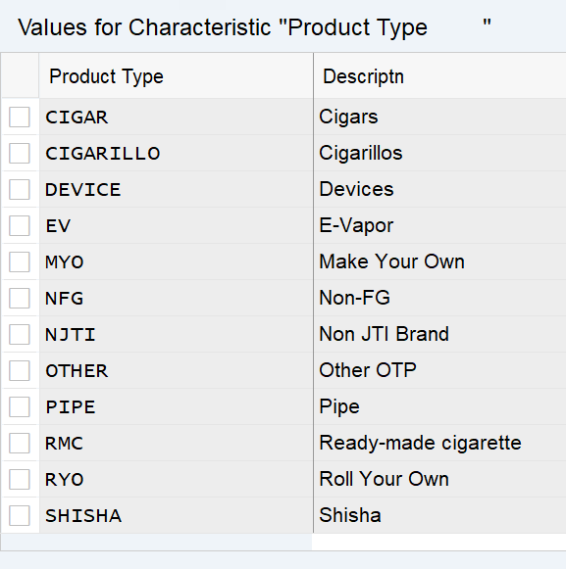
Profitability Analysis – Master Data
Master Data: In Profitability Analysis, Master Data provide the fundamental data and content
within the structures you have already determined by Characteristics and Cost Elements.
E.g. Background configuration tables in S/4 maintained by BTS

Slide 19
Course Structure
Introduction to Profitability Analysis CO-PA
Profitability Analysis Structure
Profitability Analysis: Intro to S/4
Profit Center Reorganization
Profitability Analysis Master Data
Standardization of Dimensions
Profitability Analysis Derivation
Market P&L
Reporting Capabilities
Profitability Analysis Value Flows

Slide 20







Profitability Analysis – Derivation
Using the SAP Master Data (Customer, Product, …) or CO‑PA derivation rules, the system can derive additional characteristics “automatically” based on the ones entered manually or transferred from primary transactions
From a few key input objects more dimensions are derived automatically
INPUT
OUTPUT
Brand Family
Product
BF
Brand Family
Product Type
GFB Indicator
Customer Group
Sales District
Trade Channel
Product (material)
Customer
Sales Order Type
P1
Brand Family
Product Type
GFB Indicator
Customer Group
Sales District
Trade Channel
Product (material) | P1
Customer | C1
Sales Order Type | S1
Product Type
PSG
GFB Indicator
GFB
Customer
C1
CG
Customer Group
Sales District
Sales Order Type
SD
S1
Trade Channel
TC

Slide 21
Course Structure
Introduction to Profitability Analysis CO-PA
Profitability Analysis Structure
Profitability Analysis: Intro to S/4
Profit Center Reorganization
Profitability Analysis Master Data
Standardization of Dimensions
Market P&L
Profitability Analysis Derivation
Reporting Capabilities
Profitability Analysis Value Flows

Slide 22
Profitability Analysis – Value Flows
Production Variances - Settlement
Financial Accounting
Cost Element Accounting
Production
Sales & Distribution (SD)
Profitability Analysis
CO-PA
(ACDOCA Table)
Market P&L Profit Center
Billing
Tcode: GR55 (Z4PL)
Tcode: FAGLL03H (line item)
Product Cost
Cost of Goods Sold
Overhead Management
Allocations/Settlements
Direct FI Posting

Slide 23
Course Structure
Rationale for changes in CO-PA
Profitability Analysis: Intro to S/4
Profit Center Reorganization
The 3 Building Blocks
Standardization of Dimensions
Profit Center Reorganization
Market P&L
Cost Center Standardization
Reporting Capabilities

Slide 24
Business Rationale for Profitability Analysis focus areas
Rationalization of Profit Centers to support the strategic direction of Market FCF
Development of flexible profitability model for brand contribution
Improved analytical capabilities
Visibility of different marketing initiatives across Regions and Markets
Increased visibility in understanding drivers in COGS variances
Consistent view of brand portfolio for Finance & Commercial data
“One Language One view” across Marketing, Finance and GSC both locally, Regional and in HQ
Increasingly competitive global tobacco market, utilization of cash for new business opportunities
Standardised definitions of marketing investments and allowances and allocation of marketing investments
Standardize required SKU characteristics and subsequent view of JTI’s ‘Commercial SKU’ portfolio
Simplify current PC use with clear definitions and converge to SAP best practices
Consider profitability of Commercial SKU across JTI
Define standard approach and bridge Gap between Corporate and Market
Utilise SKU characteristics to provide Product type, Brand family,..
Link with OneData

Slide 25
Course Structure
Rationale for CO-PA changes
Profitability Analysis: Intro to S/4
The 3 Building Blocks
Profit Center Reorganization
Standardization of Dimensions
Profit Center Reorganization
Market P&L
Cost Center Standardization
Reporting Capabilities

Slide 26
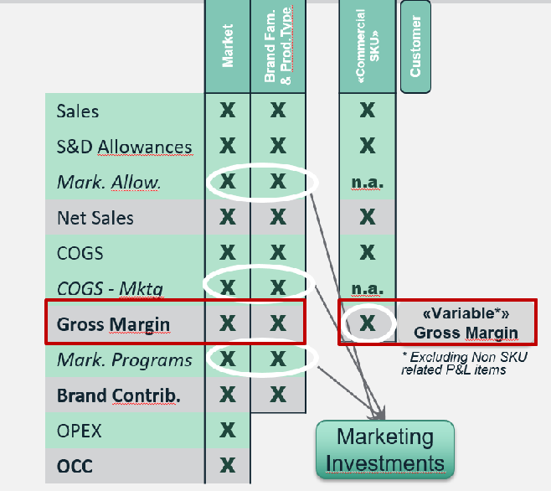
Profitability Analysis: 3 Building blocks in S/4
1. Profit Centers and Cost Centers to reflect the organization
2. Key Dimensions to support profitability analytics
3. Market P&L « slice and dice » potential & Reporting
Customers
Dimensions
Profit Centers
….
Market P&L
Cost Centers
Products
….
Markets

