Slide 1

Course Structure
Profitability Analysis: Intro to S/4
Profit Center Reorganization
Changes to Market P&L
Standardization of Dimensions
Granularity behind P&L Lines
Market P&L
Reporting Capabilities
Volume Conversion

Slide 2

What granularity do we expect behind P&L lines?
Objectives
Defined Corporate minimum standards & dimensions for P&L lines up to:
OCC → Market (Profit Center)
Gross Margin & Brand Contribution → Brand Family & Prod. Type granularity expected
“Variable Gross Margin” → Commercial SKU”
Introduction of “Variable Contribution Margin” for “Commercial – SKU” - reflecting “variable – product related P&L lines” foremost retrieved from sales data derived from SKU granularity!
Product Dimensions
Market
Br.Fam & Prod. type
C-SKU
JTI SKU
Variable Contribution Margin
X
X
X
X
Gross Margin & Brand Contribution
X
X
…….
OCC
X
Dimensions included in S/4H Profitability for posting
Commercial SKU is a new dimension and will be linked to each JTI Product (SKU). Until full consolidation of C-SKU postings will not be activated for the posting in Profitability Analysis.

Slide 3
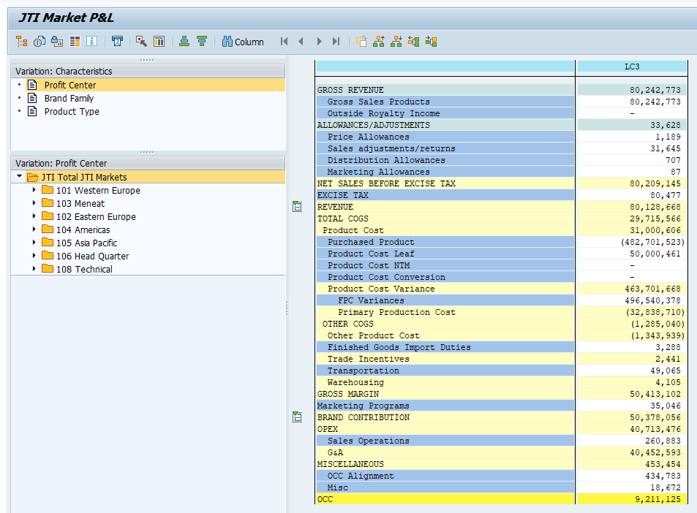
What granularity do we expect behind P&L lines?
Market
Br.Fam & Prod. type
GR55 – Z4PL
JTI SKU
C-SKU
derived
High Market P&L Structure
Gross Revenue | X | X |  | X
Price Distr Allow. & Sales adj. Allowances * | X | X |  | X
Mark. Allow. | X | X |  | n.a.
Excise | X | X |  | X
Revenue | X | X |  | X
COGS split | X | X |  | X
Trade Incentives | X | X |  | n.a.
Other/Transport/Wareh.. | X | X |  | X**
Gross Margin | X | X |  | X
Mark. Programs | X | X
Brand Contrib. | X | X
OPEX & Misc. | X
OCC | X
«Variable*» Contrib. Margin
* Excluding Non SKU related P&L items
Marketing Investments
** Br.Family & Prod.Type granularity for Other PC

Slide 4
Market P&L and granularity requirements
P&L Line | Auto Postings / Allocations | Manual Accounts
Gross Sales | Material | Brand Fam. & Prod. Type
Allowances excl. Marketing | Material | Brand Fam. & Prod. Type
Marketing Allowances | Brand Family & Product Type | Brand Fam. & Prod. Type
COGS | Material | Brand Fam. & Prod. Type
Transportation | Material | Brand Fam. & Prod. Type
Warehousing | Material | Brand Fam. & Prod. Type
Marketing Programs | Brand Family & Product Type | Brand Fam. & Prod. Type
OPEX | N/A | N/A
SKU level postings should be used when relevant for profitability analysis and when information is available. Brand Family and product type to facilitate Rev.Rec postings and other exceptions.
This category has strongest potential to leverage on SD flows and benefit from Material granularity, Manual posting not restricted to this lower level.
For Mark. Allowances (only BF&PT detail expected and not SKU)
Material flowing through from ML. Manual accounts set with higher granularity for Rev Rec and for Other COGS
Transportation for TM and WBS allow allocations to material
Warehousing to allocate to materials with WBs (exception for opex)
For Mark. Programs (only BF&PT detail expected and not SKU)
For OPEX no granularity requested on BF&PT and SKU
Table reflects Key settings of the Field Status settings of minimum requirements for Manual postings. Please look into link for latest settings. Also refer to details on Transportation & Warehousing for excpetions

Slide 5
What granularity do we expect behind P&L lines?
New enhancements in (SD) Order to Cash were re-phased to post Go-Live which has meant that a consistent number of accounting transactions that should be considered as part of standard sales operation are continuing to be treated as accounting flows (i.e. and therefore these entries are not automatically posted in lines above brand contribution with SKU information). This means a high number of JTIOs for Manual entries above Gross Margin where SKU information is flagged as optional (in cases of lack of SKU information and/or minor relevance to include these in product profitability analysis).
Postings above Brand Contribution not impacting a Market, it is not mandatory to provide Brand Family/ Project Type e.g. Global Functions postings to COGS in R&D and LRA will only be recorded on market, same is true for Factory Market Postings
Postings in Markets in JTIO accounts considered OPEX but with functional areas generating mapping above Brand Contribution, will require an additional step to enrich with brand / product characteristics (Transportation and Warehousing)
Recent update for Opex JTIOs used in FA above brand contribution (July 2019):
Transportation & Warehousing: It is not expected for OPEX Transportation & Warehousing to be allocated to SKU until a more automated solution will be put into place (Q1 2020)
Marketing related to OPEX Leasing costs / depreciation: Similar as for the above – these costs should be treated as Marketing however subject to same development as above (Q1 2020). No reclass expected prior development.

Slide 6
How do we achieve the required granularity?
Posting possibilities
Sales & Distribution
Preferred option is to use standard transactional processes that provide SKU granularity having embedded the master data at the source
WBS Allocations
Brand & Multi brand
Standard approach for allocations to Brand & Product Type level to support this granularity level is met across the P&L
SKU Allocations (Volumes)
This method is only to be used for simple allocations (eg. based on volume that can be applicable for transportation & warehousing)
Manual CO-PA postings
We cannot live without these but should be considered as last option and to be challenged for regular SKU postings.
more effort needed

Slide 7
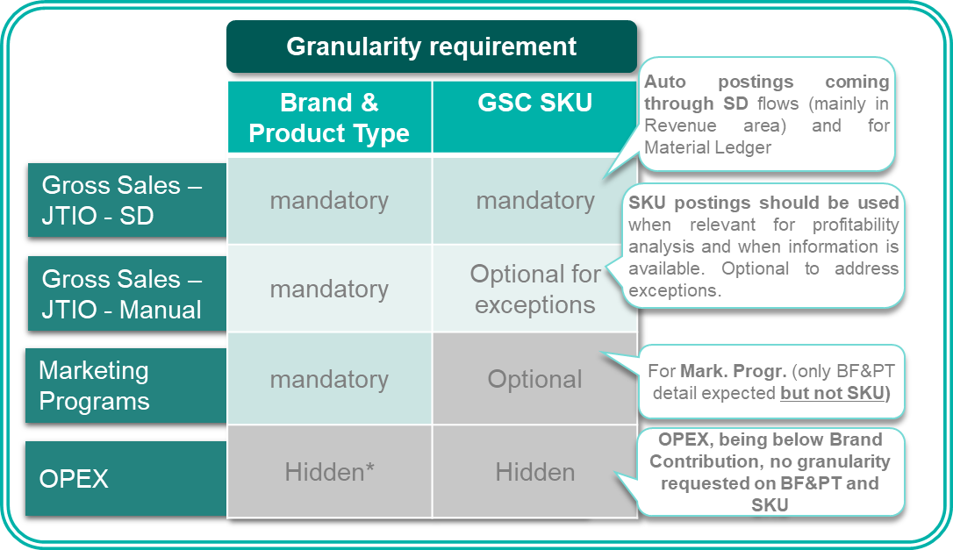
How do we achieve the required granularity?
Minimum Granularity Requirements, as set out by Corporate FP&A, have been implemented for each PL JTIO in S/4 through the use of Field Status Groups (FSG).
These settings ensure that when postings are made in S/4, validations are done, to have complied with the minimum requirements of dimensions (eg. brand family and product type or GSC SKU).
FI manual postings:
Fail if the required granularity for the specific JTIO is not met (“mandatory”)
Are accepted in where “optional” and
in cases where certain dimensions are not required (“hidden*”) this field will be still displayed during the posting. Dimensions are not physically hidden as the same accounts are used for OPEX and for above Brand Contribution
EXAMPLE

Slide 8
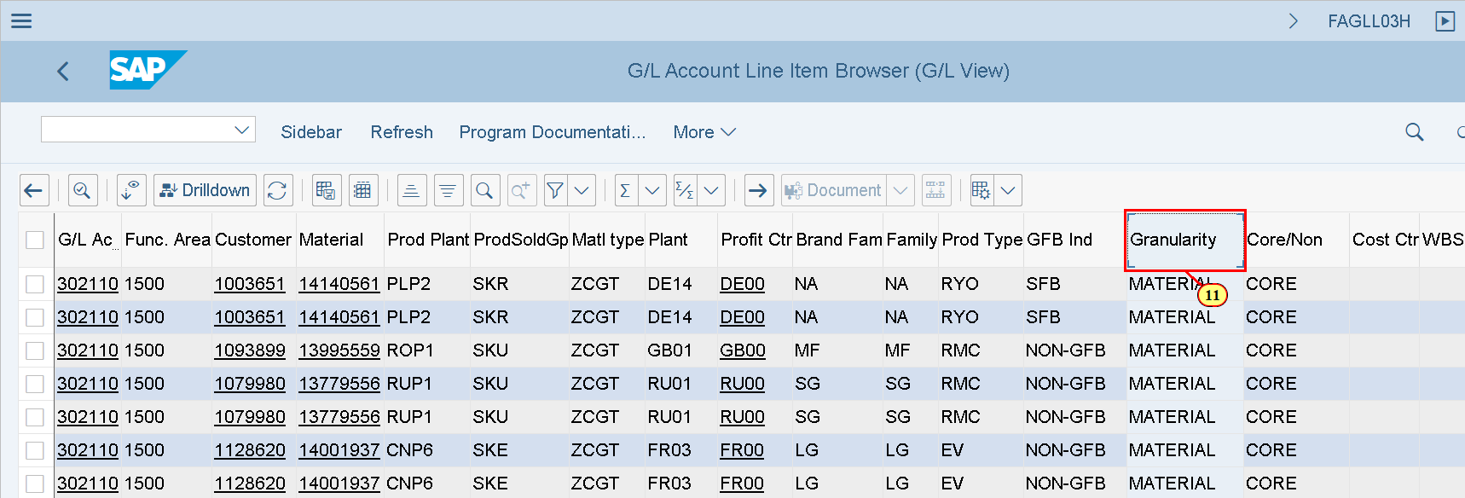
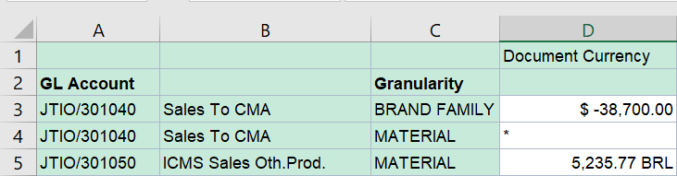
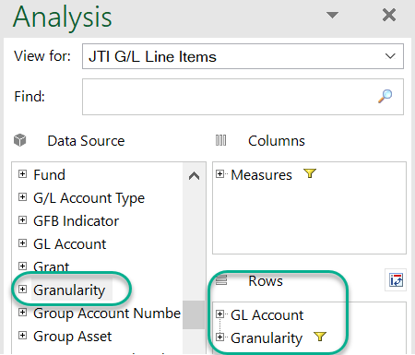
How can you check during the month required granularity?
The Granularity field is a new dimension and reflects the detail that is available in the posting and reporting and can help validate ahead of month end closing if requirements are met (eg. Brand family & Product type above Brand Contribution).
Values are:
"Brand Family" if both Brand Family and Product Type are present;
"Material" in case of postings including the latter and
"N/A" if no detail is available (to note that this can be the case for Multibrand WBS when these have NOT YET been settled – before Month end )
" # " - No profitability data available
Examples with new show “MATERIAL” granularity
1. GL Line Item Report (FAGLL03H) with Granularity dimension*
2. CDS S/4 Queries are more powerful to tailor workbooks
* See Reporting section for more details

Slide 9
Demonstration & exercises
Exercise 1.3: GR55 – Display Market P&L

