Slide 1

Course Structure
Profitability Analysis: Intro to S/4
Profit Center Reorganization
Changes to Market P&L
Standardization of Dimensions
Market P&L
Granularity behind P&L Lines
Reporting Capabilities
Volume Conversion

Slide 2
Volume Conversion Table – Embedded in S/4
ECC…
Different logic for different applications in BW
…S/4
Standard SAP functionality
GL Accounts created for different product types on which conversion is based in GPM
Issues in mismatches between MM and account determination (i.e. product type does not match category of the GL account)
Conversion linked to the source data of MM
One Logic for all applications
Flexible solution to tailor for specificities if needed

Slide 3
Volume Conversions used in JTI Volumes
S/4 (source) into GPM
Product Type | Measure
RYO / MYO (Standard conversion rate) | 0.75g = 1 Stick
RYO/MYO (High volume tobacco) | 0.5g = 1 Stick
UK / Ireland – SKR category = RYO | 0.40g = 1 Stick
Canada – SKR Category | As agreed with the OTP group
Cigars | 1 Stick = 1 Stick
Pipe | 1g = 1 Stick
Snus | 1 Can = 20 Sticks
T-Vapor Ploom S | 1 refill pack (20 sticks) = 20 sticks
T-Vapor Ploom Tech / Ploom C | 1 refill pack (5 pods) = 20 sticks
E-Vapor - Open Tanks | 1 liquid refill (10 ml bottle) = 100 sticks
E-Vapor - Closed Tanks | 1 liquid refill (capsule) = 20 sticks
RRP Packaging Units (incl. access) | Out of Scope for Conversion *
Shisha volumes are not converted but reported separately in tons (Waterpipe Volume) Due to the planning is done from KU in BW, a “dummy” conversion has been configured (diving by 1000) for product type "DEVICE" in S4.In BW DEVICE product type is not included into volume reporting.
MPL KPIs
Stick Equivalent Volume
Waterpipe Volume
Non-Tobacco Emerging Volume
Non-JTI Brands Volume
GFB Volume
GFB Revenue
Core Revenue
Marketing investments
Controllable Opex
OCC

Slide 4
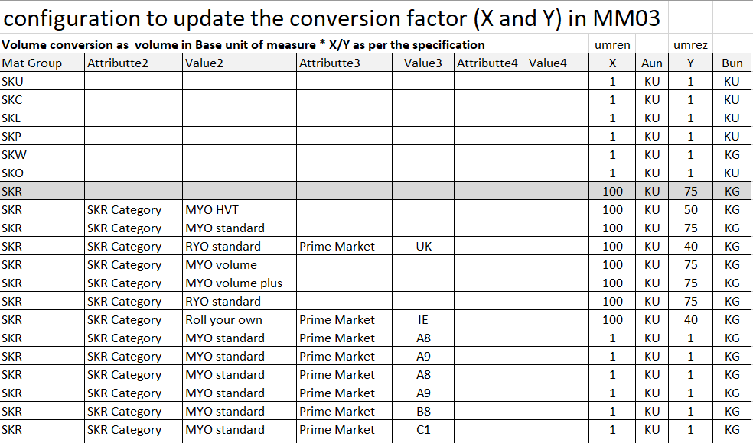
Volume conversion & Mapping Table
Conversion factor in MM for each product
Automated population of an Alternative Unit of Measure and Conversion Denominators
Based on Mapping table
Which will provide conversion denominators for specific material characteristics such as Material Group, SKR Category and Sub Brand and Markets
Trigger for conversion factor population:
Initial load (product creation)
Changes in specific material characteristic
ABSTRACT TABLE
Mapping table maintained by BTS
Mapping table allows to introduce into the volume conversion logic more dimensions to distinguish between for example product types, brands, markets.

Slide 5
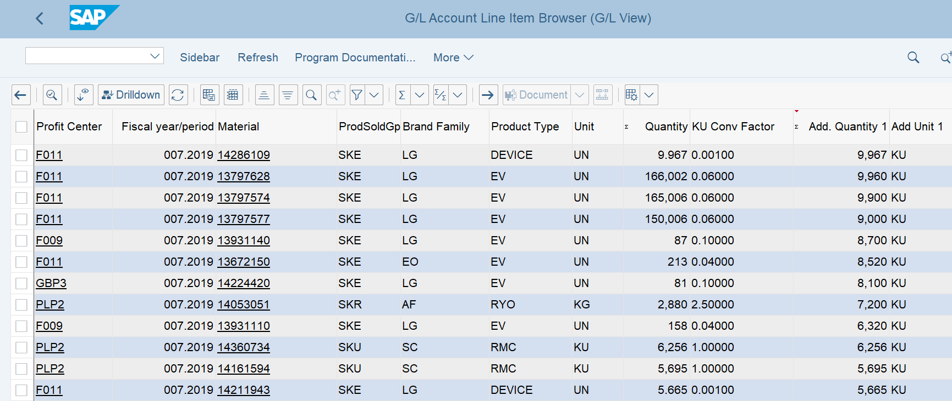
Volume Conversion – FAGLL03H
Original Quantity in Base Unit of Measure (BUoM)
Conversion Factor from Configuration table
Converted volumes in KU
FAGLL03H – Display Actual Line Item Report

Slide 6
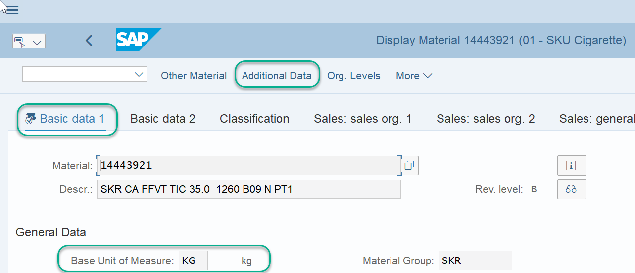
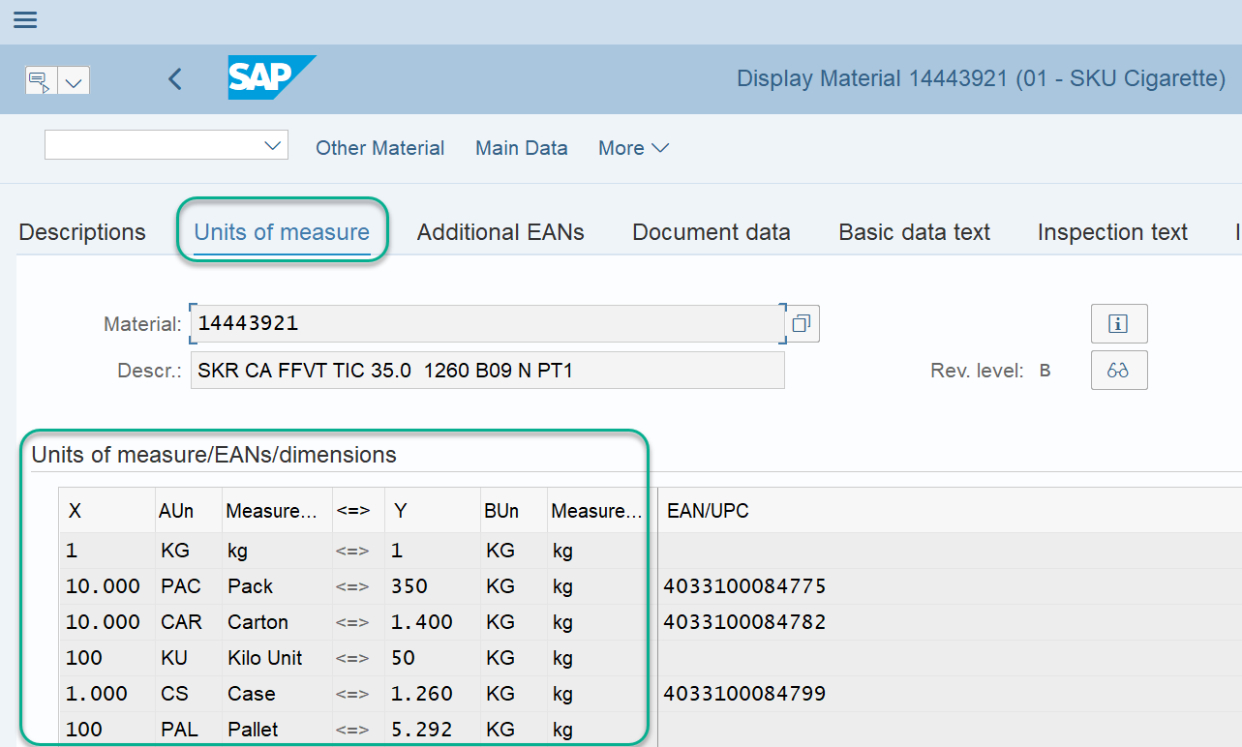
Volume Conversion Example
Volume conversion takes the Base Unit of Measure (BUoM) from Material master and converts it using the mapping table seen previously as well as conversions also within the Material Master.
The conversion information can be found in Basic Data 1 tab, Additional Data, Units of Measure.
In this example 50 KG is equal to 100 KU (Kilo Units = universal measurement) so the conversion of 2.000 is applied.
However some IDs may have different Unit of Measure (UoMs) in different processes in the system. For example an ID can be input into Sales Orders/Purchase Orders as UN or even in Cases (CS).
If Case is used and CS is not the BUoM in the Material Master then the system must convert the UoM to the BUoM before further volume conversion can occur. In this example, 1,000 CS is equal to 1,260 KG (KG being the BUoM) so the conversion of CS to KG must happen before the Volume conversion of BUoM to KU
MM03 – Display Material Master

Slide 7
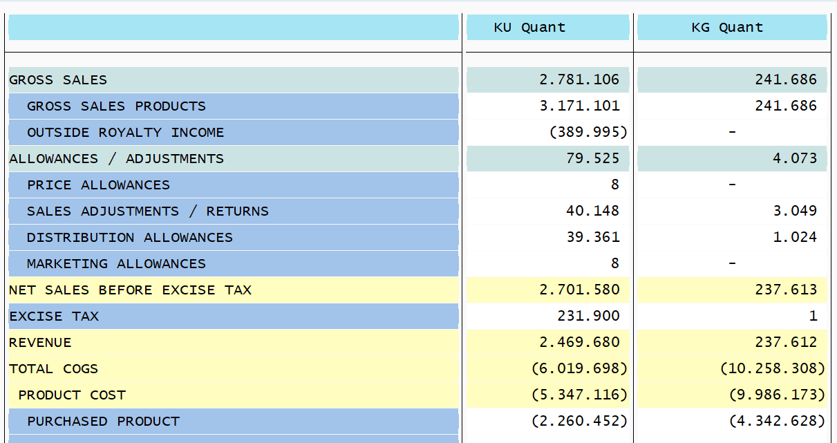



Volume Conversion not visible in GR55
Only BUoM in GR55
Although Volume Conversion takes place in real time, GR55 Z4PL report does not show converted Volumes.
In GR55 you will find the BuOM
However, if the drill down functionality is used to drill down to FAGLL03H the volume conversion will be shown.
Volume conversion can also be viewed in real time via CDS S/4 queries using Analysis for Office
GR55 – Z4PL Display Market P&L
Click on toolbar To the far right to visualize other BUoM used.
FAGLL03H – Line Item Browser
Drilldown

Slide 8
Demonstration & exercises
Exercise for Volume Conversion in Reporting section

