Slide 1
COLL 400 Project
By Stephen Ramotowski

Slide 2






host en.wikipedia.org
host www.weather.com
Wireshark
Save data
as csv
host www.google.com
host blackboard.wm.edu
Open in Excel

Slide 3

Features focused on
Samples from Dataset
Feature | Details
Length | Total size of the packet
Protocol | How the data is formatted
Website | What website the data is from
Ttruncated | The time between the previous packet Calculated in Excel using the Time column, then truncated to 6 decimal places to avoid scientific notation. (time - previous time = time between)
Protocol | Length | Website | Ttruncated
TLSv1.2 | 113 | Wikipedia | 0.000059
TCP | 74 | Wikipedia | 0.022886
TCP | 1514 | Wikipedia | 0.000396
TLSv1.2 | 3240 | Blackboard | 0.002126
TCP | 60 | Blackboard | 0.015369
TCP | 74 | Weather | 0.1375
TLSv1.3 | 1312 | Weather | 0.017867
QUIC | 1292 | Google | 0.022899
QUIC | 93 | Google | 0.000066
Dropped Columns/ Features
No. | Time | Source | Destination | Protocol | Length | Info | Time_Between | Website | Ttruncated

Slide 4
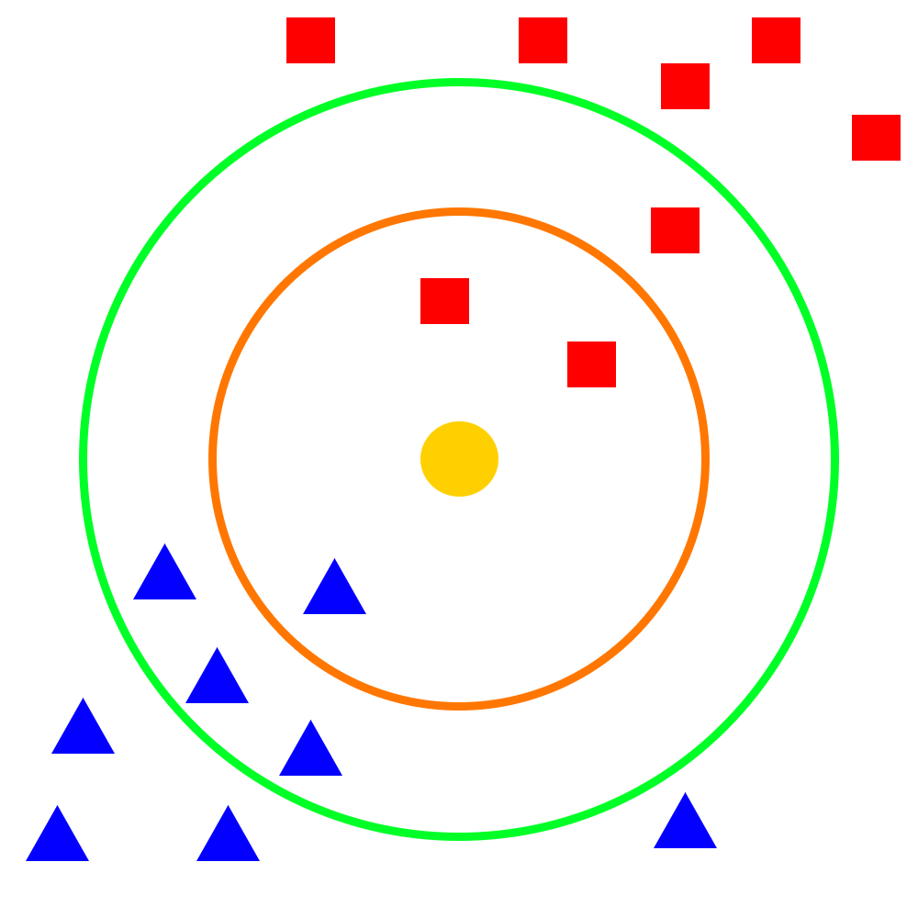
My Model: k-nearest neighbors (k-NN)
Definition: A supervised learning method used for classification and regression. An object is classified based on a plurality vote of its neighbors, with k representing the number of neighbors.
For example, if k = 1, the object is assigned to its nearest neighbor’s class (website).
Orange Ring (k = 3)
What is the yellow point classified as? Red Square
Green Ring (k = 7)
What is the yellow point classified as? Blue Triangle
The number of neighbors has a huge impact on the classification of an object!

Slide 5
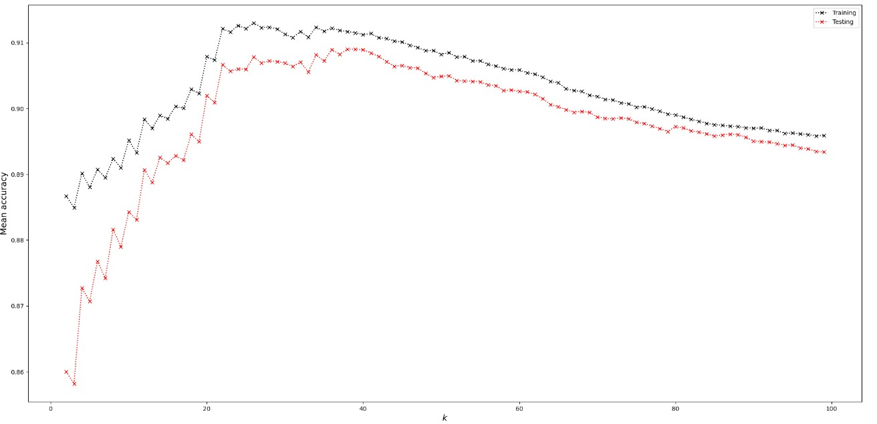
Choosing the best k (number of neighbors)
K-Fold
Cross-Validation:
Create a bunch of models with different test/train splits and different values of k.
Choose the value of k with the highest mean Testing score.
The optimal value of k (number of neighbors) is 38

Slide 6
Model | Test Accuracy
k-NN | 0.804
Logistic Regression | 0.493
Results:
Validation is done by inputting 30 seconds of network data for each website to each model
k-NN Validation
Website | Accuracy | ID
Google | 0.999 | Yes
Weather | 0.730 | Yes
Blackboard | 0.797 | Yes
Wikipedia | 0.643 | Yes
Logistic Regression Validation
Website | Accuracy | ID
Google | 1.000 | Yes
Weather | 0.484 | No
Blackboard | 0.420 | No
Wikipedia | 0.081 | No
Predicted→ -------------- Actual ↓ | Blackboard | Weather | Wikipedia
Blackboard | 826 | 39 | 171
Predicted→ -------------- Actual ↓ | Blackboard | Weather | Wikipedia
Blackboard | 436 | 564 | 36
Website identified as Blackboard
Website identified as Weather.com

