Slide 1

CAUSE OF DEATHS project
BY
SATYA JYOTHI. T
Flip robo – internship 34

Slide 2

CHAPTER 1 - INTRODUCTION
Business Problem Framing
Conceptual Background of the Domain Problem
Motivation for the Problem Undertaken

Slide 3
CHAPTER 2 - Analytical Problem Framing
Mathematical/ Analytical Modeling of the Problem
Data Sources and their formats
Data Preprocessing Done
Data Inputs- Logic- Output Relationships
State the set of assumptions (if any) related to the problem under consideration
Hardware & Software Requirements with Tool Used

Slide 4
CHAPTER 3 - Models Development & Evaluation
IDENTIFICATION OF POSSIBLE PROBLEM-SOLVING APPROACHES (METHODS)
Testing of Identified Approaches (Algorithms)
Run and Evaluate selected models
Key Metrics for success in solving problem under consideration
Visualizations
Interpretation of the Results

Slide 5
CHAPTER 4 - CONCLUSIONS
Key Findings and Conclusions of the Study
Learning Outcomes of the Study in respect of Data Science
Limitations of this work and Scope for Future Work

Slide 6

Chapter 1 introduction

Slide 7
Business problem framing
There is a historical data of different cause of deaths for all ages around the World where Disability Adjusted Life Years‘ (DALYs) are measuring lost health & a standardized metric that allow for direct comparisons of disease burdens of different diseases across countries, between different populations, and over time.
One DALY is the equivalent of losing one year in good health because of either premature death or disease or disability.
One DALY represents one lost year of healthy life
Objective is to perform the data analysis which influence Cause of Death (Both Mortality & Morbidity)
Mortality + Morbidity → Measured by ‘Disability Adjusted Life Years‘

Slide 8
Conceptual Background of the Domain Problem
Sum of mortality and morbidity → Measured by metric called ‘Disability Adjusted Life Years‘ (DALYs).We need to assess health outcomes by both mortality & morbidity (the prevalent diseases) which provides a more encompassing view on health outcomes.
DALYs Measure lost health and are a standardized metric that allow for direct comparisons of disease burdens of different diseases across countries, between different populations, and over time.
Need data analysis which influence Cause of Death (Both Mortality & Morbidity)

Slide 9
Motivation for the problem undertaken
This project was given by Flip Robo Technologies as a part of the internship program. This opportunity gives the exposure to real world data and using my skillset in solving a real time problem has been the primary motivation.
In this presentation, the focus will be on
How to analyze the dataset of Cause of Deaths
Overall data analysis on the problem

Slide 10
Chapter 2 Analytical Problem Framing

Slide 11
Mathematical/ Analytical Modeling of the Problem
The main objective of doing this project is to apply the analytical skills to get findings and conclusions in detailed data analysis of Cause of Deaths dataset
There is no target variable in the dataset hence this study is limited to only data analysis and no machine learning model is developed

Slide 12
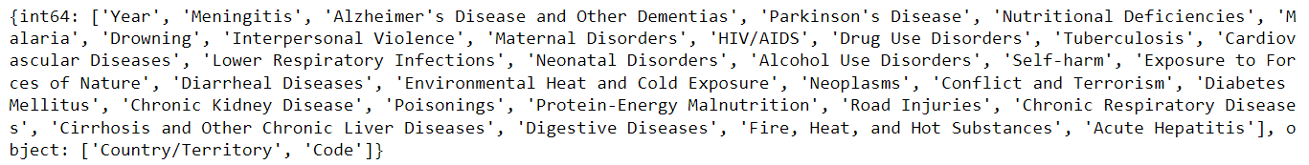
Data Sources and their formats
Data set provided by Flip Robo was in the format of CSV (Comma Separated Values). There is one data set that is given.
cause_of_deaths dataset.csv file will be used for detailed data analysis. The dimension of data is 6120 rows and 34 columns.

Slide 13
Data PREPROCESSING DONE
Data integrity is checked by checking for duplicate values, white spaces and missing values. There are no duplicate values, white spaces found in the dataset.
There are no missing values present in the dataset.
There are 2 data types in the data set. a) Object b) int64
Statistical summary is checked for both Object and Numerical data to draw the insights of descriptive statistics (count, mean, min, max, std deviation and IQR values) in a simple manner.

Slide 14
Data Inputs- Logic- Output Relationships
There is no output variable in the dataset.
However this dataset helps to draw multiple insights like below
Top countries with more deaths due to different diseases
Top diseases which are causing more deaths in the world
Diseases with least deaths
Countries with least deaths
Dataset helps the countries to take necessary steps to reduce the no. of deaths due to different diseases

Slide 15
State the set of assumptions (if any) related to the problem under consideration
Didn’t drop any column from the dataset as all the features are important for the data analysis.
Column “Code” can be dropped however it is not used in the data analysis instead used column “Country/Territory” for the data analysis.

Slide 16
Hardware & Software Requirements with Tool Used
Software Used -
Jupyter Notebook
Python 3.9.13
NumPy
Pandas
Matplotlib
Seaborn
scikit-learn
Hardware Used -
Processor — Intel i7 processor 8th Generation
RAM — 32 GB
GPU — 4GB NVIDIA Graphics card

Slide 17
Chapter 3 Models Development & Evaluation

Slide 18
IDENTIFICATION OF POSSIBLE PROBLEM-SOLVING APPROACHES
There are many features in dataset. Used various statistical and analytical techniques to solve the problem.
Performed univariate, bivariate and multivariate graphical analysis to draw the key insights from the dataset
Used Pearson’s coefficients of correlation to find out the relation among multiple features
Multi-collinearity between features is checked using VIF (Variance Inflation Factor). Typically the columns with VIF>10 need to be dropped which indicates strong multicollinearity of the features however there are many features with VIF>10. VIF can also be addressed with PCA (Principal Component Analysis) without dropping the features. In this project, used PCA to reduce the no. of features by capturing 95% of variance of the data
Outliers are checked for the X numerical data. In z-score method, removed outliers if z-score > 3 and < -3. In IQR method, removed outliers beyond Inter Quartile Range (Q3-Q1). Calculated %data loss with both methods. z-score method resulted in data loss with less than 10% (8.1%) which is acceptable where as IQR method resulted in the data loss of 50.5% hence finally used z-score method for outliers removal.
Skewness is checked for X numerical data. Applied multiple transformation techniques (PowerTransformer, QuantileTransformer) to check the skewness reduction. Considered -0.5 to +0.5 range as fairly symmetrical. QuantileTransformer has reduced the skewness within this range, hence considered the data for further processing from QuantileTransformer.
Scaled the X data using Standard Scaler.

Slide 19
Testing of Identified Approaches (Algorithms)
No ML model is developed as there is no target variable in the dataset.

Slide 20
Run and Evaluate selected models
No ML model is developed as there is no target variable in the dataset.

Slide 21
Key Metrics for success in solving problem under consideration
No ML model is developed as there is no target variable in the dataset.

Slide 22
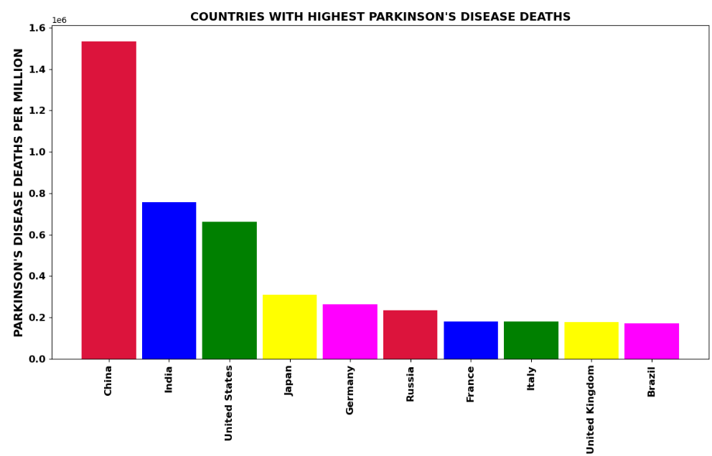
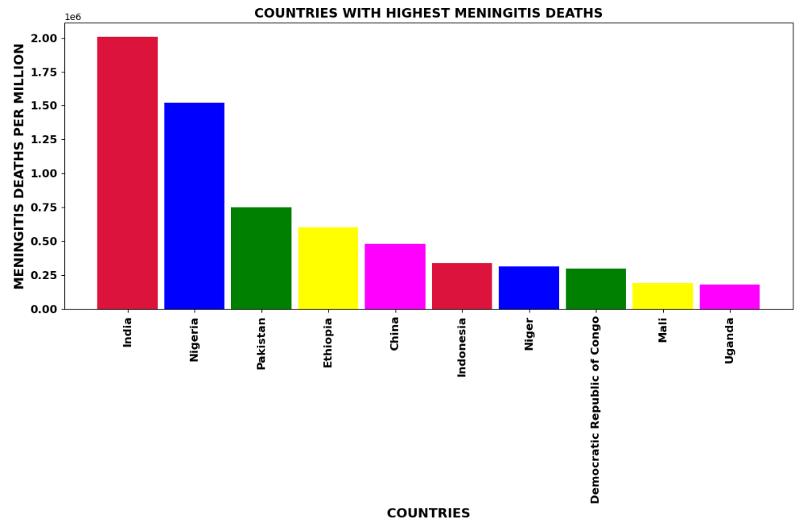
VISUALIZATIONS
TOP 10 COUNTRIES WITH MORTALITY FOR EACH DISEASE
Observations for MENINGITIS:
The highest number of deaths due to MENINGITIS occurring in country INDIA
The least number of deaths due to MENINGITIS occurring in country PALAU
Observations for PARKINSON'S DISEASE:
- The highest number of deaths due to PARKINSON'S DISEASE occurring in country CHINA
- The least number of deaths due to PARKINSON'S DISEASE occurring in country NAURU

Slide 23
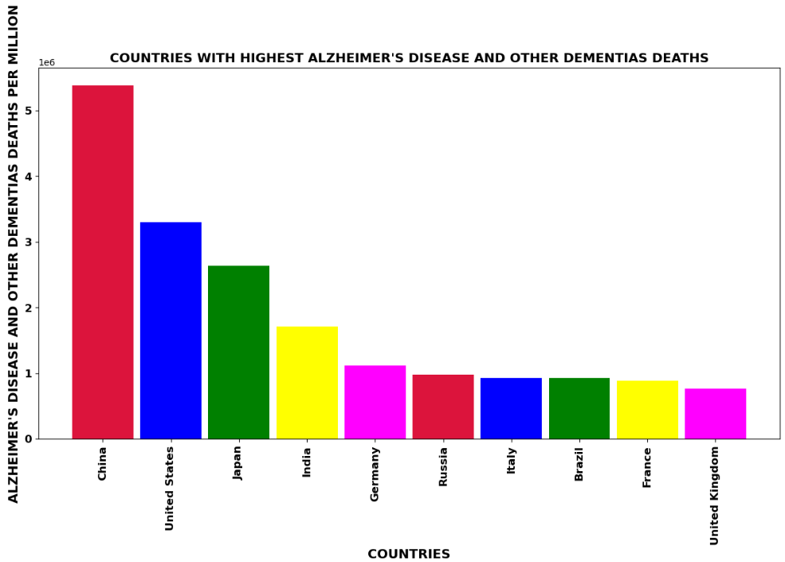
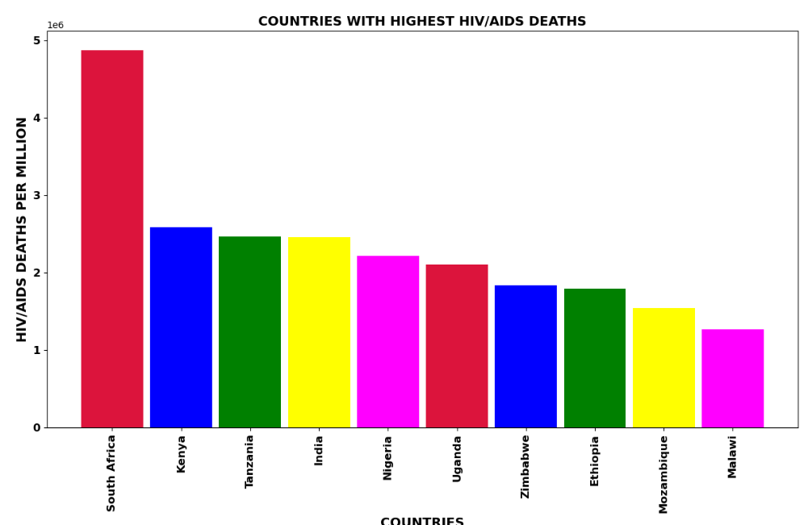
VISUALIZATIONS
TOP 10 COUNTRIES WITH MORTALITY FOR EACH DISEASE
Observations for ALZHEIMER'S DISEASE AND OTHER DEMENTIAS:
The highest number of deaths due to ALZHEIMER'S DISEASE AND OTHER DEMENTIAS occuring in country CHINA
The least number of deaths due to ALZHEIMER'S DISEASE AND OTHER DEMENTIAS occuring in country TOKELAU
Observations for HIV/AIDS:
- The highest number of deaths due to HIV/AIDS occurring in country SOUTH AFRICA
- The least number of deaths due to HIV/AIDS occurring in country NIUE

Slide 24
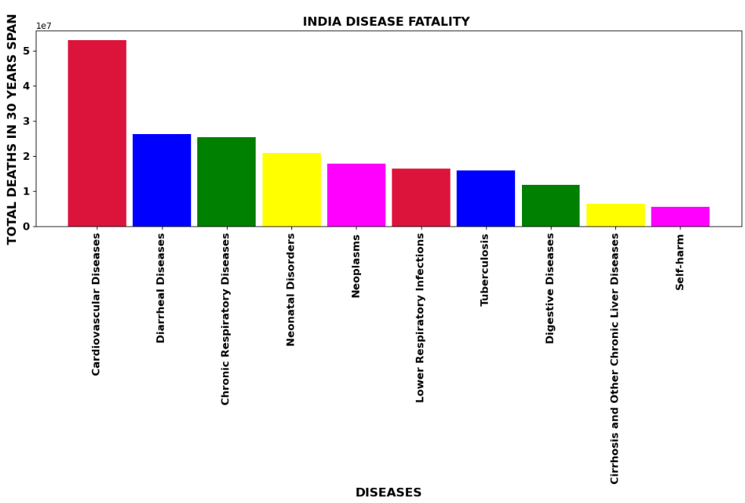
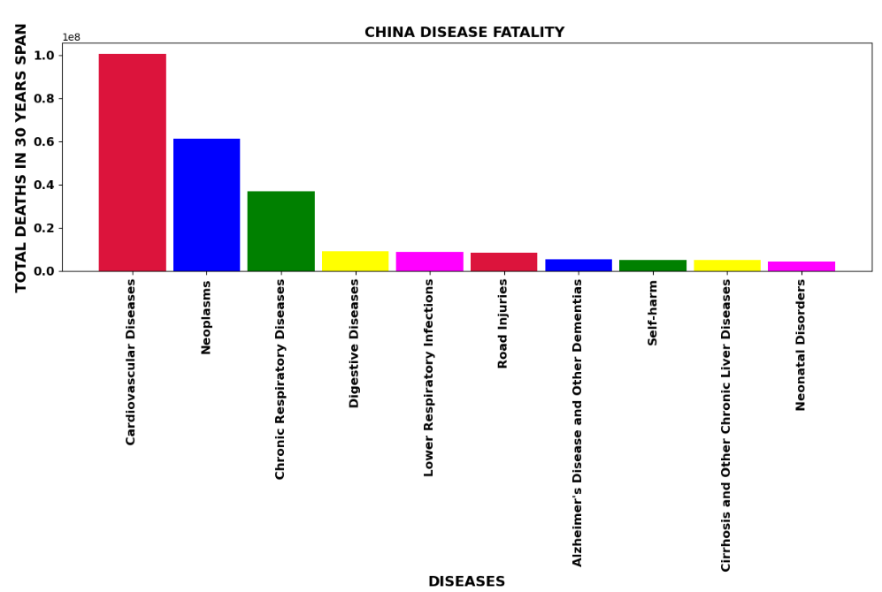
VISUALIZATIONS
COUNTRY WISE TOP 10 DISEASES WITH MORTALITY
Observations for CHINA:
In CHINA, most deaths are due to CARDIOVASCULAR DISEASES
In CHINA, least deaths are due to CONFLICT AND TERRORISM
Observations for INDIA:
- In INDIA, most deaths are due to CARDIOVASCULAR DISEASES
- In INDIA, least deaths are due to CONFLICT AND TERRORISM

Slide 25
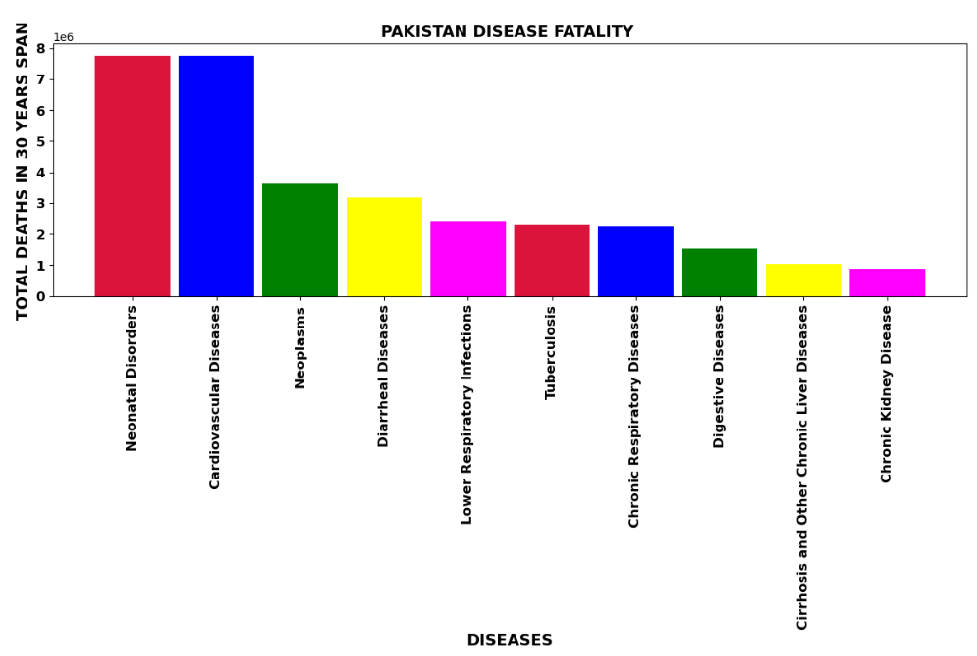
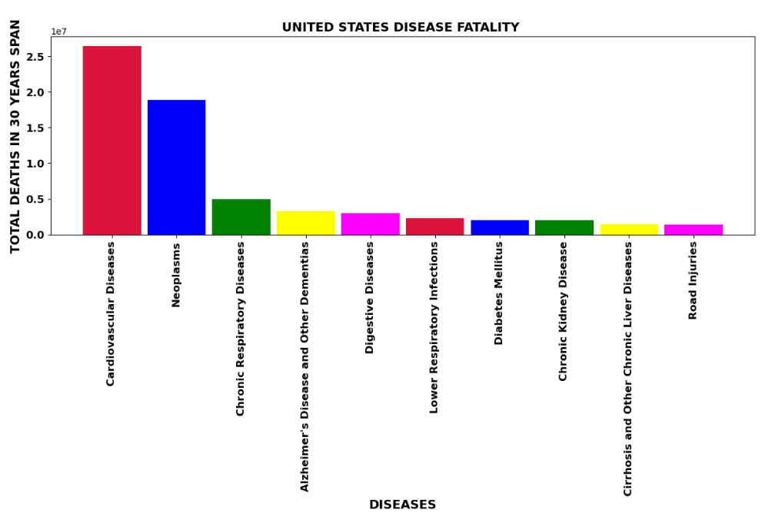
VISUALIZATIONS
COUNTRY WISE TOP 10 DISEASES WITH MORTALITY
Observations for UNITED STATES:
In UNITED STATES, most deaths are due to CARDIOVASCULAR DISEASES
In UNITED STATES, least deaths are due to MALARIA
Observations for PAKISTAN:
- In PAKISTAN, most deaths are due to NEONATAL DISORDERS
- In PAKISTAN, least deaths are due to ENVIRONMENTAL HEAT AND COLD EXPOSURE

Slide 26
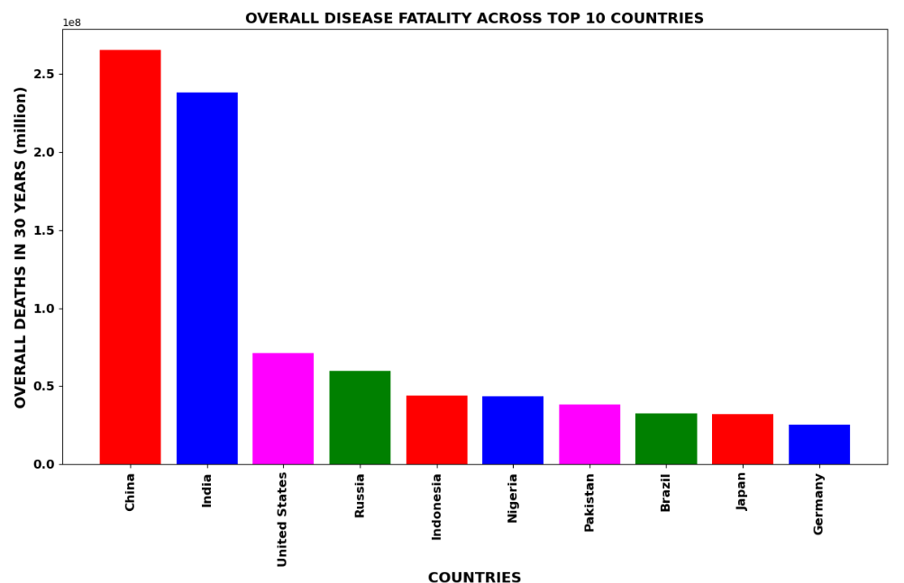
VISUALIZATIONS
COUNTRIES WITH HIGHEST DEATHS DUE TO DISEASES
Observations:
CHINA and INDIA are top countries having most deaths compared to other countries in 30 years span
This could be due to large population in these two countries
UNITED STATES is the country having more no. of deaths after CHINA and INDIA

Slide 27
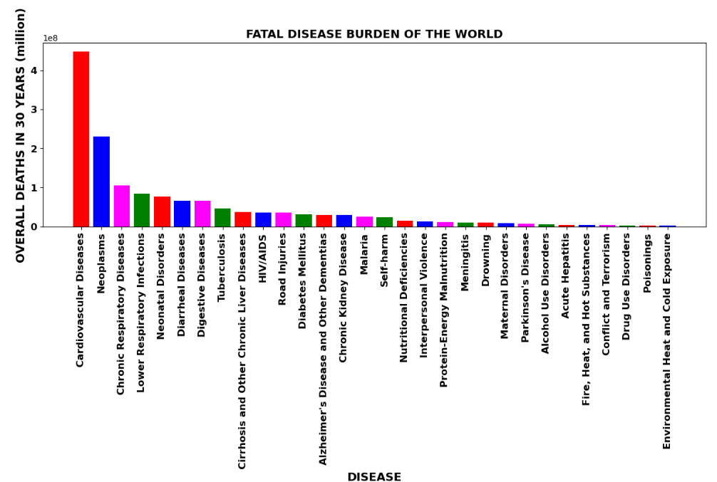
VISUALIZATIONS
TOP KILLER DISEASES IN THE WORLD
Observations:
Cardiovascular Diseases is the most killing disease in the world
The lowest no. of deaths occurred due to Environmental Heat and Cold Exposure in the world
CHINA , INDIA AND USA face the largest brunt of deaths due to diseases in the world Cardiovascular diseases , Neoplasms and Lower Respiratory Infections are the top 3 killer diseases in the world

Slide 28
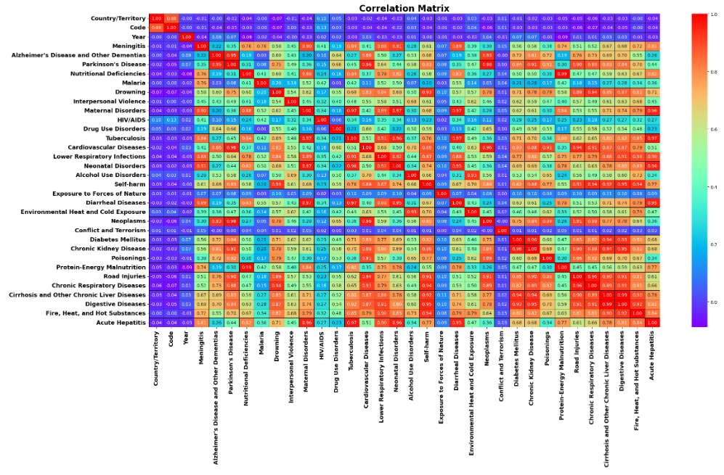
Coefficients of correlation

Slide 29
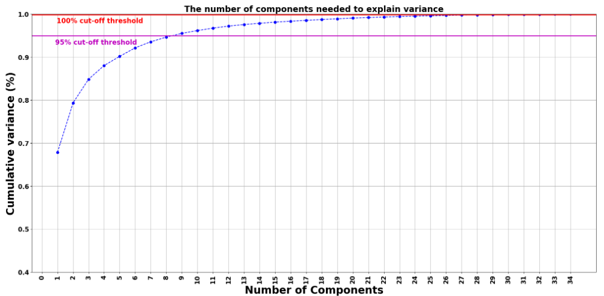
PCA
As the dataset is having many X columns and as there is multi-collinearity, used PCA technique to reduce the number of dimensions in a dataset while preserving the most important information in it
Initially, calculated the number of components needed to explain the variance
Based on that, chosen the no. of columns required be used in PCA
As per the graph, we can see that 8 principal components attribute for 95% of variation in the data. Hence I picked 8 components
I will use 8 features as no. of components in PCA to reduce the dimensions

Slide 30
Interpretation of the Results
As there is no output variable, no ML model is developed however drawn key insights from the dataset which influence the cause of deaths in different countries of the world

Slide 31
Chapter 4 conclusions

Slide 32
Key Findings and Conclusions of the Study
Cardiovascular Diseases is the most killing disease in the world
The lowest no. of deaths occurred due to Environmental Heat and Cold Exposure in the world
CHINA , INDIA AND USA face the largest brunt of deaths due to diseases in the world. The most %of deaths in CHINA and INDIA could be due to large population
Cardiovascular diseases , Neoplasms and Lower Respiratory Infections are the top 3 killer diseases in the world

Slide 33
Learning Outcomes of the Study in respect of Data Science
Data Analysis – This study helps to apply analytical skills to get findings and conclusions with the detailed data analysis of dataset which helped to identify the top diseases which caused more no. of deaths in the world in different countries. This study will help all the countries to take necessary steps to avoid or reduce the no. of deaths due to various diseases and special focus on top diseases causing more deaths.

Slide 34
Limitations of this work and Scope for Future Work
Target variable can be added to data which will helps to perform supervised machine learning model
Performing unsupervised learning can be done using clustering, anomaly detection, neural networks
More features & data can be available to help in best recommendation

Slide 35


Thank you

