Slide 1
CUSTOMER RETENTION PROJECT
BY
SATYA JYOTHI. T

Slide 2
CHAPTER 1 - INTRODUCTION
Introduction
Conceptual Background of the Domain Problem Motivation for the Problem Undertaken
Diagrammatic Representation of Customer Retention

Slide 3
CHAPTER 2 - Analytical Problem Framing
Data Sources and their formats
Hardware & Software Requirements with Tool Used
Data Pre-processing

Slide 4
CHAPTER 3 - Models Development & Evaluation
IDENTIFICATION OF POSSIBLE PROBLEM-SOLVING APPROACHES (METHODS)
VISUALIZATIONS
Encoding of categorical data
Coefficient of correlation
Feature selection using selectkbest method
Features scaling
Pca – principal component analysis

Slide 5
CHAPTER 4 - CONCLUSIONS
conclusions

Slide 6

Chapter 1 introduction

Slide 7
Introduction
Customer satisfaction has emerged as one of the most important factors that guarantee the success of online store; it has been posited as a key stimulant of purchase, repurchase intentions and customer loyalty.
A comprehensive review of the literature, theories and models have been carried out to propose the models for customer activation and customer retention.
Five major factors that contributed to the success of an e-commerce store have been identified as: service quality, system quality, information quality, trust and net benefit.
The research furthermore investigated the factors that influence the online customers repeat purchase intention. The combination of both utilitarian value and hedonistic values are needed to affect the repeat purchase intention (loyalty) positively.

Slide 8
Conceptual Background of the Domain Problem
The data is collected from the Indian online shoppers. Results indicate the e-retail success factors, which are very much critical for customer satisfaction.
Five major factors that contributed to the success of an e-commerce store have been identified as: service quality, system quality, information quality, trust and net benefit.
The research furthermore investigated the factors that influence the online customers repeat purchase intention.

Slide 9
Motivation for the problem undertaken
This project was given by Flip Robo Technologies as a part of the internship program. This opportunity gives the exposure to real world data and using my skillset in solving a real time problem has been the primary motivation.
In this presentation, the focus will be on
How to analyze the dataset of Customer Retention
What are the criterions to achieve Customer Retention
Overall data analysis on the problem.

Slide 10
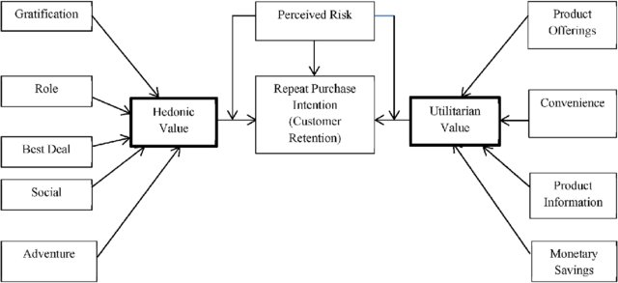
Diagrammatic Representation of Customer Retention

Slide 11
Chapter 2 Analytical Problem Framing

Slide 12
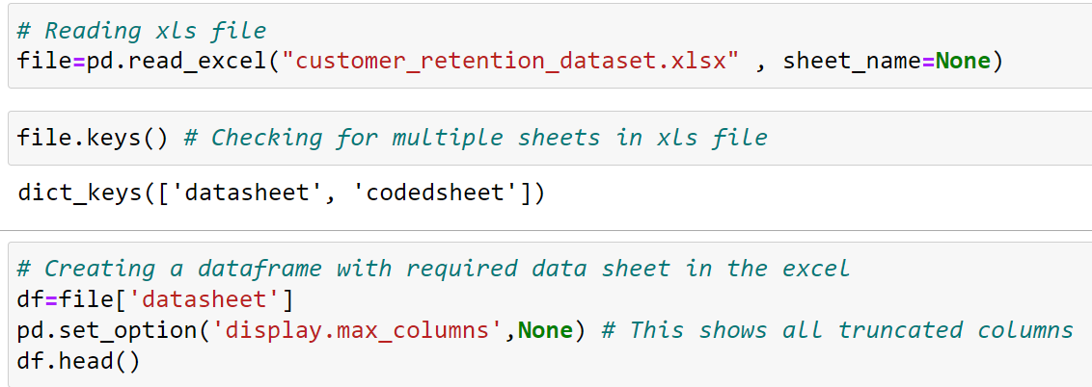
Data Sources and their formats
The dataset is provided by FlipRobo and it contains the data of the Indian online shoppers. There are two sheets (one is detailed) and second one is encoded in the excel file.
There are total 269 rows and 71 columns in this dataset

Slide 13
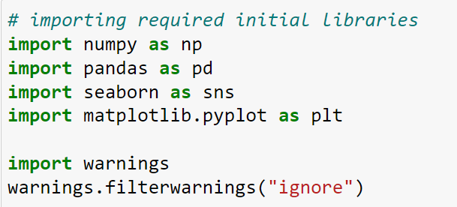
Hardware & Software Requirements with Tool Used
Hardware Used -
1. Processor — Intel i7 processor 8th Generation
2. RAM — 32 GB
3. GPU — 4GB NVIDIA Graphics card
Software utilized -
1.Anaconda – Jupyter Notebook
Libraries Used –
Different libraries are used while building Machine Learning model and Visualization of data.

Slide 14
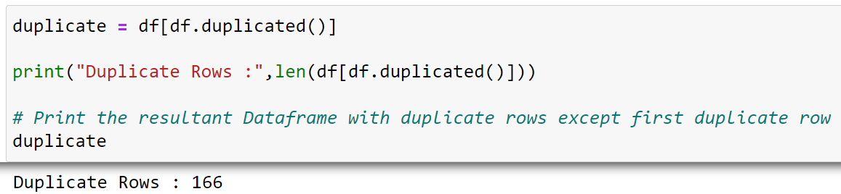
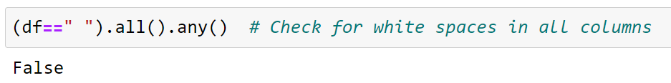
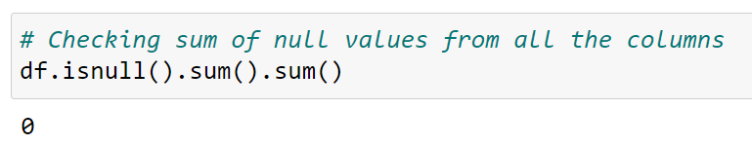
Data pre-processing
Data integrity is checked by checking for duplicate values, white spaces and missing values
There are 166 duplicate rows found in the entire dataset. Dropped remaining duplicate rows except “first” duplicate rows
Removed tabs in the columns names

Slide 15
Chapter 3 Models Development & Evaluation

Slide 16
IDENTIFICATION OF POSSIBLE PROBLEM-SOLVING APPROACHES
There are many features in dataset. Objective is to find key conclusions on customer retention using data analysis. The features are categorized into few sections so the analysis can be performed section wise on particular area. They are enlisted as below:
➢ General feature describing Population and online shopping feature
➢ Features of different aspects of personal choices of device and internet services
➢ Features of shopping purchase decision & payment
➢ Features of Website options & performance related
➢ Features of Online shopping customer service requirement
➢ Features related to Customer online shopping experiences
➢ Features of Opinion on Online Shopping Platform Websites by Customers

Slide 17
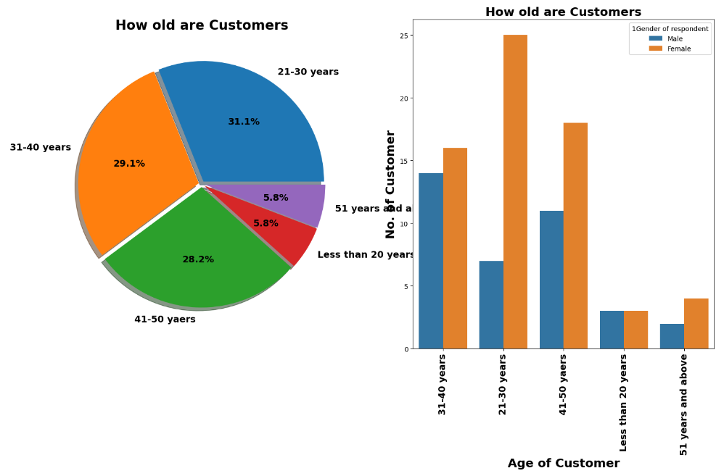
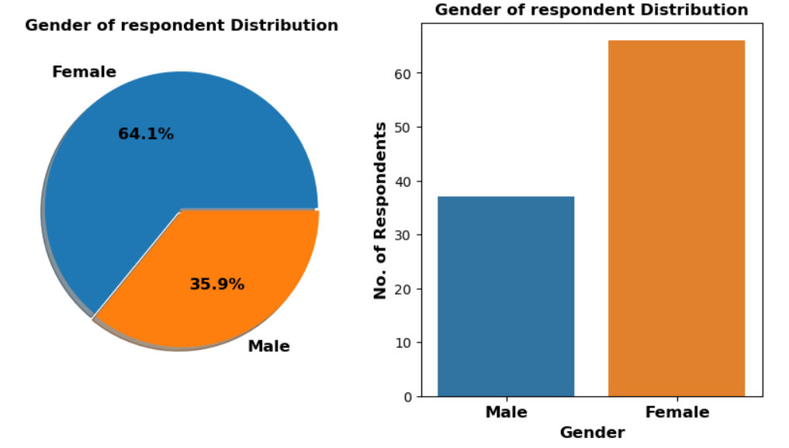
VISUALIZATIONS
1. General feature describing Population and online shopping feature
Observations:
Females (64.1%) are responding more compared to Males (35.9%).i.e. Females are doing more shopping compared to males
Majority of the respondents are falling in the age group of 21-30 years (31.1%), followed by 31-40 years (29.1%) and 41-50 years (28.2%), out of which female respondents are more in all these groups
Majority of the female respondents are falling in the age group of 21-30 years
The male customers in the age group of 31-40 years are doing more shopping, followed by 41-50 years
The customers with age < 20 years and > 50 years are doing less shopping including both males and females

Slide 18
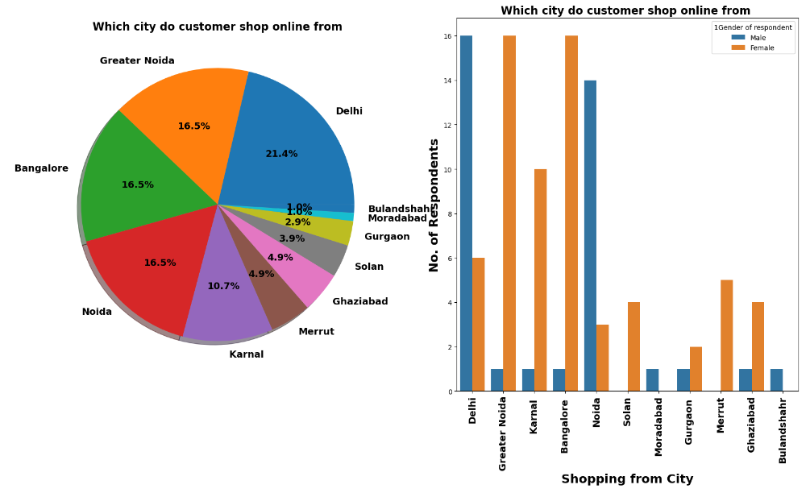
VISUALIZATIONS
1. General feature describing Population and online shopping feature
Observations:
Most of the customers are shopping from Delhi, Bengaluru, Noida, Greater Noida
More male customers are from Delhi, Noida
More female customers are from Bangalore and Greater Noida
Customers from remaining cities are less. Majority of customers are Females

Slide 19
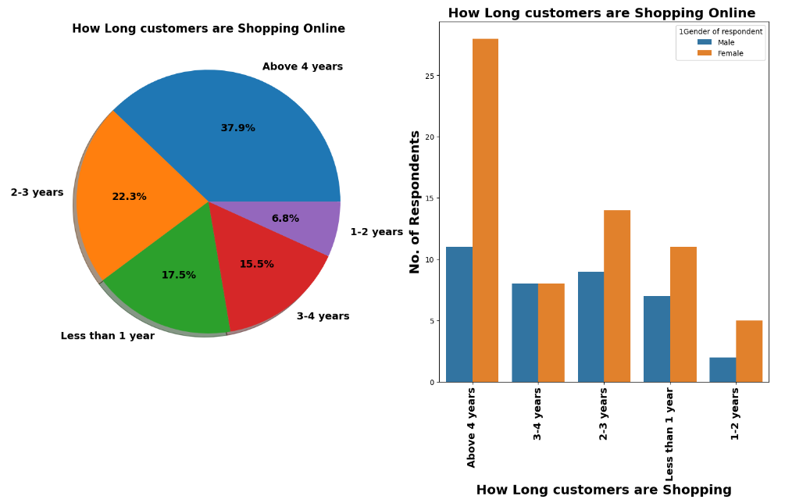
VISUALIZATIONS
1. General feature describing Population and online shopping feature
Observations:
Majority of the customers (37.9%) are shopping online for more than 4 years
Majority of the female and male customers are shopping online for more than 4 years

Slide 20
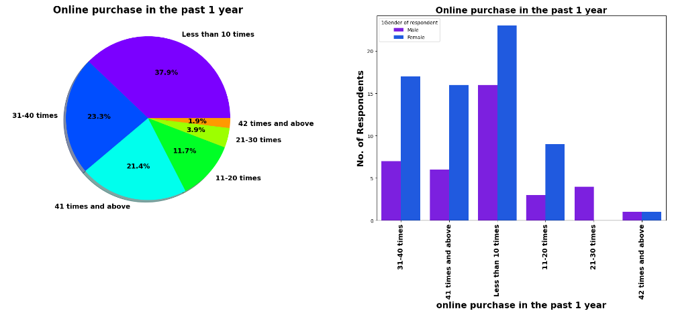
VISUALIZATIONS
1. General feature describing Population and online shopping feature
Observations:
37.9% customers in last 1 year made online shopping less than 10 times
21.4% customers in last 1 year made online shopping more than 41 times
Majorly females made the shopping in last 1 year
No female made online shopping in the range of 21-30 times in last 1 year

Slide 21
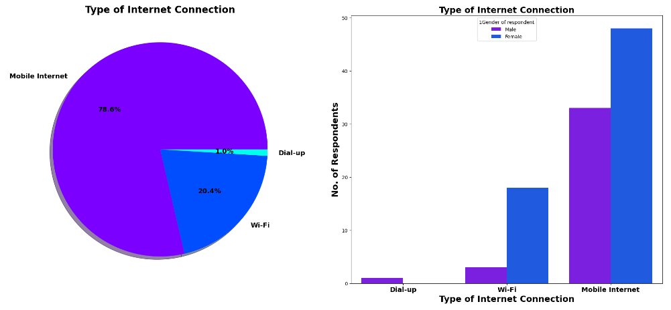
VISUALIZATIONS
1. General feature describing Population and online shopping feature
Observations:
Majority of the customers are using mobile internet (78.6%) followed by Wi-Fi
Only 1.0% of customers are using Dial up Connection
Most of the Female and Male customers are using Mobile Internet

Slide 22
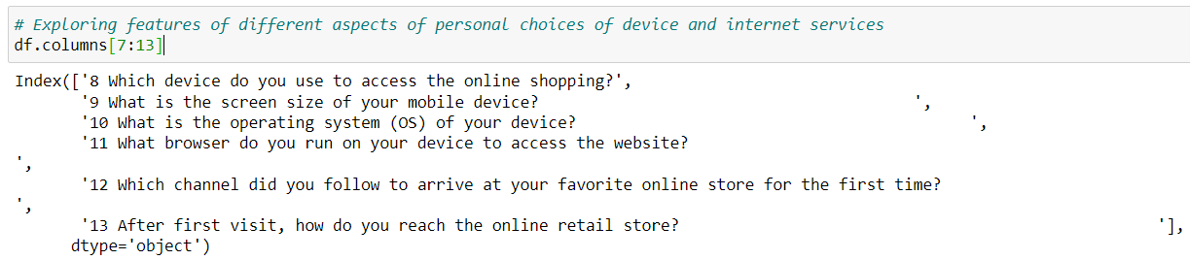
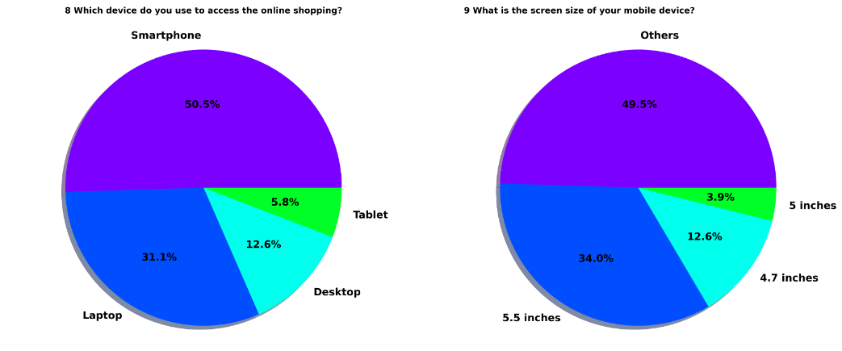
VISUALIZATIONS
2. Exploring features of different aspects of personal choices of device and internet services

Slide 23
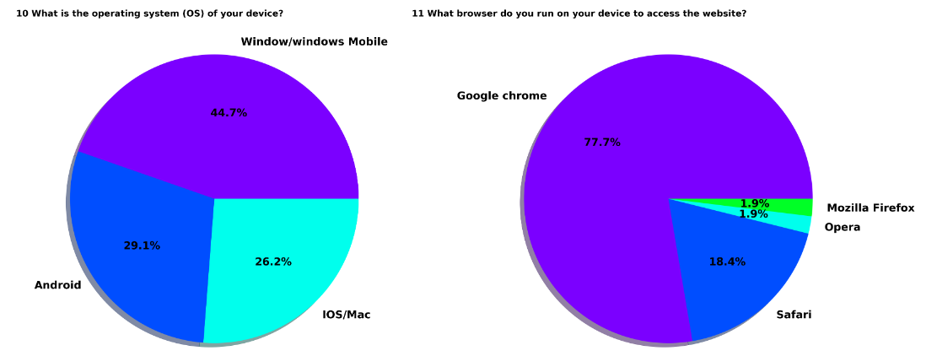
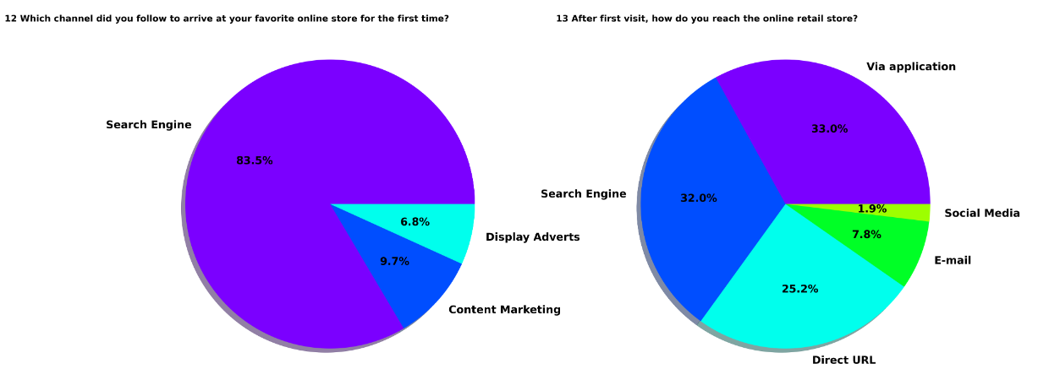
VISUALIZATIONS
2. Exploring features of different aspects of personal choices of device and internet services
Observations:
Majority of the customers are using smartphone (50.5%) for online shopping followed by Laptop (31.1%)
Almost 50% of the customers are not using smartphone hence there are not screen size details available for Others
34.0% of the customers are using 5.5 inches mobile screen size
44.7% of the customers are using Windows operating systems followed by 29.1% customers are using Android and 26.2% customers are using IOS/Mac
77.7% of the customers are using Google Chrome web browser and less % of customers are using other browsers
83.5% of the customers using Search Engine to access online shopping platform
After first visit, 33.0% of the customers reaches online retailer store via mobile application followed by search engine (32.0%)

Slide 24
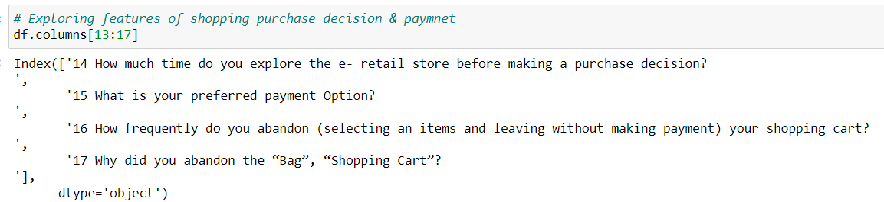
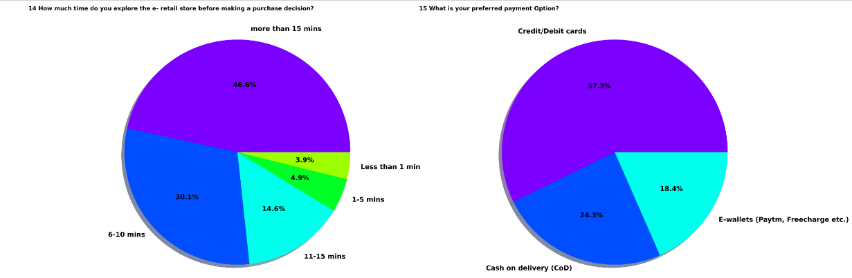
VISUALIZATIONS
3. Exploring features of shopping purchase decision & payment

Slide 25
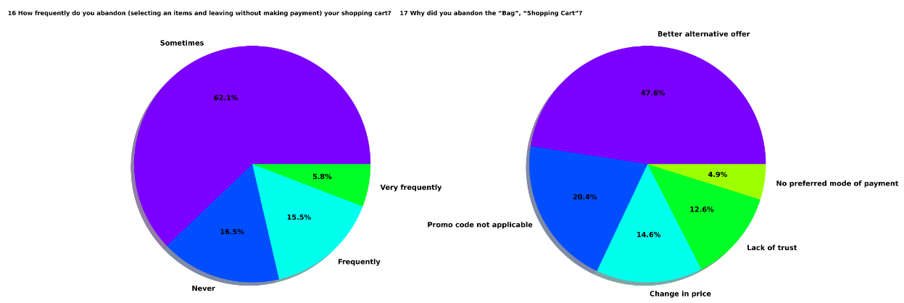
VISUALIZATIONS
3. Exploring features of shopping purchase decision & payment
Observations:
46.6% of the customers are spending more than 15 mins before making purchase decision, 30.1% customers spending 6-10 mins before making purchase decision,14.6% of the customers spending 11-15 mins before making purchase decision, 3.9% customers spending less than 1 minute
57.3% customers are using credit/debit cards, 24.3% customers are using cash on delivery, 18.4% customers are using E-wallets
62.8% of the customers who abandon the shopping cart without making payment
The reason behind abandon the shopping cart, 47.6% of customers felt that they have best alternative offer, 20.4% of customers promo code not applicable on particular product, followed by next most common reason is change in price.

Slide 26
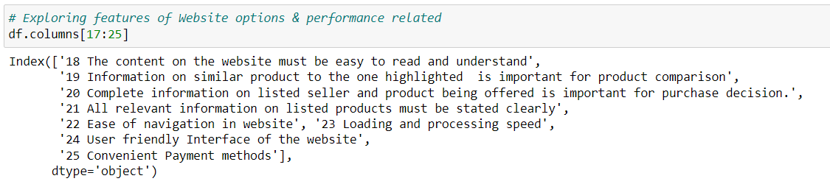
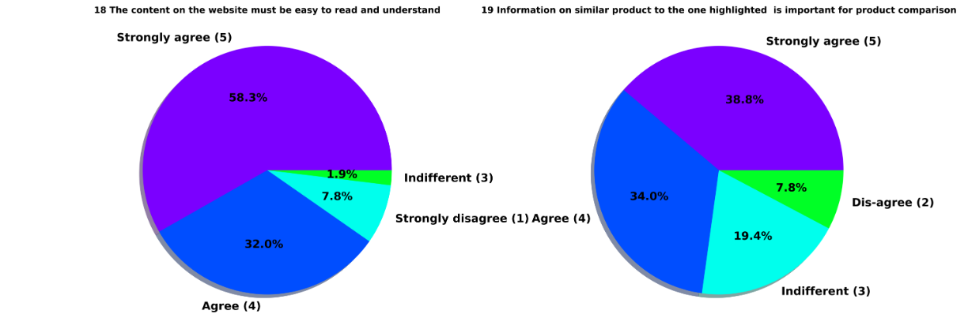
VISUALIZATIONS
4. Exploring features of Website options & performance related

Slide 27
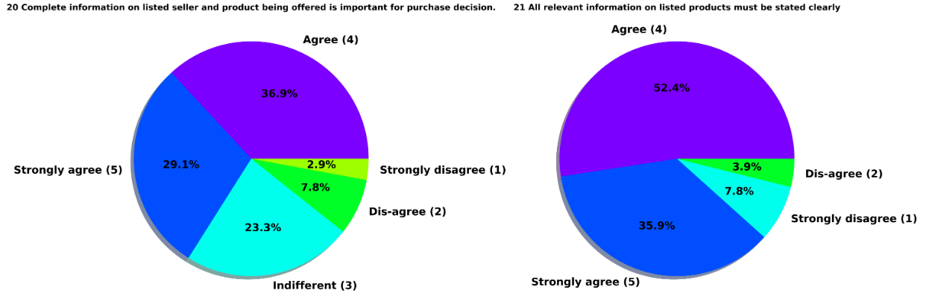
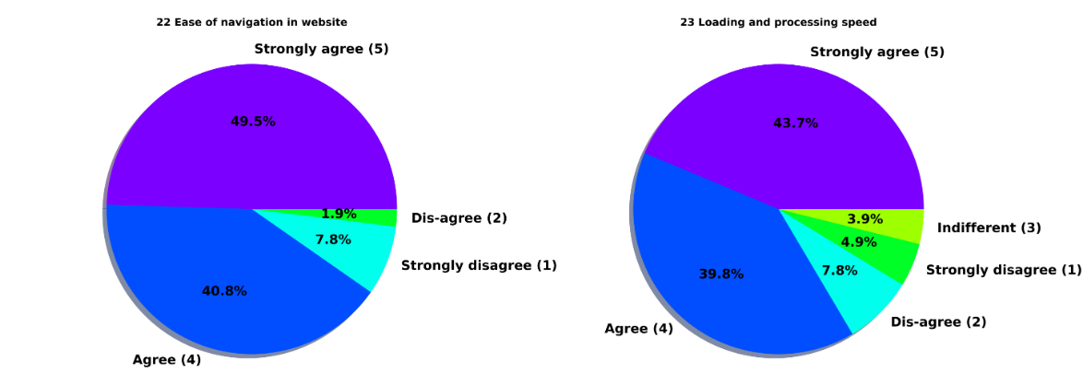
VISUALIZATIONS
4. Exploring features of Website options & performance related

Slide 28
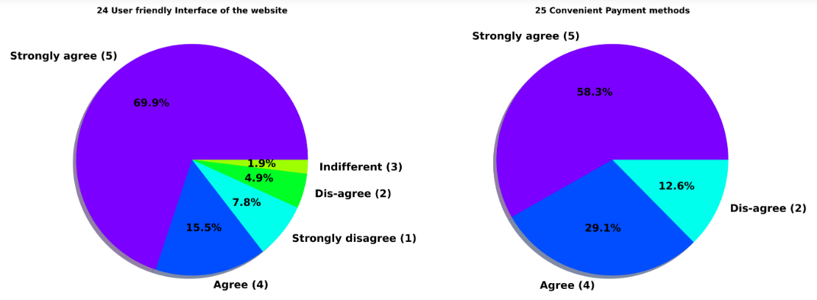
VISUALIZATIONS
4. Exploring features of Website options & performance related
Observations :
58.3 % customers strongly agree and 32.0% customers agree that content on website must be easy to read and understand.
38.8% customers strongly agree and 34.0% customers agree that information on similar product to the one highlighted on website for product comparison.
More than 60% of customers agree or strongly agree that complete information on listed seller and product being offered is important for purchase decision.
More than 90% of customers agree or strongly agree that all relevant information on listed products must be stated clearly.
Around 90% of customers agree or strongly agree that website should be easy for navigation.
43.7 % customers strongly agree and 39.8 % customers agree over high loading & processing speed.
69.9 % customers strongly agree and 15.5 % customers agree that website should be user friendly.
58.3% customers strongly agree and 29.1% customers agree that the convenient payment methods are available

Slide 29
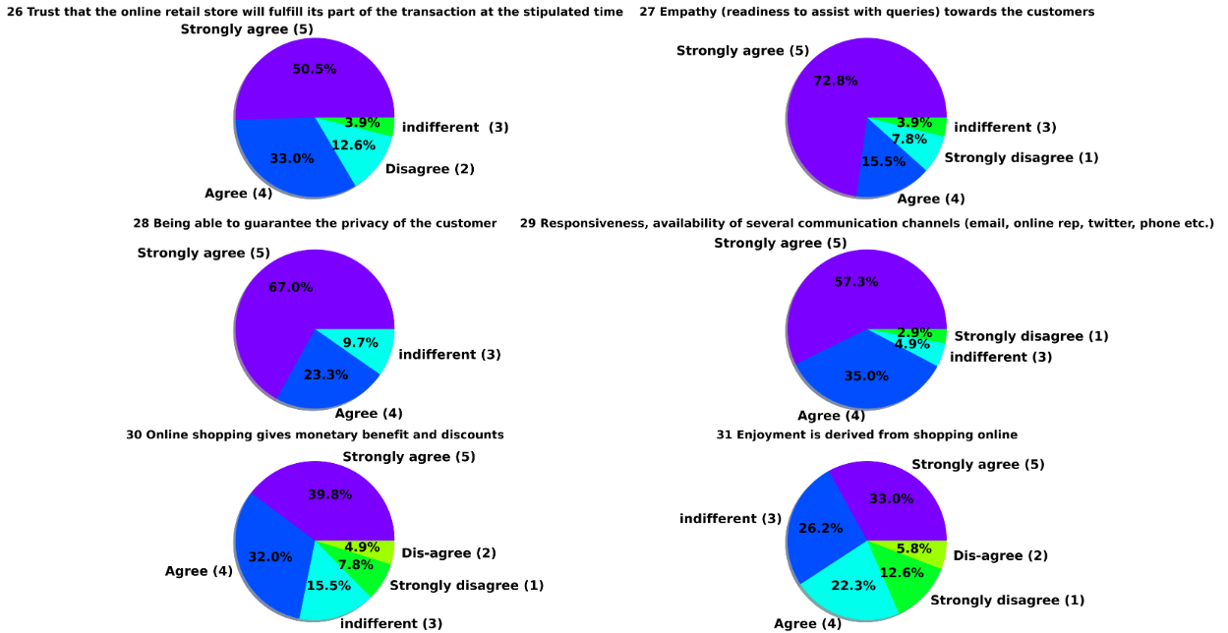
VISUALIZATIONS
5. Exploring features of Online shopping customer service requirement

Slide 30
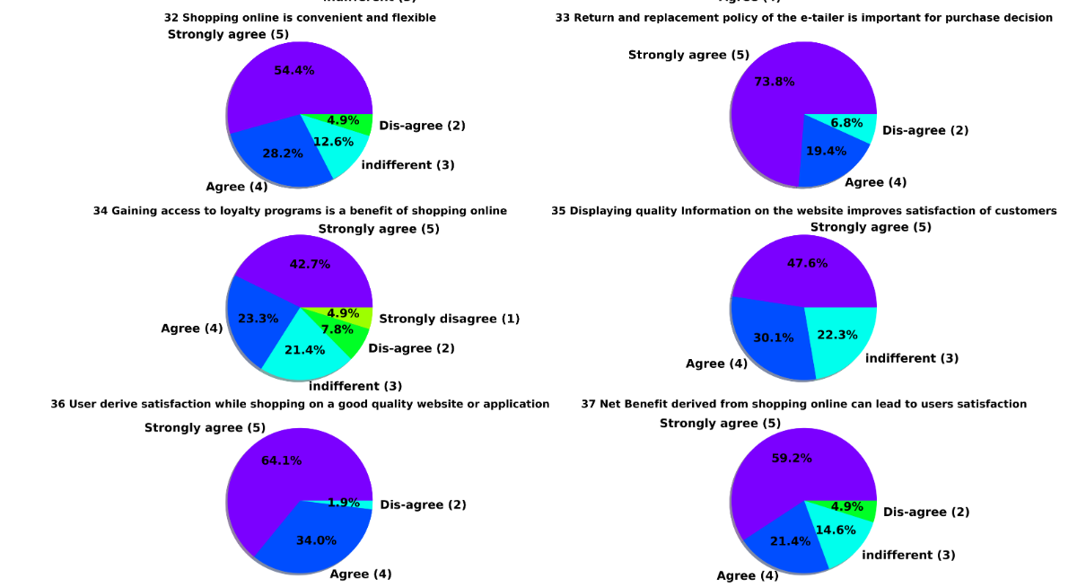
VISUALIZATIONS
5. Exploring features of Online shopping customer service requirement

Slide 31
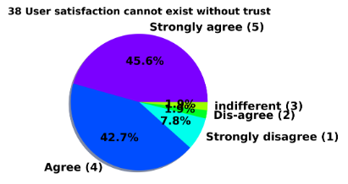
VISUALIZATIONS
5. Exploring features of Online shopping customer service requirement
Observations :
Around more than 80% customers strongly agree or agree that Trust that the online
retail store will fulfill its part of the transaction at the stipulated time
72.8% of the customers strongly agree that companies readiness to assist customer queries related to product is important factor in purchase decision.
Around more than 90% customers strongly agree or agree that being able to guarantee the privacy of the customer is important
More than 90% customers strongly agree or agree that they like product companies is availability of communication channels.
More than 70% customers strongly agree or agree that online shopping gives monetary benefit and discounts.
More than 50% customers enjoyment is derived from online shopping.
More than 80% customers strongly agree or agree that shopping online is convenient and flexible
More than 90% customers strongly agree or agree that the return and replacement policy of the e-tailer is import factor for purchase decision
Around 70% of customers strongly agree or agree that gaining access to loyalty program is a benefit of shopping online
47.6% customers strongly agree and 30.1% customers agree that displaying quality information on website helps in decision making in turn improves customer satisfaction.
More than 95% of customers strongly agree or agree that user derive satisfaction while shopping on a good quality website or application
More than 80% of customers strongly agree or agree that net benefit derived from shopping online can lead to their satisfaction
More than 85% of customers strongly agree or agree over fact that user satisfaction cannot exist without trust.

Slide 32
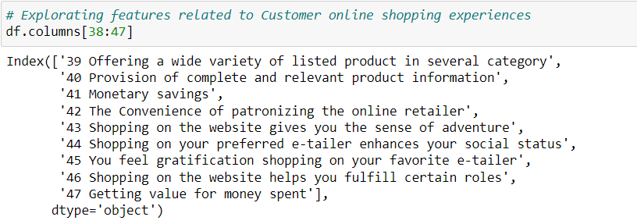
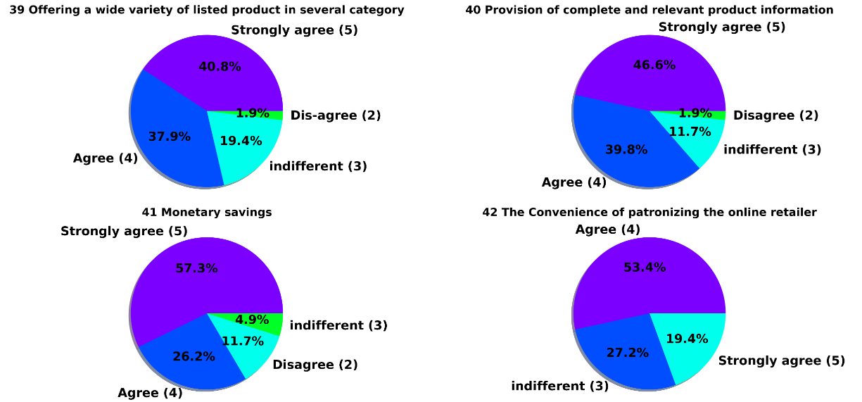
VISUALIZATIONS
6. Exploring features related to Customer online shopping experiences

Slide 33
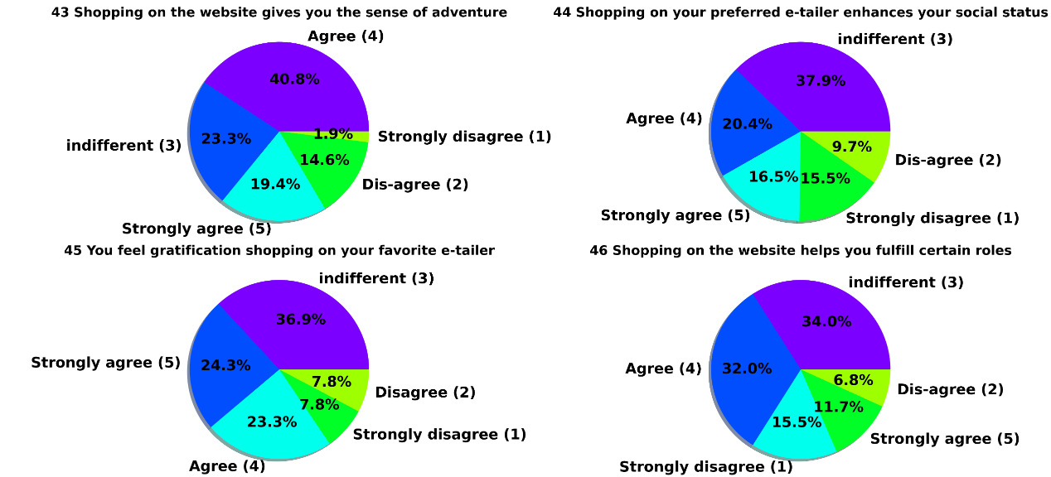
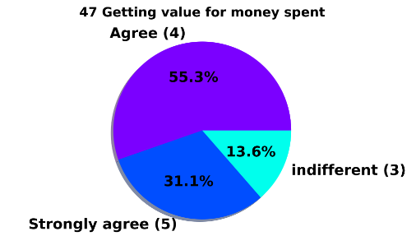
VISUALIZATIONS
6. Exploring features related to Customer online shopping experiences

Slide 34
VISUALIZATIONS
6. Exploring features related to Customer online shopping experiences
Observations :
46.6% customers strongly agree & 39.8% customer agree that for online shopping, there is a provision of complete and relevant product information.
Around 83% customer strong agree or agree that they pursue online shopping for Monetary Savings.
For 40.8 % customers Online shopping on website strongly gives the sense of adventure.
We can see different peoples have different opinions about connection between e-tailer & social status. Same with gratification on favorite e-tailer.
More than 85% customers strongly agree or agree that they prefer online shopping because they get value of money spent

Slide 35
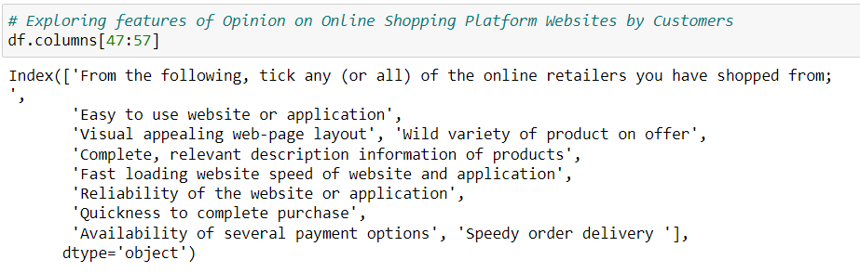
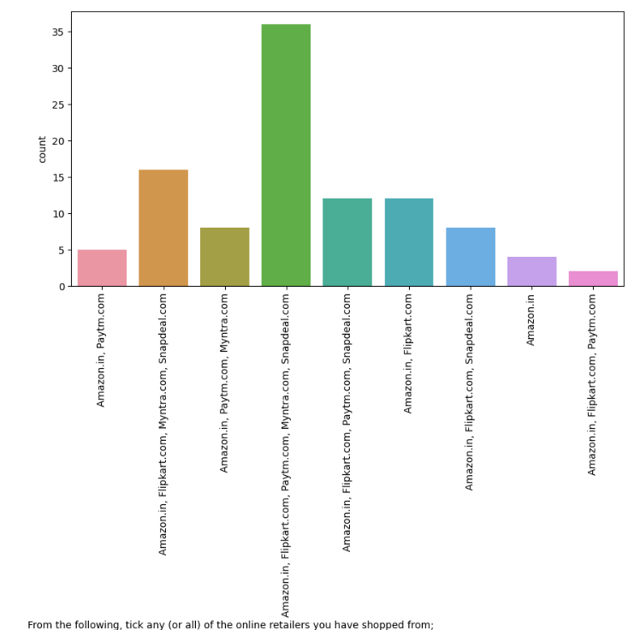
VISUALIZATIONS
7. Exploring features of Opinion on Online Shopping Platform Websites by Customers

Slide 36
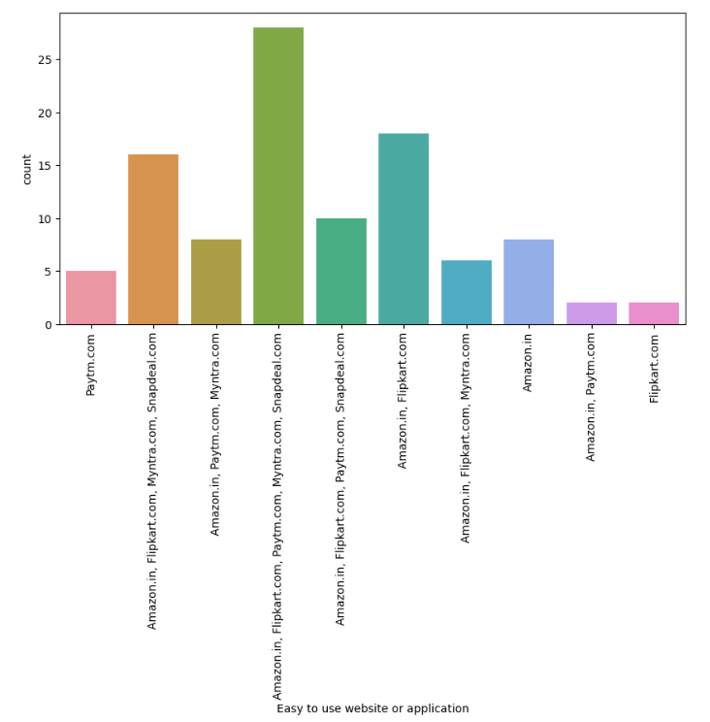
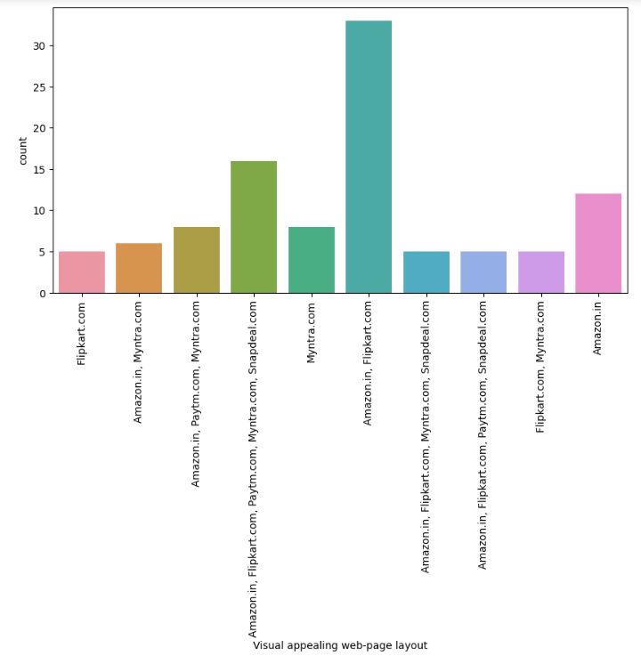
VISUALIZATIONS
7. Exploring features of Opinion on Online Shopping Platform Websites by Customers

Slide 37
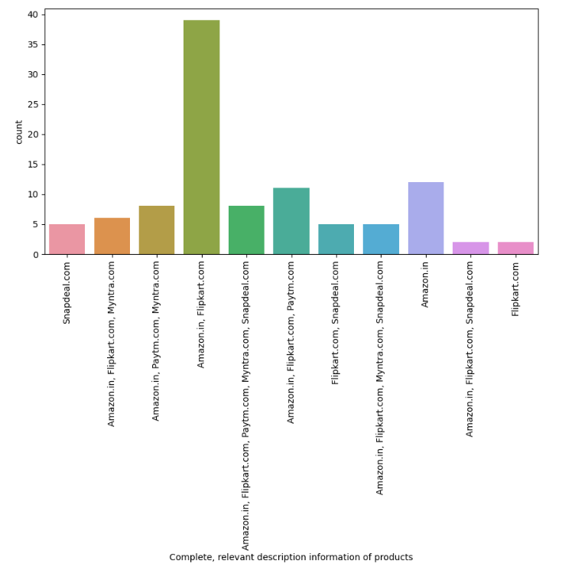
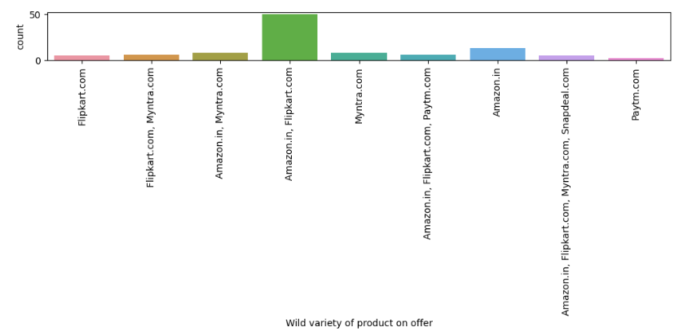
VISUALIZATIONS
7. Exploring features of Opinion on Online Shopping Platform Websites by Customers

Slide 38
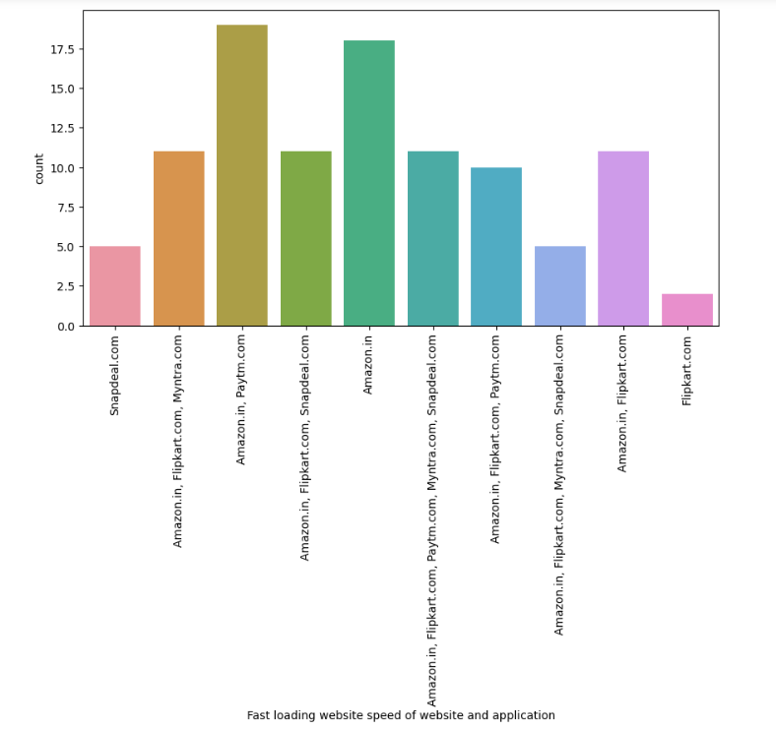
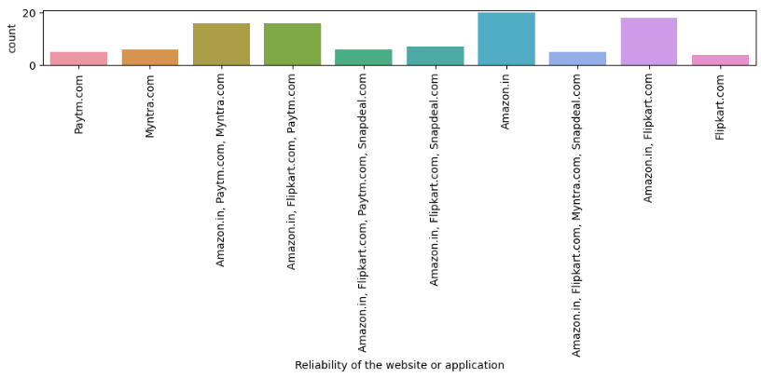
VISUALIZATIONS
7. Exploring features of Opinion on Online Shopping Platform Websites by Customers

Slide 39
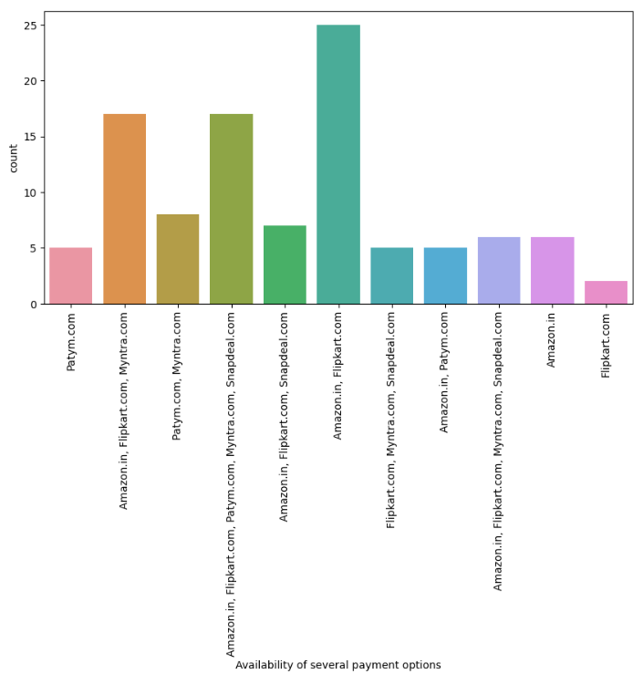
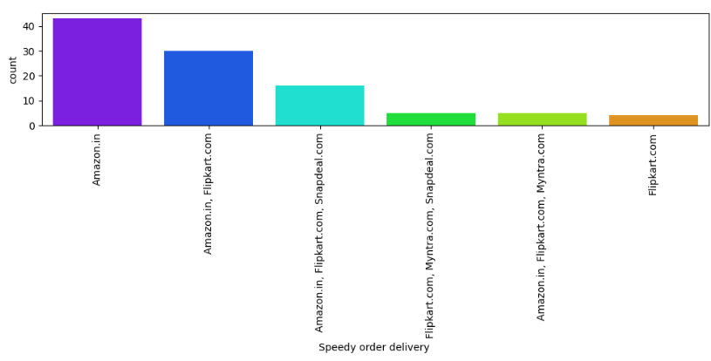
VISUALIZATIONS
7. Exploring features of Opinion on Online Shopping Platform Websites by Customers

Slide 40
VISUALIZATIONS
7. Exploring features of Opinion on Online Shopping Platform Websites by Customers
Observations :
Majority, 28 customers agree that Amazon.in, Flipkart.com, Paytm.com, Myntra.com, Snapdeal.com are Easy to use website or application. But Overall, Amazon.in got individually 1st Rank in easy to use application & website
33 customers agree that Amazon.in, Flipkart.com have Visual appealing web-page layout than most of other market players.
50 customers agree that Amazon.in, Flipkart.com provides wide variety of offer on product.
39 customers agree that Amazon.in, Flipkart.com provides complete information compare to others.
Majority of customers think that loading speed of Amazon.in is fastest while Flipkart.com slowest website to load
In terms of Reliability of website or application again Amazon top list.
Majority of people also think that Amazon.in tops the chart in terms of quickness purchase process compare to others.
Majority of customers think that Amazon.in, Flipkart.com provides several payment options compare to others
In terms of speed of delivery Amazon.in is much better than other online shopping platforms and Flipkart.com worst among all in terms of speed delivery of product.

Slide 41
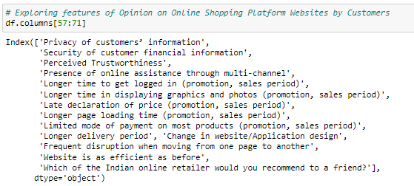
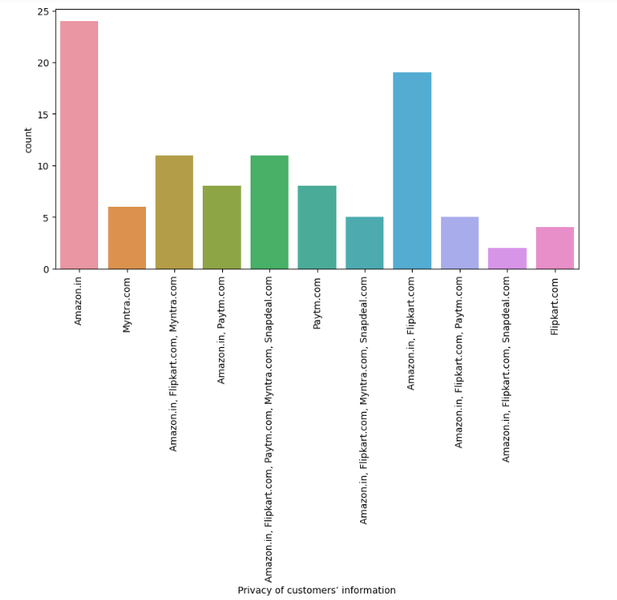
VISUALIZATIONS
7. Exploring features of Opinion on Online Shopping Platform Websites by Customers

Slide 42
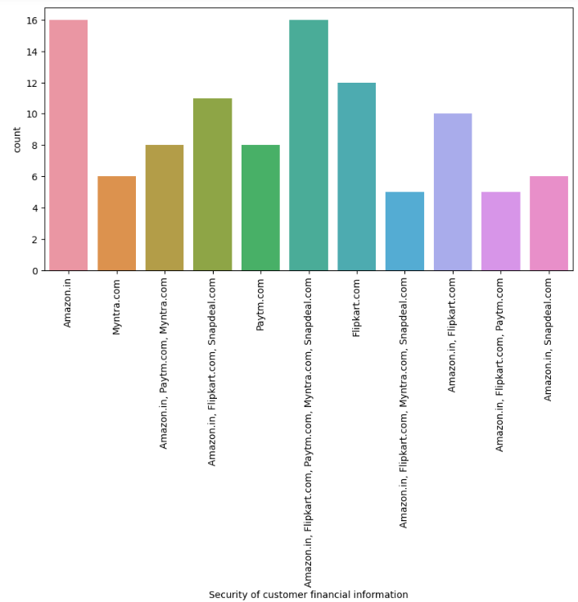
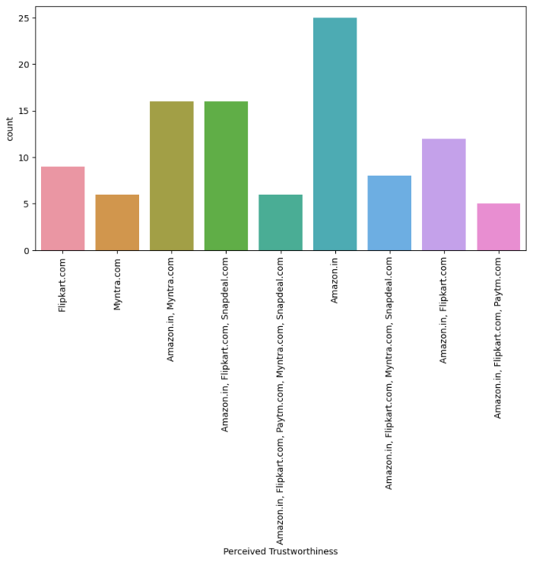
VISUALIZATIONS
7. Exploring features of Opinion on Online Shopping Platform Websites by Customers

Slide 43
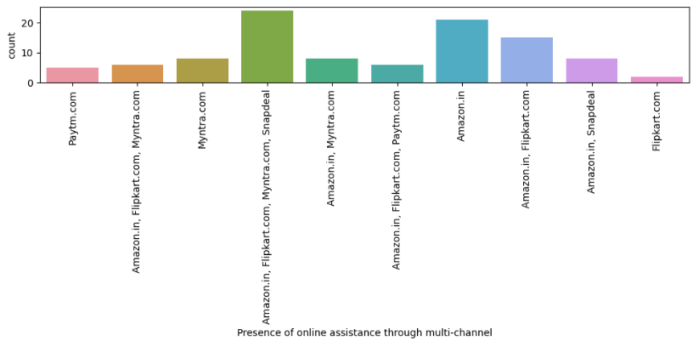
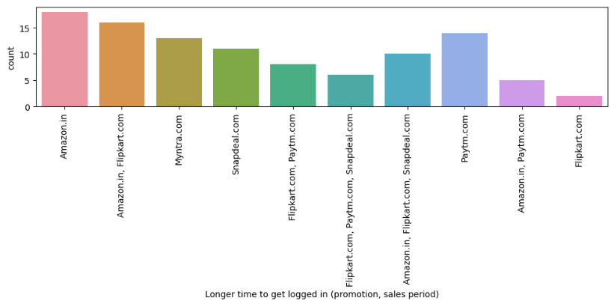
VISUALIZATIONS
7. Exploring features of Opinion on Online Shopping Platform Websites by Customers

Slide 44
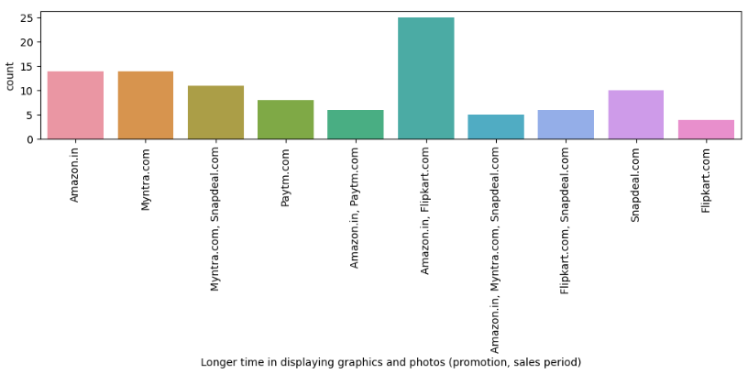
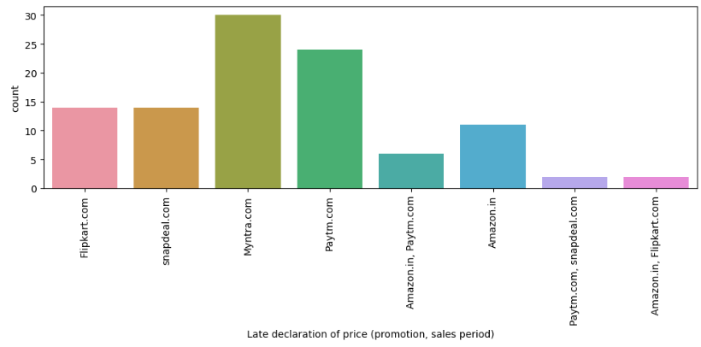
VISUALIZATIONS
7. Exploring features of Opinion on Online Shopping Platform Websites by Customers

Slide 45
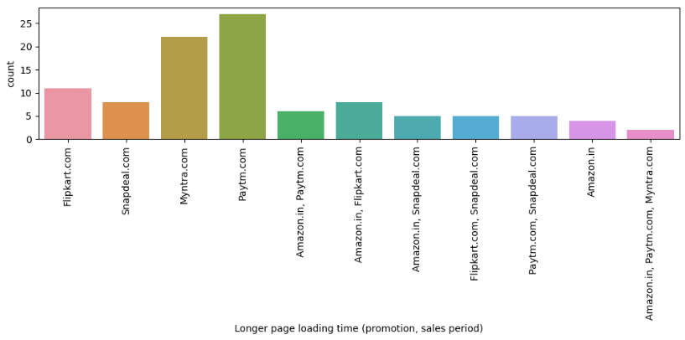

VISUALIZATIONS
7. Exploring features of Opinion on Online Shopping Platform Websites by Customers

Slide 46


VISUALIZATIONS
7. Exploring features of Opinion on Online Shopping Platform Websites by Customers

Slide 47


VISUALIZATIONS
7. Exploring features of Opinion on Online Shopping Platform Websites by Customers

Slide 48

VISUALIZATIONS
7. Exploring features of Opinion on Online Shopping Platform Websites by Customers
Observations :
Majority of customers trust Amazon.in compared to other online platforms for Privacy of customers’ information
Majority of customers trust Amazon.in followed by Flipkart.com over Security of their financial information. Only few customers trust paytm.
Amazon.in, Flipkart.com, Myntra.com, Snapdeal.com provide assistance through different multi channel.
Amazon.in take longer time to logged in while Flipkart.com take least time among all
Majority of people agree that Amazon.in, Flipkart.com takes longer time in displaying graphics and photos.
Paytm.com followed by Myntra.com take longer page loading time.
Majority customers agree that Myntra.com takes longer time for delivery* compared to others.
Majority of customers agree that Amazon.in website is as efficient as before
Majority customers recommended Amazon.in to their friends followed by Flipkart.com

Slide 49

Encoding of categorical data
There are 71 columns including target variable. Out of which, 70 columns have object data type and 1 column has int data type. In this case, column of Pincode with integers is considered as object datatype as it is a number which will be given to particular location and it will be unique. Pincode column also considered in encoding.
Used Ordinal Encoder to convert the object data into numerical data.

Slide 50

Coefficient of correlation
In this project, considered the below column as target variable.
"Which of the Indian online retailer would you recommend to a friend?
Below plot shows the relationship of all features with target variable.
Observations:
There are multiple features that have very weak correlations with target variable
Typically the correlations in the range of -0.3 to 0.3 considered as weak correlations
In this case, considering the range of -0.1 to 0.1 as very weak correlations as they are close to zero
Identified the columns in the very weak correlation range

Slide 51
Feature selection using selectkbest method
Used SelectKBest method to get the feature scores of all features with target variable
Used Chi Square test in this method as output column is having categorical data
Dataset has 70 features. The max selectKBest score is 186 and min score is 33
Considered the threshold score of 40 to drop the columns in this case as top 50 features have score more than 40
Again, checking the score values of all very weak correlated columns in the previous step and dropping the columns with very weak correlations and the score with less than 40
By applying this method, no. of features reduced from 70 to 60

Slide 52

Feature scaling
Applied MinMaxScaler to scale the entire X data to the range of values between 0 and 1.

Slide 53


Pca – principal component analysis
Applied PCA (Principal Component Analysis) to reduce the size of the dataset as dataset is having 60 features
There are 60 columns in the dataset; no. of columns will be reduced without loosing their information using PCA technique
Initially calculated the number of components needed to explain the variance
Based on that, no. of columns required be used in PCA is identified
From the plot, it is clear that 25 features are good enough to capture all the information
Hence 25 features used as no. of components in PCA to reduce the dimensions

Slide 54
Chapter 4 conclusions

Slide 55
Conclusions
Key findings of the study:
Amazon and Flipkart are standing best online retailers out in the market with competent business strategies and lot advantages over other competitors.
Paytm, Snapdeal and Myntra have poor customer services and there is lot of scope for further improvement.
Amazon and Flipkart have got more positive feedbacks than other websites with relevant to Complete, relevant description information of products, Fast loading of websites, Reliability of website, quickness to complete purchase, availability of several payment options, speedy order delivery, privacy of customers information, security of customer financial information, etc.
The customers with age < 20 years and with age> 51 years old have less tendency of shopping.
Complete description product on website or app is essential from making purchase decision.
Around 50% customers abandon cart due to better alternative offer which is obvious reason. Another most common reason is promo code not applicable on particular product.
People who have been shopping for more then 3-4 years are the ones who frequently shops.
Improve the experience of shopping for customers, as there is a lot of scope in enhancing the shopping experience to the customers. Then customers will find their way back and continue buying stuff from the best company.

Slide 56

Thank you

