Slide 1
Agent-based Modeling

Slide 2
Basics
Individual-based models or agent-based models are stochastic simulations based on the global consequences of local interactions of members of a population.
These individuals might represent plants and animals in ecosystems, vehicles in traffic, people in crowds, or autonomous characters in animation and games.

Slide 3
Basics (continued)
These models typically consist of
An environment or framework in which the interactions occur
some number of individuals defined by
their behaviors (procedural rules)
characteristic parameters.
The characteristics of each individual are tracked through time

Slide 4
Other terms
Agent-based models
Entity-based models
Individual/Entity/Agent-based simulations
Cellular automata
Differ in that all CA are homogeneous and dense

Slide 5
History of ABMs
The idea evolved in the 1940s, but was not realized as a computational approach until the 1970s/1980s.
von Neumann’s machine–an ideal cloning device– worked at Los Alamos National lab on self‐replicating systems
Stanislav Ulam, also at Los Alamos, studying crystal growth, suggested a lattice model approach
Cells on a grid with simple rules gave rise to CAs
Originally ‘by hand’ – like the game Go

Slide 6
History of ABMs
1970 ‐ John Conway, British mathematician interested in von Neumann’s work
Game of Life
Cellular Automata ‐ 2‐dimensional, ‘game’ on a grid
Simple Rules:
If a black cell has 2 or 3 black neighbors, it stays black.
If a black cell has less than 2 or more than 3 black neighbors it becomes white.
If a white cell has 3 black neighbors, it becomes black.

Slide 7
History of ABMs
Game of Life
This is expressed as “Life” as follows:
Any live cell with fewer than two live neighbors dies, as if caused by under‐population.
Any live cell with two or three live neighbors lives on to the next generation.
Any live cell with more than three live neighbors dies, as if by overcrowding.
Any dead cell with exactly three live neighbors becomes a live cell, as if by reproduction.

Slide 8
History of ABMs
Social Sciences–1960/70s
Thomas Schelling, economist, studied segregation and racial preferences.
America’s cities tend to be segregated, but people don’t necessarily express outright racism
Housing discrimination has been outlawed since 1964
Racial prejudice has declined since 1950
What is going on?

Slide 9
Schelling’s Tipping Model
Schelling’s Tipping Model (1978)
A small level of “preference” at a local scale gives rise to larger phenomena of segregation
Agents are ‘people’ on a grid, or houses in a neighborhood
Agents can have the properties of race, gender, religion, etc.
Agents evaluate “happiness”, based on neighboring squares, and ‘unhappy’ agents can switch places with each other until equilibrium occurs.
Simple rules for happiness – want 30% of neighbors in same race, gender or religion, e.g.

Slide 10
Schelling’s Tipping Model
Schelling’s neighborhood model
Netlogo – go to file: models library
Social Science and then “Segregation” model
Tweak the % similar wanted to demonstrate the neighborhood segregation emergent properties

Slide 11
Schelling’s Tipping Model
Very low preferences lead to segregation
Has been used to inform planning and such practices as affirmative action
Tipping models are useful for predicting election outcomes, demonstrating political platform efficacy, etc.
Schelling was a co‐recipient of the 2005 Nobel Prize in Economics. Considered a “father” of ABM.

Slide 12
History of ABMs ‐ Boids
1987 Craig Reynolds published “Flocks, herds and schools: A distributed behavioral model,”
This is an agent‐based model of herd behavior. Agents in these kinds of models are called “boids,” which is both a contraction of “bird‐oid” and an accented pronunciation of “bird,” although boids are also used to model fish and herding land animals.

Slide 13
History of ABMs ‐ Boids
Each agent simulates three behaviors:
Collision avoidance:
avoid obstacles, including other birds.
Flock centering:
move toward the center of the flock.
Velocity matching:
align velocity with neighboring birds.
Boids make decisions based on local information only; each boid only sees (or pays attention to) other boids in its field of vision and range.

Slide 14
History of ABMs ‐ Boids
NetLogo – “Flocking” model
Based on Boids

Slide 15
Nature of Individual Variation
Variability in space
Demographic variability or life cycle details
Phenotypic variation or behavior
Experience and learning
Genetics and evolution

Slide 16
Classic Applications
Ecology and Biology
Panthers
Fish
Bees
Trees
Humans
Traffic
Economics
Epidemiology
Commercial – Roomba!

Slide 17
Programming and Software
Object-oriented languages – C++, java
SWARM
RePast
NetLogo
Lots of other specialized packages
Event-driven versus time-step

Slide 18
Processes addressed with IBMs
Movement through space
Formation of patterns among individuals
Effects of diffusion and mixing
Management and control measures
Evolutionary processes

Slide 19
Estimating tick-borne disease risk with an agent-based model
Holly Gaff
Old Dominion University
Department of Biological Sciences

Slide 20
Tick-borne diseases
Lyme disease
Spotted fever group
Ehrlichiosis
Anaplasmosis
Tick-borne encephalitis

Slide 21
Why study ticks?
Increase in incidence of tick-borne diseases
Increase in areas reporting tick-borne diseases
Seemingly unpredictable outbreaks
Climate change will only amplify vector-borne disease prevalence

Slide 22
What makes ticks so unique?
Punctuated life history
Egg, larvae, nymph, adult
Only one bloodmeal per life stage
Can survive off host for months to years of time between meals
Many species have different preferred hosts for each life stage

Slide 23
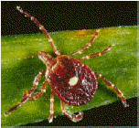
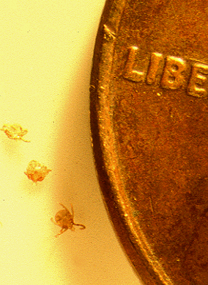
Lone Star Tick
©1999 John VanDyk

Slide 24
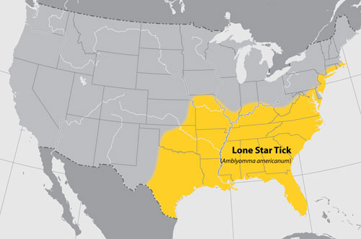
Lone Star Tick Range
©2009 CDC

Slide 25
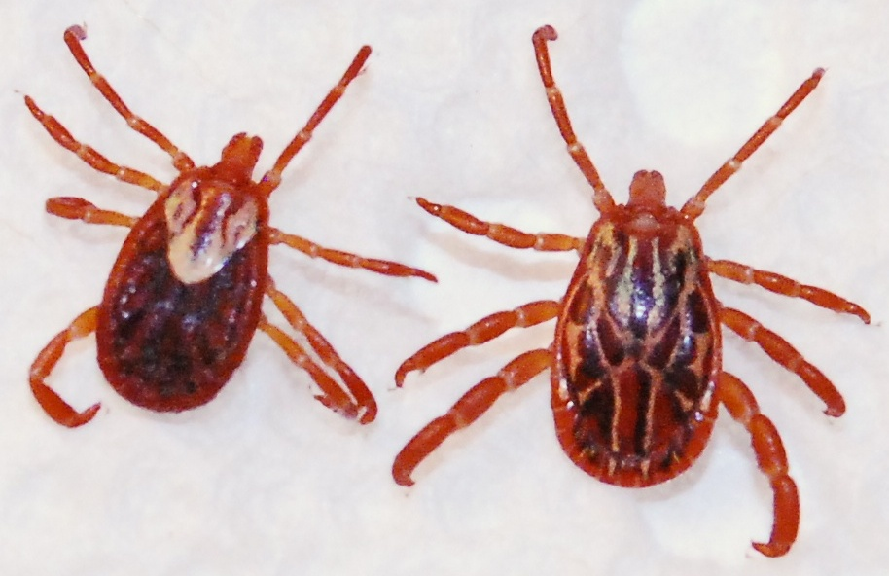
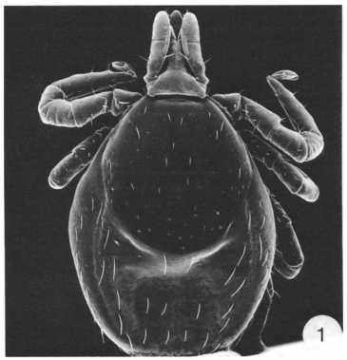
Other ticks on the move
http://www.deh.enr.state.nc.us/phpm/images/AMFemale_Male2.jpg
J Parasitol. 1987 Jun;73(3):646-52.

Slide 26
Two approaches
Population level differential equation based model
Individual-based model

Slide 27
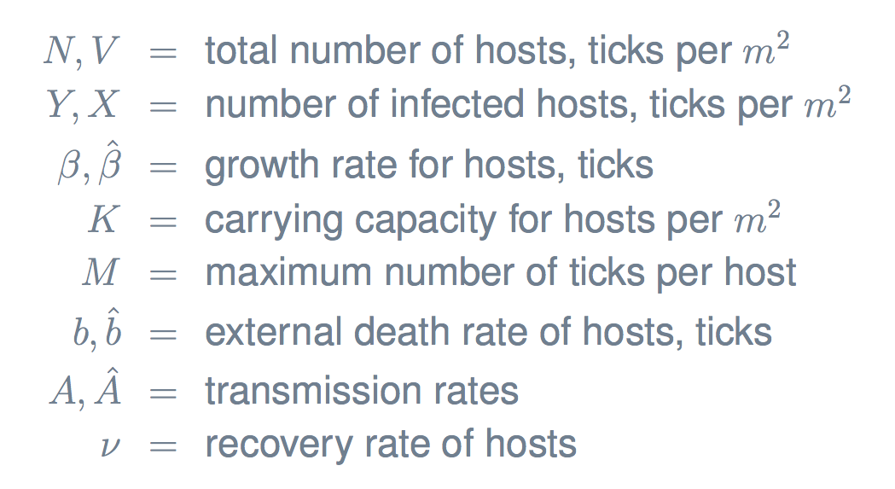
Differential Equation Model

Slide 28
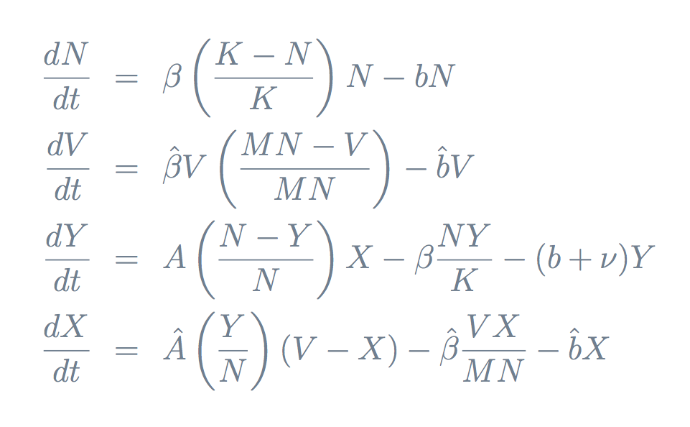
Differential Equations

Slide 29
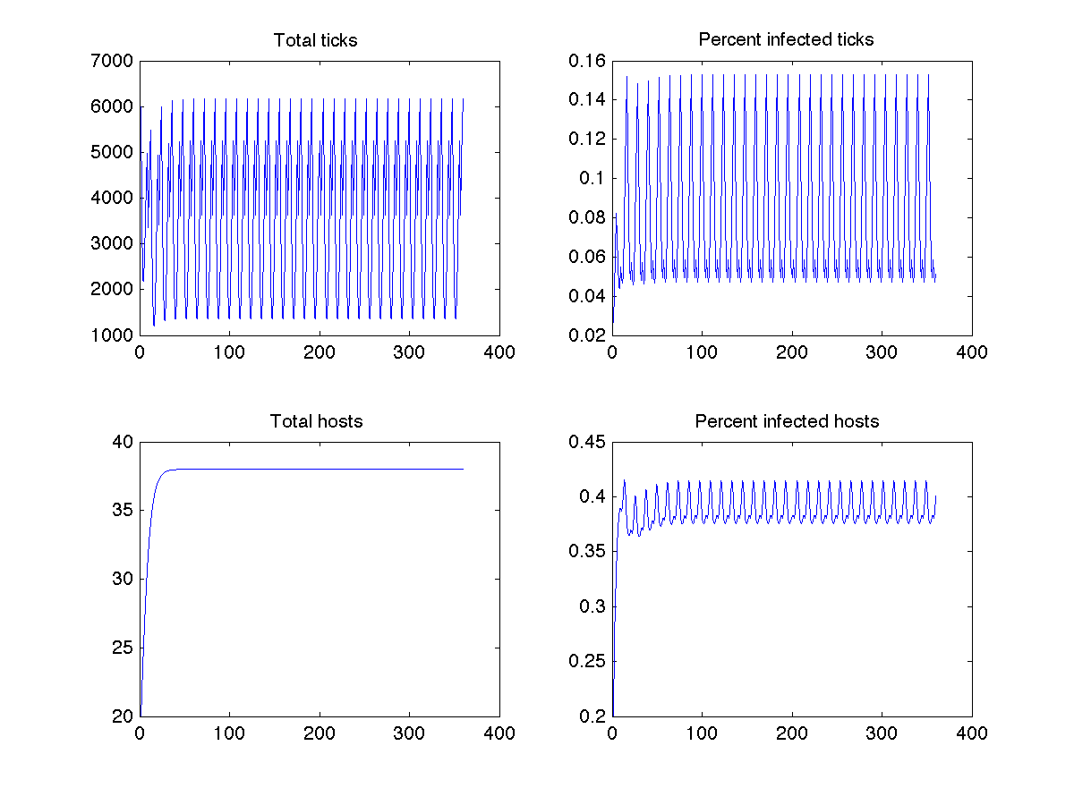
Model without recovery

Slide 30
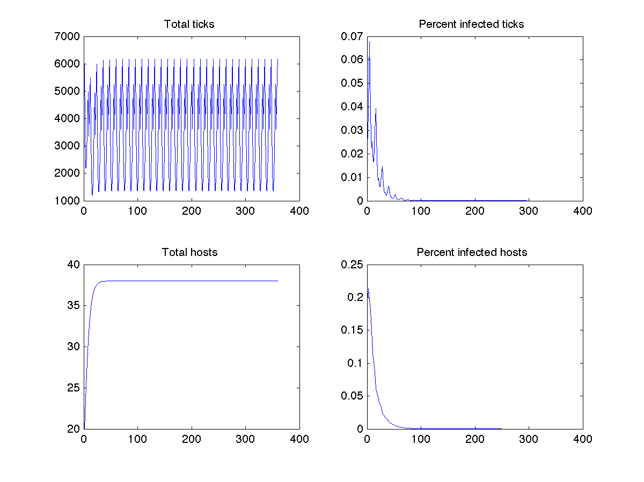
Model with recovery

Slide 31
Why agent-based?
Many models look at population based-approach
Some include age structure
Question remains if unique life history is accurately reflected in population models

Slide 32
Agent-based model
Three types of agents: ticks, deer, other hosts
Uniform landscape of patches
Behave according to rules given
Prototype implemented in NetLogo

Slide 33
Ticks
ID #: unique identifier for each tick
sex: male, female
age: # of days
location: coordinates of current patch
stage: egg, larva, nymph, adult
time in current stage: # of days
infection status: susceptible, infectious
hosts: list of all hosts used for bloodmeal by ID #
current activity: resting, questing, feeding, laying eggs (female only)

Slide 34
Deer
ID #: unique identifier for each deer
age: # of days
ticks: list of all ticks on deer at current time by ID #
ticks ever: sum of all ticks ever on deer
infection status: susceptible, infectious, immune

Slide 35
Rules for each day
Calculate mortality of ticks
Climate related death rate is calculated based on time of year
Each tick is assessed for probability of climate-related death
Calculate mortality of deer
Each deer is assessed for probability of death based on age
All ticks feeding on the deer at the time of death are assumed to also die
Any deer that dies is immediately replaced to maintain a constant population

Slide 36
Rules (continued)
Calculate mortality of hosts
Each host is assess for probability of death based on age
All ticks feeding on the host at the time of death are assumed to also die
Any host that dies is immediately replaced to maintain a constant population
Movement of deer
Deer move randomly to a neighboring patch
Movement of hosts
Hosts move randomly to a neighboring patch

Slide 37
Rules (continued)
Update ticks activity status
If resting over, change to questing
If questing, search for deer or host
If done feeding, move to resting (if larva or nymph), die (if adult male) or lay eggs (if adult female)
Check for new infections in deer
Check for new infections in hosts
Check for new infections in ticks
Check for recovery in deer
Check for recovery in hosts

Slide 38
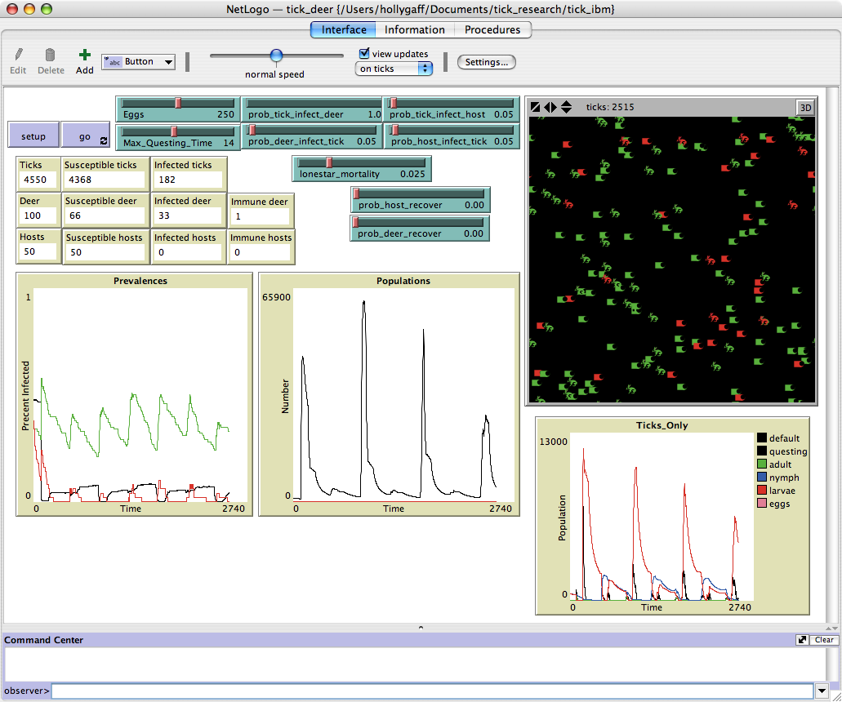
Agent-based model

Slide 39
Host questions
Many researchers feel that host diversity can significantly influence disease incidence
For most hosts, the length of illness and whether recovery confers immunity are unknown

Slide 40
Model Structure
Recovery
Reproduction
Infection
Infected Deer
Deer
Reproduction
Infected Ticks
Ticks
Infection

Slide 41
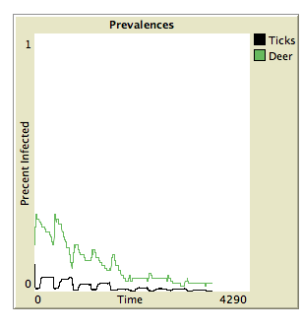
Deer only

Slide 42
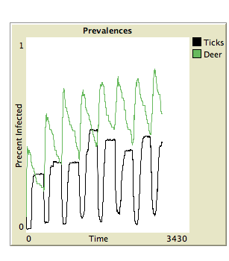
Deer only – High transmission

Slide 43
Model Structure
Recovery
Reproduction
Infection
Infected Deer
Deer
Reproduction
Infection
Infected Ticks
Ticks
Reproduction
Infection
Infected Other
Other

Slide 44
Other hosts
ID #: unique identifier for each host
age: # of days
ticks: list of all ticks on host at current time by ID #
ticks ever: sum of all ticks ever on host
infection status: susceptible, infectious, immune

Slide 45
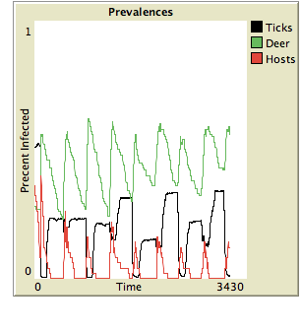
Deer (high) and Hosts (low)

Slide 46
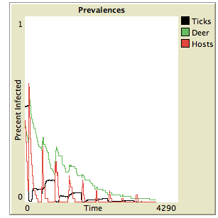
Deer (low) and Hosts (high)

Slide 47
Time to extinction
Average time to loss of disease without recovery
20 years
Average time to loss of disease with recovery in all hosts except deer
5 years
Average time to loss of disease with recovery in deer but not other hosts
2 years

Slide 48
Additional benefits of IBM
Can assign variable parameter values
IBM does provide much needed ability to track only questing ticks directly
Useful to compare with field data

Slide 49
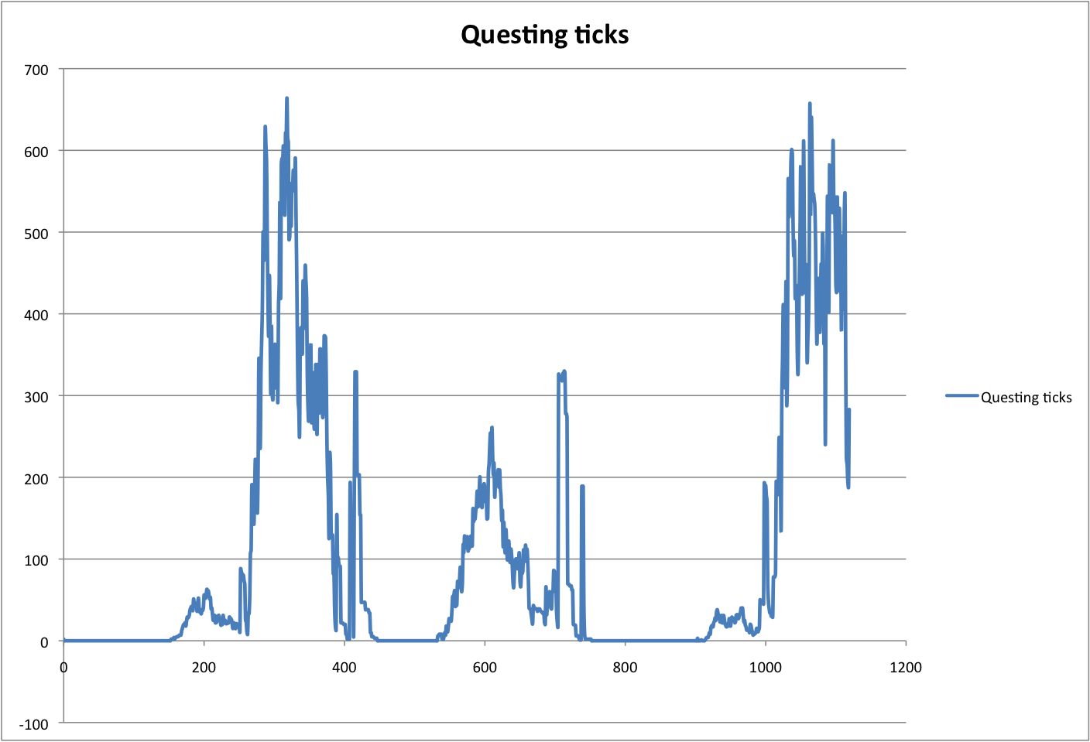
Results

Slide 50
Lone Star Ticks

Slide 51
Conclusions
Provides insights into disease dynamics
Useful in identifying key data gaps
Need more runs of ABM to truly compare with population level approach

Slide 52
Conclusions
Infectivity and recovery are important to identify for hosts
No easy solution to reducing risk of tick-borne disease

Slide 53
Acknowledgements
Steve Dumler, Dan Sonenshine, Rick Ostfeld, Abdu Azad, Denise Kirschner, Elsa Schaefer, Lou Gross
Wayne Hynes, Emily Pauler, Matt Benz, Joy Boyles, Robyn Nadolny, Ryan Wright, Brandon Rowan, Amanda Simmons, Chelsea Wright
Supported by Grant Number K25AI067791 from the National Institute Of Allergy And Infectious Diseases. The content is solely the responsibility of the author and does not necessarily represent the official views of the National Institute Of Allergy And Infectious Diseases or the National Institutes of Health.

Slide 54
Epidemiology Example
What is the most cost effective way to prevent the spread of methicillin-resistant Staphylococcus aureus (MRSA) within a 10-bed intensive care unit (ICU)?

Slide 55
MRSA in ICU
MRSA in hospitalized patients is an increasing nosocomial problem
Patient-to-patient transmission in ICU populations is thought to be a great contributor
Transmission of MRSA may be reduced through isolation of colonized individuals.

Slide 56
Infection control strategies
Passive Surveillance isolation of only those patients with a history of MRSA colonization or infection
Active surveillance using anterior nares cultures, with isolation when cultures return positive in a mean of 48 hours (a “innocent until proven guilty” strategy)
Active surveillance using a rapid-test with 8-hour return time
Active surveillance with immediate isolation and removal from isolation when standard 48-hour active surveillance cultures return negative (a “guilty until proven innocent” strategy).

Slide 57
So what do we do?
How do we want to set up this problem?
Should we use an IBM? Why or why not?

Slide 58
Ok, we want an IBM…
What is the environment?
What is an “individual”?
What are the rules?
What are we measuring?

Slide 59
Set up IBM
Environment – hospital ward
What parameters do we need here?
Individuals – patients
What parameters do we need here?
Could also include hospital workers explicitly
Rules for processes
What processes do we need to track?
Choose time step
4 hours

Slide 60
Hospital ward structure
Number of beds - maximum number of beds for that ward
New patient policy - isolate all new patients or isolate only after positive MRSA test
Proportion of new patients tested for MRSA - probability of new patient being tested
MRSA test results return time - average number of time steps for test results
Specificity of MRSA test - probability of false positive
Sensitivity of MRSA test - probability of false negative
Length of stay - average number of time steps patient remains in unit
Patients MRSA colonized on admit - probability of new admit being MRSA positive on arrival
Daily probability of MRSA infectious contact - probability of infectious contact Effectiveness of isolation for MRSA - reduction in contact rate from isolation

Slide 61
Individual Patient Data
ID Number - Unique identifying number assigned sequentially
Bed Number - Assigned bed
MRSA status – negative or positive (actual status)
Isolation status - not isolated or isolated
MRSA test status
Date of last test - time step of last test
Result of last test - neg result, pos result, pending
Return time - incremented while pending
Antibiotic use - none, penicillin, etc.

Slide 62
Rules
Admissions
MRSA test
Colonization event
Discharge

Slide 64
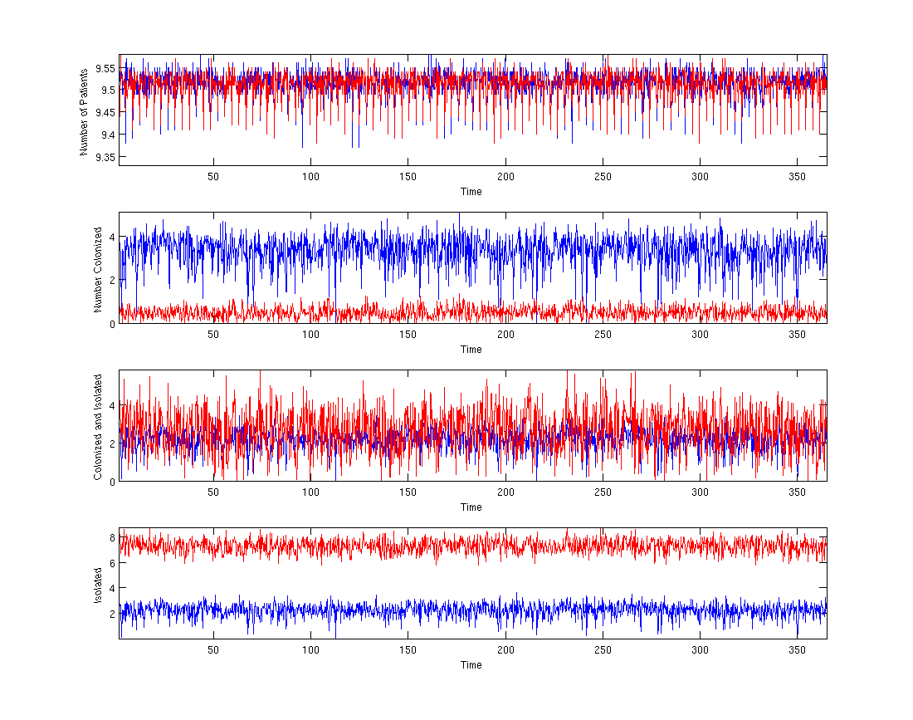
Results

Slide 65
But what are we trying to answer?
What do we care about most?
How do we measure cost effectiveness?

Slide 66
Meaningful results
 | 1% | 5% | 12.30% | 20% | 30%
LOS1 | 59491.97101 | 7442.971503 | 4497.266051 | 3395.508 | 3592.962313
LOS2 | 5573.460334 | 2733.248405 | 2139.547218 | 2263.750962 | 2229.325525
LOS3 | 3047.649485 | 2872.911243 | 2017.470506 | 2063.393079 | 2478.57986
LOS4 | 2704.226553 | 1772.923819 | 1581.283348 | 2003.640665 | 2973.169665
LOS5 | 2555.161096 | 1576.877784 | 2194.958608 | 2613.660783 | 3093.517127
Total cost of isolation with a rapid test for various lengths of stay and incoming prevalence

Slide 67
More results
Find point when cost-effectiveness of rapid testing is lower than standard testing

Slide 68
Next steps
Expand to additional wards within one hospital
Model hospital staff explicitly
Test other strategies such as even faster return test
Other ideas?

Slide 69
EpiSims
Developed by LANL
Tool for simulating the spread of epidemics at the level of individuals in a large urban region, taking into account realistic contact patterns and disease transmission characteristics

Slide 70
Other epidemiology uses
Test targeted vaccines
By age
By number of contacts
Ring vaccination
Test isolation and quarantine strategies
Assess super-spreader concepts

Slide 71
Take home messages
IBMs generally require more careful consideration
IBMs rapidly become computationally intense
Very useful for addressing some types of questions

Slide 72
NetLogo Examples
Open NetLogo
Open Library->Biology->Evolution
-> Genetic Drift
GenDrift P global
GenDrift P local
GenDrift T interact
GenDrift T reproduce

Slide 73
NetLogo Exercises
Using information from GenDrift P local to figure out how to make GenDrift P global stop when you reach fixation

Slide 74
NetLogo Exercises
Behavior Space
Use to make multiple runs of same model
Run your choice of Genetic Drift models
Save time to convergence for 100 runs of model

Slide 75
Beyond NetLogo Library
Many, many more models on-line in contributed library
http://ccl.northwestern.edu/netlogo/models/community/sheep-selection

