Slide 1
M&S in Life Sciences
BIOL 772/872

Slide 2


Slide 3
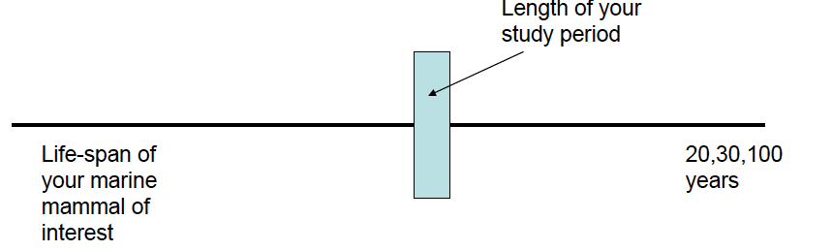
Analyzing impacts from the past in a long-lived species

Slide 4
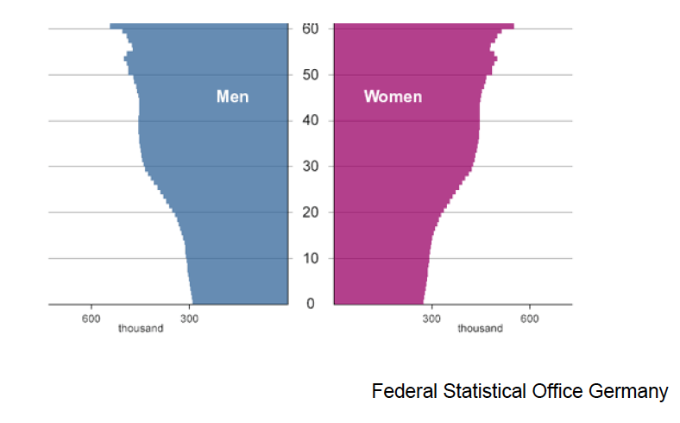
Predicted age-distribution in 2050 in Germany

Slide 5
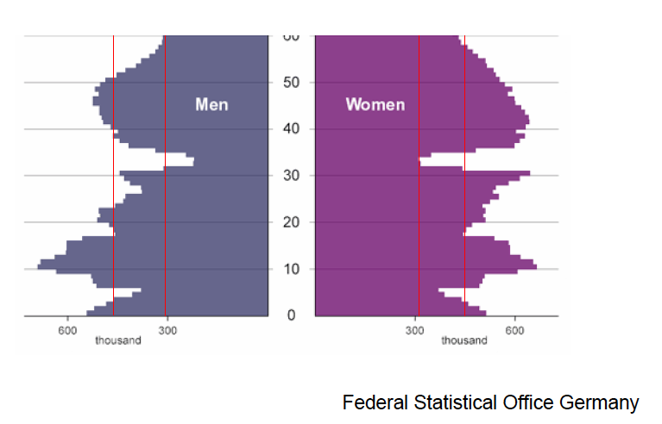
Actual age-distribution in 1950 in Germany

Slide 6
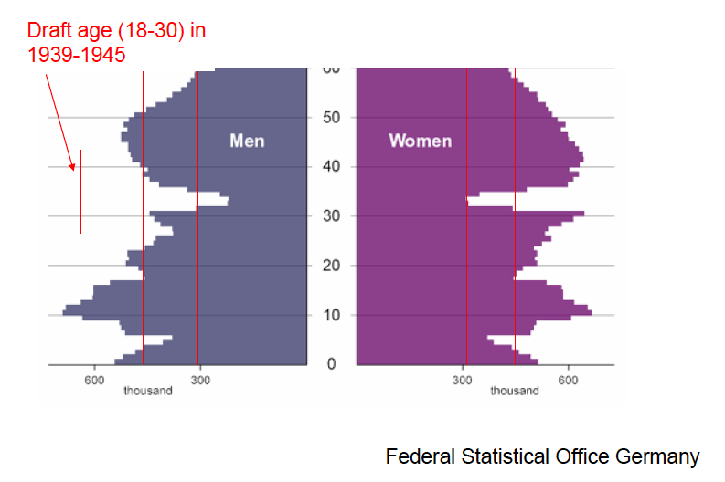
1950 Germany

Slide 7
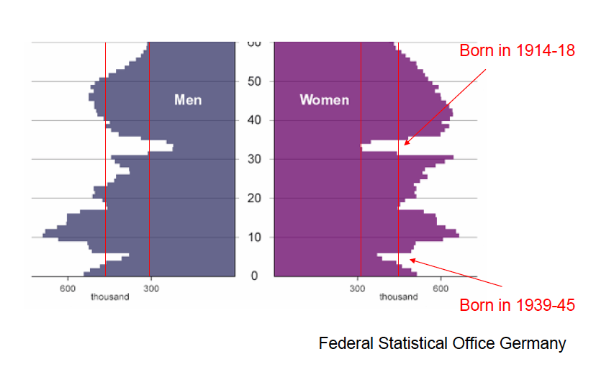
1950 Germany

Slide 8
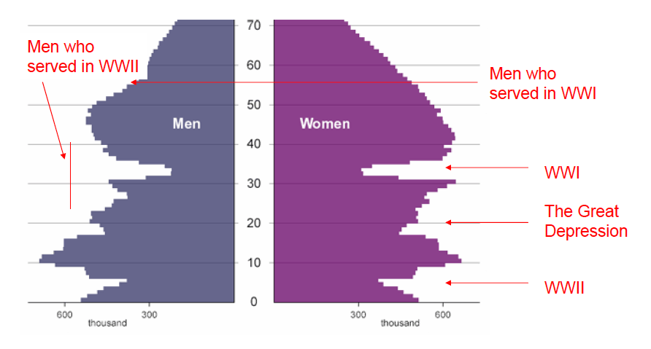
1950 Germany

Slide 9
Demographic PVAs
Particularly with long-lived organisms all individuals are not equal
Need to explicitly account for differences in growth, survival and reproduction with age
Use matrix population models to project future population growth
Based on survival, growth and reproduction of different individuals in population

Slide 10
Demographic PVAs
Conduct study using marked individuals and measure growth, survival and reproduction over several years
Classify individuals into stages like size or age (unknown for many species)
Stages dependent on species (e.g. young juvenile, old juvenile, young adult, reproductive adult, old reproductive adult)
Estimate vital rates for each stage

Slide 11
Back to Structure Example
Suppose we know the following:
Tick life stages: egg, larva, nymph, adult
On average 10% of eggs survive to larvae
On average 5% of larvae survive to nymphs
On average 5% of nymphs become adults
How many eggs would an adult female have to lay on average for this population to survive?

Slide 12
Demographic PVA
Eggs
Larvae
Nymphs
Adults

Slide 13
Vital Rates
Like most demographic analyses, PVAs focus on key birth and death processes
Simpler models ignore immigration and emigration (although more complicated ones can include multiple populations with migration)

Slide 14
Population
Stage 1
Stage 2
Stage 3
Stage 4

Slide 15
Vital Rates
Survival
Typically refers to remaining in an stage class (age class)
Growth
Typically refers to going from one stage class (age class) to another
Reproduction
Typically refers to number of offspring per individual (usually female)

Slide 16
Life Tables
Transform cohort information into survivorship and fecundity rates
Cohort | Adults (n_{x}) | Offspring (m_{x})
0 | 100 | 0
1 | 50 | 0
2 | 10 | 4
3 | 2 | 50

Slide 17
Life Tables
Number dying:
d_{X} = n_{x}-n_{x+1}
Proportion surviving:
l_{x} = n_{x} / n₀
s_{x} = n_{x+1} / n_{x}
Mortality rate:
q_{x} = d_{X} / n_{x}
Fecundity rate:
f_{x} = m_{x} / n_{x}

Slide 18
Life Tables
Cohort | Adults | Offspring | d_{x} | l_{x} | s_{x} | q_{x}
0 | 100 | 0 | 50 | 1.0 | 1.0 | 0.5
1 | 50 | 0 | 40 | 0.5 | 0.5 | 0.8
2 | 10 | 4 | 8 | 0.1 | 0.2 | 0.8
3 | 2 | 50 | 2 | 0.02 | 0.2 | 1.0

Slide 19
Life Tables
Cohort | Adults | m_{x} | l_{x} | l_{x}m_{x} | f_{x}
0 | 100 | 0 | 1.0 | 0 | 0
1 | 50 | 0 | 0.5 | 0 | 0
2 | 10 | 4 | 0.1 | 0.4 | 0.4
3 | 2 | 50 | 0.02 | 1.0 | 25

Slide 20
Mathematical Concepts
Matrix
Ordered array of numbers or variables
Arranged into rows and columns

Slide 21
Mathematical Concepts
To the board….

Slide 22
Leslie Matrix
Cohort | s_{x} | f_{x}
0 | 1.0 | 0
1 | 0.5 | 0
2 | 0.2 | 0.4
3 | 0.2 | 25

Slide 23
Leslie Matrix
Need to calculate largest eigenvalue and corresponding eigenvector
Solve

Slide 24
Leslie Matrix

Slide 25
Leslie Matrix
Solve equations by calculating determinants for eigenvalue
Solve for eigenvector using that eigenvalue

Slide 26
Leslie Matrix
Need to calculate largest eigenvalue and corresponding eigenvector

Slide 27
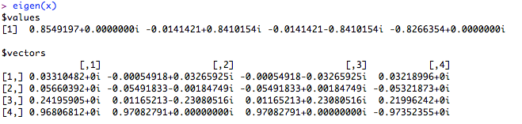
Leslie Matrix
From R:
x <- matrix(c(0,0,0.4,25,0.5,0, 0,0,0,0.2,0,0,0,0,0.2,0),4)

Slide 28
Leslie Matrix
So λ= 0.85
V ={0.856928, 0.501175, 0.117245, 0.0274283}
What does that mean for the population?

Slide 29
Matrix Models
Considerations
Elasticities
Sensitivities
Examples

Slide 30
Leslie Matrix from Life Table
Pre-breeding Census
Post-breeding Census

Slide 31
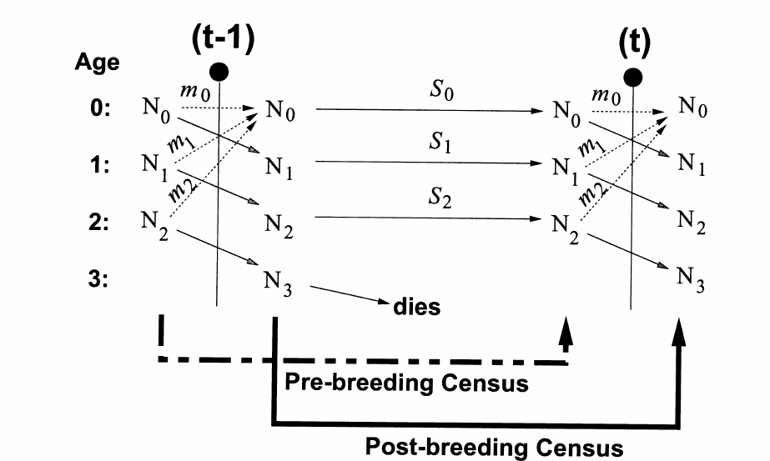
Leslie Matrix

Slide 32
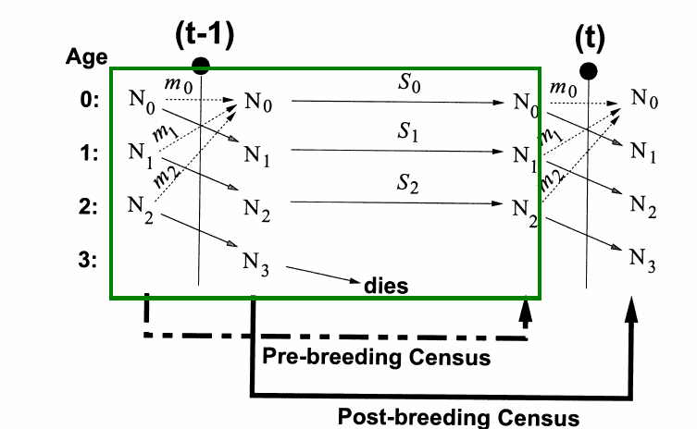
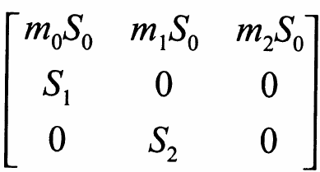
Pre-breeding Census

Slide 33
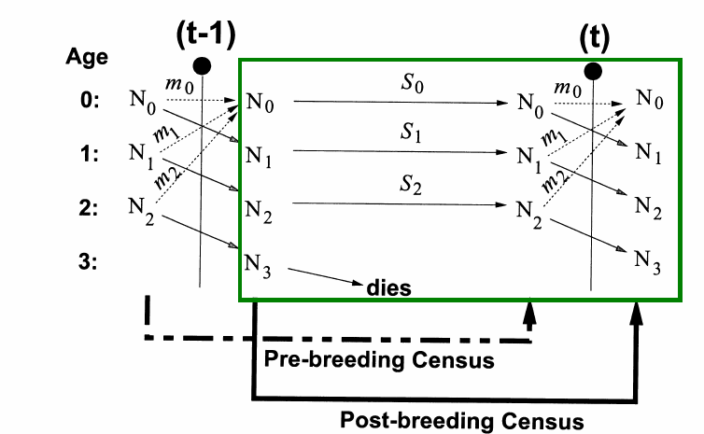
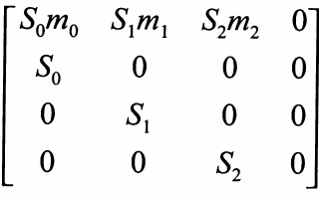
Post-breeding Census

Slide 34
Elasticity Analysis
Elasticity analysis is a method determining the “sensitivity” of population growth (λ) to scaled changes in vital rates (growth, survival, reproduction)
The analysis looks at this sensitivity of growth to change in each element in the matrix (for each stage)
Based on this, we can conclude which elements (which stages and rates) will have the greatest influence on population survival

Slide 35
Elasticity Analysis
Consider the following Leslie matrix:

Slide 36
Elasticity Analysis
If we change

Slide 37
Elasticity Analysis
If we change

Slide 38
Elasticity Analysis
So changing first-year survivorship impacts growth more than first-year reproduction, right?

Slide 39
Elasticity Analysis
Actually want to divide by amount changed to make it fair if we changed different amounts
Sensitivity coefficient is defined as:

Slide 40
Elasticity Analysis
But why might sensitivity coefficients not be fair?

Slide 41
Elasticity Analysis
Elasticity measures proportional effect of a given parameter

Slide 42
Elasticity Analysis
Coefficient | Sensitivity | Elasticity
a₁₂ | 0.2030 | 0.1532
a₁₃ | 0.0766 | 0.2312
a₂₁ | 0.7278 | 0.3844
a₃₂ | 0.6128 | 0.2312

Slide 43
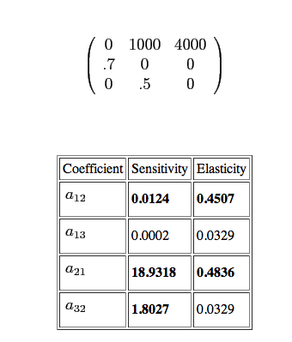
Elasticity Analysis

Slide 44
Elasticity Analysis
What is missing here?

Slide 45

Identifying Key Life Stages
Management actions can be determined based on information about which life stages are most important for population growth
Crouse et al. (1987) and Crowder et al. (1994) used PVAs to assist with management of threatened logger head turtles in southeastern U.S.

Slide 46
Identifying Key Life Stages
Need to detemine which of two major threats to logger head turtles is most important
Trampling of eggs and hatchlings on beaches
Drowning of adult turtles in fishing nets

Slide 47
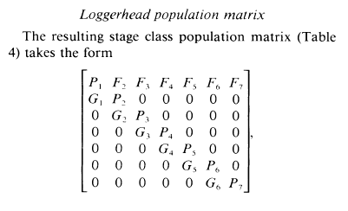
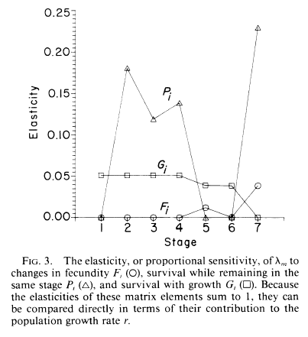
Loggerhead Turtle PVA
From Crouse et al. 1987

Slide 48
Identifying Key Life Stages
They use PVAs on population data to measure the contributions of different life stages to population growth
They found that reproductive adults were the most important stage

Slide 49
Identifying Key Life Stages
Efforts aimed at saving eggs and hatchlings would not reverse population declines even if they were 100% effective
Putting TED (turtle excluder devices) in fishing nets to prevent drowning would produce recovery even if didn’t eliminate all mortality

Slide 50
Consequences of Elasticity Analysis
Determine which stages contribute most to population growth
Management can focus on most important life stages
Reserves can be created to accommodate most important life stages for organisms with complex life histories, migration

Slide 51
Criticisms of PVA: Are Models Reliable?
Poor data quality
Data requirements for even deterministic model are not trivial
Good estimates of means (and variances) of vital rates are difficult to obtain for endangered species
Dispersal is especially tough to estimate with certainty

Slide 52
Criticisms of PVA: Are Models Reliable?
Form of density dependence unknown
Patterns of environmental stochasticity might not hold in future
Catastrophic events could alter extinction risk dramatically

Slide 53
Criticisms of PVA: Are Models Reliable?
“Canned” programs
Allow novice users to conduct PVA without enough understanding
Different programs can produce dissimilar results with same data
Models not usually validated with field data

Slide 54
General Recommendations for using PVA
PVA should be treated as a model. Validity of models should be tested with independent field data and PVA adjusted accordingly.
Evaluate relative rather than absolute rates of extinction or growth.

Slide 55
General Recommendations for using PVA
Do not focus on any one value
models are not accurate enough to make such precise predictions
Include uncertainty and sensitivity analysis
Compare short-term and long-term projections.

Slide 56
More complex structures
Doesn’t have to be simple linear life stages
Can move both directions with size or stage structure

Slide 57
Mark-Recapture for Structure
What if you have multiple age classes?
Can you use similar technique to estimate changes?

Slide 58
Mark-Recapture Game
Put handful of clear beads and blue juvenile beads in cup
Take one sample (one handful) of your population
Count beads sampled noting color
Replace all of those clear adults with blue adults, replace blue juveniles with yellow
Mix thoroughly!!!
Take another sample (one handful) of your population
Count number of each kind of beads in re-sample
Resample at least 5 times (do NOT mark, just resample)

Slide 59
Structured Game
How do your results look?
What implications could you make?
What is still missing?
This is census data.

Slide 60
Back to R

Slide 61
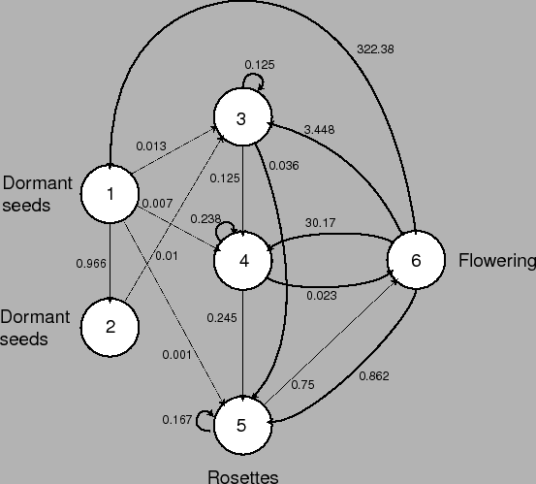
Life Cycle
http://darwin.eeb.uconn.edu/eeb310/lecture-notes/pva/node5.html

