Slide 1
Life Tables
Notes:
These are fake notes for the title page

Slide 2
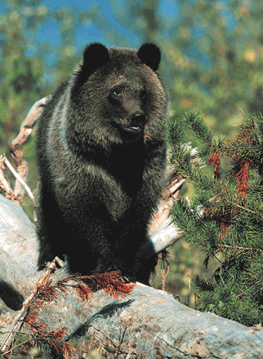
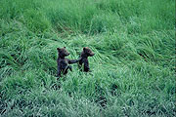
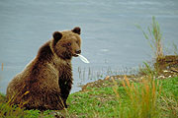
Grizzly Bears (Ursus arctos horribilis)
Notes:
The grizzly bear is one of several subspecies of brown bears. Their color ranges from light brown (almost blonde) to black. They have a sturdy, stocky build and a noticeable hump behind the head. The claws of a grizzly bear are long and curved and can not be retracted.
Grizzlies were listed as a threatened species in 1975, after populations in the lower 48 states dropped from 100,000 to less than 1,000.

Slide 3
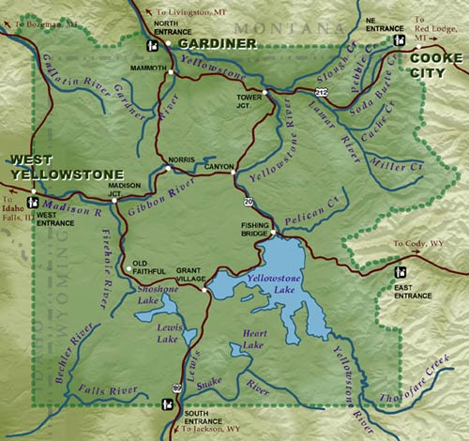
Grizzly Bears (Ursus arctos horribilis)
  Yellowstone grizzly population was declining
  Age-structured models
  survival of mothers was most important to the population
  Legislation resulting from his findings got tourists out of areas with mothers and cubs
  Yellowstone grizzlies began to recover
Notes:
Mark Shaffer, 1978 PhD at Duke
Females have cubs at around age five. She will give birth to 2 - 4 cubs, but usually twins in January. They weigh about 1 lb at birth and will suckle until May. The cubs stay with the mother until age 2 and then go off alone and repeat the cycle. Their life span is around 25 years.

Slide 4
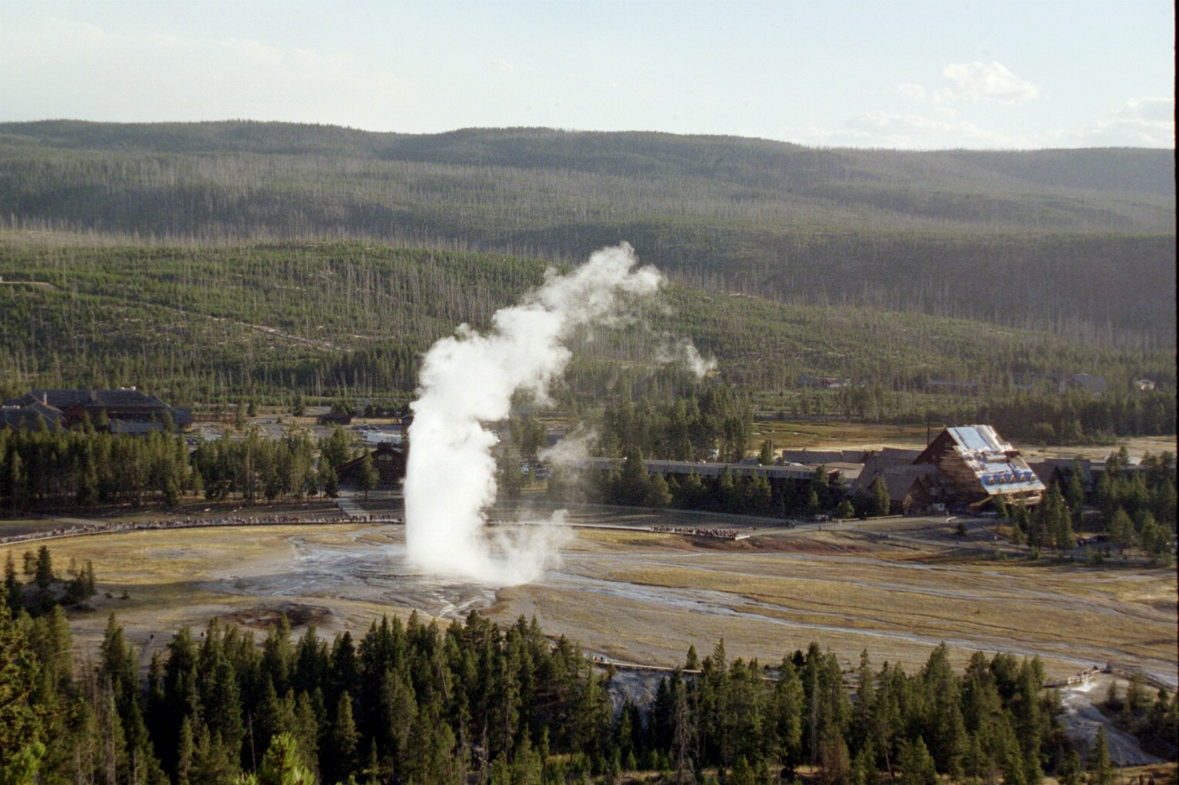
Notes:
Go to Yellowstone if you can – this is just this past summer
1988 – huge fires took out a lot of tree cover – not clear if grizzlies are just more visible now, or if the numbers are really increasing
1997 – I saw a grizzly in Yellowstone.

Slide 5
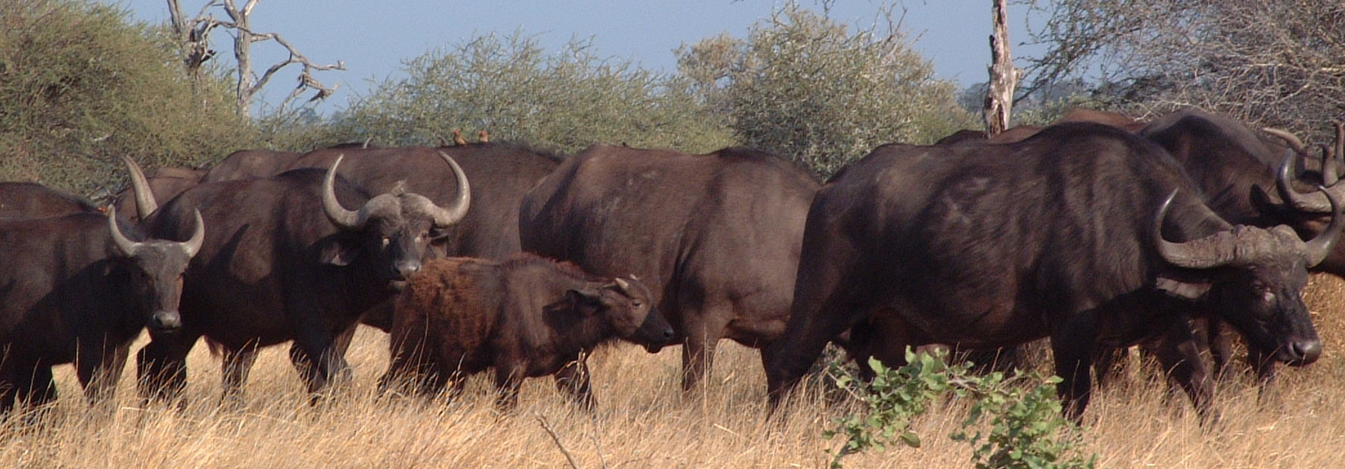
Population structure
Sex (gender)
Age
Size (better for plants)
Birth, death and movement rates vary in different sex, age, or size categories.

Slide 6
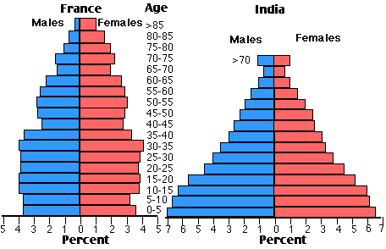
Human age and sex structure
Notes:
France is showing a decreasing population (younger age groups not enough to replace older age groups.

Slide 7
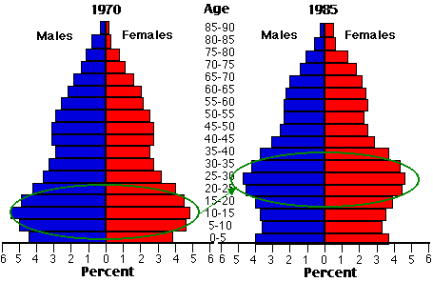
Baby boom and social security
Notes:
US population structure.
Substituting age for time.

Slide 8
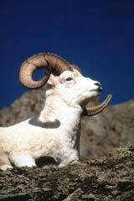
Structured data
Known (or marked) individuals
Carcasses
Age structure (how many of what age)
Sex ratio (how many of what sex)

Slide 9
Life tables
Cohort (dynamic): follow all individuals born in one time interval (e.g. year) until they die
Cross-sectional (static): take a snap-shot of the current age-structure
Composite: data taken from multiple years
Notes:
The data are neither a single cohort nor a single slice in time. Instead they represent a (we hope more or less random) sample of individuals that died over a series of years.

Slide 10
Notation
x = age of the individual
n_{x} = number of individuals of age x
l_{x} = number (or %) of individuals alive at age x
m_{x} = fecundity rate
average # of female offspring produced per female per time period
--------------------------------------------------------------------------------------------------
p_{x} = survival rate
probability of surviving from age x to x+1
q_{x} = mortality rate
probability of dying between age x and x+1

Slide 11
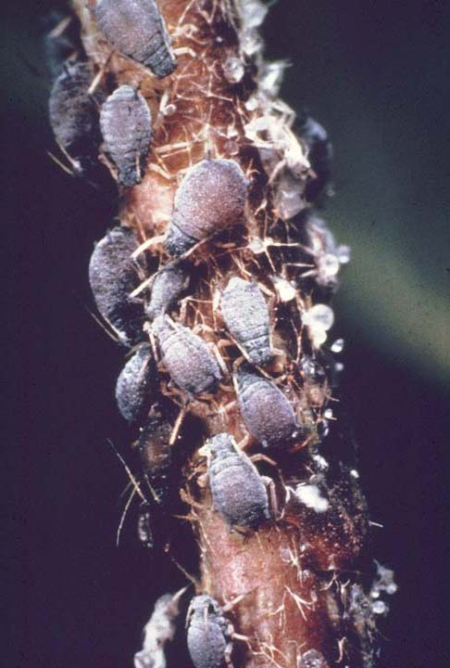
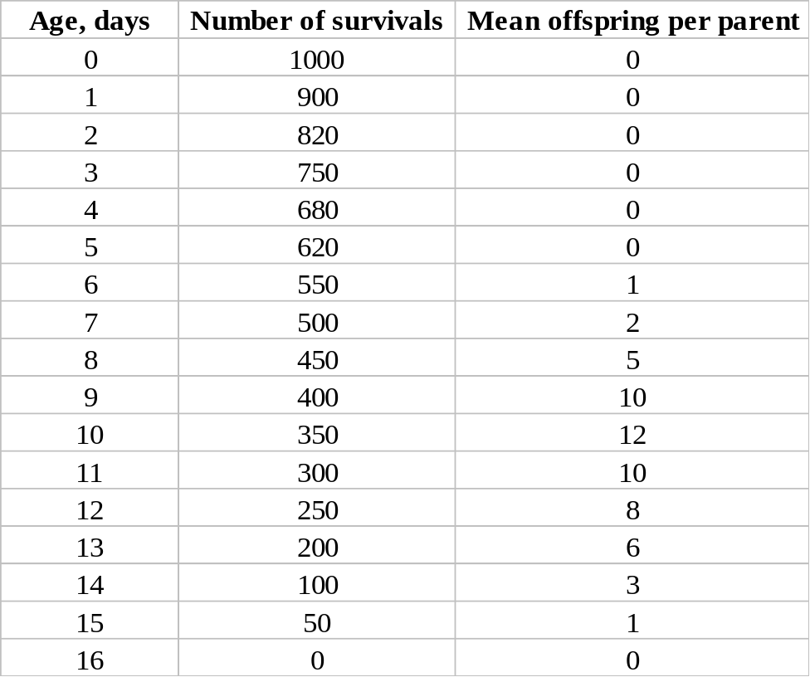
Aphids Aphidoidea
Excel data sheet – start with 1000
  Cohort study
Notes:
This is data you can collect in a lab experiment – start with a cohort of 1000 aphids born. In this case, they are all female clones.
Aphids are divided up into 10 families all of which have been extant for 50 to 70 million years. Two families, the Aphididae and the Drepanosiphidae make up 70% of the species.

Slide 12
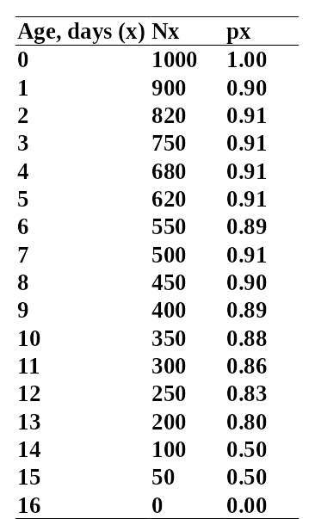
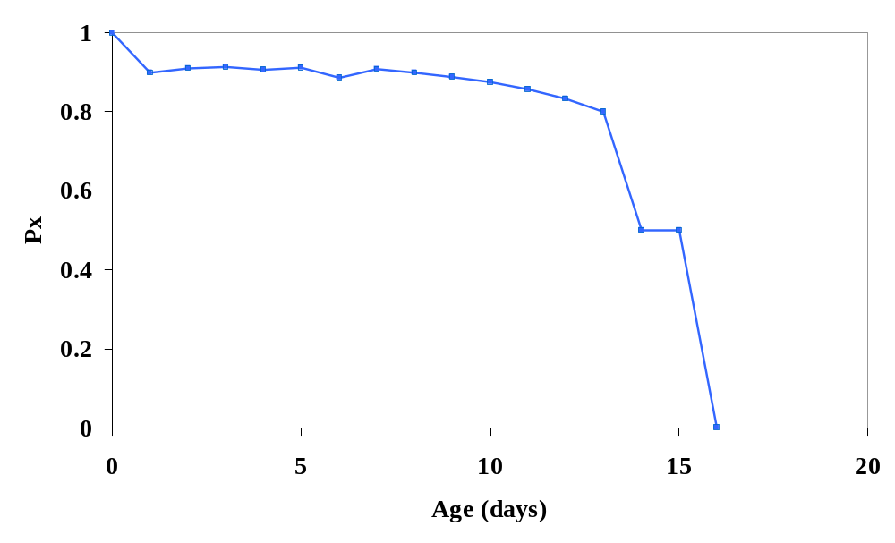
Survival – p_{x}
p_{x} – the probability of surviving from x to x+1
p_{x} = N_{x+1}/N_{x}

Slide 13
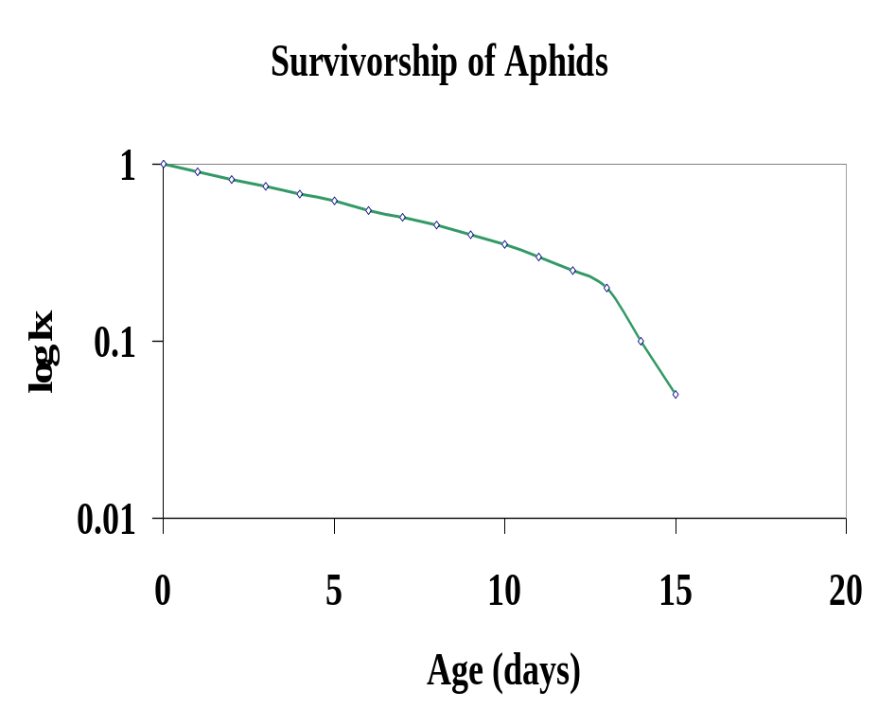
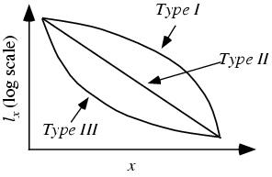
Survivorship, l_{x}
l_{x} – survival to age x - survivorship
l_{x} = N_{x}/N₀
Three types of survivorship curves – plotted on a semi-log plot
Looks like Type I – lab conditions
Notes:
Type I – mortality occurs in old age – typical of humans in developed countries; large animals w/ slow repro
Type II – Mortality not dependent on age, just constant – large birds, some fish
Type III – lots of early mortality, typical of r-selected species

Slide 14
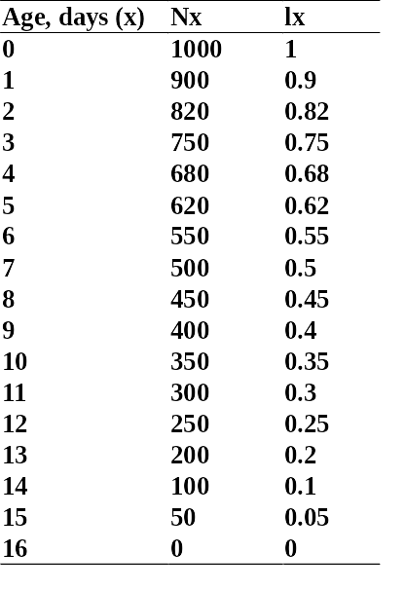
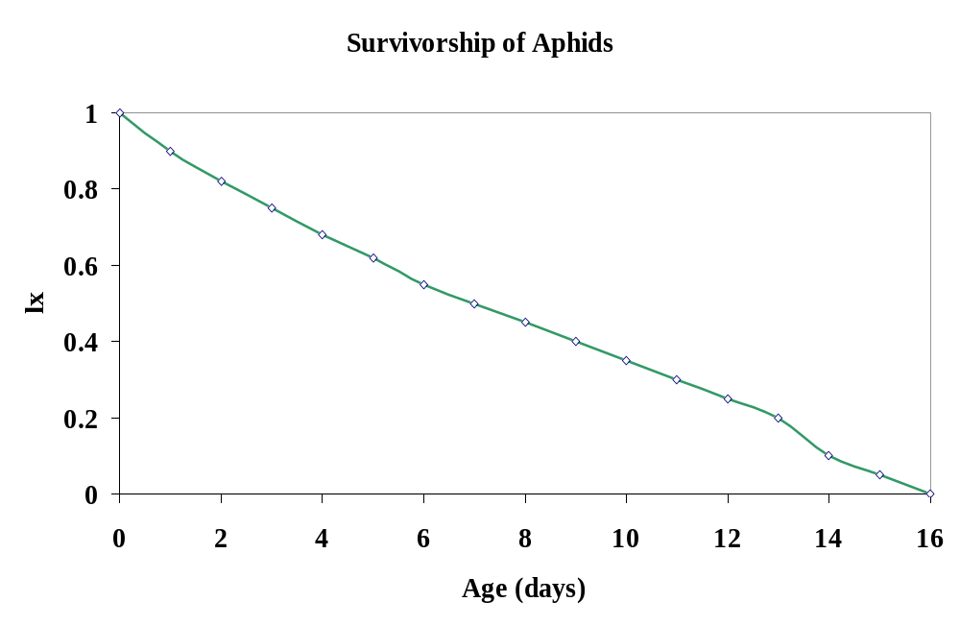
Survivorship, l_{x}
l_{x} – survival to age x - survivorship
l_{x} = N_{x}/N₀
N₀= 1000

Slide 15
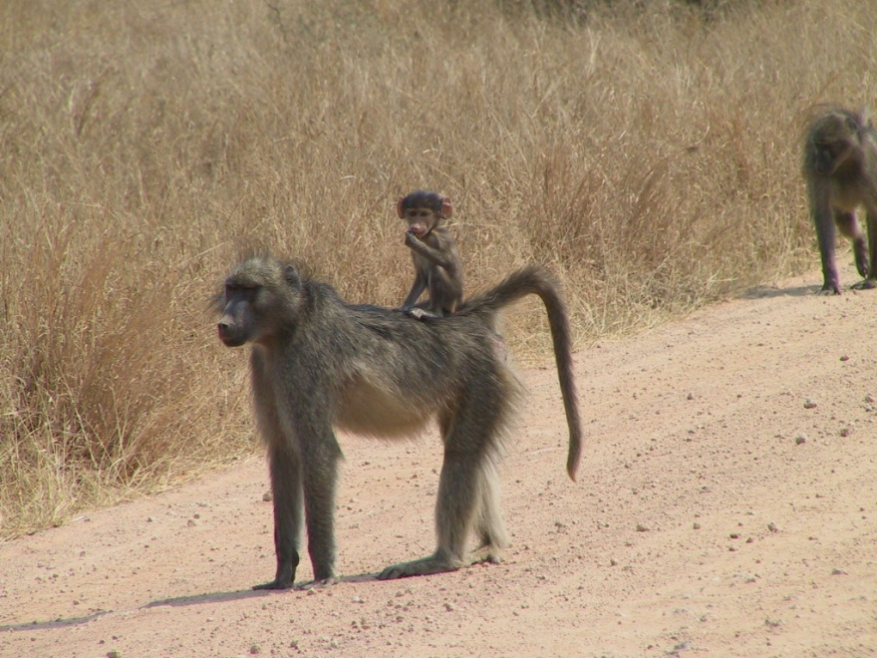
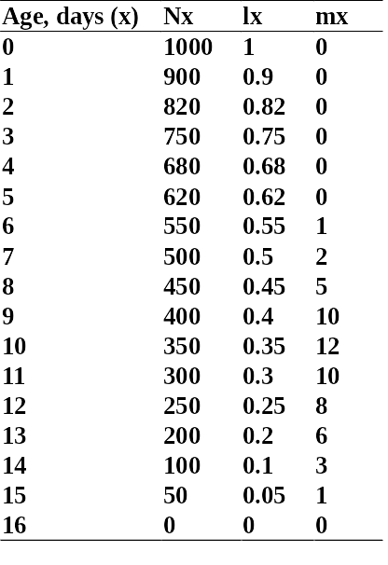
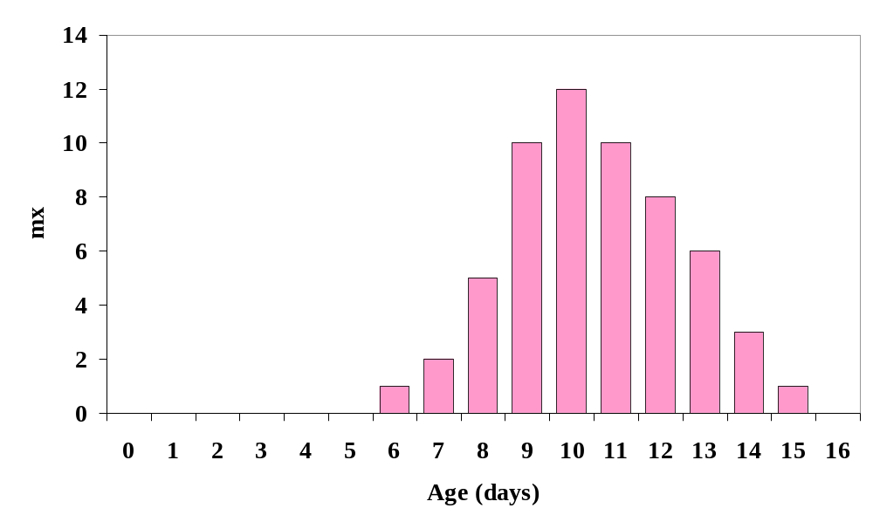
Fecundity table (m_{x})
Usually recorded as # of females produced per female of age x
Can be interpreted as the probability that a female of age x will give birth to a daughter during that time interval
Aphids
Notes:
Usually recorded as # of females produced per female of age x

Slide 16
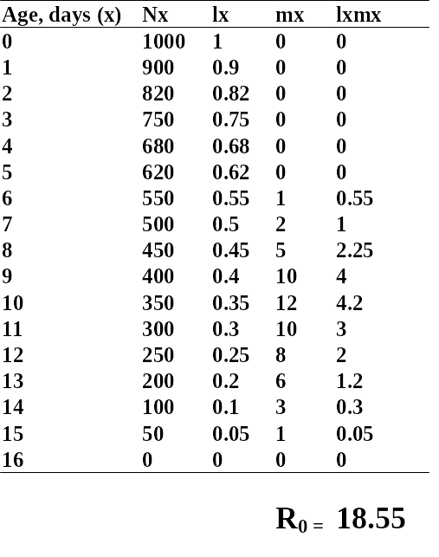
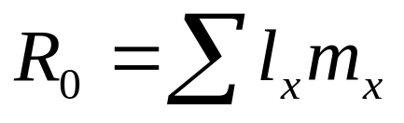
Net reproductive number
R₀: the mean number of female offspring produced by a female during her lifetime.
  R₀ < 1 population is declining
  R₀ > 1 increasing population
  R₀ = 1 indicates a stationary population
If l_{x} is a proportion:
Notes:
Aphids have an average of 18.55 offspring
What does this say about the aphid population? EXPLODING
The aphids in the 8-12 day category are really the ones creating the next generation

Slide 17
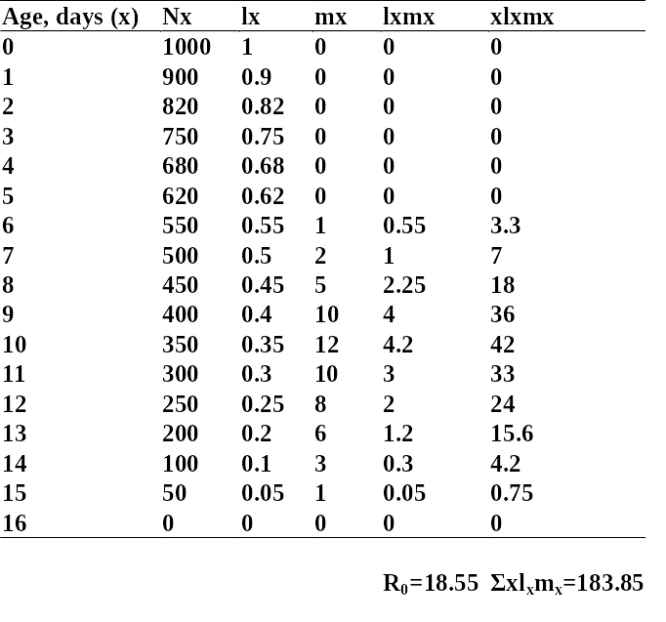
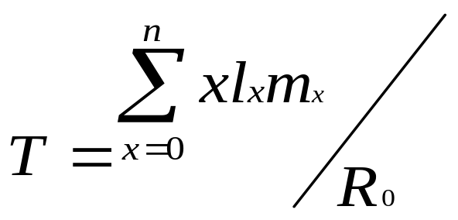
Generation Time, T
T – average generation time, is the average age a female gives birth to one offspring
T=183.85/18.55 = 9.11
An average female Aphid gives birth to one offspring at 9.11 days
Notes:
Alphabet – alpha beta; Hebrew aleph bet. The Greek alphabet derived from the earlier Caananite/Semitic alphabets, by way of the Phoenicians. You remember the Caananites as the people who were driven out by the Israelites after the Exodus from Egypt. In turn, the Greek alphabet passed, by way of the Etruscans, to Rome, where it became the basis of the alphabets used for English, French, Spanish, German, Romanian, and so forth. The Greek alphabet was adapted by Cyril and Methodius, Christian missionaries, as the Russian alphabet. Cyrillic.

Slide 18
Net Reproductive Number or λ?
Note that λ does not equal R₀
  is a rate per time step
    = N _{t+1}/N_{t}
  R₀ is a rate per lifetime/generation.
Notes:
Assuming a stable age distribution and a stationary population size:

Slide 19
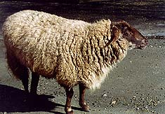
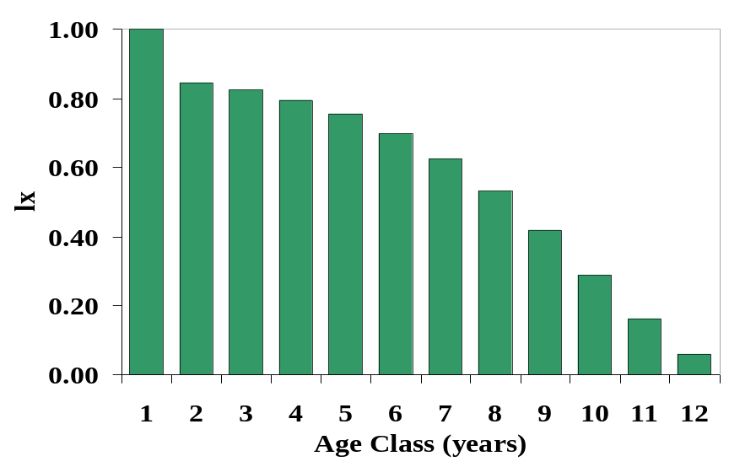
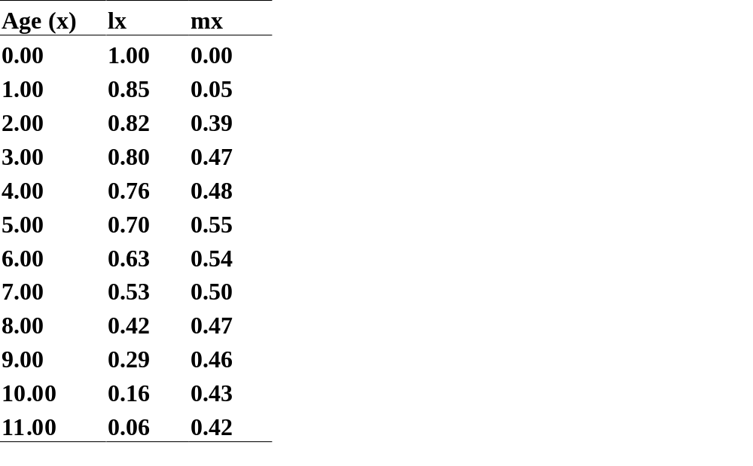
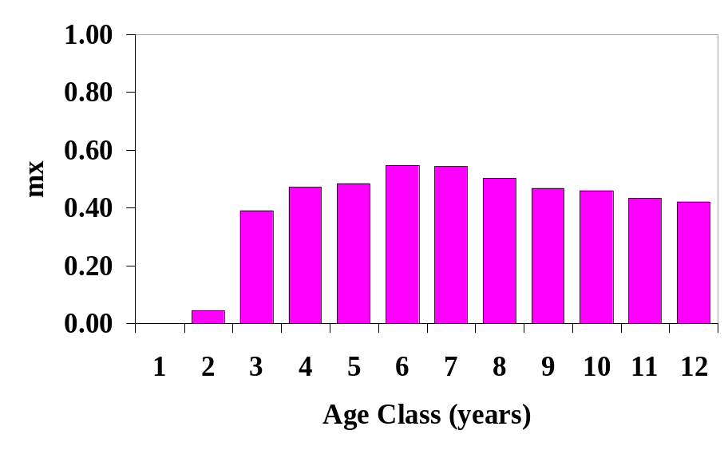
Domestic Sheep (Ovis aries)
Caughley, 1967
Notes:
Only found in domesticated state. The pure European Mouflon sheep survive in small numbers on reserves and in zoos.
Sheep are supposed to have come originally from the lofty plateaus and mountains of Central Asia. All domestic breeds of sheep descended from two different kinds of wild sheep: 1) the Urial from southern Asia; and 2) the mouflon from southern Europe. The coarse hair of wild sheep was replaced by soft wool through breeding.
Domestic sheep yield wool, milk, meat and leather and also furnish raw materials for glue, tallow, suet, soap, fertilizer, cosmetics, and catgut used in stringing tennis rackets.

Slide 20
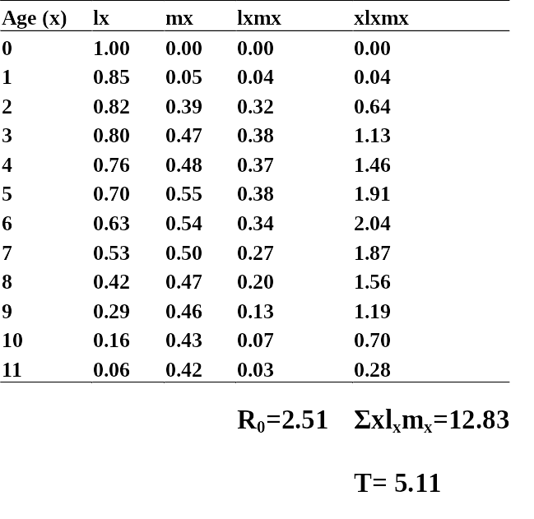

Slide 21
Notes:
R₀ is >1 – population is growing

Slide 22
Notes:
Generation time is 5.11 years – female gives birth to an offspring on average at 5.11 years.

Slide 23
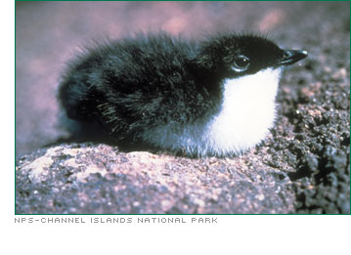
Node-arc notation
3 ages or stages
Ages – small bird
reproduces in its second year
Xantus' Murrelet Synthliboramphus hypoleucus
0
1
2
Notes:
Like a flowchart, easy to follow, helps us construct models and get appropriate data
Only 3 rates involved, p0, p1 and mx
Assumes that nothing lives beyond stage or age 2 – all will be dead by the end of year 2, or all will die after reproductive state is achieved.
Very simple – entirely female based, 1-sex model, assumes that males are just available, if necessary.

Slide 24
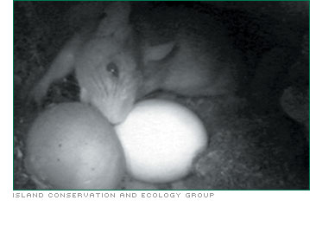

Slide 25
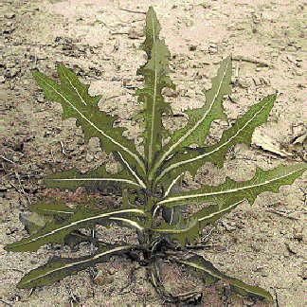
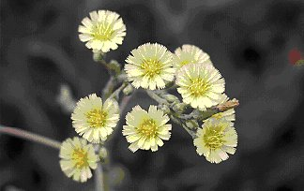
Node-arc notation
3 ages or stages
Stages – plant which can hang out
in a vegetative state
or progress to a reproductive state
Prickly lettuce Lactuca serriola
0
1
2
Notes:
Some plants will form a rosette phase and put down roots for a while, rather than invest in reproduction.
Prickly lettuce has an overwintering rosette phase and a summer reproducing flower phase; it’s an invasive.

Slide 26
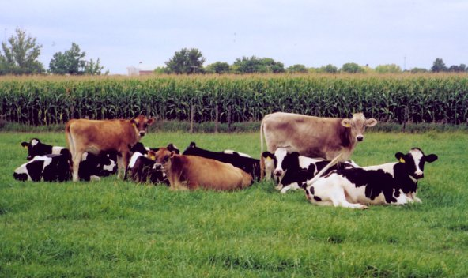
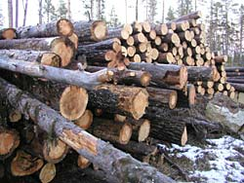
Why is age-structure useful?
Life-expectancy calculations
  Life insurance companies like it
  Planning for future funds (politics)
Harvesting
  When are fish going to be big enough to eat?
  What is the population turnover?
Conservation/Control issues
  Which age is most susceptible to mortality
  If females aren’t surviving to reproduce, then no point in saving the babies

Slide 27
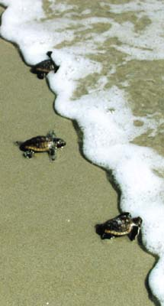
Turtle Excluding Devices (TEDs)
The loggerhead turtle (Caretta caretta)
  Very high egg loss due to beaches being developed, eggs poached
  Also very high early juvenile loss due to predation – as they disperse into the ocean
Turtle conservation in the 1980s focused on protecting eggs and beaches
Notes:
The loggerhead was listed in 1978 as a threatened species and it is considered "vulnerable" by the International Union for the Conservation of Nature. Recent population studies have concluded that the number of females that nest in the Southeast U.S. is continuing to decline.
The U.S. Federal government has listed the loggerhead as endangered worldwide. In the U.S., the loggerhead's nesting areas are divided among four states:
Florida (91%)
South Carolina (6.5%)
Georgia (1.5%)
North Carolina (1%)
Florida beaches account for one third of the world's total population of loggerheads.

Slide 28


Turtle Excluding Devices (TEDs)
1987 – Crouse et al. - programs focusing on preserving turtle eggs may be least effective; late juvenile/ early adult survival is more important
  Often caught in fish nets – huge source of mortality
  Create TEDs to prevent turtles and other large by-catch species drowning
1997 – Grand and Beissinger – move the eggs and the picture changes – we must protect eggs on beaches AND use TEDs
Notes:
Age-based models showed that there is a very high input to the earliest age class, but due to high natural mortality and predation in babies, our efforts are not well spent at that phase of life. Better to protect adult phases which are much more important to the population.
BUT, 1997, just because one phase protected will make a huge impact, doesn’t mean we can ignore the other phase completely.

Slide 29
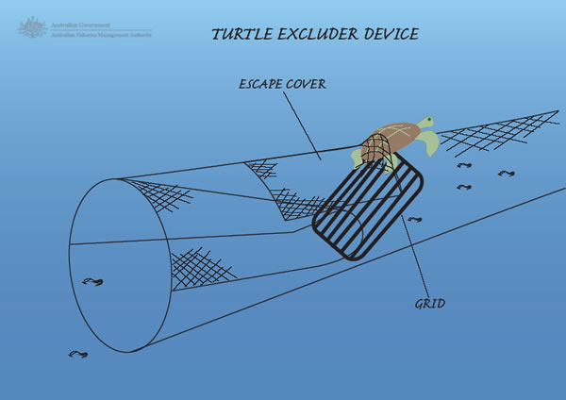

Slide 30
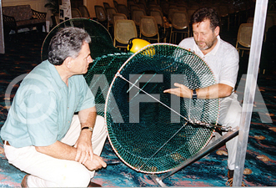

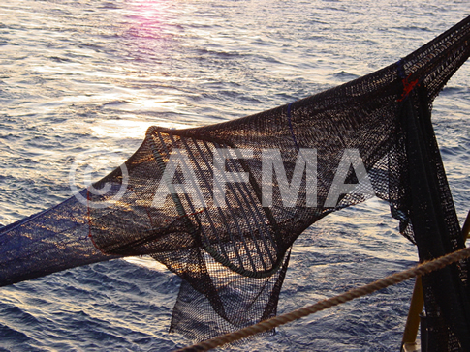
TEDs used in Australia

Slide 31

The end

