Slide 1
The Magnificent 7 and the S&P 500
Ian Choi, Utsav Manandhar, Fiona Mustard, and Spencer Smith

Slide 2
Research Questions
How do some of the largest stocks in the S&P 500 effect the entire market?
What are their correlations, and is there enough relationship to fit an explanatory model?
Could we then use that information to build and fit a predictive model that is significant in explaining the variation in returns of the S&P 500?
Do these large stocks have any influence on the broader market?

Slide 3
Data
We gathered returns for the following stocks:
Apple (AAPL), Amazon (AMZN), Google (GOOGL), Meta (META), Microsoft (MSFT), Nvidia (NVDA), and Tesla (TSLA)
We also gathered returns for the S&P 500 index (SPX)
This data came from https://www.investing.com/
For the third part, we gathered data on Inflation and Interest Rates
Inflation – Consumer Price Index (CPI)
Interest Rate – 10 minus 2 Year Treasury Yield Spread (10-2Y)
This data came from the Federal Reserve Economic Data (FRED) website https://fred.stlouisfred.org/

Slide 4
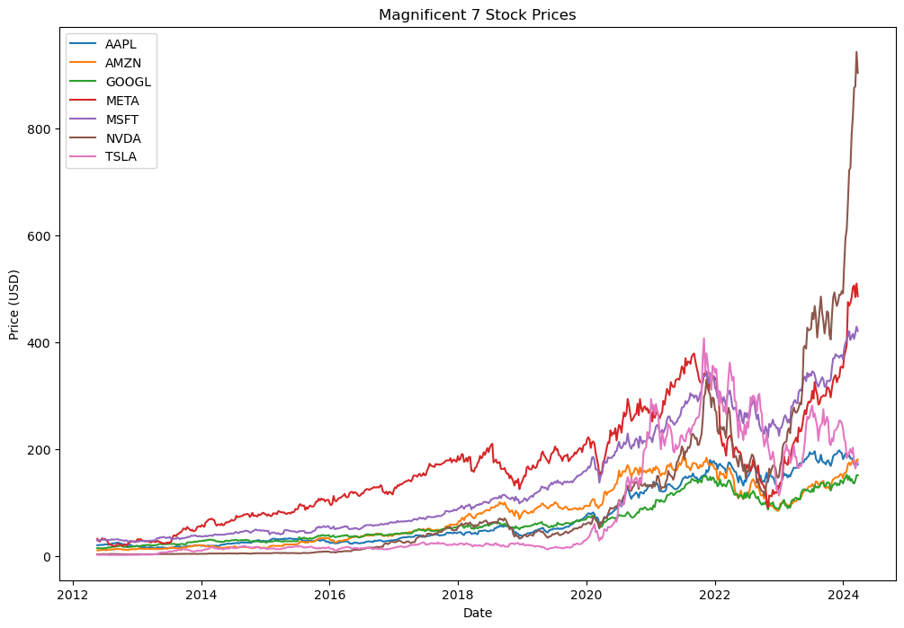
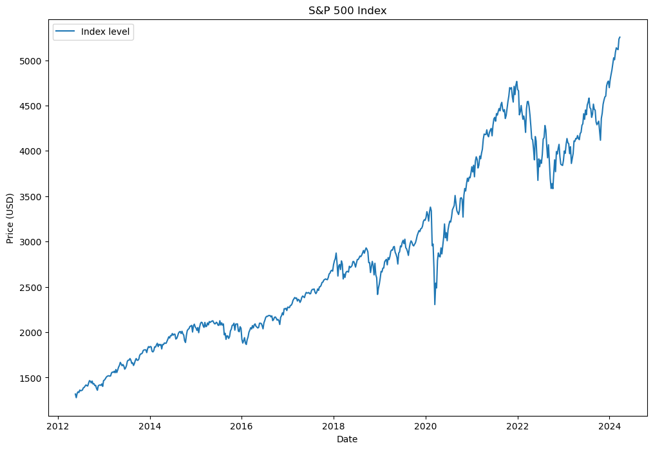
Data
Notes:
In financial modeling, it is common practice to use the return of equities by their returns and not their price levels. Graphs of returns look weird due to a lot of volatility, so we are showing the price levels as visuals.

Slide 5
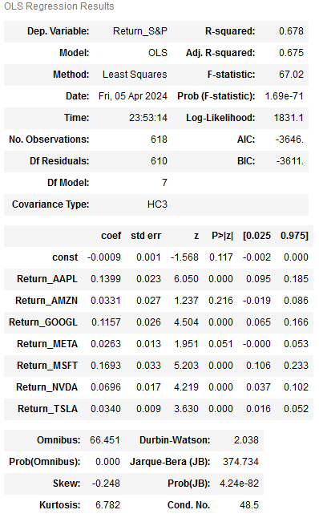
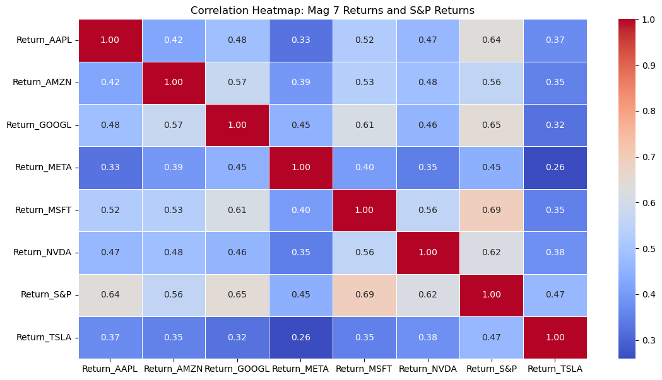
Results (part 2)

Slide 6
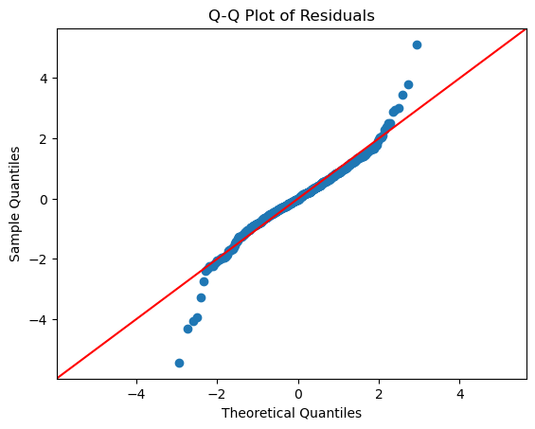
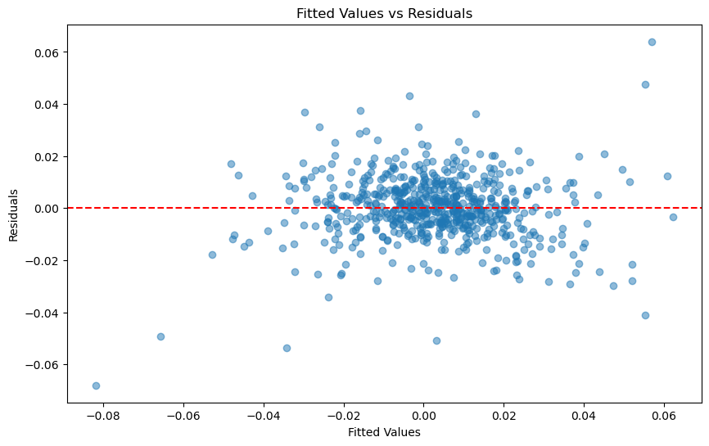
Results (part 2)

Slide 7
Initial Conclusions (part 2)
We did get a significant model, but the summary statistics tell us that our data has some issues:
Residuals not normally distributed
Data is leptokurtic rather than normally distributed
Possible issues with heteroskedasticity
Possible issues with extreme values & outliers
We decided to then do another regression on a smaller time frame to see if we could obtain normal data and more significant results.
The 7 stocks increased largely during this time, and we wanted to investigate their relationship over this time period.

Slide 8

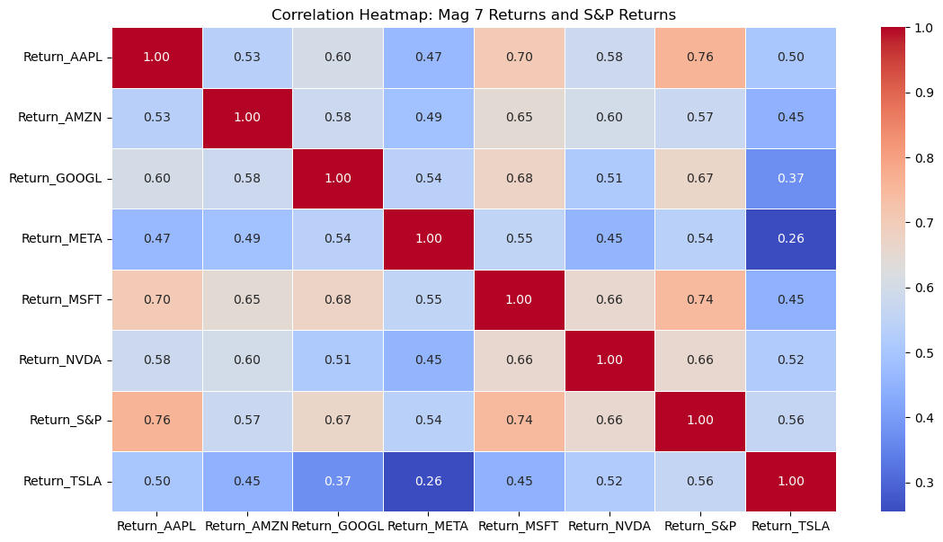
Results (part 2)

Slide 9
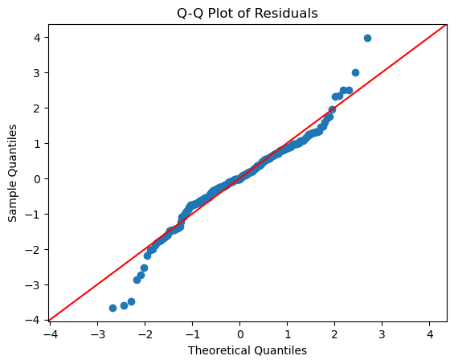
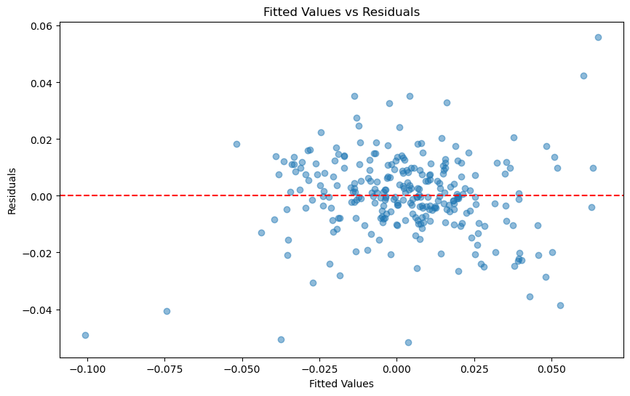
Results (part 2)

Slide 10
Conclusions (part 2)
Correlations were moderate to strong in our first regression, and slightly higher in the second
We obtained a better R2 score in the second regression, though both have issues with normality.
This means that both our models are not significant
The assumption of normality not being met means our results are not valid and we should not make decisions based off them
We did learn that there is a meaningful relationship between several of these large stocks and the S&P 500
AAPL, GOOGL, MSFT, and NVDA all seem to have strong positive relationships with the return of the overall market

Slide 11
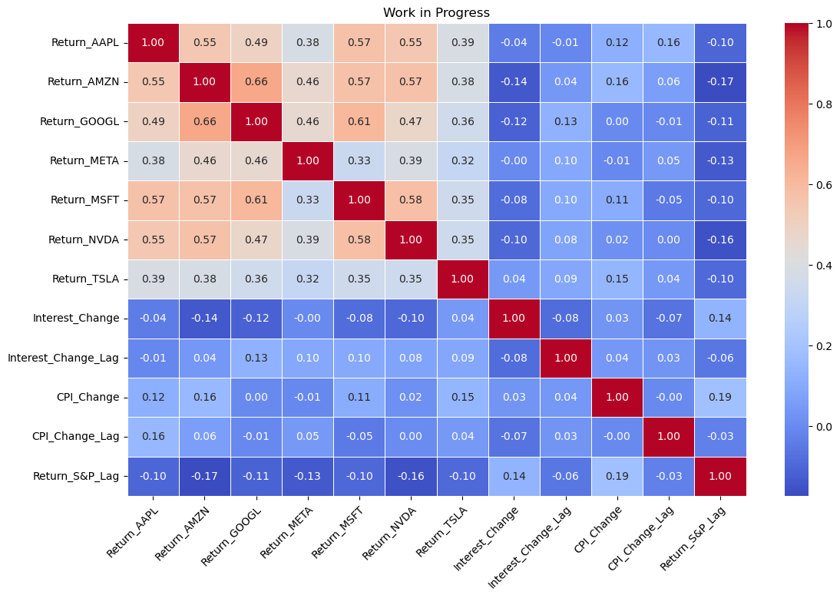
Part 3: Building on our Previous Work
Initially wanted to see if Magnificent 7 had any influence on interest rates or inflation
The early findings looked like there was not much of a relationship there, so we decided to continue with our work from part 2
We wanted to see if we could improve our current model with hopes of building a predictive model
Same regression equation as part 2, but with one added independent variable: the lagged 1 period return of the S&P 500

Slide 12
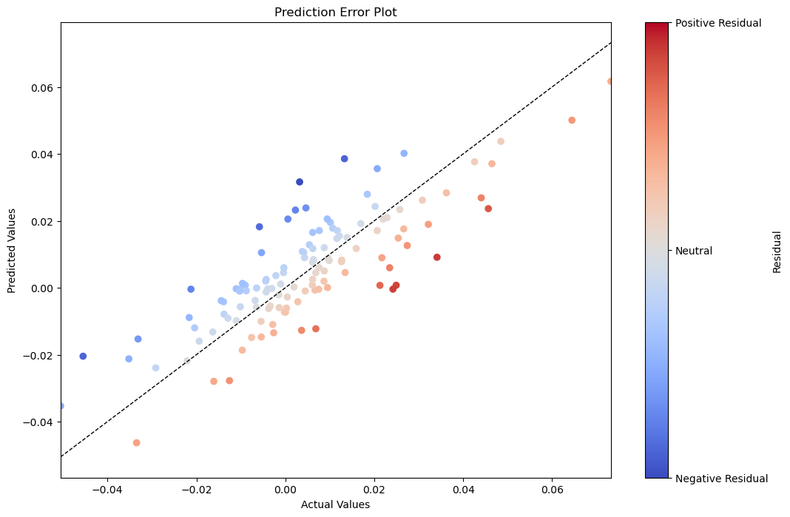
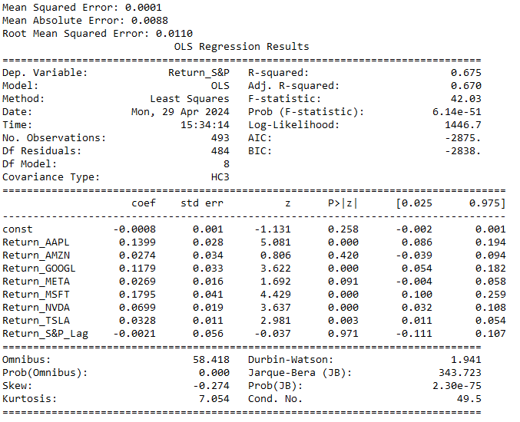
OLS Results

Slide 13
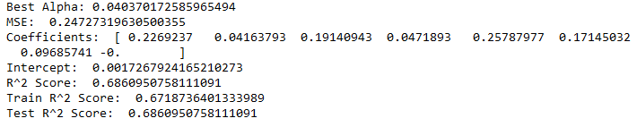
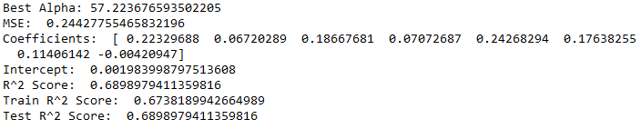
Lasso and Ridge Results
Lasso:
Ridge:

Slide 14
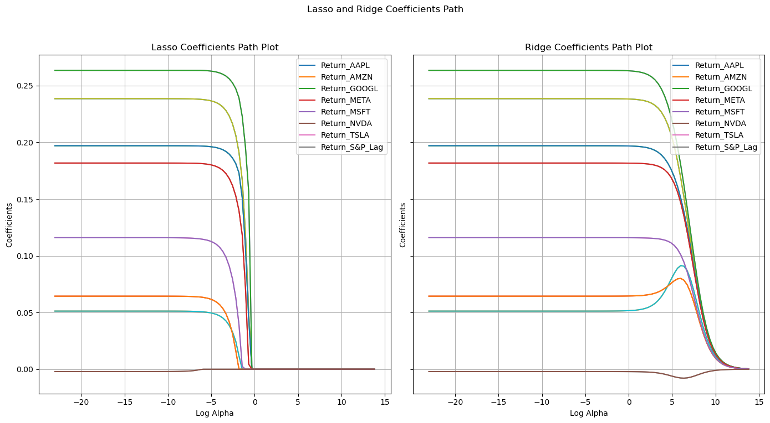
Coefficient Path Plot

Slide 15
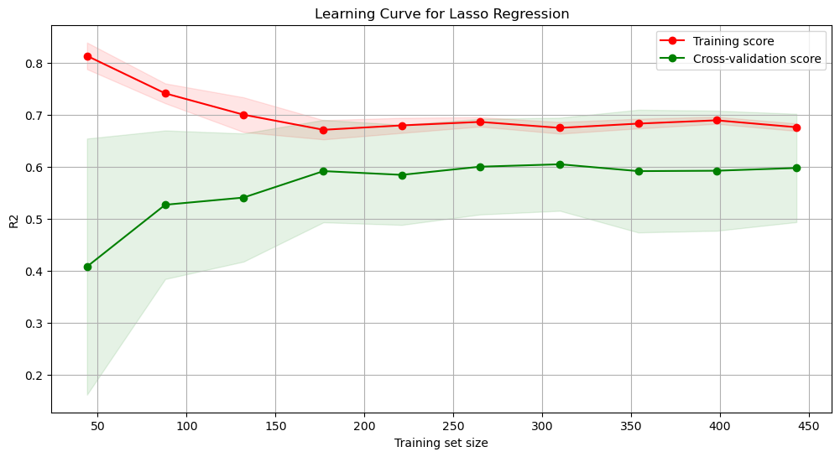
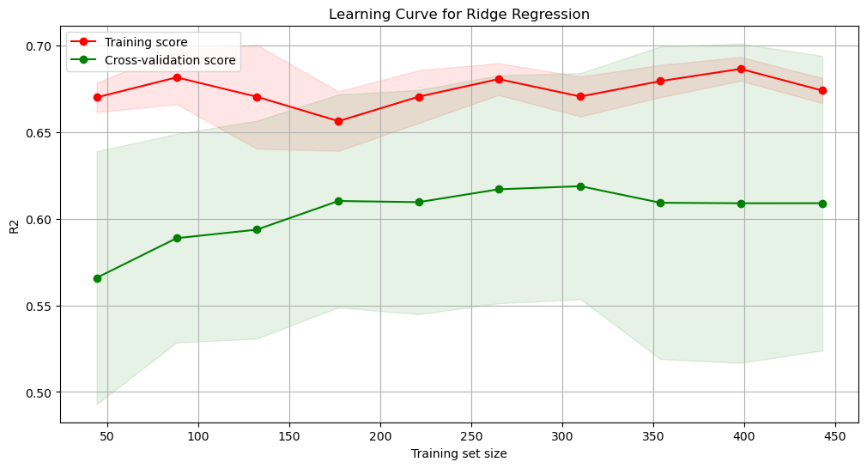
R² Score Learning Curves

Slide 16
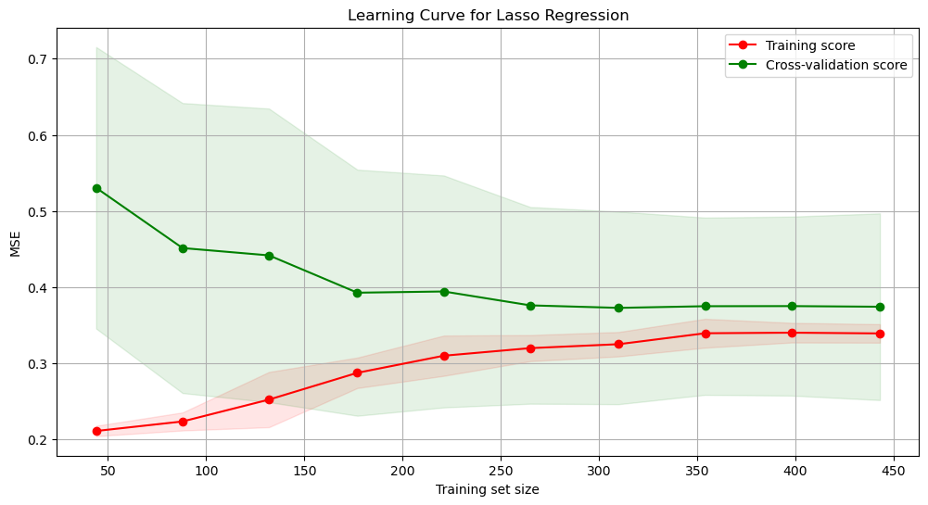
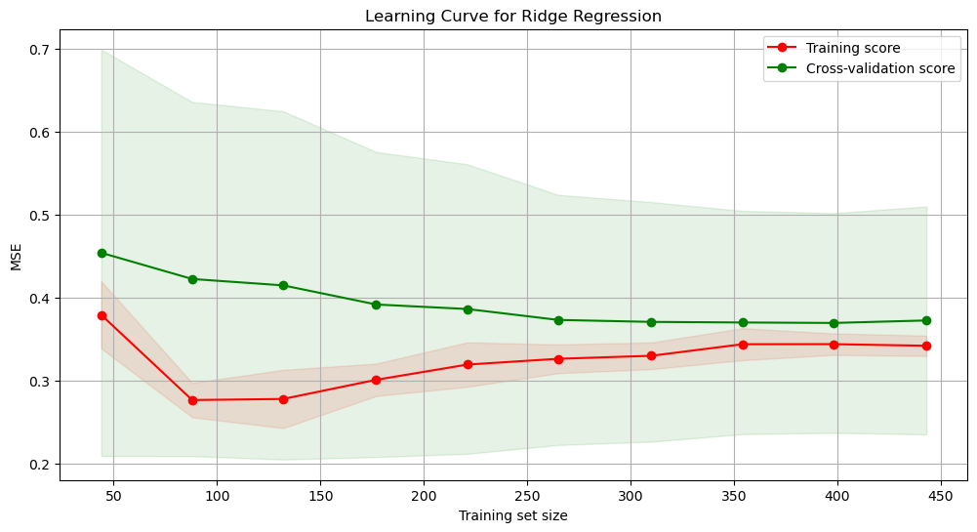
MSE Learning Curves

Slide 17
Results and Final Conclusions
We still cannot confidently say that our findings are significant due to the issues of normality in our data, here are our findings:
OLS had the lowest Mean Squared Error (MSE) out of the 3 models
Lasso and Ridge had similar MSE scores and similar R2 scores for both the training and test data
When looking at the R2 score, both Lasso and Ridge performed slightly better out of sample
This indicates that both regularizations worked well for the data
Caveats to the Conclusion
MSE can be more heavily influenced by large values and outliers, while R2 is not
This is likely why we see better R2 scores with Lasso and Ridge, but a lower MSE with OLS
OLS may fit certain points (large outliers) better than Lasso and Ridge, explaining the lower MSE
Lasso and Ridge models both do a better job of capturing the variance in the data

Slide 18
Final Conclusions
No significant findings due to issues with normality in our data.
Linear Regression (OLS) appears to perform best when we look at Mean Squared Error
Lasso and Ridge perform better when using R2 scores
Though our current model doesn’t have any significant predictive power, we recommend further research since it appears there is a significant relationship between certain variables and the return of the S&P 500

