Slide 1
RT-RRT
Implementation of RRT-based real-time path planning

Slide 2
Real-time path planning problem
Heuristic method
Potential Field method
Sampling method
rapidly exploring random trees (RRTs)

Slide 3
Rapidly exploring Random Trees (RRTs)
RRTs sample points in the space and add them to a tree which grows to the whole planning space.
Does not give optimal solution
rewiring is not performed

Slide 4
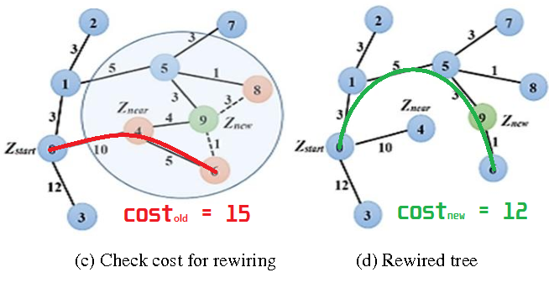
RRT*

Slide 5
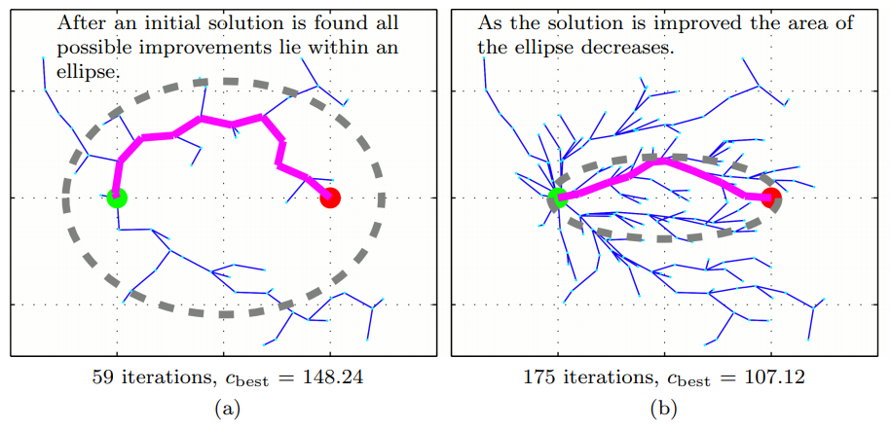
Informed RRT*

Slide 6
RT-RRT*
Retain the tree between the iterations and change the tree root when the agent moves.
Rewire the tree when the tree root changes or a dynamic obstacle blocks a node
If tree has not reached to the goal, the agent moves toward minimum of (cost + distance to goal)

Slide 7
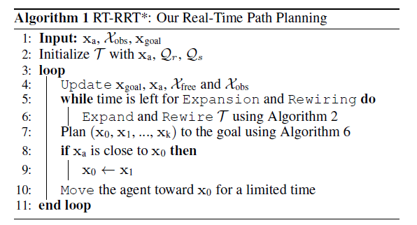
RT-RRT*

Slide 8
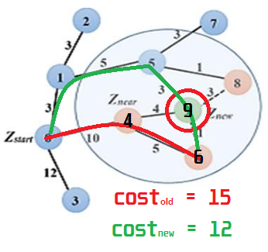
Algorithm 1

Slide 9
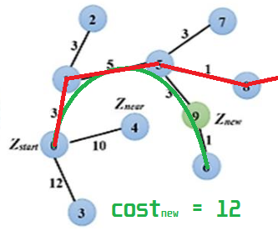
Algorithm 1

Slide 10
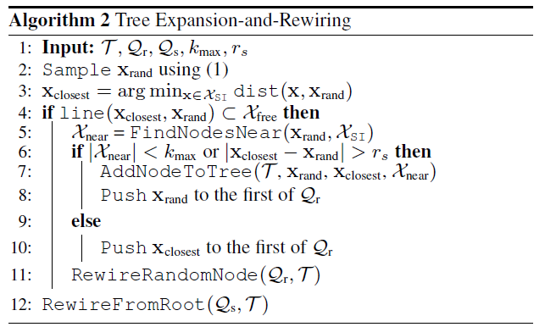
Tree Expansion and Rewiring
- Informed RRT*

Slide 11
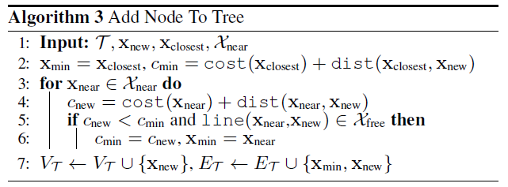
Add Node To Tree

Slide 12
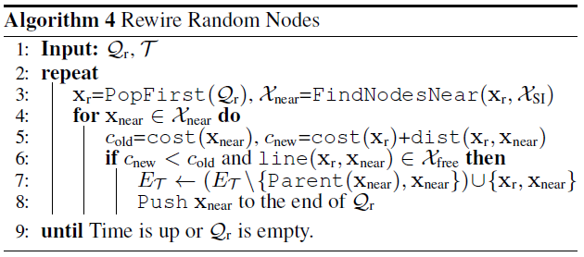
Rewire New Node

Slide 13
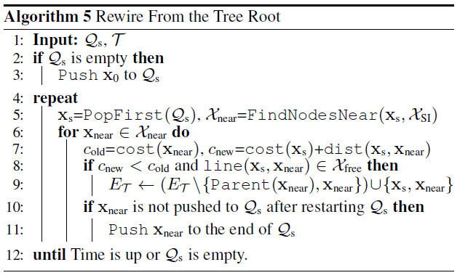
Rewire from Root

Slide 14
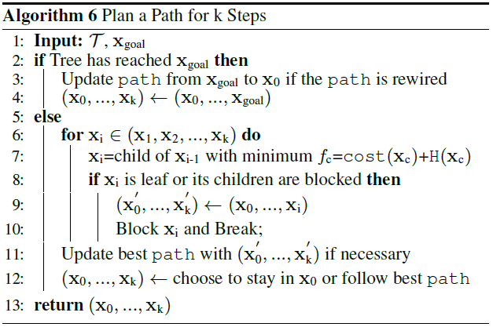
Plan Path

Slide 15
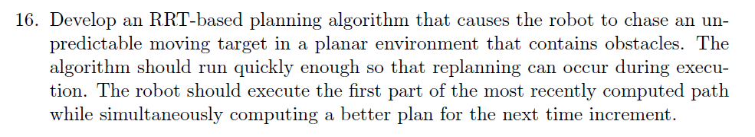
7.7 Optimal Motion Planning Exercise Implementation

Slide 16
References
GAMMELL, D, J., SRINIVASA, S, S., BARFOOT, AND D, T. 2014. Informed RRT*: Optimal Sampling-based Path Planning ` Focused via Direct Sampling of an Admissible Ellipsoidal Heuristic. In IROS, IEEE.
Naderi, Kourosh., and Rajamäki, J. "RT-RRT*: A Real-Time Path Planning Algorithm Based On RRT*". Proceedings Of The 8Th ACM SIGGRAPH Conference On Motion In Games, 2015. The ACM Digital Library, https://dl.acm.org/doi/10.1145/2822013.2822036. Accessed 3 May 2020.

