Slide 1


JavaScript Module Systems
What is covered?
Real-Life example
Modularity in coding
Intuitive Modularization

Slide 2
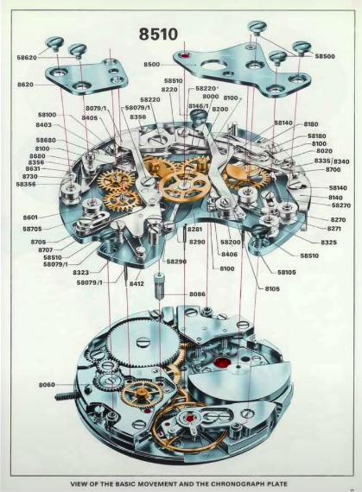
JavaScript Module Systems Real-Life Example
Advantages
Reusability
Composability
Leverage
Isolation
Organization

Slide 3
JavaScript Module Systems Modularity in code
How this can be related to code?
Just as the watch was designed, we should design our software separated into different pieces where each piece has a specific purpose and clear boundaries for how it interacts with other pieces.
In software, these pieces are called modules.

Slide 4
JavaScript Module Systems Intuitive Modularization
Intuitive Modularization
Why not put stuff in different files?
<code>demo</code>
Any <script> tags in our HTML pages will cause properties to be added to the global window object.
The result is namespace pollution which can lead to unwanted side effects.
So, this is not the right approach, now what?

Slide 5
JavaScript Module Systems Intuitive Modularization
Wrappers to rescue
Namespace pollution can be dealt with using wrappers.
<code>demo</code
But we can refactor things for better using
IIFEs

Slide 6
JavaScript Module Systems Intuitive Modularization
IIFEs (Pronounced as EE-Fi)
The term IIFE stands for Immediately Invoked Function Expression If a function is written just to be executed once, we can replace it with an IIFE.
<code>demo</code>

