Slide 1


JavaScript Module Systems
What is covered?
Real-Life example
Modularity in coding
What are module systems?

Slide 2
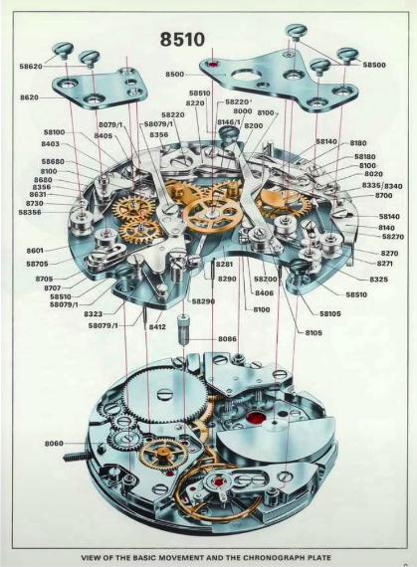
JavaScript Module Systems Real-Life Example
Advantages
Reusability
Composability
Leverage
Isolation
Organization

Slide 3
JavaScript Module Systems Modularity in code
How this can be related to code?
Just as the watch was designed, we should design our software separated into different pieces where each piece has a specific purpose and clear boundaries for how it interacts with other pieces.
In software, these pieces are called modules.

