Slide 1


JavaScript Module Systems
What is covered?
Real-Life example
Modularity in coding
Intuitive Modularization
Wrappers to Rescue
IIFEs as better wrappers
Here comes common-js
CommonJS pitfalls
And finally, the robust ES module system
Other module systems & references
Author : Sajith John Sam Email : sajith.sam@ayatacommerce.com

Slide 2
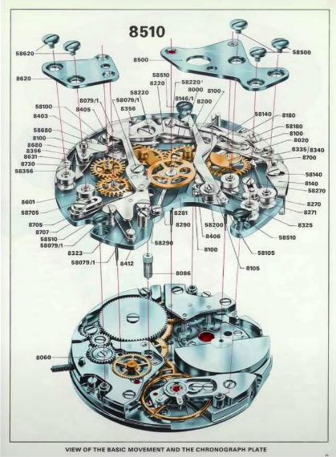
JavaScript Module Systems Real-Life Example
Advantages
Reusability
Composability
Leverage
Isolation
Organization

Slide 3
JavaScript Module Systems Modularity in code
How this can be related to code?
Just as the watch was designed, we should design our software separated into different pieces where each piece has a specific purpose and clear boundaries for how it interacts with other pieces.
In software, these pieces are called modules.

Slide 4
JavaScript Module Systems Intuitive Modularization
Intuitive Modularization
Why not put stuff in different files?
<code>demo</code>
Any <script> tags in our HTML pages will cause properties to be added to the global window object.
The result is namespace pollution which can lead to unwanted side effects.
So, this is not the right approach, now what?

Slide 5
JavaScript Module Systems Wrappers to rescue
Wrappers to rescue
Namespace pollution can be dealt with using wrappers.
<code>demo</code
But we can refactor things for better using
IIFEs

Slide 6
JavaScript Module Systems IIFEs as better wrappers
IIFEs (Pronounced as EE-Fi)
The term IIFE stands for Immediately Invoked Function Expression If a function is written just to be executed once, we can replace it with an IIFE.
<code>demo</code>
IIFEs introduce other problems:
Namespace pollution is not completely dealt with.
Order of execution matters now.
There should be some solution, here comes Common-JS

Slide 7

JavaScript Module Systems Here comes Common-JS
Common-JS
The Common-JS module system has the following features/caveats
File-based
Explicit Imports
Explicit Exports
Default module system in NodeJS, so very popular
Not very popular with browsers, so it requires a bundler like Webpack or Browserify
The Common-JS group defined a module format to solve JavaScript scope issues by making sure each module is executed in its own namespace. This is achieved by forcing modules to explicitly export those variables it wants to “expose” to the universe, and by defining those other modules required to properly work.
- Webpack Docs
<code>demo</code>

Slide 8
JavaScript Module Systems Common-JS Pitfalls
Common-JS doesn’t solve all the problems
The Common-JS module is good but not perfect.
- No async loading of modules (Browser’s memory stack is hung when a module is loaded)
- The require statement is a function and so it doesn’t give you the feel that you’re importing something. This often leads to a flawed design.
- There are other downsides which doesn’t warrant a discussion in this thread.

Slide 9
JavaScript Module Systems ES Module System
ES module system
The Common-JS module was good but not perfect. The ES module system is better – close to perfect
Inbuilt
- async loading
- import/export syntax
- Better control over the dependency
injection
<code>demo</code>

Slide 10
JavaScript Module Systems Other Module System & references
It is not all over
There are two other module systems which you will come across in your JS lifecycle.
- Universal Module Definition (UMD)
https://github.com/umdjs/umd
- Asynchronous Module Definition (AMD)
https://requirejs.org/docs/whyamd.html
My references
Tyler McGinnis’ awesome explanation of the module systems https://www.youtube.com/watch?v=qJWALEoGge4

