Slide 1
FAKE NEWS DETECTION USING NATURAL LANGUAGE Processing Kevin Saptel Samarth subramanya

Slide 2
description
As the usage of social media increased, spreading of fake news have been increasing. To overcome this problem, fake news can be detected using Natural Language Processing and several machine learning algorithms.
Problems:
News are not verified on social media.
With fake accounts fake news can be shared easily.
To overcome these issue we can enforce machine learning algorithms by training the model from trusted source of news and classify if the news is authentic or not.

Slide 3
approach

Slide 4
Data set
It consists of several comments and news published on twitter, the dataset was available on kaggle. It has 3 csv files, one file with ID and target, the train and test files with ID, Target, Location, Text and Keywords. The dataset has strings and integers, it has few missing values and special characters as well.
Samaple_submission.csv
Train.csv
Test.csv

Slide 5
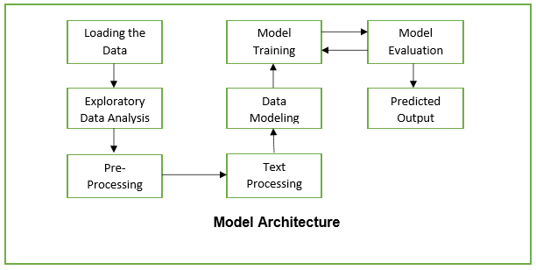
Method & Architecture
1. Import the libraries | 6. Data modeling to split the data and getting prepared to train
2. Import the data | 7. Using machine learning algorithm (Logistic Regression) classify the news being shared is false or right and from which location is it being shared.
3. Exploratory Data Analysis. | 8. Evaluate the model
4. Remove the stop words and unwanted words from the data | 9. Implement the model on test set
5. Analyze the word frequency. | 10. Output Predictions and its accuracy

Slide 6
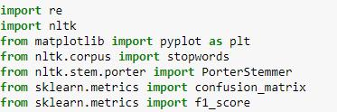
Implementation
The required libraries below were imported.
Performed basic analysis:
Checking columns in the dataset.
Total no. of observations
Missing values in the dataset.
Target variable in the dataset

Slide 7
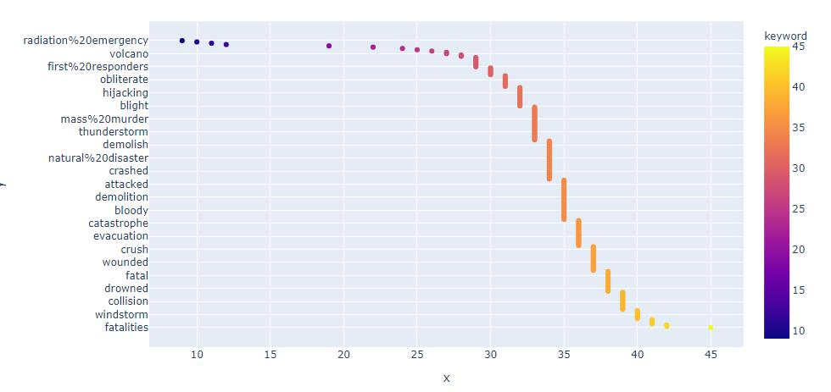
Implementation
Plotted graph to see the word frequency

Slide 8
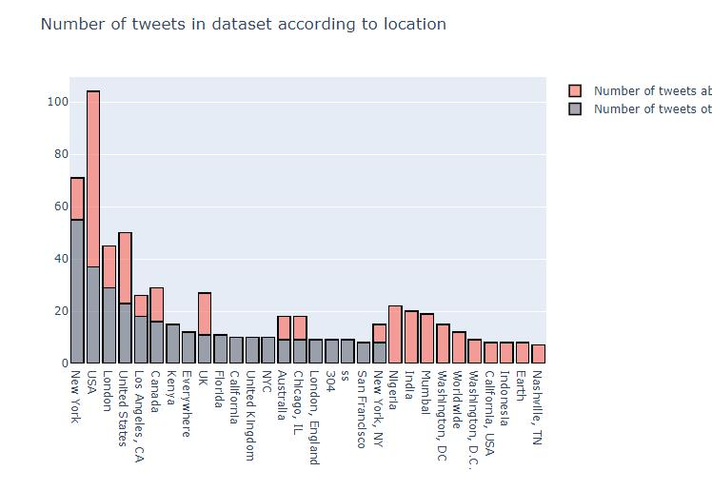

Slide 9
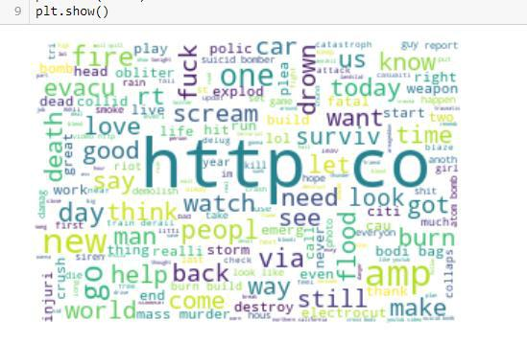
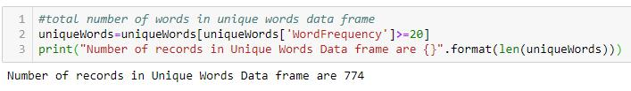
To check the keyword repeated most number of times, I plotted a word cloud using the library which has a cluster of all the repeated words.
The words which have occurred minimum number of times can be neglected from the data so that the dimension of the ‘Bag of Words’ model can be decreased

Slide 10
RESULTS
The Linear regression algorithm gave out a good result. The training accuracy on the training set was 86% and the test accuracy was 82%, finally the F1 score was reported as 78.12%.
Finally, Linear Regression Classification model gave an average result. The results can be improved if trained on a large data with more accurate location and keywords. The model did a great job on classifying fake and true news.

Slide 11
Questions?
Email: subr8944@vandals.uidaho.edu
sapt5767@vandals.uidaho.edu

