Slide 1
Library management system
By:
Lokesh Bhattarai
Oriyon Mengistu Lema
Suraj Shrestha

Slide 2
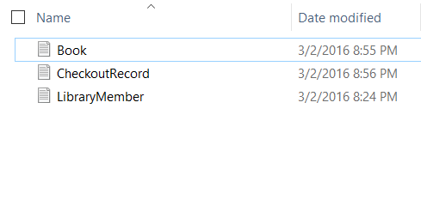
Includes:
Member record
Book record with Authors
Checkout record(book issue)
Data file for storage:

Slide 3
Member record:
Can add new library member
Can search library member
Can edit existing library member

Slide 4
Book record with Authors:
Can add new book to library collection
Can add multiple author new book
Can search existing book

Slide 5
Checkout:
Member verification
Book verification
Author listings
Checkout from available copies only

Slide 6
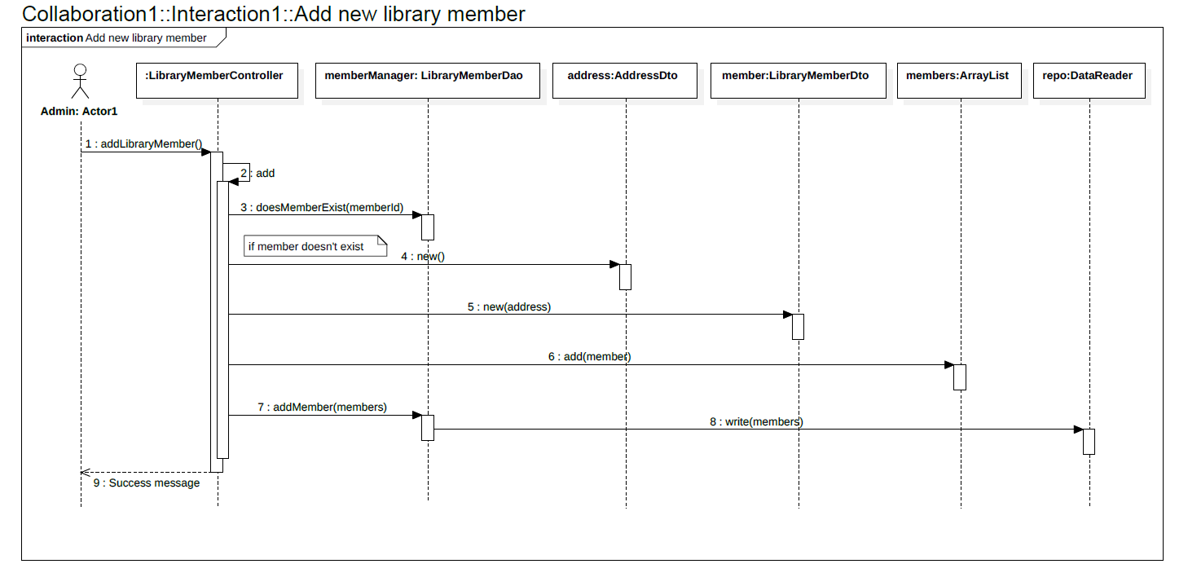
Sequence Diagram for Add New Library Member

Slide 7
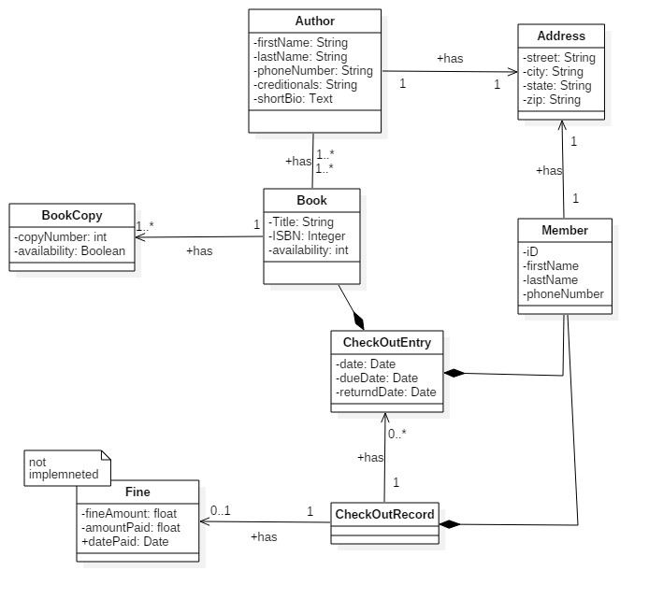
Class Diagram

Slide 8
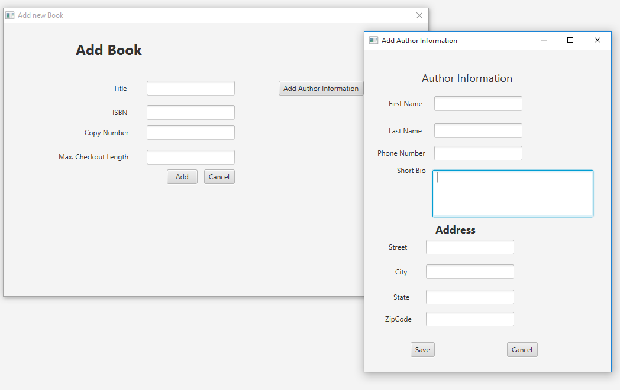
Extra credit Add book

Slide 9
Extra Credit Edit Book

Slide 10
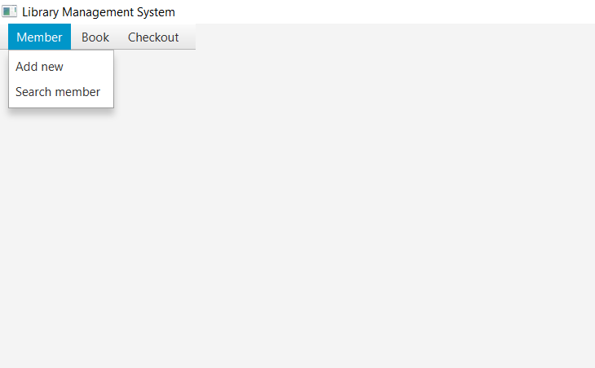
Some snapshots::
Main page

Slide 11
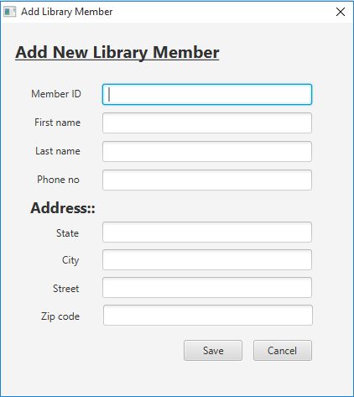
Add Library Member

Slide 12
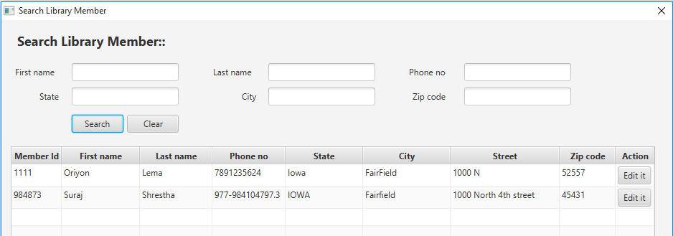
Search Library Member

Slide 13
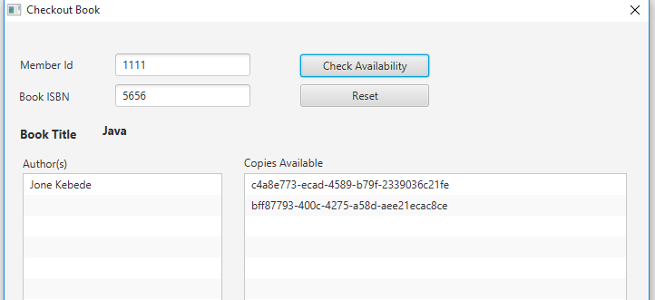
Checkout Book

