Slide 1
Investment decisions in small-scale combined heat and power technology using linear optimization techniques
￭ Shakhawat Hossain Turag ￭ 21.10.2021

Slide 2
Overview
Introduction
Methodology
Implementation
Outcome
Challenges
Conclusion

Slide 3
Introduction
Goal of the thesis:
Investment decision on new small scale combined heat and power (CHP) plant. Finding out the new opportunities for the new investors in CHP market!
Why?
Less CO2 emission than if electricity and heat are generated separately
Better efficiency than other power plants as dissipated heat is also used for other purpose such as space heating.
CHP could also become CO2 neutral in the future, when green fuels become available (like green hydrogen that is generated with renewable electricity)

Slide 4
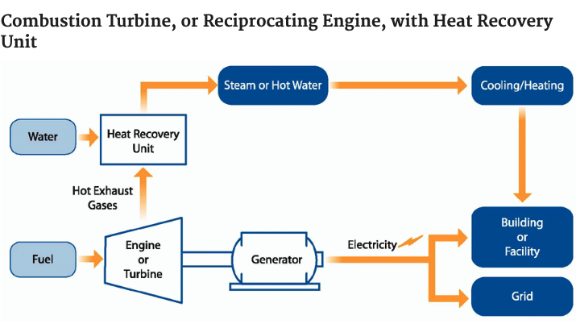
Introduction
What is CHP?
Combined heat and power is an efficient technology that generates electricity and heat. This heat is then captured to provide thermal energy like space heating, cooling, domestic hot water and industrial processes.
Source: https://www.epa.gov/chp/what-chp

Slide 5
Introduction
Investment in CHP
Why is CHP a good investment?
Better efficiency
Outcome of an investment in CHP:
Using NPV method one can evaluate the investment whether it is a good investment or not.

Slide 6
Methodology
Data Collection and Preprocessing
Linear Optimization Model
Structured and formatted data
Objective values
Investment Decision
Positive / Negative value
Net Present Value Method

Slide 7
Implementation
Linear Optimization model
retail prices for small customers
Optimization (Objective Value)
wholesale prices for industry customers
NPV
CHP with boilers
CHP with boilers
Positive
Negative
Boilers
Boilers

Slide 8
Implementation
Required Data:
Electricity Demand
Heat Demand
Electricity Price
Heat Price
Natural gas Price
Parameters:
electricity generation (y_t)
electricity sold (el_sold)
electricity bought (el_bought)
fuel consumption by CHP (x_t)
heat generation by CHP(z_t)
fuel consumption by boiler (x_tb)
heat generation by boiler(z_tb)

Slide 9
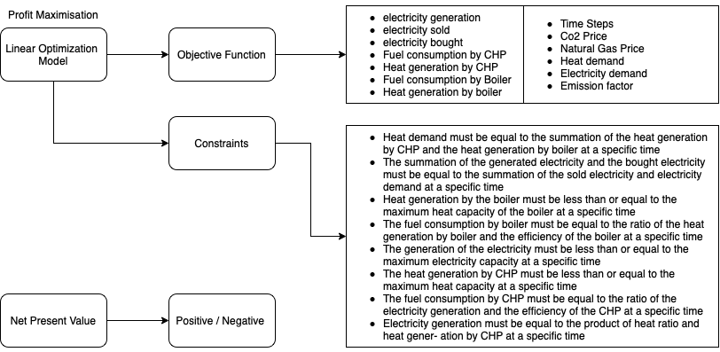
Implementation

Slide 10
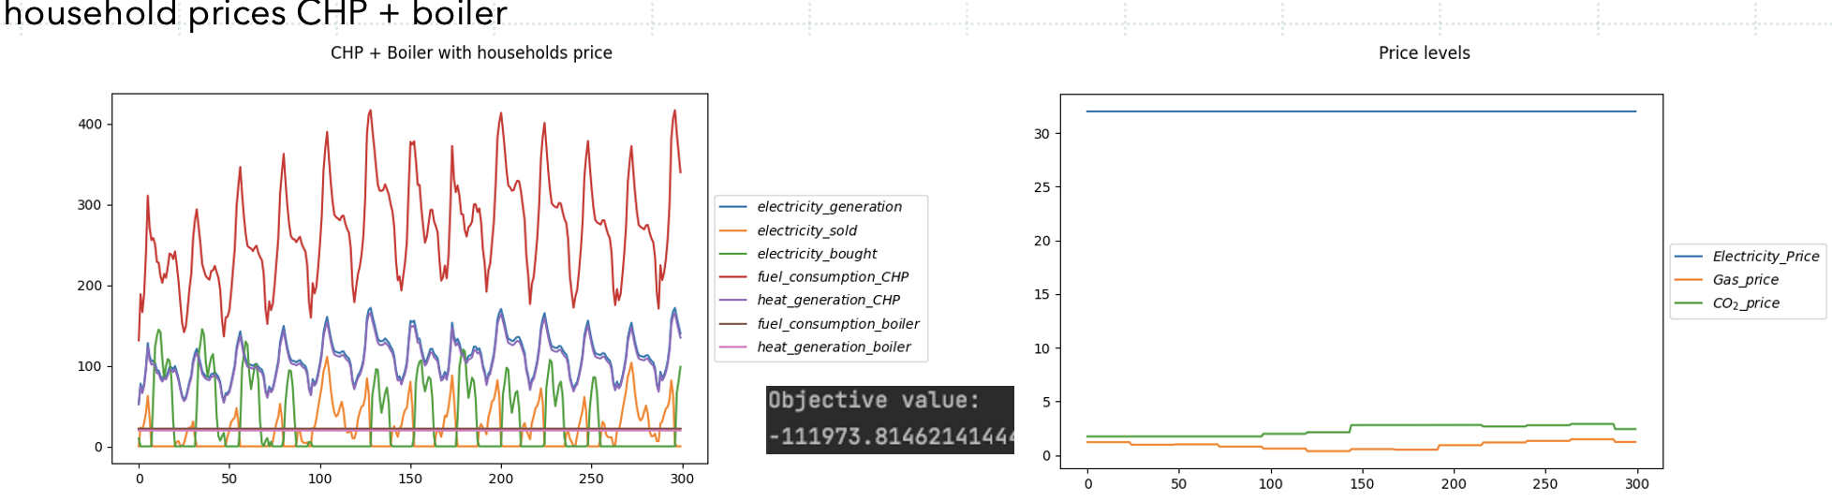
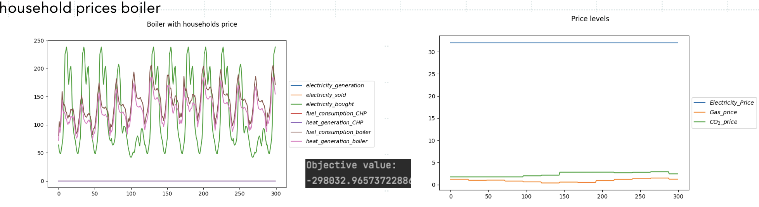
Outcome

Slide 11
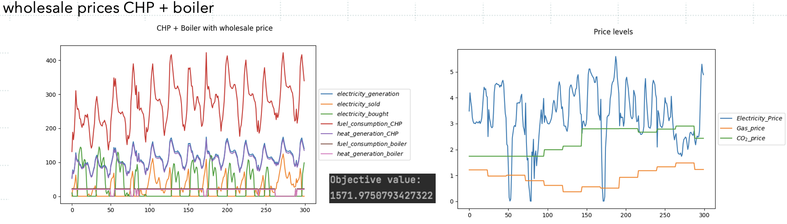
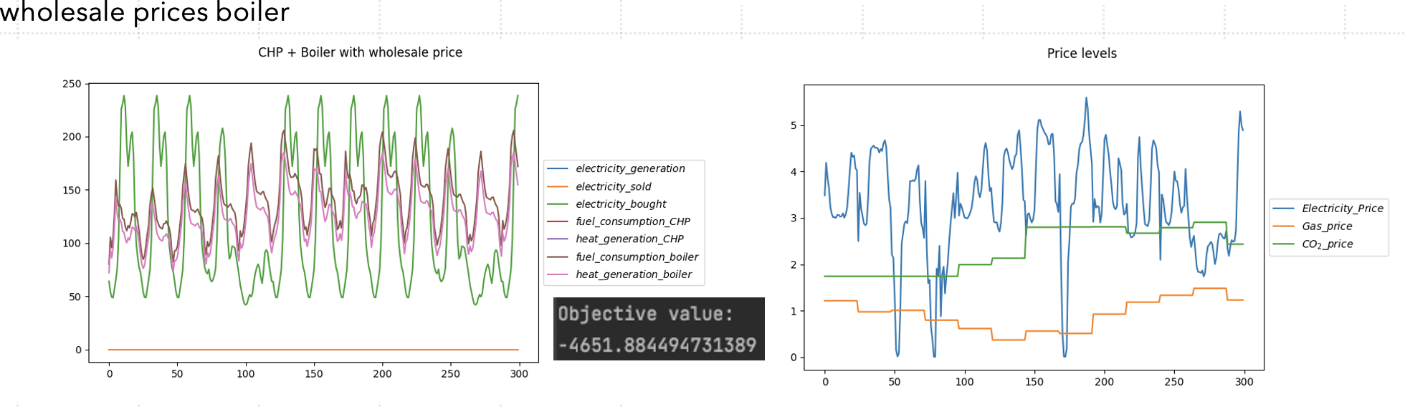
Outcome

Slide 12
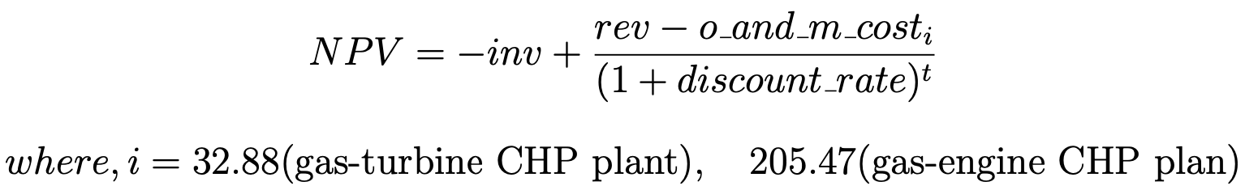
Outcome
Equation for Net Present Value:
Households prices
Wholesale prices
CHP with boiler: -111973.81 (objective value)
Boiler: -298032.96 (objective Value)
rev : difference of the objective value between both cases
• For operation cost 32.88 EUR net present value is: 16169.48
• For operation cost 205.47 EUR net present value is: 16153.55
CHP with boiler: 1571.97 (objective value)
Boiler: -4651.88 (objective Value)
rev : difference of the objective value between both cases
• For operation cost 32.88 EUR net present value is: -1003.03
• For operation cost 205.47 EUR net present value is: -1003.03

Slide 13
Outcome
Households prices
Wholesale prices
CHP with household price has positive net present value, which is a good investment.
wholesale price the net present value is negative, where the difference to zero is the amount of subsidies needed if the government wants to encourage CHP installation.
wholesale prices are much lower,
this advantage of CHP is lower.
the investor does not save enough with his electricity generation to make the investment pay out in the end.

Slide 14
Challenges
Hard to find required data
Electricity/ Heat demand and price data
Data Pre-Processing needed
Non structured data are available that needs to be pre-processed
Sometimes data is unavailable
For examples: heat demand data (2012)
Might need to generate from other data
Heat demand data can be generated from weather data

Slide 15
Challenges
Why Linear Optimization Model:
Fast solution techniques available, like the Simplex algorithm (where the target is to find out an optimal solution by a series of repetitive or successive operation to solve linear programming models)
One could also model binary variables and make it a mixed- integer linear problem
For this problem, it is decided to go with the detailed technical constraints like minimum production capacities, or minimum operation times, and the mistakes are limited

Slide 16
Challenges
Why Net Present Value Method:
Payback-period was the most popular method to evaluate investment decision
Usage of these decreased due to the study of Kelo-Harju and Puttonen in 1995
disadvantage of the payback method is the ignoring time value of money and cash flows far away from the cutoff date, which leads to low quality of investment decisions
Usage of NPV method, which has a strong theoretical foundation that calculates the optimal behavior of the investor, which maximizes the investor’s own capital
Net present value(NPV) method is selected because the goal is to know whether an investment makes sense for now when one benefits later

Slide 17
Conclusion
Goal: Investment decision on new small-scale combined heat and power (CHP) plant.
Implementation: Linear Optimization Model and compatible investment valuation method (NPV)
Positive/ Negative NPV value
Investment decision are determined

Slide 18
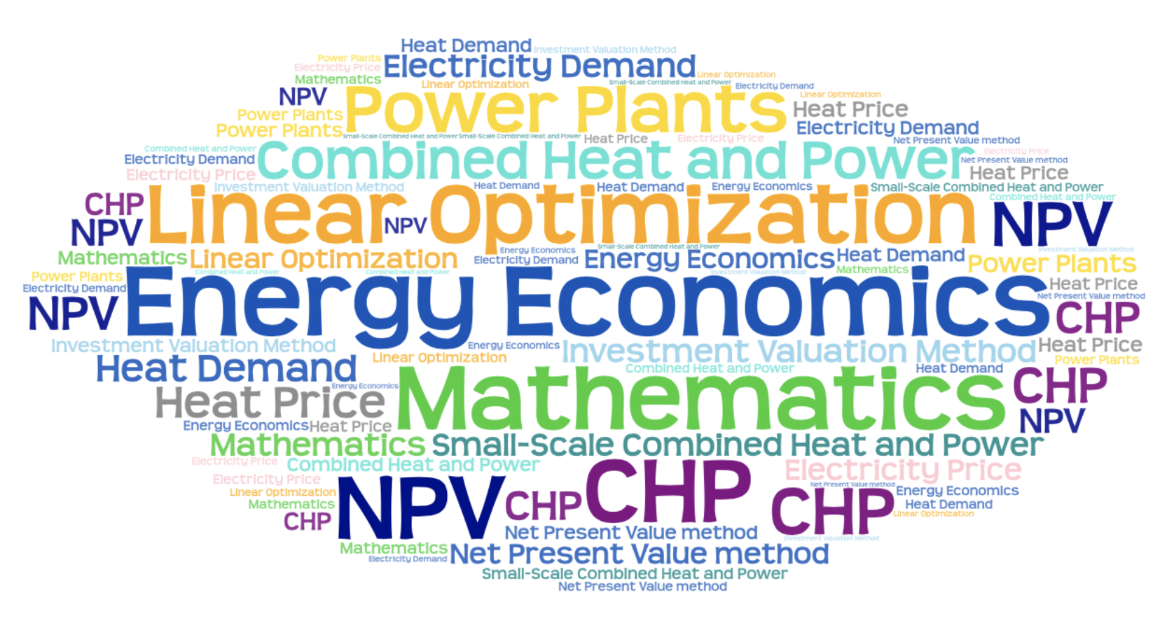
Thank You for you attention
Any questions!!!

