Slide 1
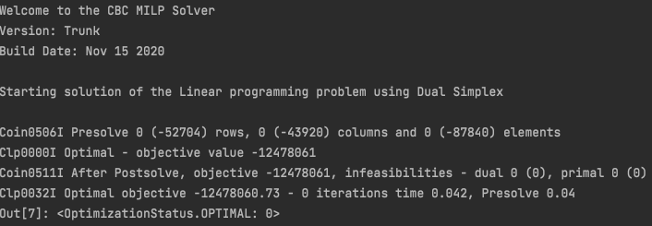
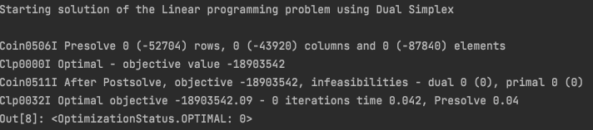
wholesale prices CHP
household prices CHP
wholesale prices CHP + boiler
household prices CHP + boiler

