Slide 1
In Time Tec
Live Data Streaming System
Presented by:
Shailja Jangid
Siddhartha Jain
Yashwant Mahawar
Shailja Maheshwari

Slide 2
Team-D presents before you a live data stream analysis system which can fetch live data from a system and perform analytics on it to obtain real time information.

Slide 3
Problem domain/purpose
Need to build scalable, fault tolerant, distributed data processing system that can handle massive amounts of data from disparate sources, with different data structures.

Slide 4
Inspiration/Use case
How-to: Detect and Report Web-Traffic Anomalies in Near Real-Time
https://blog.cloudera.com/blog/2016/06/how-to-detect-and-report-web-traffic-anomalies-in-near-real-time/

Slide 5
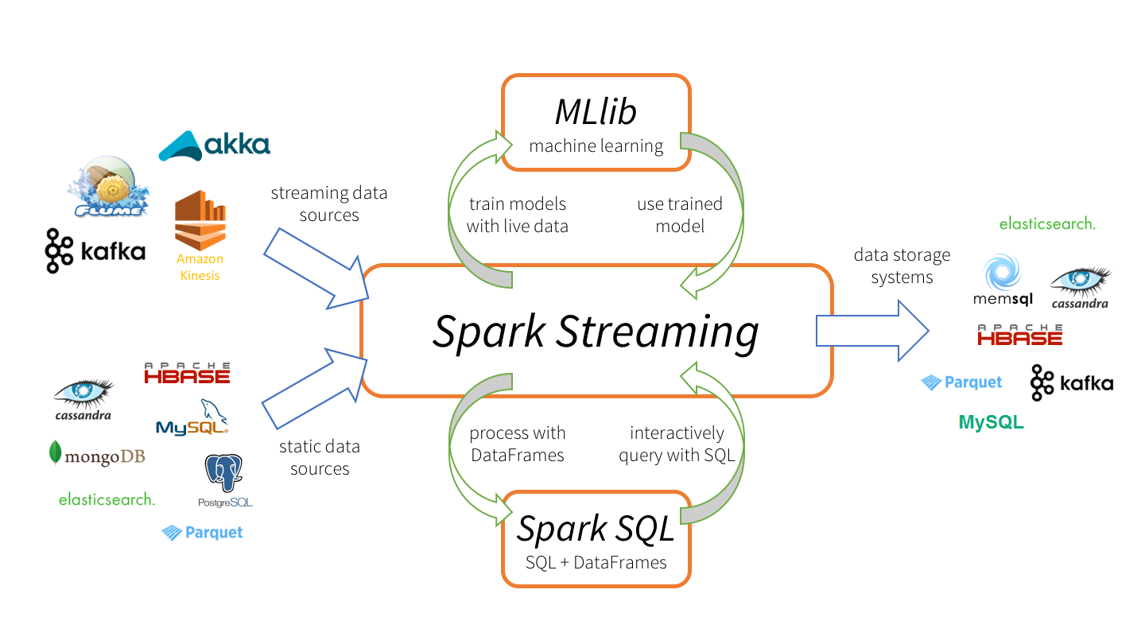

Slide 6
Companies using such system
LinkedIn: use this with Kafka+Spark+Impala
Amazon: use this integrating system with S3, keinesis
Cloudera: use both Kafka and Flume to achieve this
Google: use this to give real time advertisements on webpages.

Slide 7
What we did
Use case is that there are many websites which receive upto several thousands of HTTP GET requests per second during peak times.
Inspiration is an approach that uses kafka to keep track of the live data and uses spark streaming application to feed MySQL tables after every 30 seconds.

Slide 8
What all we used?
Spark Streaming 2.3.1
Kafka 0.10.x
Hadoop 2.7.3 (yarn)
Java 1.8
Scala 2.11
Python 3.6
MySQL 5.7

Slide 9
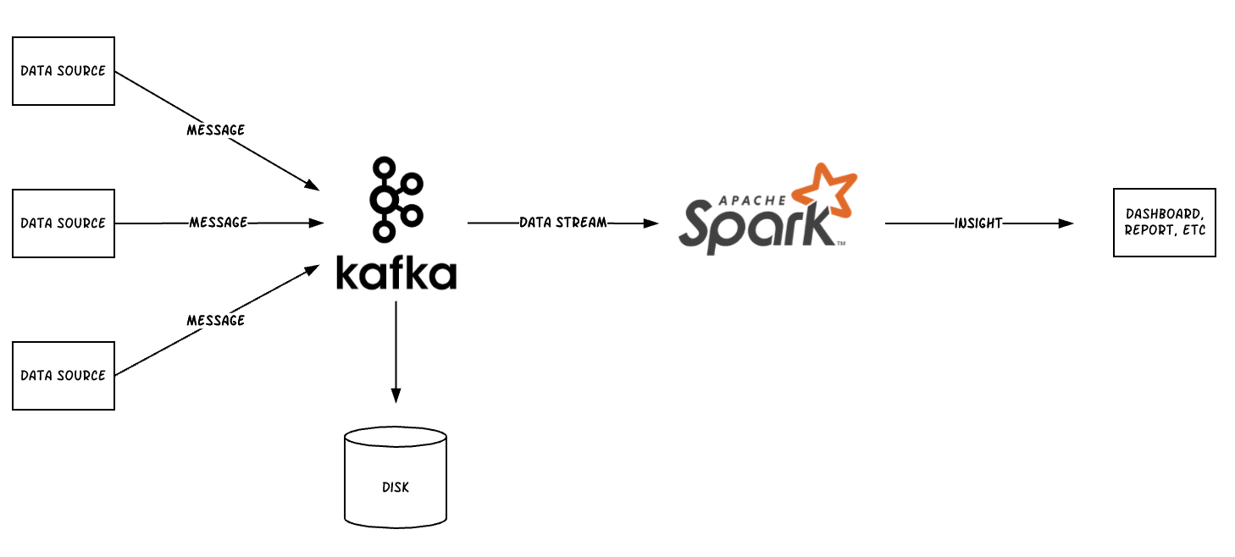

Slide 10
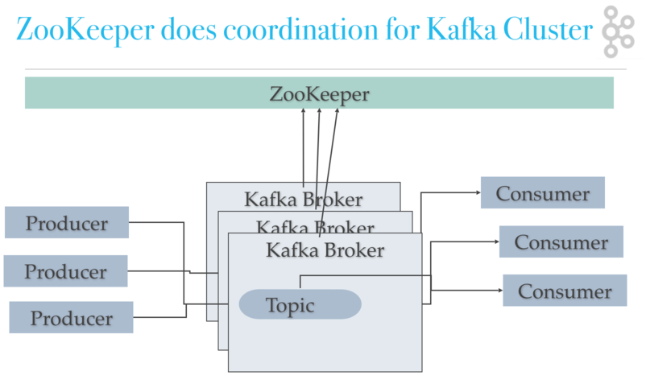
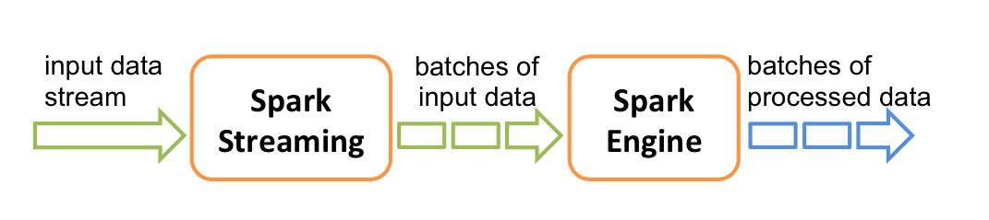

Slide 11
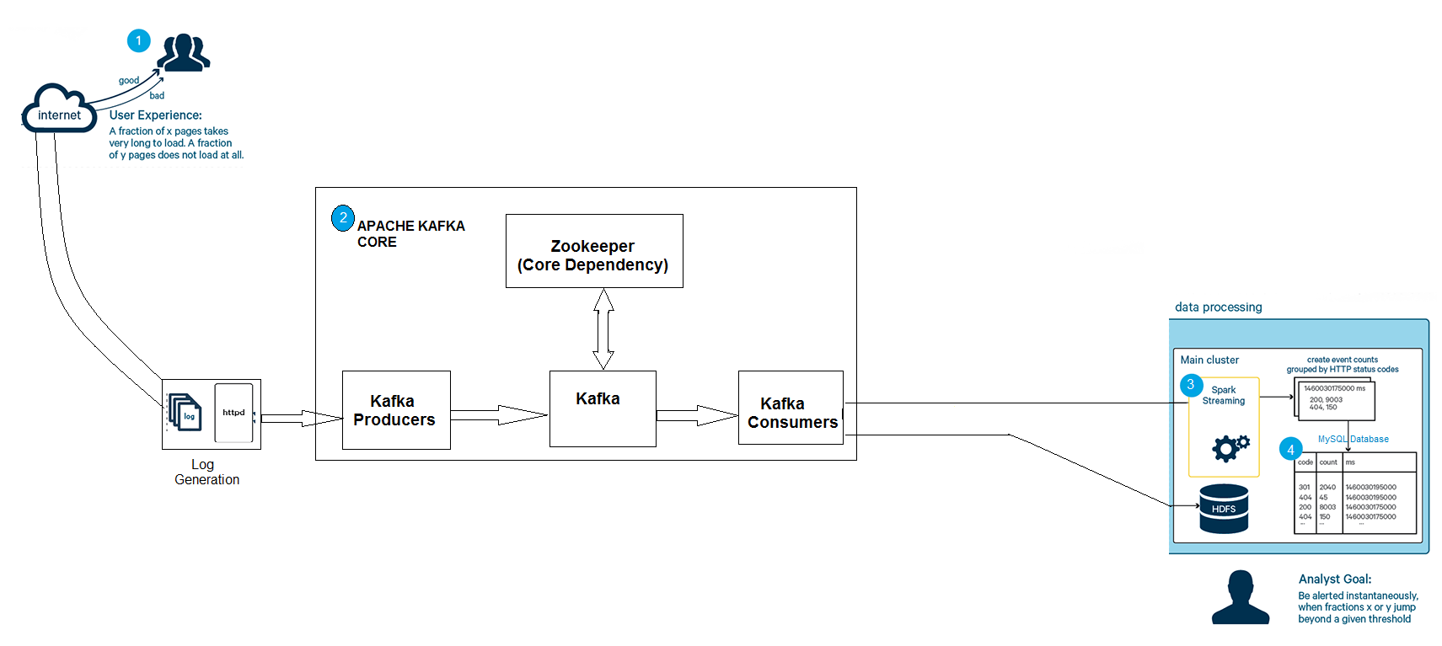

Slide 12
THANKYOU

