Slide 1
False Discovery
虚假发现

Slide 2
False Discovery - overview
What is discovery?
Reject Null
Significance level (alpha = 0.01/0.05/0.1)
P-value, if p<alpha, reject null
What is false discovery?
Stats
Non-stats

Slide 3
False Discovery – standard errors
Standard errors
t = beta/SE
measurement error
non-independent
Cluster/robust SE
small sample/non-normal
Bootstrap/permutation
Bayesian
large sample
Power high
Small effect size

Slide 4
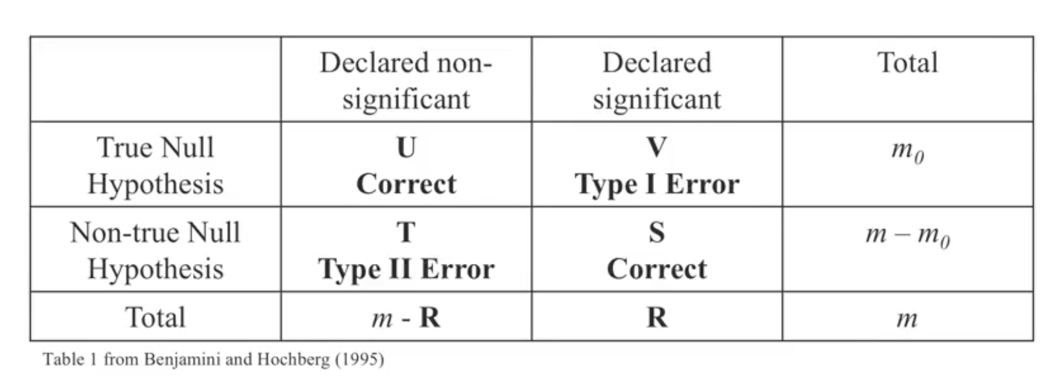
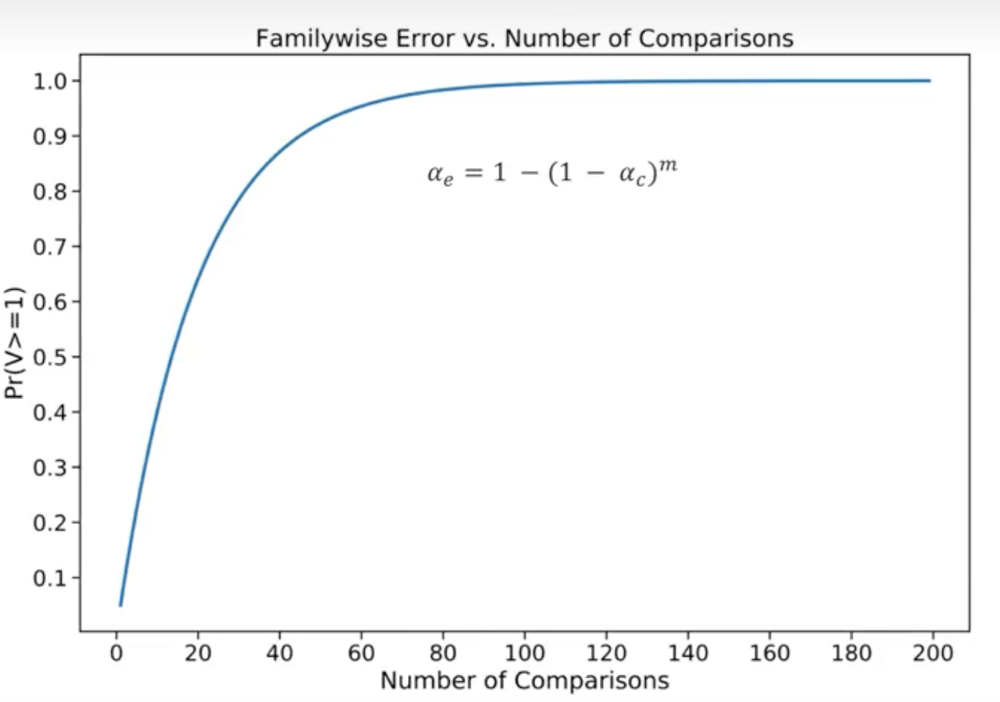

False Discovery – multiple testing
Even if we correctly estimate the standard error
Type 1 error
Reject the null when null is true
Multiple testing
Simultaneously do m individual tests
Family-wise error rate (FWER) = p(at least 1 fd) = $1−{\left(1−α\right)}^{m}$
Genes/factors/events/subgroups

Slide 5
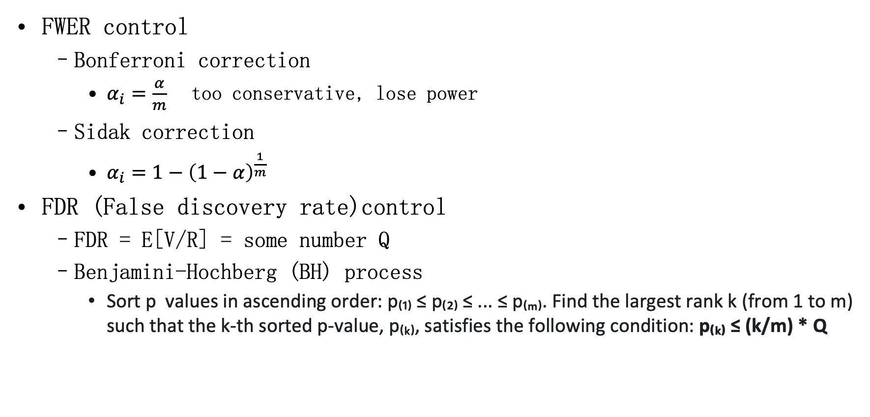
False Discovery – statistical control
FWER control
Bonferroni correction
$α_{i}=\frac{α}{m}$ too conservative, lose power
Sidak correction
$α_{i}=1−{\left(1−α\right)}^{\frac{1}{m}}$
FDR (False discovery rate)control
FDR = E[V/R] = some number Q
Benjamini-Hochberg (BH) process
Sort p values in ascending order: p₍₁₎ ≤ p₍₂₎ ≤ ... ≤ p₍ₘ₎. Find the largest rank k (from 1 to m) such that the k-th sorted p-value, p₍ₖ₎, satisfies the following condition: p₍ₖ₎ ≤ (k/m) * Q

Slide 6
False Discovery – Factor Zoo
Origin
Thousands of factors to explain stock variations
Use OLS + t=2.0
Data snooping
Replication crisis
Loads of (un)published discoveries could be false discovery
Some correction
McLean and Pontiff (2016): Does academic research destroy stock return predictivity?
Harvey, Liu, and Zhu (HLZ, 2016): test for 316 published factors raise t stats threshold t0 3.0, 27% false discovery
Chordia, Goyal, and Saretto (CGS, 2020): simulate unpublished factors, raise t-threshold to 3.4, 45.3% false discovery
Harvey (2017): minimum bayes factor
Harvey and Liu (2020, 2021): bi-mean prior

Slide 7
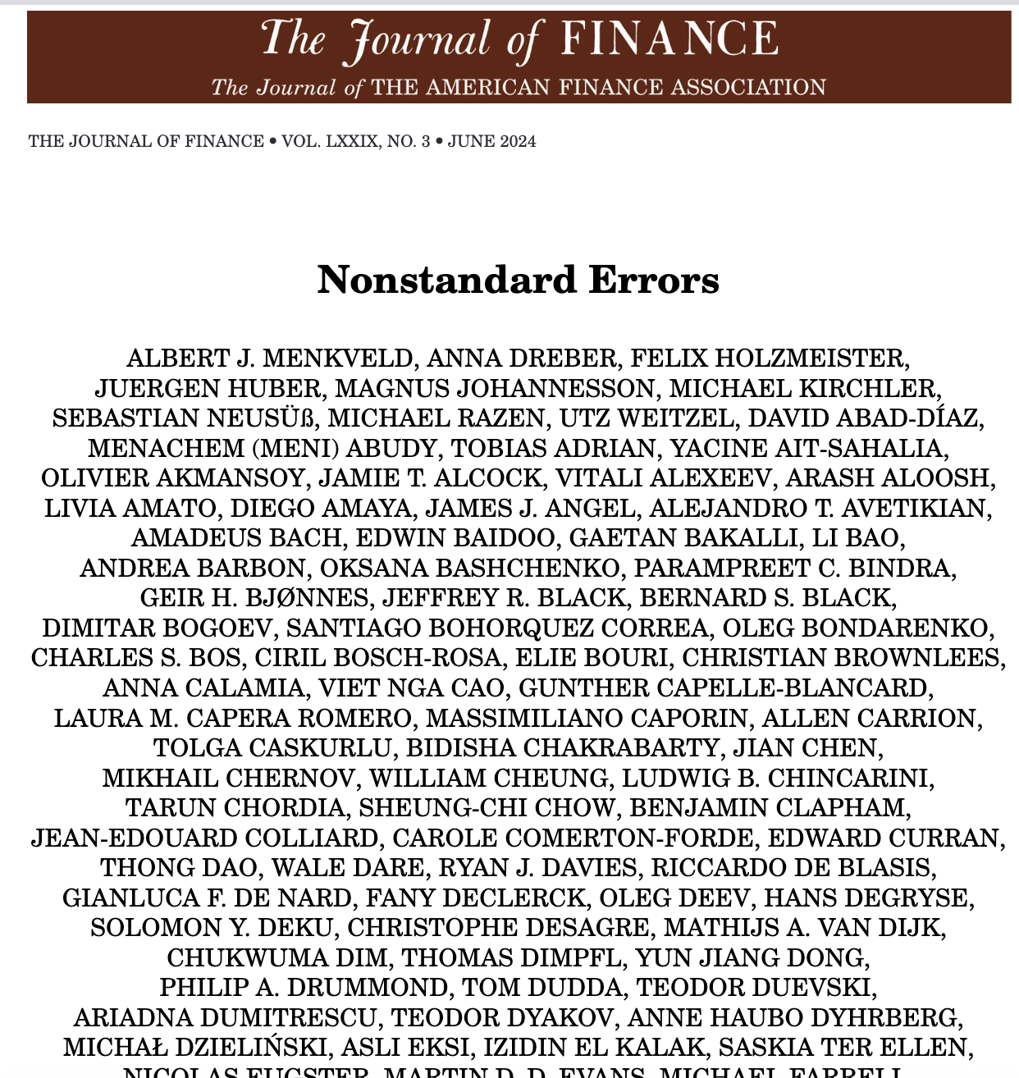
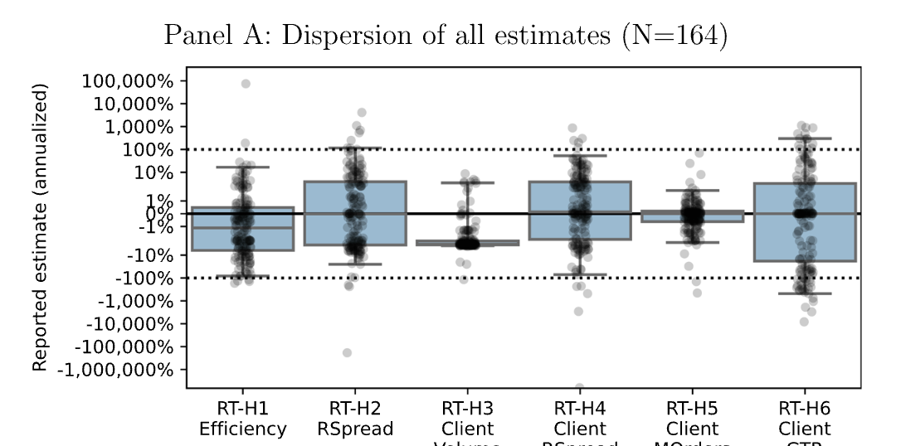
False Discovery – Non standard errors
Non-standard errors
164 teams
Same data
Same H

Slide 8
False Discovery – Non standard errors
Non-standard errors
Researcher degrees of freedom
Publication bias
data
先开枪再画靶

