Slide 1
Linux Fleet Automation
System Architecture & Operational Visibility
September 2026

Slide 2
Why this matters
A single automation platform gives the fleet one consistent way to collect logs, watch for problems, and report on host health.
Centralized visibility
Faster detection
Repeatable & safe
Less manual toil
Every host in the fleet forwards logs and inventory to one place — no more logging into individual servers to find out what happened.
Automated watchers check for service failures, disk pressure, and identity/sync issues, and raise email alerts before they become incidents.
Every capability is built as a tested, idempotent automation role — changes are validated in a controlled environment before reaching production.
Host inventory, patch history, and configuration reporting are generated automatically instead of collected by hand across the fleet.
Linux Fleet Automation — System Architecture & Operational Visibility
2

Slide 3
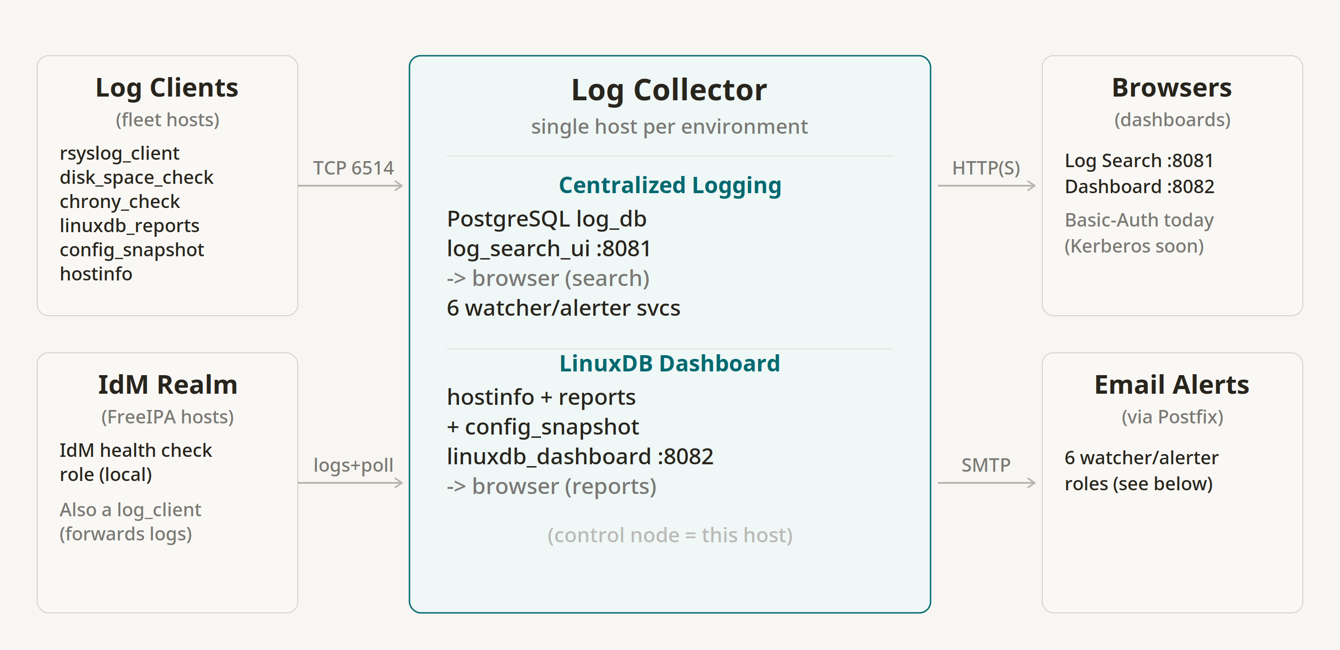
How it fits together
Fleet hosts, the identity realm, the collector, dashboards, and email alerting all connect through one automation platform.
Linux Fleet Automation — System Architecture & Operational Visibility
3

Slide 4
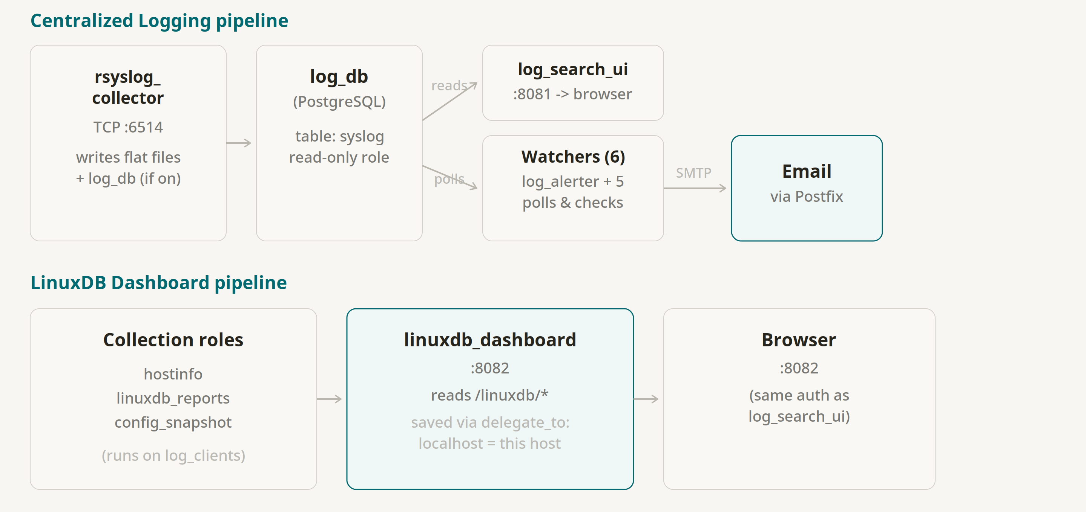
Two pipelines, one host
Centralized logging and the fleet dashboard run independently on the same collector host — each can be upgraded or restarted without affecting the other.
Linux Fleet Automation — System Architecture & Operational Visibility
4

Slide 5
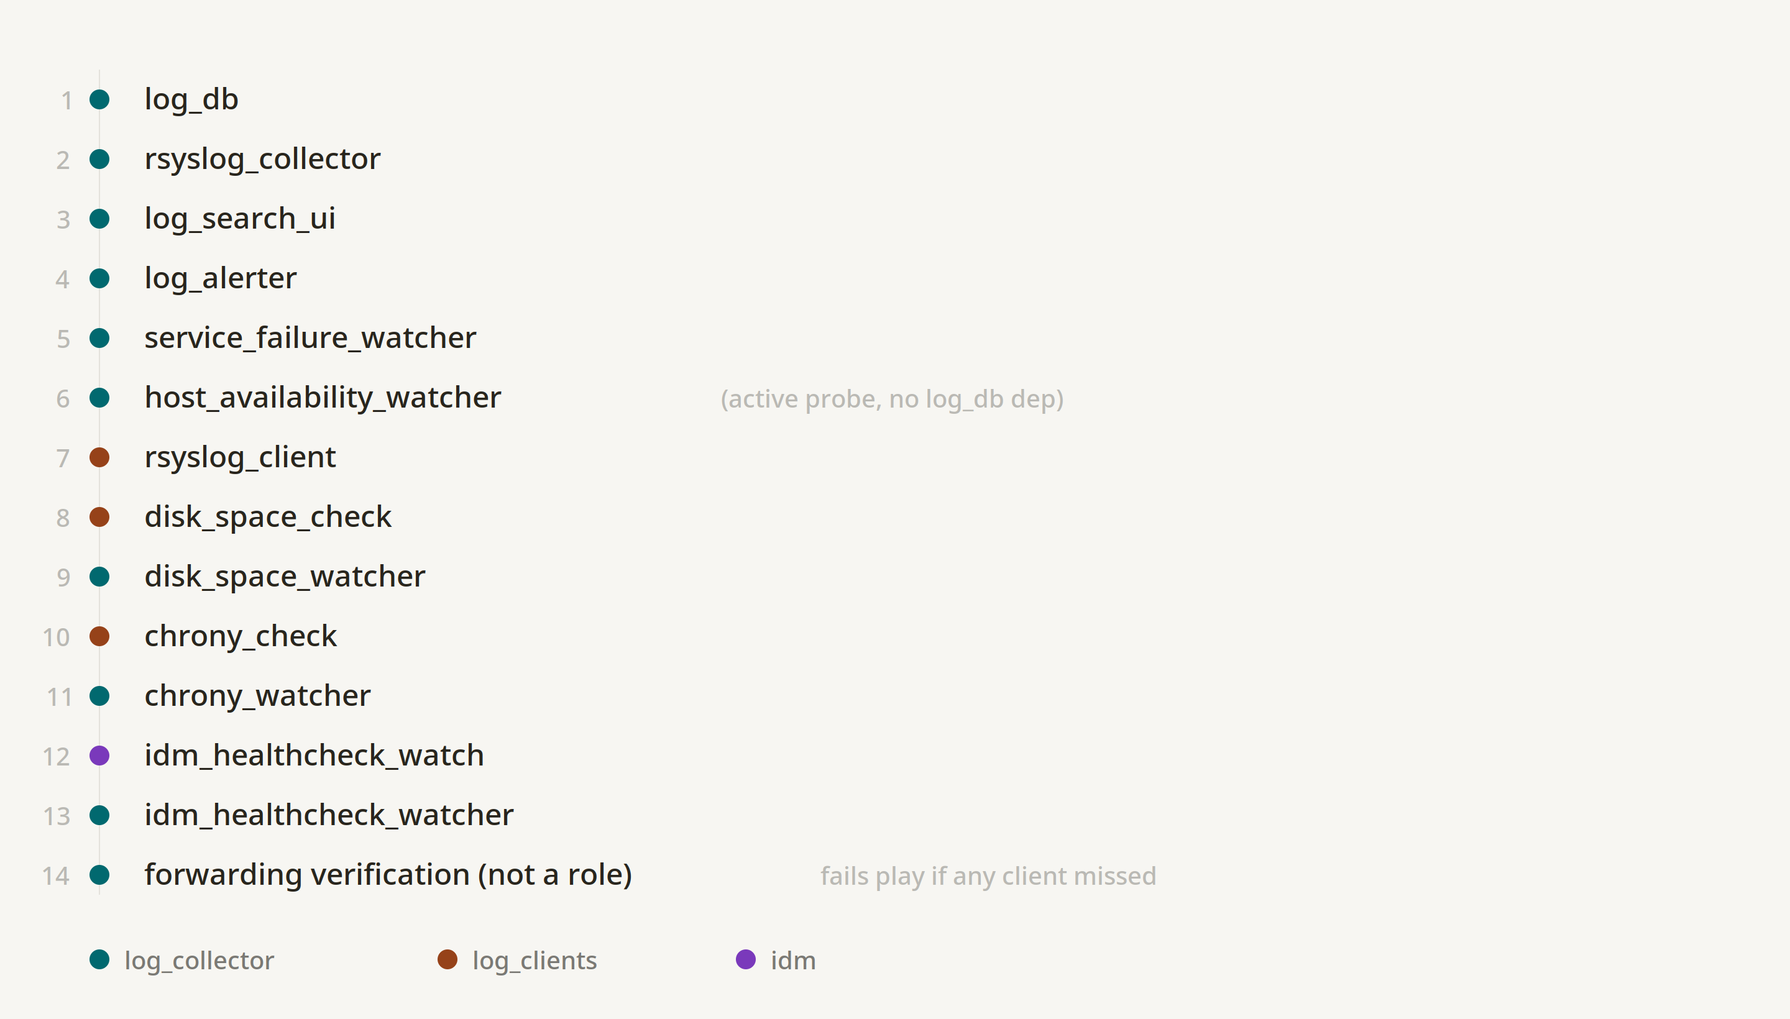
Role execution order
The centralized logging automation applies roles in a fixed, dependency-aware order across three host groups: the collector, log-forwarding clients, and the identity realm.
Linux Fleet Automation — System Architecture & Operational Visibility
5

Slide 6
Status & roadmap
Where we are today
What’s next
Centralized logging and the fleet dashboard are both running in a controlled test environment.
Access is currently protected by a single shared credential.
Alert conditions are validated: disk, service-failure, and identity/sync watchers are in place.
Storage growth and retention are being monitored ahead of a production sizing decision.
Move both dashboards to identity-realm single sign-on, replacing the shared credential.
Restore TLS on both dashboards using corporate-issued certificates.
Add per-request username logging so dashboard access is individually auditable.
Promote validated changes into the production estate once sign-off and sizing are confirmed.
Linux Fleet Automation — System Architecture & Operational Visibility
6

Slide 7
Questions & discussion
Happy to walk through any part of the architecture, current status, or rollout plan in more detail.

