Slide 1
Categorical Art Generation with a Variational Autoencoder
Steven Spencer

Slide 2
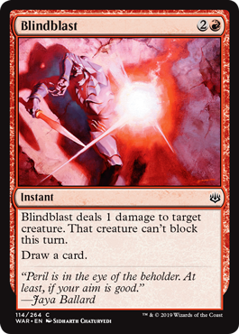
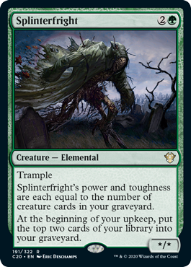
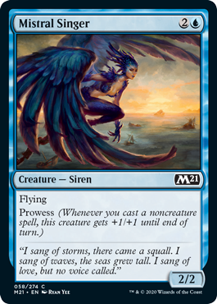
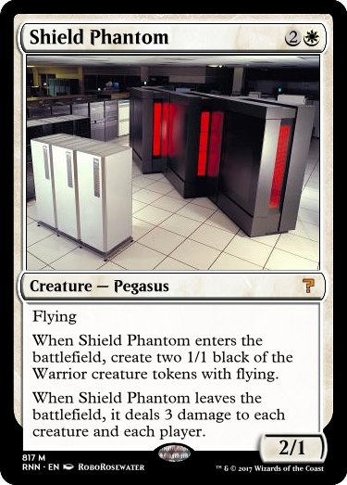
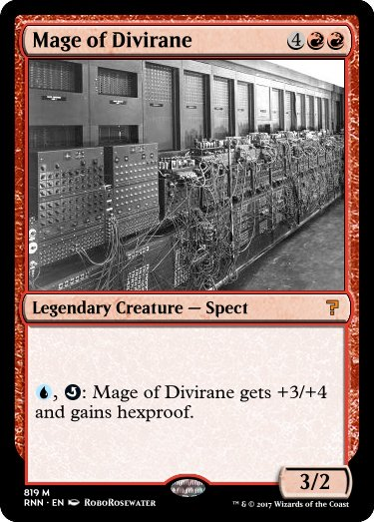
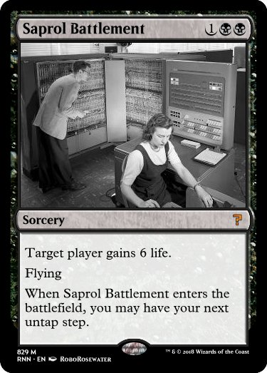
Motivation
Generate art given certain categories/qualities
Applied to Magic: The Gathering cards
Over 20,000 unique cards have been printed
Generative models have produced card names/rules/categories, but never art
Goal is to combine art generation with existing models to generate complete cards

Slide 3
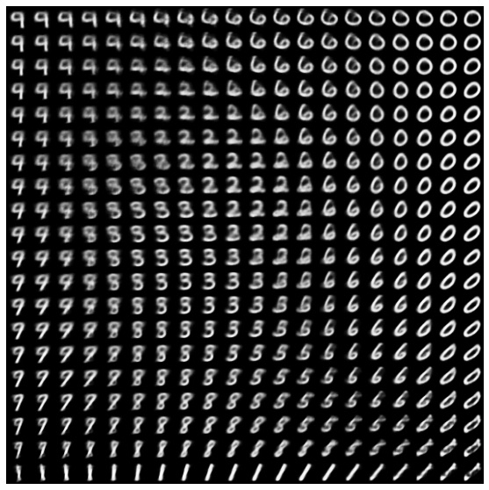
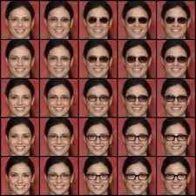
Approach
Why a VAE?
Latent variables can correspond to different categories/quality
Can adjust latent variables to match desired category

Slide 4
Experiment
Training the VAE

Slide 5
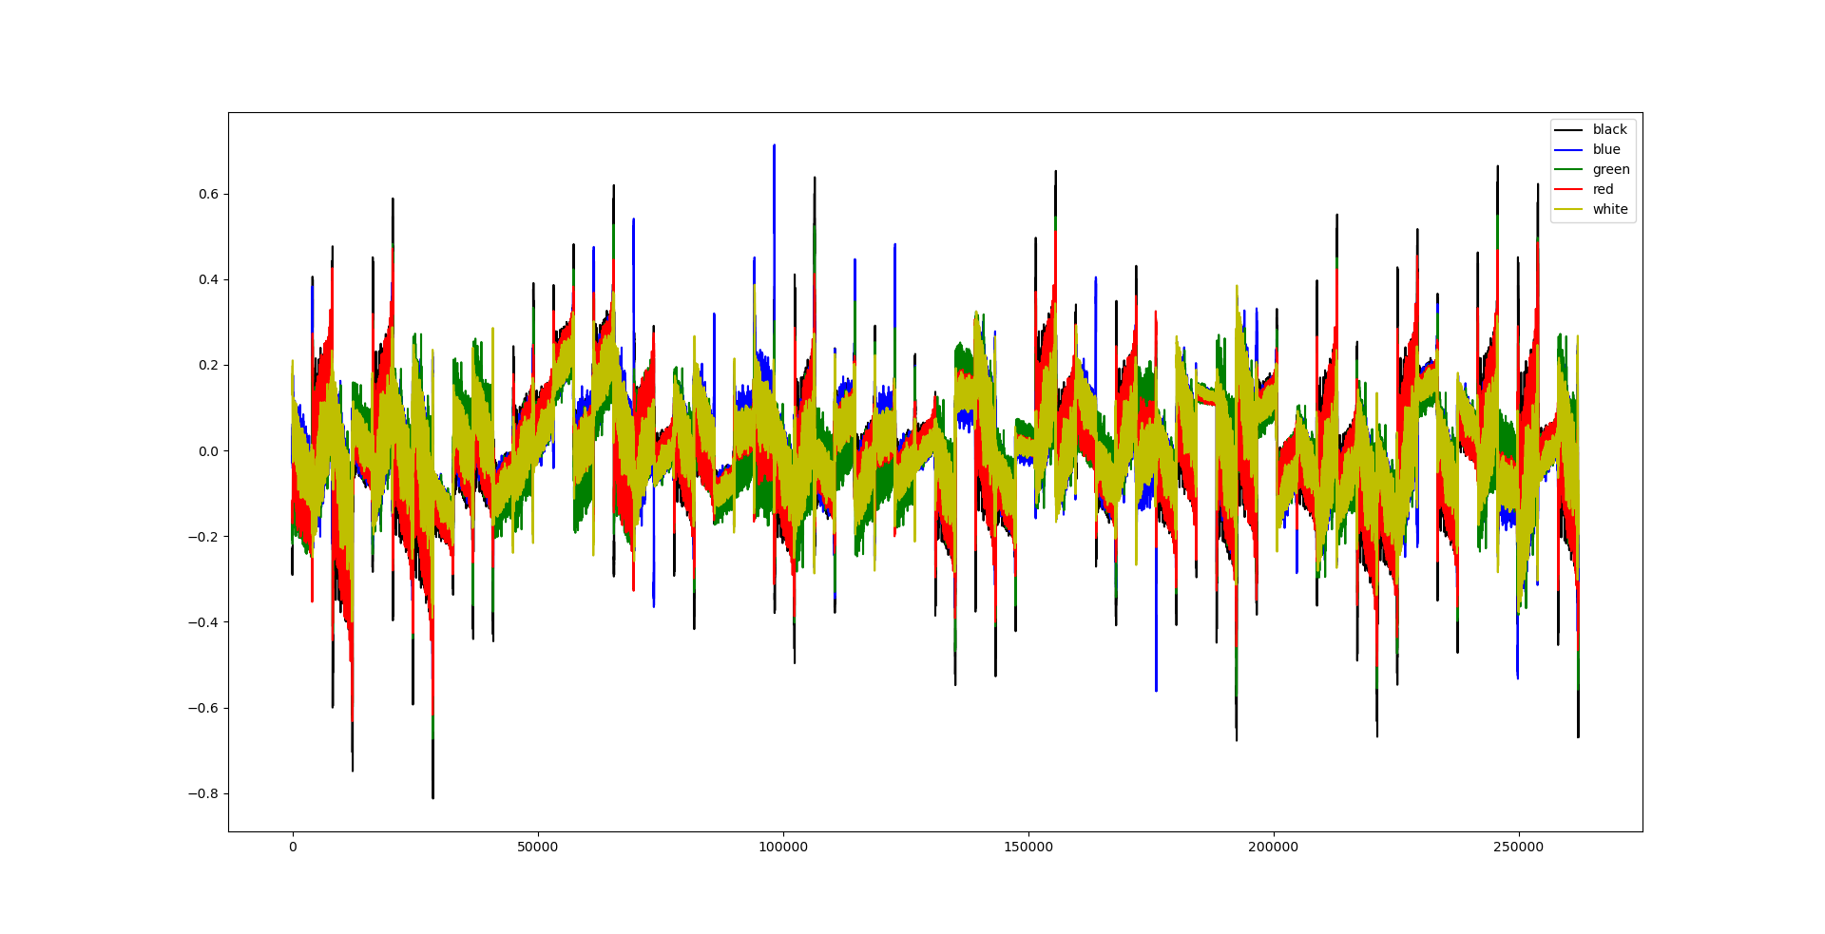
Experiment
Average latent variable value for each class

Slide 6
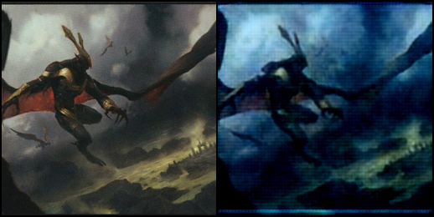


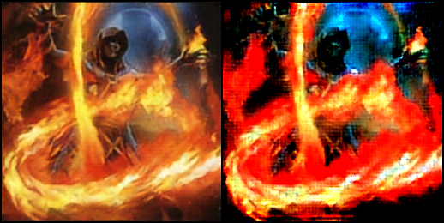
Results
VAE Struggles to learn structure
Only seems to learn color palettes
Class definitions too vague, too much variation within class

Slide 7
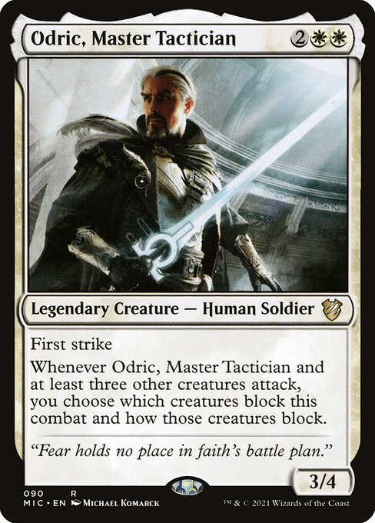
Improvements
Narrow Scope of Classes
Original class definitions too broad, use smaller classes to reduce variation within class

Slide 8
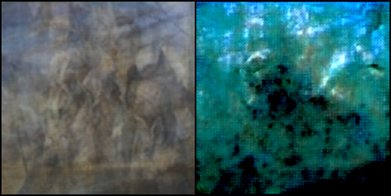
Results
Improved, but still rough
Some amount of structure is visible
Can see some change in structure, in addition to changes in color palette

Slide 9
Conclusions
Too much variation among the images to reliably train VAE
Accuracy could potentially be improved with improvements in VAE model, or in searching for latent parameters
Another approach would be to use a generator using text descriptions of images (DALL-E, GPT-3)

Slide 10
Questions

