Slide 1
Optimizing the “Point in Polygon” Algorithm in Point Pattern Analysis for PySAL
Hu Shao
Apr.25.2016

Slide 2
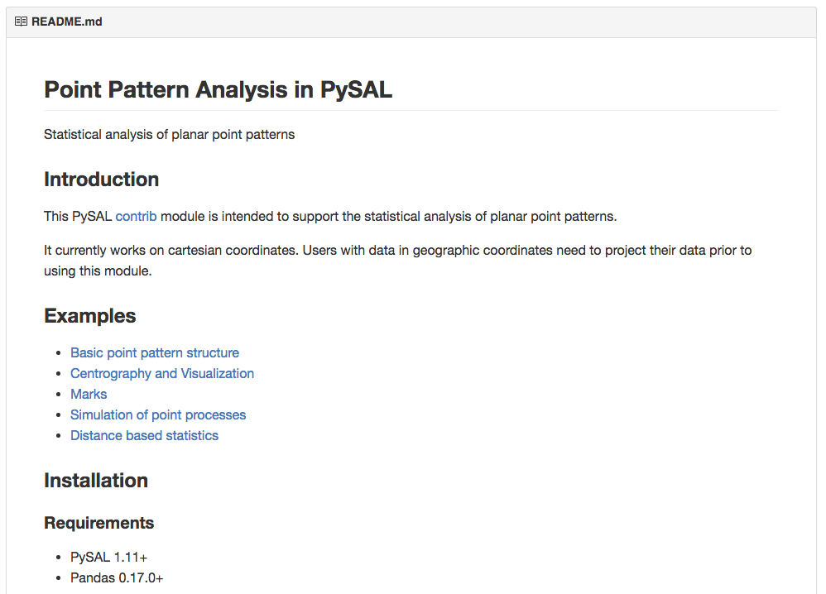
Point Pattern Analysis In PySAL

Slide 3
Simulation Envelopes
Simulation envelope is a computer intensive technique for inferring whether an observed pattern significantly deviates from what would be expected under a specific process. Here, we always use CSR as the benchmark. In order to construct a simulation envelope for a given function, we need to simulate CSR a lot of times, say 1000 times. Then, we can calculate the function for each simulated point pattern. For every distance d, we sort the function values of the 1000 simulated point patterns. Given a confidence level, say 95%, we can acquire the 25th and 975th value for every distance . Thus, a simulation envelope is constructed.

Slide 4
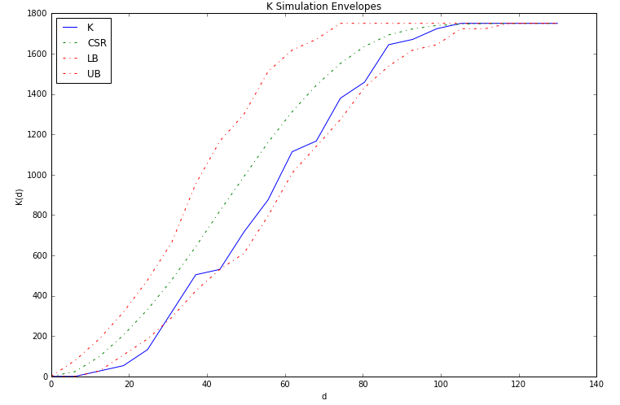

Slide 5
Computing intensive parts
Statistics
Plotting results
Reading data
Generating points

Slide 6
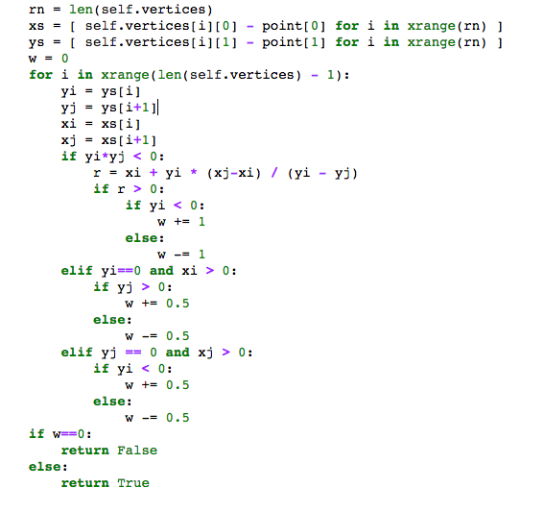
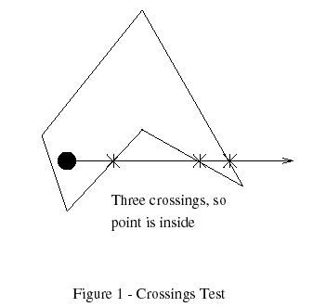

Point in polygon test
Time complexity: $o(m)×o(n)$

Slide 7
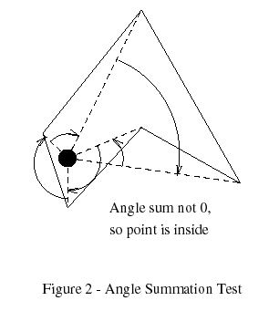
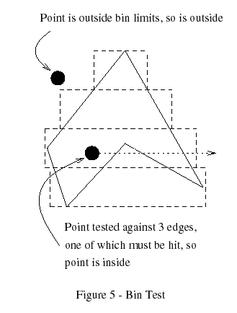
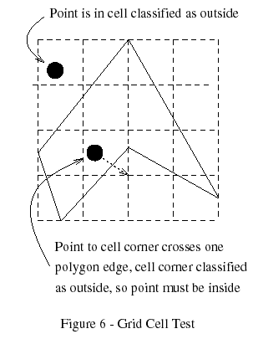

Slide 8
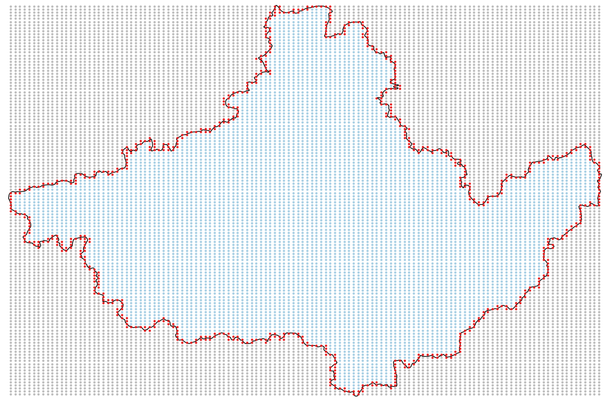
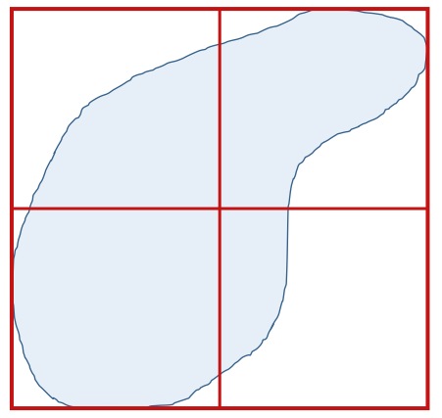
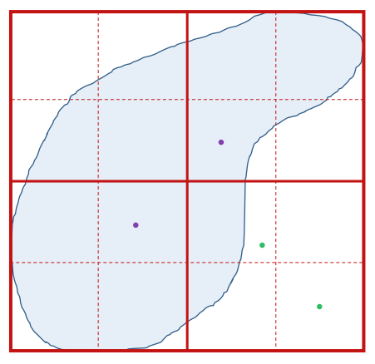
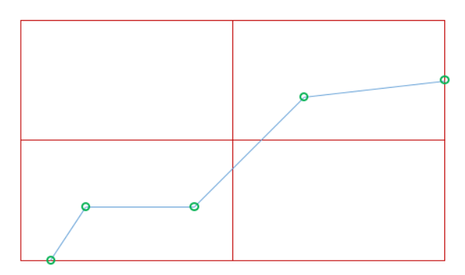
Quadtree Structure for “point in polygon test”
In
Out
Maybe

Slide 9
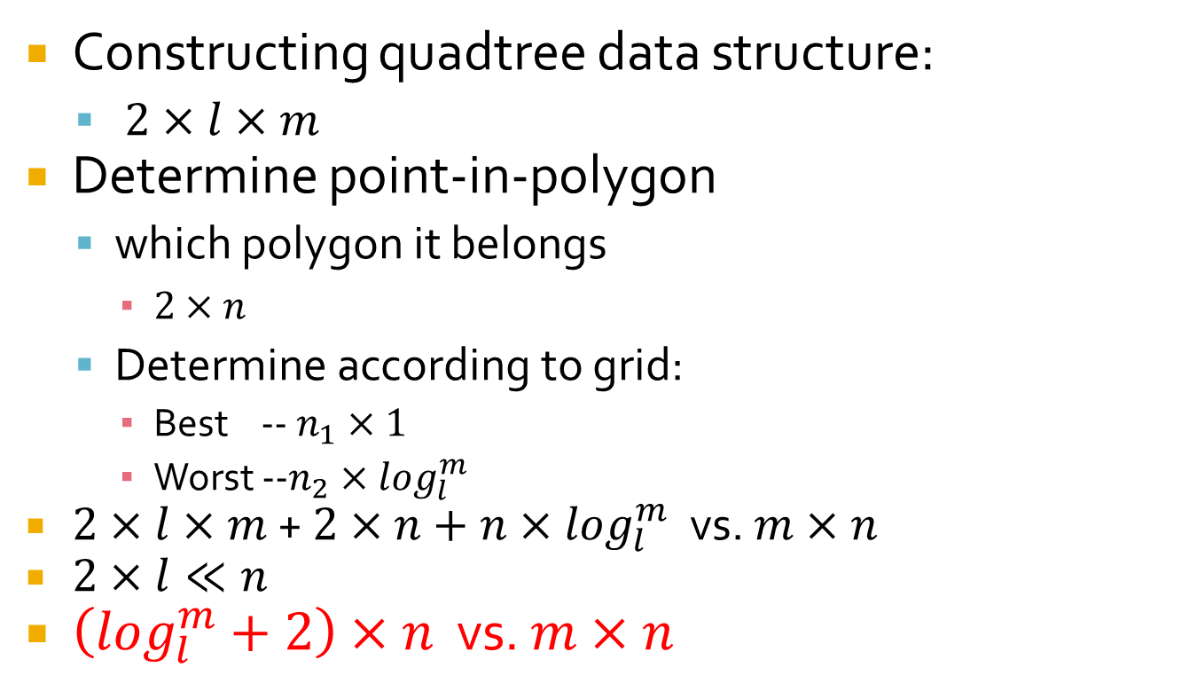
Time complexity analysis
Constructing quadtree data structure:
$2×l×m$
Determine point-in-polygon
which polygon it belongs
$2×n$
Determine according to grid:
Best -- $n_{1}×1$
Worst --$n_{2}×\log_{l}^{m}$
$2×l×m$ + $2×n+n×\log_{l}^{m}$ vs. $m×n$
$2×l≪n$
$\left(\log_{l}^{m}+2\right)×n$ vs. $m×n$

Slide 10
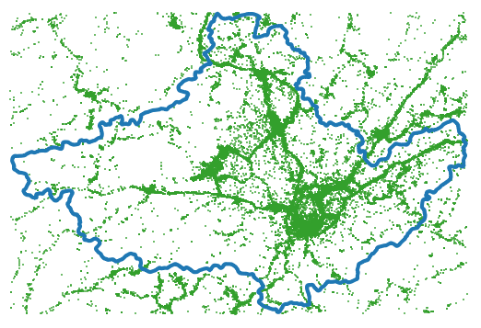
Experiments
Study area
Huangshan City, 3891 vertices
Point data
Geo-tweets, 408719
Methods:
Pysal
Shapely
Quadtree structure
Fix polygon vertices, vary point size
Fix point size, vary polygon vertices

Slide 11
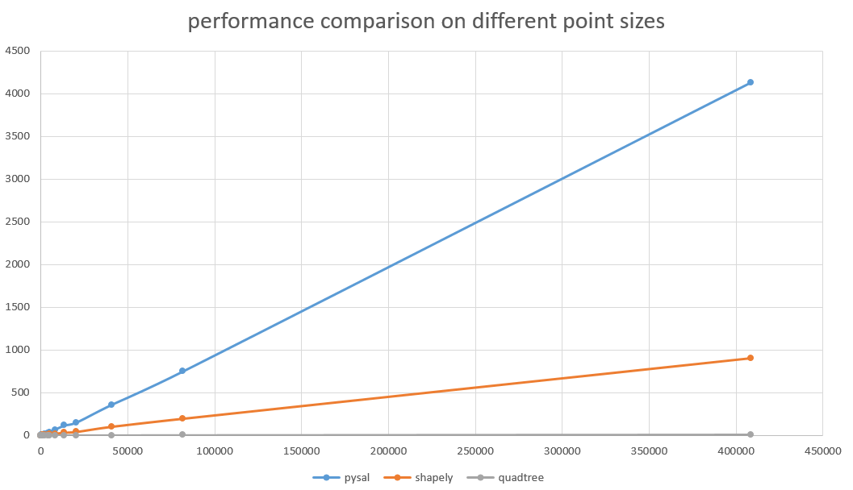
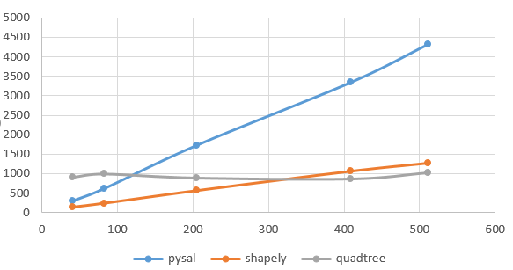

Slide 12
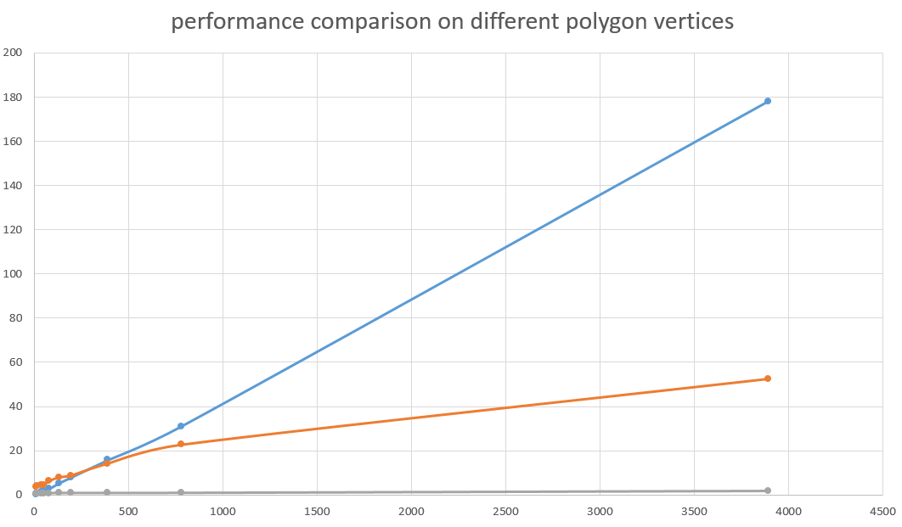
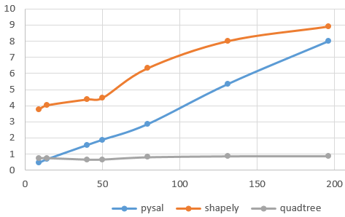

Slide 13
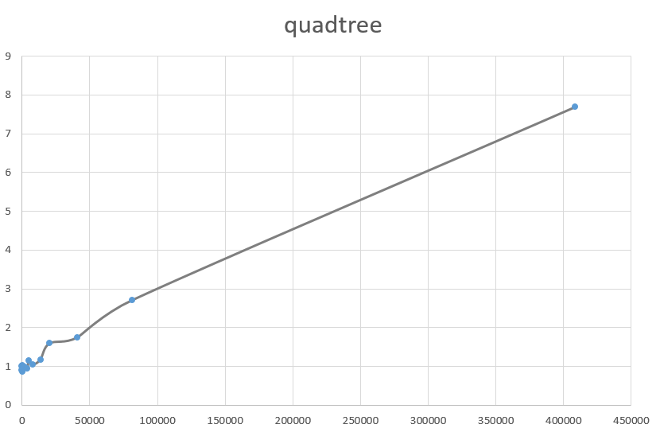

Slide 14
Conclusion and future work
Not suitable for all situations
Optimizing part 2.

