Slide 1

Data Engineering - Capstone Project
API to Visualisation
-NewsWatch-
____
30th August 2023
Simon Smith

Slide 2
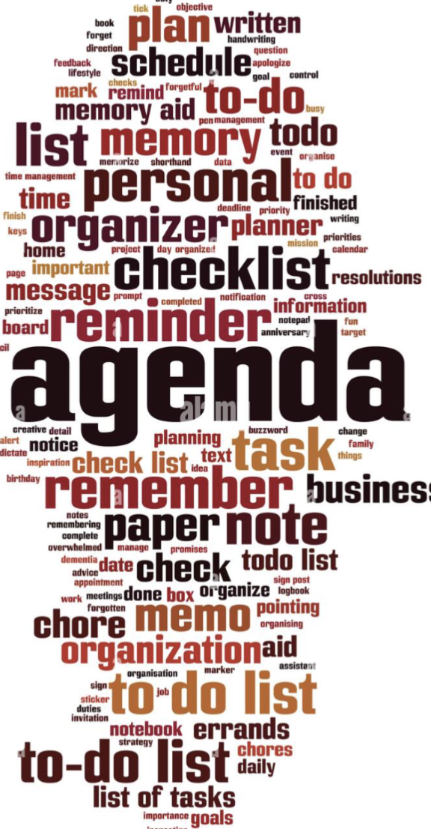
Agenda:
Problem Statement
Project Plan & Evolution
Methodology
Data Flow Diagram
Script Demo and Visualisation
Learnings

Slide 3
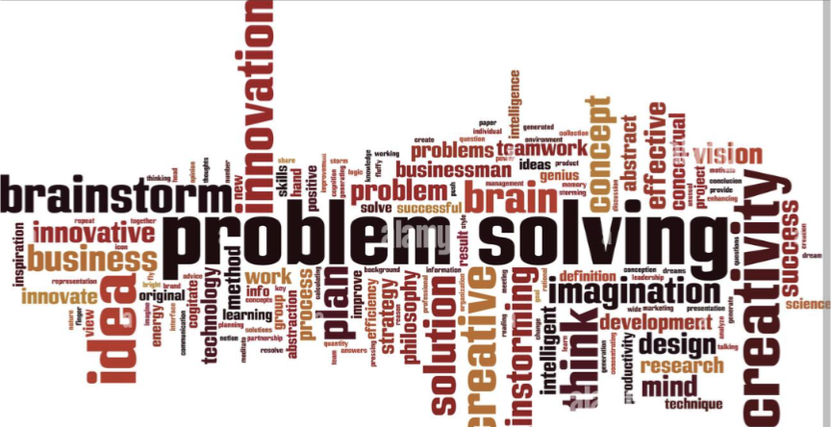
What’s your problem!
Time
Boring articles
All together
We all lead busy lives, either working or spending time with family or even training to be a Data Engineer.
Who has time to read the news!
Often the main news outlets are filled with boring, long winded articles, yet somewhere within there maybe some valuable insights.
So many different outlets of online news to choose from…
No more need to choose just one!
Notes:
I choose to focus on news articles, initially in an attempt to gain insights around cyber security news without the need to read whole articles.
Inspired by Ryan’s aversion to cyber security and a general apathy from many people regarding the subject.
From the slide…
The plan was to have an evolving word cloud with up to date buzz words around cybersecurity, providing current insights and trends.

Slide 4

Project Plan Journey & Evolution
New York Times API - CyberSecurity NewsWatch
NewsAPI - Buzzword NewsWatch
Notes:
That was the plan.
I choose NYT API, they had several but the articles API and newswire live API appeared to fit the bill.
However after a couple of days of struggling with the API’s due to the lack of regular updates and the restrictions and pagination on API calls.
Due to the extension on the project I was handed an opportunity to change direction slightly.
Further research led me to News API and the project expanded to Buzzword NewsWatch.
The plan had evolved to allow a user to input any buzzword to extract news insights around that subject.

Slide 5

NewsAPI
What is NewsAPI?
News API is a service that provides real-time news data across a large number of sources from around the world. Search through hundreds of millions of articles in 14 languages from 55 countries.
How does it work?
Users make requests to the API for specific news data. NewsAPI then aggregates this information and responds to the request.
What's so special about it?
NewsAPI saves users time and effort by providing a comprehensive and constantly updated source of information.
Notes:
Takes news articles from thousands of news sources across the world
You can make specific keyword queries or make queries from specific news providers ie bbcnews etc
and also query articles in a particular language

Slide 6
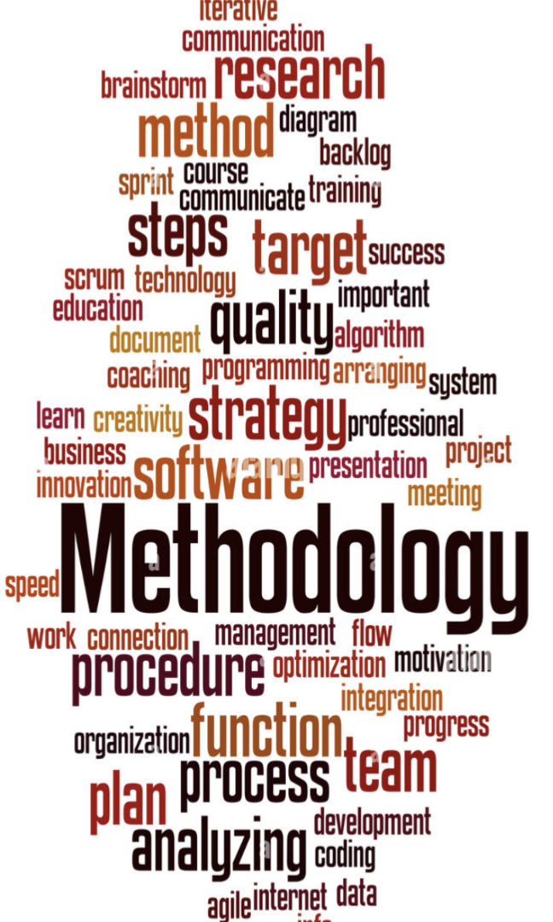
Methodology
API signup
API request
Determinate data structure
Extract and clean relevant data
Database storage
Ensure only differential data
Convert current stored tables to .csv
Prepare for visualisation
Word Cloud creation
Notes:
NewsAPI signup was relatively easy, and provides limited restrictions. 1000 calls per 24 hours
Determine data structure
JSON file dictionary keys showed that the relevant data was in the ‘articles’ key
Extract & Clean
From the articles I took the title, description and content to get the keywords from.
I realised that the url could be used as the unique identifier because it contained information from the news source, title and date altogether. This would be useful later.
In terms of cleaning data
# lower case, split in to individual words
# I then created a list of stop words to remove pronouns/ preposition/ conjunctions etc... leaving adjectives/ adverbs/ nouns/ verbs etc
# re join words
I spent quite a while on this stage and I am aware now that I can use the python natural language processing toolkit NLTK. However I wasn’t confident at this stage I and will discuss this later when we talk about learnings from the project!
Database Storage
Using Alex’s tips on how to use psycoPG2 to connect to the pagila DB
Create the table in the database
Ensure only differential data
ensure only the delta of data is inserted - url must be a unique value or it will not be added to the database
Convert to csv
Table will continue to grow as more articles are added, so using a csv of the database tables allows for an accumulation of words for the word cloud
Prepare for visualisation
Combining the columns of the csv file and separating the words ready for the word cloud.

Slide 7
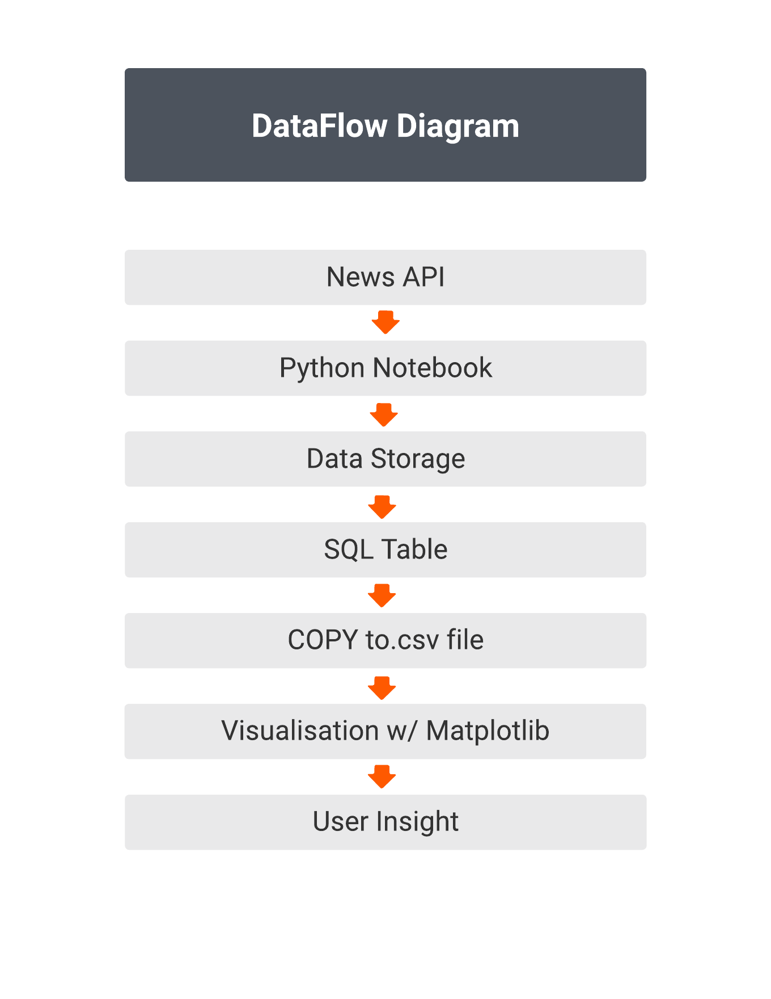


Slide 8
Demonstration

Slide 9

Learnings
and further study!
API use
Python NLTK
Tokenizing
Stemming
Lemmatizing
Chinking & chunking
matplotlib
Notes:
So many learnings that have come from this project.
Many have been around perseverance, adapting to changes, time management, problem solving/ vs problem creating!
But in terms of actual further study….
API’s
I definitely want to try more varied API’s. They seem to be very different in nature to work with.
Python NLTK
I really need to spend some time practicing using python Natural Language Tool Kit,
and get to grip with
Tokenizing (splitting by word or sentence)
Lemmatizing (returns words to bse dictionary form)
Stemming
Chinking & chunking (chunking is used to include a pattern, chinking is used to exclude a pattern)
Matplotlib
So many different options for visualisations and options within those too.

