Slide 1


NoSQL as Not Only SQL
Backend Berlin
Dezember 2015
Stefanie Janine Stölting
@sjstoelting

Slide 2

JSON Datatypes
JSON
  Available since 9.2
BSON
  Available as extension on GitHub since 2013
JSONB
  Available since 9.4
  Crompessed JSON

Slide 3
ACID
Atomicity, Consistency, Isolation, Durability is a set of properties that guarantee that database transactions are processed reliably. ¹
1 See https://en.wikipedia.org/wiki/ACID

Slide 4
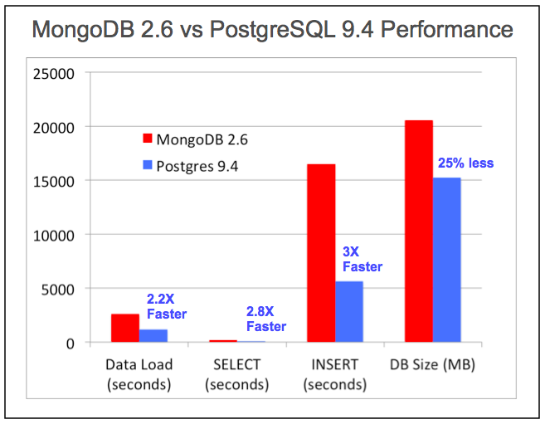
Performance
Test done by EnterpriseDB, see the articleby Marc Linster

Slide 5
JSON Functions
row_to_json({row})
Returns the row as JSON
array_to_json({array})
Returns the array as JSON

Slide 6
JSON Opertators
Array element
->{int}
Array element by name
->{text}
Object element
->> {text}
Value at path
#> {text}

Slide 7
Index on JSON
Index JSONB content for faster access
  GIN index overall
    CREATE INDEX idx_1 ON jsonb.actor USING GIN (jsondata);
  Even unique B-Tree indexes are possible
    CREATE UNIQUE INDEX actor_id_2 ON jsonb.actor((CAST(jsondata→'actor_id'::int)));

Slide 8
New JSON functions
With the next version, 9.5, there will be new functions available, for example:
  jsonb_pretty
  jsonb_set
If you can't wait using them, you might be interested in the jsonbx extentsion available at PGXN

Slide 9
Data sources
The Chinook database is available at chinookdatabase.codeplex.com
Amazon book reviews of 1998 are available at examples.citusdata.com/customer_reviews_nested_1998.json.gz

Slide 10

CTE
Common Table Expressions will be used in examples
Example:
WITH RECURSIVE t(n) AS (
VALUES (1)
UNION ALL
SELECT n+1 FROM t WHERE n < 100
)
SELECT sum(n), min(n), max(n) FROM t;
Result:

Slide 11
Live Examples
Let's see, how it does work.

Slide 12
User Group / Conferences
PostgreSQL User Group Berlin
PGDay FOSDEM
Brussels, January 29 2016
FOSDEM Dev Room
Brussels, January 31 2016

Slide 13
Link List
Extended JSONB functions for 9.5
Extended JSONB functions as extension for 9.4 from PGXN (jsonbx)
Slide and source on Github:
https://github.com/sjstoelting/talks

Slide 14
JSON by the other
Elephant
This document by Stefanie Janine Stölting is covered by theCreative Commons Attribution 4.0 International

