Slide 1
PostgreSQL As Data Integration Tool
PostgreSQL SQL-MED
pgDay Paris 2019/03/12
Stefanie Janine Stölting
@sjstoelting
mail@stefanie-stoelting.de

Slide 2

SQL/MED
First defined in ISO/IEC 9075-9:2008, revised by ISO/IEC 9075-9:2016
Supported by
  DB2
  MariaDB
    With CONNECT storage engine, implementation differs to the standard
  PostgreSQL

Slide 3
Implementation
Foreign Data Wrapper
  Read only
  Read and write
Installation as extensions

Slide 4
Available FDW
Examples:
  Oracle (pgxn.org)
  MS SQL Server / Sybase ASE
  read-only (pgxn.org)
  MongoDB (GitHub)
  MariaDB / MySQL (pgxn.org)
  Please use the GitHub repository, the extension is outdated on PGXN
  SQLite (pgxn.org)
  There is another one (read-only) on GitHub, which isn’t in active development
  Hadoop (HDFS)
  read-only (GitHub)
  ODBC (GitHub)
  There is another one on PGXN, which isn’t in active development
  Apache Kafka
  read-only (GitHub)

Slide 5
Special FDW
file_fdw
postgres_fdw
foreign_table_exposer
Some BI systems have problems with
foreign tables, that extension solves that
Notes:
foreign_table_exposer
Some BI Tools don‘t detect foreign data tables. This extension solves the problem.

Slide 6
Write your own FDW
Multicorn
  Use Python and Multicorn to write your own and access lots of stuff like
    IMAP
    HTML

Slide 7
Data source
The example data used in the live data part is available from Chinook Database:
  PostgreSQL
  CSV
  SQLite
  MariaDB

Slide 8





Chinook Tables

Slide 9
Live Data examples

Slide 10
Live Data examples
-- Create the SQLite foreign data wrapper extension in the current database
CREATE EXTENSION sqlite_fdw;

Slide 11
Live Data examples
-- Create the SQLite foreign data wrapper extension in the current database
CREATE EXTENSION sqlite_fdw;
-- Create the mapping to the foreign SQLite file
-- IMPORTANT:
-- Take care that the postgres user has the rights to write
-- not only on the SQLite file, but on the folder, too
CREATE SERVER sqlite_server_srv
FOREIGN DATA WRAPPER sqlite_fdw
OPTIONS (database '/var/sqlite/Chinook_Sqlite.sqlite')
;
-- Create the SQLite foreign table, column definitions have to match
CREATE FOREIGN TABLE chinook_sqlite."Artist"(
"ArtistId" integer OPTIONS (key 'true'),
"Name" text
)
SERVER sqlite_server_srv
OPTIONS(
table 'Artist'
);

Slide 12
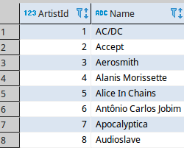
Live Data examples
-- Select some data
SELECT *
FROM chinook_sqlite."Artist"
;

Slide 13

Live Data examples
-- Update one record inside the SQLite DB
UPDATE chinook_sqlite."Artist" SET
"Name" = lower("Name")
WHERE "ArtistId" = 1
;
-- Select the updated record
SELECT *
FROM chinook_sqlite."Artist"
WHERE "ArtistId" = 1
;

Slide 14

Live Data examples
-- Revert the update
UPDATE chinook_sqlite."Artist" SET
"Name" = 'AC/DC'
WHERE "ArtistId" = 1
;
-- Check the revert of the updated record
SELECT *
FROM chinook_sqlite."Artist"
WHERE "ArtistId" = 1
;

Slide 15
Live Data examples
-- Create the foreign data wrapper extension in the current database
CREATE EXTENSION mysql_fdw;
-- Create the mapping to the foreign MariaDB server
CREATE SERVER mariadb_server_srv
FOREIGN DATA WRAPPER mysql_fdw
OPTIONS (host '127.0.0.1', port '3306')
;
-- Create a user mapping with user and password of the foreign table
-- PostgreSQL gives you options to connect this user with its own users
CREATE USER MAPPING FOR PUBLIC SERVER mariadb_server_srv
OPTIONS (username 'stefanie', password 'secret')
;
-- Create the MariaDB foreign table, column definitions have to match
CREATE FOREIGN TABLE chinook_mariadb."Album"(
"AlbumId" integer,
"Title" character varying(160),
"ArtistId" integer
)
SERVER mariadb_server_srv
OPTIONS(
dbname 'Chinook',
table_name 'Album'
);

Slide 16
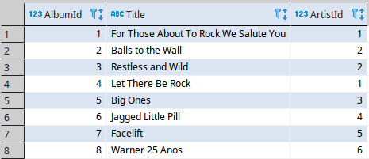
Live Data examples
-- Select some data
SELECT *
FROM chinook_mariadb."Album"
;

Slide 17
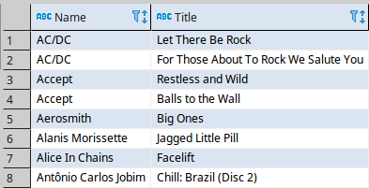
Live Data examples
-- Join SQLite with MariaDB
SELECT artist."Name"
, album."Title"
FROM chinook_sqlite."Artist" AS artist
INNER JOIN chinook_mariadb."Album" AS album
ON artist."ArtistId" = album."ArtistId"
;

Slide 18

Live Data examples
-- Select one album to check it before an update
SELECT *
FROM chinook_mariadb."Album"
WHERE "AlbumId" = 1
;

Slide 19

Live Data examples
-- Update one album in MariaDB from PostgreSQL
UPDATE chinook_mariadb."Album" SET
"Title" = 'Updated by PostgreSQL'
WHERE "AlbumId" = 1
;
-- Control the result of the updated album in MariaDB
SELECT *
FROM chinook_mariadb."Album"
WHERE "AlbumId" = 1
;

Slide 20

Live Data examples
-- Revert the update in MariaDB by the same record in PostgreSQL
UPDATE chinook_mariadb."Album" AS mariadb_album SET
"Title" = pg_album."Title"
FROM "Album" AS pg_album
WHERE pg_album."AlbumId" = mariadb_album."AlbumId"
AND mariadb_album."AlbumId" = 1
;
-- Control the result of the updated album in MariaDB
SELECT *
FROM chinook_mariadb."Album"
WHERE "AlbumId" = 1
;

Slide 21
Live Data examples
-- Create the PostgreSQL extension to link other PostgreSQL databases
CREATE EXTENSION postgres_fdw;
-- Create a connection to the other database PostgreSQL on the same server (9.6)
CREATE SERVER postgresql_9_6_localhost_chinook_srv
FOREIGN DATA WRAPPER postgres_fdw
OPTIONS (host '127.0.0.1', port '5432', dbname 'chinook')
;
-- Create a user mapping
CREATE USER MAPPING FOR stefanie
SERVER postgresql_9_6_localhost_chinook_srv
OPTIONS (user 'stefanie', password 'password')
;
-- Link foreign tables into the current database and schema
IMPORT FOREIGN SCHEMA public LIMIT TO("Track")
FROM SERVER postgresql_9_6_localhost_chinook_srv
INTO chinook_postgresql_9_6
;

Slide 22
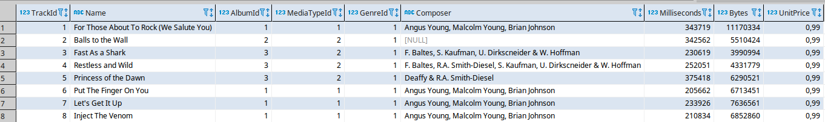
Live Data examples
-- Try to select some data
SELECT *
FROM chinook_postgresql_9_6."Track"
;

Slide 23
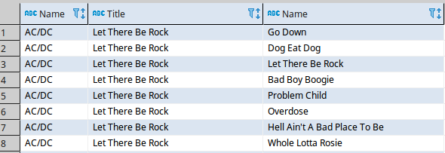
Live Data examples
-- Join SQLite and PostgreSQL tables
SELECT artist."Name"
, album."Title"
, track."Name"
FROM chinook_sqlite."Artist" AS artist
INNER JOIN chinook_mariadb."Album" AS album
ON artist."ArtistId" = album."ArtistId"
INNER JOIN chinook_postgresql_9_6."Track" AS track
ON album."AlbumId" = track."AlbumId"
;

Slide 24
Live Data examples
-- Create the file extension
CREATE EXTENSION file_fdw;
-- One does need a server, but afterwards every csv file is avilable
CREATE SERVER chinook_csv_srv
FOREIGN DATA WRAPPER file_fdw
;
-- Creating a foreign table based on a csv file
-- Options are the same as in COPY
CREATE FOREIGN TABLE chinook_csv."Genre" (
"GenreId" integer,
"Name" text
) SERVER chinook_csv_srv
OPTIONS (
filename '/var/sqlite/Genre.csv',
format 'csv',
HEADER 'true'
)
;

Slide 25
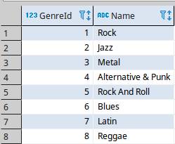
Live Data examples
-- Select some data
SELECT *
FROM chinook_csv."Genre"
;

Slide 26
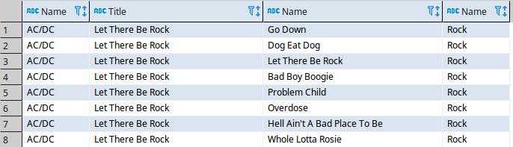
Live Data examples
-- Join SQLite, two PostgreSQL servers, and a CSV tables
SELECT artist."Name"
, album."Title"
, track."Name"
, genre."Name"
FROM chinook_sqlite."Artist" AS artist
INNER JOIN chinook_mariadb."Album" AS album
ON artist."ArtistId" = album."ArtistId"
INNER JOIN chinook_postgresql_9_6."Track" AS track
ON album."AlbumId" = track."AlbumId"
INNER JOIN chinook_csv."Genre" AS genre
ON track."GenreId" = genre."GenreId"
;

Slide 27
Live Data examples
-- Creates an materialized view on foreign tables
CREATE MATERIALIZED VIEW mv_album_artist AS
WITH album AS
(
SELECT "ArtistId"
, array_agg("Title") AS album_titles
FROM chinook_mariadb."Album"
GROUP BY "ArtistId"
)
SELECT artist."Name" AS artist
, album.album_titles
, SUM(ARRAY_LENGTH(album_titles, 1))
FROM chinook_sqlite."Artist" AS artist
LEFT OUTER JOIN album
ON artist."ArtistId" = album."ArtistId"
GROUP BY artist."Name"
, album.album_titles
;

Slide 28
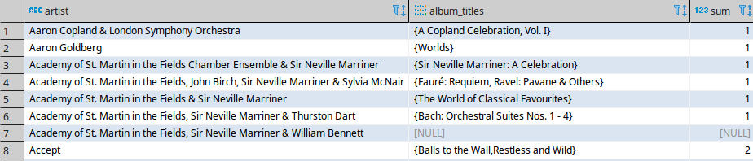
Live Data examples
-- Select Data from the materialzed view
SELECT *
FROM mv_album_artist
WHERE upper(artist) LIKE 'A%'
ORDER BY artist
;

Slide 29
Live Data examples
-- Create the multicorn extension
CREATE EXTENSION multicorn;
-- Create the server, which is simply a placeholder
CREATE SERVER rss_srv foreign data wrapper multicorn options
(
wrapper 'multicorn.rssfdw.RssFdw'
)
;
-- Create a foreign table based on an RSS feed
CREATE FOREIGN TABLE rss_music_news (
title CHARACTER VARYING,
link CHARACTER VARYING,
description CHARACTER VARYING,
"pubDate" TIMESTAMPTZ,
guid CHARACTER VARYING
) server rss_srv OPTIONS (
url 'http://www.music-news.com/rss/UK/news?includeCover=false'
)
;

Slide 30
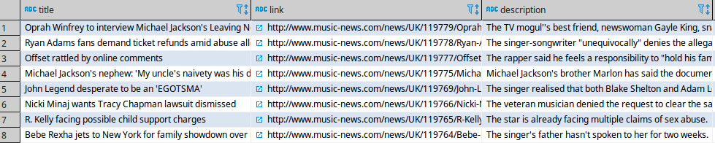
Live Data examples
-- Select some data
SELECT *
FROM rss_music_news
;

Slide 31
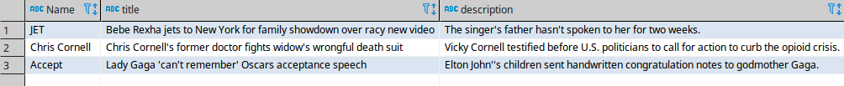
Live Data examples
-- Link the previous RSS feed to existing data
SELECT a."Name"
, r.title
, r.description
FROM rss_music_news AS r
INNER JOIN chinook_sqlite."Artist" AS a
ON r.title ilike '%' || a."Name" || '%'
;

Slide 32
Live Data examples
-- We create several tables with RSS feeds containing music news
-- Create a foreign table based on an RSS feed
CREATE FOREIGN TABLE rss_rolling_stone (
title CHARACTER VARYING,
link CHARACTER VARYING,
"content:encoded" CHARACTER VARYING,
"pubDate" TIMESTAMPTZ,
guid CHARACTER VARYING
) server rss_srv OPTIONS (
url 'http://www.rollingstone.com/music/rss'
)
;
-- Create a foreign table based on an RSS feed
CREATE FOREIGN TABLE rss_mi2nbandnews (
title CHARACTER VARYING,
link CHARACTER VARYING,
description CHARACTER VARYING,
"pubDate" TIMESTAMPTZ,
guid CHARACTER VARYING
) server rss_srv OPTIONS (
url 'http://feeds.feedburner.com/mi2nbandnews'
)
;

Slide 33
Live Data examples
-- Create a foreign table based on an RSS feed
CREATE FOREIGN TABLE rss_mi2neventnews (
title CHARACTER VARYING,
link CHARACTER VARYING,
description CHARACTER VARYING,
"pubDate" TIMESTAMPTZ,
guid CHARACTER VARYING
) server rss_srv OPTIONS (
url 'http://feeds.feedburner.com/mi2nmusicevents'
)
;

Slide 34
Live Data examples
-- This materialized view will contain the results of all RSS music feeds
CREATE MATERIALIZED VIEW mv_rss_music_newslists AS
SELECT current_timestamp AS refreshed
, ROW_NUMBER()OVER() AS rn
, 'Rolling Stone' AS source
, 'http://www.rollingstone.com/music/rss' AS url
, r.title
, r."content:encoded" AS content
, TRUE AS encoded
, r.link
, r."pubDate" AS published
FROM rss_rolling_stone AS r
UNION
SELECT current_timestamp AS refreshed
, ROW_NUMBER()OVER() AS rn
, 'Music-News' AS source
, 'http://www.music-news.com/rss/UK/news?includeCover=false' AS url
, r.title
, r.description AS content
, FALSE AS encoded
, r.link
, r."pubDate" AS publihed
FROM rss_music_news AS r
UNION
SELECT current_timestamp AS refreshed
, ROW_NUMBER()OVER() AS rn
, 'Music Industry News Network: Band News' AS source
, 'http://feeds.feedburner.com/mi2nbandnews' AS url
, r.title
, r.description AS content
, FALSE AS encoded
, r.link
, r."pubDate" AS publihed
FROM rss_mi2nbandnews AS r
UNION
SELECT current_timestamp AS refreshed
, ROW_NUMBER()OVER() AS rn
, 'Music Industry News Network: Event News' AS source
, 'http://feeds.feedburner.com/mi2nmusicevents' AS url
, r.title
, r.description AS content
, FALSE AS encoded
, r.link
, r."pubDate" AS publihed
FROM rss_mi2neventnews AS r
;

Slide 35
Live Data examples
-- The unique index will help to refresh the materilized view
CREATE UNIQUE INDEX udx_mv_rss_music_newslists_source_rn
ON mv_rss_music_newslists USING btree
(source, rn)
;

Slide 36
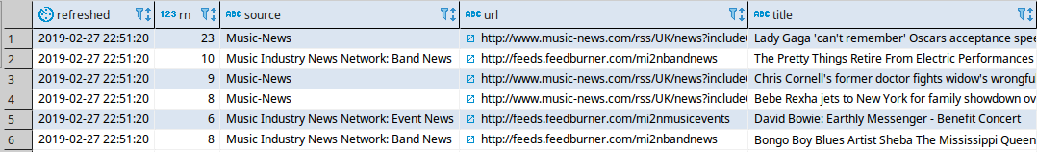
Live Data examples
-- The two materialized views are joined and return data
-- from a lot of different sources, but this time all queried
-- inside PostgreSQL
SELECT *
FROM mv_rss_music_newslists AS r
INNER JOIN mv_album_artist AS a
ON r.title ilike '%' || a.artist || '%'
OR r.content ilike '%' || a.artist || '%'
;

Slide 37
Live Data examples
-- Installing the pg_cron extension to schedule jobs in PostgreSQL
-- https://github.com/citusdata/pg_cron
DROP EXTENSION IF EXISTS pg_cron;
CREATE EXTENSION pg_cron;
-- The table is used for logging calls
CREATE TABLE cron.log (
log_id bigserial NOT NULL,
time_stamp_begin timestamp WITH time ZONE NOT NULL,
time_stamp_end timestamp WITH time ZONE NOT NULL,
executed text NOT NULL,
CONSTRAINT log_pk PRIMARY KEY (log_id)
)
;

Slide 38
Live Data examples
CREATE OR REPLACE PROCEDURE refresh_every_minute() AS $$
DECLARE
ts_start timestamp WITH time ZONE DEFAULT current_timestamp;
BEGIN
-- Refresh the materialized view concurrently to keep it available
REFRESH MATERIALIZED VIEW CONCURRENTLY mv_rss_music_newslists;
-- Write a log entry into the log table
INSERT INTO cron.log (executed, time_stamp_begin)
VALUES (
'REFRESH MATERIALIZED VIEW CONCURRENTLY mv_rss_music_newslists',
ts_start
);
END;
$$
LANGUAGE plpgsql
;

Slide 39
Live Data examples
-- Create a cron job inside PostgreSQL that will refresh the
-- Materialized view with RSS feed data every one minute
INSERT INTO cron.job (schedule, command, nodename, nodeport, database, username)
VALUES ('* * * * *', 'CALL refresh_every_minute()', '', 5434, 'chinook', 'postgres')
;
SELECT * FROM cron.job;
SELECT * FROM cron.log;

Slide 40
Live Data examples
-- Select the log written by the procedure
SELECT * FROM cron.log;

Slide 41
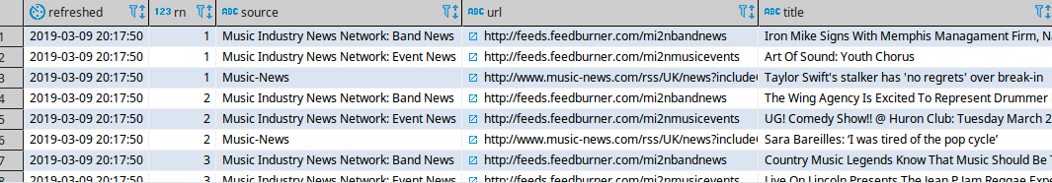
Live Data examples
-- The refresh is running transparent in the background
SELECT *
FROM mv_rss_music_newslists
;

Slide 42
Live Data examples
-- Remove the scheduled job
SELECT cron.unschedule(1);

Slide 43
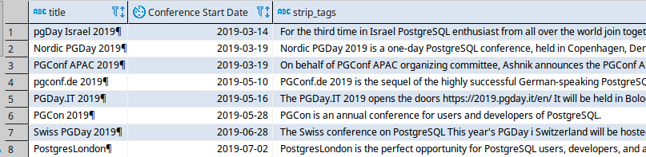
Live Data examples
-- PostgreSQL Conferences RSS feed
SELECT title
, "pubDate"::DATE AS "Conference Start Date"
, strip_tags(description)
FROM rss_postgresql_events
WHERE "pubDate"::DATE > NOW()::DATE
ORDER BY "pubDate" ASC
;

Slide 44
Link List
Slide and source on Github:
https://github.com/sjstoelting/talks/

Slide 45
PostgreSQL As Data Integration Tool
This document by Stefanie Janine Stölting is covered by theCreative Commons Attribution 4.0 International

