Slide 1
One Database To Rule 'em All
PostgreSQL SQL-MED
Buzzwords Berlin 2017
Stefanie Janine Stölting
@sjstoelting
mail@stefanie-stoelting.de

Slide 2

SQL/MED
First defined in ISO/IEC 9075-9:2008, revised by ISO/IEC 9075-9:2016
Supported by
  DB2
  MariaDB
    With CONNECT storage engine, implementation differs to the standard
  PostgreSQL

Slide 3
Implementation
Foreign Data Wrapper
  Read only
  Read and write
Installation as extensions

Slide 4
Available FDW
Examples:
  Oracle (pgxn.org)
  MS SQL Server / Sybase ASE
  read-only (pgxn.org)
  MongoDB(GitHub)
  MariaDB / MySQL (pgxn.org)
  SQLite
  read-only (GitHub)
  Hadoop (HDFS)
  read-only (GitHub)
  ODBC (GitHub)

Slide 5
Special FDW
file_fdw
postgres_fdw
foreign_table_exposer
Notes:
foreign_table_exposer
Some BI Tools don‘t detect foreign data tables. This extension solves the problem.

Slide 6
Write your own FDW
Multicorn
  Use Python and Multicorn to write your own and access lots of stuff like
    IMAP
    HTML

Slide 7
Data source
The example data used in the live data part is available from Chinook Database:
  PostgreSQL
  MySQL
  CSV
  SQLite

Slide 8





Chinook Tables

Slide 9

CTE
Common Table Expressions will be used in examples
Example:
WITH RECURSIVE t(n) AS (
VALUES (1)
UNION ALL
SELECT n+1 FROM t WHERE n < 100
)
SELECT sum(n), min(n), max(n) FROM t;
Result:

Slide 10
Live Data examples

Slide 11
Live Data examples
-- Create the SQLite foreign data wrapper extension in the current database
CREATE EXTENSION sqlite_fdw;
-- Create the mapping to the foreign SQLite file
CREATE SERVER sqlite_server
FOREIGN DATA WRAPPER sqlite_fdw
OPTIONS (database '/var/sqlite/Chinook_Sqlite.sqlite')
;
-- Create the SQLite foreign table, column definitions have to match
CREATE FOREIGN TABLE sqlite_artist(
"ArtistId" integer,
"Name" character varying(120)
)
SERVER sqlite_server
OPTIONS(
table 'Artist'
);

Slide 12
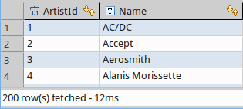
Live Data examples
-- Select some data
SELECT * FROM sqlite_artist;

Slide 13
Live Data examples
-- Create the foreign data wrapper extension in the current database
CREATE EXTENSION mysql_fdw;
-- Create the mapping to the foreign MariaDB server
CREATE SERVER mariadb_server
FOREIGN DATA WRAPPER mysql_fdw
OPTIONS (host '127.0.0.1', port '3306');
-- Create a user mapping with user and password of the foreign table
-- PostgreSQL gives you options to connect this user with its own users
CREATE USER MAPPING FOR PUBLIC SERVER mariadb_server
OPTIONS (username 'stefanie', password 'secret');

Slide 14
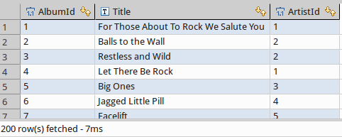
Live Data examples
-- Create the MariaDB foreign table, column definitions have to match
CREATE FOREIGN TABLE mysql_album(
"AlbumId" integer,
"Title" character varying(160),
"ArtistId" integer
)
SERVER mariadb_server
OPTIONS(
dbname 'Chinook',
table_name 'Album'
);
-- Select some data
SELECT * FROM mysql_album;

Slide 15
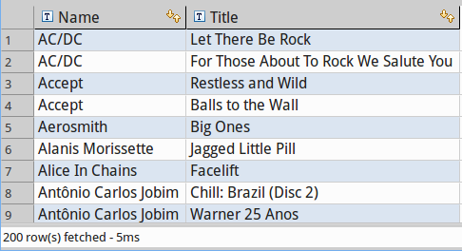
Live Data examples
-- Join SQLite and MariaDB tables
SELECT artist."Name"
, album."Title"
FROM sqlite_artist AS artist
INNER JOIN mysql_album AS album
ON artist."ArtistId" = album."ArtistId"
;

Slide 16
Live Data examples
CREATE EXTENSION postgres_fdw;
-- Create a connection to the other database on the same server
CREATE SERVER pg_localhost_chinook
FOREIGN DATA WRAPPER postgres_fdw
OPTIONS (host '127.0.0.1', port '5432', dbname 'chinook')
;
-- Create a user mapping
CREATE USER MAPPING FOR stefanie
SERVER pg_localhost_chinook
OPTIONS (user 'stefanie', password 'password')
;

Slide 17
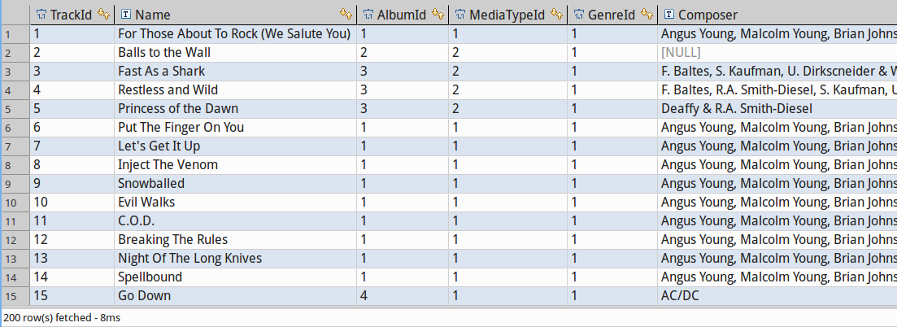
Live Data examples
-- Link foreign tables into the current database and schema
IMPORT FOREIGN SCHEMA public LIMIT TO("Track")
FROM SERVER pg_localhost_chinook
INTO public
;
-- Try to select some data
SELECT * FROM "Track";

Slide 18
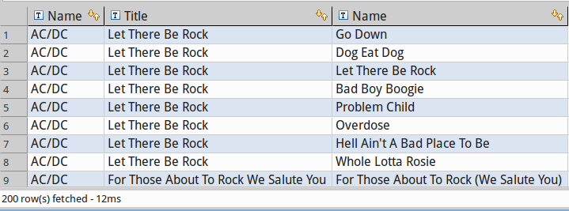
Live Data examples
-- Join SQLite, MariaDB, and PostgreSQL tables
SELECT artist."Name"
, album."Title"
, track."Name"
FROM sqlite_artist AS artist
INNER JOIN mysql_album AS album
ON artist."ArtistId" = album."ArtistId"
INNER JOIN "Track" AS track
ON album."AlbumId" = track."AlbumId"
;

Slide 19
Live Data examples
CREATE EXTENSION file_fdw;
-- One does need a server, but afterwards every csv file is avilable
CREATE SERVER chinook_csv
FOREIGN DATA WRAPPER file_fdw
;
-- Creating a foreign table based on a csv file
-- Options are the same as in COPY
CREATE FOREIGN TABLE csv_genre (
"GenreId" integer,
"Name" text
) SERVER chinook_csv
OPTIONS (
filename '/var/tmp/Genre.csv',
format 'csv',
HEADER 'true'
);

Slide 20
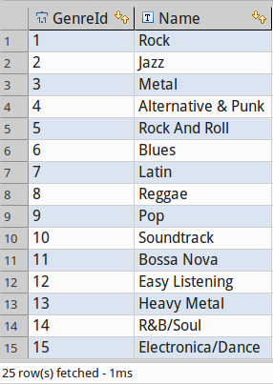
Live Data examples
-- Select some data
SELECT * FROM csv_genre;

Slide 21
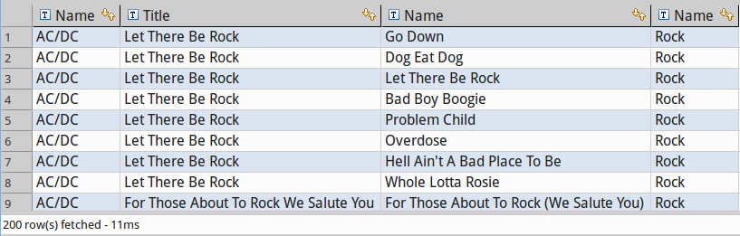
Live Data examples
-- Join SQLite, MariaDB, PostgreSQL, and CSV tables
SELECT artist."Name"
, album."Title"
, track."Name"
, genre."Name"
FROM sqlite_artist AS artist
INNER JOIN mysql_album AS album
ON artist."ArtistId" = album."ArtistId"
INNER JOIN "Track" AS track
ON album."AlbumId" = track."AlbumId"
INNER JOIN csv_genre AS genre
ON track."GenreId" = genre."GenreId"
;

Slide 22
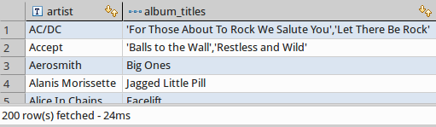
Live Data examples
-- Joining SQLite and MariaDB tables using PostgreSQL expressions
WITH album AS
(
SELECT "ArtistId"
, array_agg("Title") AS album_titles
FROM mysql_album
GROUP BY "ArtistId"
)
SELECT artist."Name" AS artist
, album.album_titles
FROM sqlite_artist AS artist
INNER JOIN album
ON artist."ArtistId" = album."ArtistId"
;

Slide 23
Live Data examples
-- Creates an materialized view on foreign tables
CREATE MATERIALIZED VIEW mv_album_artist AS
WITH album AS
(
SELECT "ArtistId"
, array_agg("Title") AS album_titles
FROM mysql_album
GROUP BY "ArtistId"
)
SELECT artist."Name" AS artist
, album.album_titles
, SUM(ARRAY_LENGTH(album_titles, 1))
FROM sqlite_artist AS artist
LEFT OUTER JOIN album
ON artist."ArtistId" = album."ArtistId"
GROUP BY artist."Name"
, album.album_titles
;

Slide 24
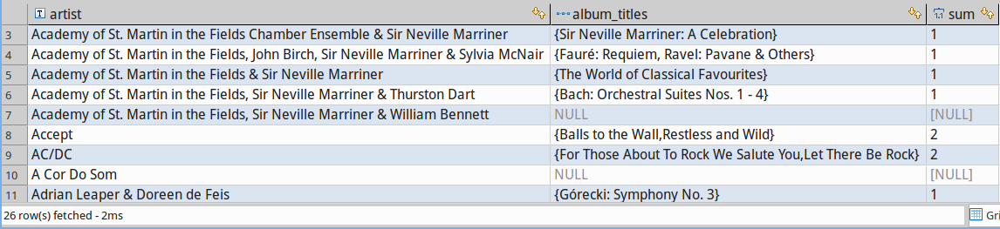
Live Data examples
-- Select the mv data
SELECT *
FROM mv_album_artist
WHERE upper(artist) LIKE 'A%'
ORDER BY artist
;

Slide 25

Live Data examples
-- SELECT the amount of albums from the MariaDB table from MariaDB, not with a foreign data wrapper
SELECT count( * ) AS AlbumCount
FROM `Album`
;

Slide 26

Live Data examples
-- Insert data calculated from foreign tables using PostgreSQL features into another foreign table
INSERT INTO mysql_album("AlbumId", "ArtistId", "Title")
WITH album AS
(
-- Generate a new album id
SELECT MAX(album."AlbumId") + 1 AS new_album_id
FROM mysql_album AS album
)
SELECT album.new_album_id
, artist."ArtistId"
, 'Back in Black'
FROM sqlite_artist AS artist, album
WHERE artist."Name" = 'AC/DC'
GROUP BY album.new_album_id
, artist."ArtistId"
;

Slide 27

Live Data examples
-- SELECT the amount of albums from the MariaDB table from MariaDB, not with a foreign data wrapper
SELECT count( * ) AS AlbumCount
FROM `Album`
;

Slide 28


Live Data examples
-- Select data from the materialized view
SELECT *
FROM mv_album_artist
WHERE artist = 'AC/DC'
ORDER BY artist
;
-- Refresh the mv to see the recently added data
REFRESH MATERIALIZED VIEW mv_album_artist;
-- We can even delete data from foreign tables
DELETE FROM mysql_album
WHERE "Title" = 'Back in Black'
AND "ArtistId" = 1
;

Slide 29
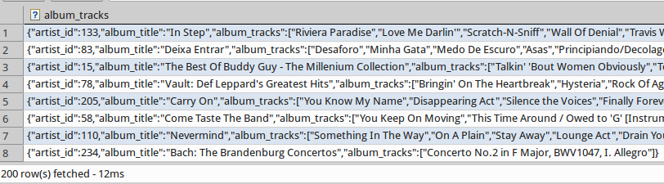
Live Data examples
-- Using PostgreSQL JSON with data from MariaDB and SQLite
-- Step 1: Albums with tracks as JSON
WITH albums AS
(
SELECT a."ArtistId" AS artist_id
, a."Title" AS album_title
, array_agg(t."Name") AS album_tracks
FROM mysql_album AS a
INNER JOIN "Track" AS t
ON a."AlbumId" = t."AlbumId"
GROUP BY a."ArtistId"
, a."Title"
)
SELECT row_to_json(albums) AS album_tracks
FROM albums
;

Slide 30
Live Data examples
-- Albums including tracks with aritsts with some JSON magic
WITH albums AS
(
SELECT a."ArtistId" AS artist_id
, a."Title" AS album_title
, array_agg(t."Name") AS album_tracks
FROM mysql_album AS a
INNER JOIN "Track" AS t
ON a."AlbumId" = t."AlbumId"
GROUP BY a."ArtistId"
, a."Title"
)
, js_albums AS
(
SELECT row_to_json(albums) AS album_tracks
FROM albums
)
SELECT a."Name" AS artist
, jsonb_pretty(al.album_tracks::jsonb) AS albums_tracks
FROM sqlite_artist AS a
INNER JOIN js_albums AS al
ON a."ArtistId" = (al.album_tracks→>'artist_id')::int
;

Slide 31
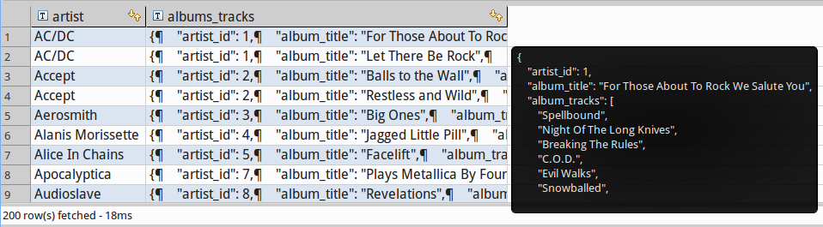
Live Data examples

Slide 32
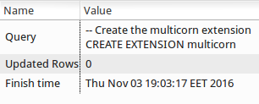
Live Data examples
-- Create the multicorn extension
CREATE EXTENSION multicorn;

Slide 33
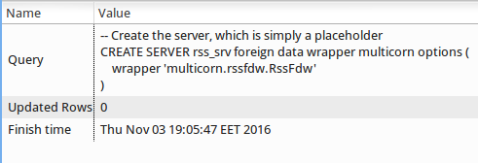
Live Data examples
CREATE SERVER rss_srv foreign data wrapper multicorn options (
wrapper 'multicorn.rssfdw.RssFdw'
)
;

Slide 34
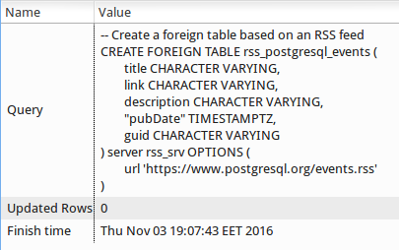
Live Data examples
-- Create a foreign table based on an RSS feed
CREATE FOREIGN TABLE rss_postgresql_events (
title CHARACTER VARYING,
link CHARACTER VARYING,
description CHARACTER VARYING,
"pubDate" TIMESTAMPTZ,
guid CHARACTER VARYING
) server rss_srv OPTIONS (
url 'https://www.postgresql.org/events.rss'
)
;

Slide 35
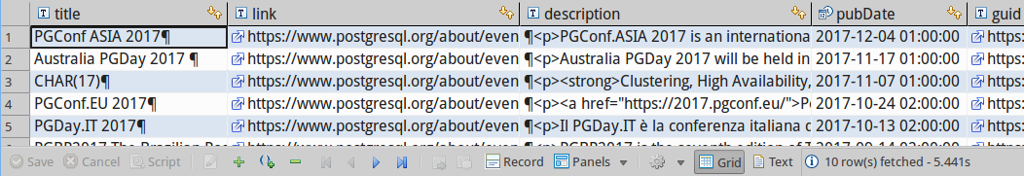
Live Data examples
-- Query the RSS feed
SELECT *
FROM rss_postgresql_events
;

Slide 36
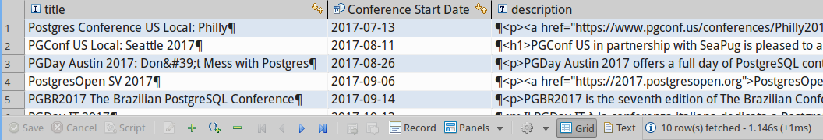
Live Data examples
-- Entend the query of the RSS feed
SELECT title
, "pubDate"::DATE AS "Conference Start Date"
, description
FROM rss_postgresql_events
WHERE "pubDate"::DATE > NOW()::DATE
ORDER BY "pubDate" ASC
;

Slide 37
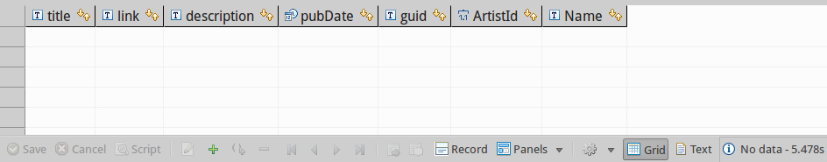
Live Data examples
CREATE FOREIGN TABLE rss_music_news (
title CHARACTER VARYING,
link CHARACTER VARYING,
description CHARACTER VARYING,
"pubDate" TIMESTAMPTZ,
guid CHARACTER VARYING
) server rss_srv OPTIONS (
url 'http://www.music-news.com/rss/UK/news?includeCover=false'
)
;
SELECT *
FROM rss_music_news AS r
INNER JOIN sqlite_artist AS a
ON r.title ilike '%' || a."Name" || '%'
;

Slide 38
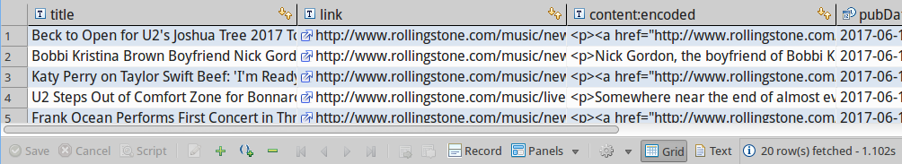
Live Data examples
CREATE FOREIGN TABLE rss_rolling_stone (
title CHARACTER VARYING,
link CHARACTER VARYING,
"content:encoded" CHARACTER VARYING,
"pubDate" TIMESTAMPTZ,
guid CHARACTER VARYING
) server rss_srv OPTIONS (
url 'http://www.rollingstone.com/music/rss'
)
;
SELECT *
FROM rss_rolling_stone
;

Slide 39
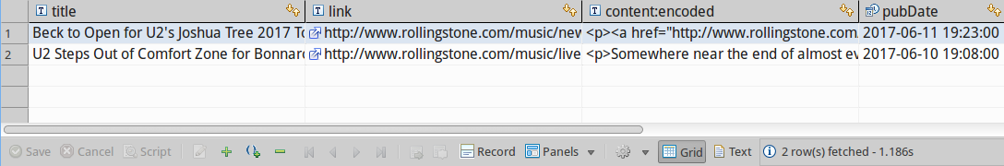
Live Data examples
SELECT *
FROM rss_rolling_stone
;

Slide 40
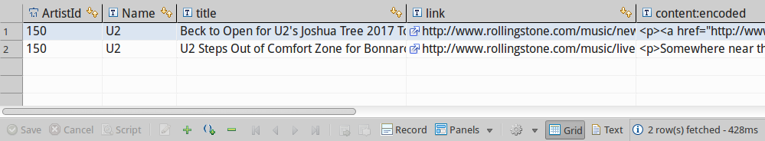
Live Data examples
SELECT *
FROM sqlite_artist AS a
INNER JOIN rss_rolling_stone AS r
ON r.title ilike '%' || a."Name" || '%'
;

Slide 41
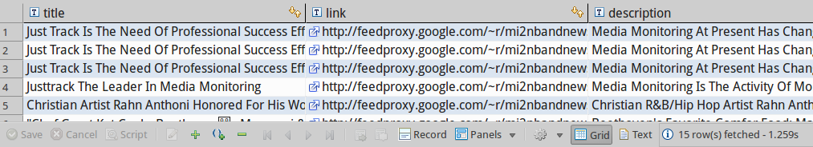
Live Data examples
CREATE FOREIGN TABLE rss_mi2nbandnews (
title CHARACTER VARYING,
link CHARACTER VARYING,
description CHARACTER VARYING,
"pubDate" TIMESTAMPTZ,
guid CHARACTER VARYING
) server rss_srv OPTIONS (
url 'http://feeds.feedburner.com/mi2nbandnews'
)
;
SELECT * FROM rss_mi2nbandnews;

Slide 42
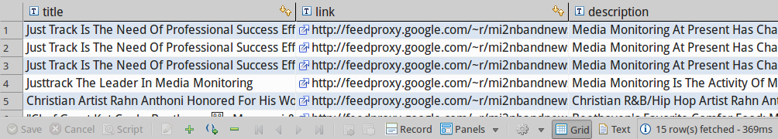
Live Data examples
CREATE FOREIGN TABLE rss_mi2neventnews (
title CHARACTER VARYING,
link CHARACTER VARYING,
description CHARACTER VARYING,
"pubDate" TIMESTAMPTZ,
guid CHARACTER VARYING
) server rss_srv OPTIONS (
url 'http://feeds.feedburner.com/mi2nmusicevents'
)
;
SELECT * FROM rss_mi2nbandnews;

Slide 43
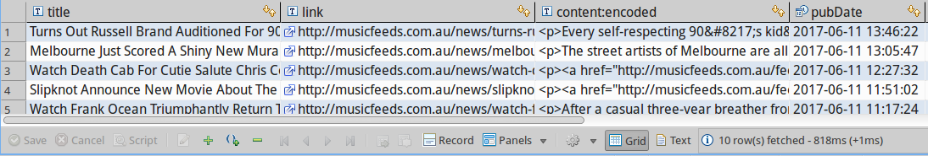
Live Data examples
CREATE FOREIGN TABLE rss_musicfeeds (
title CHARACTER VARYING,
link CHARACTER VARYING,
"content:encoded" CHARACTER VARYING,
"pubDate" TIMESTAMPTZ,
guid CHARACTER VARYING
) server rss_srv OPTIONS (
url 'http://musicfeeds.com.au/news/feed/'
)
;
SELECT * FROM rss_musicfeeds;

Slide 44
Live Data examples
CREATE MATERIALIZED VIEW mv_rss_music_newslists AS
SELECT current_timestamp AS refreshed
, ROW_NUMBER()OVER() AS rn
, 'Rolling Stone' AS source
, 'http://www.rollingstone.com/music/rss' AS url
, r.title
, r."content:encoded" AS content
, TRUE AS encoded
, r.link
, r."pubDate" AS published
FROM rss_rolling_stone AS r
UNION
SELECT current_timestamp AS refreshed
, ROW_NUMBER()OVER() AS rn
, 'Music-News' AS source
, 'http://www.music-news.com/rss/UK/news?includeCover=false' AS url
, r.title
, r.description AS content
, FALSE AS encoded
, r.link
, r."pubDate" AS publihed
FROM rss_music_news AS r
UNION
SELECT current_timestamp AS refreshed
, ROW_NUMBER()OVER() AS rn
, 'MusicFeeds' AS source
, 'http://musicfeeds.com.au/news/feed/' AS url
, r.title
, r."content:encoded" AS content
, TRUE AS encoded
, r.link
, r."pubDate" AS published
FROM rss_musicfeeds AS r
UNION
SELECT current_timestamp AS refreshed
, ROW_NUMBER()OVER() AS rn
, 'Music Industry News Network: Band News' AS source
, 'http://feeds.feedburner.com/mi2nbandnews' AS url
, r.title
, r.description AS content
, FALSE AS encoded
, r.link
, r."pubDate" AS publihed
FROM rss_mi2nbandnews AS r
UNION
SELECT current_timestamp AS refreshed
, ROW_NUMBER()OVER() AS rn
, 'Music Industry News Network: Event News' AS source
, 'http://feeds.feedburner.com/mi2nmusicevents' AS url
, r.title
, r.description AS content
, FALSE AS encoded
, r.link
, r."pubDate" AS publihed
FROM rss_mi2neventnews AS r
;

Slide 45
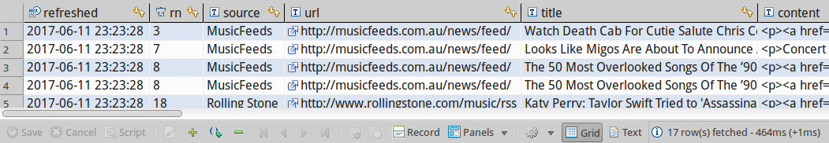
Live Data examples
CREATE UNIQUE INDEX udx_mv_rss_music_newslists_source_rn
ON mv_rss_music_newslists USING btree
(source, rn)
;
REFRESH MATERIALIZED VIEW CONCURRENTLY mv_rss_music_newslists;
SELECT *
FROM mv_rss_music_newslists AS r
INNER JOIN sqlite_artist AS a
ON r.title ilike '%' || a."Name" || '%'
OR r.content ilike '%' || a."Name" || '%'
;

Slide 46
Next Talk
FrOSCon St. Augustin
August 19th and 20th 2017
Database Change Management with Sqitch

Slide 47
Link List
PGXN Extensions:
- mysql_fdw, MySQL/MariaDB FDW
- sqlite_fdw, SQLite FDW
Slide and source on Github:
https://github.com/sjstoelting/talks/

Slide 48
One Database To Rule 'em All
This document by Stefanie Janine Stölting is covered by theCreative Commons Attribution 4.0 International

