Slide 1

Meet the other elephant
PHP Usergroup Düsseldorf
March 2015
Stefanie Janine Stölting

Slide 2

History
1986 University of California at Berkeley (UCB) and named Postgres
1995 SQL was introduced, new name: Postgres95
1996 PostgreSQL 6.0
Notes:
Prof. Michael Stonebraker, was CTO of Informix created Ingres, Postgres is the next generation idea
Andrew Yu and Jolly Chen, replaced Postgres' POSTQUEL with SQL
Became an Open Source Project, the version number reffers to the year

Slide 3
MVCC
Multiversion Concurrency Control
Notes:
MVCC provides point in time consistent views.
- Start transaction
- Change data
- Query data: only you see the changed data
- On commit: everybody sees the changed data
- On rollback: Nothing changed

Slide 4
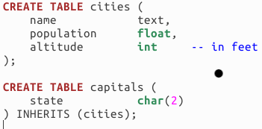
Object Relational
Inherit tables

Slide 5
Object Types
Tablespaces
Databases
Schemas
Tables
Views
Materialized Views
Functions
Trigger Functions

Slide 6

Joins between tables
INNER JOIN
  SELECT *
  FROM t1
  INNER JOIN t2
  ON t1.id = t2.t1_id
  Only those records, that match t1 and t2

Slide 7

Joins between tables
LEFT OUTER JOIN
  SELECT *
  FROM t1
  LEFT OUTER JOIN t2
  ON t1.id = t2.t1_id
  All records of t1 and all records of t2 that match with t1

Slide 8
Joins between tables
RIGHT OUTER JOIN
  SELECT *
  FROM t1
  RIGHT OUTER JOIN t2
  ON t1.id = t2.t1_id
  All records of t2 and all records of t1 that match with t2

Slide 9

Joins between tables
FULL OUTER JOIN
  SELECT *
  FROM t1
  FULL OUTER JOIN t2
  ON t1.id = t2.t1_id
  All records of t1 and all records of t2 that match on the id and all records from both tables that don't match

Slide 10
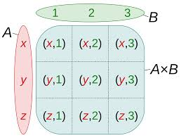
Joins between tables
CROSS JOIN
  SELECT *
  FROM t1
  CROSS JOIN t2
  ON t1.id = t2.t1_id
  A cartesian product, every record of t1 with every record of t2

Slide 11
Data Types
Numbers
Text
Blob
Arrays
XML
JSON (JSON und JSONB)
User defined types
Notes:
JSONB / BSON (MongoDB)

Slide 12

Key Value Store
hstore is a classical key value store

Slide 13
Index Types
There is more than one index type
  B-tree
  Hash
  GiST
  GIN
Indexes on expression

Slide 14
Trigger
Triggers are different:
  You can attach one trigger to several tables
  Trigger on TRUNCATE
  Trigger on simple VIEWS
  Trigger on complex VIEWS with
  INSTEAD OF

Slide 15
Procedural Languages
Most used is PL/pgSQL
Extenstions, for example JavaScript based on Google V8
Notes:
PL/pgSQL-> Transact SQL (Sybase, MS), PL/SQL (Oracle)

Slide 16
WITH Queries
(Common Table Expressions)
Is another form of subqueries
Defintion exists in the ANSI SQL standard
Advantages:
  Better readable
  Only parsed once
  Recursions

Slide 17

WITH Queries
(Common Table Expressions)
Example:
WITH RECURSIVE t(n) AS (
VALUES (1)
UNION ALL
SELECT n+1 FROM t WHERE n < 100
)
SELECT sum(n), min(n), max(n) FROM t;
Result:

Slide 18
Window Functions
Calculate data across defined rows
See tapoueh.org for detailed explanations and examples

Slide 19
Window Functions
Example
SELECT x,
row_number() OVER(),
lag(x, 1) OVER w,
lead(x, 1) OVER w
FROM generate_series(1, 15, 2) AS t(x)
WINDOW w AS (ORDER BY x);

Slide 20
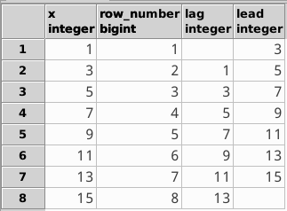
Window Functions
Result:

Slide 21
Extensions
PostGIS
  Book recommendation:
  PostGIS Cookbook
pguint implements unsigned integers
PostgreSQL Multiple Precision Arithmetic
Lots available at PGXN or GitHub
Or write your own if needed

Slide 22
Foreign data wrappers
Defined in the ANSI SQL standard
Can read and write foreign data
  Oracle (pgxn.org)
  MS SQL Server / Sybase ASE
  readonly (pgxn.org)
  MongoDB
  readonly (pgxn.org)
  MariaDB / MySQL (github.com)

Slide 23
Foreign data wrappers
Example
CREATE EXTENSION mysql_fdw;
CREATE SERVER mysql_local
FOREIGN DATA WRAPPER mysql_fdw
OPTIONS (address '127.0.0.1', port '3306');
CREATE USER MAPPING FOR PUBLIC SERVER mysql_local
OPTIONS (username 'pg_test', password 'secret');
CREATE FOREIGN TABLE fdw_mysql_users (
users_id BIGINT,
username VARCHAR(100),
firstname VARCHAR(100),
lastname VARCHAR(100),
pwhash VARCHAR(255)
)
SERVER mysql_local
OPTIONS (table 'pg_test.users');

Slide 24
JSON Functions
Functions to return JSON datatypes
For example:
  array_to_json
  row_to_json

Slide 25
Tool List
PgAdmin: Development and administration
PhpPgAdmin: Web administration
pgTAP: Database unit tests
psql: Terminal-based front-end
POWA: Workload Analyzer
More on wiki.postgresql.org

Slide 26
Book List
PostgreSQL Server Programming
PostgreSQL 9.0 High Performance
PostgreSQL 9 Admin Cookbook
PostgreSQL: Up and Running
PostgreSQL-Administration, 3rd Edition
PostGIS Cookbook

Slide 27
Meet the other
Elephant
Dieses Werk von Stefanie Janine Stölting ist lizenziert unter einer Creative Commons Namensnennung 4.0 International Lizenz.

