Slide 1


NoSQL The SQL Way
PostgreSQL JSON Features
PostgreSQL Meetup Prague
25/06/2018
Stefanie Janine Stölting
@sjstoelting
mail@stefanie-stoelting.de

Slide 2
JSON
JavaScript Object Notation
Don't have to care about encoding, it is always Unicode, most implementations use UTF8
Used for data exchange in web application
Currently two standards RFC 7159 by Douglas Crockford and ECMA-404
PostgreSQL implementation is RFC 7159

Slide 3
JSON Datatypes
JSON
  Available since 9.2
BSON
  Available as extension on GitHub since 2013
JSONB
  Available since 9.4
  Compressed JSON
  Fully transactional
  Up to 1 GB (uses TOAST)

Slide 4
JSON Functions
row_to_json({row})
Returns the row as JSON
array_to_json({array})
Returns the array as JSON
jsonb_to_recordset
Returns a recordset from JSONB

Slide 5
JSON Operators
Array element
->{int}
Array element by name
->{text}
Object element
->> {text}
Value at path
#> {text}

Slide 6
Index on JSON
Index JSONB content for faster access with indexes
  GIN index overall
    CREATE INDEX idx_1 ON jsonb.actor USING GIN (jsondata);
  Even unique B-Tree indexes are possible
    CREATE UNIQUE INDEX actor_id_2 ON jsonb.actor((CAST(jsondata->>'actor_id' AS INTEGER)));

Slide 7
New JSON functions
PostgreSQL 9.5 new JSONB functions:
  jsonb_pretty: Formats JSONB human readable
  jsonb_set: Update or add values
PostgreSQL 9.5 new JSONB operators:
  ||: Concatenate two JSONB
  -: Delete key
Available as extions for 9.4 at PGXN: jsonbx

Slide 8
New JSON functions
PostgreSQL 9.6 new JSONB function:
  jsonb_insert:
  Insert a new value into a JSONB by path returning the changed JSONB
  See 9.6 JSONB documentation for details

Slide 9
New JSON functions
PostgreSQL 10 new JSON/JSONB function:
  Text search:
  Search through JSON/JSONB with tsvector.
  See 10 Text Search Functions and Operatorsdocumentation for details.
  That will be extended in PostgreSQL 11, see the documentation for details.

Slide 10
Extension JsQuery
JsQuery is a JSON query language with GIN index support.

Slide 11
Data sources
The Chinook database is available at chinookdatabase.codeplex.com
Amazon book reviews of 1998 are available at examples.citusdata.com/customer_reviews_nested_1998.json.gz

Slide 12




Chinook Tables

Slide 13

CTE
Common Table Expressions will be used in examples
Example:
WITH RECURSIVE t(n) AS (
VALUES (1)
UNION ALL
SELECT n+1 FROM t WHERE n < 100
)
SELECT sum(n), min(n), max(n) FROM t;
Result:

Slide 14
Live Examples
Let's see, how it does work.

Slide 15
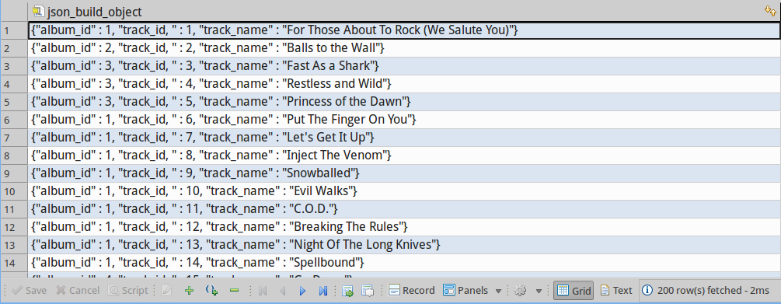
Live with Chinook data
-- Lets start the easy way: With a function call to get album data
SELECT json_build_object (
'album_id', "AlbumId",
'track_id, ', "TrackId",
'track_name', "Name"
)
FROM "Track"
;

Slide 16
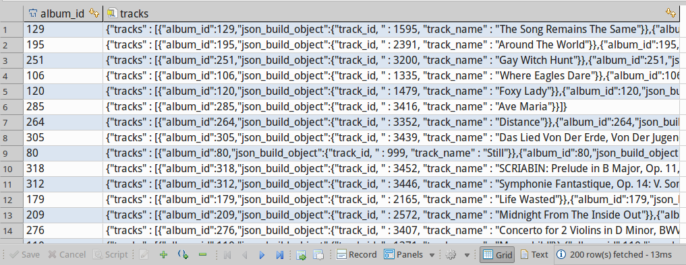
Live with Chinook data
-- Adding array_agg to build JSON arrays
WITH tracks AS
(
SELECT "AlbumId" AS album_id
, json_build_object (
'track_id, ', "TrackId",
'track_name', "Name"
)
FROM "Track"
)
SELECT album_id
, json_build_object ('tracks', array_agg (tracks)) AS tracks
FROM tracks
GROUP BY album_id
;

Slide 17
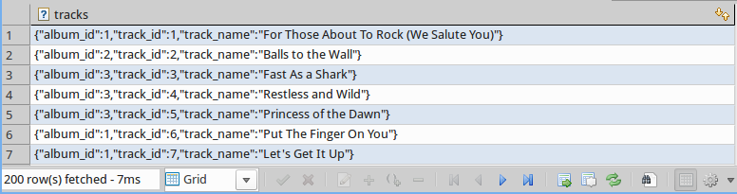
Live with Chinook data
-- Step 1: Tracks as JSON with the album identifier
WITH tracks AS
(
SELECT "AlbumId" AS album_id
, "TrackId" AS track_id
, "Name" AS track_name
FROM "Track"
)
SELECT row_to_json(tracks) AS tracks
FROM tracks
;

Slide 18
Live with Chinook data
-- Step 2 Abums including tracks with aritst identifier
WITH tracks AS
(
SELECT "AlbumId" AS album_id
, "TrackId" AS track_id
, "Name" AS track_name
FROM "Track"
)
, json_tracks AS
(
SELECT row_to_json(tracks) AS tracks
FROM tracks
)
, albums AS
(
SELECT a."ArtistId" AS artist_id
, a."AlbumId" AS album_id
, a."Title" AS album_title
, array_agg(t.tracks) AS album_tracks
FROM "Album" AS a
INNER JOIN json_tracks AS t
ON a."AlbumId" = (t.tracks->>'album_id')::int
GROUP BY a."ArtistId"
, a."AlbumId"
, a."Title"
)
SELECT artist_id
, array_agg(row_to_json(albums)) AS album
FROM albums
GROUP BY artist_id
;

Slide 19
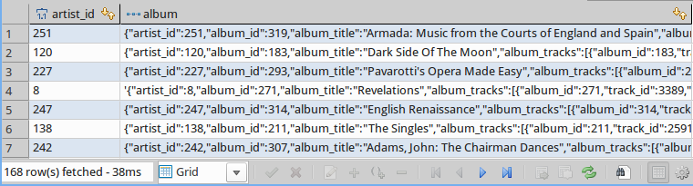
Live with Chinook data

Slide 20
Live with Chinook data
-- Step 3 Return one row for an artist with all albums as VIEW
CREATE OR REPLACE VIEW v_json_artist_data AS
WITH tracks AS
(
SELECT "AlbumId" AS album_id
, "TrackId" AS track_id
, "Name" AS track_name
, "MediaTypeId" AS media_type_id
, "Milliseconds" As milliseconds
, "UnitPrice" AS unit_price
FROM "Track"
)
, json_tracks AS
(
SELECT row_to_json(tracks) AS tracks
FROM tracks
)
, albums AS
(
SELECT a."ArtistId" AS artist_id
, a."AlbumId" AS album_id
, a."Title" AS album_title
, array_agg(t.tracks) AS album_tracks
FROM "Album" AS a
INNER JOIN json_tracks AS t
ON a."AlbumId" = (t.tracks->>'album_id')::int
GROUP BY a."ArtistId"
, a."AlbumId"
, a."Title"
)
, json_albums AS
(
SELECT artist_id
, array_agg(row_to_json(albums)) AS album
FROM albums
GROUP BY artist_id
)
-- -> Next Page

Slide 21
Live with Chinook data
-- Step 3 Return one row for an artist with all albums as VIEW
, artists AS
(
SELECT a."ArtistId" AS artist_id
, a."Name" AS artist
, jsa.album AS albums
FROM "Artist" AS a
INNER JOIN json_albums AS jsa
ON a."ArtistId" = jsa.artist_id
)
SELECT (row_to_json(artists))::jsonb AS artist_data
FROM artists
;

Slide 22
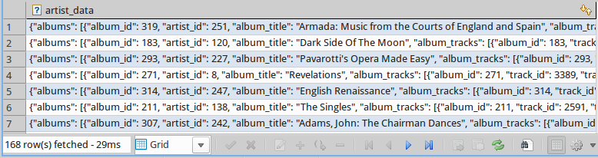
Live with Chinook data
-- Select data from the view
SELECT *
FROM v_json_artist_data
;

Slide 23
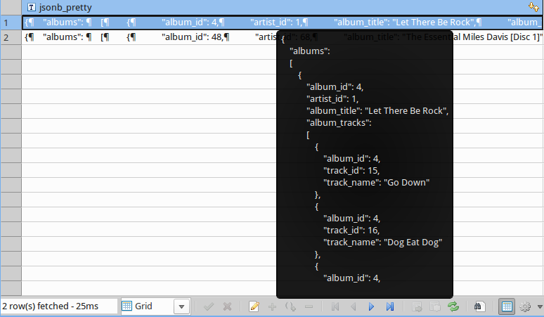
Live with Chinook data
-- SELECT data from that VIEW, that does querying
SELECT jsonb_pretty(artist_data)
FROM v_json_artist_data
WHERE artist_data->>'artist' IN ('Miles Davis', 'AC/DC')
;

Slide 24

Live with Chinook data
-- SELECT some data from that VIEW using JSON methods
SELECT artist_data->>'artist' AS artist
, artist_data#>'{albums, 1, album_title}' AS album_title
, jsonb_pretty(artist_data#>'{albums, 1, album_tracks}') AS album_tracks
FROM v_json_artist_data
WHERE artist_data->'albums' @> '[{"album_title":"Miles Ahead"}]'
;

Slide 25
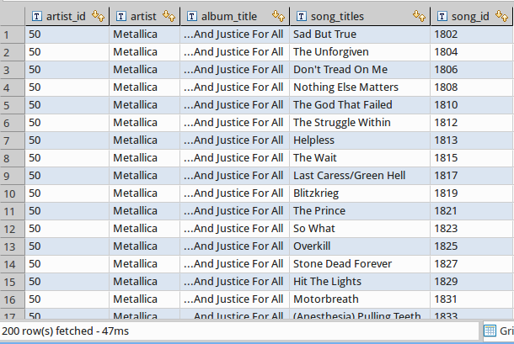
Live with Chinook data
-- Array to records
SELECT artist_data->>'artist_id' AS artist_id
, artist_data->>'artist' AS artist
, jsonb_array_elements(artist_data#>'{albums}')->>'album_title' AS album_title
, jsonb_array_elements(jsonb_array_elements(artist_data#>'{albums}')#>'{album_tracks}')->>'track_name' AS song_titles
, jsonb_array_elements(jsonb_array_elements(artist_data#>'{albums}')#>'{album_tracks}')->>'track_id' AS song_id
FROM v_json_artist_data
WHERE artist_data->>'artist' = 'Metallica'
ORDER BY album_title
, song_id
;

Slide 26
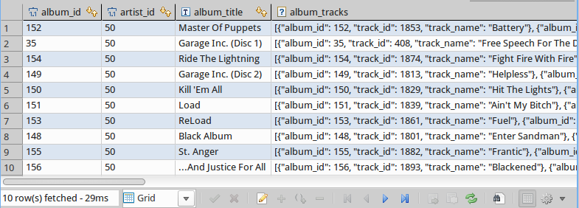
Live with Chinook data
-- Convert albums to a recordset
SELECT *
FROM jsonb_to_recordset(
(
SELECT (artist_data->>'albums')::jsonb
FROM v_json_artist_data
WHERE (artist_data->>'artist_id')::int = 50
)
) AS x(album_id int, artist_id int, album_title text, album_tracks jsonb)
;

Slide 27
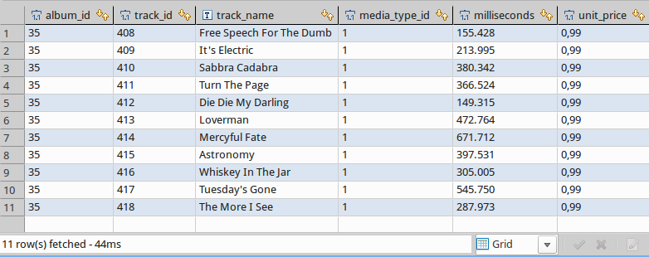
Live with Chinook data
-- Convert the tracks to a recordset
SELECT album_id
, track_id
, track_name
, media_type_id
, milliseconds
, unit_price
FROM jsonb_to_recordset(
(
SELECT artist_data#>'{albums, 1, album_tracks}'
FROM v_json_artist_data
WHERE (artist_data->>'artist_id')::int = 50
)
) AS x(album_id int, track_id int, track_name text, media_type_id int, milliseconds int, unit_price float)
;

Slide 28
Live with Chinook data
-- Create a function, which will be used for UPDATE on the view v_artrist_data
CREATE OR REPLACE FUNCTION trigger_v_json_artist_data_update()
RETURNS trigger AS
$BODY$
-- Data variables
DECLARE rec RECORD;
-- Error variables
DECLARE v_state TEXT;
DECLARE v_msg TEXT;
DECLARE v_detail TEXT;
DECLARE v_hint TEXT;
DECLARE v_context TEXT;
BEGIN
-- Update table Artist
IF (OLD.artist_data->>'artist')::varchar(120) <> (NEW.artist_data->>'artist')::varchar(120) THEN
UPDATE "Artist"
SET "Name" = (NEW.artist_data->>'artist')::varchar(120)
WHERE "ArtistId" = (OLD.artist_data->>'artist_id')::int;
END IF;
-- Update table Album with an UPSERT
-- Update table Track with an UPSERT
RETURN NEW;
EXCEPTION WHEN unique_violation THEN
RAISE NOTICE 'Sorry, but the something went wrong while trying to update artist data';
RETURN OLD;
WHEN others THEN
GET STACKED DIAGNOSTICS
v_state = RETURNED_SQLSTATE,
v_msg = MESSAGE_TEXT,
v_detail = PG_EXCEPTION_DETAIL,
v_hint = PG_EXCEPTION_HINT,
v_context = PG_EXCEPTION_CONTEXT;
RAISE NOTICE '%', v_msg;
RETURN OLD;
END;
$BODY$
LANGUAGE plpgsql;

Slide 29
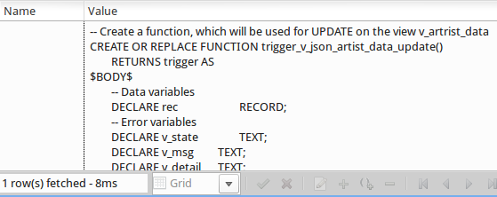
Live with Chinook data

Slide 30
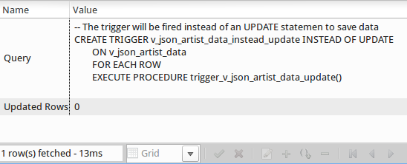
Live with Chinook data
-- The trigger will be fired instead of an UPDATE statement to save data
CREATE TRIGGER v_json_artist_data_instead_update INSTEAD OF UPDATE
ON v_json_artist_data
FOR EACH ROW
EXECUTE PROCEDURE trigger_v_json_artist_data_update()
;

Slide 31
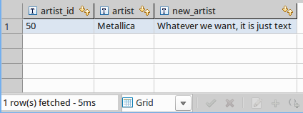
Live with Chinook data
-- Manipulate data with jsonb_set
SELECT artist_data->>'artist_id' AS artist_id
, artist_data->>'artist' AS artist
, jsonb_set(artist_data, '{artist}', '"Whatever we want, it is just text"'::jsonb)->>'artist' AS new_artist
FROM v_json_artist_data
WHERE (artist_data->>'artist_id')::int = 50
;

Slide 32
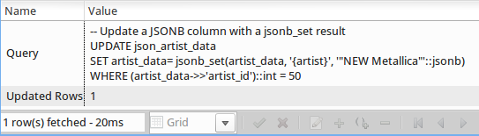
Live with Chinook data
-- Update a JSONB column with a jsonb_set result
UPDATE v_json_artist_data
SET artist_data= jsonb_set(artist_data, '{artist}', '"NEW Metallica"'::jsonb)
WHERE (artist_data->>'artist_id')::int = 50
;

Slide 33
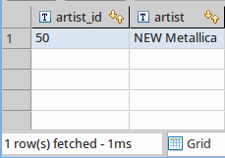
Live with Chinook data
-- View the changes done by the UPDATE statement
SELECT artist_data->>'artist_id' AS artist_id
, artist_data->>'artist' AS artist
FROM v_json_artist_data
WHERE (artist_data->>'artist_id')::int = 50
;

Slide 34
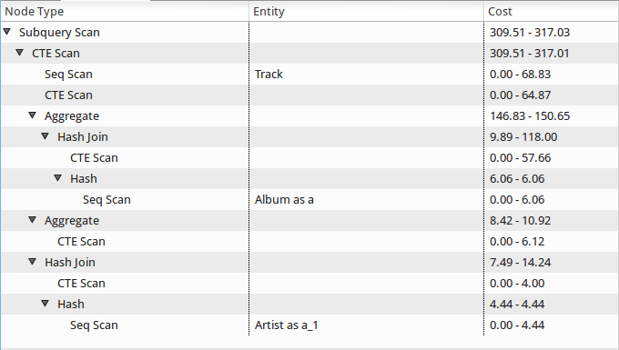
Live with Chinook data
-- Lets have a view on the explain plans
– SELECT the data from the view

Slide 35
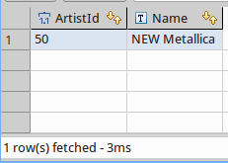
Live with Chinook data
-- View the changes in in the table instead of the JSONB view
-- The result should be the same, only the column name differ
SELECT *
FROM "Artist"
WHERE "ArtistId" = 50
;

Slide 36
Live with Chinook data
-- Lets have a view on the explain plans
– SELECT the data from table Artist

Slide 37

Live with Chinook data
-- Manipulate data with the concatenating / overwrite operator
SELECT artist_data->>'artist_id' AS artist_id
, artist_data->>'artist' AS artist
, jsonb_set(artist_data, '{artist}', '"Whatever we want, it is just text"'::jsonb)->>'artist' AS new_artist
, artist_data || '{"artist":"Metallica"}'::jsonb->>'artist' AS correct_name
FROM v_json_artist_data
WHERE (artist_data->>'artist_id')::int = 50
;

Slide 38
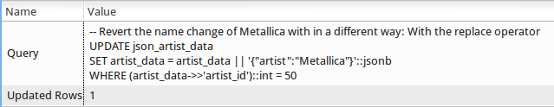
Live with Chinook data
-- Revert the name change of Metallica with in a different way: With the replace operator
UPDATE v_json_artist_data
SET artist_data = artist_data || '{"artist":"Metallica"}'::jsonb
WHERE (artist_data->>'artist_id')::int = 50
;

Slide 39

Live with Chinook data
-- View the changes done by the UPDATE statement with the replace operator
SELECT artist_data->>'artist_id' AS artist_id
, artist_data->>'artist' AS artist
FROM v_json_artist_data
WHERE (artist_data->>'artist_id')::int = 50
;

Slide 40
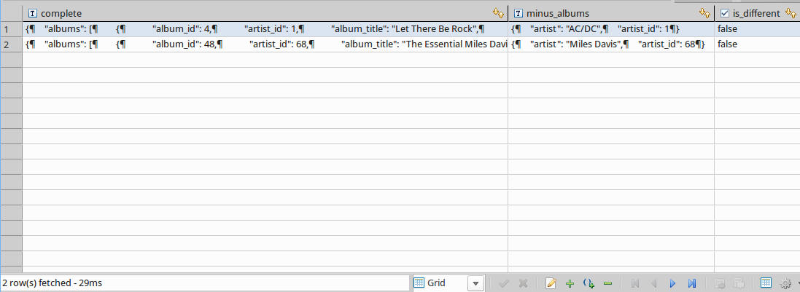
Live with Chinook data
-- Remove some data with the - operator
SELECT jsonb_pretty(artist_data) AS complete
, jsonb_pretty(artist_data - 'albums') AS minus_albums
, jsonb_pretty(artist_data) = jsonb_pretty(artist_data - 'albums') AS is_different
FROM v_json_artist_data
WHERE artist_data->>'artist' IN ('Miles Davis', 'AC/DC')
;

Slide 41
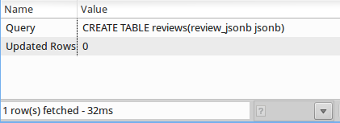
Live Amazon reviews
-- Create a table for JSON data with 1998 Amazon reviews
CREATE TABLE reviews(review_jsonb jsonb);

Slide 42
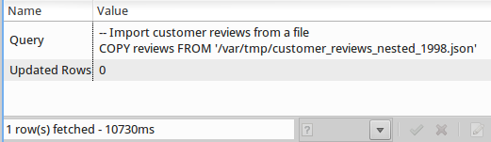
Live Amazon reviews
-- Import customer reviews from a file
COPY reviews
FROM '/var/tmp/customer_reviews_nested_1998.json'
;

Slide 43
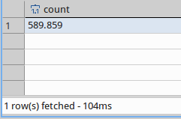
Live Amazon reviews
-- There should be 589.859 records imported into the table
SELECT count(*)
FROM reviews
;

Slide 44
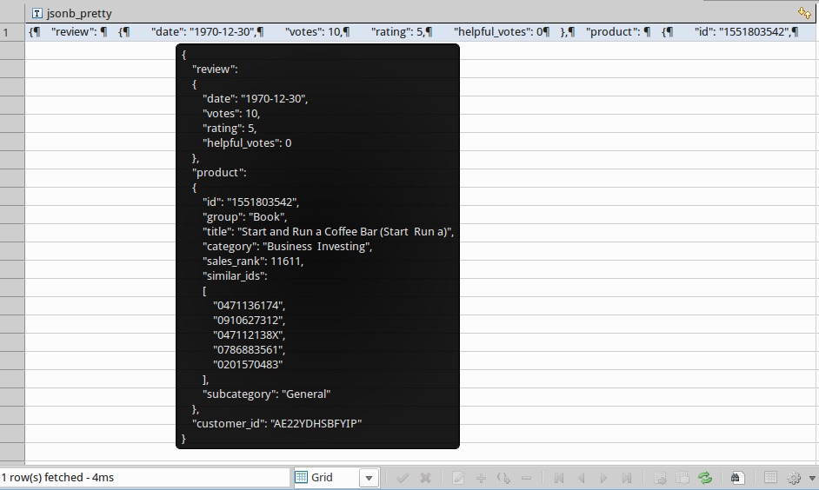
Live Amazon reviews
SELECT jsonb_pretty(review_jsonb)
FROM reviews
LIMIT 1
;

Slide 45
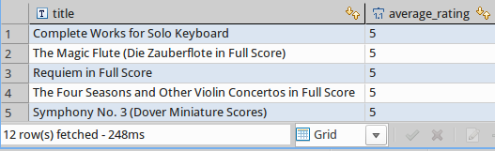
Live Amazon reviews
-- Select data with JSON
SELECT
review_jsonb#>> '{product,title}' AS title
, avg((review_jsonb#>> '{review,rating}')::int) AS average_rating
FROM reviews
WHERE review_jsonb@>'{"product": {"category": "Sheet Music & Scores"}}'
GROUP BY title
ORDER BY average_rating DESC
;
Without an Index: 248ms

Slide 46
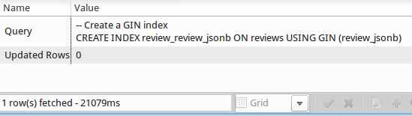
Live Amazon reviews
-- Create a GIN index
CREATE INDEX review_review_jsonb ON reviews USING GIN (review_jsonb);

Slide 47
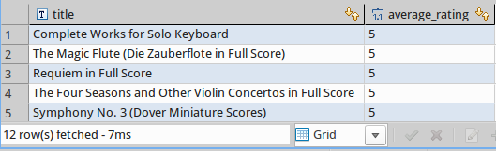
Live Amazon reviews
-- Select data with JSON
SELECT review_jsonb#>> '{product,title}' AS title
, avg((review_jsonb#>> '{review,rating}')::int) AS average_rating
FROM reviews
WHERE review_jsonb@>'{"product": {"category": "Sheet Music & Scores"}}'
GROUP BY title
ORDER BY average_rating DESC
;
The same query as before with the previously created GIN Index: 7ms

Slide 48
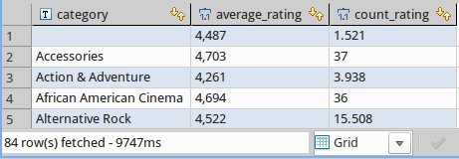
Live Amazon reviews
-- SELECT some statistics from the JSON data
SELECT review_jsonb#>>'{product,category}' AS category
, avg((review_jsonb#>>'{review,rating}')::int) AS average_rating
, count((review_jsonb#>>'{review,rating}')::int) AS count_rating
FROM reviews
GROUP BY category
;
Without an Index: 9747ms

Slide 49
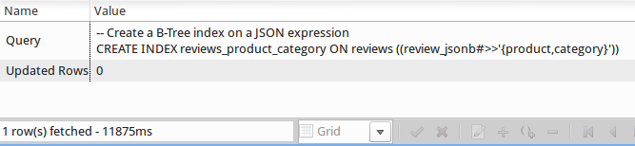
Live Amazon reviews
-- Create a B-Tree index on a JSON expression
CREATE INDEX reviews_product_category ON reviews ((review_jsonb#>>'{product,category}'));

Slide 50
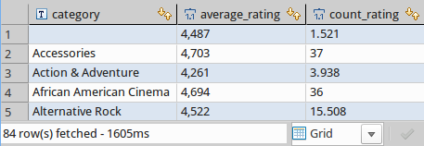
Live Amazon reviews
-- SELECT some statistics from the JSON data
SELECT review_jsonb#>>'{product,category}' AS category
, avg((review_jsonb#>>'{review,rating}')::int) AS average_rating
, count((review_jsonb#>>'{review,rating}')::int) AS count_rating
FROM reviews
GROUP BY category
;
The same query as before with the previously created BTREE Index: 1605ms

Slide 51
JSON by example
This document by Stefanie Janine Stölting is covered by theCreative Commons Attribution 4.0 International

