Slide 1

No SQL The SQL Way
t
11. – 14.12.2017
Frankfurt am Main
Stefanie Janine Stölting
PostgreSQL JSON
#ittage

Slide 2


NoSQL The SQL Way
PostgreSQL JSON Features
Stefanie Janine Stölting
PostgreSQL Consulting
@sjstoelting
mail@stefanie-stoelting.de

Slide 3
JSON
JavaScript Object Notation
Man muss sich nicht um das Encoding kümmern, es ist immer Unicode, die meisten Implementationen verwenden UTF8
Es wird für den Datenaustausch in Web Applikationen benutzt
Momentan gibt es zwei Standards RFC 7159 von Douglas Crockford und ECMA-404
Die PostgreSQL Implementation ist RFC 7159

Slide 4
ISO SQL/JSON
Standard
Im März 2017 wurde ein Standard veröffentlicht: ISO/IEC TR 19075-6:2017
Zusätzlich frei verfügbar: ISO/IEC TR 19075-6

Slide 5
JSON Datentypen
JSON
  Verfügbar seit 9.2
BSON
  Verfügbar als Extension auf GitHub seit 2013
JSONB
  Verfügbar seit 9.4
  Voll transactional
  Bis zu 1 GB (benutzt TOAST)

Slide 6
JSON Funktionen
row_to_json({row})
Returns the row as JSON
array_to_json({array})
Returns the array as JSON
jsonb_to_recordset
Returns a recordset from JSONB

Slide 7
JSON Operatoren
Array Element
->{int}
Array Element über Name
->{text}
Objekt Element
->> {text}
Wert über einen Pfad
#> {text}

Slide 8
Indexierung von JSON
JSONB kann für schnelleren Zugriff mit Indizes genutzt werden
  GIN Index über alles
    CREATE INDEX idx_1 ON jsonb.actor USING GIN (jsondata);
  Aber auch eindeutige B-Tree Indizes sind möglich
    CREATE UNIQUE INDEX actor_id_2 ON jsonb.actor((CAST(jsondata->>'actor_id' AS INTEGER)));

Slide 9
Neue JSON
Funktionen
Neue JSBON Funktion in PostgreSQL 9.6 :
  jsonb_insert:
  Fügt einen neuen Wert über den Pfad in ein JSONB Feld ein und gibt das JSONB Ergebnis zurück
  Siehe 9.6 JSONB documentation für Details

Slide 10
Neue JSON
Funktionen
Neue JSBON Funktion in PostgreSQL 10.0 :
  Volltextsuche über JSON und JSONB
  Unterstützung von Pseudo Typen (annyarray) in to_json() und to_jsonb()
  Weitere Infos sind in den Release Notes unter https://www.postgresql.org/docs/devel/static/release-10.htmlzu finden.

Slide 11
Erweiterungen
JSON Erweiterungen für PostgreSQL:
JsQuery
Implementiert eine Sprache, um JSONB Objekte abzufragen.
postgres-json-schema
Implementiert Schemas für JSON

Slide 12
Datenquellen
Die Chinook Datenbank ist verfügbar unter chinookdatabase.codeplex.com
Die Amazon book reviews von 1998 sind verfügbar unter examples.citusdata.com/customer_reviews_nested_1998.json.gz

Slide 13




Chinook Tabellen

Slide 14

CTE
Common Table Expressions werden in den Beispielen benutzt
Beispiel:
WITH RECURSIVE t(n) AS (
VALUES (1)
UNION ALL
SELECT n+1 FROM t WHERE n < 100
)
SELECT sum(n), min(n), max(n) FROM t;
Ergebnis:

Slide 15
Live Beispiele
Let's see, how it does work.

Slide 16
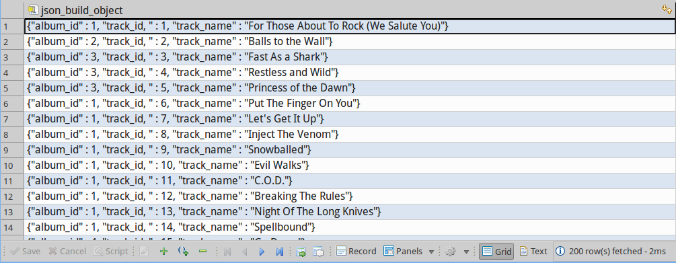
Live mit Chinook Daten
-- Lets start the easy way: With a function call to get album data
SELECT json_build_object (
'album_id', "AlbumId",
'track_id, ', "TrackId",
'track_name', "Name"
)
FROM "Track"
;

Slide 17
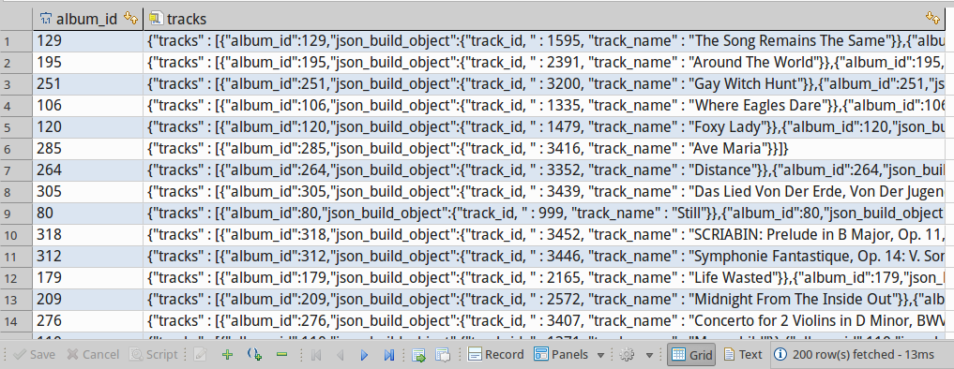
Live mit Chinook Daten
-- Adding array_agg to build JSON arrays
WITH tracks AS
(
SELECT "AlbumId" AS album_id
, json_build_object (
'track_id, ', "TrackId",
'track_name', "Name"
)
FROM "Track"
)
SELECT album_id
, json_build_object ('tracks', array_agg (tracks)) AS tracks
FROM tracks
GROUP BY album_id
;

Slide 18
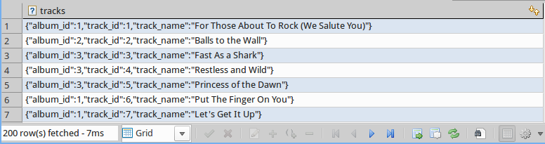
Live mit Chinook Daten
-- Step 1: Tracks as JSON with the album identifier
WITH tracks AS
(
SELECT "AlbumId" AS album_id
, "TrackId" AS track_id
, "Name" AS track_name
FROM "Track"
)
SELECT row_to_json(tracks) AS tracks
FROM tracks
;

Slide 19
Live mit Chinook Daten
-- Step 2 Abums including tracks with aritst identifier
WITH tracks AS
(
SELECT "AlbumId" AS album_id
, "TrackId" AS track_id
, "Name" AS track_name
FROM "Track"
)
, json_tracks AS
(
SELECT row_to_json(tracks) AS tracks
FROM tracks
)
, albums AS
(
SELECT a."ArtistId" AS artist_id
, a."AlbumId" AS album_id
, a."Title" AS album_title
, array_agg(t.tracks) AS album_tracks
FROM "Album" AS a
INNER JOIN json_tracks AS t
ON a."AlbumId" = (t.tracks->>'album_id')::int
GROUP BY a."ArtistId"
, a."AlbumId"
, a."Title"
)
SELECT artist_id
, array_agg(row_to_json(albums)) AS album
FROM albums
GROUP BY artist_id
;

Slide 20
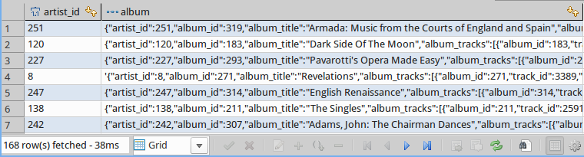
Live mit Chinook Daten

Slide 21
Live mit Chinook Daten
-- Step 3 Return one row for an artist with all albums as VIEW
CREATE OR REPLACE VIEW v_json_artist_data AS
WITH tracks AS
(
SELECT "AlbumId" AS album_id
, "TrackId" AS track_id
, "Name" AS track_name
, "MediaTypeId" AS media_type_id
, "Milliseconds" As milliseconds
, "UnitPrice" AS unit_price
FROM "Track"
)
, json_tracks AS
(
SELECT row_to_json(tracks) AS tracks
FROM tracks
)
, albums AS
(
SELECT a."ArtistId" AS artist_id
, a."AlbumId" AS album_id
, a."Title" AS album_title
, array_agg(t.tracks) AS album_tracks
FROM "Album" AS a
INNER JOIN json_tracks AS t
ON a."AlbumId" = (t.tracks->>'album_id')::int
GROUP BY a."ArtistId"
, a."AlbumId"
, a."Title"
)
, json_albums AS
(
SELECT artist_id
, array_agg(row_to_json(albums)) AS album
FROM albums
GROUP BY artist_id
)
-- -> Next Page

Slide 22
Live mit Chinook Daten
-- Step 3 Return one row for an artist with all albums as VIEW
, artists AS
(
SELECT a."ArtistId" AS artist_id
, a."Name" AS artist
, jsa.album AS albums
FROM "Artist" AS a
INNER JOIN json_albums AS jsa
ON a."ArtistId" = jsa.artist_id
)
SELECT (row_to_json(artists))::jsonb AS artist_data
FROM artists
;

Slide 23
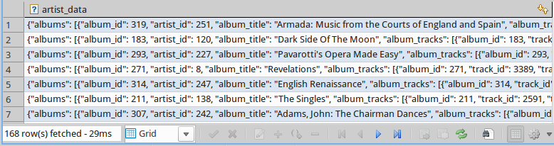
Live mit Chinook Daten
-- Select data from the view
SELECT *
FROM v_json_artist_data
;

Slide 24
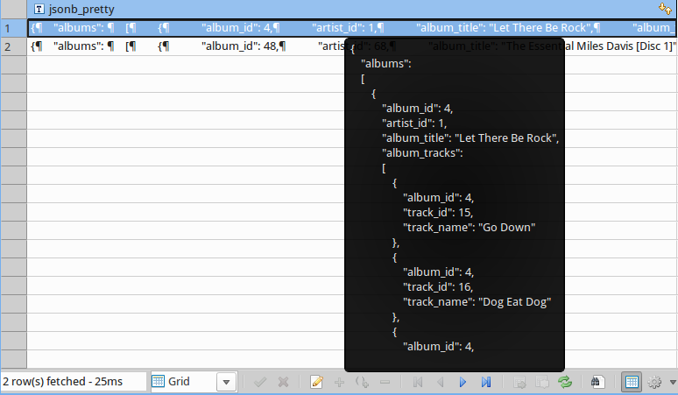
Live mit Chinook Daten
-- SELECT data from that VIEW, that does querying
SELECT jsonb_pretty(artist_data)
FROM v_json_artist_data
WHERE artist_data->>'artist' IN ('Miles Davis', 'AC/DC')
;

Slide 25

Live mit Chinook Daten
-- SELECT some data from that VIEW using JSON methods
SELECT artist_data->>'artist' AS artist
, artist_data#>'{albums, 1, album_title}' AS album_title
, jsonb_pretty(artist_data#>'{albums, 1, album_tracks}') AS album_tracks
FROM v_json_artist_data
WHERE artist_data->'albums' @> '[{"album_title":"Miles Ahead"}]'
;

Slide 26
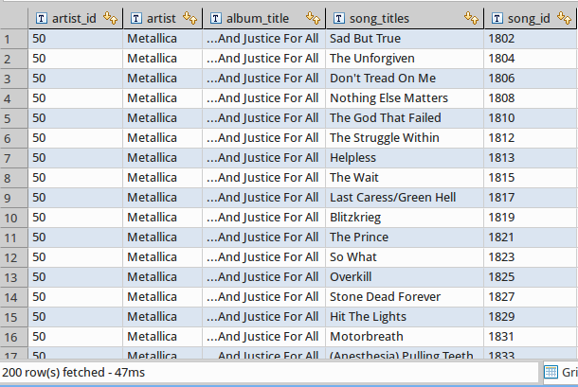
Live mit Chinook Daten
-- Array to records
SELECT artist_data->>'artist_id' AS artist_id
, artist_data->>'artist' AS artist
, jsonb_array_elements(artist_data#>'{albums}')->>'album_title' AS album_title
, jsonb_array_elements(jsonb_array_elements(artist_data#>'{albums}')#>'{album_tracks}')->>'track_name' AS song_titles
, jsonb_array_elements(jsonb_array_elements(artist_data#>'{albums}')#>'{album_tracks}')->>'track_id' AS song_id
FROM v_json_artist_data
WHERE artist_data->>'artist' = 'Metallica'
ORDER BY album_title
, song_id
;

Slide 27
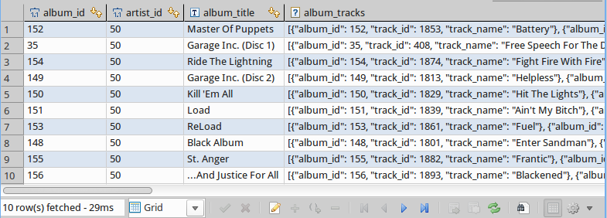
Live mit Chinook Daten
-- Convert albums to a recordset
SELECT *
FROM jsonb_to_recordset(
(
SELECT (artist_data->>'albums')::jsonb
FROM v_json_artist_data
WHERE (artist_data->>'artist_id')::int = 50
)
) AS x(album_id int, artist_id int, album_title text, album_tracks jsonb)
;

Slide 28
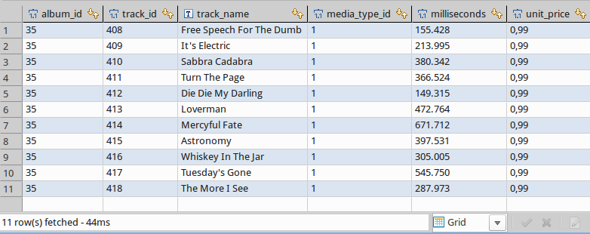
Live mit Chinook Daten
-- Convert the tracks to a recordset
SELECT album_id
, track_id
, track_name
, media_type_id
, milliseconds
, unit_price
FROM jsonb_to_recordset(
(
SELECT artist_data#>'{albums, 1, album_tracks}'
FROM v_json_artist_data
WHERE (artist_data->>'artist_id')::int = 50
)
) AS x(album_id int, track_id int, track_name text, media_type_id int, milliseconds int, unit_price float)
;

Slide 29
Live mit Chinook Daten
-- Create a function, which will be used for UPDATE on the view v_artrist_data
CREATE OR REPLACE FUNCTION trigger_v_json_artist_data_update()
RETURNS trigger AS
$BODY$
-- Data variables
DECLARE rec RECORD;
-- Error variables
DECLARE v_state TEXT;
DECLARE v_msg TEXT;
DECLARE v_detail TEXT;
DECLARE v_hint TEXT;
DECLARE v_context TEXT;
BEGIN
-- Update table Artist
IF (OLD.artist_data->>'artist')::varchar(120) <> (NEW.artist_data->>'artist')::varchar(120) THEN
UPDATE "Artist"
SET "Name" = (NEW.artist_data->>'artist')::varchar(120)
WHERE "ArtistId" = (OLD.artist_data->>'artist_id')::int;
END IF;
-- Update table Album with an UPSERT
-- Update table Track with an UPSERT
RETURN NEW;
EXCEPTION WHEN unique_violation THEN
RAISE NOTICE 'Sorry, but the something went wrong while trying to update artist data';
RETURN OLD;
WHEN others THEN
GET STACKED DIAGNOSTICS
v_state = RETURNED_SQLSTATE,
v_msg = MESSAGE_TEXT,
v_detail = PG_EXCEPTION_DETAIL,
v_hint = PG_EXCEPTION_HINT,
v_context = PG_EXCEPTION_CONTEXT;
RAISE NOTICE '%', v_msg;
RETURN OLD;
END;
$BODY$
LANGUAGE plpgsql;

Slide 30
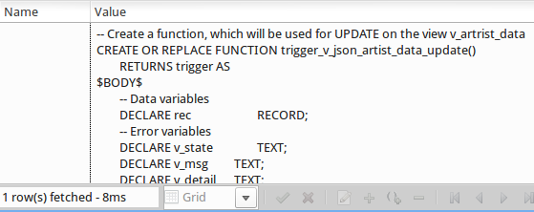
Live mit Chinook Daten

Slide 31
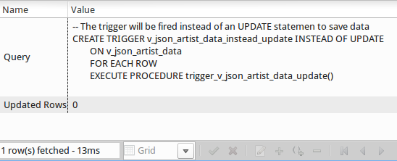
Live mit Chinook Daten
-- The trigger will be fired instead of an UPDATE statement to save data
CREATE TRIGGER v_json_artist_data_instead_update INSTEAD OF UPDATE
ON v_json_artist_data
FOR EACH ROW
EXECUTE PROCEDURE trigger_v_json_artist_data_update()
;

Slide 32
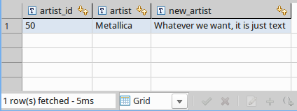
Live mit Chinook Daten
-- Manipulate data with jsonb_set
SELECT artist_data->>'artist_id' AS artist_id
, artist_data->>'artist' AS artist
, jsonb_set(artist_data, '{artist}', '"Whatever we want, it is just text"'::jsonb)->>'artist' AS new_artist
FROM v_json_artist_data
WHERE (artist_data->>'artist_id')::int = 50
;

Slide 33
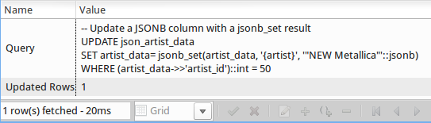
Live mit Chinook Daten
-- Update a JSONB column with a jsonb_set result
UPDATE v_json_artist_data
SET artist_data= jsonb_set(artist_data, '{artist}', '"NEW Metallica"'::jsonb)
WHERE (artist_data->>'artist_id')::int = 50
;

Slide 34
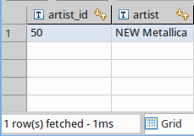
Live mit Chinook Daten
-- View the changes done by the UPDATE statement
SELECT artist_data->>'artist_id' AS artist_id
, artist_data->>'artist' AS artist
FROM v_json_artist_data
WHERE (artist_data->>'artist_id')::int = 50
;

Slide 35
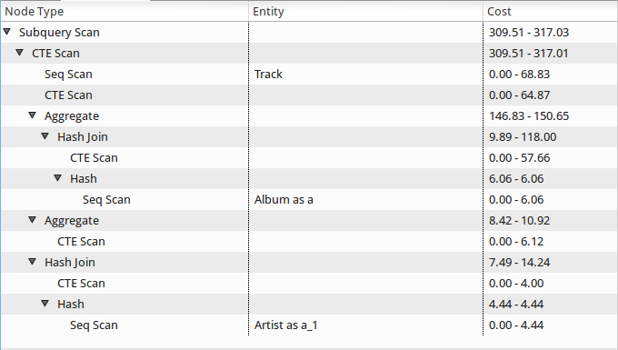
Live mit Chinook Daten
-- Lets have a view on the explain plans
– SELECT the data from the view

Slide 36
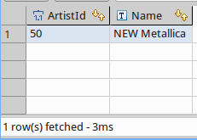
Live mit Chinook Daten
-- View the changes in in the table instead of the JSONB view
-- The result should be the same, only the column name differ
SELECT *
FROM "Artist"
WHERE "ArtistId" = 50
;

Slide 37
Live mit Chinook Daten
-- Lets have a view on the explain plans
– SELECT the data from table Artist

Slide 38

Live mit Chinook Daten
-- Manipulate data with the concatenating / overwrite operator
SELECT artist_data->>'artist_id' AS artist_id
, artist_data->>'artist' AS artist
, jsonb_set(artist_data, '{artist}', '"Whatever we want, it is just text"'::jsonb)->>'artist' AS new_artist
, artist_data || '{"artist":"Metallica"}'::jsonb->>'artist' AS correct_name
FROM v_json_artist_data
WHERE (artist_data->>'artist_id')::int = 50
;

Slide 39
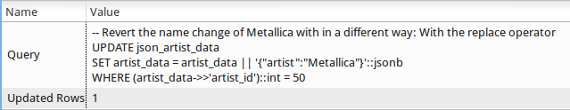
Live mit Chinook Daten
-- Revert the name change of Metallica with in a different way: With the replace operator
UPDATE v_json_artist_data
SET artist_data = artist_data || '{"artist":"Metallica"}'::jsonb
WHERE (artist_data->>'artist_id')::int = 50
;

Slide 40

Live mit Chinook Daten
-- View the changes done by the UPDATE statement with the replace operator
SELECT artist_data->>'artist_id' AS artist_id
, artist_data->>'artist' AS artist
FROM v_json_artist_data
WHERE (artist_data->>'artist_id')::int = 50
;

Slide 41
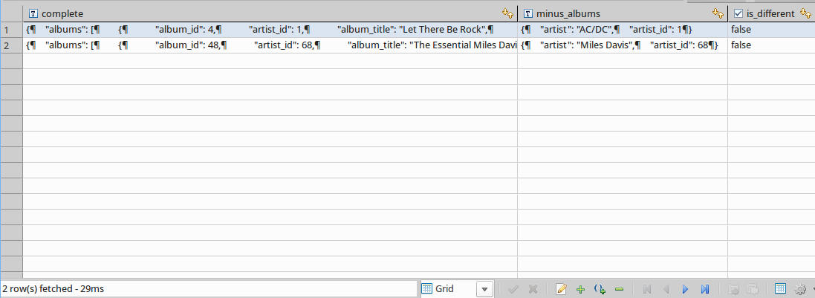
Live mit Chinook Daten
-- Remove some data with the - operator
SELECT jsonb_pretty(artist_data) AS complete
, jsonb_pretty(artist_data - 'albums') AS minus_albums
, jsonb_pretty(artist_data) = jsonb_pretty(artist_data - 'albums') AS is_different
FROM v_json_artist_data
WHERE artist_data->>'artist' IN ('Miles Davis', 'AC/DC')
;

Slide 42
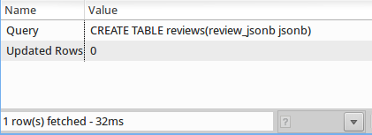
Live Amazon Reviews
-- Create a table for JSON data with 1998 Amazon reviews
CREATE TABLE reviews(review_jsonb jsonb);

Slide 43
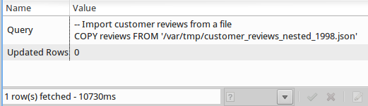
Live Amazon Reviews
-- Import customer reviews from a file
COPY reviews
FROM '/var/tmp/customer_reviews_nested_1998.json'
;

Slide 44
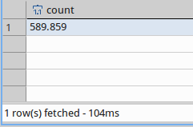
Live Amazon Reviews
-- There should be 589.859 records imported into the table
SELECT count(*)
FROM reviews
;

Slide 45
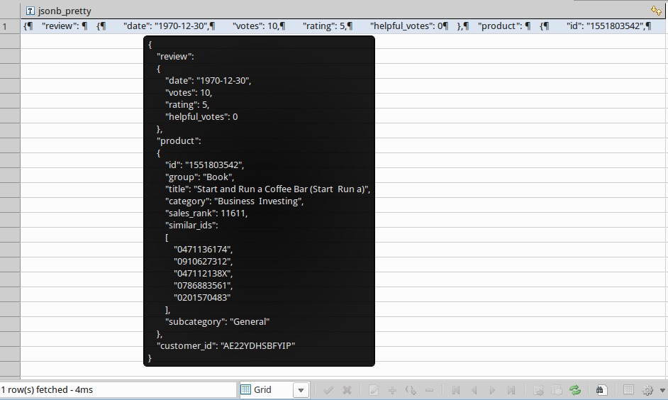
Live Amazon Reviews
SELECT jsonb_pretty(review_jsonb)
FROM reviews
LIMIT 1
;

Slide 46
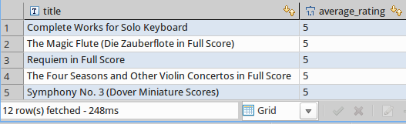
Live Amazon Reviews
-- Select data with JSON
SELECT
review_jsonb#>> '{product,title}' AS title
, avg((review_jsonb#>> '{review,rating}')::int) AS average_rating
FROM reviews
WHERE review_jsonb@>'{"product": {"category": "Sheet Music & Scores"}}'
GROUP BY title
ORDER BY average_rating DESC
;
Without an Index: 248ms

Slide 47
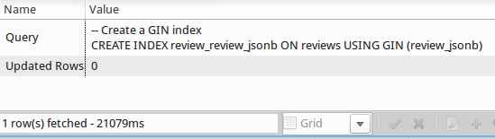
Live Amazon Reviews
-- Create a GIN index
CREATE INDEX review_review_jsonb ON reviews USING GIN (review_jsonb);

Slide 48
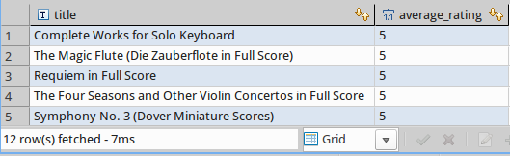
Live Amazon Reviews
-- Select data with JSON
SELECT review_jsonb#>> '{product,title}' AS title
, avg((review_jsonb#>> '{review,rating}')::int) AS average_rating
FROM reviews
WHERE review_jsonb@>'{"product": {"category": "Sheet Music & Scores"}}'
GROUP BY title
ORDER BY average_rating DESC
;
The same query as before with the previously created GIN Index: 7ms

Slide 49
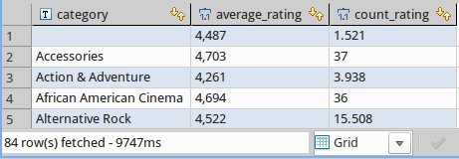
Live Amazon Reviews
-- SELECT some statistics from the JSON data
SELECT review_jsonb#>>'{product,category}' AS category
, avg((review_jsonb#>>'{review,rating}')::int) AS average_rating
, count((review_jsonb#>>'{review,rating}')::int) AS count_rating
FROM reviews
GROUP BY category
;
Without an Index: 9747ms

Slide 50
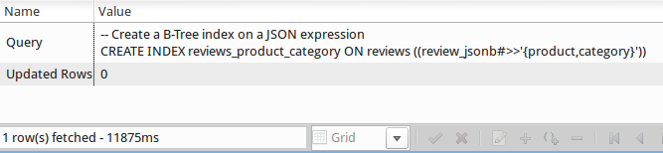
Live Amazon Reviews
-- Create a B-Tree index on a JSON expression
CREATE INDEX reviews_product_category ON reviews ((review_jsonb#>>'{product,category}'));

Slide 51
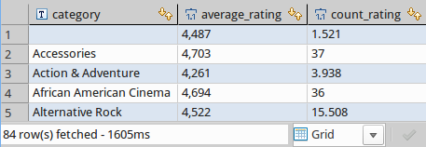
Live Amazon reviews
-- SELECT some statistics from the JSON data
SELECT review_jsonb#>>'{product,category}' AS category
, avg((review_jsonb#>>'{review,rating}')::int) AS average_rating
, count((review_jsonb#>>'{review,rating}')::int) AS count_rating
FROM reviews
GROUP BY category
;
The same query as before with the previously created BTREE Index: 1605ms

Slide 52
NoSQL The SQL Way
Dieses Dokument von Stefanie Janine Stölting steht unter derCreative Commons Attribution 4.0 International Lizenz.

