Slide 1


JSON by the other elephant
FOSDEM PGDay
January 2016
Stefanie Janine Stölting
@sjstoelting

Slide 2

JSON
JavaScript Object Notation
Don't have to care about encoding, it is always Unicode, most implemantations use UTF8
Used for data exchange in web application
Currently two standards RFC 7159 by Douglas Crockford und ECMA-404
PostgreSQL impementation is RFC 7159

Slide 3
JSON Datatypes
JSON
  Available since 9.2
BSON
  Available as extension on GitHub since 2013
JSONB
  Available since 9.4
  Crompessed JSON

Slide 4
JSON Functions
row_to_json({row})
Returns the row as JSON
array_to_json({array})
Returns the array as JSON

Slide 5
JSON Opertators
Array element
->{int}
Array element by name
->{text}
Object element
->> {text}
Value at path
#> {text}

Slide 6
Index on JSON
Index JSONB content for faster access with indexes
  GIN index overall
    CREATE INDEX idx_1 ON jsonb.actor USING GIN (jsondata);
  Even unique B-Tree indexes are possible
    CREATE UNIQUE INDEX actor_id_2 ON jsonb.actor((CAST(jsondata->>'actor_id' AS INTEGER)));

Slide 7
New JSON functions
PostgreSQL 9.5 new JSONB functions:
  jsonb_pretty
  jsonb_set
Available as extions for 9.4 at PGXN: jsonbx

Slide 8
Data sources
The Chinook database is available at chinookdatabase.codeplex.com
Amazon book reviews of 1998 are available at examples.citusdata.com/customer_reviews_nested_1998.json.gz

Slide 9




Chinook Tables

Slide 10

CTE
Common Table Expressions will be used in examples
Example:
WITH RECURSIVE t(n) AS (
VALUES (1)
UNION ALL
SELECT n+1 FROM t WHERE n < 100
)
SELECT sum(n), min(n), max(n) FROM t;
Result:

Slide 11
Live Examples
Let's see, how it does work.

Slide 12
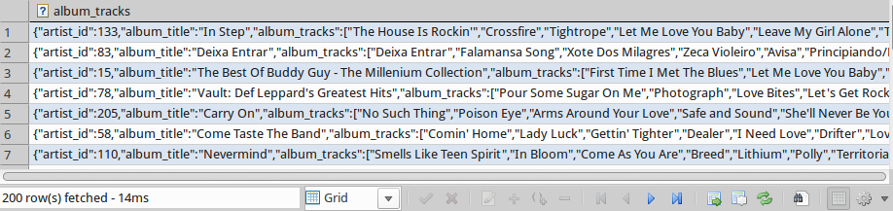
Live with Chinook data
-- Step 1: Albums with tracks as JSON
WITH albums AS
(
SELECT a."ArtistId" AS artist_id
, a."Title" AS album_title
, array_agg(t."Name") AS album_tracks
FROM "Album" AS a
INNER JOIN "Track" AS t
ON a."AlbumId" = t."AlbumId"
GROUP BY a."ArtistId"
, a."Title"
)
SELECT row_to_json(albums) AS album_tracks
FROM albums
;

Slide 13
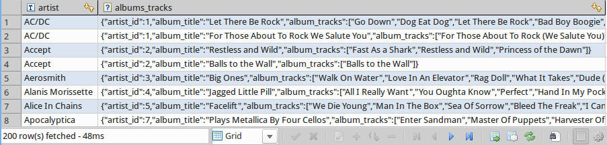
Live with Chinook data
-- Step 2 Abums including tracks with aritsts
WITH albums AS
(
SELECT a."ArtistId" AS artist_id
, a."Title" AS album_title
, array_agg(t."Name") AS album_tracks
FROM "Album" AS a
INNER JOIN "Track" AS t
ON a."AlbumId" = t."AlbumId"
GROUP BY a."ArtistId"
, a."Title"
)
, js_albums AS
(
SELECT row_to_json(albums) AS album_tracks
FROM albums
)
SELECT a."Name" AS artist
, al.album_tracks AS albums_tracks
FROM sqlite_artist AS a
INNER JOIN js_albums AS al
ON a."ArtistId" = CAST(al.album_tracks->>'artist_id' AS INT)
;

Slide 14
Live with Chinook data
-- Step 3 Return one row for an artist with all albums as VIEW
CREATE OR REPLACE VIEW v_artist_data AS
WITH albums AS
(
SELECT a."ArtistId" AS artist_id
, a."Title" AS album_title
, array_agg(t."Name") AS album_tracks
FROM "Album" AS a
INNER JOIN "Track" AS t
ON a."AlbumId" = t."AlbumId"
GROUP BY a."ArtistId"
, a."Title"
)
, js_albums AS
(
SELECT row_to_json(albums) AS album_tracks
FROM albums
)
, artist_albums AS
(
SELECT a."Name" AS artist
, array_agg(al.album_tracks) AS albums_tracks
FROM "Artist" AS a
INNER JOIN js_albums AS al
ON a."ArtistId" = CAST(al.album_tracks->>'artist_id' AS INT)
GROUP BY a."Name"
)
SELECT CAST(row_to_json(artist_albums) AS JSONB) AS artist_data
FROM artist_albums
;

Slide 15
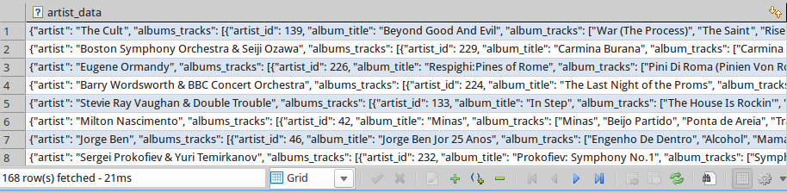
Live with Chinook data
-- Select data from the view
SELECT *
FROM v_artist_data
;

Slide 16
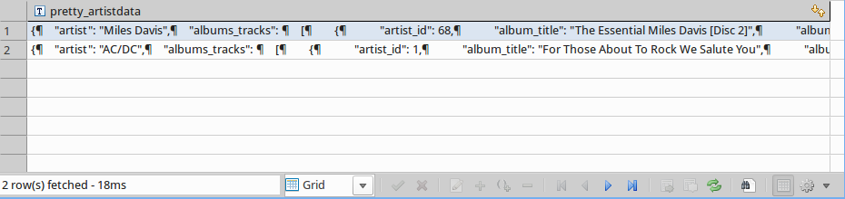
Live with Chinook data
-- SELECT data from that VIEW, that does querying
SELECT jsonb_pretty(artist_data) pretty_artistdata
FROM v_artist_data
WHERE artist_data->>'artist' IN ('Miles Davis', 'AC/DC')
;

Slide 17
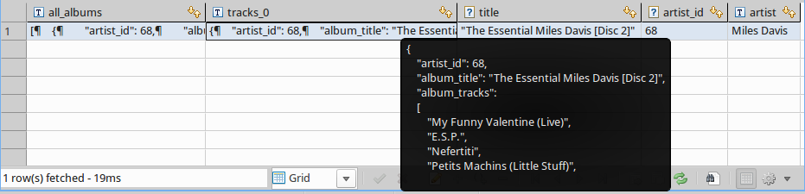
Live with Chinook data
-- SELECT some data that VIEW using JSON methods
SELECT jsonb_pretty(artist_data#>'{albums_tracks}') AS all_albums
, jsonb_pretty(artist_data#>'{albums_tracks, 0}') AS tracks_0
, artist_data#>'{albums_tracks, 0, album_title}' AS title
, artist_data#>'{albums_tracks, 0, artist_id}' AS artist_id
, artist_data->>'artist' AS artist
FROM v_artist_data
WHERE artist_data->'albums_tracks' @> '[{"album_title":"Miles Ahead"}]'
;

Slide 18
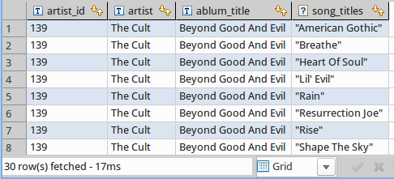
Live with Chinook data
-- Array to records
SELECT jsonb_array_elements(artist_data#>'{albums_tracks}')->>'artist_id' AS artist_id
, artist_data->>'artist' AS artist
, jsonb_array_elements(artist_data#>'{albums_tracks}')->>'album_title' AS ablum_title
, jsonb_array_elements(jsonb_array_elements(artist_data#>'{albums_tracks}')#>'{album_tracks}') AS song_titles
FROM v_artist_data
WHERE artist_data->'albums_tracks' @> '[{"artist_id":139}]'
ORDER BY 3, 4;

Slide 19
Live with Chinook data
-- Create a function, which will be used for UPDATE on the view v_artrist_data
CREATE OR REPLACE FUNCTION trigger_v_artist_data_update()
RETURNS trigger AS
$BODY$
-- Data variables
DECLARE rec RECORD;
-- Error variables
DECLARE v_state TEXT;
DECLARE v_msg TEXT;
DECLARE v_detail TEXT;
DECLARE v_hint TEXT;
DECLARE v_context TEXT;
BEGIN
-- Update table Artist
IF OLD.artist_data->>'artist' <> NEW.artist_data->>'artist' THEN
UPDATE "Artist"
SET "Name" = NEW.artist_data->>'artist'
WHERE "ArtistId" = artist_data#>'{albums_tracks, 0, artist_id}';
END IF;
-- Update table Album in a foreach
-- Update table Track in a foreach
RETURN NEW;
EXCEPTION WHEN unique_violation THEN
RAISE NOTICE 'Sorry, but the something went wrong while trying to update artist data';
RETURN OLD;
WHEN others THEN
GET STACKED DIAGNOSTICS
v_state = RETURNED_SQLSTATE,
v_msg = MESSAGE_TEXT,
v_detail = PG_EXCEPTION_DETAIL,
v_hint = PG_EXCEPTION_HINT,
v_context = PG_EXCEPTION_CONTEXT;
RAISE NOTICE '%', v_msg;
RETURN OLD;
END;
$BODY$
LANGUAGE plpgsql;

Slide 20
Live with Chinook data
-- The trigger will be fired instead of an UPDATE statemen to save data
CREATE TRIGGER v_artist_data_instead_update INSTEAD OF UPDATE
ON v_artist_data
FOR EACH ROW
EXECUTE PROCEDURE trigger_v_artist_data_update()
;

Slide 21
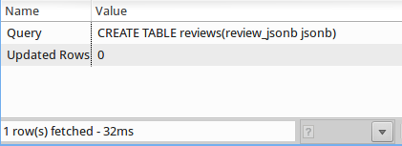
Live Amazon reviews
-- Create a table for JSON data with 1998 Amazon reviews
CREATE TABLE reviews(review_jsonb jsonb);

Slide 22
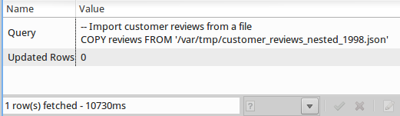
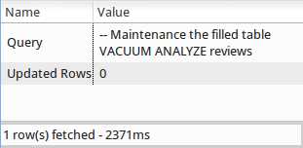
Live Amazon reviews
-- Import customer reviews from a file
COPY reviews FROM '/var/tmp/customer_reviews_nested_1998.json'
-- Maintenance the filled table
VACUUM ANALYZE reviews;

Slide 23
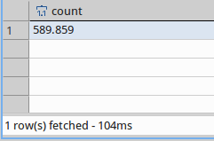
Live Amazon reviews
-- There should be 589.859 records imported into the table
SELECT count(*) FROM reviews;

Slide 24
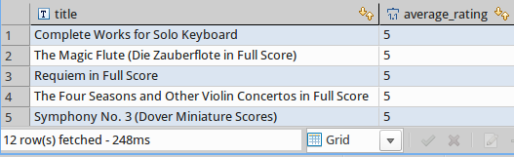
Live Amazon reviews
-- Select data with JSON
SELECT
review_jsonb#>> '{product,title}' AS title
, avg((review_jsonb#>> '{review,rating}')::int) AS average_rating
FROM reviews
WHERE review_jsonb@>'{"product": {"category": "Sheet Music & Scores"}}'
GROUP BY 1
ORDER BY 2 DESC
;
Without an Index: 248ms

Slide 25
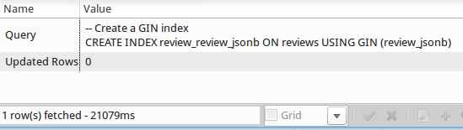
Live Amazon reviews
-- Create a GIN index
CREATE INDEX review_review_jsonb ON reviews USING GIN (review_jsonb);

Slide 26
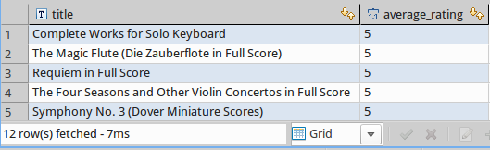
Live Amazon reviews
-- Select data with JSON
SELECT
review_jsonb#>> '{product,title}' AS title
, avg((review_jsonb#>> '{review,rating}')::int) AS average_rating
FROM reviews
WHERE review_jsonb@>'{"product": {"category": "Sheet Music & Scores"}}'
GROUP BY 1
ORDER BY 2 DESC
;
The same query as before with the previously created GIN Index: 7ms

Slide 27
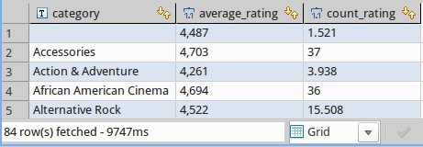
Live Amazon reviews
-- SELECT some statistics from the JSON data
SELECT review_jsonb#>>'{product,category}' AS category
, avg((review_jsonb#>>'{review,rating}')::int) AS average_rating
, count((review_jsonb#>>'{review,rating}')::int) AS count_rating
FROM reviews
GROUP BY 1
;
Without an Index: 9747ms

Slide 28
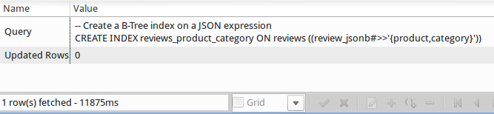
Live Amazon reviews
-- Create a B-Tree index on a JSON expression
CREATE INDEX reviews_product_category ON reviews ((review_jsonb#>>'{product,category}'));

Slide 29
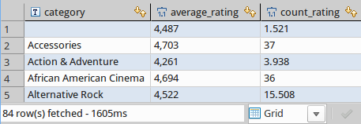
Live Amazon reviews
-- SELECT some statistics from the JSON data
SELECT review_jsonb#>>'{product,category}' AS category
, avg((review_jsonb#>>'{review,rating}')::int) AS average_rating
, count((review_jsonb#>>'{review,rating}')::int) AS count_rating
FROM reviews
GROUP BY 1
;
The same query as before with the previously created BTREE Index: 1605ms

Slide 30
JSON by example
This document by Stefanie Janine Stölting is covered by theCreative Commons Attribution 4.0 International

