Slide 1
CPAT-AI-Mitigation-MVP v1.03
ADVANCED FEATURES · v1.01 TO v1.03
v1.01
Results in one place
MTOutputs collects 25 key results per scenario by output code; Charts plots them.
Since v1.00 the MVP prices an ETS from its cap, runs many scenarios in one go, and stores and compares their results. AI wrote all of it, including the Excel macro.
v1.02
A real ETS
Cap against baseline emissions, fast price estimate, goal seek, benchmarks and a volatility adjustment.
Cap-based ETS
Batch scenarios
Stored results
v1.03
Many scenarios
Scenario table in MTInputs, a macro that runs it, results stored as values, and a comparison tab.
Draft, October 2026 · Egypt data · for the team
Notes:
Three releases since the v1.00 overview deck: results collected by code (v1.01), an ETS that finds its own price from a cap (v1.02), and multiple scenarios with a macro, stored results and a comparison tab (v1.03).

Slide 2
The ETS now finds its own price from a cap
NEW ETS
1
Set a cap
A change against baseline covered emissions, stored as data from scenario 1 (no circular reference).
2
Estimate the price
LN(cap ÷ baseline) ÷ (semi-elasticity × effectiveness × volatility adjustment).
3
Goal seek
Legacy's damped iteration until covered emissions are within 0.5% of the cap, as a macro or in Python.
THE PRICE SPLITS IN TWO
Auctioned share × (1 − benchmark)
Enters fuel prices like a carbon tax: usage and efficiency respond; raises revenue.
Permit price
× volatility adjustment
Free allocation × benchmark
A shadow price on efficiency only, like feebates; no change in prices or revenue.
Benchmarks by sector group replace the single auction share. Volatility adjustment = 1/1.1 at Medium, as legacy.
Covered emissions stay within 0.5% of the cap (−5% in 2027 to −20% by 2035) in every year.
Notes:
The cap is set against baseline covered emissions, which are stored as data from scenario 1 to avoid a circular reference. A fast closed-form estimate gives the starting price; the goal seek (legacy's damped log-space iteration) then meets the cap. The permit price splits by the benchmarks: the auctioned part acts like a carbon tax, the free part like a feebate. Package B prices: about $19 in 2027, $41 in 2030, $77 in 2035.

Slide 3
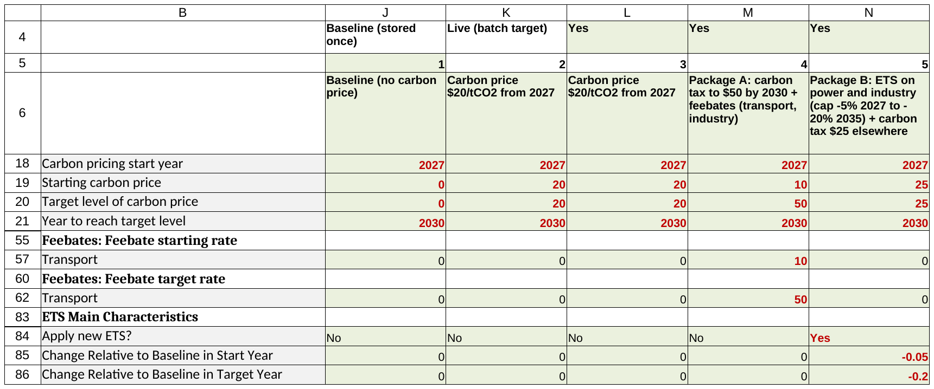
One table of scenarios, one macro to run them
MULTIPLE SCENARIOS · SET UP AND RUN
RunAllScenarios (Alt+F8)
1
Stores the baseline once
It does not change unless you ask.
2
Copies each scenario into K
Every column marked Run? = Yes, one at a time.
3
Recalculates
And runs the ETS goal seek when the scenario has an ETS.
MTInputs: J baseline, K live scenario, L onwards one column per scenario (row 4: Run? = Yes)
Pastes results as values
Into StoredResults, under the scenario's number.
4
Shipped packages: A carbon tax to $50 by 2030 + feebates; B ETS on power and industry + $25 carbon tax elsewhere.
Other macros: StoreBaseline, StoreLiveScenario, SolveETSLive, ClearStoredScenarios.
5
Puts K back
The live scenario is as you left it.
Notes:
Scenario definitions follow legacy CPAT: one MTInputs column per scenario. The macro copies each one marked Yes into the live column, recalculates, runs the ETS goal seek where needed and stores the MTOutputs block as values. To add a scenario, copy the last definition column to the right and edit it.

Slide 4
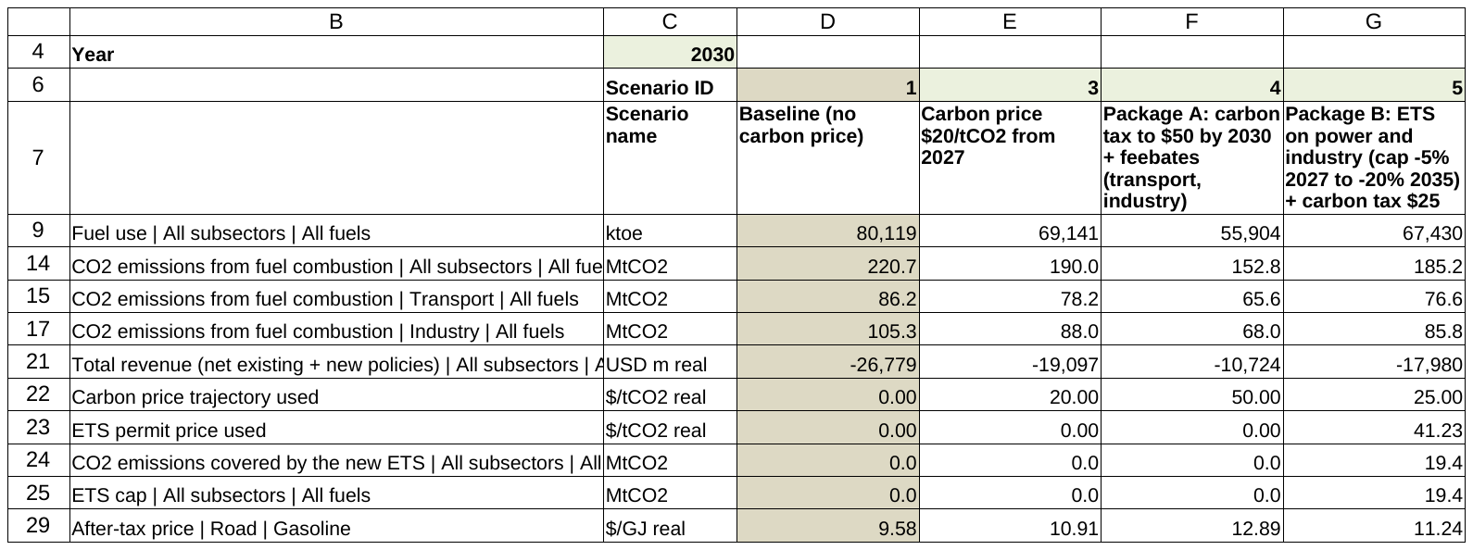
Stored results, compared in one view
MULTIPLE SCENARIOS · COMPARE
ScenarioCompare: choose a year and the scenario IDs; levels, differences and % vs the baseline
8e-15
0.5%
0
NEXT
Run CheckBatchRun once in Excel (one-click test)
Power sector, CH4 and N2O
Partial adjustment of fuel use; review benchmarks
Largest relative difference between the macro run in LibreOffice and the Python emulation
Largest gap between the ETS package's covered emissions and its cap
Change in the 3,642 output codes shared with v1.02
Notes:
ScenarioCompare reads only the stored values, so results from earlier runs or other files can be compared too. AI wrote the VBA project from the file-format specification, without Excel; LibreOffice runs it and reproduces the Python emulation exactly. Its first run in Excel is one click: the macro CheckBatchRun checks the lookups, compares Excel's recalculation with the stored results and reports PASS on sheet MacroCheck.

