Slide 1
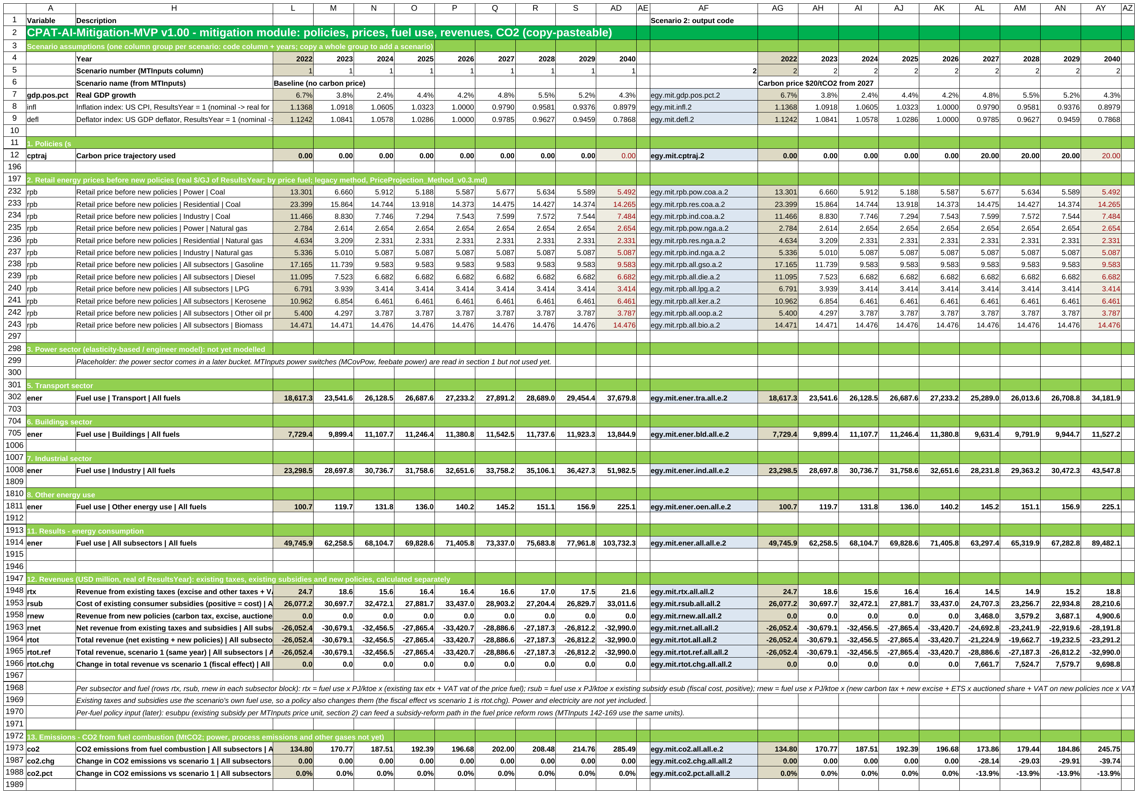
CPAT-AI-Mitigation-MVP v1.00
PITCH + USER GUIDE
CPAT's mitigation equations, generated by AI as a tidy Excel workbook that you can copy, drag and extend: one tab, scenarios side by side.
AI-generated
Copy-pasteable
Scenarios left to right
The Mitigation tab as it opens: everything rolled up
Draft, October 2026 · Egypt data · prototype for discussion
Notes:
A one-tab Excel version of the CPAT mitigation chain (policies, prices, fuel use, revenues, CO2), generated and checked by AI. The deck is both a short pitch (slides 2-3) and a user guide (slides 4-6).

Slide 2
What this workbook is for
PURPOSE AND SCOPE
1
Show that AI can generate a working Excel model
Every formula, label and check was written by AI from plain-language instructions, and every value is re-computed independently to confirm it.
DEFINITION
A minimum viable product (MVP): the CPAT mitigation module rebuilt as an AI-generated, copy-pasteable Excel file.
IN SCOPE
Egypt; 16 energy-use sectors × 8 fuels; 2022–2040
Carbon tax, ETS, fuel price reform, feebates
Prices, fuel use, revenues and CO2, in real 2026 USD
NOT YET
Power sector, other gases, local pollutants
Full numerical match with legacy CPAT
2
Do it for the main mitigation equations
Policies → retail prices → fuel use → revenues → CO2, following the CPAT documentation and legacy rules.
3
Make it easier to read than today's CPAT
One tab, numbered sections, one row per fuel, everything rolled up on open. Tidier and more compact.
The chain on the Mitigation tab (legacy CPAT section numbers)
1. Policies
2. Retail prices
5-8. Fuel use
12. Revenues
13. CO2
Notes:
Three purposes: (1) demonstrate AI generation of an Excel model; (2) for the core mitigation equations; (3) make it more readable than the current workbook. Scope and gaps on the right.

Slide 3
Four problems with today's Excel, four fixes
WHAT CHANGES
TODAY IN CPAT
IN THE MVP
Messy and hard to read
Numbered sections, one row per fuel, rolled up on open; differences with legacy listed on one tab
Hard to copy when a formula points to a fixed row, e.g. a time series
Years run left to right and scenarios sit side by side, so fixed rows stay fixed: one formula per block
Hard to copy when a formula needs a sector- or fuel-specific number
Those numbers sit in a left-hand section (columns D:G), so every row uses the same formula
New scenarios are slow to build
Copy a scenario block; it finds its settings with one lookup on its MTInputs column
Notes:
Points 3-6 of the brief: readability, fixed rows (time series), sector- and fuel-specific quantities, and speed of building scenarios.

Slide 4
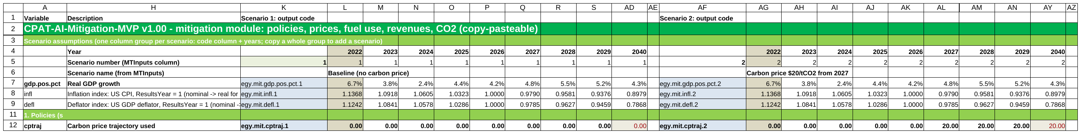
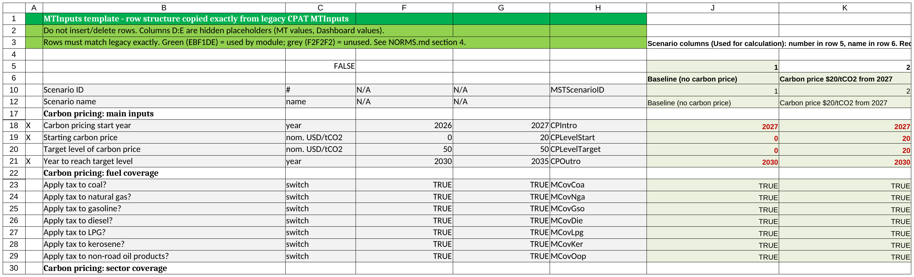
Scenarios sit side by side: add one in three steps
USER GUIDE · SCENARIOS
Each scenario is a block of columns: output codes, 2022 (beige), years to 2040, and a blank column.
1
Copy a settings column
In MTInputs, copy the last scenario column one to the right and edit it.
2
Copy a scenario block
In Mitigation, copy a whole block and paste it to the right.
3
Done
The scenario number goes up by one and the block reads its own MTInputs column.
MTInputs keeps the legacy rows; one column per scenario (red = changed)
Notes:
Point 6: scenarios via a simple lookup. Row 5 holds the scenario number; every input row looks up its value in that MTInputs column. Copying a block increments the number automatically.

Slide 5
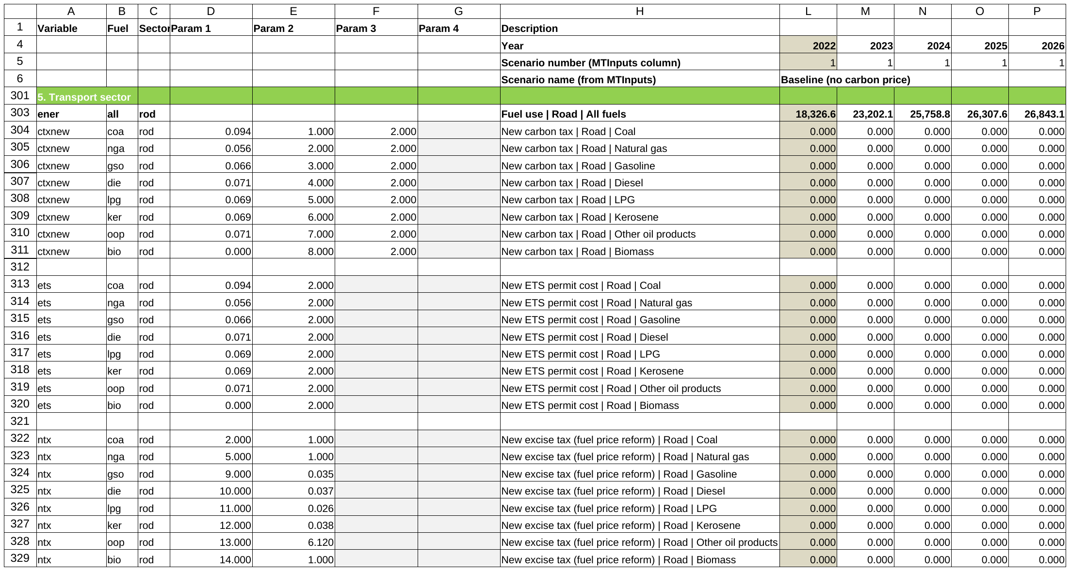
Sector- and fuel-specific numbers live on the left
USER GUIDE · ROWS
A
Columns B:C — fuel and sector
Every row is one fuel in one sector (here: road transport).
B
Columns D:G — that row's numbers
Emission factor, elasticities, positions: looked up once from the Inputs sheet.
C
Year columns — one formula
The same formula in every row of a block: copy, drag or paste freely.
Columns B:G and I:K are grouped and rolled up on open: click + above the columns to show them.
Notes:
Point 5: equations that need a sector- or fuel-specific quantity read it from the parameter columns of their own row, so the formula is identical everywhere.

Slide 6
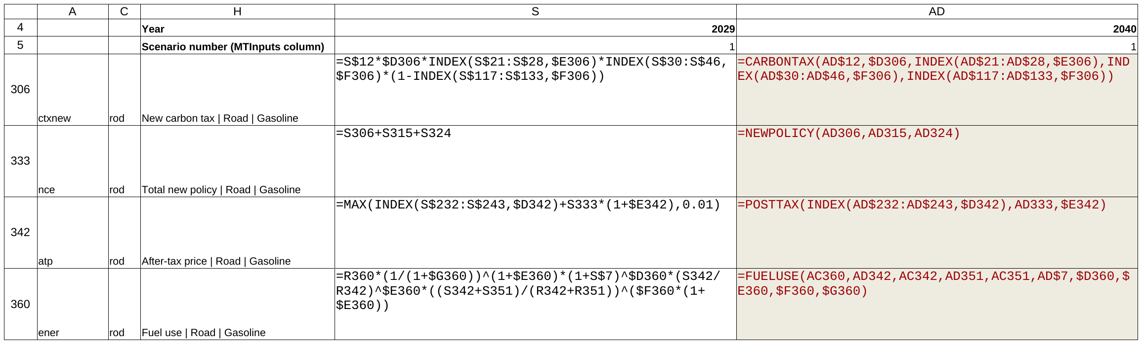
Two ways to write the same formula
USER GUIDE · FORMULAS
Direct formulas (left)
Plain Excel arithmetic, readable cell by cell. Data years and projection years are separate blocks.
LAMBDA formulas (right)
Named functions such as FUELUSE(…), defined once in Name Manager, in the light-beige 2040 column. They may hold IF conditions.
Both can be dragged
Drag a direct formula right, or copy the LAMBDA left across the whole row: the checks confirm the results are identical.
Notes:
Point 8: direct formulas on the left (2022-2039) and compact LAMBDA formulas on the right (2040). Light beige marks blocks that are copy-pasteable within themselves but not into white cells.

Slide 7
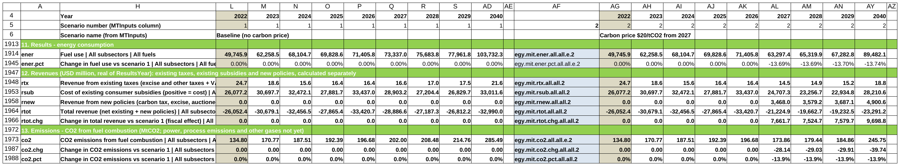
Next: keep data, charts and scenarios together
NEXT STEPS
GETTING STARTED
Open the file: the Mitigation tab opens rolled up
Buttons 1 / 2 / 3 (top left) open more rows
Change a scenario in its MTInputs column
ReadMe explains assumptions; LegacyDiff lists every difference with legacy CPAT
Formulas: Formulas > Name Manager
Results already carry full CPAT codes per scenario, e.g. egy.mit.co2.all.all.2
1
Store data, charts and scenario settings in CPAT
Settings already sit in MTInputs columns; add data and charts next to them.
2
Collect outputs for many scenarios in an updated MTOutputs
Copy results across scenarios by their codes. Inputs stay as they are for now.
3
Extend and validate
Power sector, other gases, and a numerical check against legacy CPAT.
Notes:
Point 7: store data, graphs and scenario settings with CPAT, then copy outputs for many scenarios into an updated MTOutputs sheet (outputs only for now, not inputs).

