Slide 1
Text-to-Pay
Multiply your revenue through SMS based payments

Slide 2
Problem
What are we trying to solve at hand?

Slide 3
Businesses struggle to get repeat customers and hence there is a need for a system that allows them to create and send marketing messages and offer discounts that help them to increase conversion rates.
It takes the average person 90 minutes to respond to an email, but only 90 seconds to respond to a text message. With technology advancing at rapid speeds, successful businesses have adopted the new way to pay - completely through text.

Slide 4
Solution

Slide 5
Text to pay, also known as SMS (Short Messaging Service) payment, is a payment solution that allows consumers to make a payment via texting on their smartphones.
With this payment method, your customers send out a text to their client's phone stating they can make a payment and have the option to text back “yes” to complete the transaction.
The business will have their client's payment information on file so they don’t have to worry about typing in their credit card information each time.
If the business does not have their payment information available, there is an option for the client to add their credit card or bank details to the business's system, so that it is on file for future purchases. This process makes for a seamless experience for both your customer’s business as well as for their clients.

Slide 6
Benefits
Get paid from any phone number: Text offers to your customers.
Frictionless buying for existing customers: Repeat customers simply reply Yes to buy, increasing your sales and delivering higher lifetime values.
Onboard new customers easily: We text new users a fast, easy and secure onboarding link. They only need to enter their payment details once. Voilà! Their phone number is now their payment method.

Slide 7
Demo
https://merchant.getgranularity.com

Slide 8
Try it out!
https://app.getgranularity.com/demo

Slide 9
Architecture

Slide 10
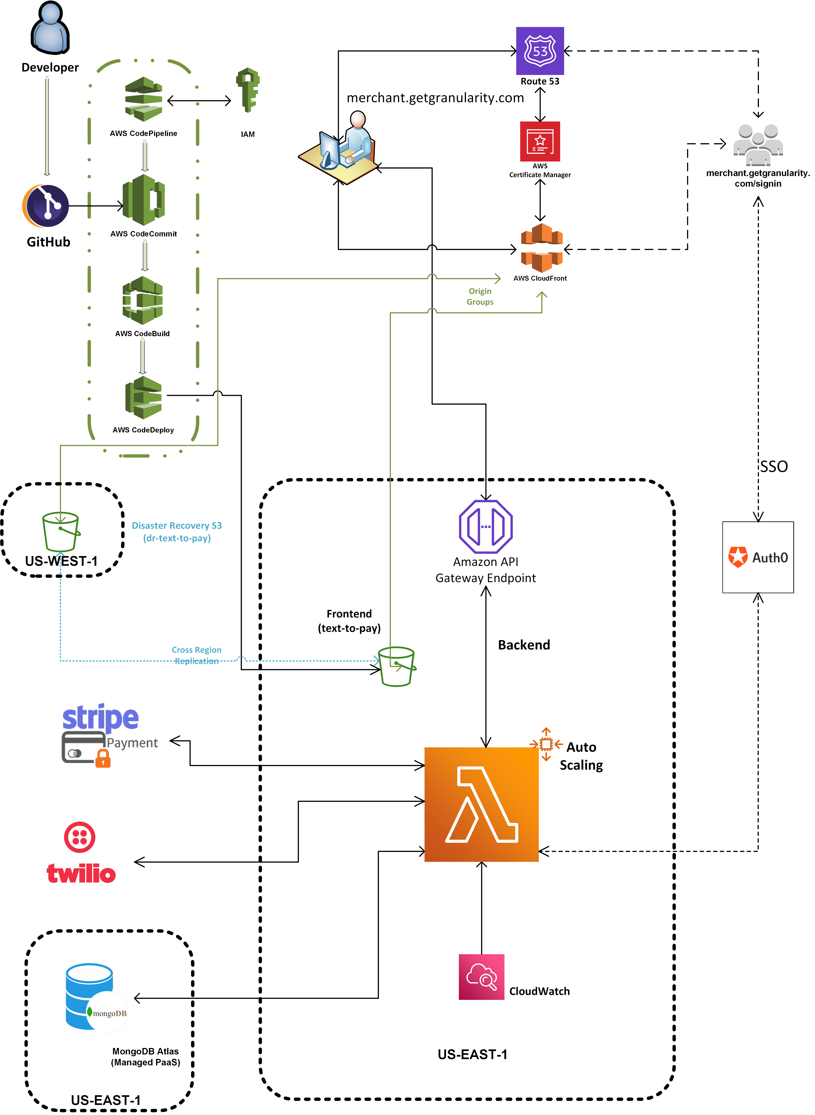

Slide 11
Q&A

Slide 12
Thank You!

