Slide 1

Term project CMPE 282 – Sec 48 HIRE MY SERVICES
Team Members
ANANTH UPADHYA
DEESHA DESAI
PREETI PARIHAR
PRIYANKA DEVENDRAN

Slide 2
What is HIRE MY SERVICES
Online platform to find and hire housekeeping services
Creates employment opportunities
Connects local area housekeeping service providers with customers
Easy and convenient way to book or cancel appointments

Slide 3
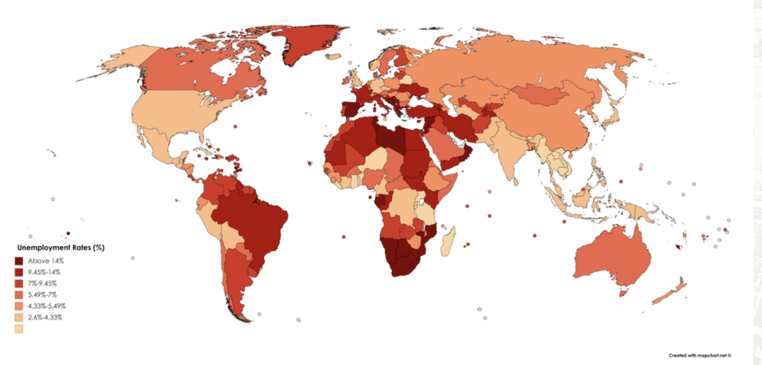
Unemployment Rate Across The World
Alarming raise in Unemployment rate
COVID-19 Pandemic impact on unemployment was catastrophic
Unemployment rate in Feb 2021, was around 6.7%, 1.4 percentage points above its pre-pandemic level
Source: Reddit.com

Slide 4
Why we need HIRE MY SERVICES website?
Provides required housekeeping services at doorstep
Online platform reduces un-necessary hassle to travel outside
Provides employment for blue collared workers
Eases the burden of doing all housekeeping services alone
Helps in part time employment
Provides extra sources of income
More time for friends and family

Slide 5
Components of HIRE MY SERVICES
1. PROVIDER
Register for services
Accept requested appointments
Cancel the requested appointments
Update the Profile
2. CONSUMER
Request for services
Cancel scheduled services
Rate the provider services
Update the profile

Slide 6
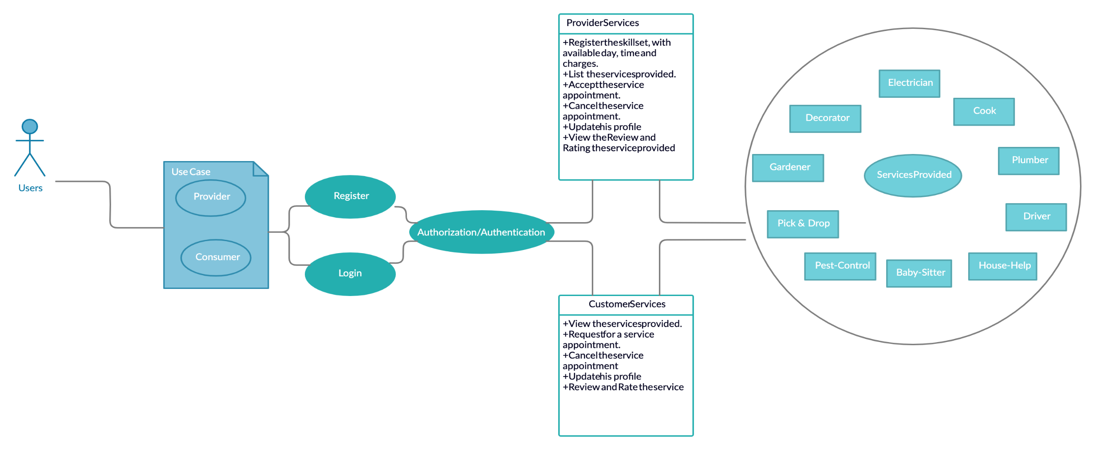
UML DIAGRAM

Slide 7
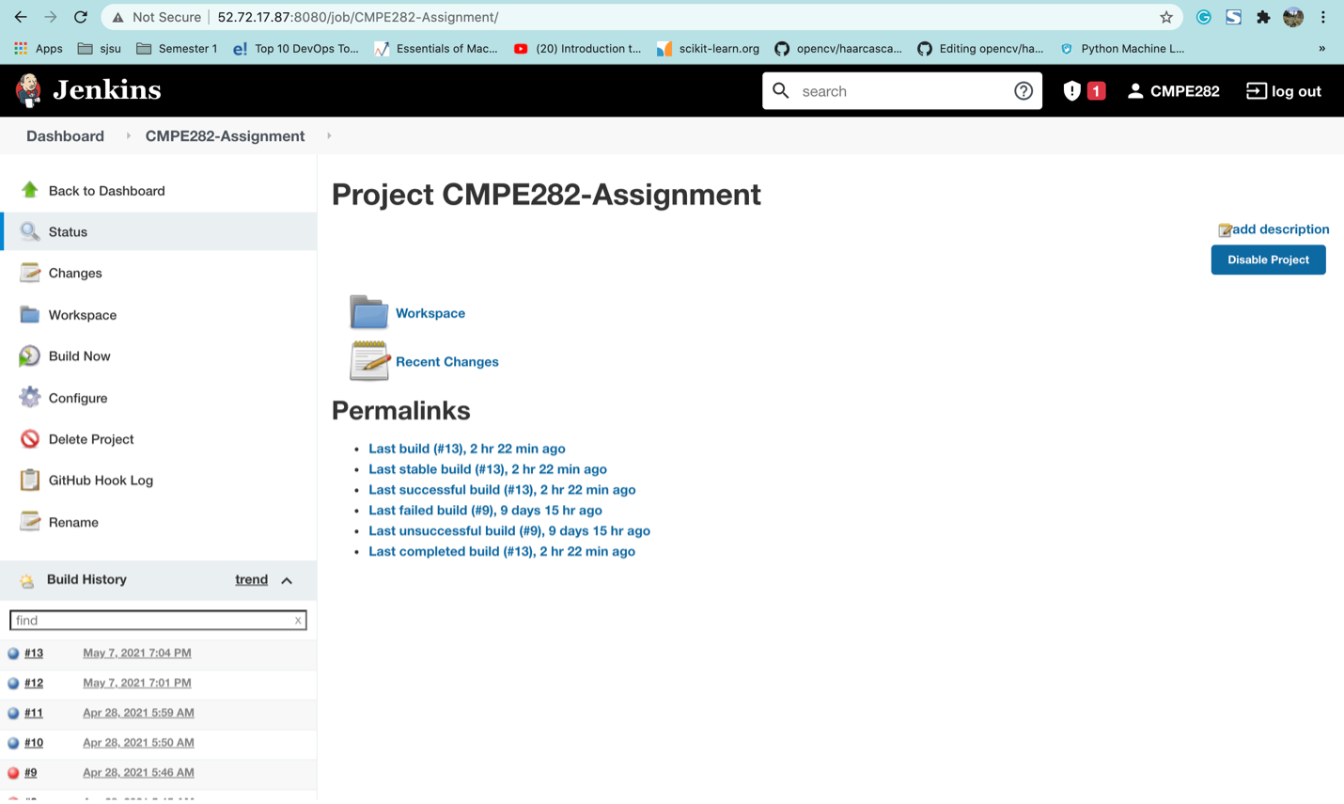
CICD Setup - Jenkins

Slide 8
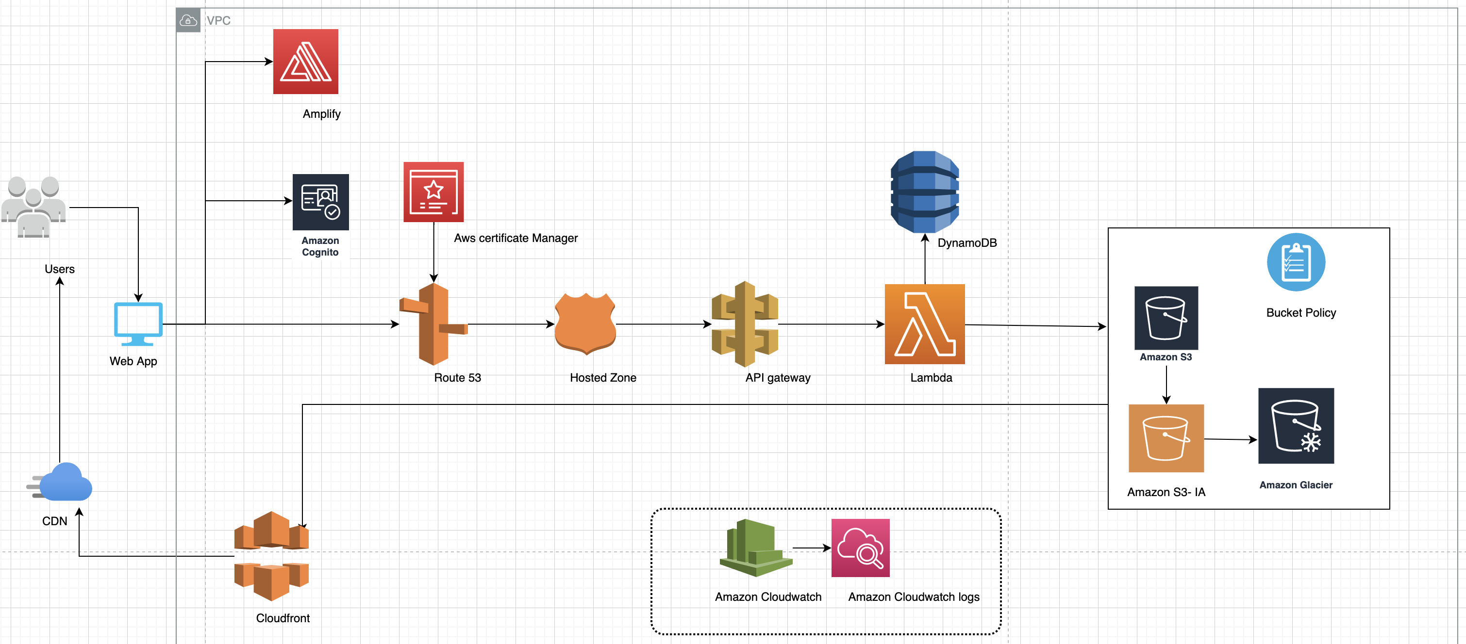
AWS Architecture Diagram

Slide 9
Technologies Used:
Python3-Flask
Angular
Bootstrap
SCSS
HTML
Angular material
REST API
Jenkins
AWS Services

