Slide 1
DON’T SLEEP
Drowsiness Detector
TEAM 27
Karan | Emma | Thai | Ninad
TEAM 27
Karan | Emma | Thai | Ninad

Slide 2
Introduction
Problem: Every year about 100,000 police-reported, drowsy-driving crashes result in nearly 800 fatalities and about 50,000 injuries.
Solution: A tool to detect if the driver has slept and send an SOS message to immediate family member with the coordinates and location name (using Twilio API).

Slide 3
Initial Version
What it involved?: Use opencv to open the webcam
Advantages: Processing was really fast.
Disadvantage: Cannot be used to deploy as the django app runs on server
Solution: Shift the frame-fetching part to client side, that is, do it using javascript.

Slide 4
Final Version
What it involved?: Use javascript to fetch a frame and send it to server.
Advantages: The app can be deployed now (Deployed on Heroku).

Slide 5
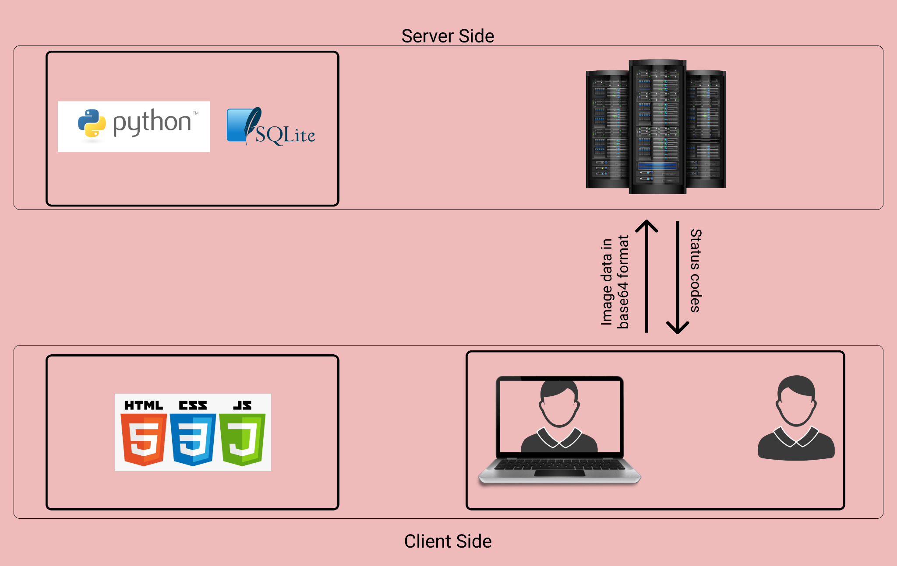

Slide 6

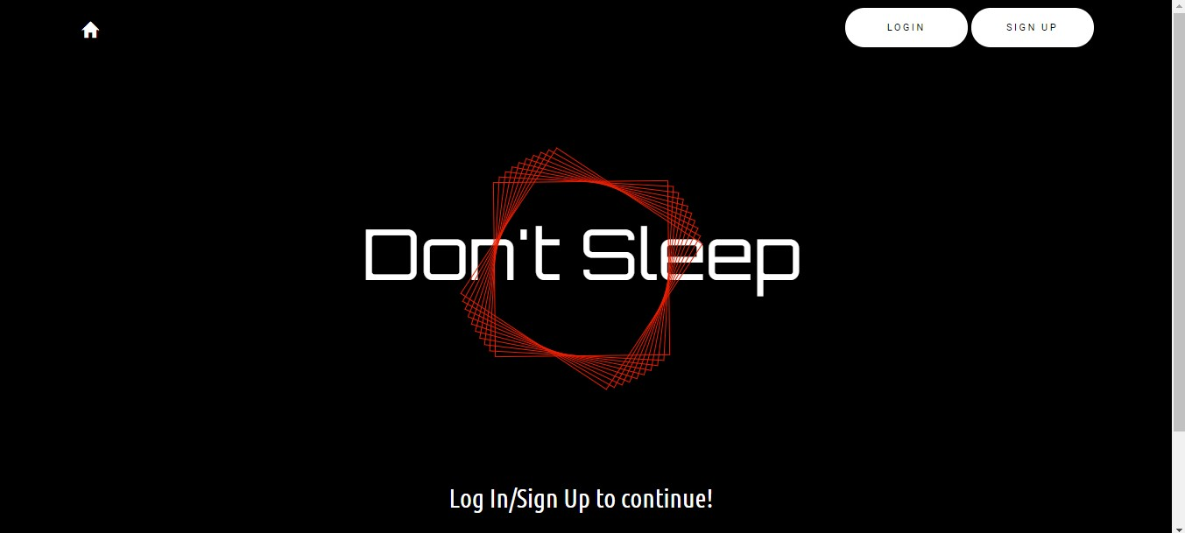

How it looks?

Slide 7
References
https://www.nsc.org/road/safety-topics/fatigued-driver
https://www.twilio.com/docs/usage/api
https://pypi.org/project/opencv-python/
https://developer.mozilla.org/en-US/docs/Web/API/Geolocation_API

Slide 8
THANK YOU!

