Slide 1
VENDIMAN
Team 8:
Sai Krishna Dosapati
Teja Ramisetty
Mu-Te Shen
Wenhao Tseng

Slide 2
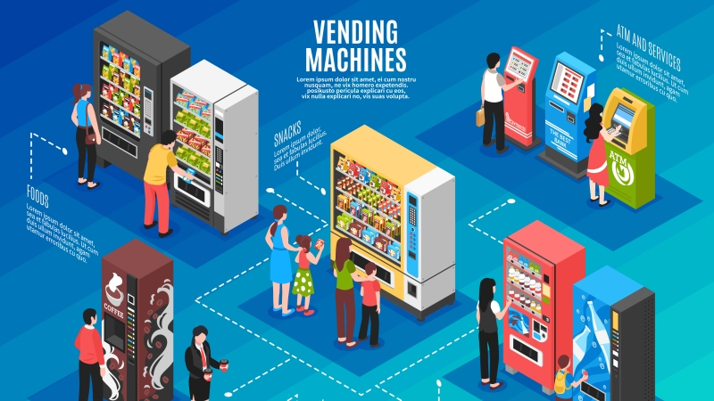
InTRODUCTION
Vending machines are very common things which we come across everyday.
These machines generate significant revenue for owners.
These machines often run out of stock and causes great impact to their business.
Our Project “Vendiman” addresses such problems and provides better solutions.

Slide 3
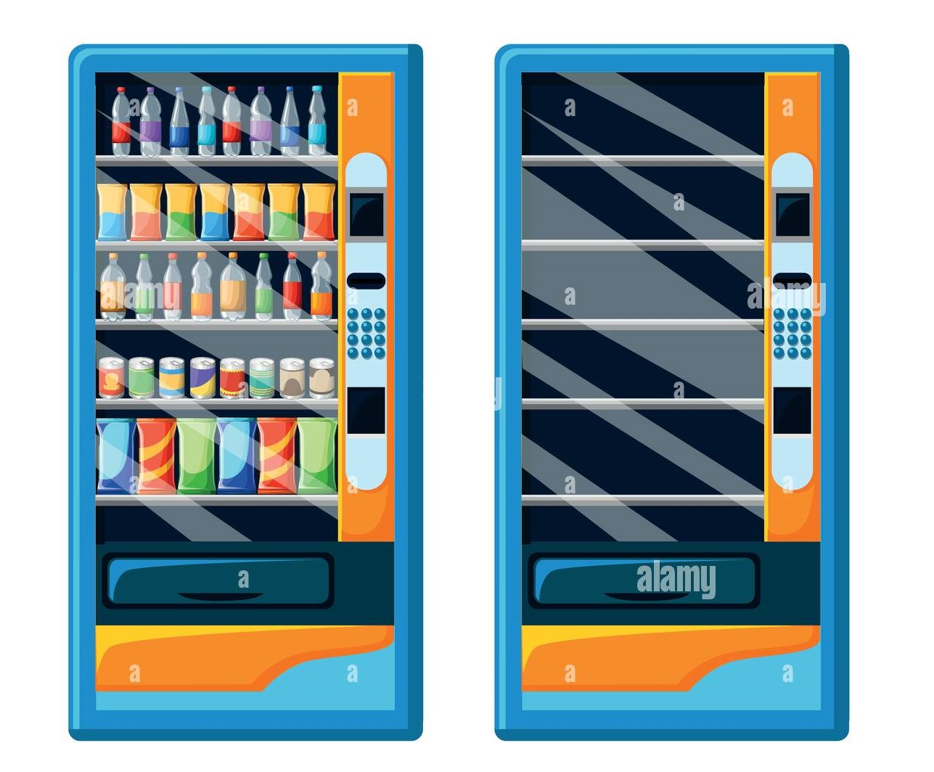
Persona & Use cases
It is a smart web application which provides better services for vendors and customers.
Our machines can help a customer to get his product even though if that machine is out of stock on that particular item.
Owners can easily refill their machines without physically inspecting each machine

Slide 4







Architecture
CUSTOMER
OWNER
Owner Application
API calls
Data
Vending Machine
API Calls
Data
Data

Slide 5
CUSTOMER Scenarios
If a customer wants to have a available product from a vending machine he can have it after a successful payment.
Concerned stock reduction will takes place on our database tables.
For this we are using a transaction on the backend so that proper updating happens on multiple tables or entire action will be rolled back.
If a customer requested product is out of stock we can suggest him 3 machines which has that product.

Slide 6
Screenshot from UI

Slide 7
Owner Scenarios
Refilling multiple vending machines is a hectic task.
For simplifying it we provide an application to the owner through which he can check every machines stock.
Through this he’ll only fill those machines which need refilling.
We also provide sales trend for every machine so that a owner can implement his own strategies for improving revenue.

Slide 8
Screenshot from UI

Slide 9
Future Scope
We can inculcate email automation into this project, which can send stock alerts to the owners.
Using machine learning concepts, we can suggest customers a relevant product which they might buy.
Using machine learning concepts, we can suggest new products to the owner which can increase hi revenue.
We can increase the scalability of this project by increasing number of items in the vending machines and a number of owners.

Slide 10
DEMO

Slide 11
THANK YOU

