Slide 1

Movie Recommender System

Slide 2
Authors
Ashutosh Sharma
Chetan Punekar
Swetha Muchukota
Watsh Rajneesh
(Project Group 5)

Slide 3
Objectives
To build a recommender system for movies
To provide movie recommendations using collaborative filtering technique in near real-time
To provide an Android mobile application client as user interface for the movie recommender system.

Slide 4
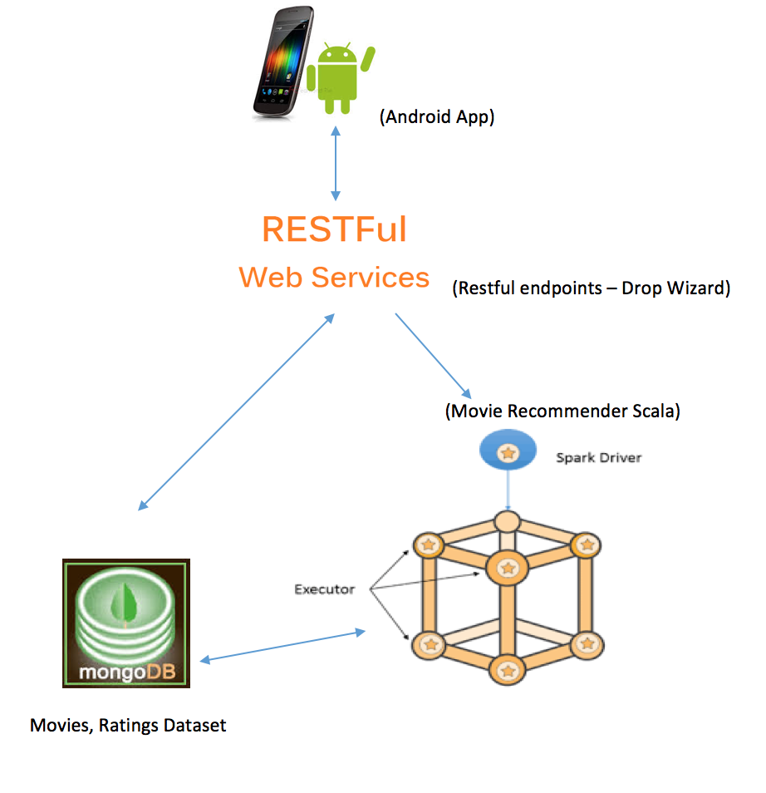
Architecture
Mobile App as user interface
RESTful Web Services – provide interface for mobile app to communicate with the backend service
Movie Recommender System – an Apache Spark based recommender system
MongoDB – stores the movie ratings dataset

Slide 5

Technologies Used
Android Mobile App
Target SDK 24 for Nougat (Android 7.0)
Minimum SDK 16 for Jellybean (Android 4.1)
REST API gateway using Dropwizard Framework (1.0.1)
Apache Spark (2.0.1) – for data processing and machine learning (ALS)
Mongo DB – to store data set used by Spark
Movielens.org dataset – a non-commercial personalized recommendation system built by GroupLens research lab at University of Minnesota.
Size of dataset used =
105339 ratings for 10329 movies
by 668 users collected between 1996 and 2016

Slide 6
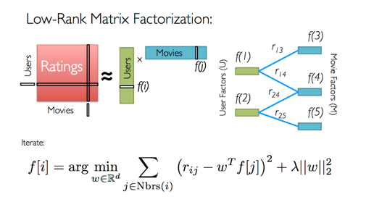
Alternating Least Squares
A common technique for recommender systems
These techniques aim to fill in the missing entries of a user-item association matrix, in our case, the user-movie rating matrix.
Apache Spark MLlib currently supports model-based collaborative filtering, in which users and products are described by a small set of latent factors that can be used to predict missing entries.
Source: https://databricks-training.s3.amazonaws.com/movie-recommendation-with-mllib.html

Slide 7
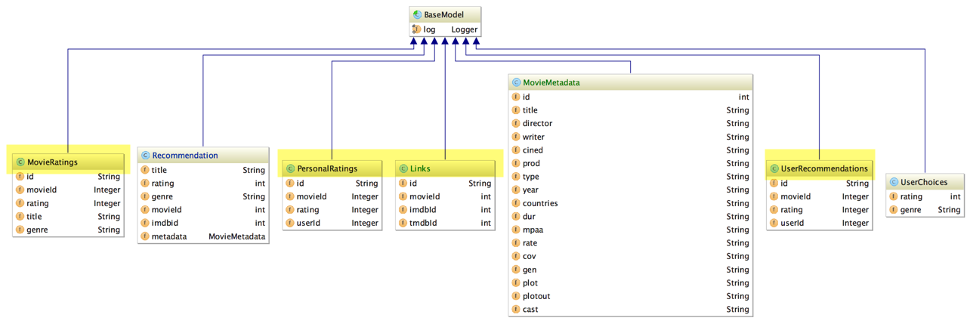
Design – Data Model
MovieRatings – movie and its ratings by users of movielens.org
PersonalRatings – movie and ratings for the current user
UserRecommendations – recommended movies for the current user
Links – imdb ID for the movie which is then used as: https://moviesapi.com/m.php?i={id}&type=movie&r=json

Slide 8
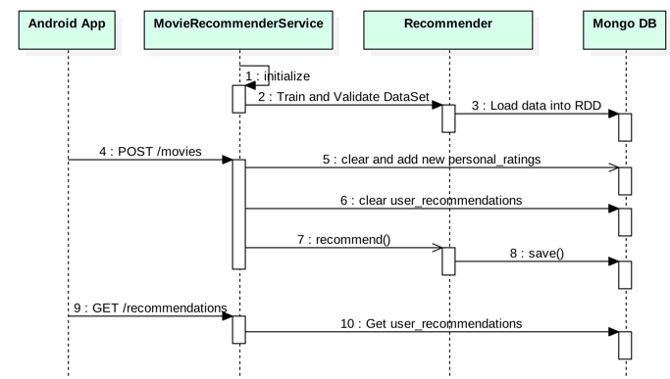
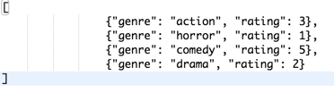
Design – REST APIs
GET /api/v1.0/movies
GET /api/v1.0/movies/{movieId}
POST /api/v1.0/movies
GET /api/v1.0/recommendations

Slide 9
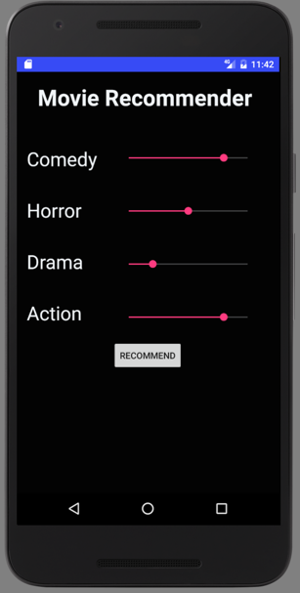
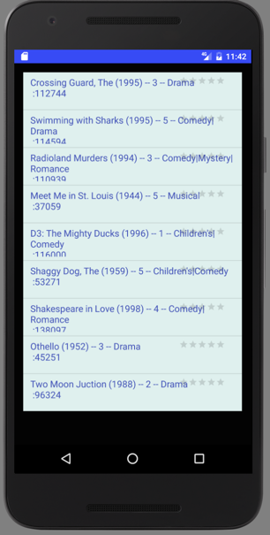
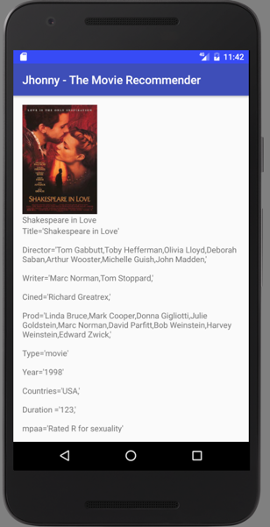
Design – Android App

Slide 10
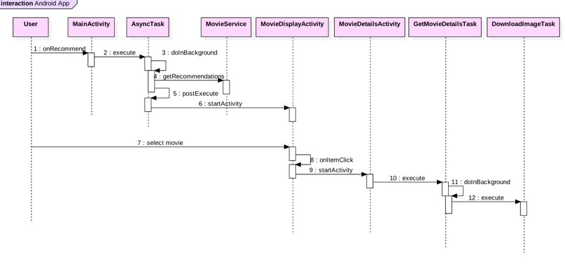
Design – Android App Sequence

Slide 11
Observations and Learnings
Using Apache Spark for big data processing
Using Apache Spark MLlib for movie recommendations
Using Mongo DB as datastore for Spark (for storing initial dataset and also persisting the processed results)
Android app development with backend service

Slide 12
Challenges
Learning enough Scala to be able to implement the recommender system using Apache Spark.
Separating the training and validation of data from the recommendation process.
Training and validating only needs to happen once.

Slide 13
Future Enhancements
Host the recommendation service in cloud
Support user profile so we can track recommendations and ratings on a per user basis
Support integration with other data sources than mongo DB – like AWS S3.
Improve the mobile app UI
Provide a web UI as well

Slide 14
Bibliography
Matrix Factorization Techniques for Recommender Systems
Collaborative Filtering for Implicit Datasets, Hu et. Al
Alternating Least Square for Personalized Ranking
ALS in MLlib - Spark 1.4.1 Documentation
MovieLens dataset

Slide 15
Thank You

