Slide 1

My Connect
A Social Networking App for School Students

Slide 2
Authors
Ashutosh Sharma
Chetan Punekar
Swetha Muchukota
Watsh Rajneesh
(Project Group 5)

Slide 3
Objectives
To build a social networking app for school students
To allow students from across schools to make friends and share pics
To enable sharing of location
To enable instant messaging

Slide 4
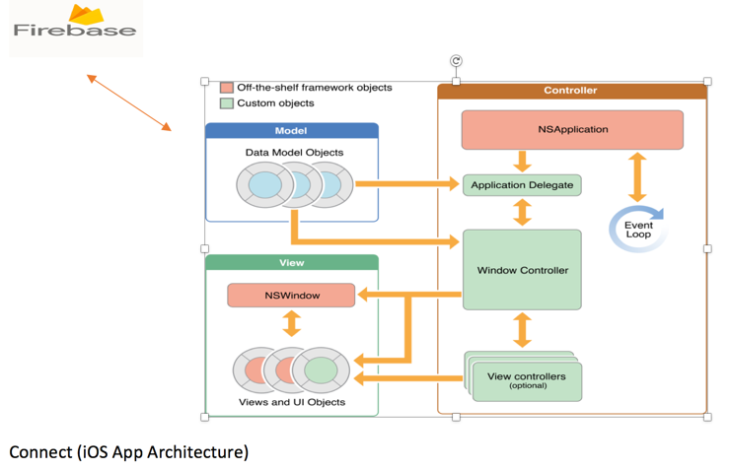
Architecture
Mobile App as user interface
Firebase – backend as a service for authentication and persistence

Slide 5
Technologies Used
iOS 10
Swift 3
Firebase
Sketch

Slide 6
Third-party Libraries
# Pods for myconnect
pod 'Firebase/Core'
pod 'Firebase/Database'
pod 'Firebase/Storage'
pod 'Firebase/Auth'
# Pods for keyboard
pod 'IQKeyboardManagerSwift'
# Pods for UIPicker
pod 'ActionSheetPicker-3.0'
# Pods for image handling
pod 'SDWebImage'

Slide 7
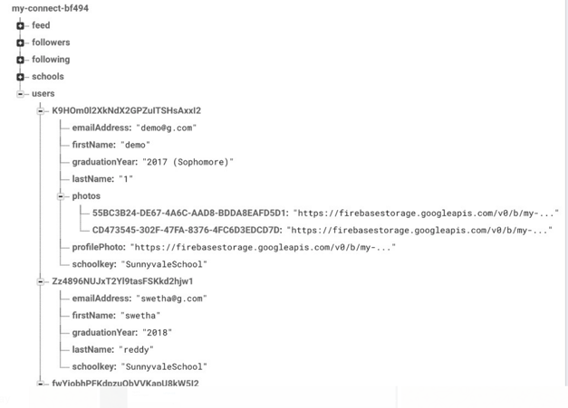
Data Model – Users

Slide 8
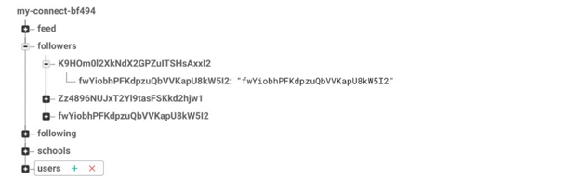
Data Model - Followers

Slide 9
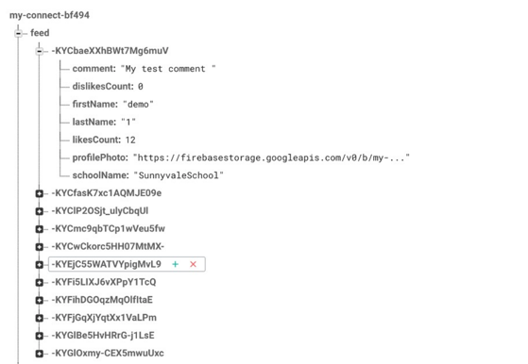
Data Model - Feed

Slide 10


Gestures
Swipe
Single Tap

Slide 11
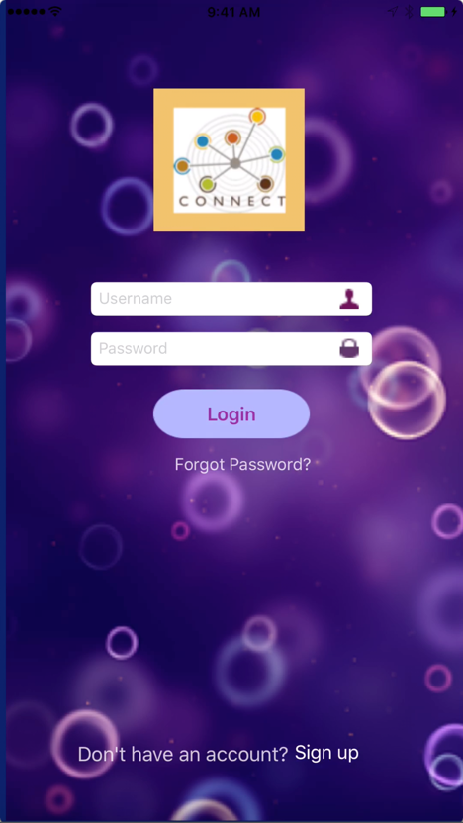
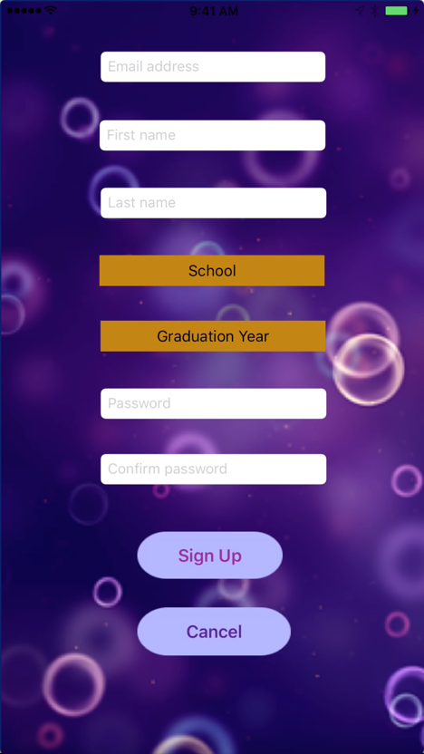
Login Screen

Slide 12

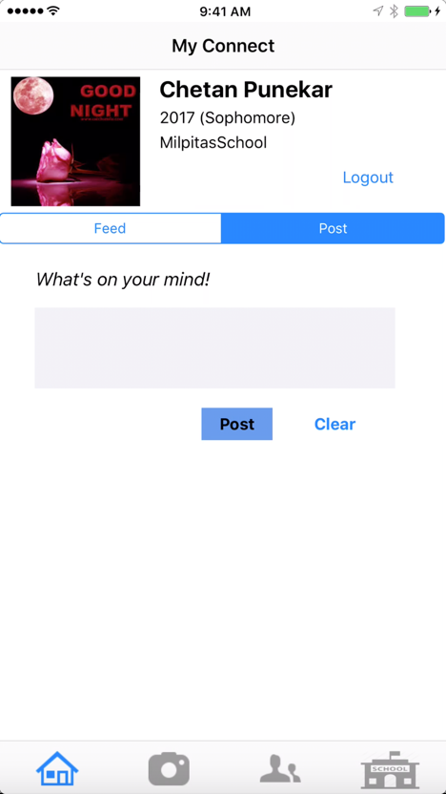
Feeds Screen

Slide 13

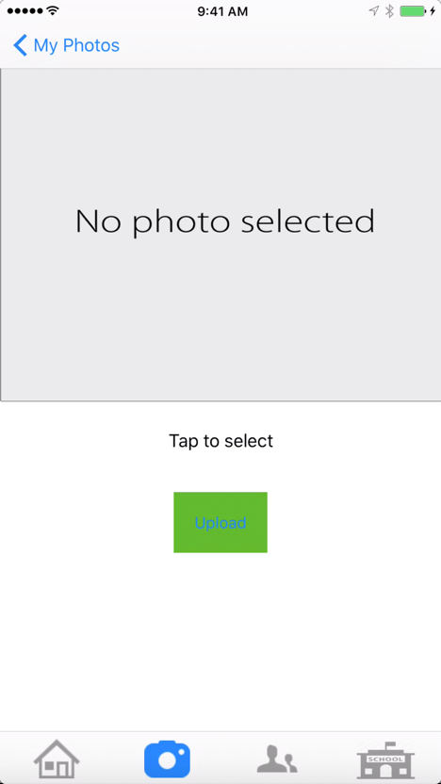
Photos Screen

Slide 14
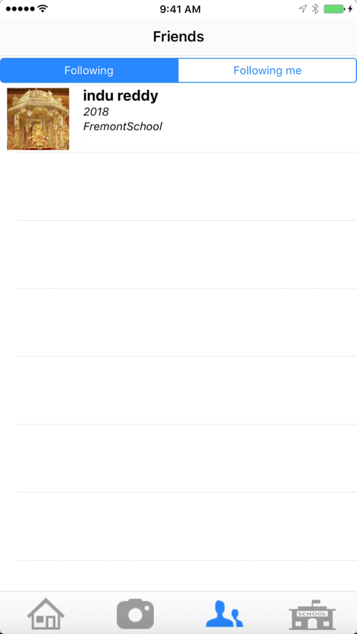
Follow Screens

Slide 15
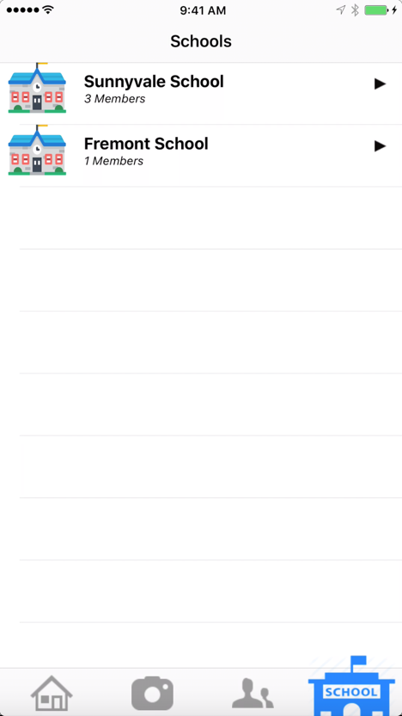
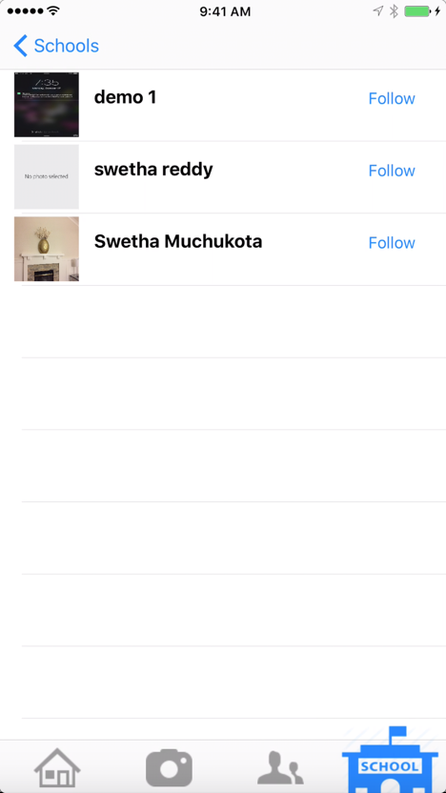
Schools Screen

Slide 16
Observations and Learnings
Using Firebase – authentication, image storage and database
Using Sketch for UI and Icon design

Slide 17
Challenges
Learning Swift 3
Integrating with Firebase
Image handling was slow – used third party image caching library SDWebImage

Slide 18
Future Enhancements
Instant messaging
Private message to specific friend
Online users location sharing
Personal preferences
Security
Emoticons support
Better UI
Better performance

Slide 19
Thank You

