Slide 1
卷积神经网络与图像识别
BUSINESS
2019
JULYED
北京七月在线科技有限公司
褚则伟 zeweichu@gmail.com
https://www.julyedu.com/

Slide 2

CONTENTS
01
卷积神经网络
02
常用卷积神经网络架构
推荐系统实战课程
julyedu.com

Slide 3
卷积神经网络
01
Supporting text here.
When you copy & paste, choose "keep text only" option.

Slide 4
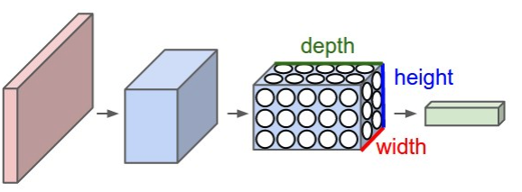
Convolutional Neural Network
local feature detector

Slide 5
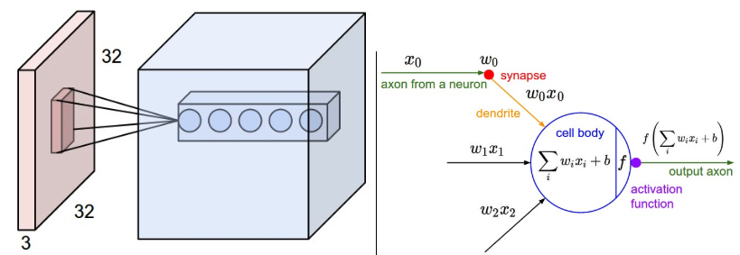
Convolutional Neural Network

Slide 6
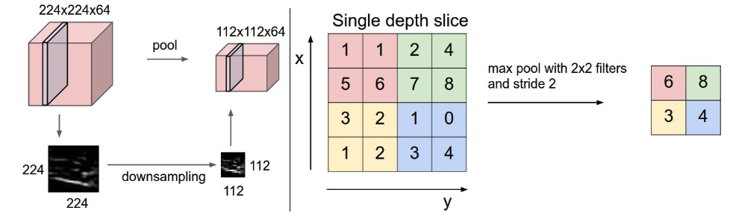
Pooling Layer

Slide 7
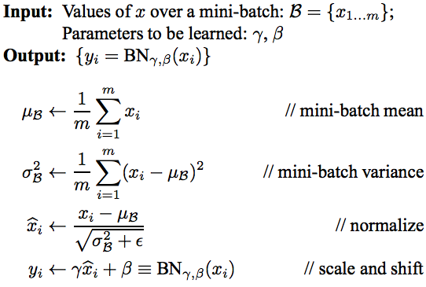
Batch Normalization
https://arxiv.org/pdf/1502.03167v3.pdf

Slide 8
常用卷积神经网络架构
02
Supporting text here.
When you copy & paste, choose "keep text only" option.

Slide 9
常见的ConvNet架构
INPUT -> [[CONV -> RELU] * N -> POOL] * M -> [FC -> RELU]*K -> FC

Slide 10
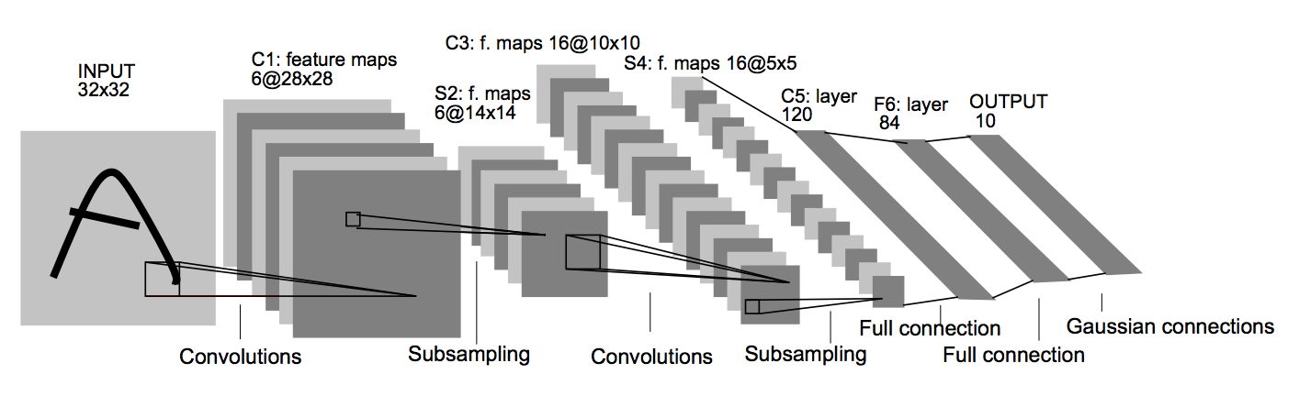
LeNet
Yann Lecun, 1998年

Slide 11
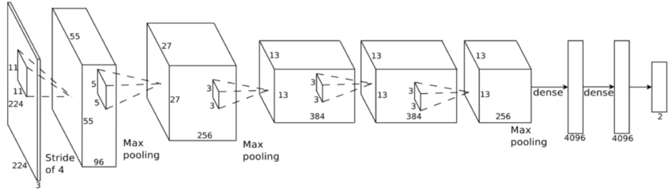
AlexNet
Alex Krizhevsky et al., 2012年
ImageNet Classification with Deep Convolutional Neural Networks
https://www.nvidia.cn/content/tesla/pdf/machine-learning/imagenet-classification-with-deep-convolutional-nn.pdf

Slide 12
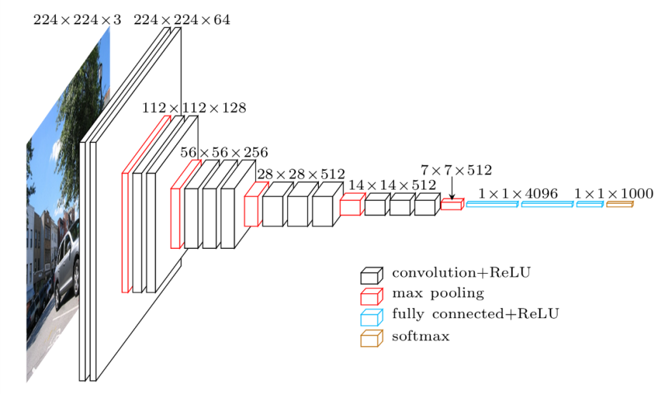
VGG-16
Simonyan and Zisserman,
Very Deep Convolutional Networks for Large-Scale Image Recognition
https://arxiv.org/abs/1409.1556

Slide 13
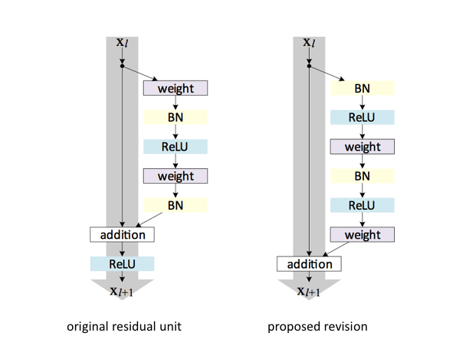
ResNet
He, et al., Deep Residual Learning for Image Recognition
https://arxiv.org/abs/1512.03385

Slide 14
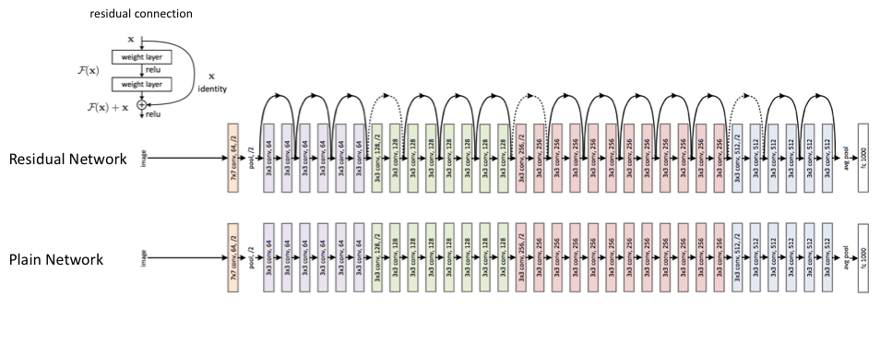
ResNet

Slide 15
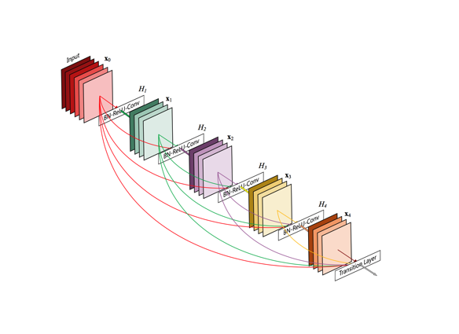
DenseNet

Slide 16
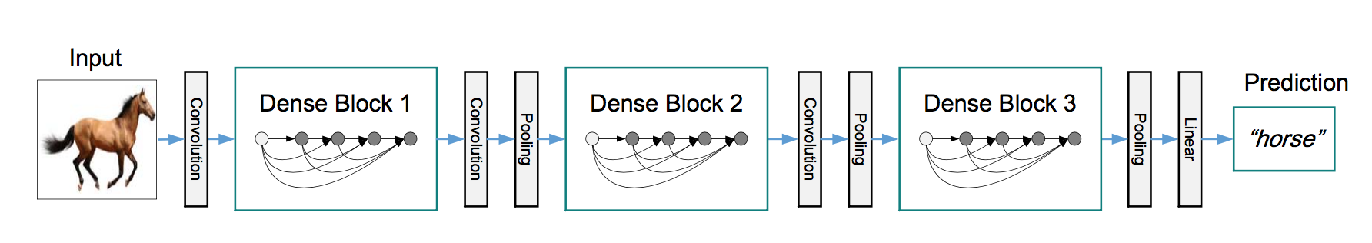
DenseNet
Huang et al., Densely Connected Convolutional Networks
https://arxiv.org/abs/1608.06993

Slide 17
微信扫一扫关注我们
褚则伟 zeweichu@gmail.com
https://www.julyedu.com/

